Slide 1
A Binomial Lattice Method for Pricing Corporate Debt and Modeling Chapter 11 proceedings
Author:Mark Braodie and ÖzgÜr Kaya*
報告者:柯婷瑱

Slide 2
Basic setup
Bankruptcy with Immediate Liquidation
Bankruptcy with Grace Period and Bargaining
Bankruptcy with Grace Period, Automatic Stay and Arrears Account

Slide 3
It develop a binomial lattice method that can be used to handle complex structural models such as ones that include Chapter 11 proceeding of the U.S bankruptcy code.
In a structural model, the value of firm’s asset or the firm’s earnings process is modeled as a primitive variable, and all other variables are derived from this basic variable.

Slide 4
It treat bankruptcy and liquidation as the different event.
While in bankruptcy, the coupon payments are stopped and are recorded in an arrears account. The earning of the firm are collected in a separated account.
The collected earnings are then used to pay the arrears when the firm comes out of bankruptcy.
It shows that the issue of the limited liability of equality holders can be handled.

Slide 5
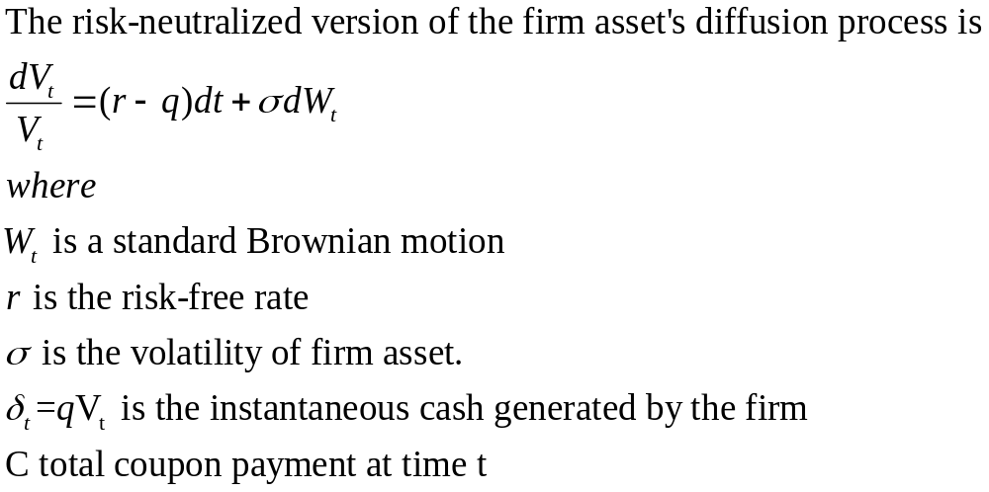
Basic Setup

Slide 6
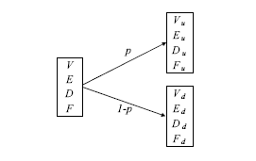
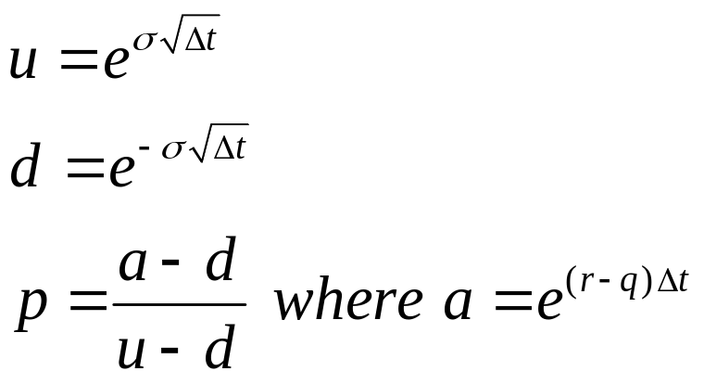
To Build a lattice based on the binomial method of Cox, Ross, and Rubinstein(1979)

Slide 7
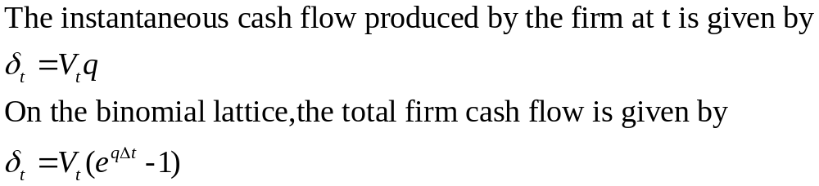

Slide 8
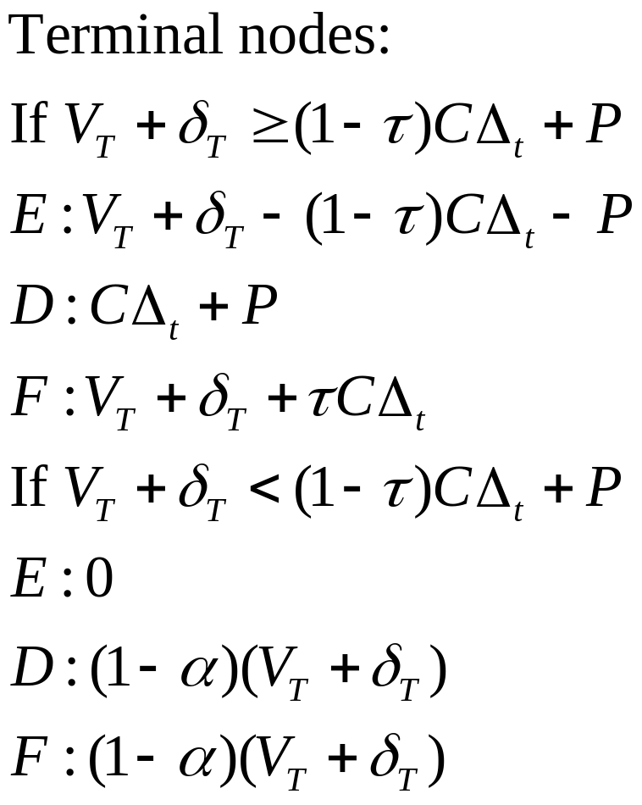
Finite Maturity Case

Slide 9
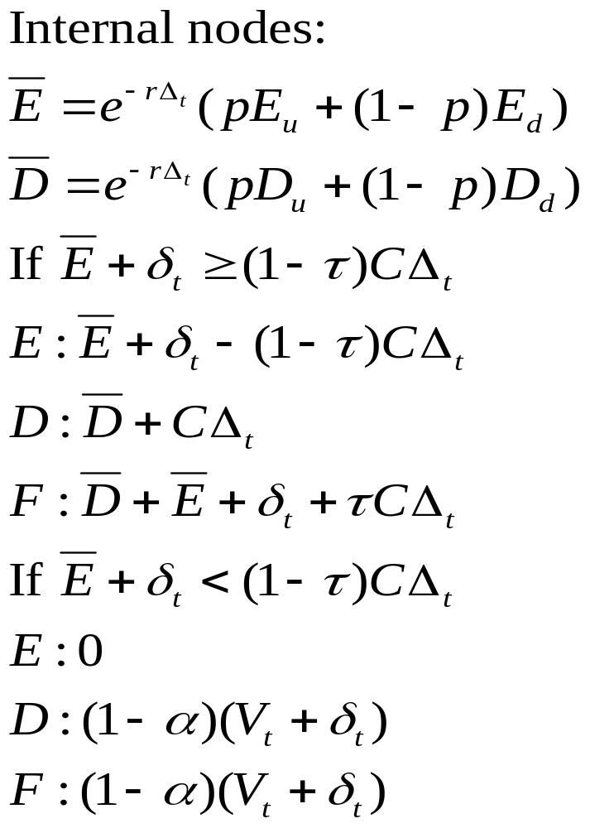
Backward Induction
E_{u}
D_{u}
E
D
E_{d}
D_{d}

Slide 10
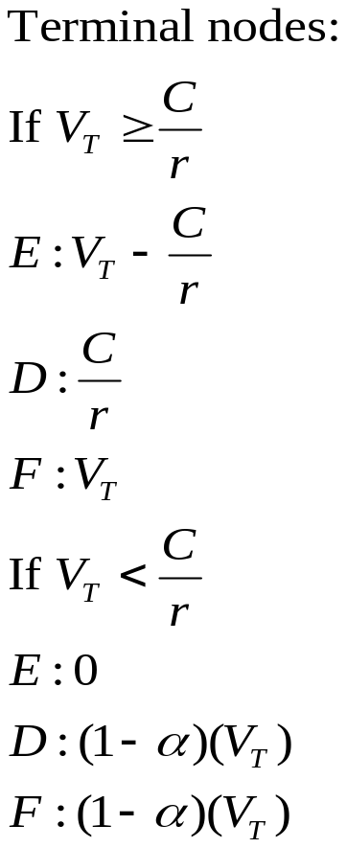
Infinite Maturity Case
This model can be used to price a consol with infinite maturity.
time
T

Slide 11
Bankruptcy and Grace Period and Bargaining
It consider the approach of FM(2004) and assume that, at a certain level of the firm asset value V_{B}, equity holders decide to declare bankruptcy.
There is a distress cost ω that reduces the net firm cash flow when then firm is in bankruptcy. Thus, the firm cash flow rate is reduced from q to q-ω.

Slide 12
It follow Fan and Sundaresan (2000) to determine the debt service using a Nash bargaining game.
It assume that the bargaining power of the equity holders is η and the bargaining power of the debt holders is 1-η.
If the firm is not liquidated, its value will be F_{B} and this amount will be shared between equity holders and debt holders.

Slide 13


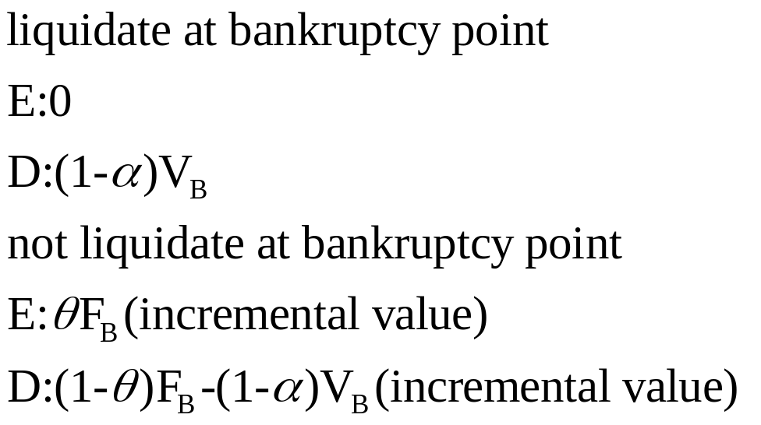
It denotes the sharing rule at the bankruptcy point as θ, then the incremental value gain by equity holders is and the incremental value gain by debt holders is

Slide 14
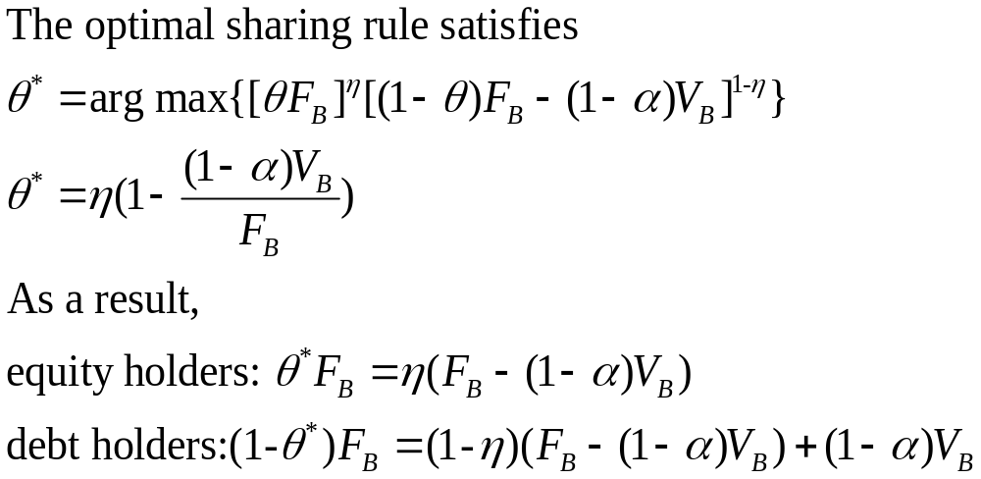

Slide 15

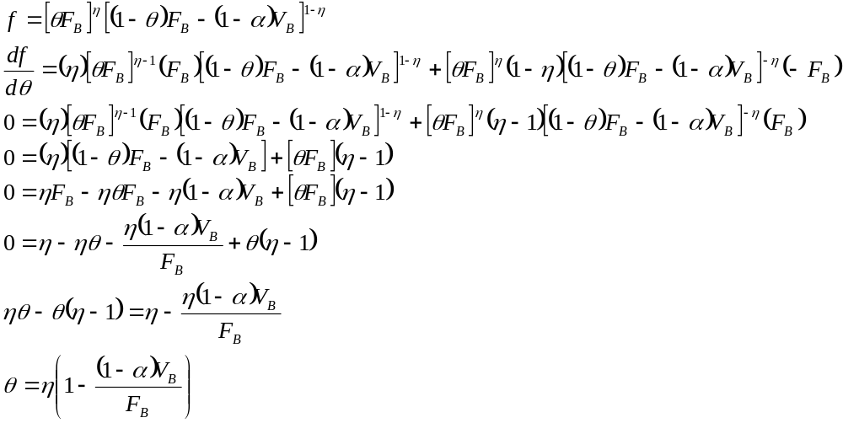

Slide 16
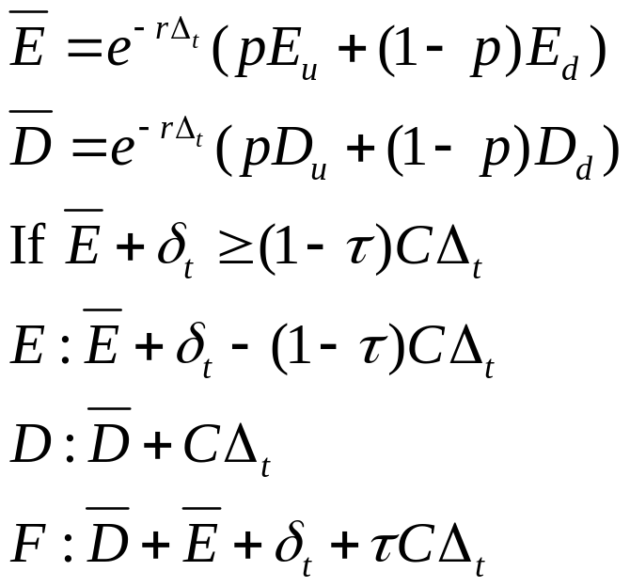
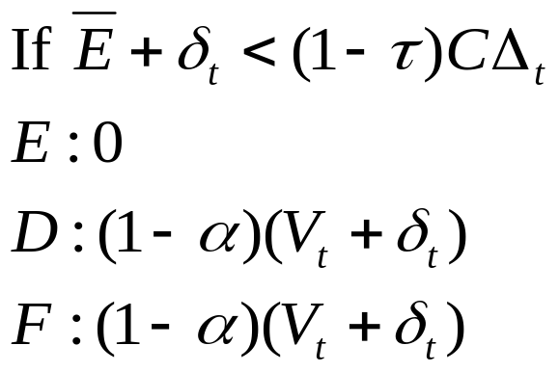
case 1
nodes with V_{t}>V_{B}
For these nodes, we update the equity and debt values in the following way:
E_{u}
D_{u}
E
D
E_{d}
D_{d}

Slide 17
case 2
nodes with V_{t}<V_{B}
The debt is served strategically based on the outcome of the bargaining game.
There is no tax benefits for payments to debt holders.
We only need to keep track of the firm value F when the firm is in bankruptcy.
The total time spent in bankruptcy needs to be recorded so that it can be checked against the allowed graced period G.

Slide 18
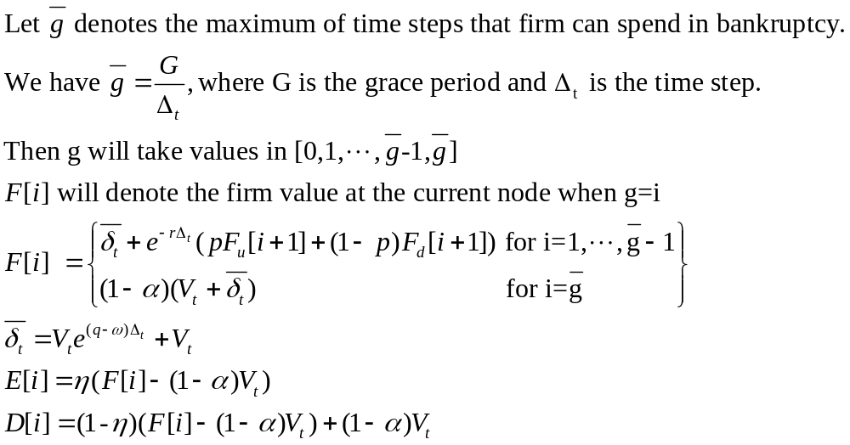

Slide 19
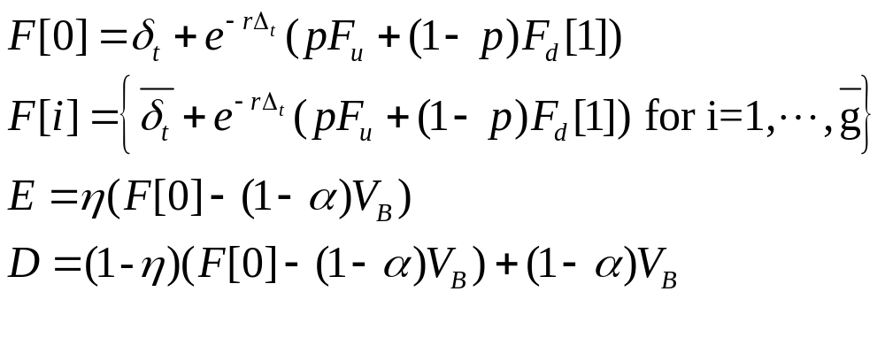
case 3
nodes with V_{t}=V_{B}

Slide 20
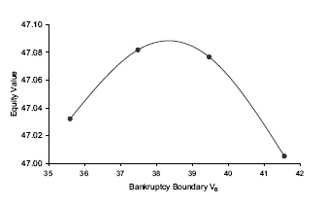
Using Bisection method to find optimal bankruptcy boundary
Choose an arbitrary bound. one natural choice is the Leland liquidation boundary on equity has value zero.

Slide 21
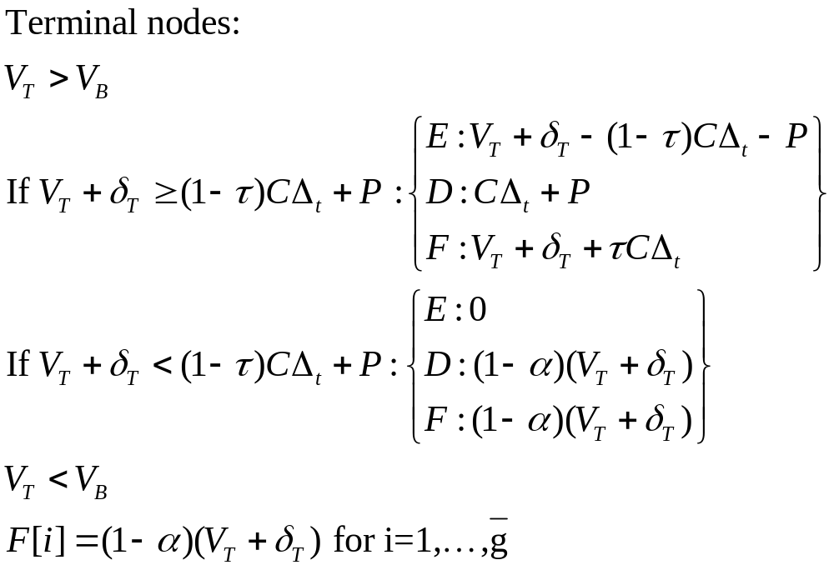
Pricing Finite Maturity Debt

Slide 22
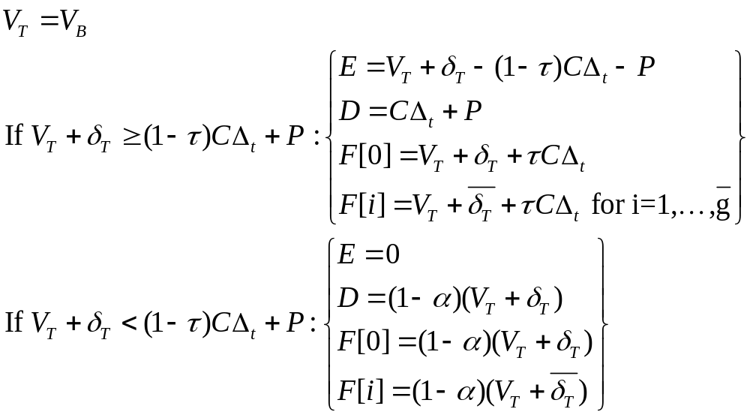

Slide 23
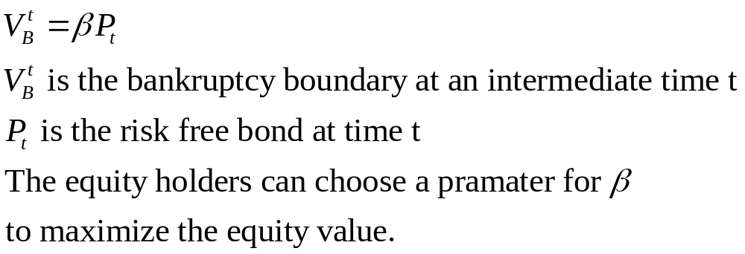
Optimal bankruptcy Boundary
The optimal V_{B} in the finite maturity setting will not be constant, but rather be time dependent since the remaining value of the bond is changing over time.

Slide 24
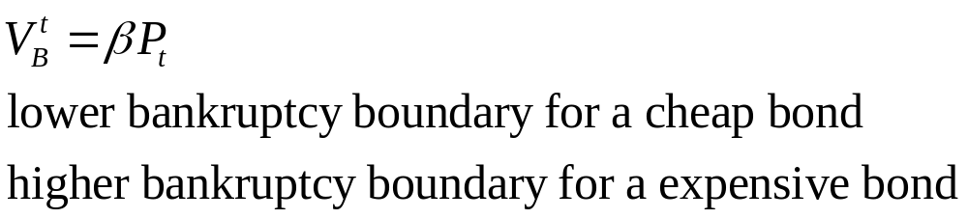
Bankruptcy boundary
  it will be an increasing function of time t for a discount bond, decreasing function of time t for a premium bond.
  it will be constant of time t for a par bond

Slide 25
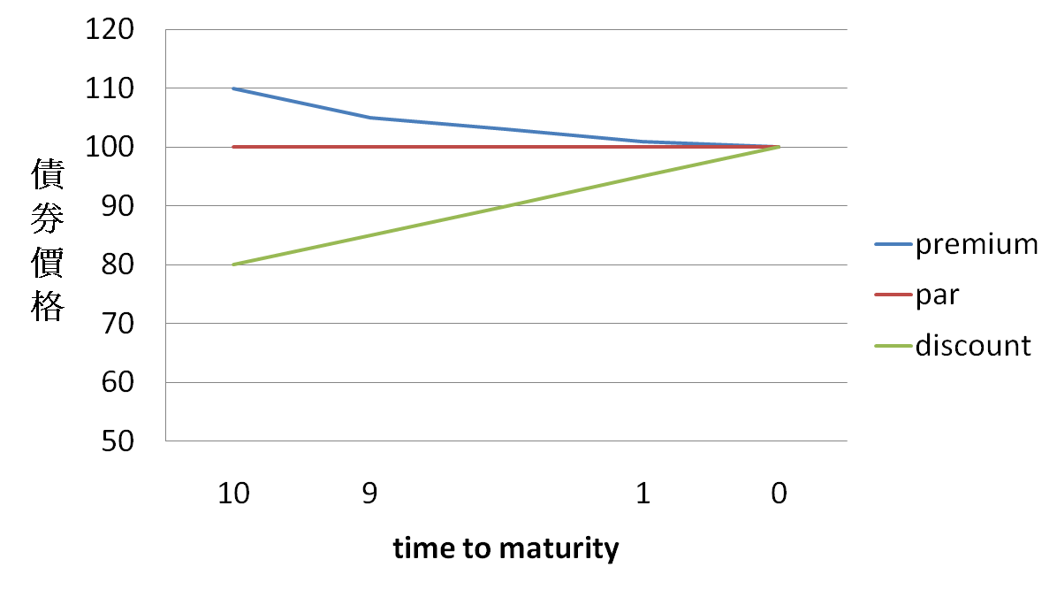
face value =100

Slide 26
Bankruptcy with Grace Period, Automatic Stay and Arrears Account
It consider the approach of BCS(2005) and uses as its primitive variable the earnings before interest and taxes(EBIT).
It consider a consol bond with infinite maturity. While the firm is in bankruptcy, all coupon payments are stopped, and unpaid coupons are recorded in an arrears account A_{t}.
The entire firm cash flow or EBIT is accumulated in a separate account S_{t}.

Slide 27
If the firm reaches a healthy state at a future time T, the amount S_{T} is used to pay the arrears θA_{T}.
In order to do the calculations, we need to distinguish among three types of nodes:
  nodes with V_{t}>V_{B}
  nodes with V_{t}<V_{B}
  nodes with V_{t}=V_{B}
(V_{B} is the time independent default boundary)

Slide 28
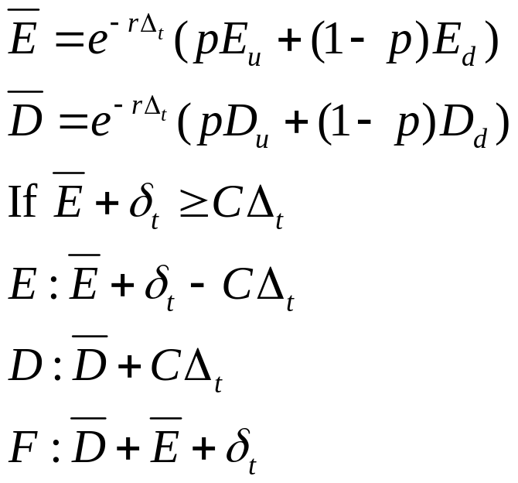
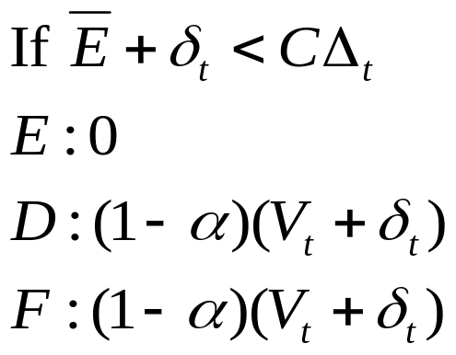
case1
nodes with V_{t}>V_{B}
For these nodes, we update the equity and debt values in the following way:
E_{u}
D_{u}
E
D
E_{d}
D_{d}

Slide 29
case2
  nodes with V_{t}<V_{B}
  Firm is in bankruptcy.
    The coupon payments are accumulated in an arrears account A.
    The firm cash flows are accumulated in a automatic stay payoff account S.
    There is a grace period G, which is the maximum amount of time that the firm can spend in bankruptcy.
    We will add two state variables each node to represent the values of g and S for each node.

Slide 30


To keep track of the automatic stay payoffs S, we will use a discrete grid for its values and then use linear interpolation. An upper bound on the value of S is given by
Assume we want to use M values in the discrete grid. Then S is represented by the values on the grid , where j takes values in the set[0,1,…,M-1,M]

Slide 31
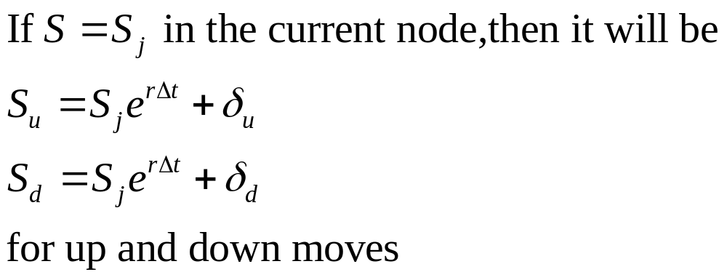
E[i,j] denotes the equity value in the current node when g=i and S=S_{j}.
Assume we know the values E_{u}[i,j] in the up state and E_{d}[i,j] in the down state in the next time step for all i and j.

Slide 32

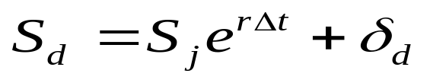
0 | S
1 | S
. . . | . . .
G-1 | S
G | S
0 | 1S*/M | 2S*/M |  | M-1(S*) /M | M
Sj
0 | S
1 | S
. . . | . . .
G-1 | S
G | S
Su
E[i+1,j]
Sj
E[i+1,j+1]
Sj+1
0 | S
1 | S
. . . | . . .
G-1 | S
G | S

Slide 33
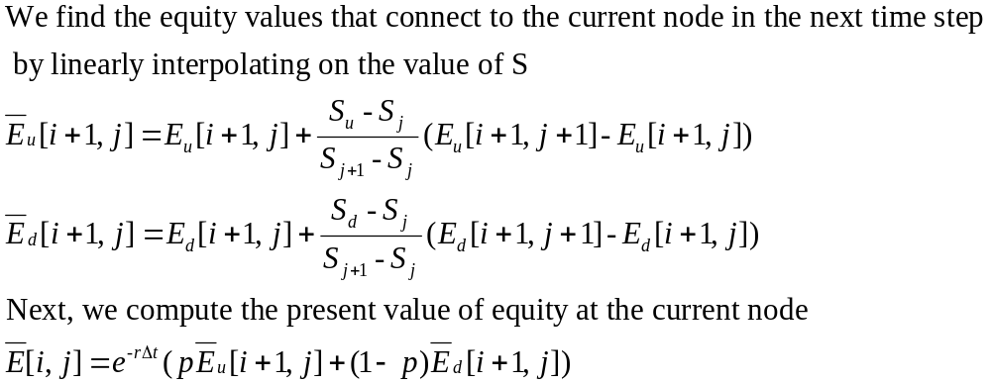

Slide 34
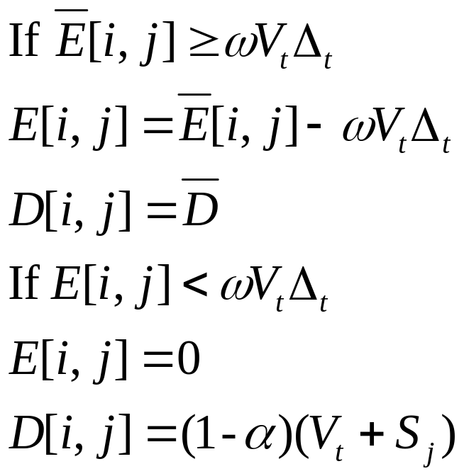
Before we finalize the values, we need to check for liquidation. Liquidation may occur because of the distress cost ω.

Slide 35
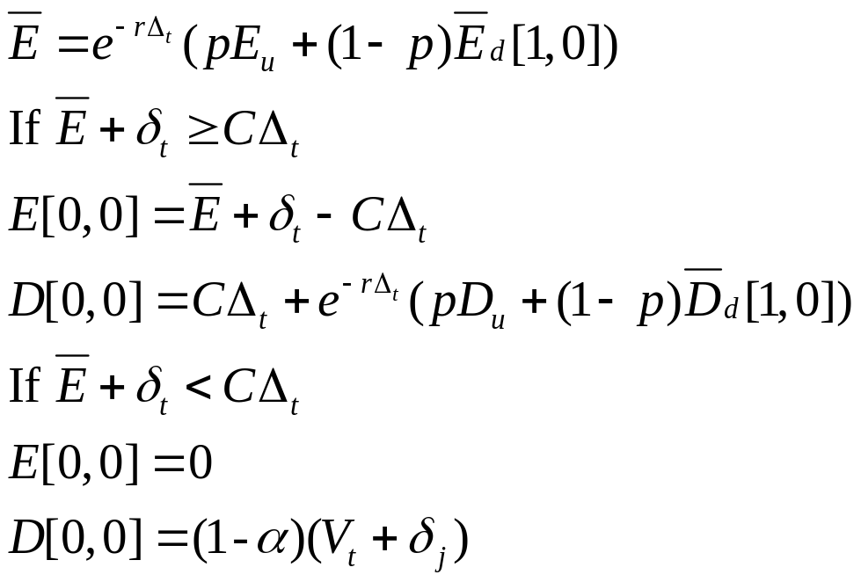
case3
  nodes with V_{t}=V_{B}
  The firm may have reached the nodes with V_{t}<V_{B} either from above, being in a healthy state, or from below, being in bankruptcy.
E_{u}
E[0,0]
E_{d}[1,0]

Slide 36
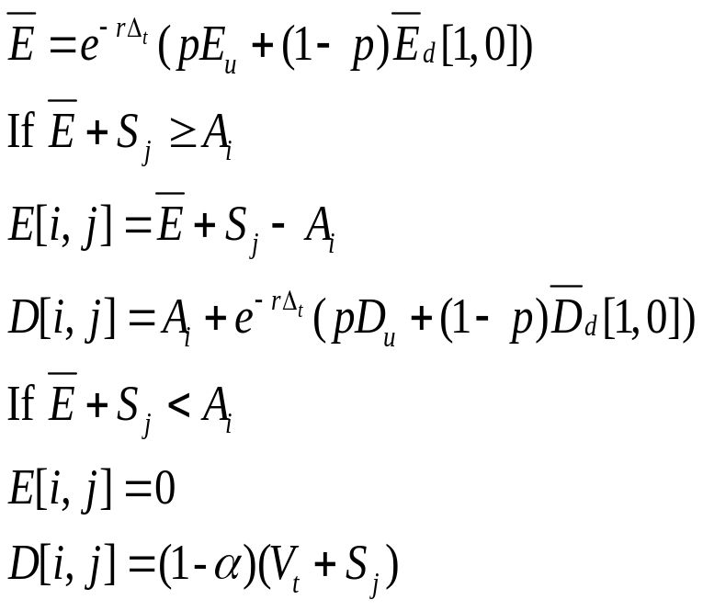
For a firm to continue in a healthy state, it needs to clear the arrears. Therefore the sum of automatic stay payoffs S_{j} and the present value of equity should be larger than A_{i}.
E_{u}
E[i,j]
E_{d}[1,0]

