Slide 1
Pricing vulnerable European options when the option’s payoff can increase the risk of financial distress
Peter Klein, Michael Inglis (2001)
報告者：劉彥君

Slide 2
Introduction
考慮一個 European option，當到期日 T時，如果 S_{T} > K，則 option writer 要支付option holder
option 的價值 c_{T} = S_{T}-K。
如果option writer 的 asset (V_{T})無法支付 S_{T}-K 則 default，即V_{T} < S_{T}-K
(J&S 1987) 因此這種 vulnerable option 內建一個 barrier ，即在到期日時， V_{T} ≧ S_{T}-K
(This paper)考慮 option writer 有其他債務 D* , 則在到期日時， V_{T} ≧ D* + S_{T} - K

Slide 3
Introduction
Johnson and Stulz(1987)
  The default barrier depend on the value of the option that has been written
  If default, assume the option holder receive all the assets of the option writer.
Klein (1996)
  延伸 Stulz(1987) 的 Model，利用 B-S Model 評價 vulnerable option，得到公式解。
Rich (1996)
  Extent by allowing the default boundary to be stochastic.
  Although the other liabilities of the option writer are allowed to change over time, the effect of the option’s payoff on the probability of default is not directly considered.
Notes:
Rich (1996)
雖然 option writer 的債務 D* 可隨時間變動，但並沒有直接考慮 option 報酬對違約機率的影響

Slide 4
Assumption (1)
The assumptions underlying the Klein (1996) model for valuing European calls.
  The basic assumptions of this framework follow
    Merton(1974)
    Black and Cox(1976)
    Johnson and Stulz(1987)

Slide 5
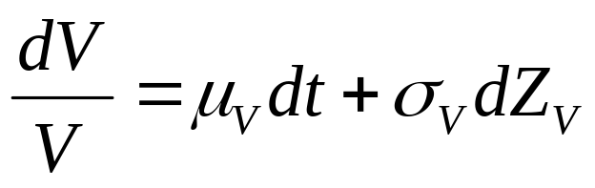
Assumption (2)
Assumption 1
  V : the market value of the assets of the option writer.
  The dynamics of V are given by
  where
    μ_{v} is the instantaneous expected return on the assets of the option writer.
    σ²_{V} is the instantaneous variance of the return (assumed to be constant),
    Z_{v} is the standard Wiener process.

Slide 6
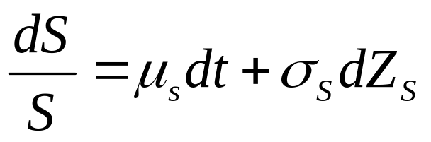
Assumption (3)
Assumption 2
  S : the market value of the asset underlying the option.
  The dynamics of S are given by
  where
    μ_{S} is the instantaneous expected return on the asset underlying the option.
    σ²_{S} is the instantaneous variance of the return (assumed to be constant),
    Z_{S} is the standard Wiener process.
    The instantaneous correlation between Z_{v} and Z_{s} is ρ_{VS}

Slide 7
Assumption (4)
Assumption 3
  Markets are perfect and frictionless.
  There are no transaction costs or taxes and securities trade in continuous time.
Notes:
完美市場，且沒有交易成本、稅，且連續交易

Slide 8
Assumption (5)
Assumption 4
  Default occurs at the maturity of the option, T, only if
  V_{T} < D* + c_{T}
  where
    c_{T} = max(S_{T} - K, 0)
    D* : the value of the other liabilities of the option writer.
    S_{T} : the price of the underlying asset at the maturity of the option
    K : the strike price of the option.

Slide 9
Assumption (6)
Assumption 5
  The nominal claim of the option holder is the intrinsic value of the option at its maturity.
Assumption 6
  Upon resolution of the financial distress, the option holder receives (1-w) times the nominal claim.
    w : the percentage write-down of the nominal claim.

Slide 10
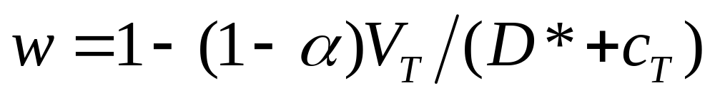
Assumption (7)
Assumption 7
  The percentage write-down on the nominal claim of the option holder is
  where
    α : the deadweight costs of the financial distress, expressed as a percentage of the value of the assets of the option writer.
    V_{T}/(D*+c_{T}) : the value of the option writer’s assets available to pay the claim expressed as a proportion of total claims at T.

Slide 11
The Model
These assumptions allow default to occur only at the maturity of the option.
  Johnson and Stulz (1987), Klein (1996)
Contrast to other models (default can occur at any time during the life of the option)
  Hull and White (1995), Jarrow and Turnbull (1995) and Rich (1996)
  Require additional assumptions to make the model tractable.

Slide 12
The Model
Rich (1996)
  Provides no analytical solution in the case where the recovery in the event of default is linked to the moneyness of the option.
  Assumes that upon default, the option holder exercises the option immediately and forgoes any remaining time value of the option.
Notes:
Moneyness: 價值狀況

Slide 13
The Model
In our model, we assume that default can occur only if
V_{T} < D* + max(S_{T} – K)
  Primarily interested in the impact of exercising a potentially in-the-money option on the probability of default of the option writer and the resulting consequences for the value of the vulnerable option.
  We are able to develop an approximate analytical solution.

Slide 14
The Model
Debt accelerate
  Debt indentures which stipulate that when financial distress occurs the principal amount of the indebtedness is accelerated.
The manner in which European options are treated when financial distress occurs.
  Most OTC (over-the-counter) options are governed by the standardized contract recommended by the ISDA (International Swaps and Derivatives Association.)
    歐式選擇權在到期日時才知道其內含價值 (Assumption 5)。
    所以一般 holder 會 wait until the maturity date T.
Notes:
Debt accelerate:
發生 financial stress 時所有債務在那一瞬間到期

Slide 15
The Model
If financial distress occurs before the maturity of the option and the holder of the option decides to accelerate.
  financial distress 時 option的價值如何決定？
    Because of the “market quotation” clause (in ISDA) : sets the nominal claim of the option holder equal to the market value of the option at that time.
    market value in turn depends on the expected payoff from the option at the maturity date T.

Slide 16
The Model
Further, basing the percentage write-down of the nominal claim of the option holder (w in Assumption 6 & 7) on the value of the assets of the option writer at the time of the initiation of financial distress is certainly not accurate.
在 t 時間無法決定, t < T

Slide 17
The Model
Given the substantial delay that is typically involved before the resolution of financial distress.
We choose time T as a reasonable proxy for the time when the assets of the option writer are distributed,
  which is also convenient computationally.
Notes:
在財務危機解除前給與大量的 delay 會使情況更加複雜 而不能解決

Slide 18
The Model
Divide the percentage write-down, w, into two components (Klein 1996, K&I 1999):
  α: represents proportional deadweight costs
  V_{T}/(D*+c_{T}): linked to the assets of the option writer.
Assume all claims on the option writer are of equal priority (J&S 1987, Klein 1996)
  Our model could easily be extended to allow for multiple levels of seniority.

Slide 19
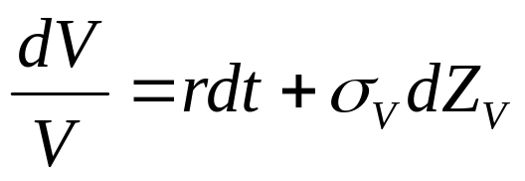
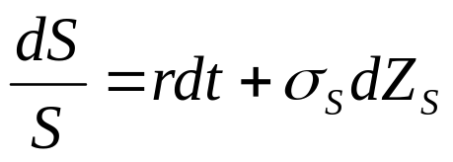
Valuation equations (1)
Based on the risk neutral pricing approach
  Cox and Ross (1976) and
  Harrision and Pliska (1981)
The appropriate risk neutral processes for V and S are given by
where
  r represents the riskless rate of interest.
  S and V at time T is joint lognormal.

Slide 20
Valuation equations (2)
Based on this distribution, we can write the value of the vulnerable call as the discounted expected value of the option payoff at time T after also taking into account the expected loss due to financial distress.
Notes:
期望值的折線
可以計算預期損失

Slide 21
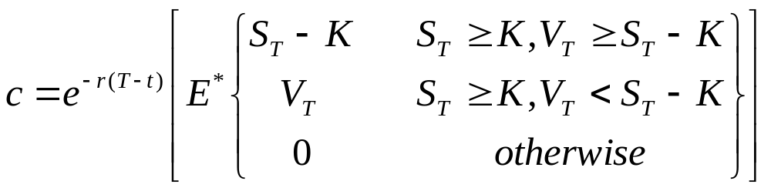
Valuation equations (3)
The Johnson and Stulz (1987) pricing equation for vulnerable European calls can be written as
  First line : no financial distress, V_{T} ≥ S_{T} – K
  Second line : option expires in-the-money
    Can be written = V_{T} * (該債務佔總債務的比例)
    因為該 option writer 只擁有此一單獨債務，所以設為 1
(5)

Slide 22
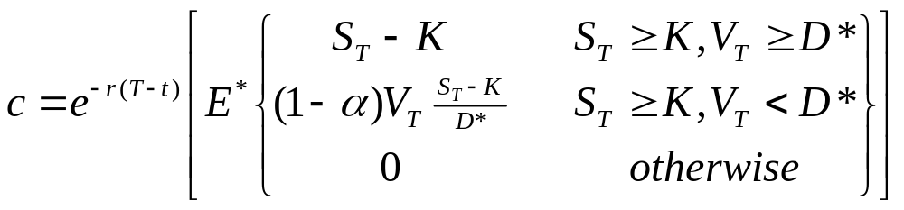
Valuation equations (4)
By comparison, the Klein (1996) pricing equation for vulnerable European calls can be written as
where
  D* : fixed default boundary (“FDB”)
  (S_{T}-K)/D* : 佔總負債的比例
    選擇權的報酬與其他的債務相比是可以忽略的 ( Klein 1996 的假設 )，所以 option payoff 的分母沒有選擇權的報酬
(6)
Notes:
選擇權的報酬與其他的債務相比是可以忽略的 ( Klein 1996 的假設 )，所以 option payoff 的分母沒有選擇權的報酬

Slide 23
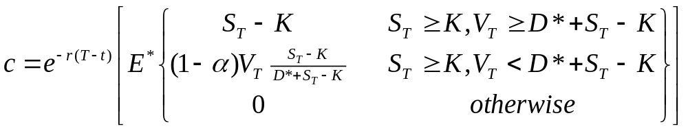
Valuation equations (5)
This paper,
  The default barrier is the sum of variable barrier in eq(5) and fixed barrier in eq(6).
  D* : the total of other liabilities.
    If option writer has no other liabilities, i.e., D* = 0, it is Johnson and Stulz (1987) model.
    If D* >> S_{T} - K, the ratio converges to the ratio in Eq.(6), which is Klein (1996)
(7)

Slide 24
Valuation methods (1)
Eq.(7) does not have an analytic solution in most cases, and thus must be evaluated numerically.
This section describe the
  numerical method
  how an approximate analytic solution can be obtained.

Slide 25
Valuation methods (2)
Numerical method (a 3D binomial tree).
  Orthogonalize the two process to ensure zero correlation.
    Get grid variable x₁ and x₂
  Construct a 3D tree using the approach suggested by Hull and White (1990)
  Backward through the tree.
  Grid variables are transformed back to their original form at each node of the tree.
    V , S ➔ x₁ and x₂ is one to one.

Slide 26
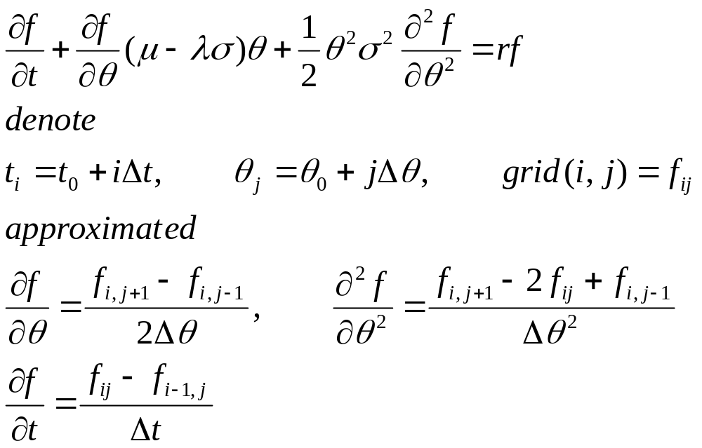
Hull and White (1990)
II. The Explicit finite Difference Method
對微分方程式

Slide 27
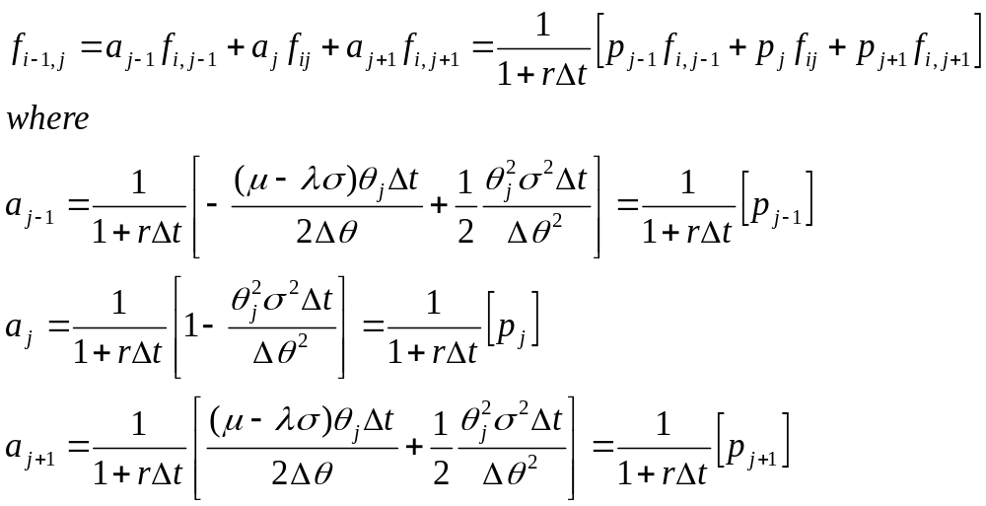
Hull and White (1990)
II. The Explicit finite Difference Method
代入後
像是期望值的折現
f_{i,j+1}
f_{i-1,j}
f_{i,j}
f_{i+1,j}
p corresponds to the procedure suggest in
Cox, Ingersoll, and Ross (1985a, Lemma 4), 可視為 CIR 三元樹

Slide 28
Hull and White (1990)
III. The Proposed Procedure
A. The Transformation of Variables
  When θ is a stock price, the instantaneous standard deviation of Lnθ is constant
    i.e. the standard deviation of changes in Lnθ in a time interval Δt is independent of θ and t.
  When applying the explicit finite difference method, to define a new state variable ψ(θ,t) that has a constant instantaneous standard deviation.

Slide 29
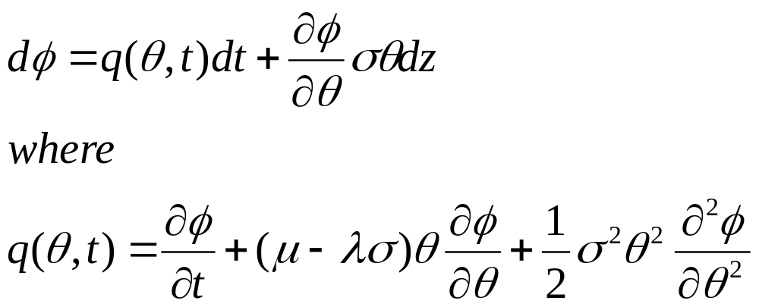
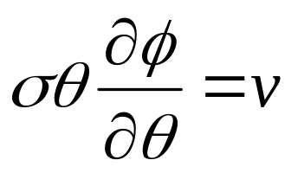
Hull and White (1990)
III. The Proposed Procedure
From Ito’s lemma, the process followed by ψ in a risk-neutral world is
We wish to choose the variable ψ so that
for some constant v.

Slide 30
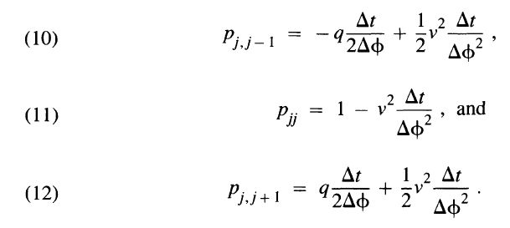
Hull and White (1990)
III. The Proposed Procedure
A grid is constructed for values of ψ₀… ψ_{n}, where ψ_{j} = ψ₀ + jΔψ
The probabilities become

Slide 31


Hull and White (1990)
III. The Proposed Procedure
B. The Modification to the Branching Process
  Ensure that as Δt and Δψ→0, the estimated value of the derivative security converges to its true value.
  ➔a sufficient condition for convergence (Ames (1977) p.15): p_{j,j-1}, p_{jj}, and p_{j,j+1} > 0 as Δt and Δψ→0.
  ➔帶入上頁的機率值可得條件

Slide 32
Hull and White (1990)
III. The Proposed Procedure
There are some situations where q is unbounded.
  Ex: when θ is an interest rate following a mean-reverting process.
  ➔The explicit finite difference method may not converge.
Overcome the problem:
  Allow a movement from ψ_{j} to one of ψ_{k-1}, ψ_{k}, and ψ_{k+1}, where k is not necessarily equal to j.
Notes:
Why θ is mean-reverting process , then finite difference method may not converge?

Slide 33
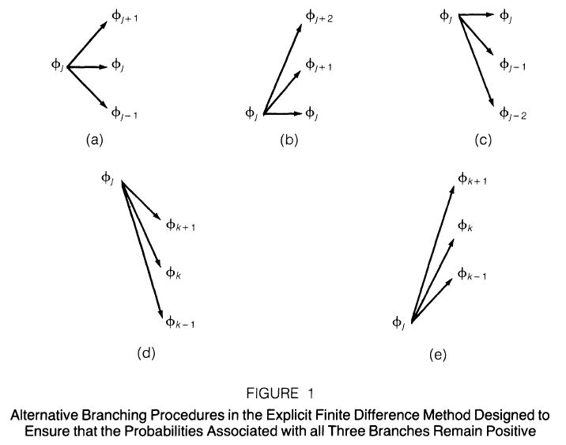
E(δψ) > 0
E(δψ) < 0
E(δψ) << 0
E(δψ) >> 0

Slide 34
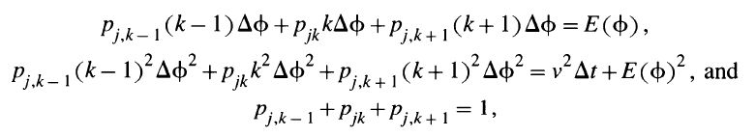
Hull and White (1990)
III. The Proposed Procedure
We choose k so that ψ_{k} is the value of ψ on the grid closest to ψ_{j}+qΔt
The probability:
  Match the 1st and 2nd moments
Where E(ψ)=jΔψ+E(δψ) is the expected value of ψ-ψ₀
at the end of the time interval, Δt.

Slide 35
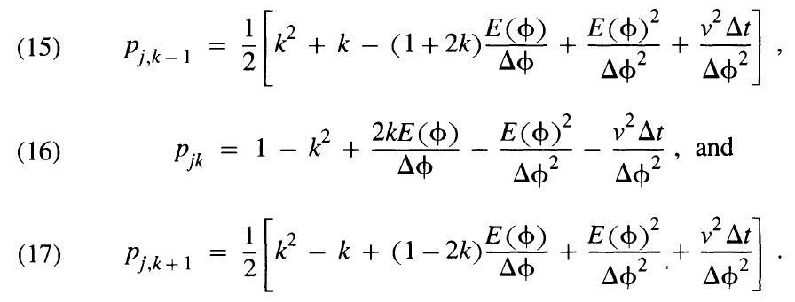
Hull and White (1990)
III. The Proposed Procedure
The solution:
Can handle jump because of dividend.

Slide 36
Hull and White (1990)
III. The Proposed Procedure
The explicit finite difference method provides one degree of freedom:
  The choice of v²Δt/Δψ² ≡ w
  One constraint on w: it should always possible to find a k such that p_{j,k-1}, p_{jk}, p_{j,k+1} > 0
  Implies that 0.25 < w < 0.75
  If q is small (ex: q=0), then suggest that a sensible value for w is 1/3

Slide 37
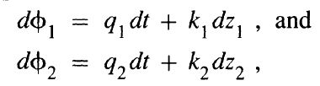
Hull and White (1990)
V. Dealing with Than One State Variable
Two variable θ₁, θ₂
  ➔transformed to two new variable ψ₁, ψ₂ with σ₁, σ₂ are constant.
assume the volatility of θ_{i} depends only on θ_{i} and t (t = 1, 2). The processes for ψ₁, ψ₂ :
where k₁ and k₂ are constants, and q₁, q₂ are defined analogously to q in (8).

Slide 38
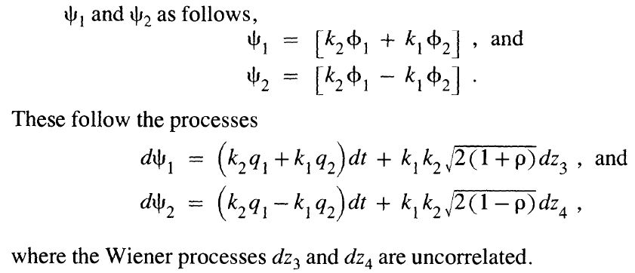
Hull and White (1990)
V. Dealing with Than One State Variable
ρ: the instantaneous correlation between dz₁ and dz₂. Assume this is constant.
Eliminate the correlation: Define new variables

Slide 39
Hull and White (1990)
V. Dealing with Than One State Variable
The probabilities of Ψ₁, Ψ₂ are chosen in the same way as they are for ψ in Section III.
Using a 2D lattice for each variables, and with 9 branches emanating from each node.
  The probability of any given point being reached is the product of two probabilities in Ψ₁, Ψ₂ .

Slide 40
Valuation methods (3)
Approximate analytical solution to Eq.(7)
  Perform the standard log transformation
  Employ a first order Taylor series approximation to linearize the boundary conditions.
  The denominator in the second term of Eq.(7) must also be linearized through a first order Taylor series approximation.
  Eliminate S from boundary condition for V
    A standard rotation as outlined in Abramowitz and Stegun (1972) is used

Slide 41
Klein (1996)
3. A model of expected credit loss
D: amount of claims
D* : the default boundary, (D* may be < D)
  當V_{T} < D 時，有可能 counterparty continuing in operation.
In the event of a credit loss, only the proportion (1-α)V_{T}/D,
  α: deadweight cost

Slide 42
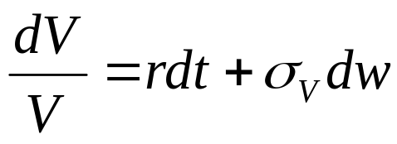
Klein (1996)
3. A model of expected credit loss
V is a traded security,
  r denotes the riskfree rate,
  w follows a standard Wiener process
V_{T} is normally distributed with
  Mean (r-σ_{V}²/2)(T-t)
  Standard deviation of σ_{V} (T-t)^{1/2}

Slide 43
Klein (1996)
3. A model of expected credit loss
B: a nominal claim on the counterparty
B* : the expected actual payout B*
  Where E* denotes risk neutral expectation.
  V_{T} ≧ D* : (沒有default) 取得全部 B
  V_{T} < D* : (發生 default) 取得部份比例的 B

Slide 44
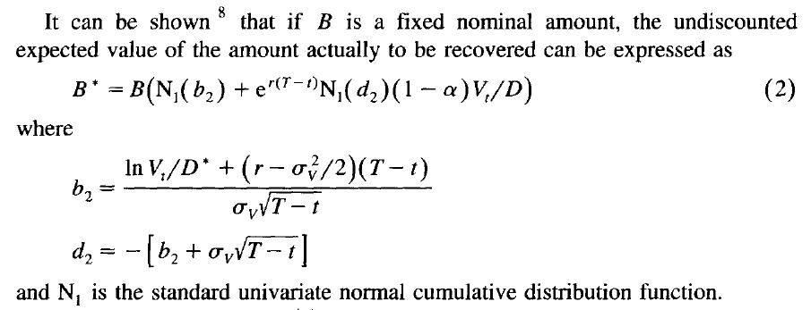
Klein (1996)
3. A model of expected credit loss
When B=1, Eq (2) may be used to value a zero coupon bond
issued by the counterparty.
Notes:
B* 是一個沒有折現的期望值

Slide 45
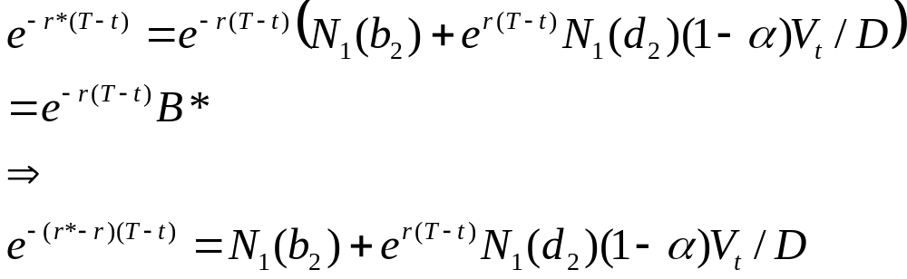
Klein (1996)
3. A model of expected credit loss
If r* is the yield on a traded zero coupon bond (i.e. B=1) , the following relationship must hold:
Undiscounted effect of credit risk on
a cash flow of fixed nominal amount
The difference in yield between risk zero coupon bonds and
a similar term riskless zero coupon bond.

Slide 46
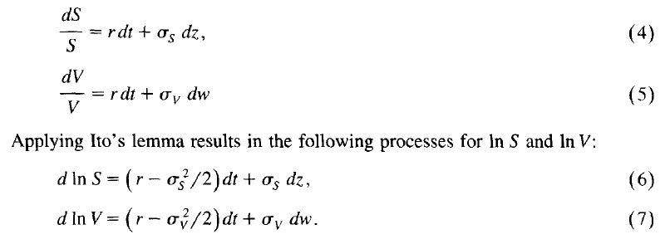
Klein (1996)
4. Vulnerable Black-Scholes options
S and V, the appropriate risk neutral processes are:

Slide 47
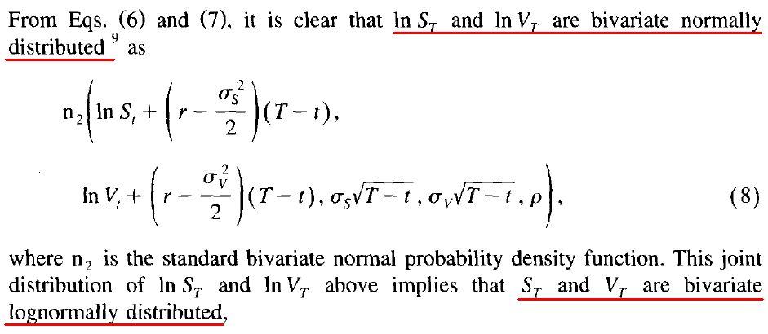
Klein (1996)
4. Vulnerable Black-Scholes options

Slide 48
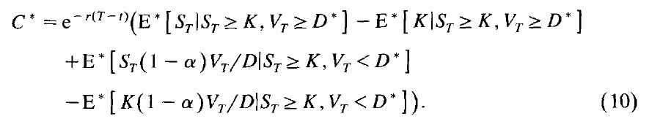
Klein (1996)
4. Vulnerable Black-Scholes options
C* : the value of a vulnerable call
Non-vulnerable call
No default
default
where
α: deadweight cost (%) (ex: bankruptcy cost)
E* : denotes risk neutral expectations over S_{T} and V_{T}
K : the exercise price

Slide 49
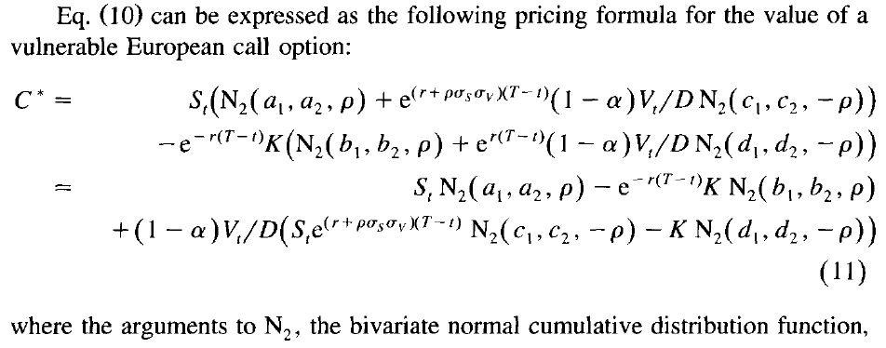
Klein (1996)
4. Vulnerable Black-Scholes options
Klein (2001) 更改分母的地方
參數請見該篇 paper …

Slide 50
Klein (1996)
4. Vulnerable Black-Scholes options
Continuous dividend yield q
  第一個bivariate normal 的參數：r ➔ r-q
  S_{t} 用 e^{-q(T-t)} 折現

Slide 51
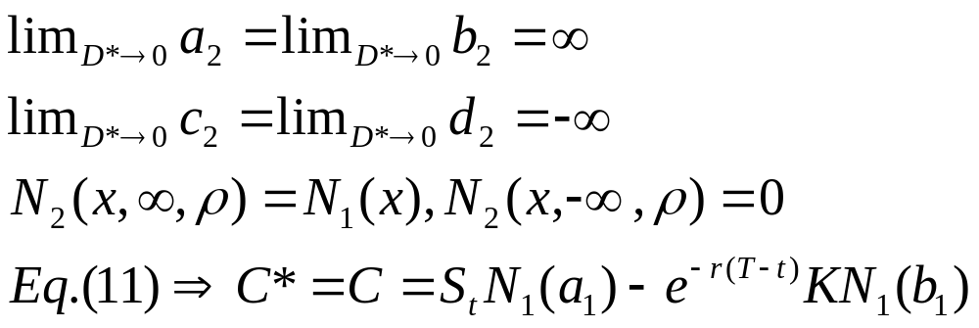
Klein (1996)
5. Specific cases of the pricing formula
5.1 Non-vulnerable options (D* = 0)
  No risk of bankruptcy, D*=0,
  ➔ the price of call = Black-Scholes price
  可對 eq.(11) 取 limit , D*→0 來驗證
  二元常態分配的參數
  which is the standard Black-Scholes result.

Slide 52
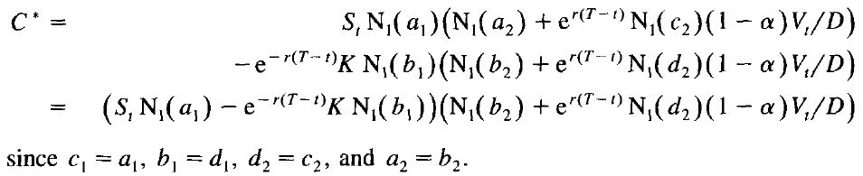
Klein (1996)
5. Specific cases of the pricing formula
5.2 Independence (ρ=0)
  When ρ=0, Eq(11) simplifies
B-S option
Eq(2), B*, B=1
Similar to Hull and White (1995) under the independence assumption,
but relates the undiscounted expected value of a claim of fixed nominal amount.
Notes:
ρ: the correlation of the credit risk of the counterparty and the process for the asset underlying the option

Slide 53
Klein (1996)
5. Specific cases of the pricing formula
5.3 Certain default (D* = ∞)
  The formulas in this paper can be applied assuming default is certain to value options on the product of two correlated assets.

Slide 54
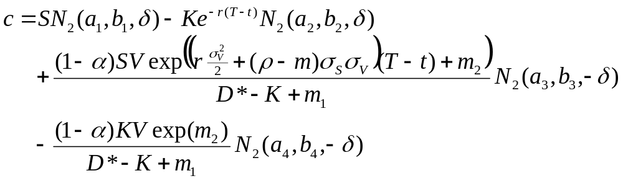
Valuation methods (4)
Which enables us to rewrite the approximation in terms of the cumulative bivariate normal distribution as follows:
b₁, b₂ : Prob. Of financial distress
BS formula
The expected value of the option
conditional upon financial distress
having occurred.
(incorporate the expected loss to
option holder because of financial
distress.)
If there is no probability of financial distress
(V >> D*), the 3rd and 4th term = 0.

Slide 55
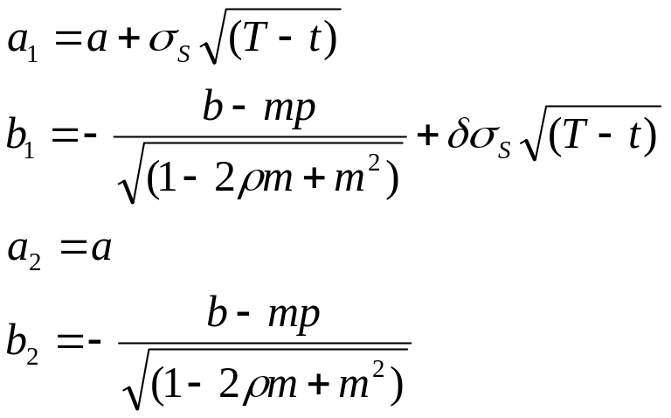
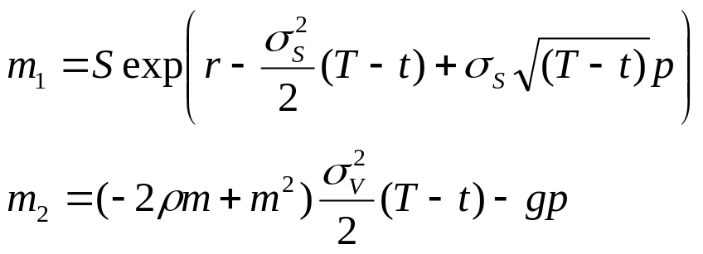
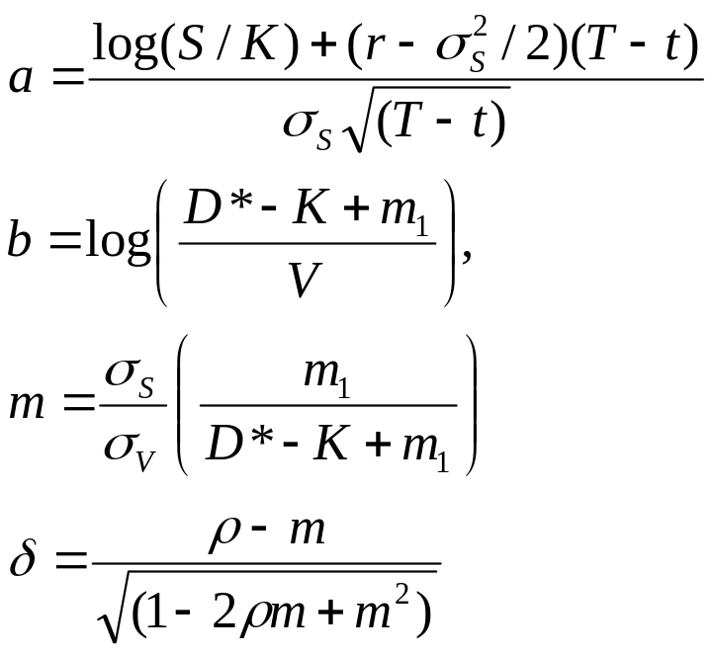
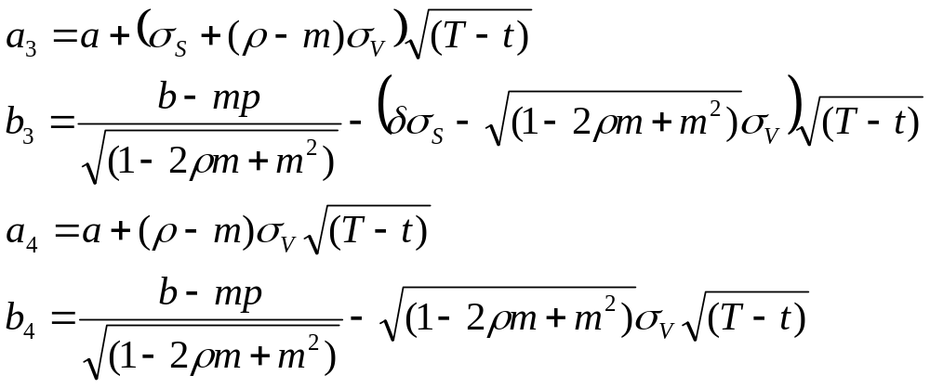
where
and

Slide 56
Valuation methods (5)
The approximate valuation equation also expends on the point (p) around which the Taylor series is expanded.
Fig1 & Fig2 provide insight to the effect of choosing a particular value for p.

Slide 57
Valuation methods (6)
If D*=K, the valuation equation does not depend on the point of expansion p.
  In other words, the term involving p cancel each other.
  Because the default barrier depends only upon ln(S_{T}) which, after log transformation, is already linear.
Notes:
含有 p 的項彼此抵銷
Ln(S_{T}) is a const

Slide 58
Valuation methods (7)
If D*>K, the true default barrier is the convex line in Fig1.
  true default barrier always above tangent line
  area below the curve>area below the tangent
    Area below the curve is the prob. of financial distress will occur
  Approximation based on the tangents will underestimate the effect of credit risk on the value of the vulnerable call option.
  The optimal value for p will be the value that minimizes the value of the vulnerable option.
Notes:
Minimize: 如果不是最佳點， tangent barrier 和真實 barrier 會有更大的差別
➔ the value of the vulnerable (上方面積)↑
➔所以 min[ the value of the vulnerable option ] 可得 optimal p

Slide 59
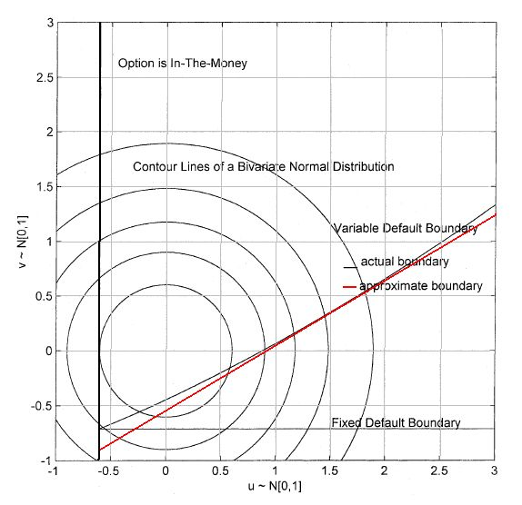
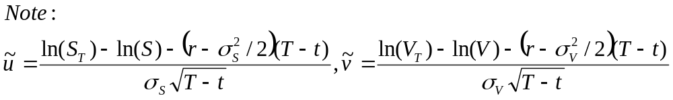
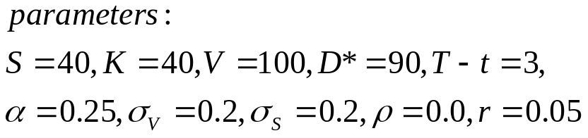
Actual default
boundary of our model
1st order Taylor series approximation
of the actual default boundary
FDB of Klein (1996)
Fig. 1. Integration region for the vulnerable European call when D*>K.

Slide 60
Valuation methods (8)
If D*<K, the correct default barrier is concave
  an approximation based on a tangent will underestimate the value of the vulnerable call.
  The optimal value for p will be the value that maximizes the value of the vulnerable option.

Slide 61
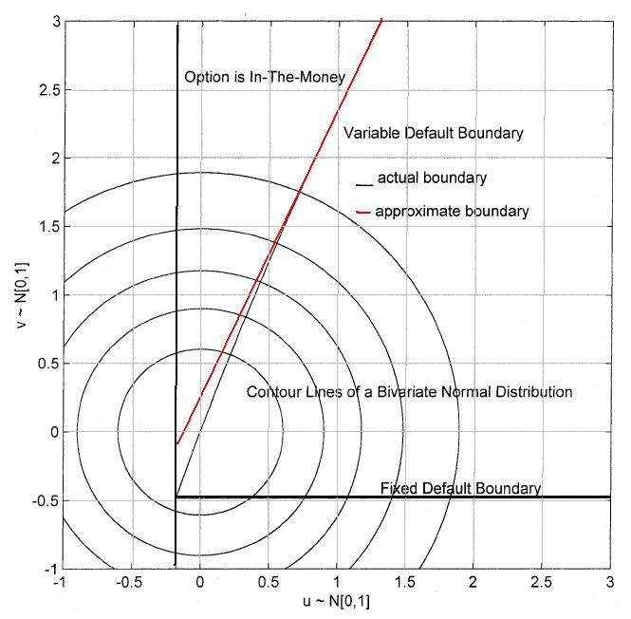
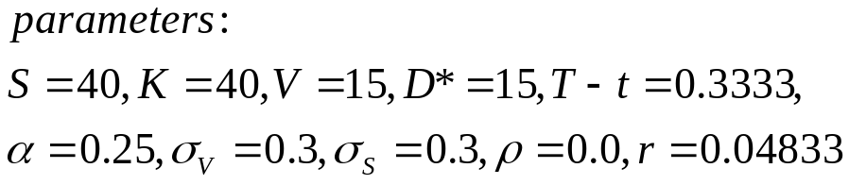
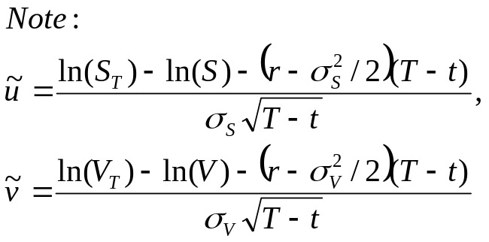
Actual default
boundary of our model
1st order Taylor series approximation
of the actual default boundary
FDB of Klein (1996)
Fig. 2. Integration region for the vulnerable European call when D*<K.

Slide 62
Valuation methods (9)
Converges to other models :
  D* increase ≒ S_{T} – K (FDB line in Fig1&2)
  D* >> S_{T} - K (Klein (1996))
  D* = 0 (Johnson and Stulz (1987))

Slide 63
Valuation methods
本篇 paper 雖然都以 call 為例子，但也可以計算Vulnerable European put
Easily extended when underlying asset pays continuous dividend yield
  Ex: vulnerable European options on foreign currencies.

Slide 64
Numerical examples

Slide 65
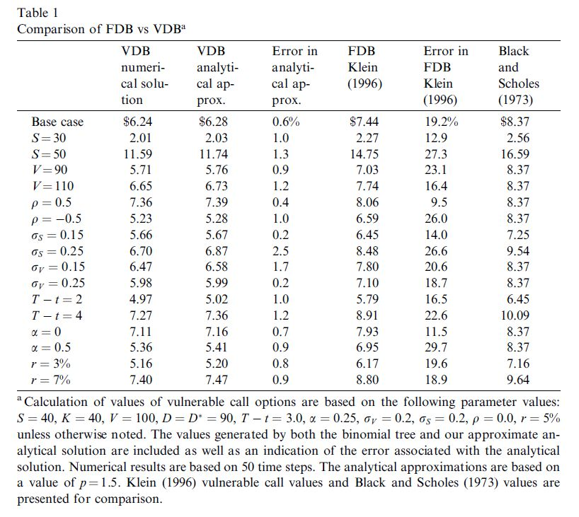
大部份 <1%
Overstate
最高

Slide 66
Numerical examples
Table 1
  Base case:
    at the money, highly leveraged (D* = D),
    Assumes a time to maturity of 3 years (T-t = 3)
    No correlation (writer’s asset & underlying asset)
  Error (Column 3) 公式：(C2 – C1) / C1
    大部分 < 1%, 最高 2.5%
    所有的值都是正值
      ➔ 分析解 overestimate the value of the option
      because D* > K, 與 Fig 1. 顯示相同的結果

Slide 67
Numerical examples
Table 1
  VDB > FDB (Klein 1996)
  Error in the range of 20% ➔ overstates
    ➔Klein (1996) assumes that the expected payoff from the option << other liabilities of option writer.
    ➔ ignoring the possibility that the payoff on the option itself may increase the risk of financial distress.
    ➔ consistently understates the prob. of financial distress
    Overstates would disappear if D* >> K

Slide 68
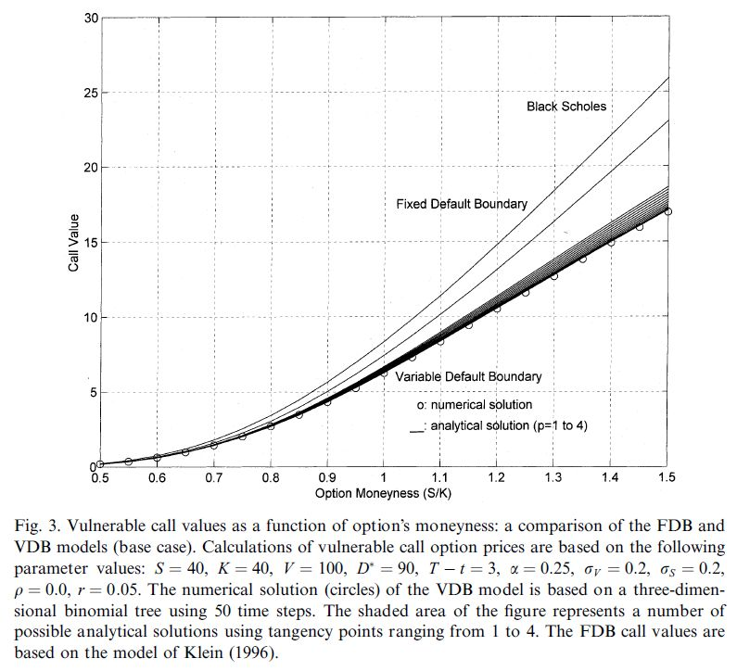
p=1.0~4.0
analytics > numerical
(D* > K)
<
difference increase with the moneyness
S=20~60
➔moneyness=0.5~1.5

Slide 69
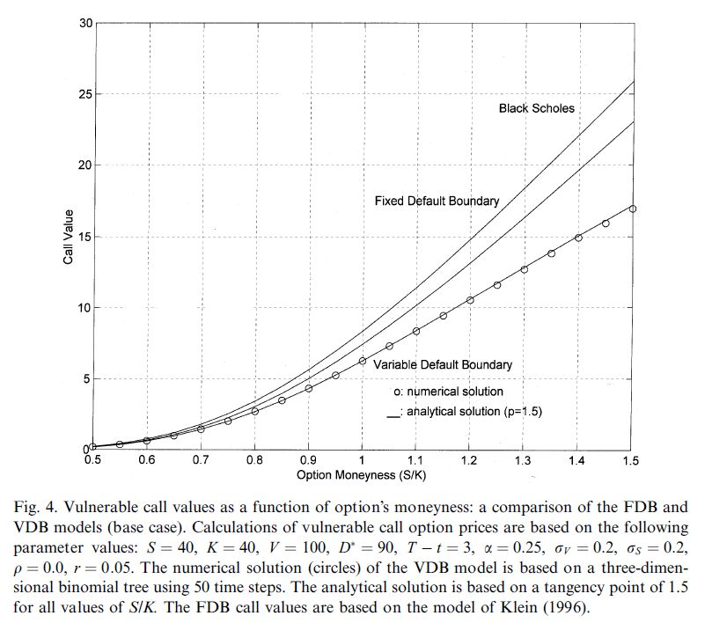
p=1.5,
Analytical ≒Numerical
➔ Robust to moneyness (S/K)

Slide 70
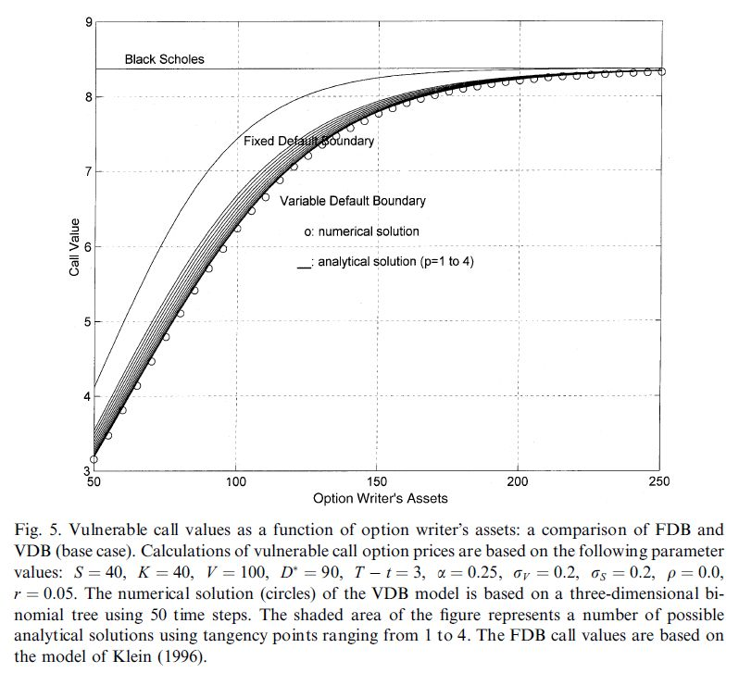
analytics > numerical
(D* > K)
p=1.0
~4.0

Slide 71
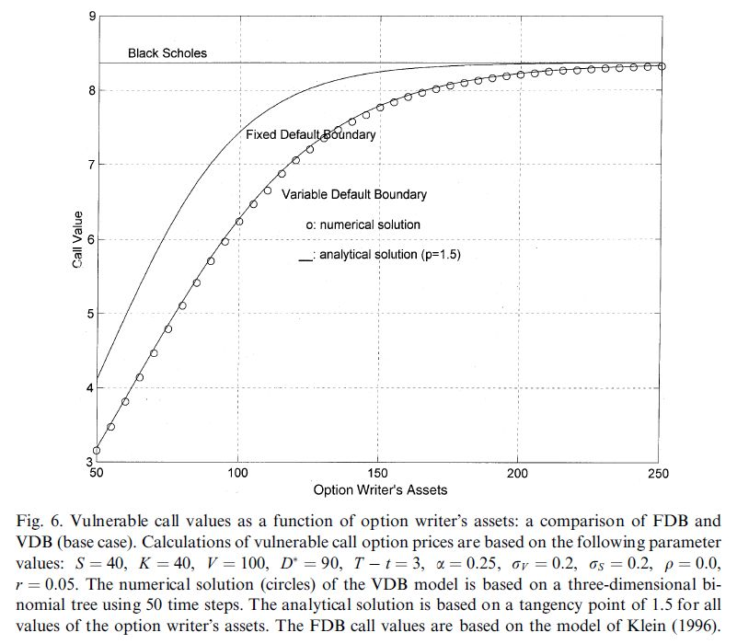
Converge with B-S
(V 非常大)
>
當債務很小要描述 financial distress
對 option value 的影響，
可用 FDB model of Klein (1996)
Analytical ≒Numerical ➔ Robust to leverage ratios (V/D*)
p=1.5

Slide 72
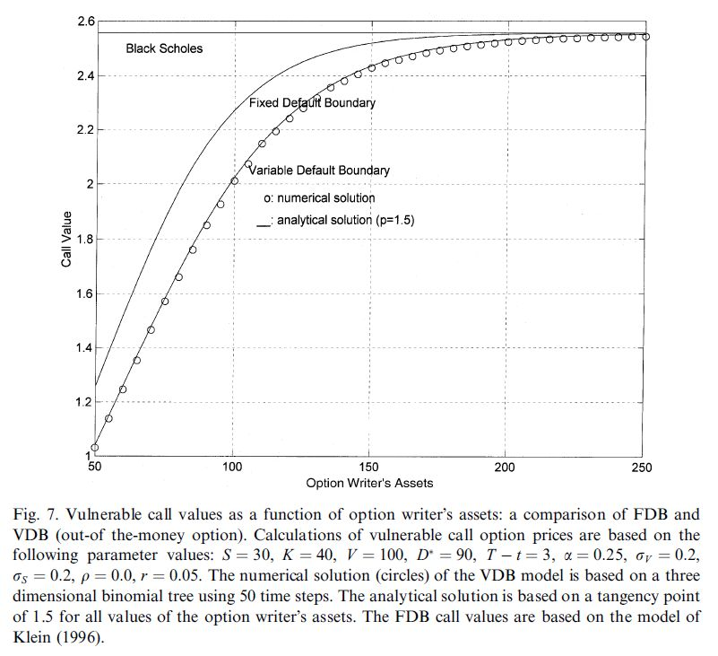
Out-of-the-money

Slide 73
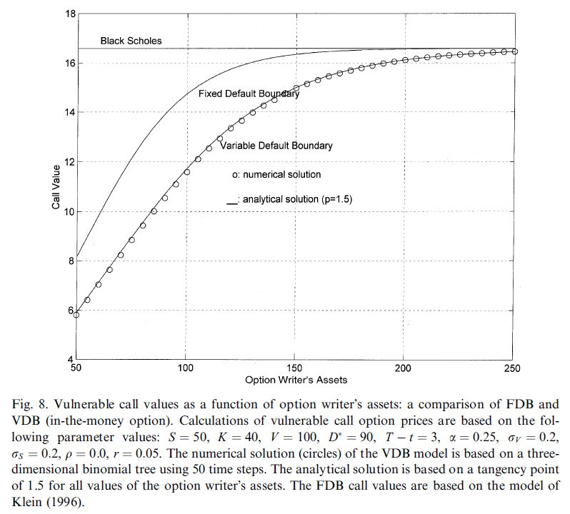
in-the-money

Slide 74
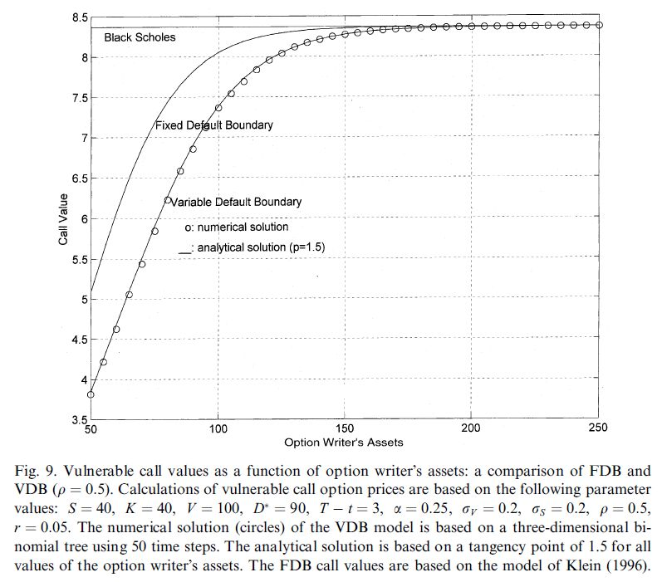
ρ=0.0 ➔ 0.5

Slide 75
Conclusion
Extends the result of Sohnson and Stulz (1987) & Klein (1996) to allow for other liabilities of the option writer and for the default boundary to depend on the payoff of the option itself.
Employ a 3D binomial tree to generate numerical examples
Derive an approximate analytical solution
  A function of the point of expansion
Describe how to choose the optimal point of expansion and find when p=1.5 the analytical are very close to numerical solution.
When the payoff under the option is expected to be large as compared to the other liabilities, VDB is extremely important.

