Slide 1
Pricing vulnerable European options when the option’s payoff can increase the risk of financial distress
Peter Klein, Michael Inglis (2001)
報告者：劉彥君

Slide 2
Introduction
考慮一個 European option，當到期日 T時，如果 S_{T} > K，則 option writer 要支付option holder
option 的價值 c_{T} = S_{T}-K。
如果option writer 的 asset (V_{T})無法支付 S_{T}-K 則 default，即V_{T} < S_{T}-K
(J&S 1987) 因此這種 vulnerable option 內建一個 barrier ，即在到期日時， V_{T} ≧ S_{T}-K
(This paper)考慮 option writer 有其他債務 D* , 則在到期日時， V_{T} ≧ D* + S_{T} - K

Slide 3
Introduction
Johnson and Stulz(1987)
  The default barrier depend on the value of the option that has been written
  If default, assume the option holder receive all the assets of the option writer.
Klein (1996)
  延伸 Stulz(1987) 的 Model，利用 B-S Model 評價 vulnerable option，得到公式解。
Rich (1996)
  Extent by allowing the default boundary to be stochastic.
  Although the other liabilities of the option writer are allowed to change over time, the effect of the option’s payoff on the probability of default is not directly considered.
Notes:
Rich (1996)
雖然 option writer 的債務 D* 可隨時間變動，但並沒有直接考慮 option 報酬對違約機率的影響

Slide 4
Assumption (1)
The assumptions underlying the Klein (1996) model for valuing European calls.
  The basic assumptions of this framework follow
    Merton(1974)
    Black and Cox(1976)
    Johnson and Stulz(1987)

Slide 5
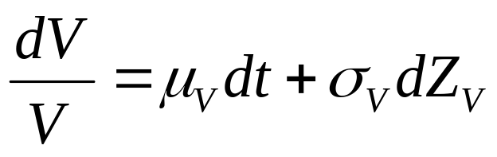
Assumption (2)
Assumption 1
  V : the market value of the assets of the option writer.
  The dynamics of V are given by
  where
    μ_{v} is the instantaneous expected return on the assets of the option writer.
    σ²_{V} is the instantaneous variance of the return (assumed to be constant),
    Z_{v} is the standard Wiener process.

Slide 6
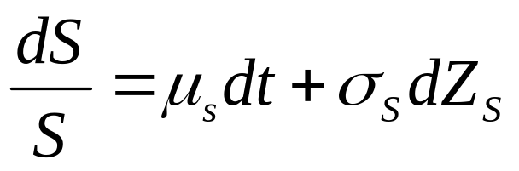
Assumption (3)
Assumption 2
  S : the market value of the asset underlying the option.
  The dynamics of S are given by
  where
    μ_{S} is the instantaneous expected return on the asset underlying the option.
    σ²_{S} is the instantaneous variance of the return (assumed to be constant),
    Z_{S} is the standard Wiener process.
    The instantaneous correlation between Z_{v} and Z_{s} is ρ_{VS}

Slide 7
Assumption (4)
Assumption 3
  Markets are perfect and frictionless.
  There are no transaction costs or taxes and securities trade in continuous time.
Notes:
完美市場，且沒有交易成本、稅，且連續交易

Slide 8
Assumption (5)
Assumption 4
  Default occurs at the maturity of the option, T, only if
  V_{T} < D* + c_{T}
  where
    c_{T} = max(S_{T} - K, 0)
    D* : the value of the other liabilities of the option writer.
    S_{T} : the price of the underlying asset at the maturity of the option
    K : the strike price of the option.

Slide 9
Assumption (6)
Assumption 5
  The nominal claim of the option holder is the intrinsic value of the option at its maturity.
Assumption 6
  Upon resolution of the financial distress, the option holder receives (1-w) times the nominal claim.
    w : the percentage write-down of the nominal claim.

Slide 10
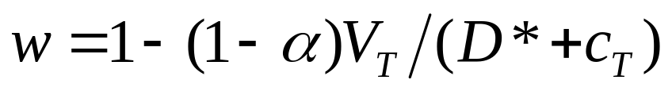
Assumption (7)
Assumption 7
  The percentage write-down on the nominal claim of the option holder is
  where
    α : the deadweight costs of the financial distress, expressed as a percentage of the value of the assets of the option writer.
    V_{T}/(D*+c_{T}) : the value of the option writer’s assets available to pay the claim expressed as a proportion of total claims at T.

Slide 11
The Model
These assumptions allow default to occur only at the maturity of the option.
  Johnson and Stulz (1987), Klein (1996)
Contrast to other models (default can occur at any time during the life of the option)
  Hull and White (1995), Jarrow and Turnbull (1995) and Rich (1996)
  Require additional assumptions to make the model tractable.

Slide 12
The Model
Rich (1996)
  Provides no analytical solution in the case where the recovery in the event of default is linked to the moneyness of the option.
  Assumes that upon default, the option holder exercises the option immediately and forgoes any remaining time value of the option.
Notes:
Moneyness: 價值狀況

Slide 13
The Model
In our model, we assume that default can occur only if
V_{T} < D* + max(S_{T} – K)
  Primarily interested in the impact of exercising a potentially in-the-money option on the probability of default of the option writer and the resulting consequences for the value of the vulnerable option.
  We are able to develop an approximate analytical solution.

Slide 14
The Model
Divide the percentage write-down, w, into two components (Klein 1996, K&I 1999):
  α: represents proportional deadweight costs
  V_{T}/(D*+c_{T}): linked to the assets of the option writer.
Assume all claims on the option writer are of equal priority (J&S 1987, Klein 1996)
  Our model could easily be extended to allow for multiple levels of seniority.

Slide 15
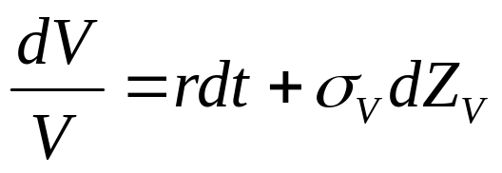
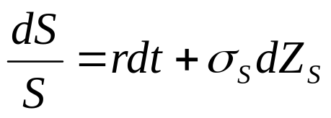
Valuation equations (1)
Based on the risk neutral pricing approach
  Cox and Ross (1976) and
  Harrision and Pliska (1981)
The appropriate risk neutral processes for V and S are given by
where
  r represents the riskless rate of interest.
  S and V at time T is joint lognormal.

Slide 16
Valuation equations (2)
Based on this distribution, we can write the value of the vulnerable call as the discounted expected value of the option payoff at time T after also taking into account the expected loss due to financial distress.
Notes:
期望值的折線
可以計算預期損失

Slide 17
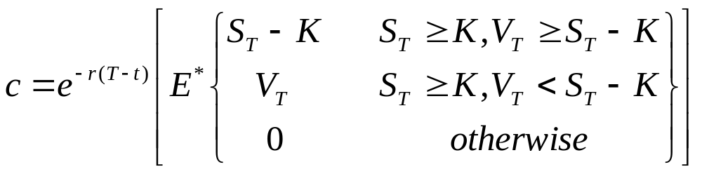
Valuation equations (3)
The Johnson and Stulz (1987) pricing equation for vulnerable European calls can be written as
  First line : no financial distress, V_{T} ≥ S_{T} – K
  Second line : option expires in-the-money
    Can be written = V_{T} * (該債務佔總債務的比例)
    因為該 option writer 只擁有此一單獨債務，所以設為 1
(5)

Slide 18
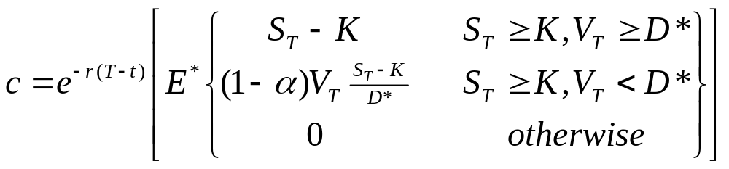
Valuation equations (4)
By comparison, the Klein (1996) pricing equation for vulnerable European calls can be written as
where
  D* : fixed default boundary (“FDB”)
  (S_{T}-K)/D* : 佔總負債的比例
    選擇權的報酬與其他的債務相比是可以忽略的 ( Klein 1996 的假設 )，所以 option payoff 的分母沒有選擇權的報酬
(6)
Notes:
選擇權的報酬與其他的債務相比是可以忽略的 ( Klein 1996 的假設 )，所以 option payoff 的分母沒有選擇權的報酬

Slide 19
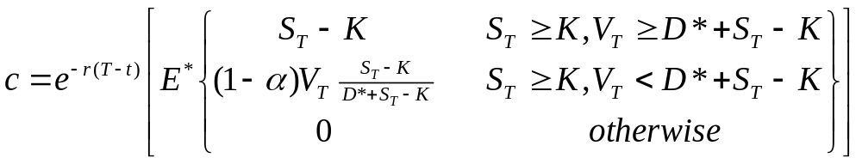
Valuation equations (5)
This paper,
  The default barrier is the sum of variable barrier in eq(5) and fixed barrier in eq(6).
  D* : the total of other liabilities.
    If option writer has no other liabilities, i.e., D* = 0, it is Johnson and Stulz (1987) model.
    If D* >> S_{T} - K, the ratio converges to the ratio in Eq.(6), which is Klein (1996)
(7)

Slide 20
Valuation methods (1)
Eq.(7) does not have an analytic solution in most cases, and thus must be evaluated numerically.
This section describe the
  numerical method
  how an approximate analytic solution can be obtained.

Slide 21
Valuation methods (2)
Numerical method (a 3D binomial tree).
  Orthogonalize the two process to ensure zero correlation.
    Get grid variable x₁ and x₂
  Construct a 3D tree using the approach suggested by Hull and White (1990)
  Backward through the tree.
  Grid variables are transformed back to their original form at each node of the tree.
    V , S ➔ x₁ and x₂ is one to one.

Slide 22
Valuation methods (3)
Approximate analytical solution to Eq.(7)
  Perform the standard log transformation
  Employ a first order Taylor series approximation to linearize the boundary conditions.
    The denominator in the second term of Eq.(7) must also be linearized through a first order Taylor series approximation.
  Eliminate S from boundary condition for V
    A standard rotation as outlined in Abramowitz and Stegun (1972) is used

Slide 23
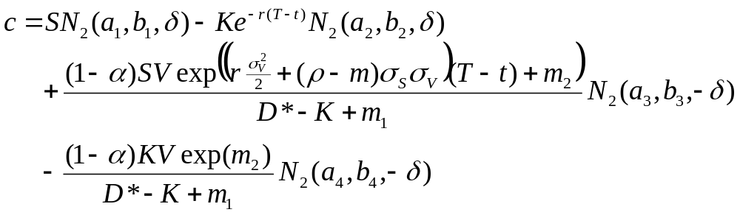
Valuation methods (4)
Which enables us to rewrite the approximation in terms of the cumulative bivariate normal distribution as follows:
b₁, b₂ : Prob. Of financial distress
BS formula
The expected value of the option
conditional upon financial distress
having occurred.
(incorporate the expected loss to
option holder because of financial
distress.)
If there is no probability of financial distress
(V >> D*), the 3rd and 4th term = 0.

Slide 24
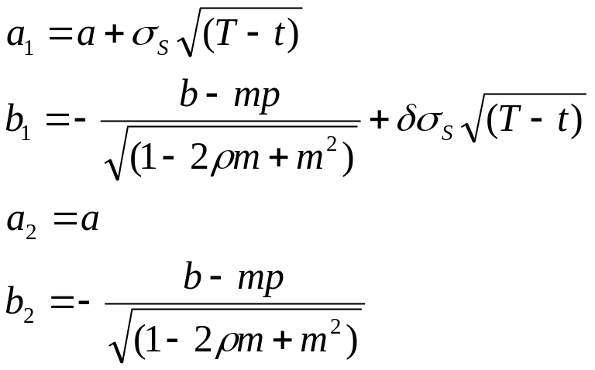
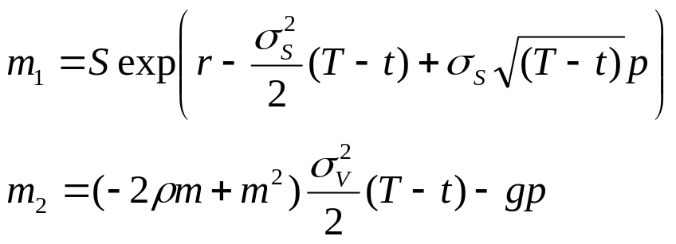
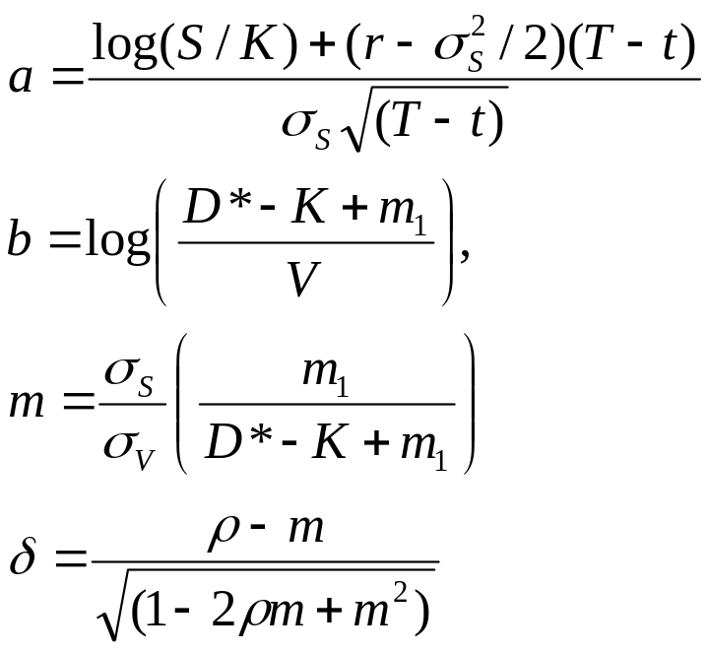
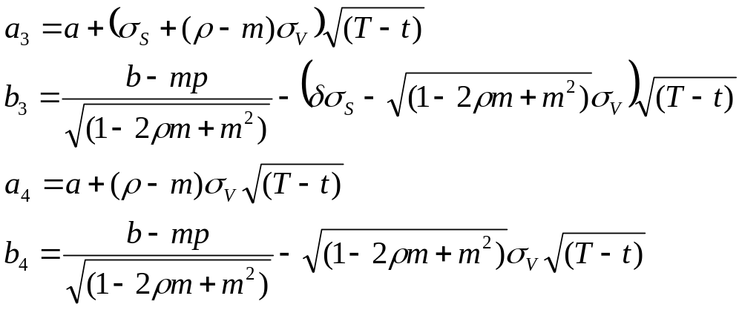
where
and

Slide 25
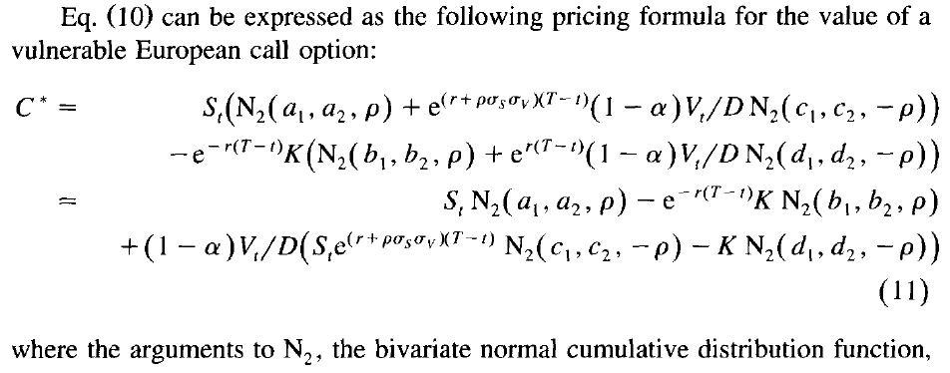
Klein (1996)
4. Vulnerable Black-Scholes options
Klein (2001) 更改分母的地方
參數請見該篇 paper …

Slide 26
Valuation methods (5)
The approximate valuation equation also depends on the point (p) around which the Taylor series is expanded.
Fig1 & Fig2 provide insight to the effect of choosing a particular value for p.

Slide 27
Valuation methods (6)
If D*=K, the valuation equation does not depend on the point of expansion p.
  In other words, the term involving p cancel each other.
  Because the default barrier depends only upon ln(S_{T}) which, after log transformation, is already linear.
Notes:
含有 p 的項彼此抵銷
Ln(S_{T}) is a const

Slide 28
Valuation methods (7)
If D*>K, the true default barrier is the convex line in Fig1.
  true default barrier always above tangent line
  area below the curve>area below the tangent
    Area below the curve is the prob. of financial distress will occur
  Approximation based on the tangents will underestimate the effect of credit risk on the value of the vulnerable call option.
  The optimal value for p will be the value that minimizes the value of the vulnerable option.
Notes:
Minimize: 如果不是最佳點， tangent barrier 和真實 barrier 會有更大的差別
➔ the value of the vulnerable (上方面積)↑
➔所以 min[ the value of the vulnerable option ] 可得 optimal p

Slide 29
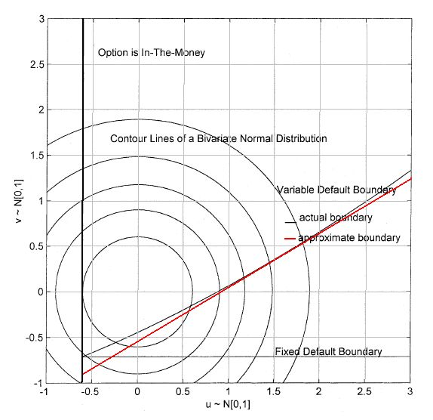
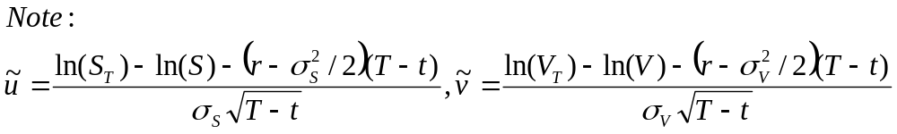
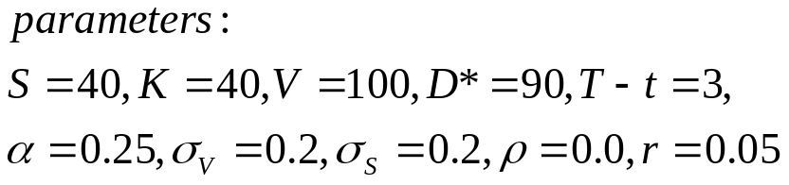
Actual default
boundary of our model
1st order Taylor series approximation
of the actual default boundary
FDB of Klein (1996)
Fig. 1. Integration region for the vulnerable European call when D*>K.

Slide 30
Valuation methods (8)
If D*<K, the correct default barrier is concave
  an approximation based on a tangent will underestimate the value of the vulnerable call.
  The optimal value for p will be the value that maximizes the value of the vulnerable option.

Slide 31
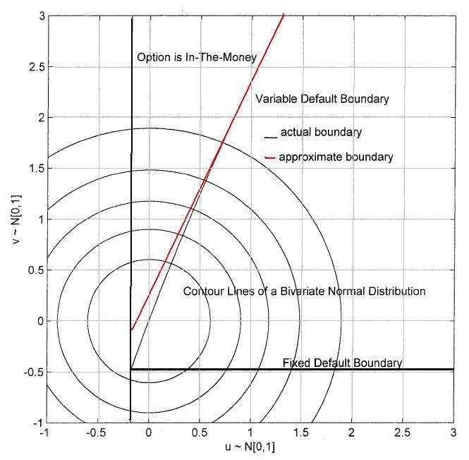
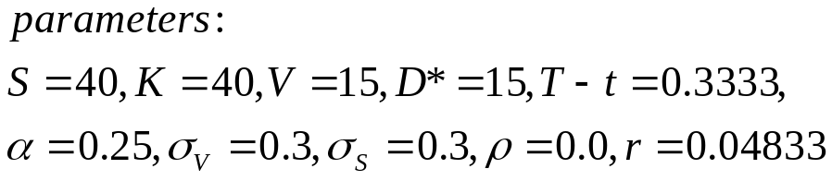
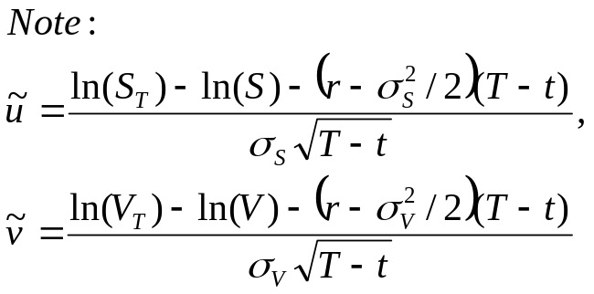
Actual default
boundary of our model
1st order Taylor series approximation
of the actual default boundary
FDB of Klein (1996)
Fig. 2. Integration region for the vulnerable European call when D*<K.

Slide 32
Valuation methods (9)
Converges to other models :
  D* increase ≒ S_{T} – K (FDB line in Fig1&2)
  D* >> S_{T} - K (Klein (1996))
  D* = 0 (Johnson and Stulz (1987))
Notes:
D* = ST-K ➔ 分母變成 2(ST-K)
D* >> ST – K ➔ 分母只有 D*
D* = 0 ➔ J&S

Slide 33
Valuation methods
本篇 paper 雖然都以 call 為例子，但也可以計算Vulnerable European put
Easily extended when underlying asset pays continuous dividend yield
  Ex: vulnerable European options on foreign currencies.

Slide 34
Numerical examples

Slide 35
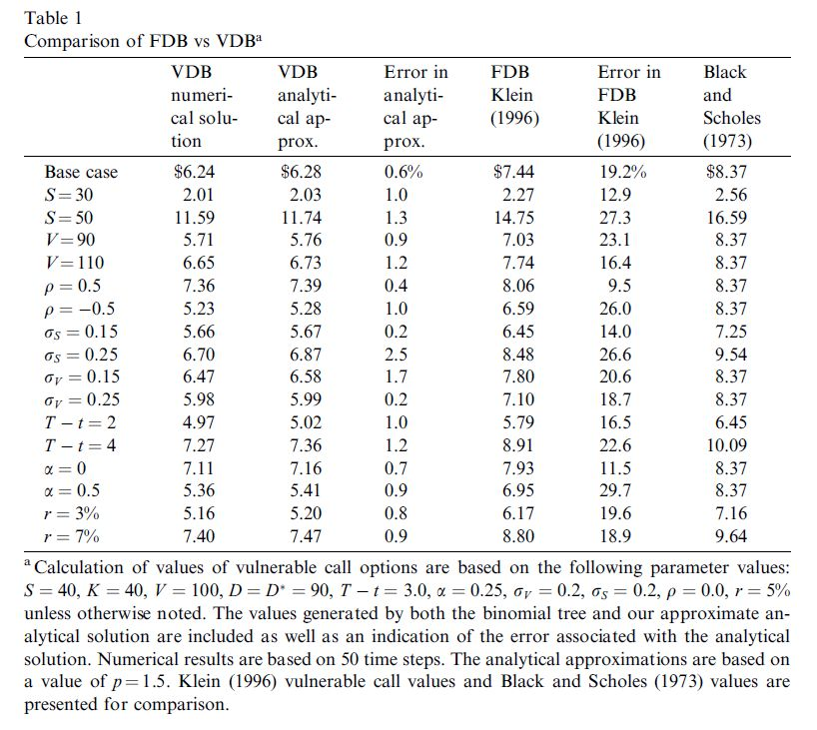
大部份 <1%
Overstate ≒ 20%
<
最高

Slide 36
Numerical examples
Table 1
  Base case:
    at the money, highly leveraged (D* = D),
    Assumes a time to maturity of 3 years (T-t = 3)
    No correlation (writer’s asset & underlying asset)
  Error (Column 3) 公式：(C2 – C1) / C1
    大部分 < 1%, 最高 2.5%
    所有的值都是正值
      ➔ 分析解 overestimate the value of the option
      because D* > K, 與 Fig 1. 顯示相同的結果
Notes:
* Barrier 比較低，所以算出來的值比較大

Slide 37
Numerical examples
Table 1
  VDB > FDB (Klein 1996)
  Error in the range of 20% ➔ overstates
    ➔Klein (1996) assumes that the expected payoff from the option << other liabilities of option writer.
    ➔ ignoring the possibility that the payoff on the option itself may increase the risk of financial distress.
    ➔ consistently understates the prob. of financial distress
    Overstates would disappear if D* >> K

Slide 38
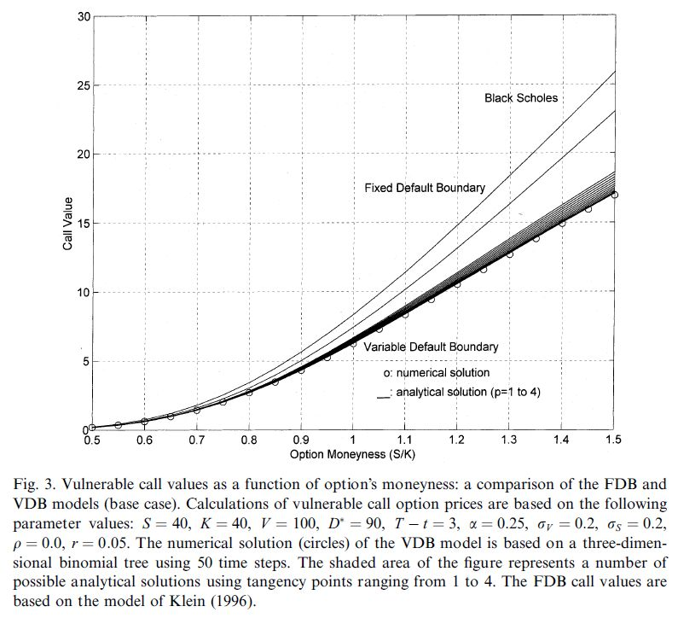
p=1.0~4.0
analytics > numerical
(D* > K)
<
difference increase with the moneyness
S=20~60
➔moneyness=0.5~1.5
Notes:
Moneyness: 價值狀況

Slide 39
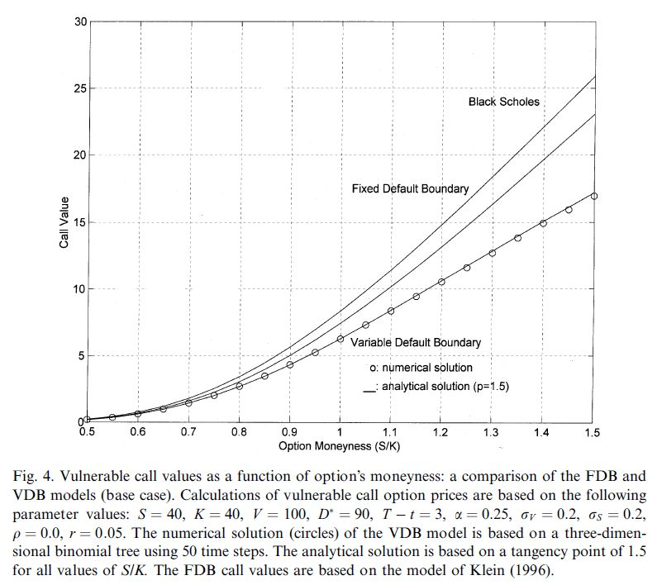
p=1.5,
p=1.5,
Analytical ≒Numerical
➔ Robust to moneyness (S/K)

Slide 40
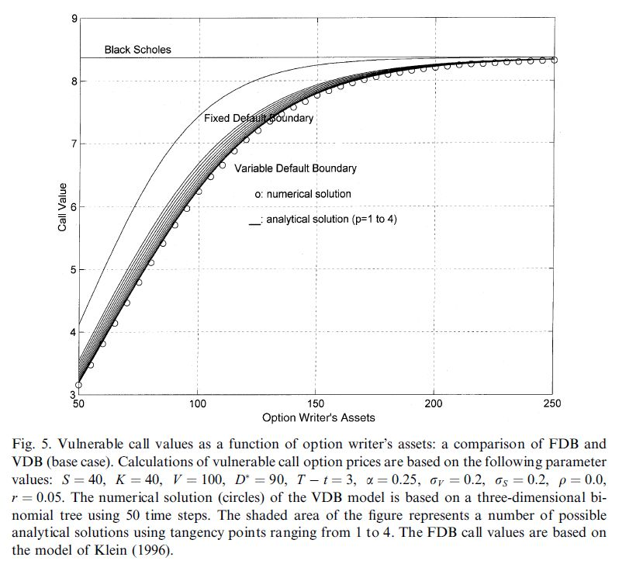
analytics > numerical
(D* > K)
analytics > numerical
(D* > K)
p=1.0
~4.0
p=1.0
~4.0

Slide 41
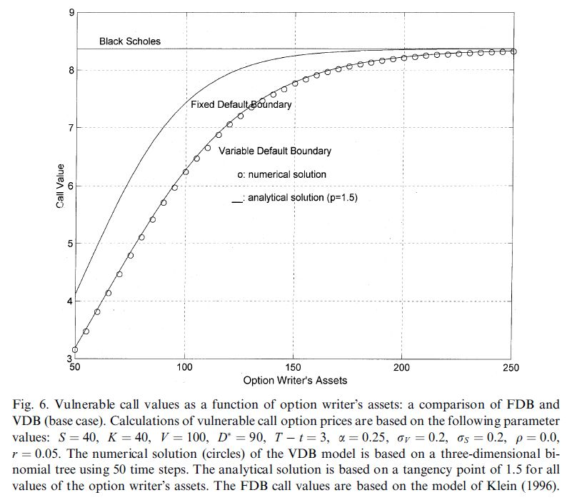
Converge with B-S
(V 非常大)
>
當債務很小要描述 financial distress
對 option value 的影響，
可用 FDB model of Klein (1996)
Analytical ≒Numerical ➔ Robust to leverage ratios (V/D*)
p=1.5

Slide 42
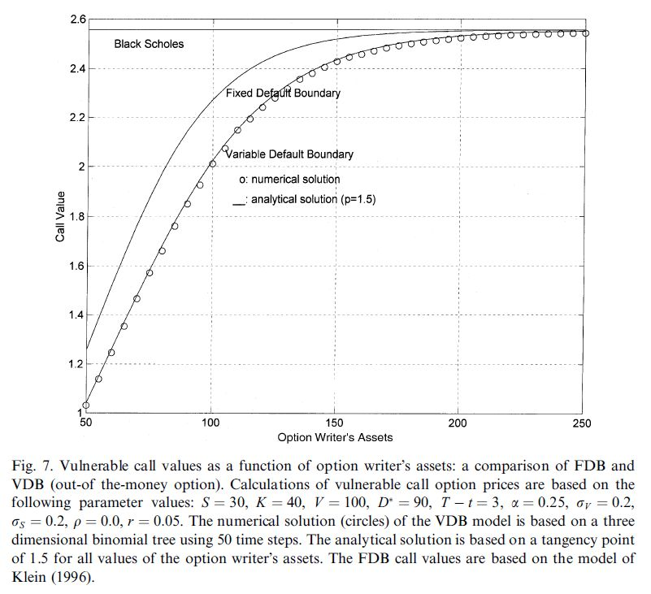
Out-of-the-money

Slide 43
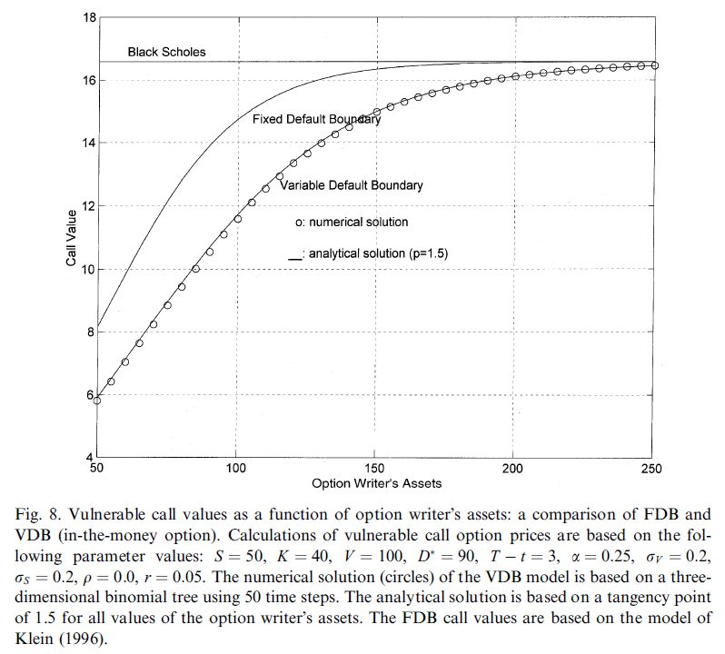
in-the-money

Slide 44
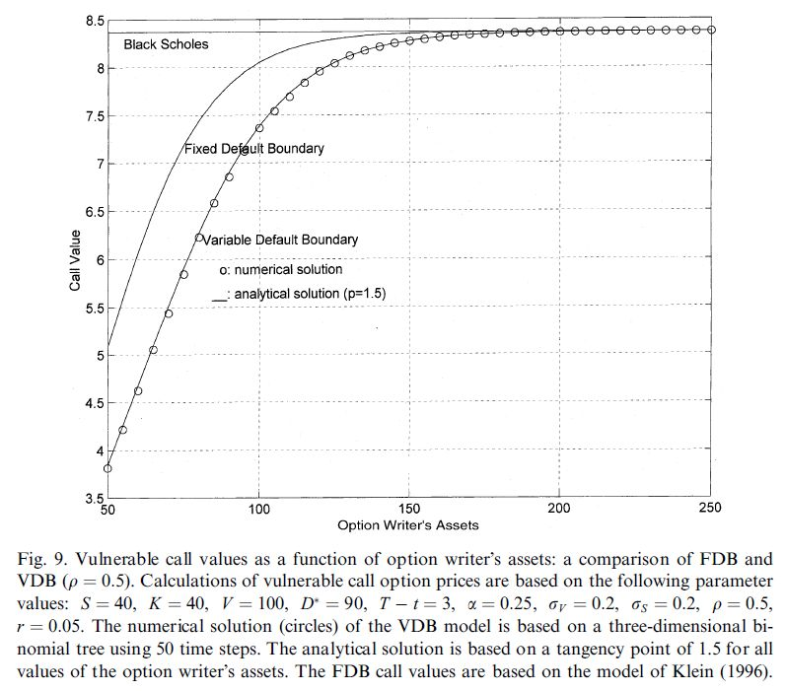
ρ=0.0 ➔ 0.5

Slide 45
Conclusion
Extends the result of Sohnson and Stulz (1987) & Klein (1996) to allow for other liabilities of the option writer and for the default boundary to depend on the payoff of the option itself.
Employ a 3D binomial tree to generate numerical examples
Derive an approximate analytical solution
  A function of the point of expansion
Describe how to choose the optimal point of expansion and find when p=1.5 the analytical are very close to numerical solution.
When the payoff under the option is expected to be large as compared to the other liabilities, VDB is extremely important.

