Slide 1
DOSE DEFAULT RISK IN COUPONS AFFECT THE VALUATION OF CORPORATE BONDS? : A CONTINGENT CLAIMS MODEL
In Joom Kim; Krishna Ramaswamy; Suresh Sundaresan
Presenter: Tai Tzu

Slide 2
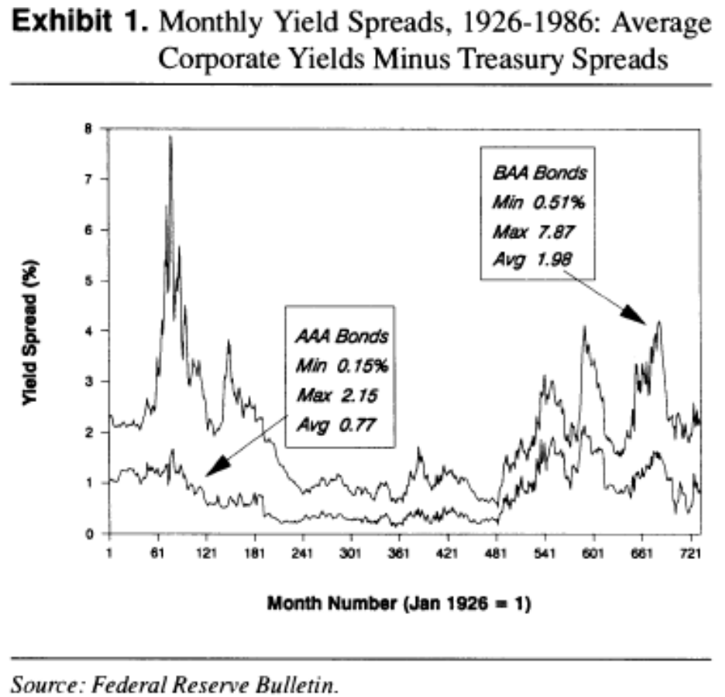
INTRODUCTION
Black and Scholes, Merton : use the theory of option pricing corporate liabilities.
Brennan and Schwartz, Ingersoll : price convertible and callable corporate liabilities.
Merton: unable to generate default premiums > 120 basis points
Jones, Mason and Rosenfeld: stochastic interest rate rates might improve the performance of contingent claims pricing models.

Slide 3
Contingent claims model
No taxes, transaction costs or information asymmetries.
Value of firm V follows the log-normal diffusion process; firm’s capital structure consists of equity and a single, coupon bond with principal P.
Stochastic interest rate
The possibility of the firm defaults on its coupon obligations
Call provision

Slide 4

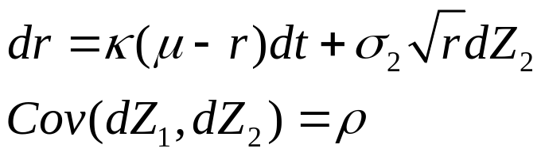

I The valuation of Noncallable Corporate Bond
The firm’s value V follows:
  α is the instantaneous expected return rate
  γV is the net cash outflow which is independent of the capital structure of the firm.
Short rate (CIR model)
The payoffs to bondholders upon bankruptcy follows: when V=V*, the payoff is
  B(r, τ;c) is the value of a comparable Treasury bond with a time-to-maturaty given by τ and δ(τ) is a positive fraction.
  δ(0)=1, bondholders are promised P or V , whichever is less, at maturity.

Slide 5
Assumptions
Prohibit the stockholders from selling the assets of the firm to pay dividends.
Coupon to bondholders (priority)
Lower boundary V*= c/γ
Not allow for either new equity issues or side-payments (ex. reorganization)
Managers have an incentive to reduce the amount of planned investment and pay the coupon in order to avoid bankruptcy.
Brennan and Schwartz rule: bondholders will take over the firm when the firm’s value < a fraction of the par value of the bond.
δ(τ)B(τ;c) < payoff if bondholders forego coupons for next n months and receive higher level of coupons thereafter.

Slide 6
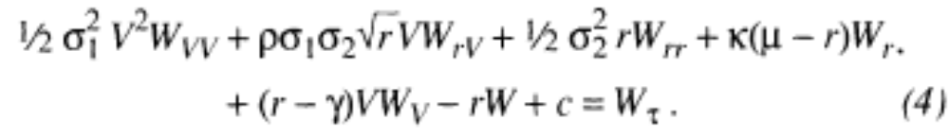
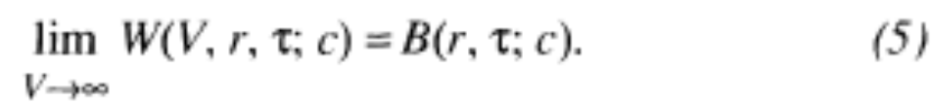
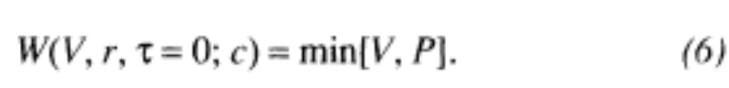
The valuation equation
W( V, r, τ; c): corporate bond value
  Boundary condition (V -> infinity => W ( V, r, τ; c)-> comparable default-free bond B ( r, τ; c): )
  Terminal condition:

Slide 7
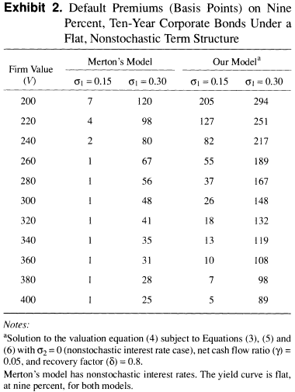
II Numerical Solutions to the Valuation Equation for Noncallable Bonds
Face value P=$100
Interest rate r=μ=9%, σ2=0.0; σ1=0.15
Recovery factor δ=0.8
Net cash flow ratio γ=0.05
Ex. Dabt ratio=30%, coupon rate=9%, dividend yield=3.5%
=>γ=0.3*0.09+0.7*0.35=0.0515
Exhibit 2 : close to market spreads at conventional debt level, it seems preferable to us to move contingent claims modeling effort in the direction of valuing coupon-bearing bonds with the possibility of premature default, rather than increase the asset volatility.
P/V=50%
P/V=25%

Slide 8
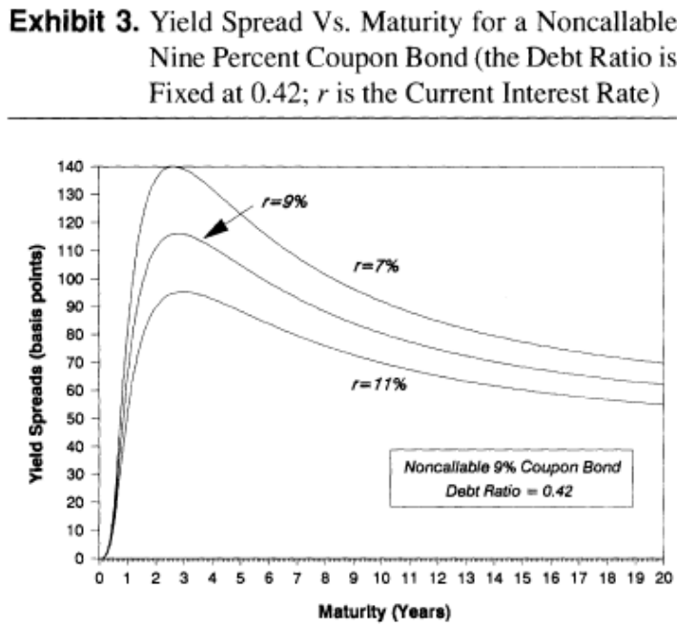
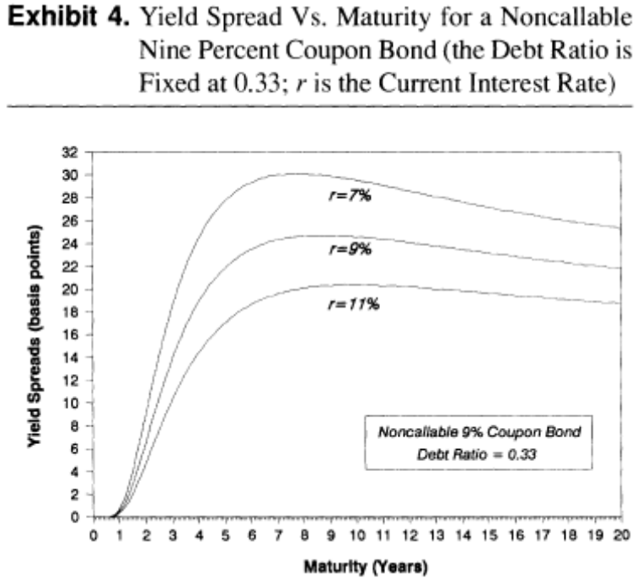
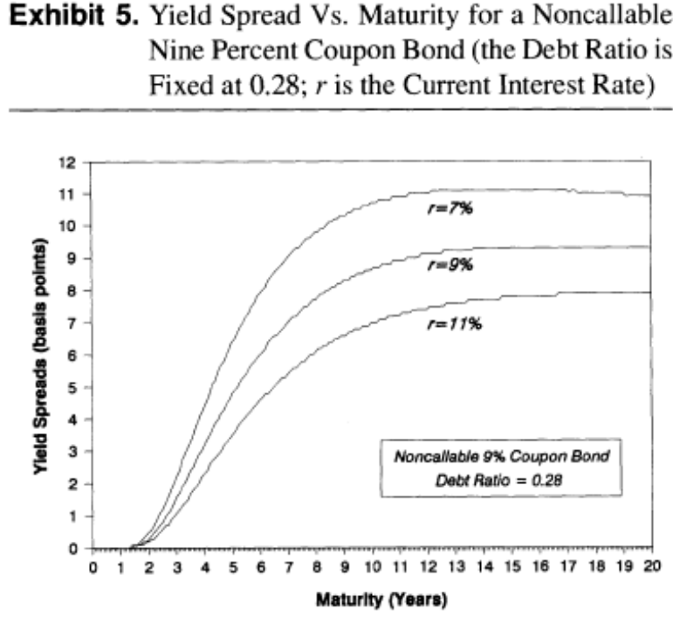
Debt ratio(0.42;0.33;0.28)
The capital structure of the firm has a significant effect on the shape of the term structure of yield spreads.
High debt ratio: investors holding short-term bonds are exposed to the more significant possibility of default on the balloon payment (只付利息 不還本金).
Low debt ratio: long-term bonds are riskier than short-term bonds because more coupons are subject to default risk.

Slide 9
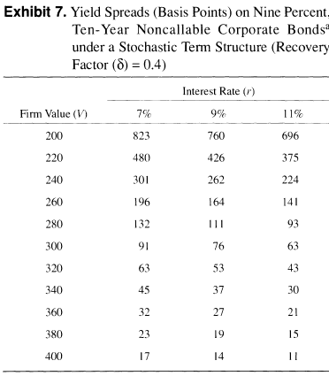
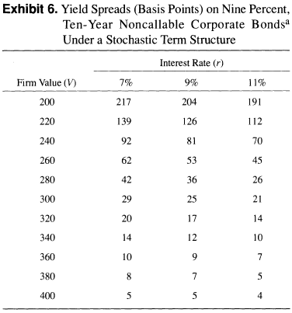
Interest rate and recovery factor
P=$100, r=μ=9%, σ1=0.15, κ=0.5, ρ=-0.2,σ2=0.078
Recovery factor δ=0.8 (表6), 0.4(表7)
Net cash flow ratio γ=0.05
Spread=82 (表2 V=240, r=9%, P/V=0.42σ2=0.0 )
Spread=37 (γ=0.06,P/V=0.42)
Uncertainty in the interest rate(σ2) significantly influenced the yields on both Treasury and corporate issues. Thus, the interest rate risk is independent of default risk.
The yield spread can be very large for low-grade bonds with a small recovery factor.
Interest rate decreases => present value of default risk increases
  This should cause the spread to widen significantly.
The higher is the net cash flow ratio, the lower is the yield spread.
  Because given a firm’s value, a higher net cash flow means the firm is more likely to meet coupon obligations.

Slide 10

III The numerical solutions for callable corporate bonds
Corporations issue debt with call features to refinance the debt.
Total spread: the yield differential between a callable corporate bond and an otherwise similar but noncallable Treasury bond.
Call premium: the difference in the yields of callable and noncallable, but similar (either Treasury or corporate) bonds.
Optimal call policy: the issuing firm to retire the bond when the interest rate R(τ) is low and the value of the firm C(τ) is high. Thus, the upper bond condition follows:
  G (C(τ), R(τ), τ; c) is the value of a callable corporate bond and K is the fixed call price.

Slide 11
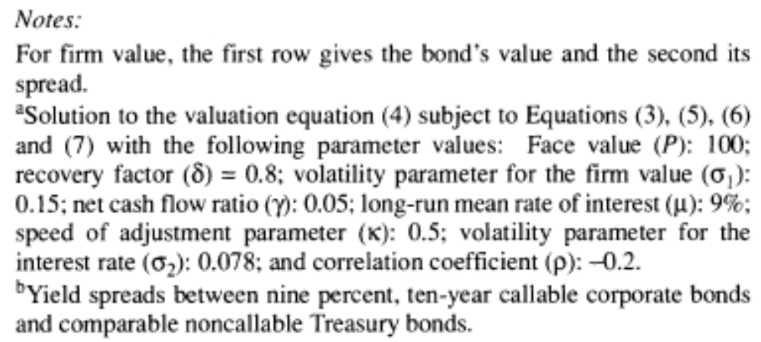
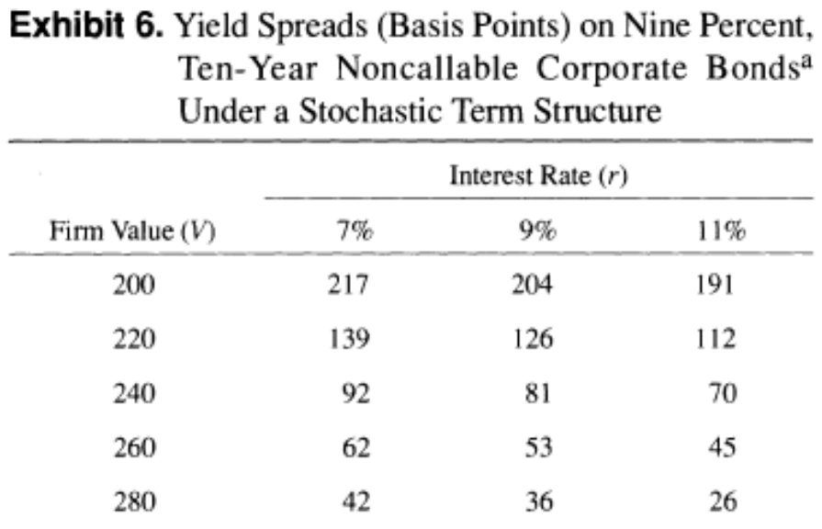
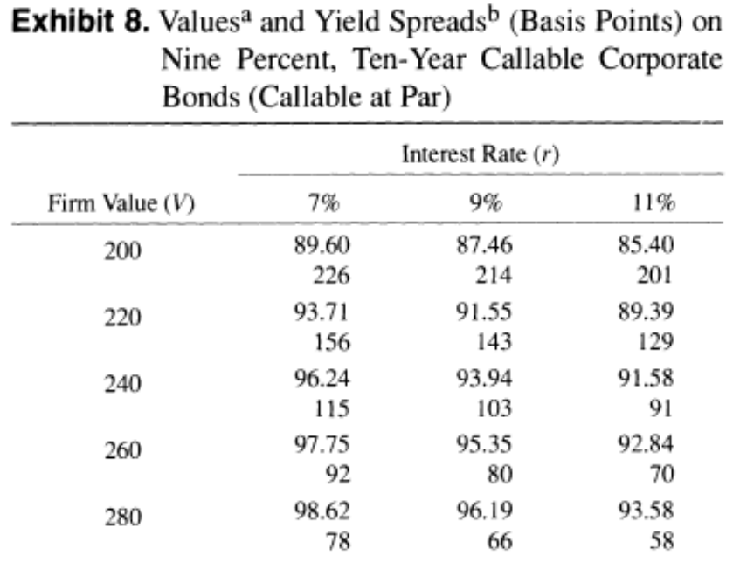
Call provision
At debt ratio 42%, interest rate 9%, the call provision of the bond is 22 basis point. (103-81=22)
a
b

Slide 12
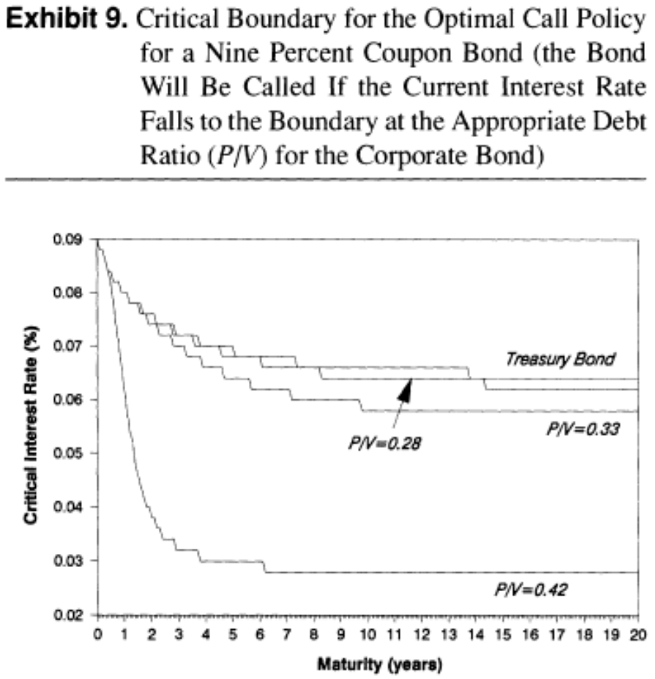
Optimal call policy
At low firm values, the issuing firm waits much longer before calling the bonds.
The trade-off here is that a decision to call forces an immediate cash outflow but relieves the firm of its (now) high coupon binds.
At long-term maturity, critical interest rate of Treasury bond is lower than corporate bond.
  As default risk serves to reduce the value of corporate bond, it takes lower interest rates to raise the value of the corporate bond to the call price.

Slide 13
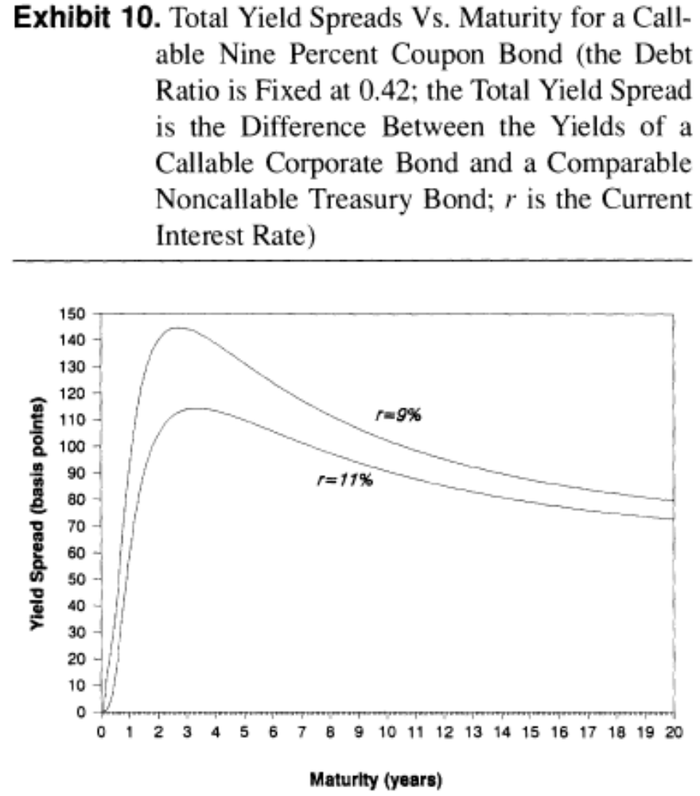
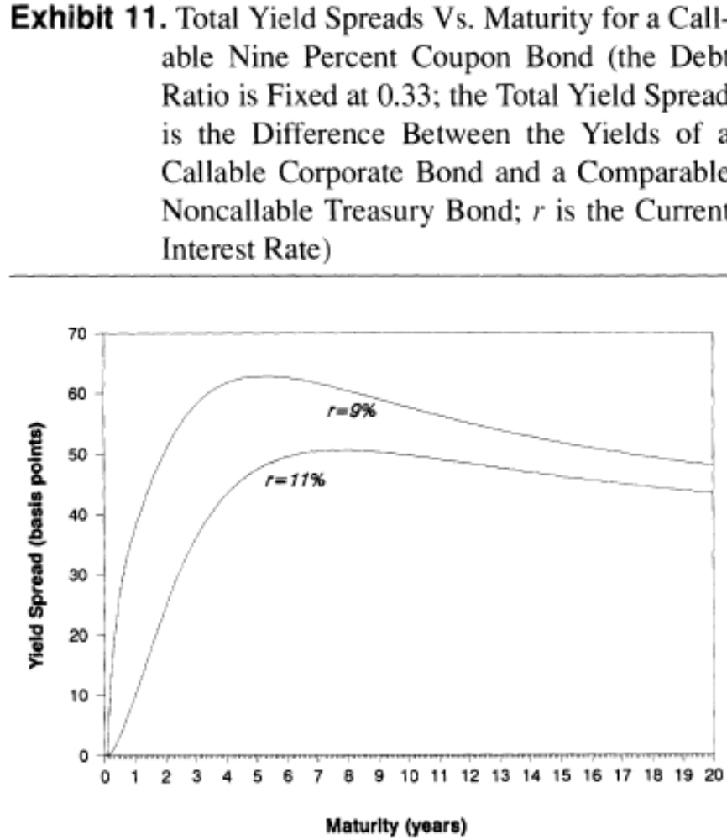
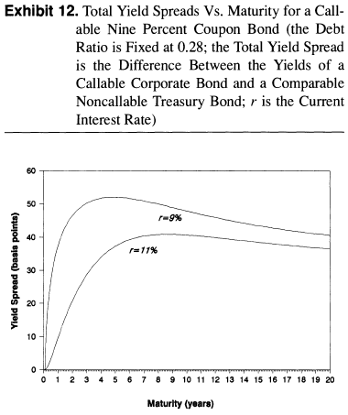
The shape of the curves is the same regardless of the debt ratio

Slide 14
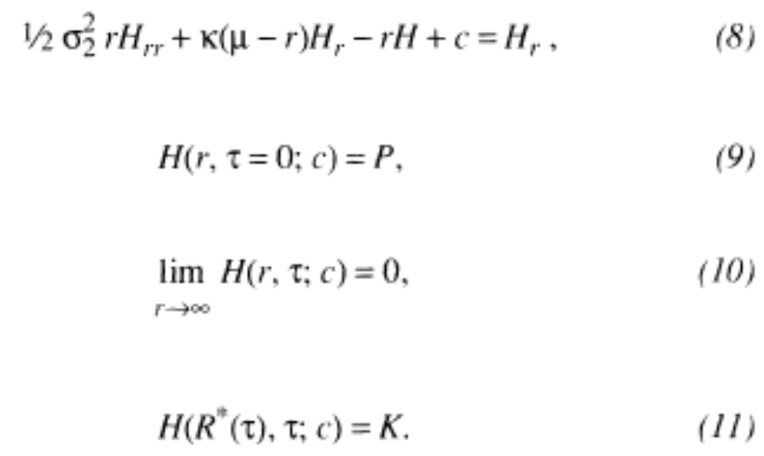
Callable Treasury bond
H(r, τ;c): callable, coupon-bearing Treasury bond will satisfy a valuation equation and reflect an optimal call policy R*(τ). It’s partial differential equation follows (which is equivalent to setting Hv to zero in eq4):

Slide 15
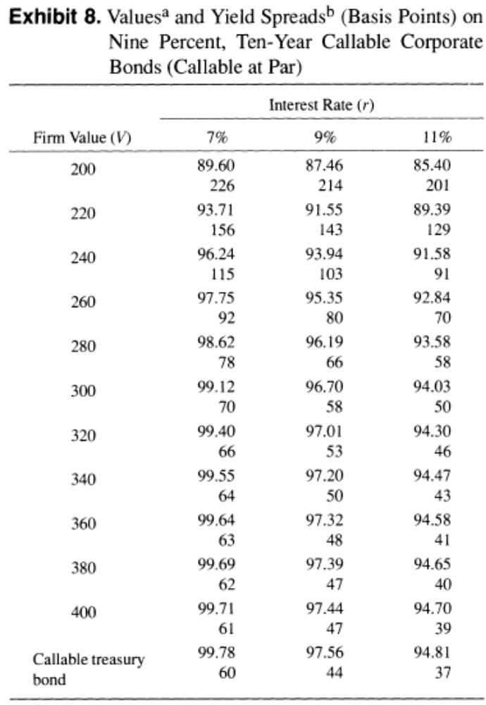
At debt ratio 42%, interest rate 9%, the call provision of Treasury bond is 44 basis point and is larger than call provision of corporate bond (103-81=22).

Slide 16
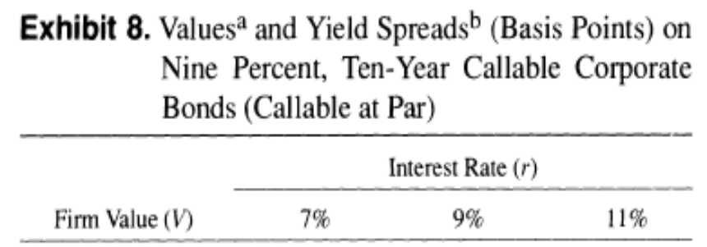
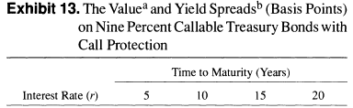
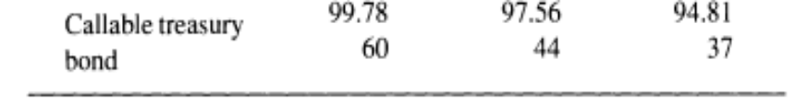
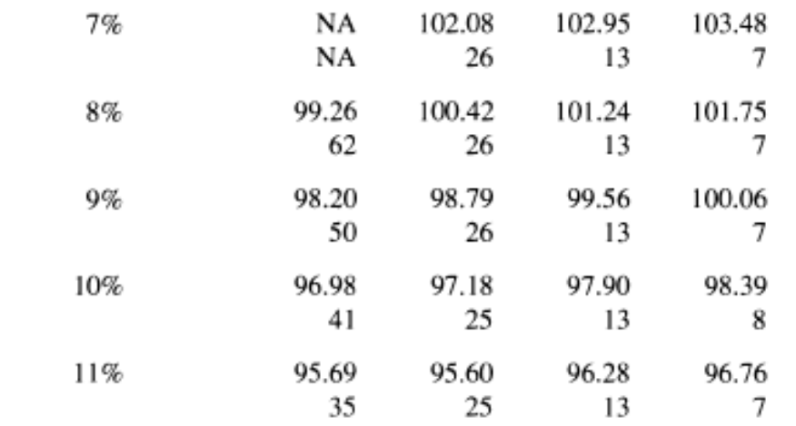
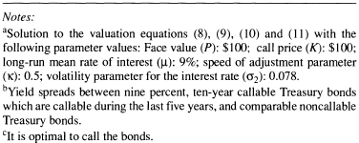
Call protection
With the call protection, yields are lower, since the protection feature works to the advantage of the buyers.
Call protection: bonds are callable during the last five years.

Slide 17
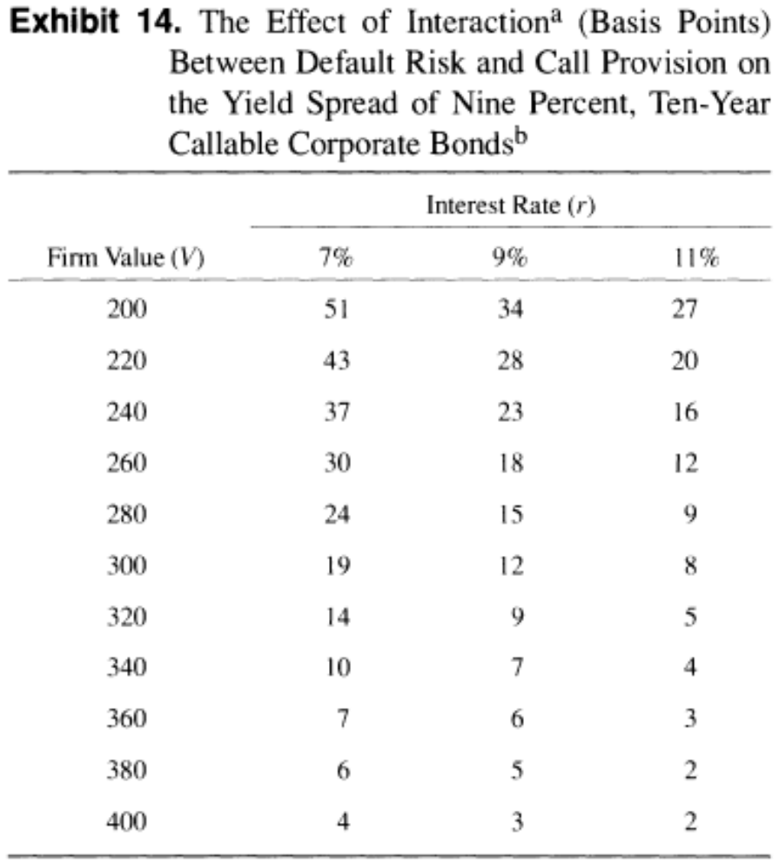
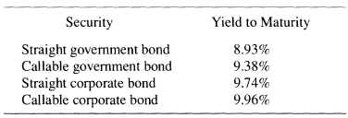
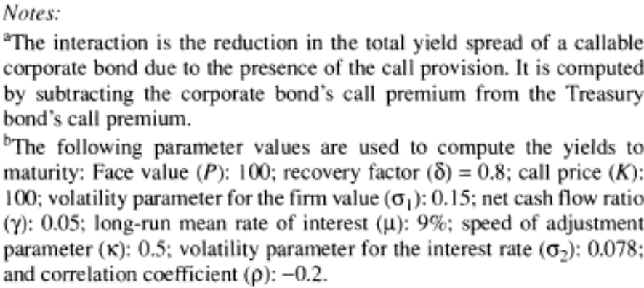
The effect of interaction between default risk and call provision
Total spread (callable corporate –straight government)=1.03%
Default risk (straight corporate –straight government)=0.81%
The contribution of the call provision to total spread (callable government –straight government )
=0.45%
Interaction between default risk and
call provision is 0.23%.
(0.81%+0.45%-1.03%)

Slide 18
IV Summary
Model stochastic interest rates and the importance of cash flow shortages in precipitating bankruptcy.
Stochastic interest rates seem to play an importance role in determining the yield differentials between a callable corporate bond and an equivalent government bond due to the interactions between call provisions and default risk.
This suggests that care should be taken in interpreting empirical results regarding the effect of default risk on the values of callable corporate bonds.

