Slide 1
TriValley Coders Events Project

Slide 2
Site Demo

Slide 3
Tech Stack

Slide 4
Tech Stack
React
Material UI
React Router
date-fns
Ramda
Redux
React Redux
Redux Form
Redux Thunk
Express
AWS SDK
MongoDB Node Driver
Passport
Helmet (to be added)
Ramda
MongoDB
Locally in development
MongoDB Atlas for production

Slide 5

Material UI
Material UI is a set of React components that implement Google’s Material Design
Save you a lot of work
Excellent grid component
Add consistency to your UI
Are highly customizable
Version 1.0 on 17-May-18
Currently v3.1.1 and evolving fast
I enjoy their styling & customization model

Slide 6

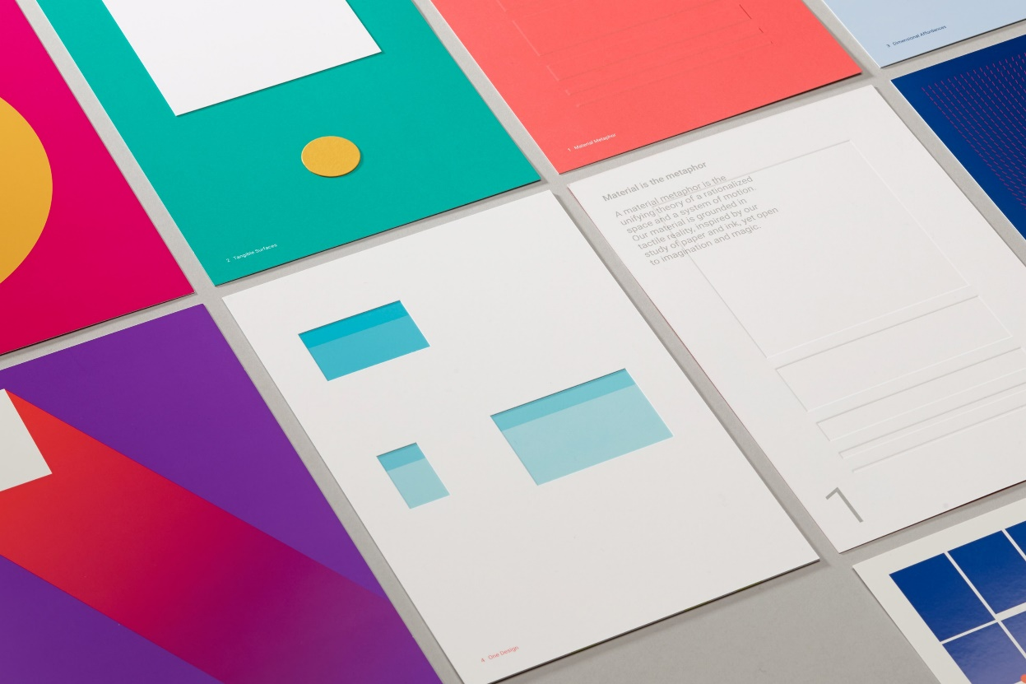
Material Design
A “design language”
A design language or design vocabulary is an overarching scheme or style that guides the design of a complement of products or architectural settings.
Wikipedia

Slide 7

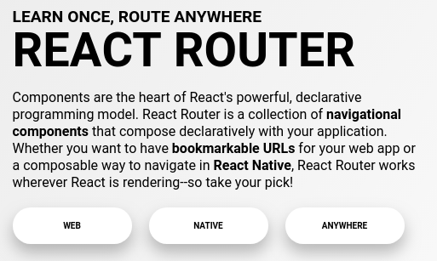
React Router for Navigation
React Router is a set of React components.
Your components are displayed based on the path in the browser’s address bar.
There are web and native versions

Slide 8
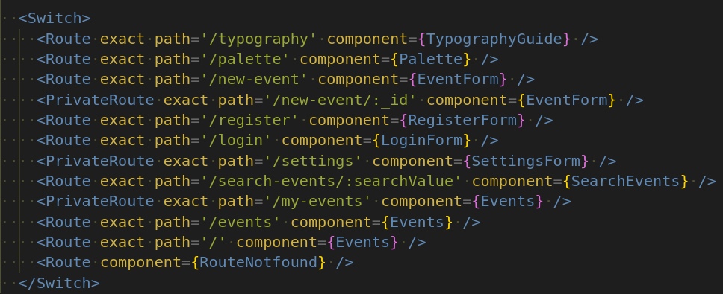
React Router Code Example
1
2
3

Slide 9
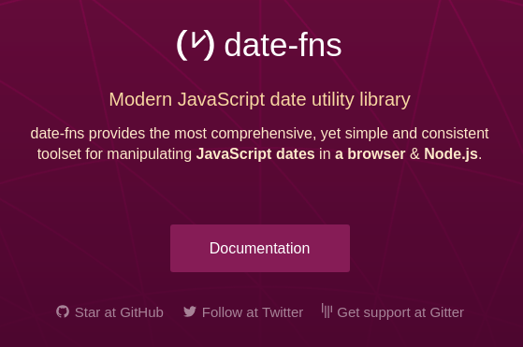
date-fns
Date functions
Light weight

Slide 10
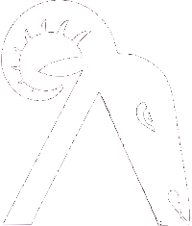
Ramda
Immutability library with a functional style
Large library of functions
Not sure that you will need to use it but if you do it will only be a few of Ramda’s many functions

Slide 11
Project Structure

Slide 12
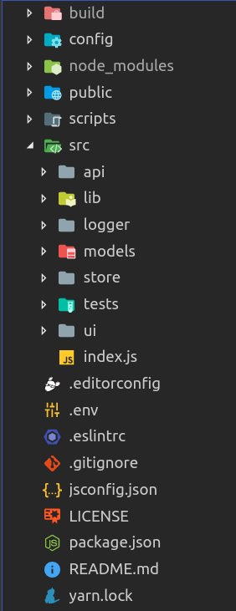
Top Level Folder Structure

Slide 13
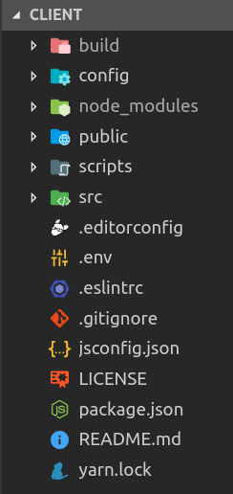
Root Directory
build – production build
config – for test, Webpack, etc.
public – fairly empty html file
scripts – Create React App scripts
src – application code where most work is done
.editorconfig – VS Code config settings
.env – environment variables
.eslintrc – custom ESLint rules
.gitignore – rules for Git
jsconfig.json – more VS Code config
LICENSE – MIT open source
package.json – npm configuration
README
yarn.lock – used by Yarn to manage package versions

Slide 14
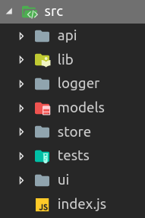
/src Directory
api – all API calls are made from files in this directory
lib – utility functions used throughout the project
logger – an alternative to console.log() that produces colored output to the browser’s console
models – not in use
store – the Redux store
test – test suite
ui – all UI components and where 95% of code is written
index.js – main entry point for app

Slide 15
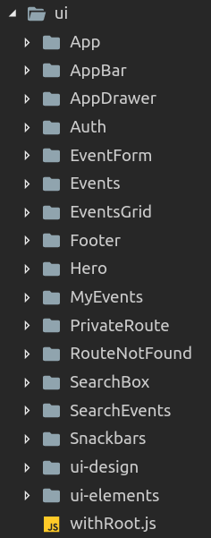
/ui Directory
App – main app director, i.e., App.jsx
AppBar – bar at top of page
AppDrawer – menu slides out from left side
Auth – components used for registration and authorization (register, login, etc.)
EventForm – create, edit and view details of an event
Events – container for EventsGrid
EventsGrid – grid of events displayed on the home page
Footer – the footer
Hero – top section of home page that has search box
MyEvent – view of events for the currently logged-in user
PrivateRoute – higher order component that wraps Route and blocks access unless user is logged-in
RouteNotFounc – used only in development
SearchBox – component for search input
SearchEvents – grid of events that are the result of a search
Snackbars – temporary ui that shows results of user actions e.g., ‘Events loaded’
ui-design – contains components that display colors and typography
ui-elements – common components such as Button used through the app
withRoot.js – contains the project theme

Slide 16
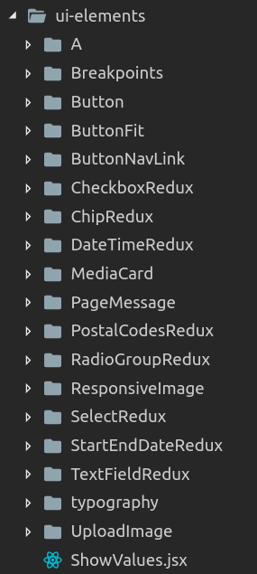
/ui-elements Directory
Why?
Reuse of common components
Encapsulate styling and or desired functionality
Reduce redundant code
A (<a>), Button – encapsulate styling
ChipRedux, RadioGroupRedux, etc
Wrap Material UI components with Redux Form
typography – components for displaying text
Explained later
UploadImage – used on EventForm to upload images while creating/editing events

Slide 17
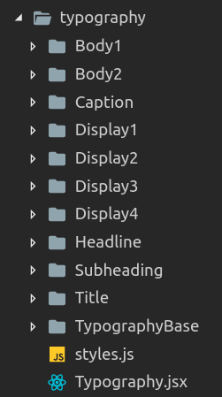
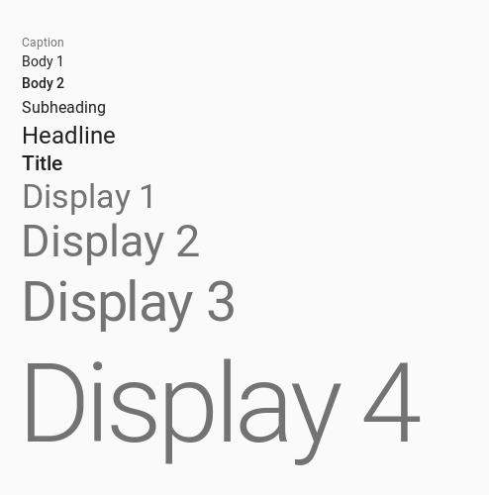
/src/ui-elements/typography

Slide 18
Project Startup
index.js
withRoot(<App />)
<AppBar />
/new-event
<EventForm />
<SnackBars />
/my-events
<MyEvents/>
<AppDrawer />
/register
<Register />
<App />

Slide 19
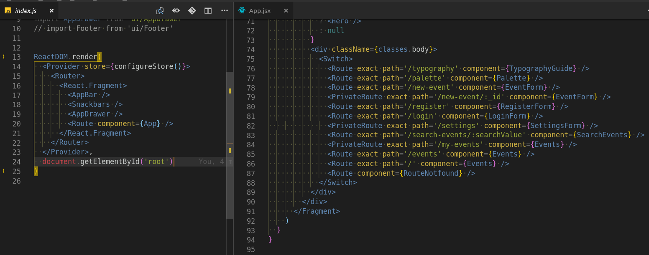
Routing

Slide 20
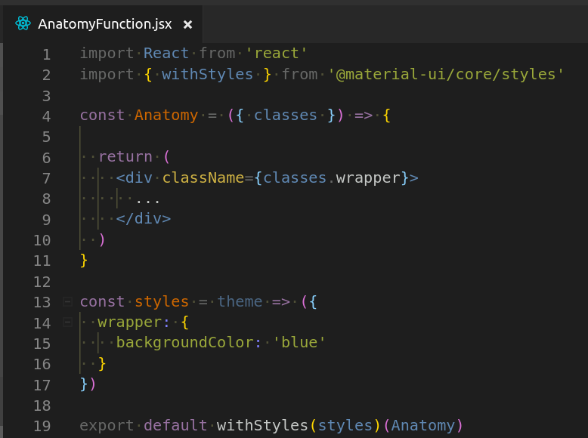
Basic Componant Anatomy (functional component)
1
Import withStyles()
Create a ‘styles’ object optionally passing it the theme
Write the style as an object using camelCase properties
‘classes’, an object, is passed in as a prop
Use classes.propertyName inside of className={}
1
2
4
3
5
4
2
5
3

Slide 21
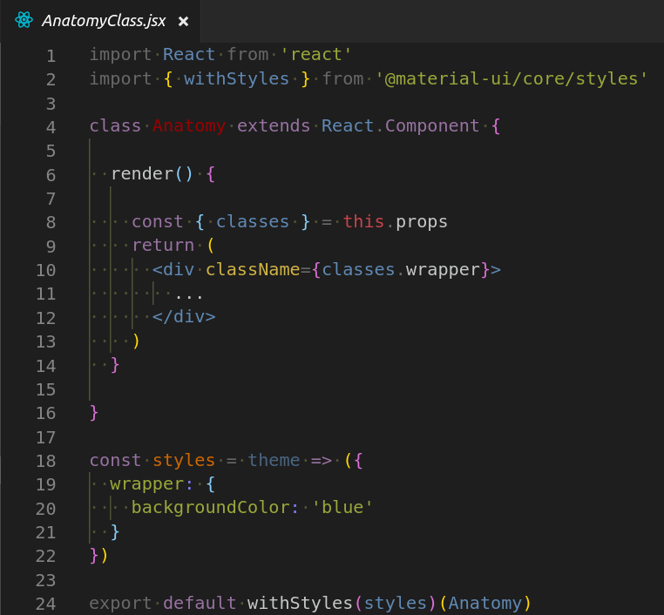
Basic Componant Anatomy (class component)

Slide 22
Debugging

Slide 23
Get to know your machines

Slide 24
Do you know what you don’t know?
You may discover from this project things you had never thought about
It may get overwhealming
They are both good things
Focus on getting one discrete thing done at a time

Slide 25
It isn’t perfect (works, long way)

Slide 26
More Stuff
Style System ½ hour
GitHub/ZenHub – what needs to be done
Pick issues
Show Issue log
Explain labels
Demo styling stuff
Forking- Hema
Chaos

