Slide 1

PROPOSAL PRESENTATION
The Adaptive Learning Style RAG (ALS-RAG):
Investigating Personalized Learning Style Adaptation in RAG-MCP Using Virtual LLM Agents
Nyein Chan Aung - Student ID: st125553
COMMITTEE MEMBERS
Dr. Chaklam Silpasuwanchai (Chairperson)
Prof. Attaphongse Taparugssanagorn(Member)
Dr. Chantri Polprasert (Member)
Notes:
Hello, everyone. My name is Nyein Chan Aung, student ID st125553.
Today I'll be presenting my thesis proposal titled: "The Adaptive Learning Style RAG — or ALS-RAG — Investigating Personalized Learning Style Adaptation in RAG-MCP Using Virtual LLM Agents."

Slide 2
01
BACKGROUND
02
RELATED WORK
03
METHODOLOGY
TABLE OF CONTENTS
04
EXPERIMENT
05
EXPECTED PROJECTED RESULT
Notes:
●The presentation is structured into five main sections.
●We'll start with the Background and Motivation, then move into Related Work. From there, I'll cover the Methodology in detail, followed by the Experimental Design, and finally the Projected Expected Results.

Slide 3



INTRODUCTION: Background and Motivation
Evolution of AI in Education
The Pedagogical Gap
From rigid rule-based ITS to fluid LLM-powered dialogues (e.g., Khanmigo, Google Socratic). Modern systems offer interactive, Socratic-style tutoring at scale.
AI tutors rely on static knowledge profiles and fail to dynamically adapt to validated learning style models like FSLSM. Instruction often mismatches learner preferences.
Critical Need of Learning Style
Frameworks that unify factual grounding (RAG) with stylistic adaptation (FSLSM) and efficient tool management (MCP) to deliver truly personalized AI tutoring.
FSLSM: 4 Dimensions of Learning Preferences
Notes:
Let me start with why this research matters.
AI in education has come a long way. We've moved from rigid, rule-based intelligent tutoring systems to large language model-powered dialogues like Khanmigo from Khan Academy, or Google Socratic.
These use LLM to talk with students naturally, like a real tutor. That is really impressive.
But there is still a pedagogical gap. These AI tutors treat everyone the same. They give the same style of answer, no matter what kind of learner you are.
Some students learn better with diagrams, while others prefer step-by-step text. But most of the system ignores that part.
This is where the Felder-Silverman Learning Style Model, or FSLSM, comes in. FSLSM is one of the most validated frameworks in educational psychology for characterizing how people learn. It describes the learner behaviors in four dimensions.
-Processing — Active vs. Reflective;
-Perception — Sensing vs. Intuitive;
-Input — Visual vs. Verbal; and
-Understanding — Sequential vs. Global.
This research combines FSLSM with RAG for content retrieval and MCP for tool management. --- Together, they make a tutoring system that is truly personalized.

Slide 4
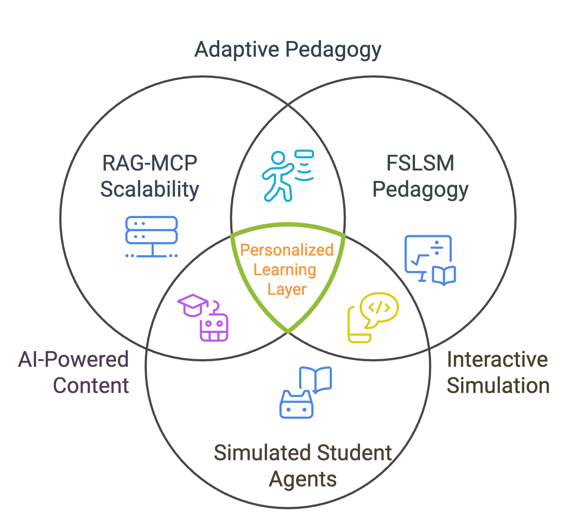
INTRODUCTION: Research Gaps
Pedagogical Blindness: Standard RAG retrieves content matching semantic queries but ignores learner cognitive preferences, e.g., text-heavy proofs for visual learners.
No Validated Testbed: Lack of robust simulation-based testbeds with virtual student agents that reliably reflect FSLSM learning styles for empirical evaluation.
MCP Tool Selection: Persona + retrieval approaches exist, but are limited and rarely use scalable MCP tool protocols for FSLSM-based adaptation
Notes:
Let me be specific about the gaps we're addressing
-First: Pedagogical Blindness. Standard RAG systems retrieve content based on semantic similarity to the query. That's useful, but it completely ignores the learner's cognitive preferences. Imagine a visual learner asking about backpropagation — a standard RAG might return a dense, text-heavy mathematical proof as the top result, even though that's exactly what that learner struggles with.
-The second gap is the lack of a good testbed for evaluating a personalized tutoring system. We need simulated students with known learning styles so we can test if the system is really working.
-The third gap is in the MCP tool selection. Some systems use personas with retrieval, but they do not use MCP in a way that is connected to learning styles
This research closes all three gaps at the same time.

Slide 5
1.1 RESEARCH QUESTIONS
RQ1
Tutor Efficacy
To what extent does FSLSM-based personalization in the PersonaRAG tutoring system improve response relevance and style conformance compared to a non-personalized RAG baseline?
RQ2
Agent Fidelity
How can virtual LLM student agents be built to consistently reflect distinct FSLSM profiles, while ensuring their behavioral fidelity is validated as a testbed for adaptive tutoring evaluation?
RQ3
System Efficiency
To what extent does FSLSM-conditioned MCP tool selection improve pedagogical tool appropriateness compared to unconditioned tool selection, and what is the associated efficiency trade-off?
Notes:
●These three gaps map directly to three research questions.
●RQ1 is about Tutor Efficacy: To what extent does FSLSM-based personalization in the tutoring system improve response relevance and style conformance, compared to a non-personalized RAG baseline?
●RQ2 is about Agent Fidelity: How can we build virtual LLM student agents that consistently reflect distinct FSLSM profiles — and how do we validate that they're a reliable testbed for evaluation?
●RQ3 is about System Efficiency: To what extent does FSLSM-conditioned MCP tool selection improve pedagogical tool appropriateness compared to unconditioned tool selection — and what's the efficiency trade-off in terms of prompt tokens?
Each of these questions corresponds to a dedicated experiment, which I'll cover shortly.

Slide 6
1.2 HYPOTHESIS
H1
Personalization Improves Conformance
FSLSM-based personalization yields statistically significant improvements in response relevance and style conformance vs. baseline, measured by similarity to style-specific guidelines.
H2
Agent Fidelity Scales with Capability
Virtual LLM agents with structured FSLSM profiles demonstrate consistent behavioral patterns aligning with ILS dimensions, with performance scaling with model capability.
H3
MCP Reduces Bloat and Maintains Quality
FSLSM-conditioned MCP tool selection significantly reduces prompt token usage while maintaining or enhancing retrieval accuracy vs. standard RAG.
Notes:
My three hypotheses match the three research questions.
●H1 — Personalization works. FSLSM-based tutoring will produce responses that match the student's style significantly better than the baseline.
●H2 — Agent quality scales with model size. When we give structured FSLSM profiles to LLMs, larger and more capable models will produce more accurate student personas.
●H3 — MCP with FSLSM is more efficient. Conditioning tool selection on the learning style will reduce prompt token usage while keeping retrieval quality the same or even better.

Slide 7
1.3 OBJECTIVES
To design, implement, and evaluate an AI tutoring framework that leverages RAG-MCP to adapt educational content dynamically based on FSLSM learning styles, with efficacy validated through simulations involving virtual student LLM agents.
To develop a hybrid RAG-MCP pipeline that incorporates personalized learning-style parameters , enabling efficient and relevant retrieval of adaptive resources, and to measure its impact on retrieval metrics like latency and alignment.
To encode FSLSM learning-style profiles into virtual LLM agents, facilitating personalized instructional actions, and to assess the resulting adaptability through simulation-based metrics such as response fidelity and engagement scores.
To investigate the effects of LLM model size and MCP tool-set complexity on key performance indicators, using ablation studies and benchmarks to identify optimal configurations for educational applications.
1
2
3
Notes:
●The three core objectives follow naturally.
●First, to build a RAG-MCP pipeline that includes the student's learning style — and to measure how it affects retrieval latency and alignment.
●Second, to encode FSLSM profiles into virtual student agents — and to measure how well they adapt using simulation-based metrics like fidelity and engagement scores.
●Third, to investigate how model size and tool complexity affect performance — using ablation studies to find the best configuration.

Slide 8


1.4 SCOPE & LIMITATION
Scope
Limitation
Domain: Introductory Machine Learning
(D2L corpus)
Virtual agents may not replicate real-world learner variability
FSLSM 4 dimensions with text-based visual scaffolding
D2L-specific; performance may differ in non-technical domains
8–16 text-only MCP tools, mid-sized LLMs + API services
Text-only visual adaptation (no multimodal image generation)
80 virtual agents, multi-turn simulation validation
MCP latency and tool-chain security risks if unoptimized
Multi-hop 5-chunk synthetic ground-truth dataset
Circular evaluation risk (LLM-judge + agent)
Notes:
Before diving into methodology, let me be transparent about the scope and limitations.
●In scope: The domain is introductory Machine Learning, using the Dive into Deep Learning (D2L) textbook as the knowledge corpus. We'll cover all four FSLSM dimensions using text-based visual scaffolding. The toolset is 8 to 16 text-only MCP tools, with mid-sized LLMs and API services. We'll use 80 virtual agents across 16 profiles, with multi-turn simulation, and a custom multi-hop, 5-chunk synthetic ground-truth dataset.
●In Key limitations: Virtual agents may not fully replicate the variability of real human learners. The D2L corpus is domain-specific, so results may not generalize to non-technical fields. We're doing text-only visual adaptation — no multimodal image generation. There are also MCP latency concerns if tools are not optimized very well. And there may have a circular evaluation risk when both the judge and the agent are LLMs; We address this through careful experimental design.

Slide 9
2. RELATED WORK: Positioning in the Research Landscape
Criterion | Sanyal et al. (2025) Pedagogical | Zerhoudi & (2024) PersonaRAG | Gan & Sun (2025) Prompt Bloat | Graf et al. (2007) FSLSM | Proposed: ALS-RAG-MCP ★
FSLSM Integration | Partial (VARK hybrid) | None (implicit profile) | None (style-agnostic) | Full 4-dim (ILS survey) | Full binary ±1 4 dimensions
LLM Agent Simulation | VARK-based LLM personas | Real user behavior logs | No student agent used | Human students ILS quest. | 80 LLM agents 16 profiles ×5
RAG Personalization | Genetic-algo teacher adapt. | Persona-aware retrieval layer | Semantic RAG query only | None pre-RAG era | FSLSM-conditioned RAG retrieval
MCP Tool Selection | Not applicable | Not applicable | RAG-MCP unconditioned | Not applicable | FSLSM-cond. RAG-MCP k=1
Evaluation Approach | LLM-as-Judge + human eval | ROUGE / NQ TriviaQA | TSA + token count metrics | ILS scoring + LDA analysis | SCS · PRA · TSA · LLM-as-Judge
Gap Addressed | Static student profiles | Style-blind retrieval | Prompt bloat tool selection | Profile encoding granularity | Combination of all gaps ★
Notes:
Now let me show how this work compares to existing research.
●The comparison table on this slide shows five systems across five criteria: FSLSM Integration, LLM Agent Simulation, RAG Personalization, MCP Tool Selection, and Evaluation Approach.
●The pedagogical study paper by Sanyal investigates pedagogical LLM agents with genetic adaptation, but uses only a partial VARK-hybrid learning style model and not the full FSLSM.
●PersonaRAG by Zerhoundi introduced persona-aware retrieval, but it does not use any formal learning style model and relies on real user logs — not a controlled simulation.
●The Prompt Bloat paper by Gan and Sun (2025addresses MCP efficiency, but it does not consider any learning style or student modeling at all.
●Index of learning styles by Graf gave us the FSLSM foundation, but this work was done before RAG even existed.
●Our proposed system — is the approach that combines all five criteria: full 4-dimensional FSLSM integration, 80 virtual LLM agents across 16 profiles, learning style - conditioned RAG retrieval, MCP tool selection, and a comprehensive multi-metric evaluation.
●It directly addresses the combination of all identified gaps.

Slide 10
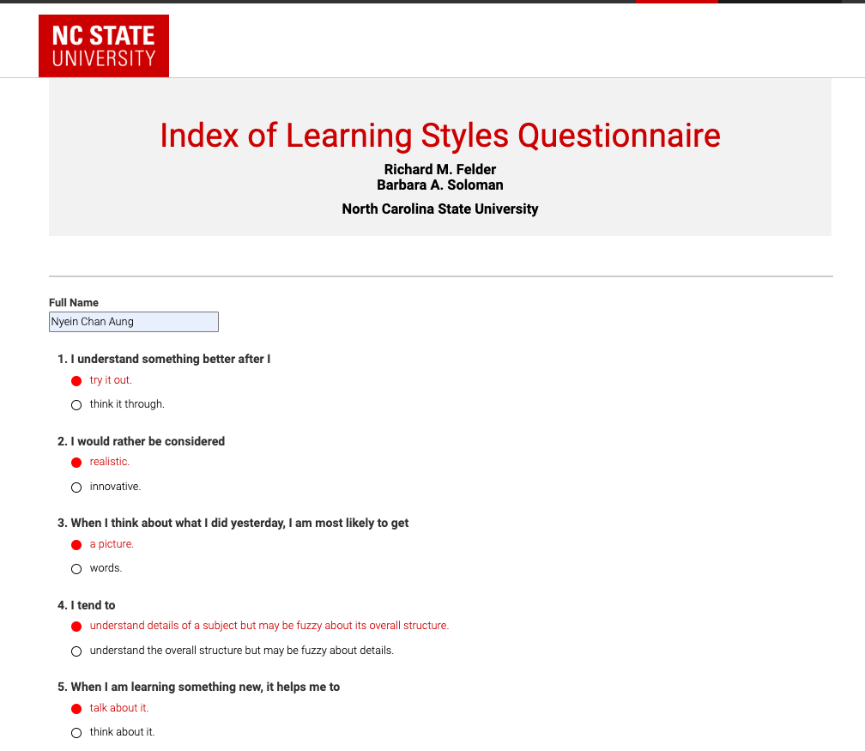
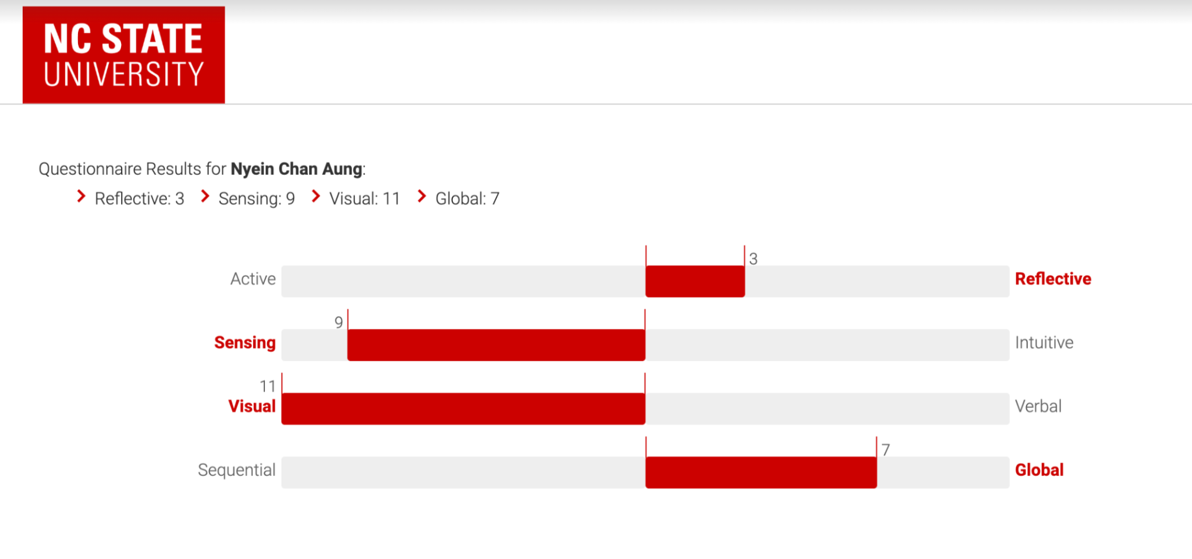
2.1 Learning Styles (FSLSM)
FSLSM Questionnaire (Index of Learning Styles - ILS)
The ILS Questionnaire identifies individual preferences based on the four FSLSM dimensions. Respondents answer 44 questions with choices that determine their learning style on a +11 to -11 scale
FSLSM Dimensions
Active vs. Reflective: Group discussion, hands-on learning vs. solitary reflection.
Sensing vs. Intuitive: Concrete facts and details vs. abstract concepts and theories.
Visual vs. Verbal: Preference for diagrams vs. spoken or written explanations.
Sequential vs. Global: Step-by-step learning vs. grasping the overall picture first.
Soloman, B. A., & Felder, R. M. (n.d.): Index of learning styles questionnaire. North Carolina State University.
Notes:
●Let me explain FSLSM in a bit more detail since it is the theoretical foundation of everything.
●The Index of Learning Styles, or ILS, is a questionnaire with 44 questions. It gives each learner a score on each of the four dimensions. The original scale goes from minus 11 to plus 11.
●The four dimensions are:
○Active versus Reflective: do you learn by doing, or by thinking?
○Sensing versus Intuitive: do you prefer facts, or theory?
○Visual versus Verbal: do you prefer pictures, or written explanation?
○Sequential versus Global: do you like step-by-step, or the big picture first?

Slide 11
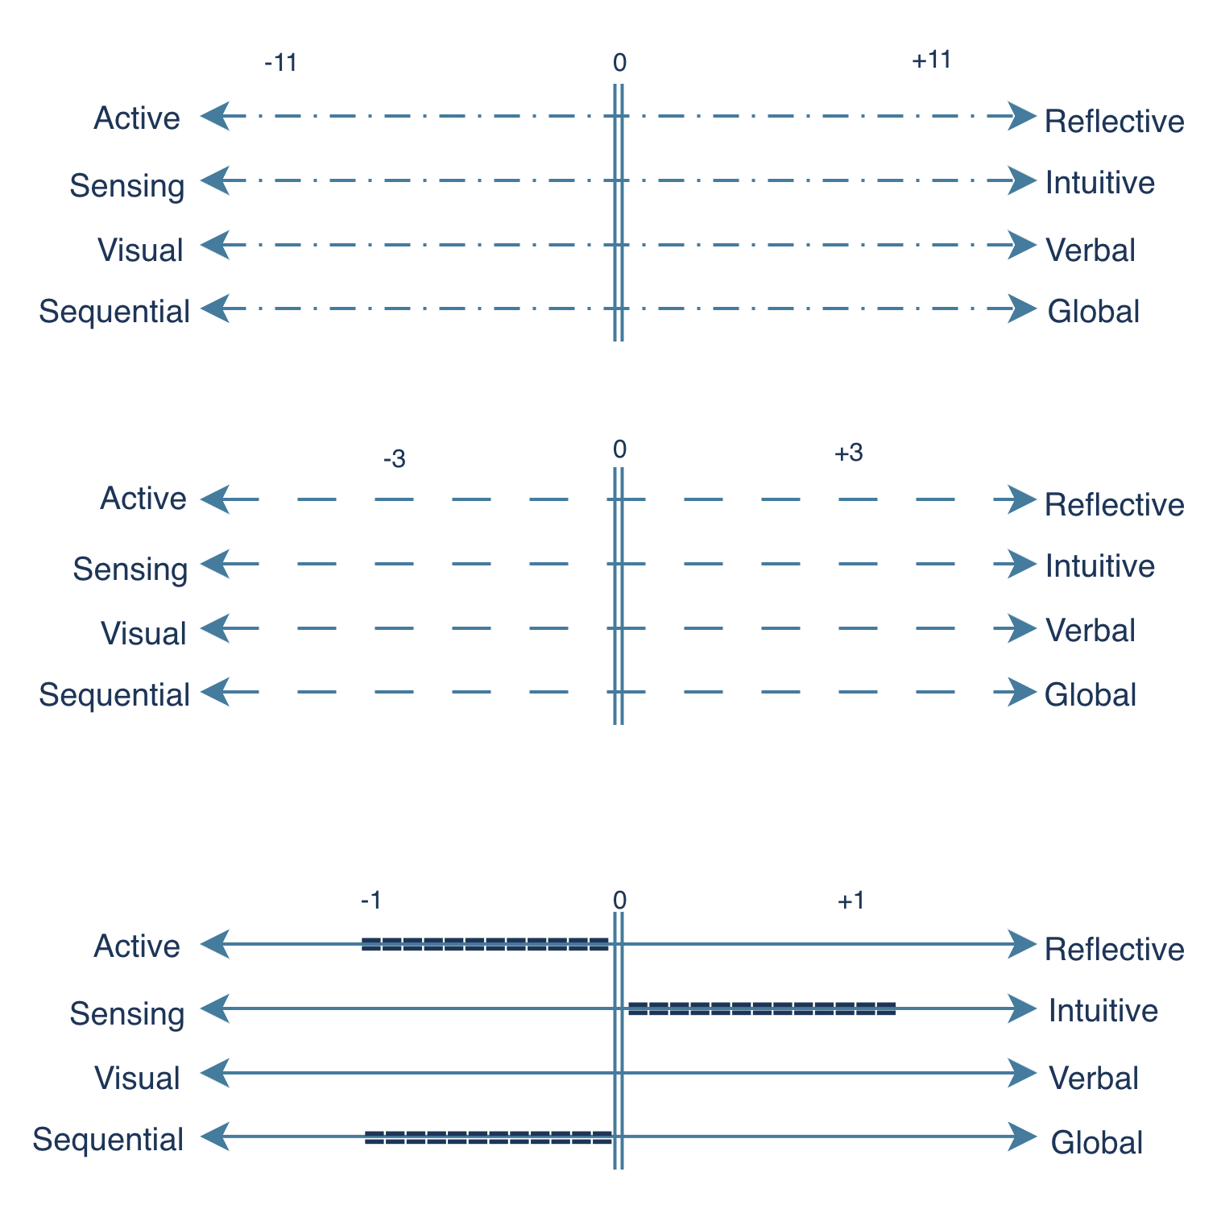
2.2 Learning Styles (FSLSM)
Original Index
44 Question of index between -11 to +11 or a11 to b11 for each dimension
Score Range: -11, -9, -7, -5, -3, -1, +1, +3, +5, +7, +9, +11
Scores per dimension: 12
Number of Dimension: 4
Total Combination: 20,736
Active/Reflective = -11
Compromised Version
Fewer Question for each index and measure as +/-3 strong, +/-2 moderate, and +/-1 balance.
Score Range: -3, -2, -1, 1, 2, 3
Scores per dimension: 6, or 3
Number of Dimension: 4
Total Combination: 1,296, or 81
Active/Reflective = -2
Minimum Version
Fewer Question for each index and measure as Active, Balanced or Reflective.
i.e., Active or Reflective
Score Range: -1,+1
Scores per dimension: 2
Number of Dimension: 4
Total Combination: 16
Active/Reflective = Active
Dimension Selection: 2 Score | 4 Dimension | 16 combination (agent)
Felder, R. M., & Soloman, B. A. (1997): Index of learning styles questionnaire
Notes:
●Since the original ILS based on the -11 and +11, it gives over 20,000 possible profile combinations. That is too complex for our simulation.
●So we use a simplified "binary version." Instead of a full scale, each dimension is just one of two values — like Active or Reflective. With 4 dimensions and 2 values each, we get exactly 16 profiles. We create 5 agents per profile, giving us 80 virtual students in total.
●This is simple enough to test systematically, but still captures the key differences between learning styles.

Slide 12
2.3 PersonaRAG: User-Centric Retrieval Agents
Core Concept
References
PersonaRAG extends standard RAG with user-centric agents that adapt retrieval based on interaction profiles, enabling real-time personalization beyond static queries.
Zerhoudi & Granitzer (2024): User-centric agents for adaptive retrieval
Chen et al., (2024): From persona to personalization, A survey on role-playing language agents
Kaiyrbekov et al., (2025): Automated survey collection with llm-based conversational agents.
Yao & González-Vélez (2025): Multi-agent RAG with knowledge graphs
User Profile Agent
1
Monitors FSLSM vector; generates reasoning plan for retrieval structure
Context Retrieval Agent
2
Reformulates queries with style directives (e.g., visual scaffolding)
Document Ranking Agent
3
Re-ranks results to surface style-matched passages
4
Feedback Agent
Continuously integrates interaction data to refine outputs
Notes:
●The tutoring layer is based on PersonaRAG, extended with FSLSM awareness. There are four agents working together.
●A User Profile Agent monitors the FSLSM vector and generates a reasoning plan for the retrieval structure.
●A Context Retrieval Agent rewrites the query using style instructions — for example, adding visual scaffolding for a visual learner.
●A Document Ranking Agent re-ranks the retrieved passages to put the most style-appropriate ones first.
●And a Feedback Agent continuously integrates interaction data to refine future outputs.
●Together all these agents, make retrieval dynamic and aware the learner behaviour.

Slide 13
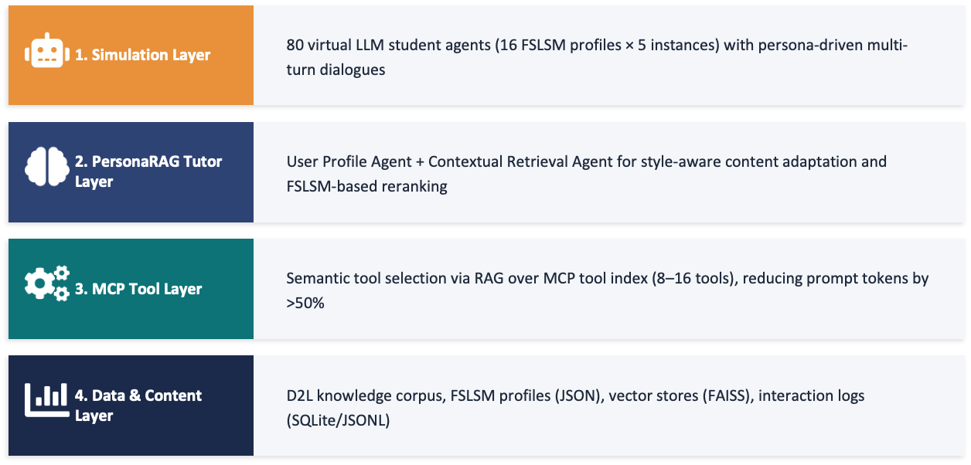
3. METHODOLOGY
Notes:
●The full system has four architectural layers.
●The Simulation Layer houses the 80 virtual LLM student agents.
●The PersonaRAG Tutor Layer handles style-aware content adaptation and FSLSM-based reranking.
●The MCP Tool Layer does smart tool selection using a vector index of tool descriptions.
●And the Data Layer includes the D2L corpus, FSLSM profiles as JSON, a FAISS vector store, and interaction logs.

Slide 14
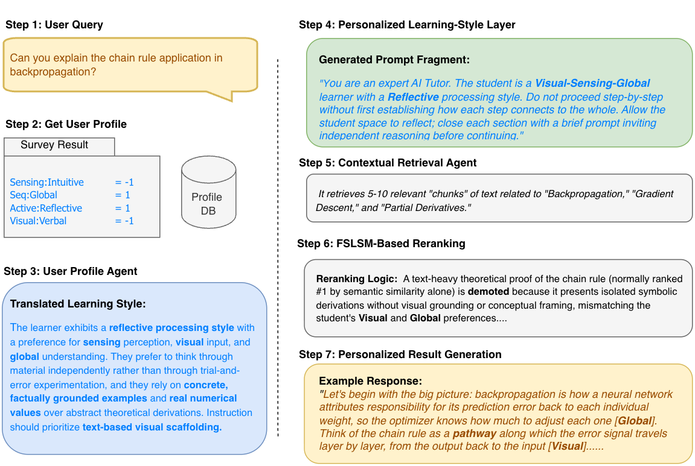
3.1 Learning Style integration in PersonaRAG
Notes:
To make this concrete, let me walk through the 7-step flow for learning style integration.
-A student or virtual LLM agent sends a question.
-The system loads their FSLSM profile from the database.
-The User Profile Agent translates that profile into teaching instructions — for example, "this student is visual and global, so start with the big picture and use structured examples."
-Those instructions are injected into the prompt.
-The Retrieval Agent pulls 5 to 10 chunks from the D2L corpus.
-The Ranking Agent re-orders them to have a best match the student's style.
-Finally, the system generates a personalized response — that opens with the big picture for a global learner, or goes step-by-step for a sequential learner.

Slide 15
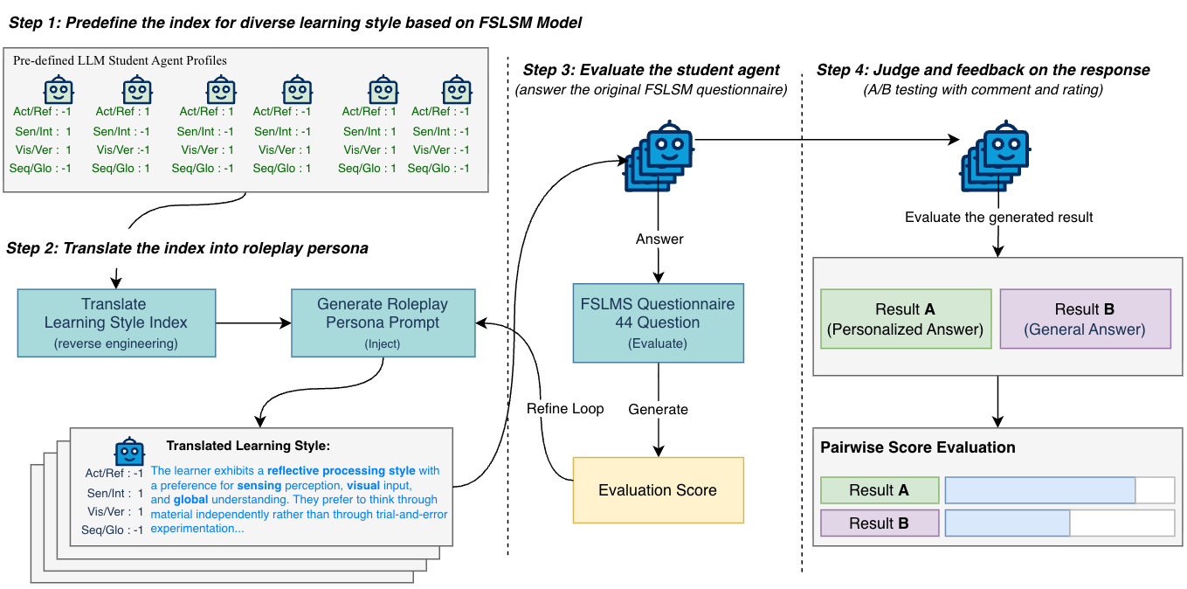
3.2 Virtual Agent
Notes:
●The virtual student agents will be built by following a four-step lifecycle.
●First, we predefine 16 FSLSM profiles using the minimum binary encoding.
●Second, we translate each profile into a roleplay persona prompt through reverse engineering, we ask the LLM to act like a student with those specific preferences.
●Third, we evaluate agent fidelity by having it answer the real 44-question ILS survey. We then compare the result to the intended profile.
●And fourth, we conduct pairwise A/B evaluation where the agent rates two responses — one personalized, one generic — and tells us which one is more suitable for it.

Slide 16
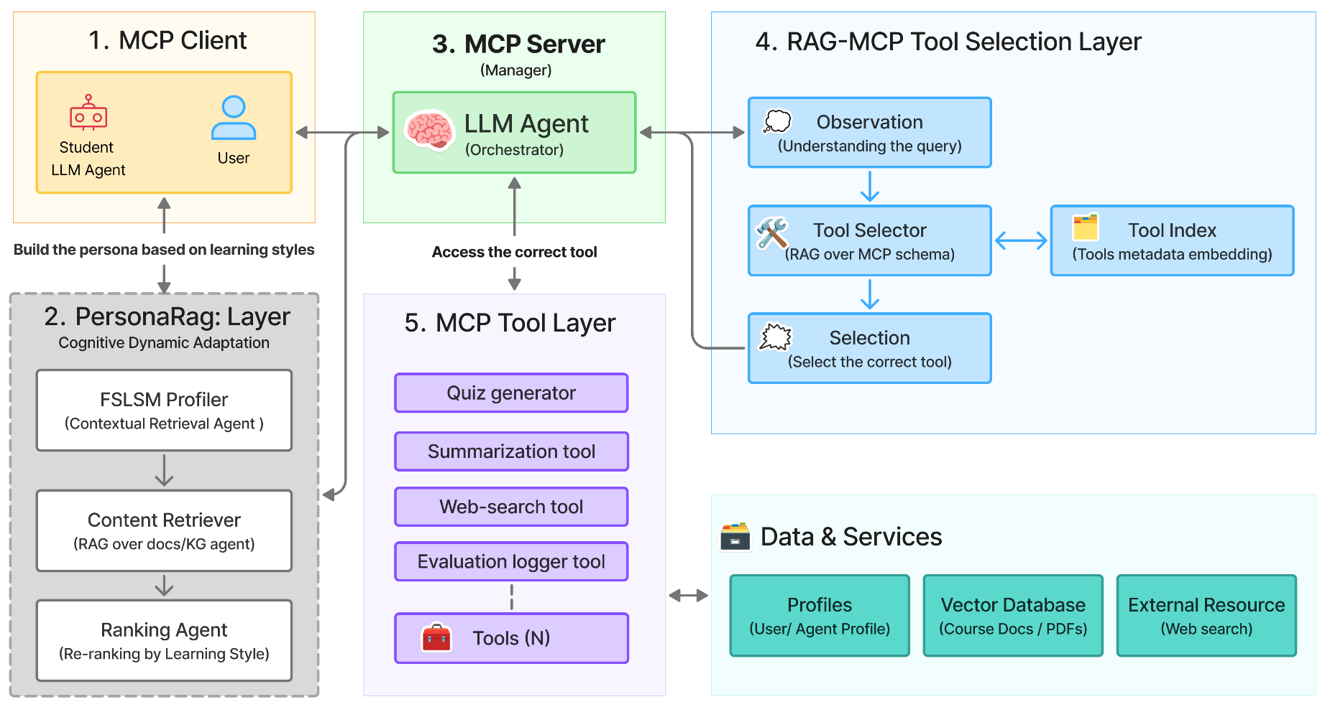
3.3 Tutor Agent in RAG-MCP
Notes:
●That is how I construct the RAG-MCP architecture layer.
●The MCP Client — which can be a student agent or a real user- it will get the Learning Style Preferences from the PersonaRG layer and connect to an MCP Server housing the LLM orchestrator.
●The orchestrator uses a RAG-MCP Tool Selection Layer: it encodes the user query, searches a vector index of tool metadata, and selects only the single most relevant tool — rather than loading all tool schemas into the prompt at once. This keeps the prompt short and the selection accurate.
●The available tools include a quiz generator, a summarizer, a web search tool, and an evaluation logger and other additional tools, each connected to specific learning styles and query types.

Slide 17
3.4 Dataset
Primary Knowledge Corpus
Multi-Hop 5-Chunk D2L-QA Dataset Generation
Dive into Deep Learning (D2L)
Zhang et al., 2021 — open-source textbook
Question Types: Compare, Trace-evolution, Explain-relationship, Synthesize-workflow · Debug-scenario
Per Record: Question, Gold answer, 5 gold chunk IDs, Essential vs. supporting chunk annotations
Ablation Check: To ensure each question genuinely requires multi-chunk reasoning, a leave-one-out ablation protocol is applied during dataset construction.
• Neural networks & optimization fundamentals
• ~2,500 semantically coherent chunks
• Metadata tags: chapter, section, concept
• Undergraduate instructional level
• Single domain to control confounds
D2L Book
Chunk & Parse
Cluster By Topic
Find 5-Chunk
Generate QA
Validation
Notes:
●The knowledge corpus is the Dive into Deep Learning textbook which is open-source, covering neural networks and optimization.
●We split it into about 2,500 chunks with metadata for chapter, section, and concept.
●For evaluation, we create a custom dataset where each question needs information from exactly 5 chunks to be answered correctly.
●Question types include compare, trace-evolution, and debug-scenario, ect,. Each record include question, gold answer with chunk IDs in addition to supporting chunk annotation.
●We also run a leave-one-out check during construction to make sure every question truly needs all 5 chunks.

Slide 18

4. EXPERIMENTAL DESIGN : EXP1-QA2
To Validate that virtual student LLM agents consistently reflect assigned FSLSM profiles
Key Metrics
Profile Recovery Accuracy (PRA)
Target: 0.80+
Dimension Alignment Score (DAS)
Target: 0.75+
Proportion of agents whose detected profile matches the assigned profile across all 4 FSLSM dimensions.
Cosine similarity between agent's aggregated responses and validated FSLSM trait descriptors (Graf et al., 2007).
Projected Results
Model | PRA | DAS
Non-Personalized Baseline | 0.60 ± 0.13 | 0.58 ± 0.14
FSLSM + GPT-4o | 0.82 ± 0.10 | 0.78 ± 0.10
FSLSM + Claude Sonnet | 0.80 ± 0.10 | 0.75 ± 0.10
FSLSM + Llama 3 8B | 0.75 ± 0.10 | 0.70 ± 0.10
Notes:
●EXP1 is designed for the research question 2, to validate whether our 80 virtual agents really act like their assigned FSLSM profile.
●We use two metrics.
○Profile Recovery Accuracy (PRA) is used to decide whether it can recover the correct profile from the agent's answers to the ILS survey. The expected target is 0.80 or above.
○And the Dimension Alignment Score (DAS) will help to answer how well the agent's responses match the FSLSM trait descriptions. The expected target is 0.75 or above.
●We projected that GPT-4o will reach 0.82 in PRA and 0.78 in DAS. Claude Sonnet could hit both targets, but Llama 3 8B could be slightly below.
●The baseline without FSLSM could only score around 0.60, which shows that profile encoding is essential.
------
PRA measures whether a virtual agent, after completing a multi-turn simulation session, produces ILS questionnaire answers that correctly recover its originally assigned FSLSM profile. It is essentially a classification accuracy: did the agent act consistently enough that we can identify its profile?
Limitation to be aware of: PRA uses a strict all-or-none matching rule — the agent must get all 4 dimensions correct. This is a conservative criterion. If an agent gets 3 out of 4 dimensions right, it still scores 0. This strictness is intentional: a testbed that only partially matches profiles could mislead the tutor efficacy experiments.
5 agents tested, 3 correct matches → PRA = 3/5 = 0.60
In our full experiment with 80 agents:
GPT-4o target: PRA = 0.82 → means 66 out of 80 agents correctly recovered
Baseline target: PRA = 0.60 → means only 48 out of 80 agents correct
----

Slide 19
4. EXPERIMENTAL DESIGN : EXP2-QA1
Compare personalized vs. baseline RAG tutor on style conformance, response relevance, and chunk recall across 4,000 A/B sessions.
Key Metrics
Style Conformance Score (SCS)
Response Relevance (PR)
Chunk Recall@5
Essential Recall
Cosine sim: response vs. FSLSM style descriptor
LLM-as-a-Judge: 1-5 vs. ground truth
Fraction of gold chunks in top-5 retrieved
Must-have chunks found by retriever
Projected Results
Model | SCS | RR (Judge) | Chunk Recall@5 | Essential Recall | Engagement
Non-Pers. Baseline (R0) | 0.45 ± 0.12 | 4.1 ± 0.5 | 0.42 ± 0.10 | 0.48 ± 0.12 | 3.2 ± 0.8
FSLSM Tutor (R1) | 0.70 ± 0.10 | 4.2 ± 0.4 | 0.50 ± 0.10 | 0.55 ± 0.11 | 4.5 ± 0.6
Notes:
●EXP2 compares the personalized tutor against the baseline across 4,000 A/B testing sessions.
●Key metrics are
○Style Conformance Score,
○Response Relevance from an LLM judge,
○Chunk Recall at 5,
○Essential Recall, and
○Engagement scores from the agents.
●We expect that
○Style conformance improves from 0.45 to 0.70
○Engagement rises from 3.2 to 4.5.
○And the other retrieval metrics could also improve.
It is showing that personalization helps the content quality, not only the style.

Slide 20
4. EXPERIMENTAL DESIGN : EXP3-QA3
Ablation Study: Comparing tool-handling architectures across 4000 sessions
Tool corpus: 8 - 16 diverse MCP tools
Ground truth: optimal tool pre-defined per query type × FSLSM dimension
Key Metrics
Prompt Token Savings (PTS) Reduction of input tokens per session
Tool Selection Accuracy (TSA)
Precision of choosing the optimal pedagogical tool
Projected Results
Architecture | PTS | TSA
Standard RAG (Baseline) | — | 14.2% ± 3.5
RAG-MCP Unconditioned | 30–40% | 35.5% ± 5.0
RAG-MCP + FSLSM (Proposed) | 30–50% | 45.5% ± 5.0
Notes:
●EXP3 is an ablation study comparing three tool-handling approaches.
●Key metrics are Prompt Token Savings and Tool Selection Accuracy.
●The plain RAG baseline should have a Tool Selection Accuracy of only 14 percent.
●RAG-MCP without learning style could improve to about 35 percent and save 30 to 40 percent of prompt tokens.
●Our proposed RAG-MCP with FSLSM conditioning is projected to reach about 45 percent accuracy and save up to 50 percent of tokens.
●This shows that adding learning style awareness improves both accuracy and efficiency.

Slide 21
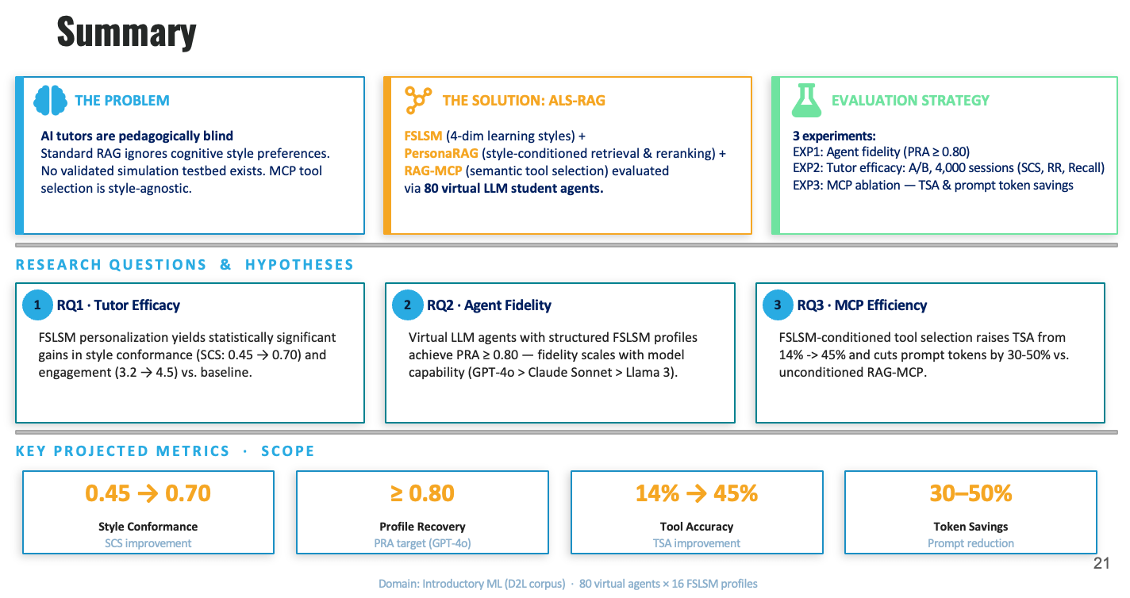
Notes:
●So let me bring everything together on this summary slide.
●The problem is straightforward: today's AI tutors are pedagogically blind. Standard RAG retrieves/ semantically relevant content, but it completely ignores how a learner prefers to learn. There's no validated simulation testbed, and MCP tool selection is entirely style-agnostic.
●The proposed solution is a framework that connects three things/ that have never been combined before. FSLSM gives us a validated 4-dimensional model of learning preferences. PersonaRAG gives us the architecture for style-conditioned retrieval and reranking. And RAG-MCP gives us an efficient, semantic tool selection.
●I believe this work has real potential to move AI tutoring beyond one-size-fits-all responses toward something that actually meets each learner preferences.

Slide 22
TENTATIVE WORK PLAN
2025
2026
JUN
JUL
AUG
SEP
OCT
NOV
DEC
JAN
FEB
MAR
APR
MAY
JUN
JUL
Literature Review
Proposal Defense
Development
Experiment
Progress Defense
Analysis
Writing
Publication
Final Defense
Notes:
The tentative timeline spans from June 2025 through July 2026.
The first phase — literature review and proposal defense — is already nearly complete, with the proposal defense happening now. Development and experimentation are planned from August through November 2025. A progress defense is scheduled around December to January. Analysis and writing follow through March to April 2026, with a target publication submission and final defense by June to July 2026.

Slide 23
REFERENCES
Pedagogical Foundations (Learning Styles, Adaptive Education, AI Tutoring & Agent Simulation)
Al-Azawei, A., & Badii, A. (2014). State of the Art of Learning Styles-Based Adaptive Educational Hypermedia Systems. International Journal of Computer Science and Information Technology.
Angeioplastis, A., et al. (2025). The Learning Style Decoder: FSLSM-Guided Behavior Mapping Meets Deep Neural Prediction in LMS Settings. Computers, 14(9), 377.
Bernard, J., et al. (2017). Learning Style Identifier: Improving the Precision of Learning Style Identification Through Computational Intelligence Algorithms. Expert Systems with Applications, 75, 94–108.
Felder, R. M., & Soloman, B. A. (1997). Index of Learning Styles Questionnaire. NC State University.
Graf, S., et al. (2007). In-Depth Analysis of the Felder-Silverman Learning Style Dimensions. Journal of Research on Technology in Education, 40(1), 79–93.

Slide 24
REFERENCES
Pedagogical Foundations (Learning Styles, Adaptive Education, AI Tutoring & Agent Simulation)
Kaiyrbekov, K., Dobbins, N. J., & Mooney, S. D. (2025). Automated Survey Collection with LLM-Based Conversational Agents.
Olea, C., et al. (2024). Evaluating Persona Prompting for Question Answering Tasks. 10th International Conference on Artificial Intelligence and Soft Computing.
Sanyal, D., et al. (2025). Investigating Pedagogical Teacher and Student LLM Agents: Genetic Adaptation Meets Retrieval-Augmented Generation Across Learning Styles.
Slijepcevic, N., & Yaylali, A. (2025). Leveraging "Khanmigo" Generative AI-Powered Tool for Personalized Tutoring to Learn Scientific Concepts. Journal of Teaching and Learning, 19(4), 155–178.
Soloman, B. A., & Felder, R. M. (n.d.). Index of Learning Styles Questionnaire. NC State University.
Zhang, A., et al. (2021). Dive into Deep Learning. Cambridge University Press.

Slide 25
REFERENCES
Retrieval-Augmented Generation (RAG) and Framework
Zerhoudi, S., & Granitzer, M. (2024). PersonaRAG: Enhancing Retrieval-Augmented Generation Systems with User-Centric Agents. IR-RAG Workshop at SIGIR 2024. CEUR Workshop Proceedings, Vol. 3784.
Chen, J., et al. (2024). From Persona to Personalization: A Survey on Role-Playing Language Agents. Transactions on Machine Learning Research.
Yao, Y., & González-Vélez, H. (2025). AI-Powered System to Facilitate Personalized Adaptive Learning in Digital Transformation. Applied Sciences, 15(9), 4989.
Model Context Protocol (MCP)
Gan, T., & Sun, Q. (2025). RAG-MCP: Mitigating Prompt Bloat in LLM Tool Selection via Retrieval-Augmented Generation.
Hou, X., et al. (2025). Model Context Protocol (MCP): Landscape, Security Threats, and Future Research Directions.
Luo, Z., et al. (2025). MCP-Universe: Benchmarking Large Language Models with Real-World Model Context Protocol Servers.

Slide 26
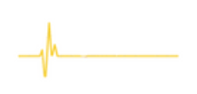
THANK YOU
for your attention

