Slide 1
Visualization and Analyzing of Data
Presented By Group 13

Slide 2
Members of Group 13
NAME | COURSE | REG. NO.
NYEMERA ANNA GRACE | AMI | BU/UP/2024/0838
NASASIRA AUSTINE | WAR | BU/UP/2024/1048
BARASA ELVIS | AMI | BU/UP/2024/3817
BRAVO GIFT | PTI | BU/UG/2024/5059
NAMUWAWU PATRICIA | APE | BU/UG/2024/2670
AINAMATSIKO JEREMIAH | WAR | BU/UP/2024/3826
ACHAM LOYCE | AMI | BU/UP/2024/0821
MUGUME MATHIAS | MEB | BU/UP/2024/0983
ABUROT MARTHA | WAR | BU/UP/2024/3823
KINTU GADAFFI | AMI | BU/UP/2024/3734

Slide 3
Background of MATLAB
MATLAB stands for matrix Laboratory.
It is a high-performance programming language and environment designed primarily for technical computing

Slide 4
TASK ONE
In this task, we were able to obtain a file from Kaggle.com named “Electric cars dataset” and using this data, we were able to do the following activities
Reading the data into MATLAB
Creating tables of different years
Converting the tables into structural arrays into different worksheets
Exporting the data to excel
Analyzed data through statistics
Visualizing of the data

Slide 5
READING THE DATA INTO MATLAB
The code that was used is as follows
data=readtable("C:\Users\LENOVO\Desktop\Electric cars dataset.xlsx");
disp(data);

Slide 6
CREATING TABLES OF DIFFERENT YEARS
After reading the tables from the data set, we created individual tables for different years. for example,
Year2015 = data(data.Year == 2015, :);
Year2016 = data(data.Year == 2016, :);
Year2017 = disp(Year2015);
disp(Year2016);

Slide 7
CONVERTING THE TABLES INTO STRUCTURAL ARRAYS INTO DIFFERENT WORKSHEETS
struct2015 = table2struct(Year2015);
struct2016 = table2struct(Year2016);
struct2017 = table2struct(Year2017);
struct2018 = table2struct(Year2018);
struct2019 = table2struct(Year2019);
struct2020 = table2struct(Year2020);
struct2021 = table2struct(Year2021);
struct2022 = table2struct(Year2022);
struct2023 = table2struct(Year2023);
struct2024 = table2struct(Year2024);
struct2025 = table2struct(Year2025);
disp(struct2015);
disp(struct2016);
disp(struct2017);
disp(struct2018);
disp(struct2019);
disp(struct2020);
disp(struct2021);
disp(struct2022);
disp(struct2023);
disp(struct2024);
disp(struct2025);
When working in MATLAB we convert tables into structured arrays to gain more flexibility and control over the data .Tables can be limited when dealing with complex irregular data but Structured arrays can handle these challenges effectively

Slide 8
EXPORTING THE DATA TO EXCEL
Once the data has been structured, we now export each year into an excel file using the command;
output1 = "C:\Users\LENOVO\Desktop\Question1\car_struct2015.xlsx"
writetable(Year2015,output1,"Sheet","Year2015");
Note: the above command applies to all years , only the variable and year are changed for different years

Slide 9
ANALYZED DATA THROUGH STATISTICS
Yearly_distribution_of_cars = groupsummary(data,"Year")
disp(Yearly_distribution(:,["Year","GroupCount"]));
Country_distribution_of_cars = groupsummary(data,"Country_of_Manufacture")
disp(Country_distribution_of_cars(:,["Country_of_Manufacture","GroupCount"]));
maximum_Country_distribution_of_cars = max(Country_distribution_of_cars.GroupCount);
disp(maximum_Country_distribution_of_cars);
fprintf("mean country distribution of cars: %.2f\n",mean(Country_distribution_of_cars.GroupCount));
fprintf("mode country distribution of cars: %.2f\n",mode(Country_distribution_of_cars.GroupCount));
fprintf("median country distribution of cars: %.2f\n",median(Country_distribution_of_cars.GroupCount));
fprintf("standard deviation country distribution of cars: %.2f\n",std(Country_distribution_of_cars.GroupCount));
fprintf("maximum country distribution of cars: %.d\n",max(Country_distribution_of_cars.GroupCount));
fprintf("minimum country distribution of cars: %.d\n",min(Country_distribution_of_cars.GroupCount));

Slide 10
CONT…
Color_distribution_of_cars = groupsummary(data,"Color")
disp(Color_distribution_of_cars(:,["Color","GroupCount"]));
Manufacturer_distribution_of_cars = groupsummary(data,"Manufacturer")
disp(Manufacturer_distribution_of_cars(:,["Manufacturer","GroupCount"]));
fprintf("mean Manufacturer distribution of cars: %.2f\n",mean(Manufacturer_distribution_of_cars.GroupCount));
fprintf("mode Manufacturer distribution of cars: %.2f\n",mode(Manufacturer_distribution_of_cars.GroupCount));
fprintf("median Manufacturer distribution of cars: %.2f\n",median(Manufacturer_distribution_of_cars.GroupCount));
fprintf("standard deviation Manufacturer distribution of cars: %.2f\n",std(Manufacturer_distribution_of_cars.GroupCount));
fprintf("maximum Manufacturer distribution of cars: %.d\n",max(Manufacturer_distribution_of_cars.GroupCount));
fprintf("minimum Manufacturer distribution of cars: %.d\n",min(Manufacturer_distribution_of_cars.GroupCount));
Model_distribution_of_cars = groupsummary(data,"Model")
disp(Model_distribution_of_cars(:,["Model","GroupCount"]));
Battery_Type_distribution_of_cars = groupsummary(data,"Battery_Type")
disp(Battery_Type_distribution_of_cars(:,["Battery_Type","GroupCount"]));
fprintf("mean Battery Type distribution of cars: %.2f\n",mean(Battery_Type_distribution_of_cars.GroupCount));
fprintf("mode Battery Type distribution of cars: %.2f\n",mode(Battery_Type_distribution_of_cars.GroupCount));
fprintf("median Battery Type distribution of cars: %.2f\n",median(Battery_Type_distribution_of_cars.GroupCount));
fprintf("standard deviation Battery Type distribution of cars: %.2f\n",std(Battery_Type_distribution_of_cars.GroupCount));
fprintf("maximum Battery Type distribution of cars: %.d\n",max(Battery_Type_distribution_of_cars.GroupCount));
fprintf("minimum Battery Type distribution of cars: %.d\n",min(Battery_Type_distribution_of_cars.GroupCount));

Slide 11
Visualization of Data
Basing on the knowledge attained, we visualized our data in various graphs depending on which graph best suited the data we wanted to visualize
The general code we used for plotting the graphs was;
Plot type(x,y);
xlabel(“x");
ylabel(“y");
title("");
For all the graphs we plotted

Slide 12
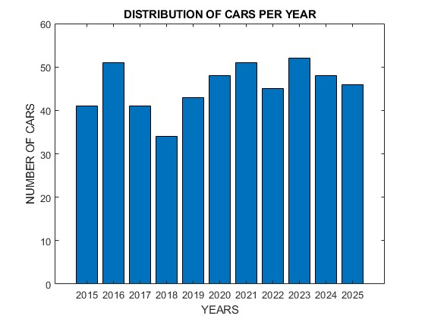
bar(Yearly_distribution_of_cars.Year,Yearly_distribution_of_cars.GroupCount);
xlabel("YEARS");
ylabel("NUMBER OF CARS");
title("DISTRIBUTION OF CARS PER YEAR");
saveas(gcf,"bar graph.png");

Slide 13
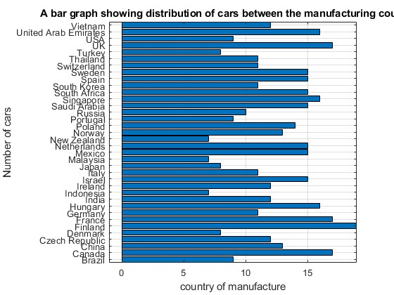
barh(Country_distribution_of_cars.Country_of_Manufacture,Country_distribution_of_cars.GroupCount);
xlabel("country of manufacture");
ylabel("Number of cars");
title("A bar graph showing distribution of cars between the manufacturing countries")
saveas(gcf,"horizontal bar.png");
grid on;

Slide 14
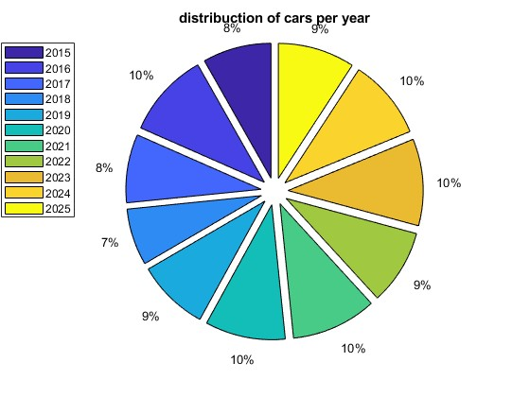
pie(Yearly_distribution_of_cars.GroupCount,Yearly_distribution_of_cars.Year);
title("distribuction of cars per year");
legend("2015","2016","2017","2018","2019","2020","2021","2022","2023","2024","2025");
saveas(gcf,"pie chart.png");

Slide 15
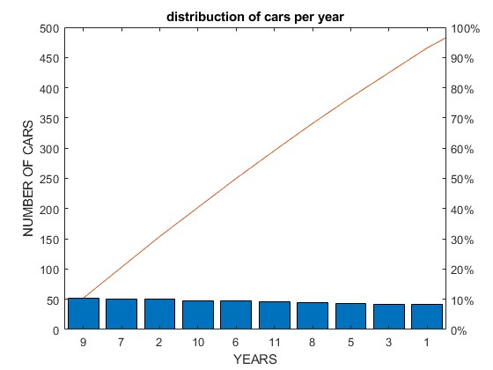
pareto(Yearly_distribution_of_cars.GroupCount);
title("distribuction of cars per year");
xlabel("YEARS");
ylabel("NUMBER OF CARS");
saveas(gcf,"pareto.png");

Slide 16
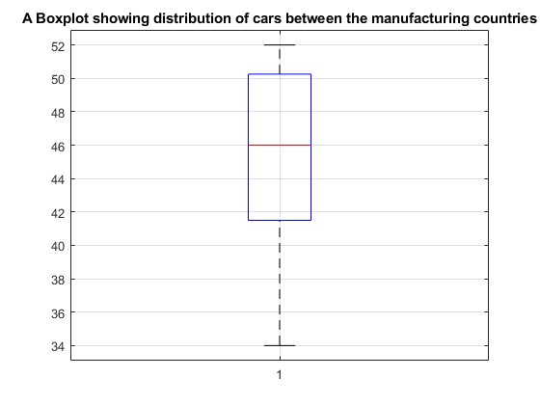
boxplot(Yearly_distribution_of_cars.GroupCount);
title("A Boxplot showing distribution of cars between the manufacturing countries")
saveas(gcf,"boxplot.png");
grid on;

Slide 17
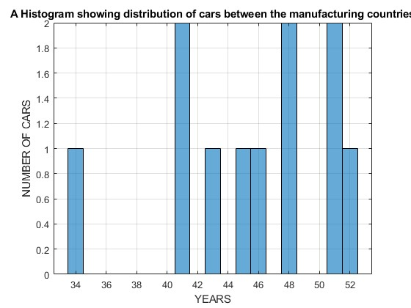
histogram(Yearly_distribution_of_cars.GroupCount);
xlabel("YEARS");
ylabel("NUMBER OF CARS");
title("A Histogram showing distribution of cars between the manufacturing countries")
saveas(gcf,"histogram.png");
grid on;

Slide 18
TASK TWO
After collecting the necessary information from all the members, we then obtained codes for the following activities;
Created a table for the data collected
Obtained statistical analysis on religion, tribes, hobbies and districts
Obtained statistics (mode, mean, standard deviation, maximum and minimum values)
Visualizing of the data

Slide 19
Created a table for the data collected
Name = ["Bravo Gift";"Austine NASASIRA";"Patricia Namuwawu";"Nyemere Anna Grace";"Kintu Gadaffi";"Jeremiah Ainamatsiko";"Mugume Mathias";"Aburot Martha";"Earasa Elvis";"Acham Royce"];
Age = [21;22;21;22;22;21;22;26;23;22;];
Tribe = ["alur";"munyankole";"muganda";"itesot";"muganda";"munyankole";"munyankole";"itesot";"samia";"langi"];
District = ["pakwach";"bushenyi";"masaka";"butebo";"mityana";"kazo";"bushenyi";"amuria";"busia";"lira"];
Hobby = ["music";'dancing';"reading";"footbal";"swimming";"music";"praying";"adventure";"football";"adventure"];
YearofBirth = [2004;2003;2004;2003;2003;2004;2003;1999;2002;2003];
IncomeLevel = [23;34;68;90;23;12;6;23;45;89];
WeeksAttended = [8;9;10;11;12;13;10;11;14;15];
MarksScored = [51;56;79;90;89;67;56;54;53;60];
Course = ["PTI";"WAR";"APE";"AMI";"AMI";"WAR";"MEB";"WAR";"AMI";"AMI"];
Religion = ["catholic";"catholic";"anglican";"catholic";"muslim";"anglican";"catholic";"anglican";"anglican";"catholic"];
Students = table(Name,Age,Tribe,District,Hobby,YearofBirth,IncomeLevel,WeeksAttended,MarksScored,Course,Religion);
disp(Students);

Slide 20
Obtained statistical analysis on religion, tribes, hobbies and districts
distribution of religion
Religion_distribution = groupsummary(Students,"Religion");
disp(Religion_distribution(:,["Religion","GroupCount"]));
distribution of tribes
Tribe_distribution = groupsummary(Students,"Tribe");
disp(Tribe_distribution(:,["Tribe","GroupCount"]));
distribution of hobbies
HObby_distribution = groupsummary(Students,"Hobby");
disp(HObby_distribution(:,["Hobby","GroupCount"]));
distribution of districts
District_distribution = groupsummary(Students,"District");
disp(District_distribution(:,["District","GroupCount"]));

Slide 21
Obtained statistics (mode, mean, standard deviation, maximum and minimum values)
fprintf("mean Age: %.2f\n",mean(Students.Age));
fprintf("median Age: %.2f/n",median(Students.Age));
fprintf("modal Age: %.2f/n",mode(Students.Age));
fprintf("standard dviation Age: %.2f/n",std(Students.Age));
fprintf("minimum Age: %d/n",min(Students.Age));
fprintf("maximum Age: %d/n",max(Students.Age))
statistics on marks
fprintf("mean mark scored: %.2f\n",mean(Students.MarksScored));
fprintf("median mark scored: %.2f\n",median(Students.MarksScored));
fprintf("modal mark scored: %.2f\n",mode(Students.MarksScored));
fprintf("standard deviation mark scored: %.2f\n",mean(Students.MarksScored));
fprintf("maximum mark scored: %.d\n",max(Students.MarksScored));
fprintf("minimum mark scored: %.d\n",min(Students.MarksScored));
statistic on income level
fprintf("mean income level: %.2f\n",mean(Students.IncomeLevel));
fprintf("median income level: %.2f\n",median(Students.IncomeLevel));
fprintf("modal income level: %.2f\n",mode(Students.IncomeLevel));
fprintf("standard deviation income level: %.2f\n",std(Students.IncomeLevel));
fprintf("maximum income level: %.d\n",max(Students.IncomeLevel));
fprintf("minimum income level: %.d\n",min(Students.IncomeLevel));

Slide 22
VISUALIAZATION OF DATA

Slide 23
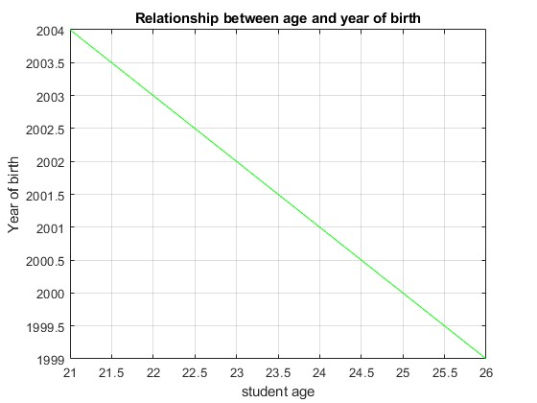
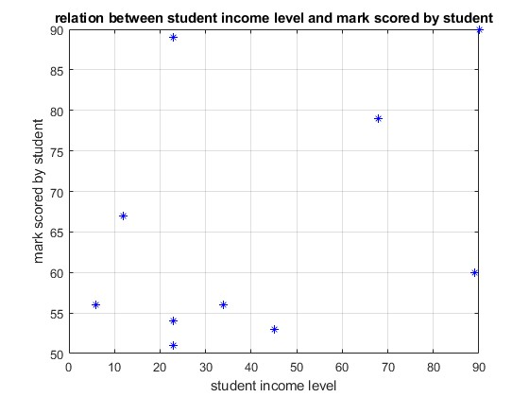
relationship between income level and marksscored
plot(IncomeLevel,MarksScored,"b*");
xlabel("student income level");
ylabel("mark scored by student");
title("relation between student income level and mark scored by student");
grid on;
relationship between students' age and year of birth
plot(Age,YearofBirth,"g");
xlabel("student age");
ylabel("Year of birth");
Title
("Relationship between age and year of birth");
grid on;

Slide 24
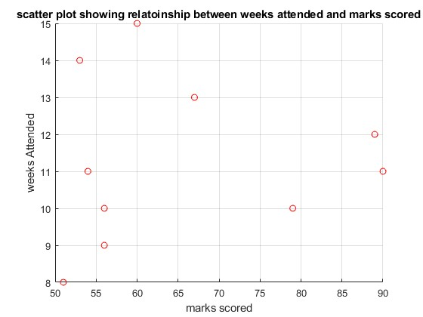
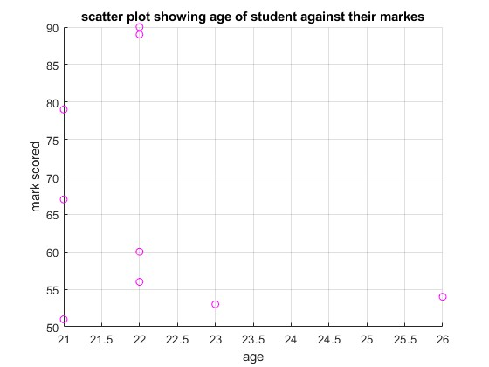
relationship of markscored and weeks attended
scatter(MarksScored,WeeksAttended,"r");
xlabel("marks scored");
ylabel("weeks Attended");
title("scatter plot showing relatoinship between weeks attended and marks scored");
grid on;
relationship of age and marks scored
scatter(Age,MarksScored,"magenta");
xlabel("age");
ylabel("mark scored");
title("scatter plot showing age of student against their markes");

Slide 25
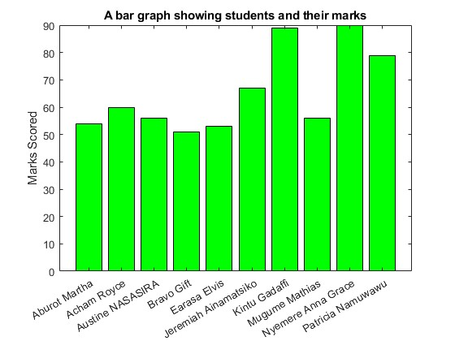
Bar Graph
x = categorical(Name)
y = MarksScored
bar(x,y,"g");
title("A bar graph showing students and their marks");
ylabel("Marks Scored");

