Slide 1
Scheduling Py Design
(All puns “py design”, and do not reflect any actual humor.)
[https://github.com/Nyght76/HackPSU2017Fall]

Slide 2
Event planning and scheduling
Talks, rooms, speakers, workshops, room sizes, breaks, ceremonies…
Having too much for your attendees to do is just as bad as not having enough…
How to find that happy medium – where you have enough for everyone, but not wasting time and space?

Slide 3
Fake data, real issues.
The more options there are for attendance, the more data to keep track of for mini-events.
Opimizing mini-event placement while concurrent options are taking place can become a shell game
What’s worse? An empty room, or a room overfilled?
Class | Seats | Attendance
Keynote | 95 | 145
Workshop | 40 | 18
Guest Speaker | 24 | 30

Slide 4
Event planning… making a square peg fit into a triangle… and getting a round peg for your efforts.
Rooms
Daily Schedule
How many?
Capacity?
Single or multi day event?
Breaks, Meals, Priority Items (Ceremonies, Awards, etc.)
Duration?
Concurrent events?
Fitting them into the rooms…
Attendees
How many?
Sign-in/Check-out?
Mind Melting
Effective time management
Effective use of space.

Slide 5
Time. They say it’s a killer…
And for event planning, it is. Time is money. Venue space is money. Underutilized venue space is wasting time and money. Guest speakers don’t want to present to empty rooms…
…make sure you don’t have to.

Slide 6
Volunteers != Experts
College student:
Professional Event Planner
Cooperative effort on ensuring event success.
May be a top notch student, but a STEM student may not have much interaction with scheduling.
Collaborative approaches can lead to gaps in information.
And they are STUDENTS. 1 Credit hour = How much effective work nowadays? (2Hr, 3Hr, etc.?)
Gets paid to do this.
Doesn’t get paid if they are bad at their job.
This IS their job. If they are splitting up their workweek with outside tasks, their future in not tied directly to the success of those tasks.

Slide 7
Do the math. (seriously, just turn the process into math)

Slide 8
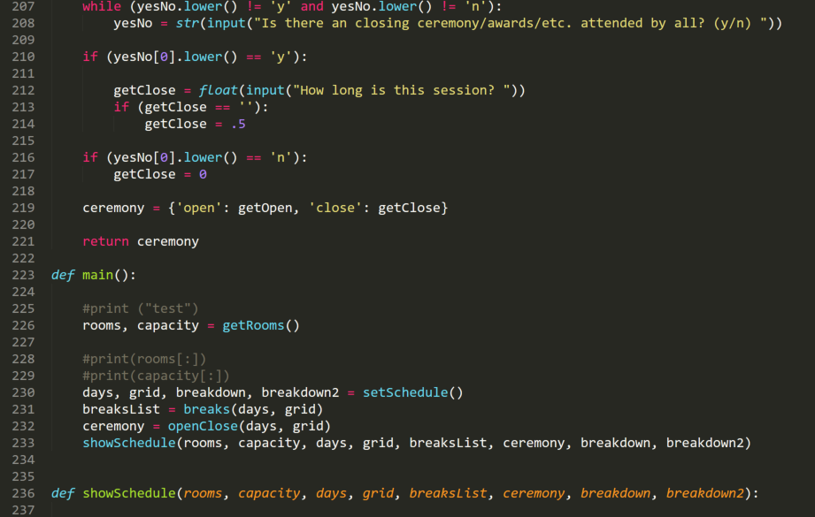
Python. PyDesign.
Why Python?
Lists and Dictionary management.
C++ Vectors/Arrays are straightforward… and procedurally generating arrays is not one of the language’s strong suits.

Slide 9
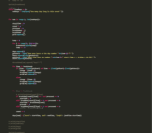
Blur the lines.
Give organizers the tools to do their work, without making them feel like it’s still a question mark at the end…
Know the numbers, but don’t get blinded by staring at them.

