Slide 1
Scorecard
School Project made by Piia Laine

Slide 2

Project Content
Scorecard is a website project that was done in two parts:
Concept (Diagrams, etc.)
Website

Slide 3
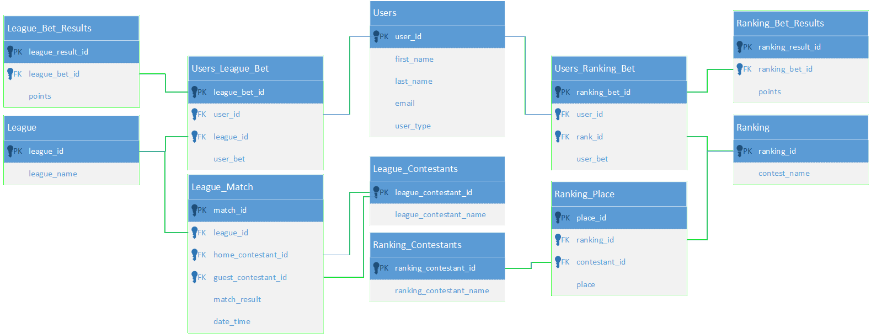
Database Diagram

Slide 4
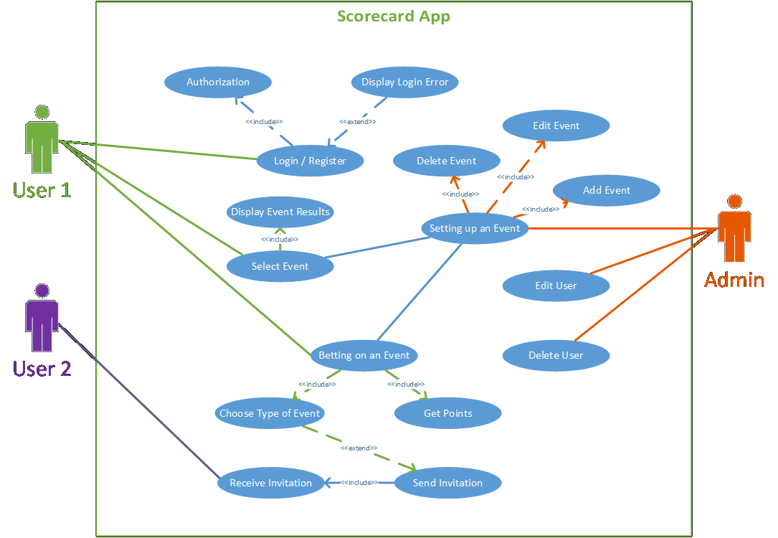
Use Case Diagram

Slide 5



Svelte App (Front End)
Data
Back End
Data

Slide 6
Thank you!
Link to the website: scorecard-piia.netlify.app

