Slide 1
Unity Game
Work Experience – Piia Laine

Slide 2
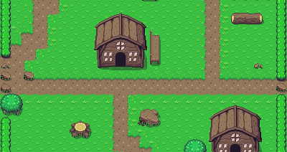
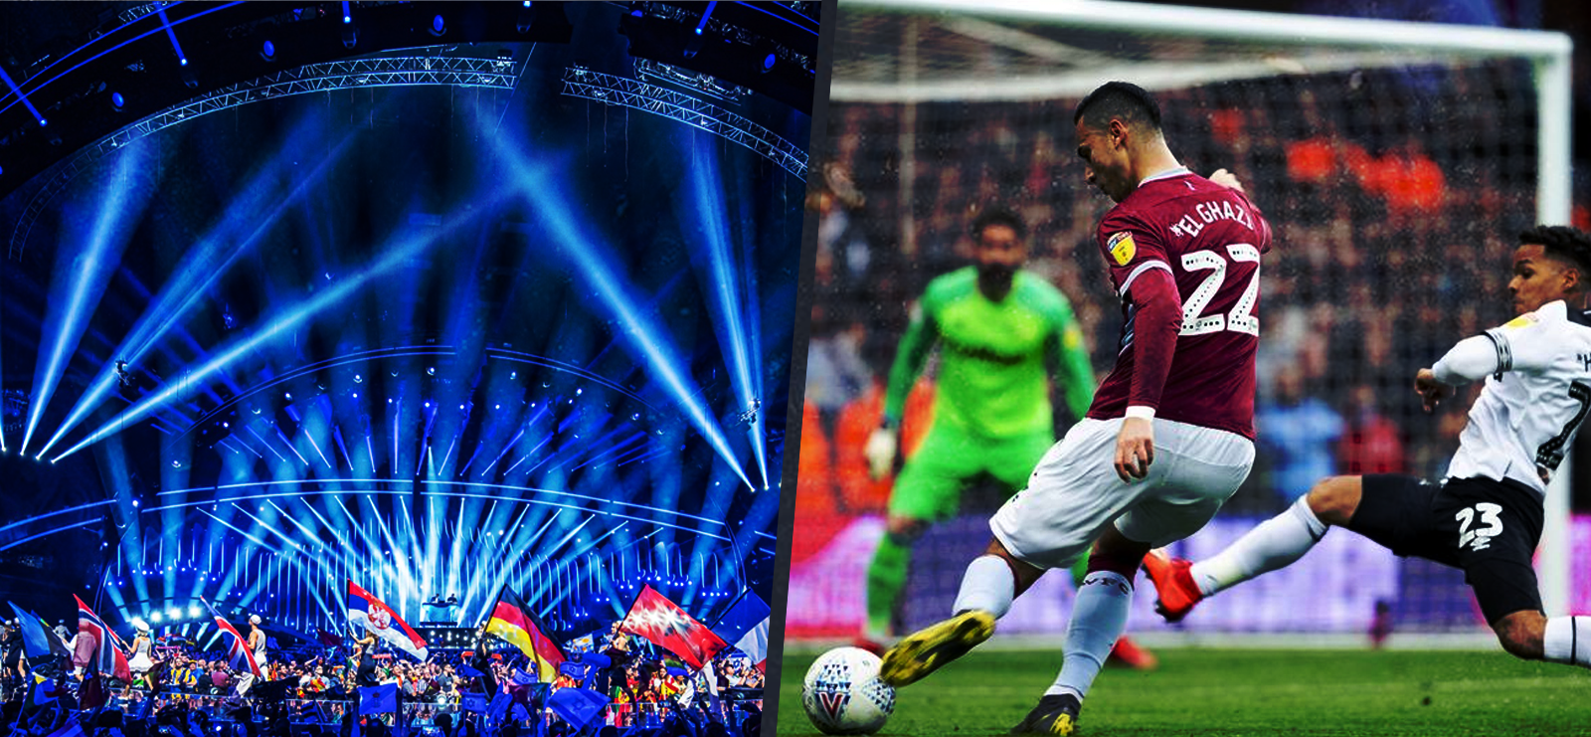
Project Content
The Game
the biggest part of the project
Project Management
consists of hourlist, self-gradings, testing document, diagrams, reports
Website
includes download links and a section for feedback

Slide 3
The Game
The idea was to make a 2D game similar to older Zelda games. When I started I set myself some features that I want the game to have:
Camera movement like 2D Zelda
Switches that trigger something
Pushable objects to create puzzles
Attacks
World (made in a program called Tiled)

Slide 4
Camera & Attacks
Camera:
I made the camera follow the player by using linear interpolation. This drags the camera from its current place to the player’s position.
Attacks:
Along with animations, I made the attacks using hitboxes. Those are 2D-colliders that act as triggers.

Slide 5
Objects & Switches
Objects:
Objects are kinematic bodies that can be pushed by holding down a button and walking into them.
Switches:
Switches trigger things in the world, when a player or object is standing or placed on them.

Slide 6
Working Hours
Hours Spent
Planning | 26,5
Research | 72
Game-Work | 138,5
Website | 15
Total | 252

Slide 7
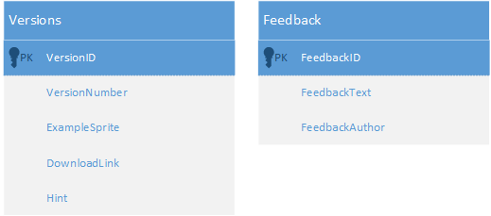
Database

Slide 8
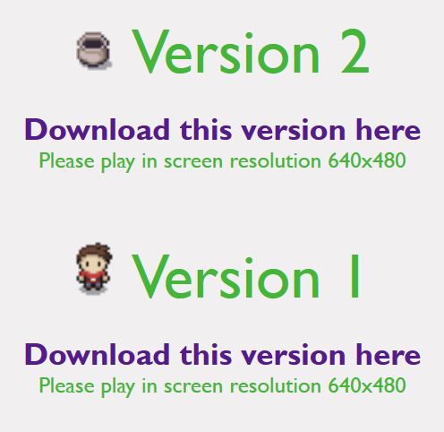
Website
This is how people can get access to the different versions of the game.
Additionally, they can choose to write a comment on the website.

Slide 9



Svelte App (Front End)
STRUCTURE
Data
Back End
Data

Slide 10
Thank you!
The game is available at the website:
unity-website.netlify.app

