Slide 1
A Take on the Movie Industry
By Nyla Duperval

Slide 2
Purpose of Presentation
How much does it cost to make a successful movie?

Slide 3
Movie/Film Industry Background
1800s: First moving film was introduced in Europe
1906: Color motion pictures began
1970s: Special effect technology was introduced
2000s: Streaming services were beginning

Slide 4



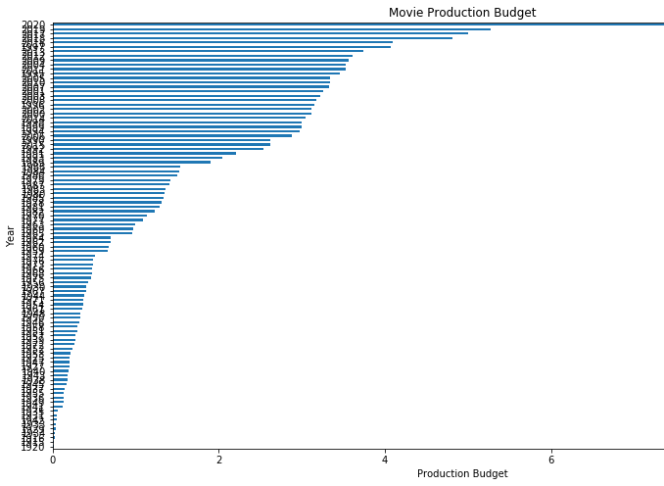
First View of Data
Data timeframe:
Begin: 1916
End: 2020
Observation:
As years pass, the production budget increases

Slide 5
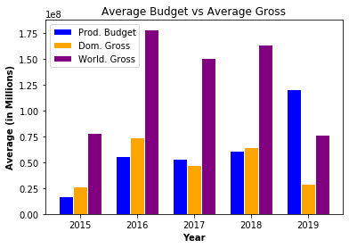
Average Budget vs. Average Gross
Observations:
World. gross surpassed Prod. budget between 2015-2018
Dom. Gross is close in margin to Prod. budget
Dom. and World. gross was significantly lower in 2019, specifically Dom. gross

Slide 6
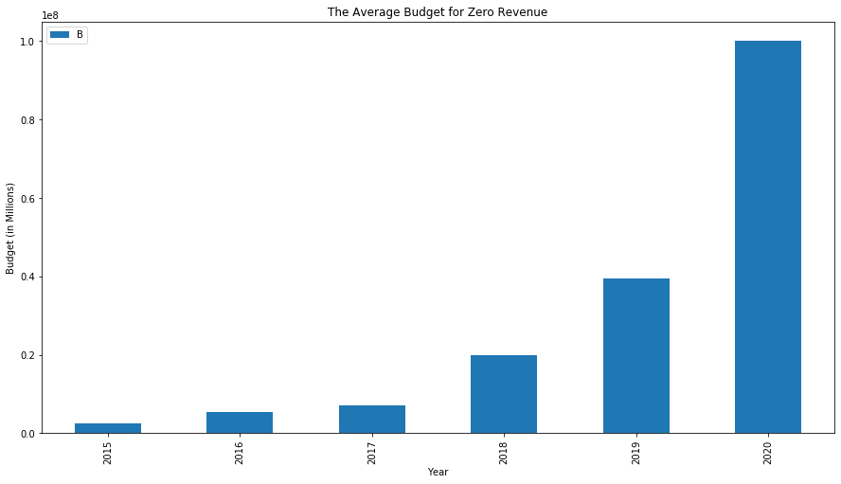
The Average Budget of Zero Revenue
Budget Analysis:
Highest budget: approx. 100 million
Lowest budget: approx. 2 million
Observation:
As year increases, production budget increases

Slide 7
Recommendation
I recommend pursing business venture into the movie industry. The movie industry is evolving with the times and more options may arise for ways content is provided to customers.

Slide 8
Recommendation #1
Focus efforts on worldwide movie market

Slide 9
Recommendation #2
Determine what are the budget lines for a movie production

Slide 10
Recommendation #3
Examine genre popularity based on year in comparison to production budget

Slide 11
Thank You for Time!

