Slide 1

The COVID-19 Impact on ABC Company’s Parcel Delivery Business
By: Evelyn George & Gracious Akokadike
DATE: Dec 2025

Slide 2
Table of Contents
1.
Executive Summary
2.
When were customer volumes first impacted by COVID-19?
3.
What events within the COVID timeline may have contributed to the change?
4.
How did COVID-19 impact peak season in 2020?
5.
How has COVID affected different customer groups (Enterprise, Large, etc.)?
6.
What % of each customer group is growing, stable, or declining?
7.
What % of each group are new customers during COVID?
8.
What % of 2019 customers in each group were lost?
9.
What was the overall impact on volume and revenue by group?

Slide 3
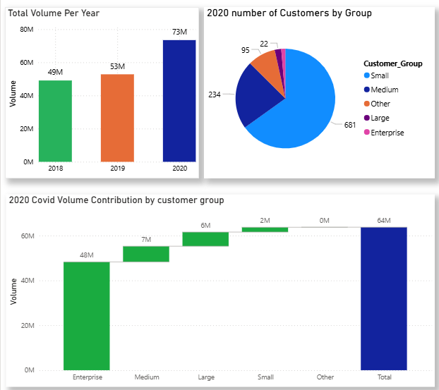
Executive Summary
Volume Surge:
Total Parcel volume in 2020 37% compared to 2019 above the growth baseline (ISGR: +11.40%).
Customer Segment Health
Total active customers in 2020: 1,046
  Enterprise: 14 (1.34% of total)
  Large: 22 (2.10% of total)
  Medium: 234 (22.37% of total)
  Small: 681 (65.11% of total)
  Other /emerging accounts: 95 (9.08%) with very low parcel volumes (<1,000)
Profitability & Volume Drivers
Enterprise and Large customers contributed the most to volume, confirming that established high-volume (Enterprise) accounts drove the majority of the parcel volume surge.
14
Notes:
Key Takeaway:
The COVID-19 pandemic drove exceptional parcel volume growth, dominated by high-value established customers, while a small number of low-volume new entrants emerged, suggesting opportunities for targeted engagement and revenue optimization.
1046 customer base in 2020, from which 56% of the customers were high growth accounts, 7% stable accounts, 36% declining accounts and 1% lost accounts during the pandemic.

Slide 4
How COVID-19 impact ABC Company’s parcel business
Metric
2019 (Wk 12–53)
2020 (Wk 12–53)
% Change
Parcel Volume
43 million
63 million
+47.84%
Active Customers
1,060
1,035
-2.36%
Parcel Volume: Increased by 47.84% during COVID (Week 12–53, 2020 vs 2019 same period). This suggests that revenue likely grew by a similar percentage during the same period.
Active Customers: Slight decline of −2.36% in the number of customers ABC catered to in 2020(Wk 12-53) compared to the same period in 2019.
Notes:
Comparing 2020 with 2029 same periods
Key Inflection Point : The shift began abruptly after Week 11, 2020, driven by the WHO pandemic declaration and subsequent work-from-home mandates.

Slide 5
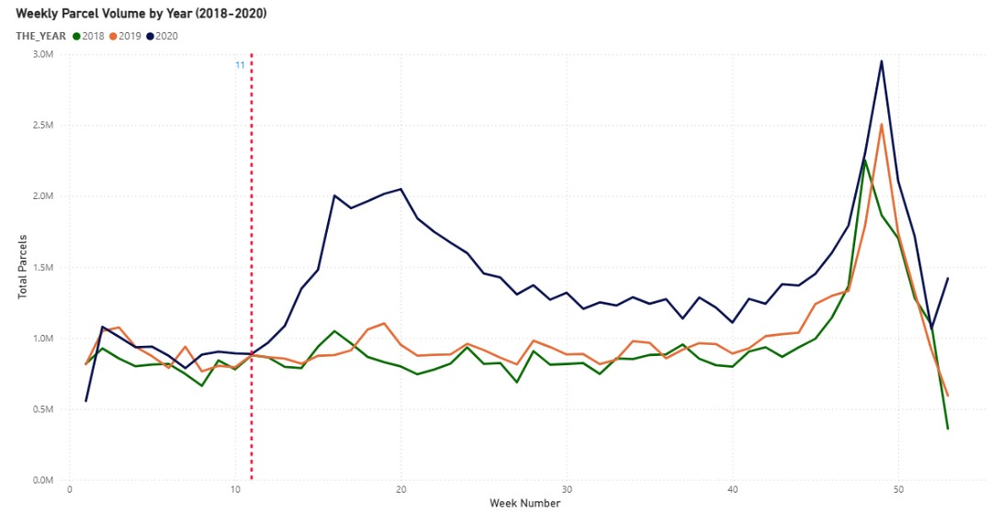
When Customer Volumes Were First Impacted
Pre COVID observation: Wk 1-11
Post COVID observation: Wk 12-53
Key Parcel Volume Insights
Pre-Shift: Volumes stable at 900K-1m until Week 11 (2020).
The Break
Volume diverged sharply starting Week 12 which was due to March Pandemic Declaration.
New Baseline
A new weekly baseline emerged (1.2m minimum). And a record end-of-year peak reaching 3M parcels.
Notes:
COVID drove accelerated e-commerce activity, resulting in above-normal growth compared to ISGR (11.40%).

Slide 6
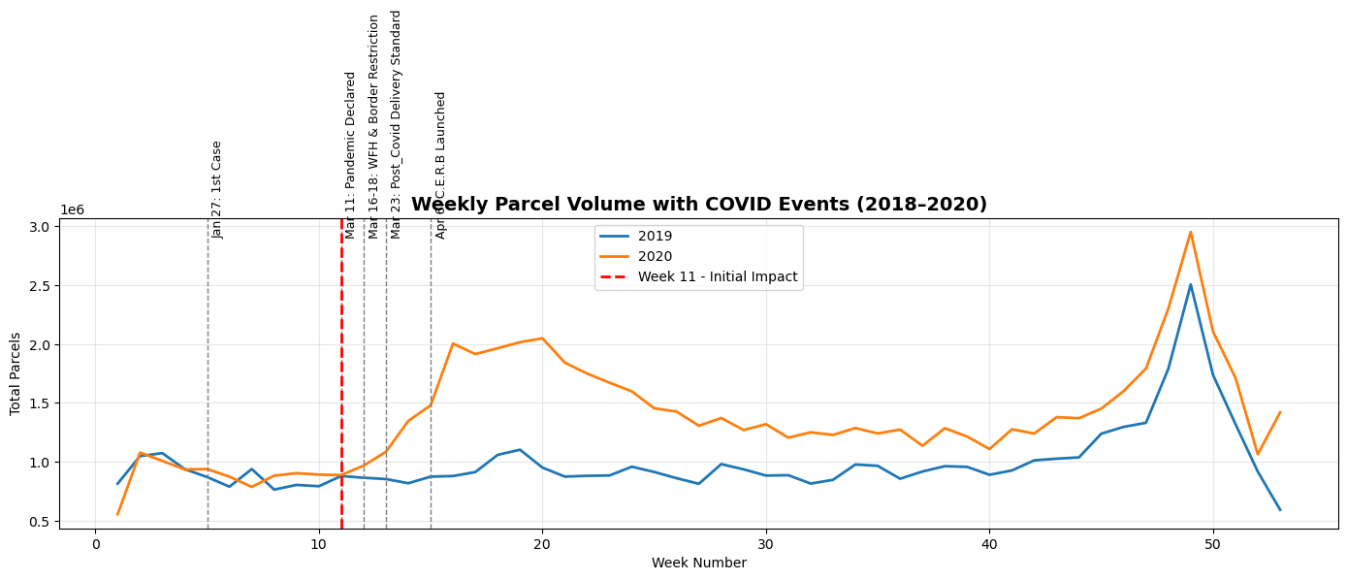
Key COVID-19 Events That Drove The Change

Slide 7
External Drivers & Timeline
A rapid sequence of events created the operational necessity for our growth.
Week 11 (Mar 11):
1
WHO declares COVID-19 a pandemic. Initial shift in consumer fear/buying.
Week 11 ended with 900k parcels by ABC.
2
Week 12 (Mar 16):
Work-From-Home Mandates & School Closures begin.
US/Canada border restriction
These were key drivers of e-commerce adoption and ABC ended with 1m parcels.
Week 13 (Mar 23):
3
Emergency Declarations and new Post-COVID Delivery Standards implemented.
4
Week 15 (Apr 6):
Government Income Support (e.g., CERB) programs launched. And for ABC, 1.5m parcels delivered in week 15 and 2m in week 16 indicating sustained increase in business and increasing disparity with same period 2019.

Slide 8
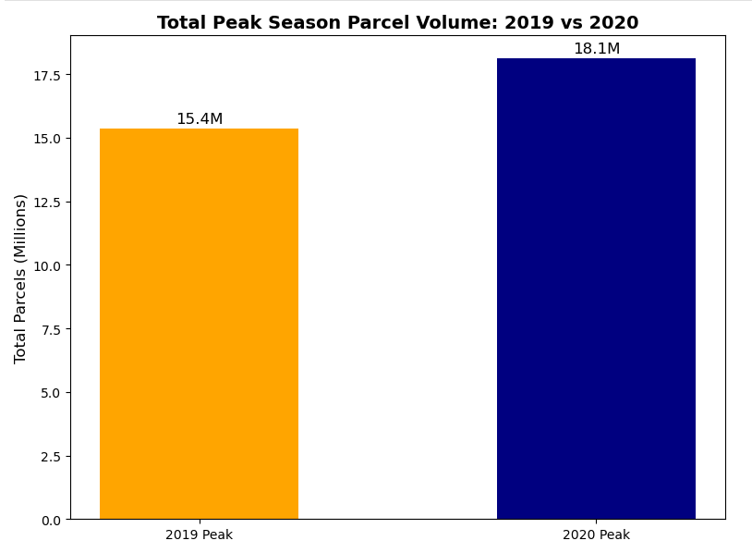
COVID-19’s Impact on 2020 Peak Season
Volume Surge: 2020 weekly volumes were consistently higher than 2019 during peak season, confirming that COVID-19 significantly increased peak season parcel demand. Total 2020 peak volume stood at 18.1m as against 2019 volume of 15.4 (17% growth)
Strategic Insight: ABC should expect a higher baseline post-pandemic due to accelerated customer habit formation (Shift to online shopping)

Slide 9
Pandemic Effects Across Customer Segments
Large Customers: the highest percentage growth (+47%), confirming volume acquisition in the higher-tier segments.
Medium & Enterprise Customers: showed significant growth (34% and 17% respectively).
Small Customers: Experienced a substantial decline (-15.96%), suggesting they were disproportionately impacted by the pandemic (closures/consolidation).
A new segment of customer emerged in 2020 which we categorized as others. They had volumes lower than 1k and they contributed 9.1% of 2020 volumes.

Slide 10
Customer Group Performance Status Breakdown (1/2)
Key Observations
Enterprise Customers
  10 high growth, reflecting significant parcel increases. 3 declined and 1 stable.
Large Customers
  19 high growth, 1 declined, 2 stable.
Medium Customers
  171 high growth, 44 declined, 19 stable.
Small Customers
  386 high growth, 54 stable.
  241 declined, showing vulnerability in smaller accounts.
Small → Other Transition
  “Other” represents downgraded small customers.
  84 declined, 11 lost.

Slide 11
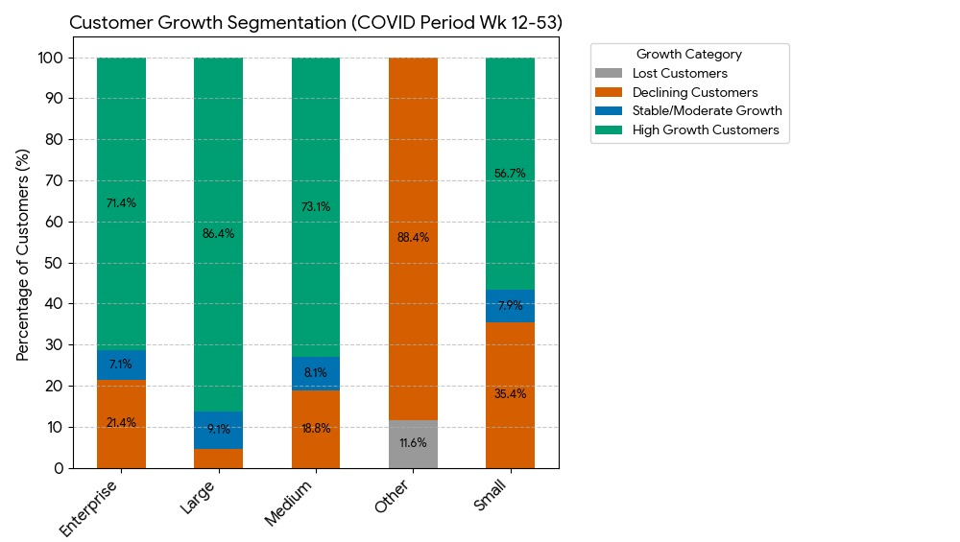
Customer Group Performance Status Breakdown (2/2)
Key Observations
Enterprise Customers
  71.43% experienced high growth, reflecting significant parcel increases. 21.43% declined and 7.1% stable.
Large Customers
  86.36% high growth, 4.55% declined, .09% stable.
Medium Customers
  73.08% high growth, 18.8% declined, 8.12% stable.
Small → Other Transition
  “Other” represents downgraded small customers.
  88.42% declined, 11.58% lost.
Small Customers
  56.68% high growth, 7.93% stable.
  35.39% declined, showing vulnerability in smaller accounts.

Slide 12
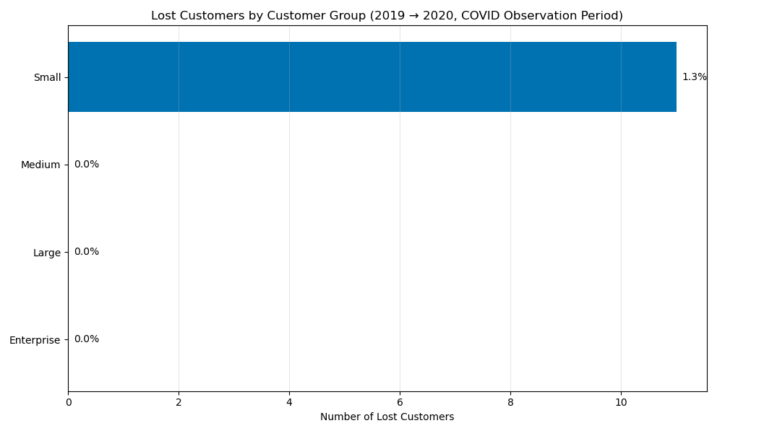
Percentage of New & Lost Customers by Group
Lost customers: Mostly in Small group (drop of 11 of Small customers).
No new customer was recorded in 2020.
Retention of Small customers could improve profitability.

Slide 13
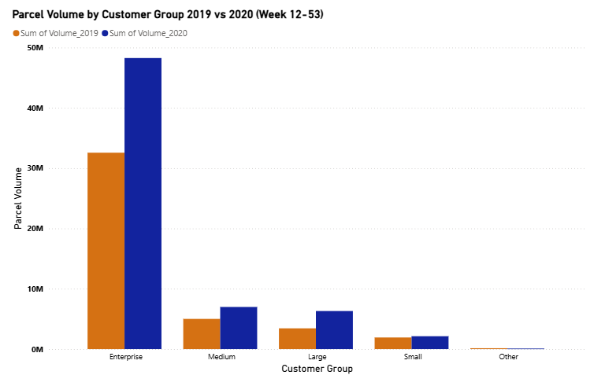
Impact on Volume
Overall Performance
2020 Volume grew significantly above 2019 rate, confirming a pandemic-driven spike. Volume trend shows a drastic positive change after Week 11, coinciding with the WHO declaration and lockdowns.
Customer Base
Volume growth was primarily driven by high-value clients (Enterprise). Small customers were the source of volume decline, suffering a 20.81% decline in active accounts.
Strategy
The 2020 peak season exceeded 2019 volumes, confirming a record holiday surge. Operational planning must now account for the new, elevated peak volume baseline which would likely continue to an extent in 2021 due to change in customer shopping habit.

Slide 14
Thank You

Slide 15
Appendix

Slide 16
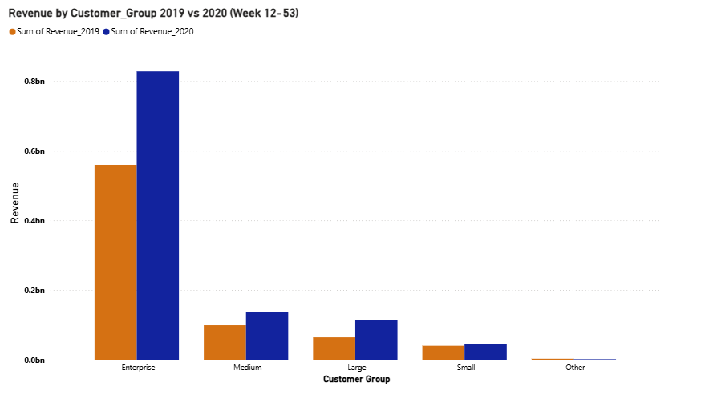
Impact on Revenue
Overall Performance
Revenue grew significantly above the normal rate, aligning with the volume spike.

Slide 17
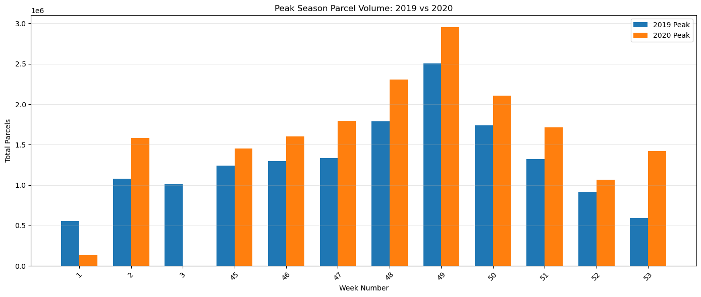
COVID-19’s Impact on 2020 Peak Season
2020 Volume Surge: 2020 volumes were consistently higher than 2019, confirming that COVID-19 significantly increased peak season parcel demand.
Strategic Insight: ABC should expect a higher baseline post-pandemic due to accelerated customer habit formation (Shift to online shopping)

Slide 18
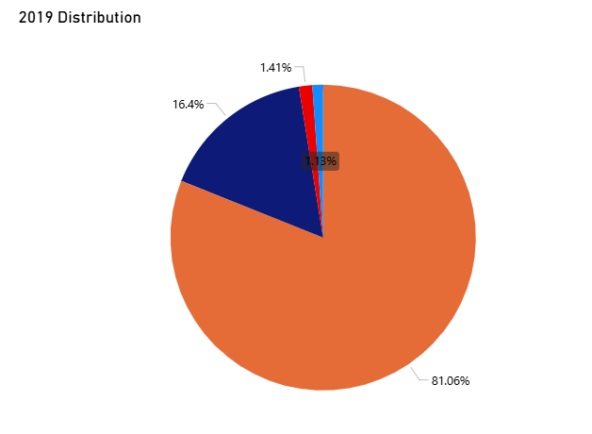
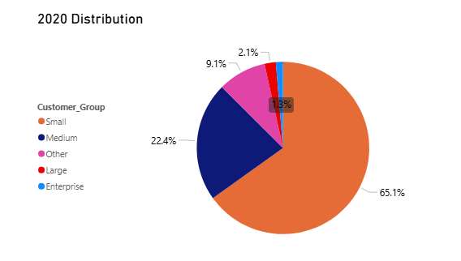
Pandemic Effects Across Customer Segments (1/2)
Small Customers: Experienced a substantial decline (-15.96%), suggesting they were disproportionately impacted by the pandemic (closures/consolidation).
Medium Customers: showed significant growth (+6%).
Large Customers: the highest percentage growth (+0.67%), confirming volume acquisition in the higher-tier segments.
A new segment of customer emerged in 2020 which we categorized as others. They had volumes lower than 1k and they contributed 9.1% of 2020 volumes.

Slide 19
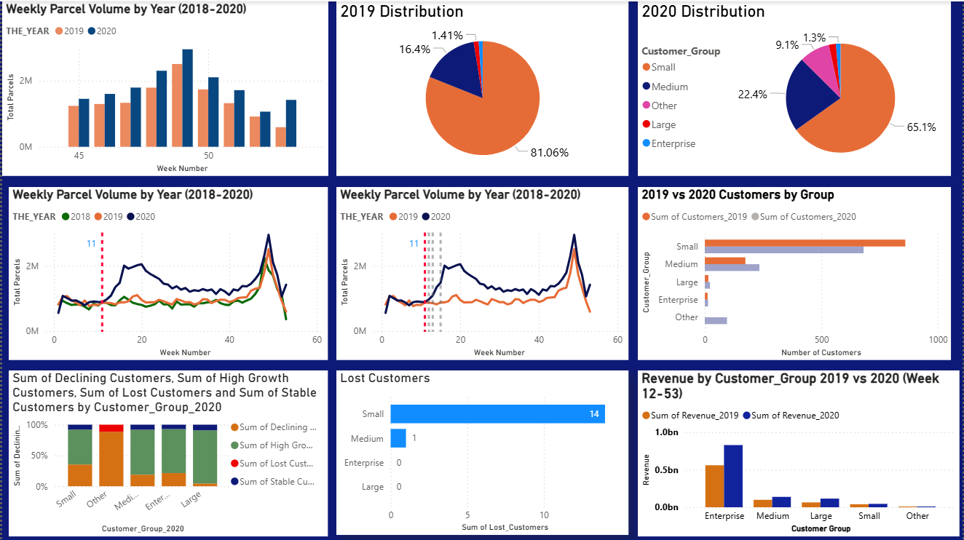

Slide 20
