Slide 1

The COVID-19 Impact on ABC Company’s Parcel Delivery Business
By: Evelyn & Gracious
DATE: Dec 2025

Slide 2
Table Of Contents
1.
Executive Summary
2.
When were customer volumes first impacted by COVID-19?
3.
What events within the COVID timeline may have contributed to the change?
4.
How did COVID-19 impact peak season in 2020?
5.
How has COVID affected different customer groups (Enterprise, Large, etc.)?
6.
What % of each customer group is growing, stable, or declining?
7.
What % of each group are new customers during COVID?
8.
What % of 2019 customers in each group were lost?
9.
What was the overall impact on volume and revenue by group?

Slide 3
Executive Summary
Volume Surge:
Key Inflection Point:
Parcel volume increased by +47.84% during the COVID Observation Period (Week 12–53, 2020 vs 2019), well above the pre-COVID baseline (ISGR: +11.40%).
The shift began abruptly after Week 11, 2020, driven by the WHO pandemic declaration and subsequent work-from-home mandates.
Segment Health:
Profitability:
1046 customer base in 2020, from which 56% of the customers were high growth accounts, 7% stable accounts, 36% declining accounts and 1% lost accounts during the pandemic. The highest revenue impacting accounts were from enterprise group confirming that established customers drove the majority of the volume surge.
Despite the high number of customers, the Small/other customer segments showed high volatility (e.g., 42% of these groups were Declining), suggesting a high-risk, low-value portion of the new market.

Slide 4
How COVID-19 impact ABC Company’s parcel business
Metric
2019 (Wk 12–53)
2020 (Wk 12–53)
% Change
Parcel Volume
43,110,710
63,735,887
+47.84%
Active Customers
1,060
1,035
-2.36%
Parcel Volume: Increased by 47.84% during COVID (Week 12–53, 2020 vs 2019 same period). This suggests that revenue likely grew by a similar percentage during the same period.
Active Customers: Slight decline of −2.36%, indicating stable customer retention with minor churn.
COVID drove accelerated e-commerce activity, resulting in above-normal growth compared to ISGR (11.40%).

Slide 5
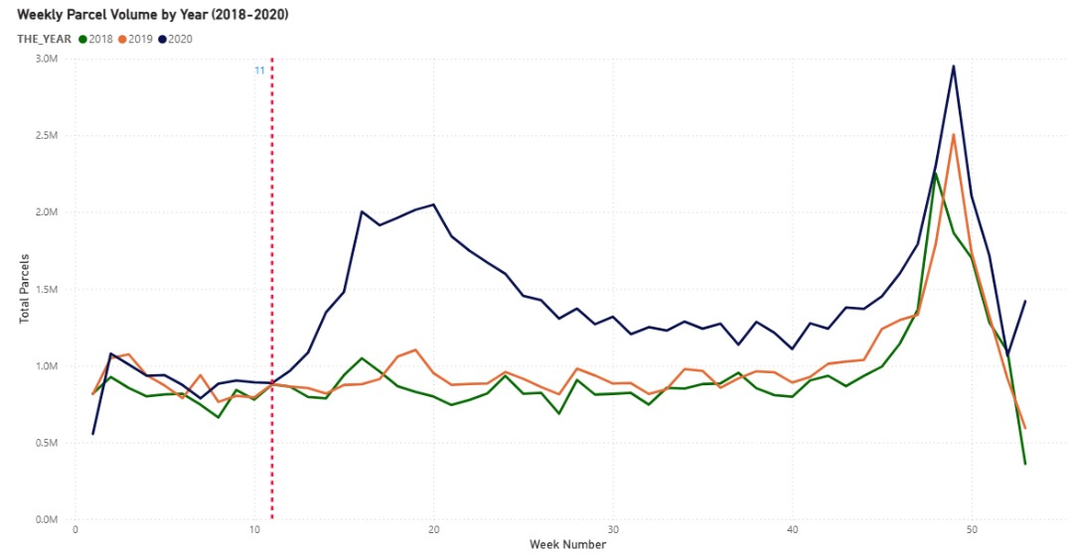
When Customer Volumes Were First Impacted
Pre COVID observation: Wk 1-11
Post COVID observation: Wk 12-53
Key Parcel Volume Insights
Pre-Shift: Volumes stable at 900K-1m until Week 11 (2020).
The Break
Volume diverged sharply starting Week 12 which was due to March Pandemic Declaration.
New Baseline
A new weekly baseline emerged (1.2m minimum).
2020 Peak
Record end-of-year peak reached 3.0M parcels.

Slide 6
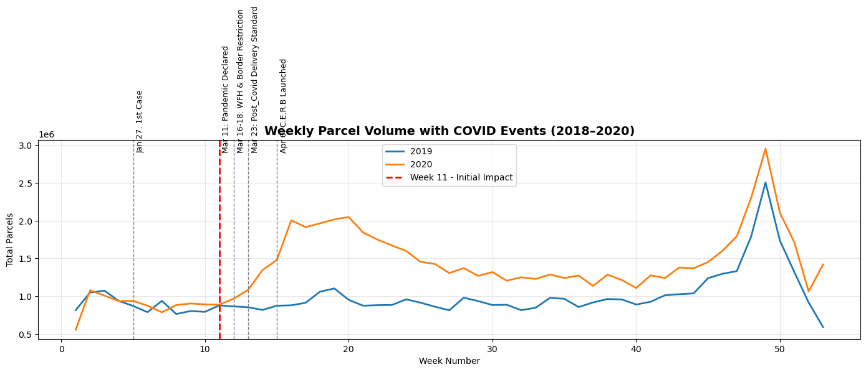
Key COVID-19 Events That Drove The Change

Slide 7
External Drivers & Timeline
NARRATIVE: A rapid sequence of events created the operational necessity for our growth.
Week 11 (Mar 11):
1
WHO declares COVID-19 a pandemic. Initial shift in consumer fear/buying.
Week 11 ended with 900k parcels by ABC.
2
Week 12 (Mar 16):
Work-From-Home Mandates & School Closures begin.
US/Canada border restriction
These were key drivers of e-commerce adoption and ABC ended with 1m parcels.
Week 13 (Mar 23):
3
Emergency Declarations and new Post-COVID Delivery Standards implemented.
4
Week 15 (Apr 6):
Government Income Support (e.g., CERB) programs launched. And for ABC, 1.5m parcels delivered in week 15 and 2m in week 16 indicating sustained increase in business and increasing disparity with same period 2019.

Slide 8
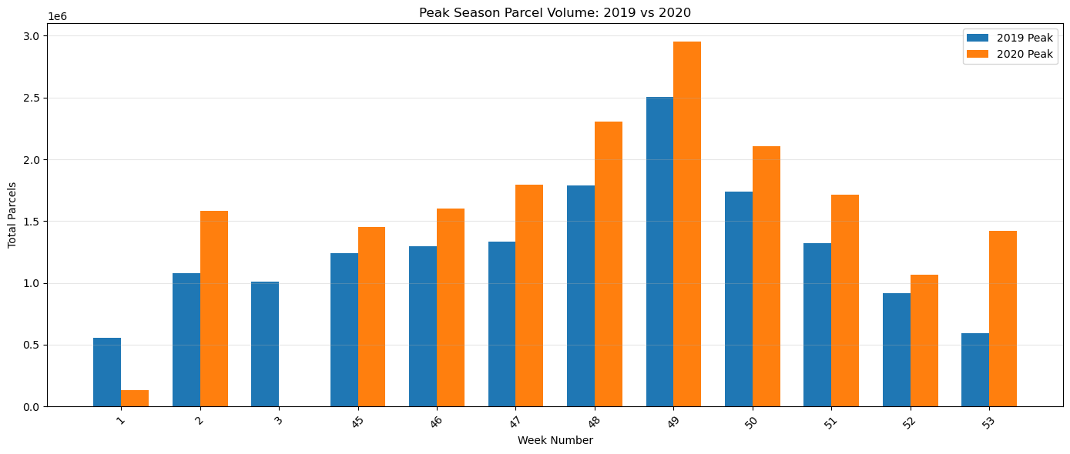
COVID-19’s Impact on 2020 Peak Season
2020 Volume Surge: 2020 volumes were consistently higher than 2019, confirming that COVID-19 significantly increased peak season parcel demand.
Strategic Insight: ABC should expect a higher baseline post-pandemic due to accelerated customer habit formation (Shift to online shopping)

Slide 9
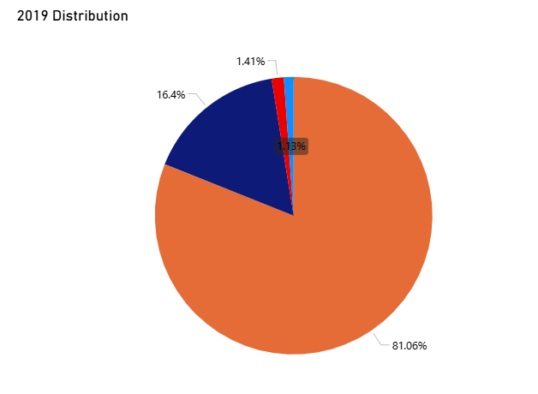
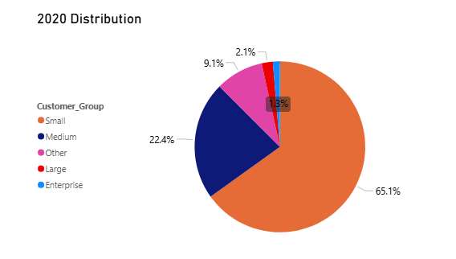
Pandemic Effects Across Customer Segments (1/2)
Small Customers: Experienced a substantial decline (-15.96%), suggesting they were disproportionately impacted by the pandemic (closures/consolidation).
Medium Customers: showed significant growth (+6%).
Large Customers: the highest percentage growth (+0.67%), confirming volume acquisition in the higher-tier segments.
A new segment of customer emerged in 2020 which we categorized as others. They had volumes lower than 1k and they contributed 9.1% of 2020 volumes.

Slide 10
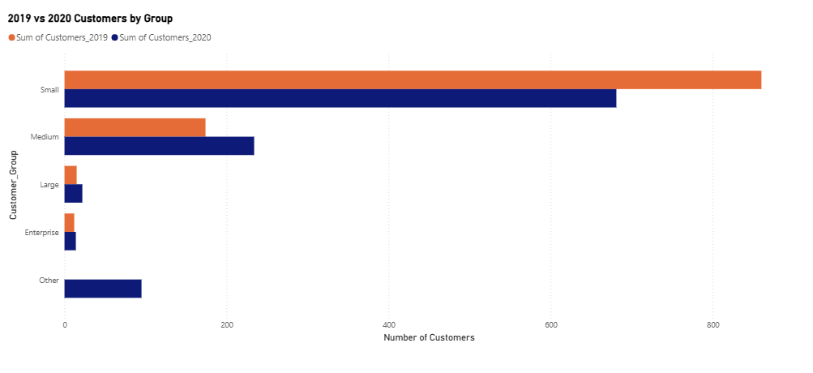
Pandemic Effects Across Customer Segments (2/2)
Enterprise Customers: Slight increase from 12 → 14 (+16.67%).
Large Customers: Noticeable growth from 15 → 22 (+46.67%).
Medium Customers: Significant growth from 174 → 234 (+34.48%).
Small Customers: Decrease from 860 → 681 (-20.81%).
Other: 95 new customers in 2020 appear in “Other” (9.08% of total with balances below 1k). Very low-volume accounts that did not fit into standard categories in 2020.

Slide 11
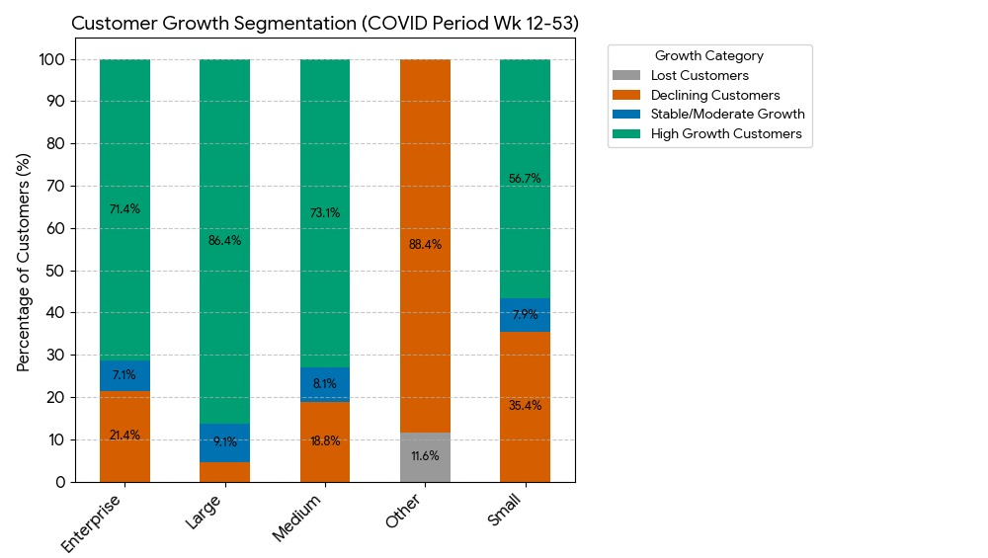
Customer Group Performance Status Breakdown
Key Observations
Enterprise Customers
  71.43% experienced high growth, reflecting significant parcel increases. 21.43% declined and 7.1% stable.
Large Customers
  86.36% high growth, 4.55% declined, 9.09% stable.
Medium Customers
  73.08% high growth, 18.8% declined, 8.12% stable.
Small → Other Transition
  “Other” represents downgraded small customers.
  88.42% declined, 11.58% lost.
Small Customers
  56.68% high growth, 7.93% stable.
  35.39% declined, showing vulnerability in smaller accounts.

Slide 12
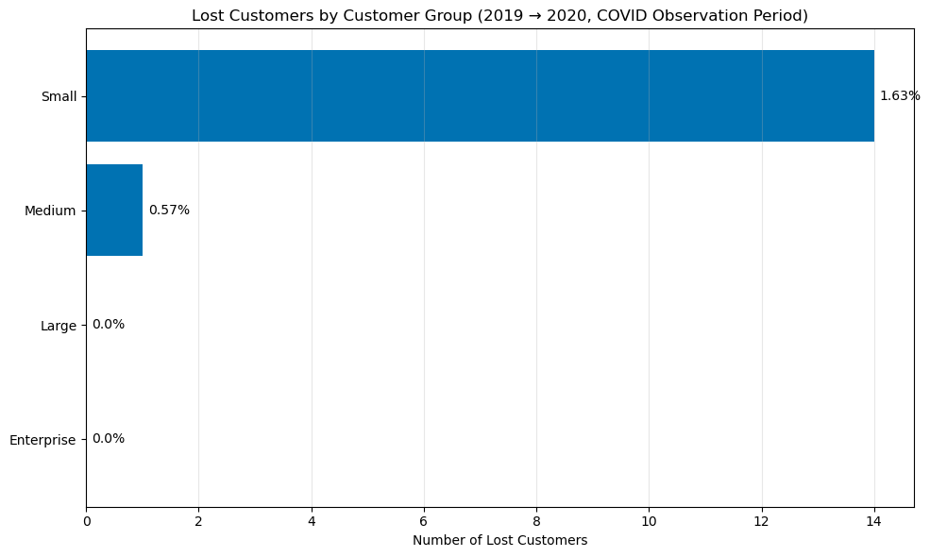

Percentage of New & Lost Customers by Group
Lost customers: Mostly in Small group (drop of 14 of Small customers and 1 medium).
Retention of Small customers could improve profitability.
No new customer was recorded in 2020.

Slide 13
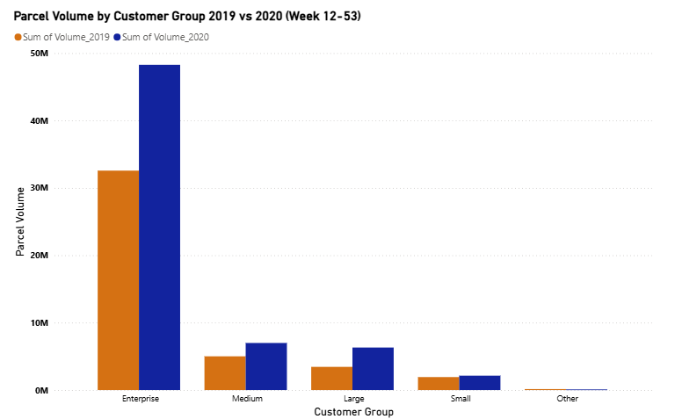
Impact on Volume
Overall Performance
2020 Volume grew significantly above 2019 rate, confirming a pandemic-driven spike. Volume trend shows a drastic positive change after Week 11, coinciding with the WHO declaration and lockdowns.
Customer Base
Volume growth was primarily driven by high-value clients (Enterprise). Small customers were the source of volume decline, suffering a 20.81% decline in active accounts.
Strategy
The 2020 peak season exceeded 2019 volumes, confirming a record holiday surge. Operational planning must now account for the new, elevated peak volume baseline which would likely continue to an extent in 2021 due to change in customer shopping habit.

Slide 14
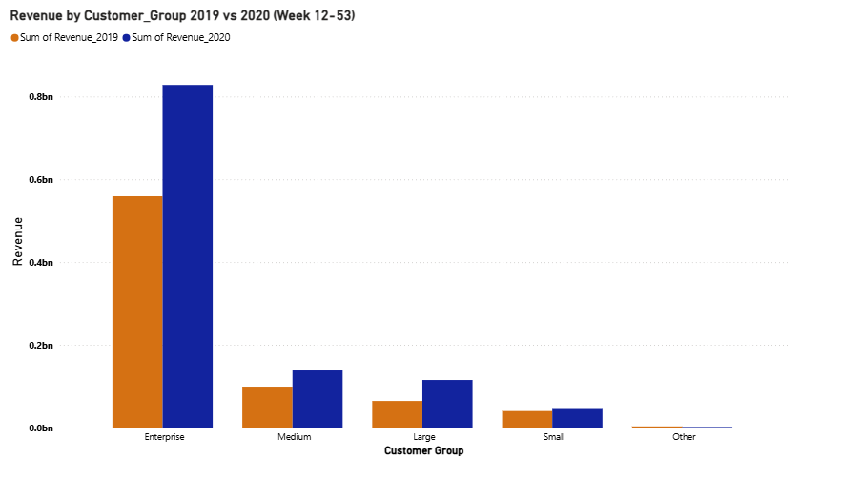
Impact on Revenue
Overall Performance
Revenue grew significantly above the normal rate, aligning with the volume spike.

Slide 15
Thank You

Slide 16
