Slide 1
Obstacle Avoider Robotic Vehicle
Submitted by:

Slide 2
ABSTRACT
Our proposed project puts forward an obstacle avoider robotic vehicle that uses ultrasonic sensors for this purpose. The system uses an 8051 family microprocessor to achieve this functionality.
The robotic vehicle is designed to first track and avoid any kind of obstacles that comes it’s way. The vehicle achieves this smart functionality with the help of ultrasonic sensors coupled with an 8051 microprocessor and motors. The entire system combined gives the vehicle an intelligent object detection and obstacle avoidance scheme.
This system allows the vehicle to guide itself in case it encounters any obstacle. The obstacle detection is done using the ultrasonic sensor. This is detected and a signal is passed on to the 8051 microcontroller. On receiving the signal it guides the vehicle in another direction by actuating the motors through the motor driver IC.

Slide 3
contents
Block diagram
Microcontroller 8052
ULTRASONIC
Motor Driver IC

Slide 4
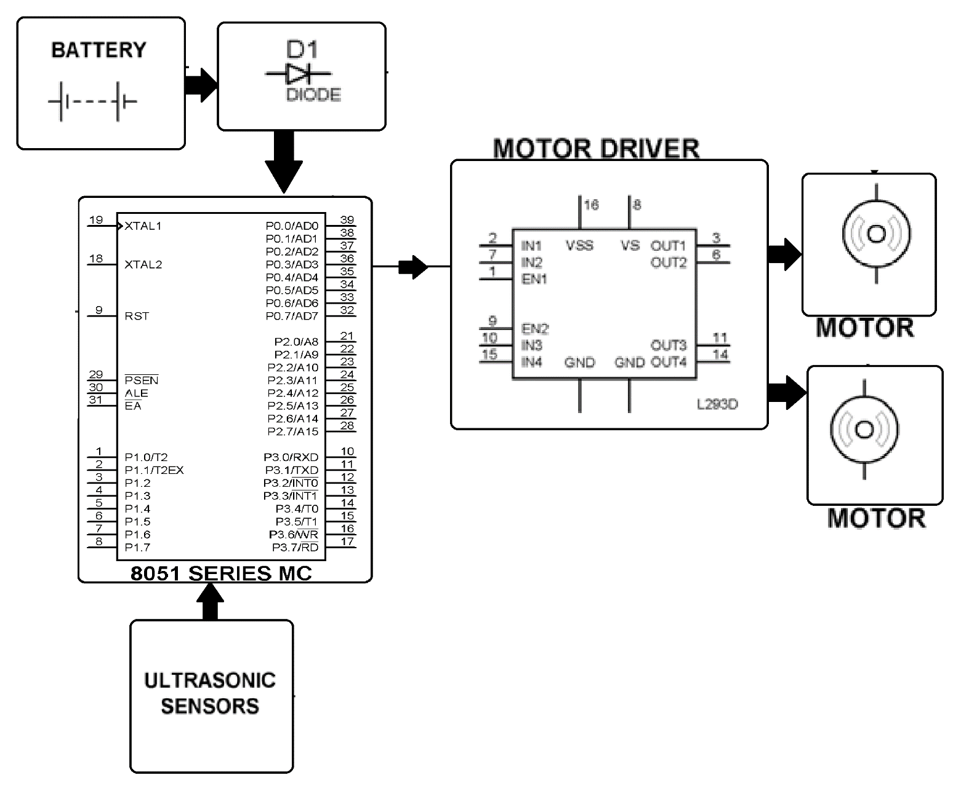
Block diagram

Slide 5
Features of MC 8052
8K Bytes of In-System Programmable (ISP) Flash Memory
4.0V to 5.5V Operating Range
Fully Static Operation: 0 Hz to 33 MHz
256 x 8-bit Internal RAM
32 Programmable I/O Lines
Three 16-bit Timer/Counters
Eight Interrupt Sources
Full Duplex UART Serial Channel

Slide 6
Block diagram of MC
External interrupts
On-chip ROM for program code
Timer/Counter
Interrupt Control
On-chip RAM
Timer 1
Counter Inputs
Timer 0
CPU
Bus Control
Serial Port
4 I/O Ports
OSC
P0 P1 P2 P3
TxD RxD
Address/Data

Slide 7
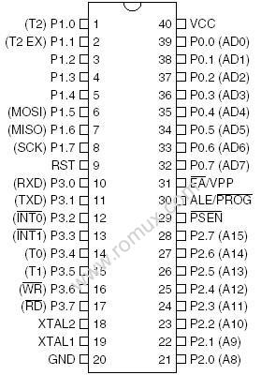
Pin out of 8052

Slide 8

Power on Reset circuit
+5V
+
10 uF
31
EA/VPP
X1
30 pF
19
11.0592 MHz
8.2 K
X2
30 pF
18
9
RST

Slide 9
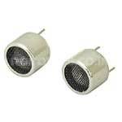
ULTRASONIC TRANSMITTER AND RECIVER
Ultrasonic sensors (also known as transceivers) work on a principle similar to radar or sonar which evaluate attributes of a target by interpreting the echoes from radio or sound waves respectively.
Ultrasonic sensors generate high frequency sound waves and evaluate the echo which is received back by the sensor.

Slide 10
Ultrasonic generators use piezoelectric materials such as zinc or lead zirconium tartrates or quartz crystal.
The material thickness decides the resonant frequency when mounted and excited by electrodes attached on either side of it.
The medical scanners used for abdomen or heart ultrasound are designed at 2.5 MHz. In this circuit, a 40 kHz transducer is used for object detection in the air medium.
FEATURES
Use for motion or distance sensing
Frequency: 40kHz ±1.0kHz
Aluminum case
Capacitance: 2000Pf ±20%
Transmitter: bandwidth 5.0kHz/100Db, sound pressure level
112Db/40 ±1.0kHz

Slide 11
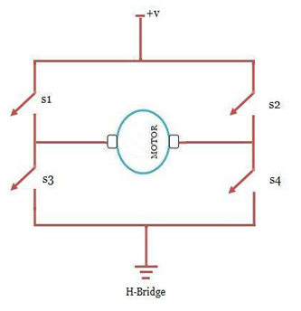
MOTOR driver L293D
L293D is a dual H-bridge motor driver integrated circuit (IC).
Motor drivers act as current amplifiers since they take a low-current control signal and provide a higher-current signal.
This higher current signal is used to drive the motors.
L293D contains two inbuilt H-bridge driver circuits. In its common mode of operation, two DC motors can be driven simultaneously, both in forward and reverse direction.

Slide 12
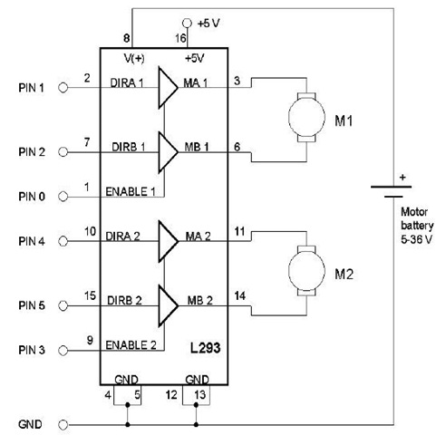
Operation of motor driver
L293D has 2 set of arrangements where one set has input 1, input 2, output 1 and output 2 and other set has input 3, input 4, output 3 and output 4, according to block diagram if pin no 2 & 7 are high then pin no 3 & 6 are also high.
If enable 1 and pin number 2 are high leaving pin number 7 as low then the motor rotates in forward direction.
If enable 2 and pin number 10 are high leaving pin number 15 as low then the motor rotates in forward direction.

Slide 13
Contd..
If enable 1 and pin number 2 are low leaving pin number 7 as high then the motor rotates in reverse direction.
If enable 2 and pin number 15 are high leaving pin number 10 as low then the motor rotates in forward direction.

Slide 14
Software requirements
Keil an ARM Company makes C compilers, macro assemblers, real-time kernels, debuggers, simulators, integrated environments, evaluation boards, and emulators for ARM7/ARM9/Cortex-M3, XC16x/C16x/ST10, 251, and 8051 MCU families.
Compilers are programs used to convert a High Level Language to object code. Desktop compilers produce an output object code for the underlying microprocessor, but not for other microprocessors.

Slide 15
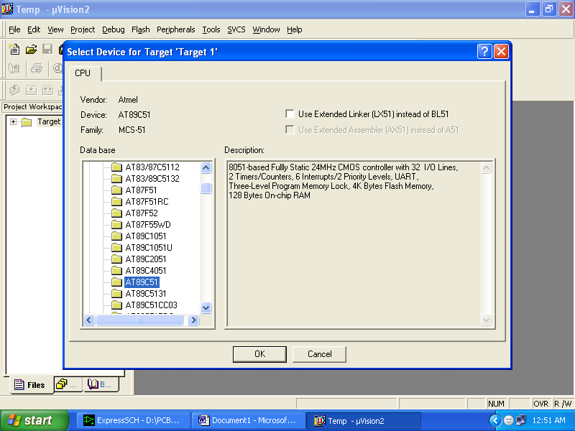
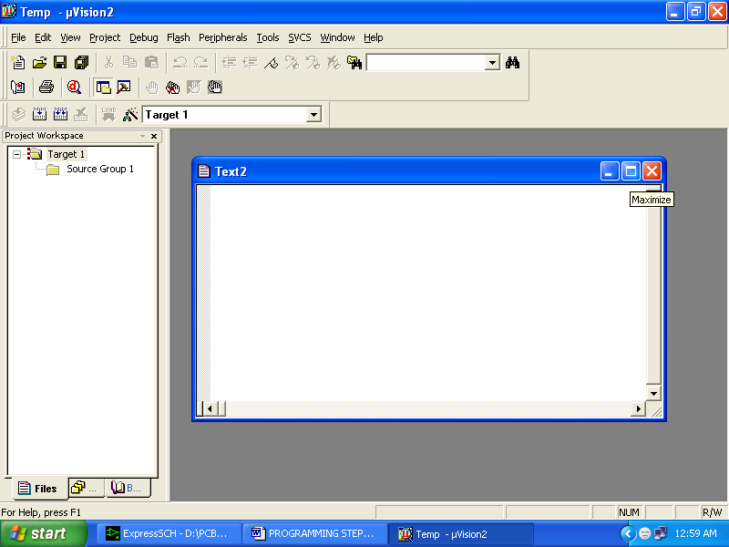
Contd..
i.e., the programs written in one of the HLL like ‘C’ will compile the code to run on the system for a particular processor like x86 (underlying microprocessor in the computer).
For example compilers for Dos platform is different from the Compilers for Unix platform So if one wants to define a compiler then compiler is a program that translates source code into object code.

