Slide 1
Security (XML)
> bin\add-user.bat
//add application users with roles
web.xml
<login-config> <auth-method>BASIC</auth-method> <realm-name>default</realm-name> </login-config>
auth-method – определяет каким образом пользователь передаст данные для своей аутентификации
realm – определяет откуда сервер возьмет данные для аутентификации и авторизации пользователя (если в приложении не указан, то будет использоваться дефолтный realm севера приложений)

Slide 2
HttpServletRequest (security)
String getAuthType();
String getRemoteUser();
boolean isUserInRole(String role);
Principal getUserPrincipal();
void login(String username, String password)
throws ServletException;
void logout() throws ServletException;
boolean authenticate(HttpServletResponse response)
throws IOException, ServletException;

Slide 3
Security (user defined)
@WebServlet("/auth-test")
public class AuthTestServlet extends HttpServlet {
@Override
protected void doGet(HttpServletRequest req, HttpServletResponse resp)
throws ServletException, IOException {
Principal principal = req.getUserPrincipal();
if (principal == null || !req.isUserInRole("employee")) {
req.getSession().setAttribute("RET_ADDR", req.getRequestURI());
LoginServlet.forwardToLogin(req, resp, null);
return;
}
//req.changeSessionId();
resp.setContentType("text/html");
PrintWriter writer = resp.getWriter();
writer.println("Welcome to the secured app!");
writer.printf("<br/>User: " + req.getRemoteUser());
writer.printf("<br/>time: " + LocalDateTime.now());
writer.println("<br/><a href='logout'>Logout</a>");
}
}

Slide 4
Security (user defined 2)
login.jsp
<html><body>
<div style="color:red">
<%
Object msg = request.getAttribute("errorMsg");
if(msg != null ){
out.println(msg);
}
%>
</div>
<form action="login" method="post">
<table>
<tr>
<td>User:</td>
<td><input type="text" name="theUser"/></td>
</tr>
<tr>
<td>Password:</td>
<td><input type="password" name="thePassword"/></td>
</tr>
</table>
<input type="submit" value="Submit"/>
</form>
</body></html>

Slide 5
Security (user defined 3)
@WebServlet("/login")
public class LoginServlet extends HttpServlet {
@Override
protected void doPost(HttpServletRequest req, HttpServletResponse resp)... {
try {
req.login(req.getParameter("theUser"),
req.getParameter("thePassword"));
} catch (ServletException e) {
forwardToLogin(req, resp, "Error: " + e.getMessage());
return;
}
if (req.getUserPrincipal() != null && req.isUserInRole("employee")) {
Object ret_addr = req.getSession().getAttribute("RET_ADDR");
resp.sendRedirect(ret_addr == null ? "" : ret_addr);
} else {
forwardToLogin(req, resp, "Login failed.");
}
}
public static void forwardToLogin(HttpServletRequest req,
HttpServletResponse resp, String errorMessage) ... {
req.setAttribute("errorMsg", errorMessage);
req.getRequestDispatcher("/login.jsp").forward(req, resp);
}
}

Slide 6
Security (user defined 4)
@WebServlet("/logout")
public class LogoutServlet extends HttpServlet {
@Override
protected void doGet(HttpServletRequest req, HttpServletResponse resp)
throws ServletException, IOException {
req.logout();
if (req.getUserPrincipal() != null) {
throw new ServletException("Cannot log out the user");
}
HttpSession session = req.getSession(false);
if (session != null) {
session.invalidate();
}
resp.sendRedirect("");
}
}

Slide 7
Security (XML)
web.xml
<security-constraint> <web-resource-collection> <web-resource-name>secure</web-resource-name> <url-pattern>/rest/*</url-pattern> <http-method>GET</http-method> </web-resource-collection> <auth-constraint> <role-name>employee</role-name> </auth-constraint> </security-constraint> <login-config> <auth-method>BASIC</auth-method> <realm-name>default</realm-name> </login-config>
BASIC – сервер сам показывает простую форму для ввода логина/пароля
FORM – вы создаете форму которая запрашивает логин/пароль
DIGEST – в header-е запроса передается логин и хэш от логина+пароля
CLIENT-CERT – аутентификация на основе сертификата

Slide 8
Security (annotation)
@ServletSecurity( @HttpConstraint(rolesAllowed = {"employee"}) ) @WebServlet(...) public class BaseServlet extends HttpServlet { }
@ServletSecurity(
httpMethodConstraints = {
@HttpMethodConstraint(value = "GET", rolesAllowed = {"employee"}),
@HttpMethodConstraint(value = "POST", rolesAllowed = {"director"})
}
)
@ServletSecurity(
httpMethodConstraints = {
@HttpMethodConstraint(value = "GET", rolesAllowed = {"employee"}),
@HttpMethodConstraint(value = "POST", rolesAllowed = {"director"})
},
value = @HttpConstraint(value = ServletSecurity.EmptyRoleSemantic.DENY)
)
@ServletSecurity(value = @HttpConstraint(rolesAllowed = "R1"),
httpMethodConstraints = @HttpMethodConstraint("GET")) //For GET no check
//XML приоритетнее аннотаций !

Slide 9
Security (form based)
web.xml
<security-constraint>
<web-resource-collection>
<web-resource-name>security</web-resource-name>
<url-pattern>/*</url-pattern>
</web-resource-collection>
<auth-constraint>
<role-name>employee</role-name>
</auth-constraint>
<user-data-constraint>
<transport-guarantee>CONFIDENTIAL</transport-guarantee>
</user-data-constraint>
</security-constraint>
<login-config>
<auth-method>FORM</auth-method>
<form-login-config>
<form-login-page>/loginform.html</form-login-page>
<form-error-page>/loginerror.html</form-error-page>
</form-login-config>
</login-config>
CONFIDENTIAL - SSL

Slide 10
Security (form based 2)
loginform.html
<form action="j_security_check" method=post>
<input type="text" name="j_username"><br>
<input type="password" name="j_password"><br>
<input type="submit" value="Submit">
<input type="reset" value="Reset">
</form>
loginerror.html
<html>
<c:url var="url" value="/index.jsp"/>
<h2>Invalid user name or password.</h2>
<p>Click here to <a href="${url}">Try Again</a></p>
</html>

Slide 11
Security (jdbc realm)
security_user
security_user_role
security_role
id
username
password
user_id
role_id
Id
name
@Entity
@Table(name = "security_user")
public class User {
@Id
@GeneratedValue(strategy = GenerationType.SEQUENCE)
public Long id;
public String username;
public String password;
@ManyToMany
@JoinTable(name = "security_user_role",
joinColumns = @JoinColumn(name = "user_id"),
inverseJoinColumns = @JoinColumn(name = "role_id"))
public List<Role> roles;
}
INSERT INTO security_user(id, username, password) VALUES (nextval('hibernate_sequence'), 'anton', encode(sha256('password'), 'hex'));
INSERT INTO security_role(id, name) VALUES (1, 'employee');
INSERT INTO security_user_role(user_id, role_id) select id, 1 from security_user where username = 'anton';

Slide 12
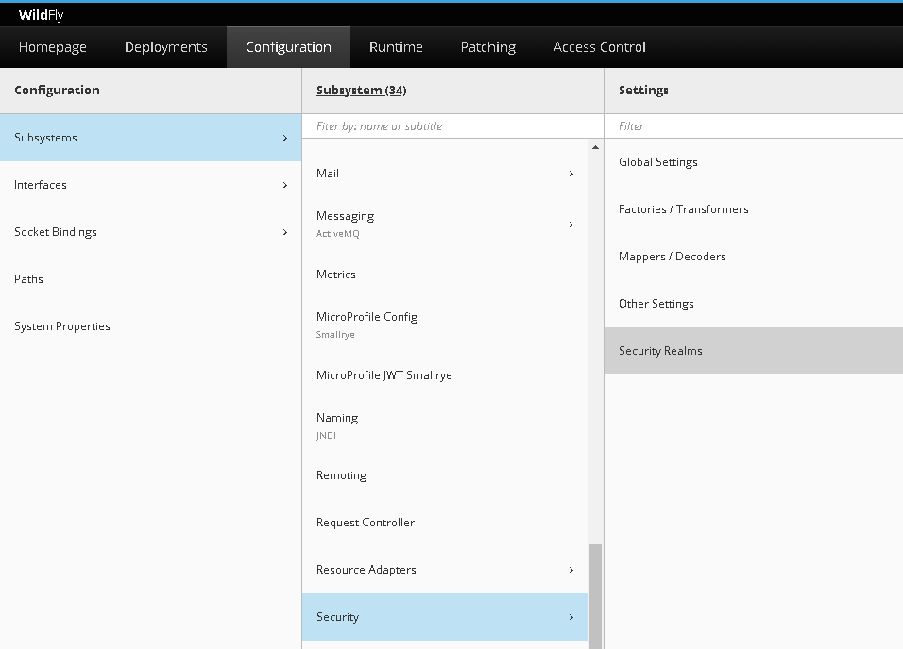
Security (jdbc realm 2)

Slide 13
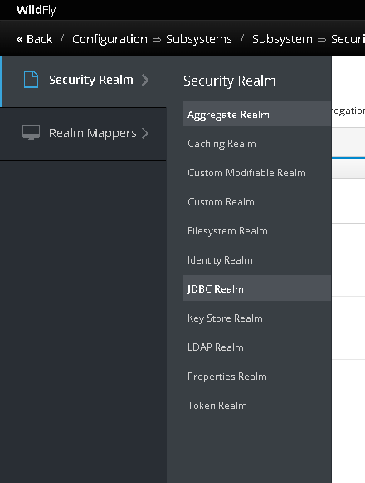
Security (jdbc realm 3)

Slide 14
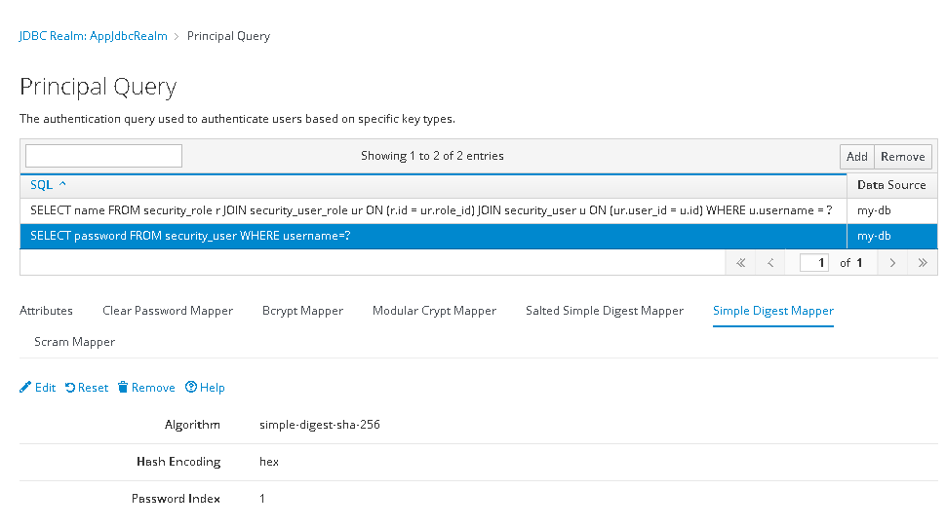
Security (jdbc realm 4)

Slide 15
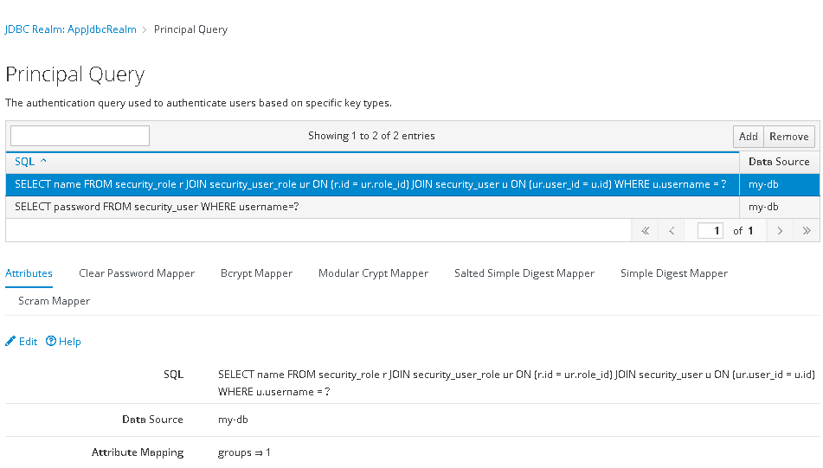
Security (jdbc realm 5)

Slide 16
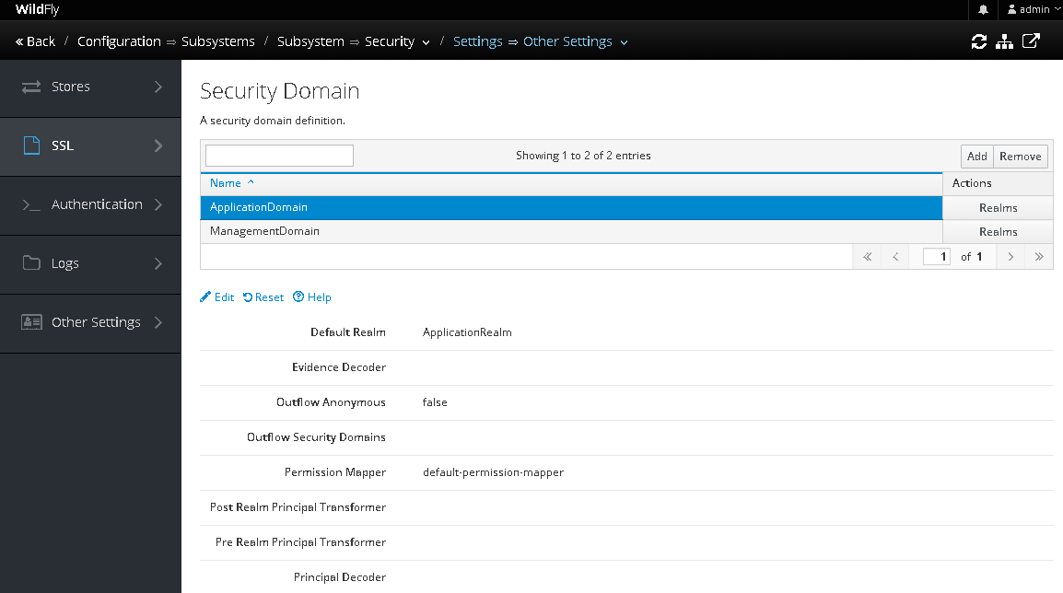
Security (jdbc realm 6)
Несколько источников данных для проверки
/subsystem=elytron/distributed-realm=DistributedRealm:add(realms=[Realm1, Realm2])

Slide 17
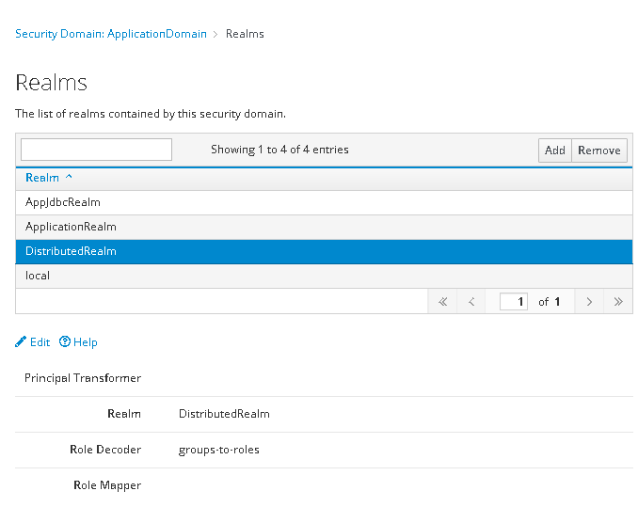
Security (jdbc realm 7)
Login Modules

