Slide 1

EDA Project on Housing DataSet
Younes ABAROUDI
08/27/2024

Slide 2
Project Overview
Objective: Transform raw housing data into a clean, model-ready dataset.
Key Steps:
Data Inspection
Data Cleaning
Feature Engineering
Exploratory Data Analysis (EDA)
Outlier Detection
Data Transformation and Consistency
Final Dataset Preparation

Slide 3
Initial Data Inspection
Actions Taken:
Checked dataset structure and summary statistics.
Assessed missing values and unique values per column.
Key Insights:
Identified columns with missing data.
Determined initial data types and distributions.
We will see in details the issues encountered while inspecting the dataset in the following slides.

Slide 4
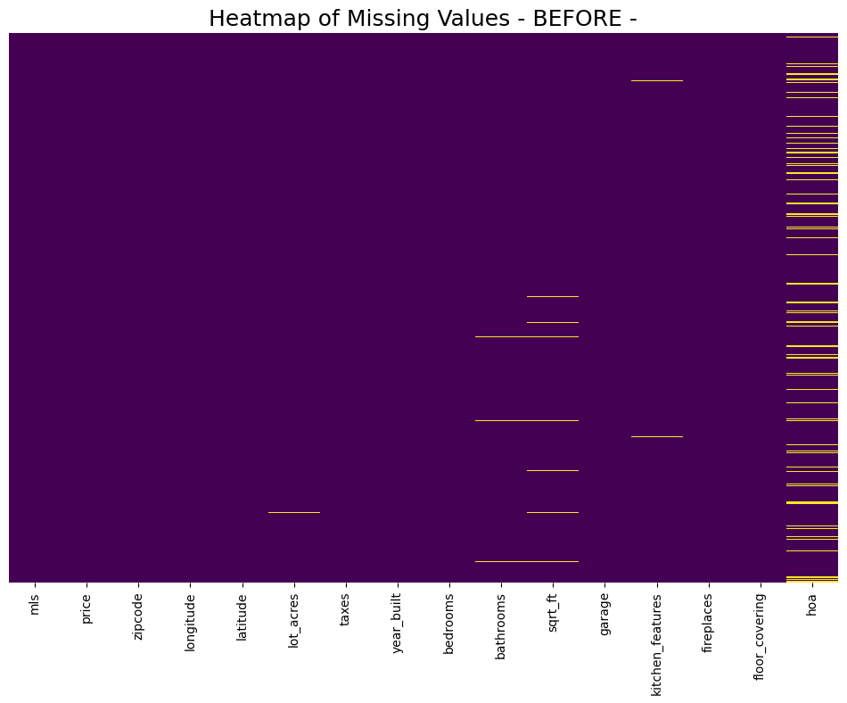
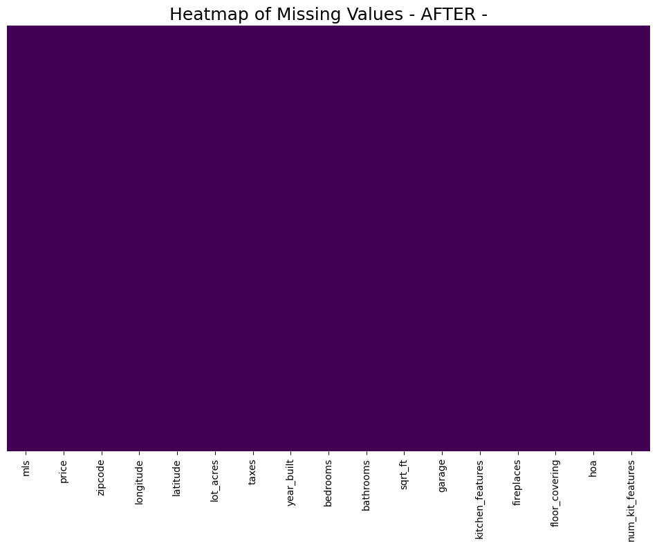
Data Cleaning
Handling Missing Values:
Dropped columns with more than 90% missing data → OK (no deletions)
Imputed missing numerical values with the median. → 79 + 1 = 80 cells imputed
Imputed missing categorical values with the mode. → 596 cells imputed
Column Renaming: Renamed columns for clarity and consistency.
'MLS' changed to "mls", 'sold_price' changed to "price", "HOA" changed to "hoa”

Slide 5
Feature Engineering
New Features:
Added a feature to count the number of kitchen features “num_kit_features”
Justification
Potential relationship between the number of kitchen features and the house price.

Slide 6
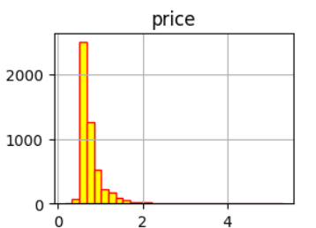
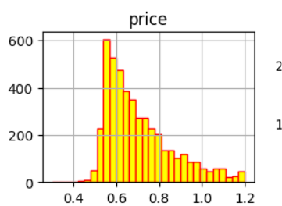
Outlier Detection
Method Used: IQR (Interquartile Range) Method
Process:
Calculated IQR for price.
Removed outliers beyond 1.5 times the IQR.
Reasoning: Price data was right-skewed; IQR method is more appropriate than Z-score.

Slide 7
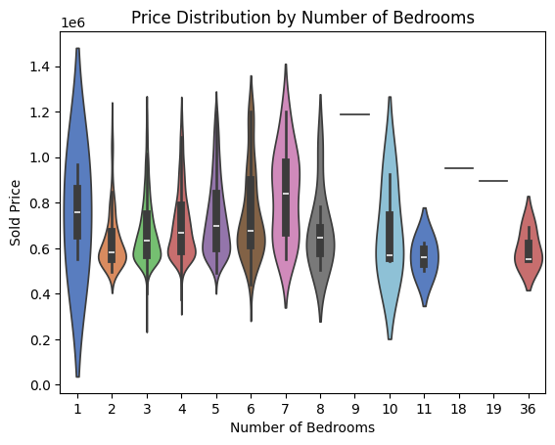
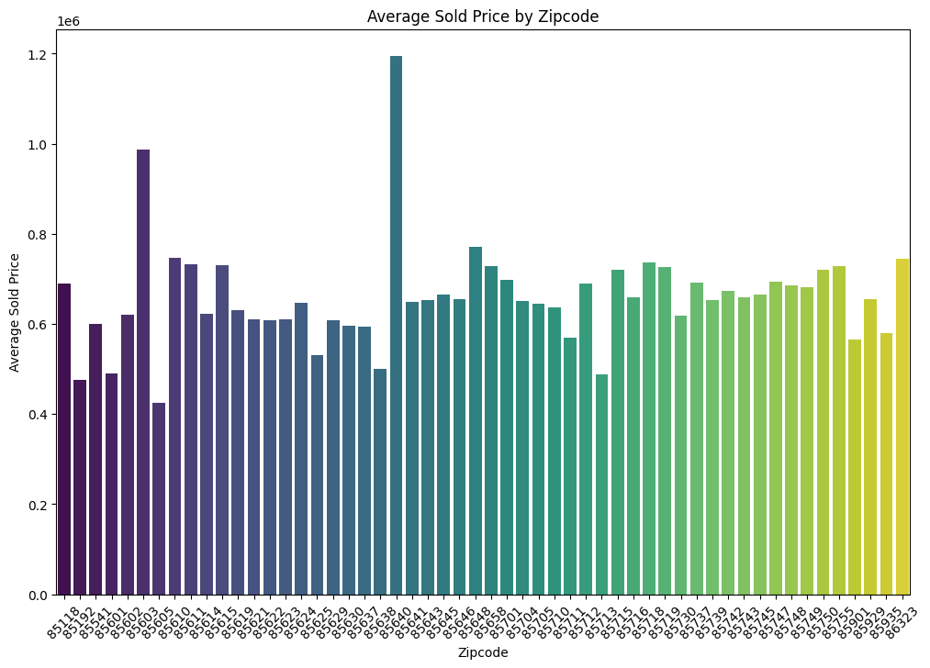
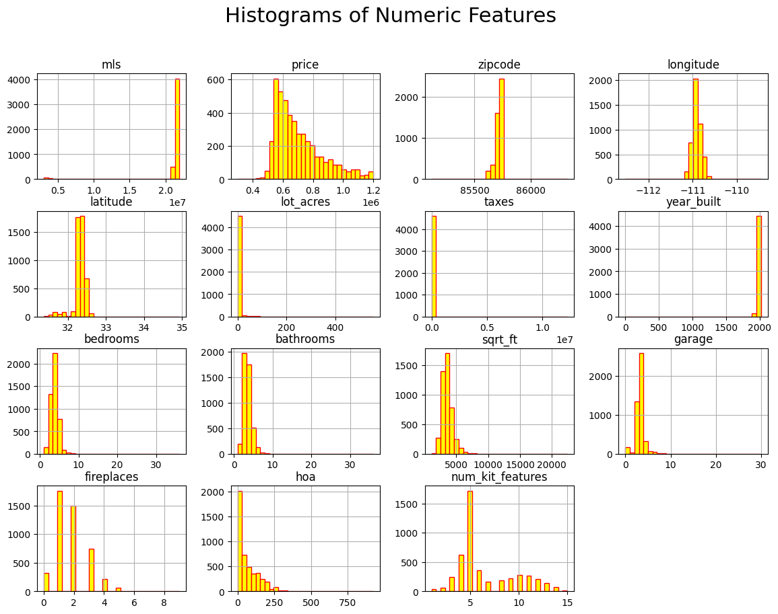
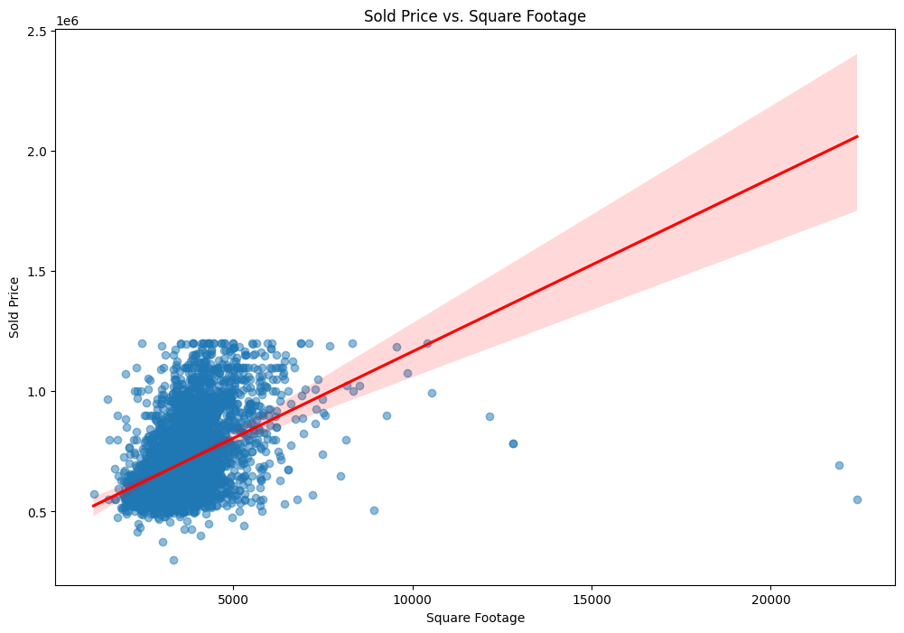
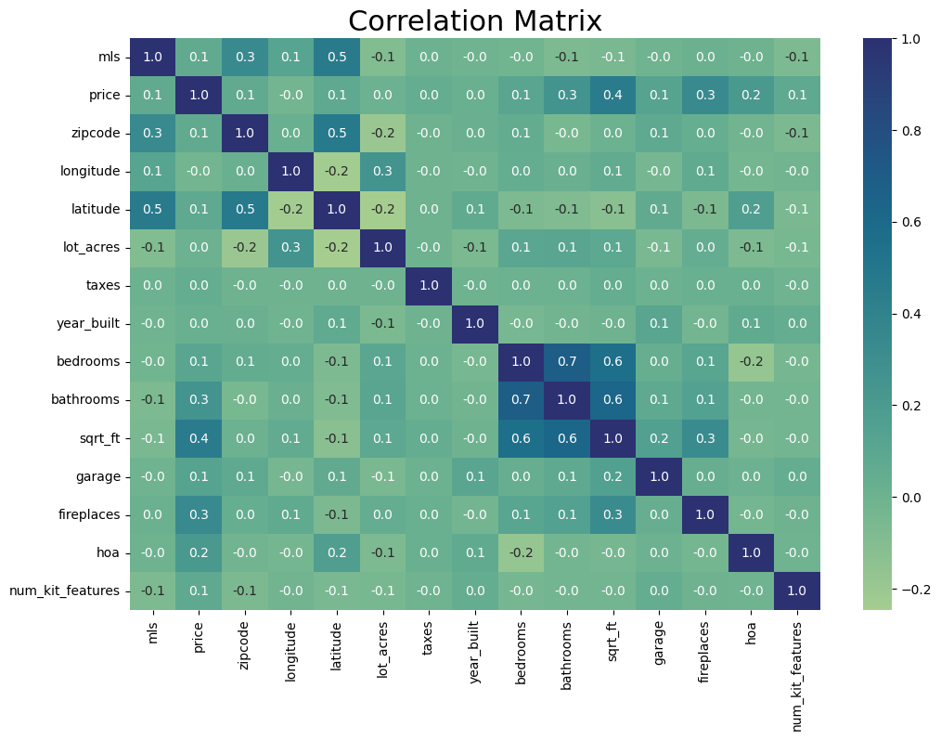
Exploratory Data Analysis (EDA)
Visualizations:
Key Findings:
Strong correlation between square footage and price.
Distribution of price across different numbers of bedrooms.

Slide 8
Data Transformation and Final Preparation
Data Consistency:
Converted data types for consistency (e.g., fireplaces, HOA).
Final Dataset:
Saved the cleaned dataset, ready for the modeling team.

Slide 9
Summary
In this project, we performed the following preprocessing steps:
Data inspection and missing value treatment.
Column renaming for consistency.
Handling of missing values using median/mode imputation.
Outlier detection and removal using the IQR method.
Feature engineering, such as calculating the number of kitchen features.
Ensuring data consistency through type conversions.

Slide 10
Annexe
GitHub Link
https://github.com/NyoYoAB/housingData_EDA

