Slide 1

EDA Project on Housing DataSet
Younes ABAROUDI
08/27/2024

Slide 2
Project Overview
Objective: Transform raw housing data into a clean, model-ready dataset.
Key Steps:
Data Inspection
Data Cleaning
Feature Engineering
Exploratory Data Analysis (EDA)
Outlier Detection
Data Transformation and Consistency
Final Dataset Preparation

Slide 3
Initial Data Inspection
Actions Taken:
Checked dataset structure and summary statistics.
Assessed missing values and unique values per column.
Key Insights:
Identified columns with missing data.
Determined initial data types and distributions.
We will see in details the issues encountered while inspecting the dataset in the following slides.

Slide 4
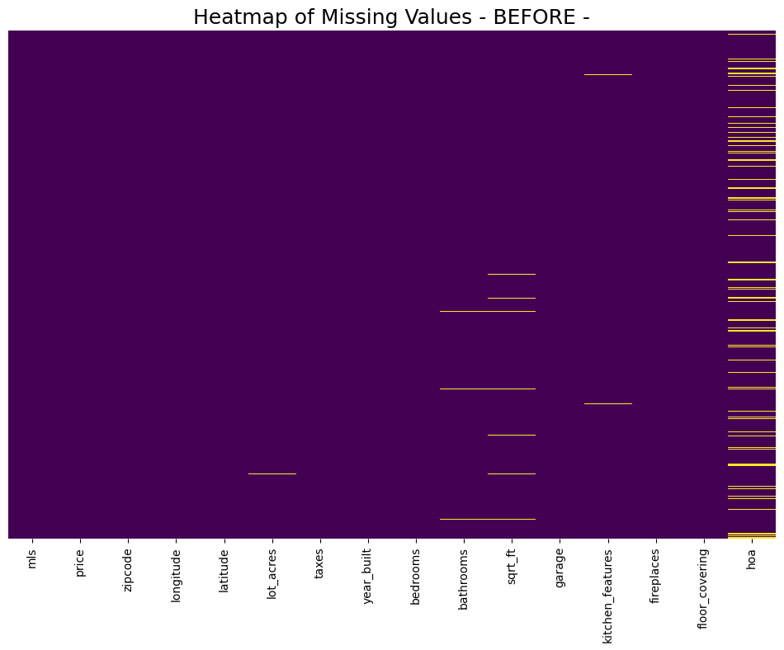
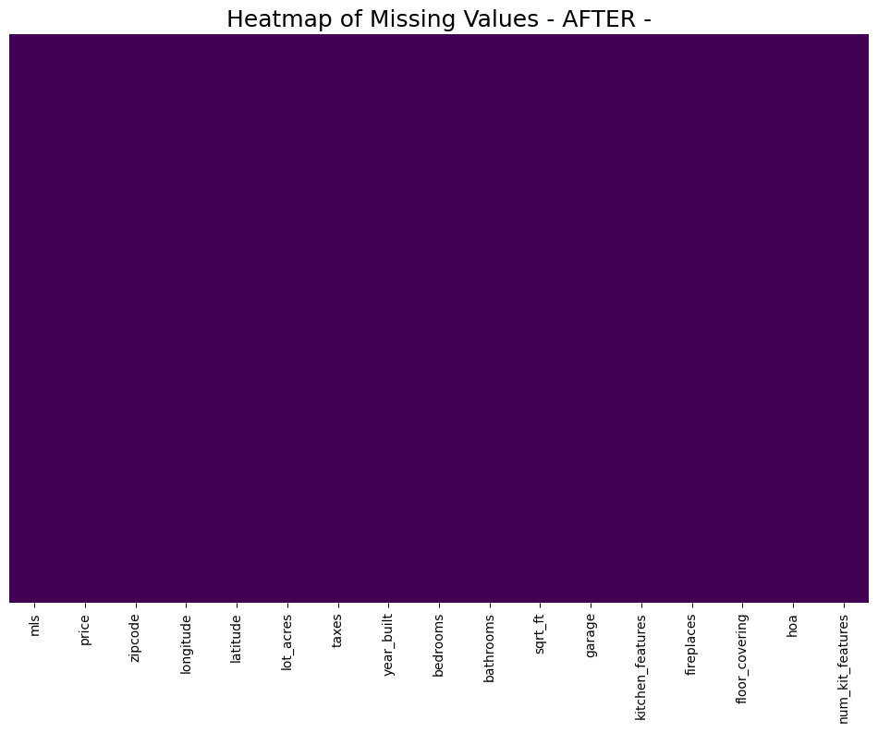
Data Cleaning
Handling Missing Values:
Dropped columns with more than 90% missing data → OK (no deletions)
Imputed missing numerical values with the median. → 79 + 1 = 80 cells imputed
Imputed missing categorical values with the mode. → 596 cells imputed
Column Renaming: Renamed columns for clarity and consistency.
'MLS' changed to "mls", 'sold_price' changed to "price", "HOA" changed to "hoa”

Slide 5
Feature Engineering
New Features:
Added a feature to count the number of kitchen features “num_kit_features”
Justification
Potential relationship between the number of kitchen features and the house price.

Slide 6
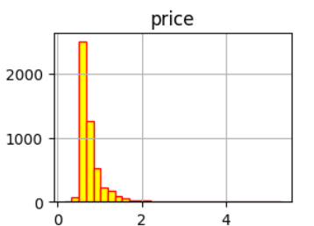
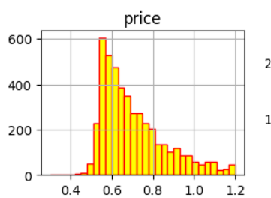
Outlier Detection
Method Used: IQR (Interquartile Range) Method
Process:
Calculated IQR for price.
Removed outliers beyond 1.5 times the IQR.
Reasoning: Price data was right-skewed; IQR method is more appropriate than Z-score.

Slide 7
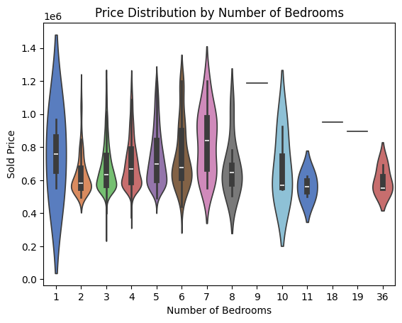
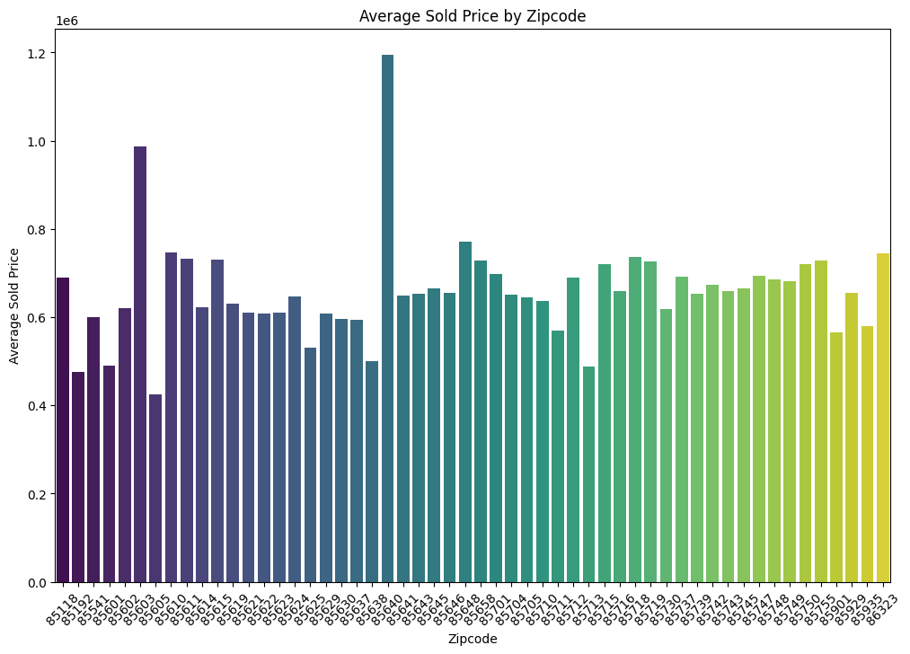
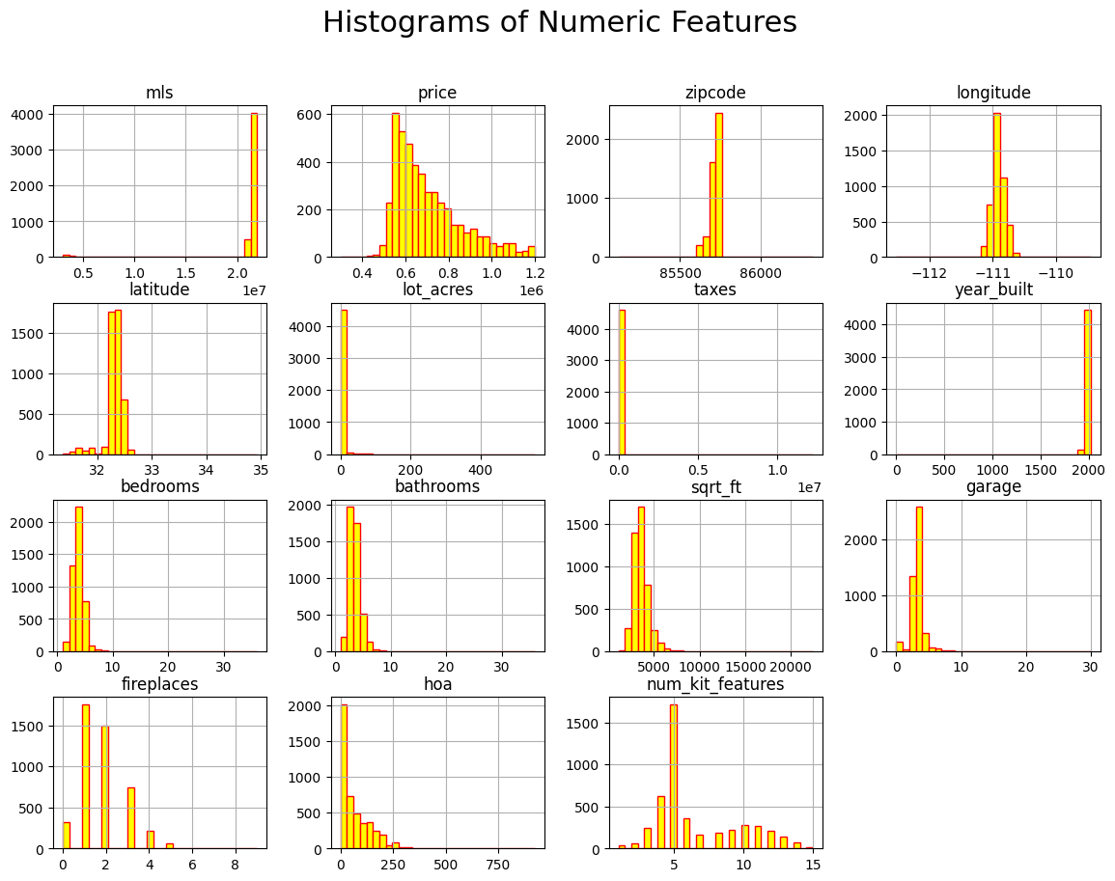
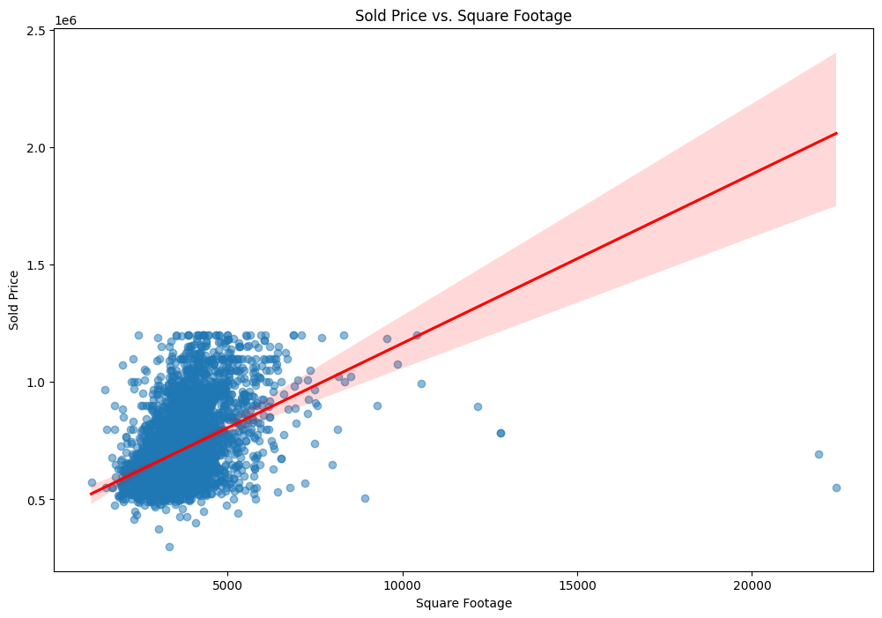
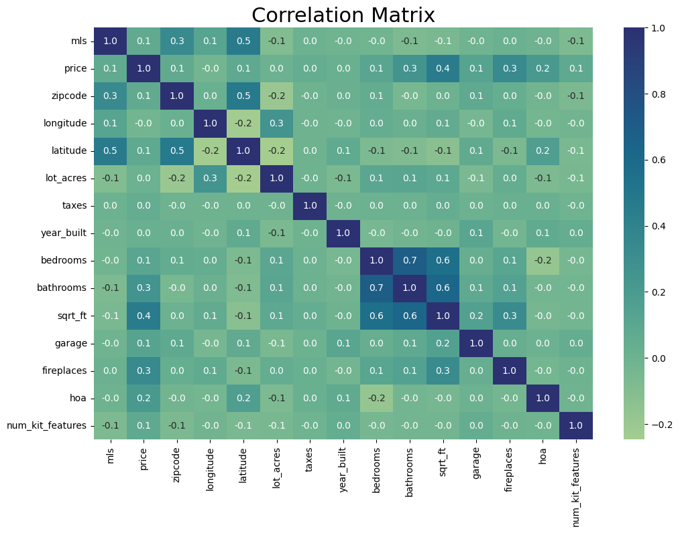
Exploratory Data Analysis (EDA)
Visualizations:
Key Findings:
Strong correlation between square footage and price.
Distribution of price across different numbers of bedrooms.
Houses located in 85638 seems to be more expensive than the rest.

Slide 8
Data Transformation and Final Preparation
Data Consistency:
Converted data types for consistency (e.g., fireplaces, HOA).
Final Dataset:
Saved the cleaned dataset, ready for the modeling team.

Slide 9
Summary
In this project, here is a takeaway:
5000 raws transformed to 4605 raws as a cleaned data-set.
16 features transformed to 17 features in the cleaned dataset after feature engineering (added « number of kitchen features »)
Data inspection and missing value handled efficiently.
Column renaming for consistency.
Handling of missing values using median/mode imputation.
Outlier detection and removal using the IQR method.
Ensuring data consistency through type conversions

Slide 10
Annexe
GitHub Link
https://github.com/NyoYoAB/housingData_EDA

