Slide 1

Note: The data and information in this document is reflective of a hypothetical situation and client. This document is to be used for KPMG Virtual Internship purposes only.
Sprocket Central Pty Ltd
Data analytics approach
[Division Name] - [Engagement Manager], [Senior Consultant], [Junior Consultant]

Slide 2
Note: The data and information in this document is reflective of a hypothetical situation and client. This document is to be used for KPMG Virtual Internship purposes only.
Agenda
Introduction
Data Exploration
Model Development
Interpretation

Slide 3
Note: The data and information in this document is reflective of a hypothetical situation and client. This document is to be used for KPMG Virtual Internship purposes only.
Introduction
3493 Customers Versus 101 Products
Sprocket Central Pty Ltd has 3494 customers who bought 20,000 products.
101 distinct products were bought from Sprocket Central ltd 20,000 times.
Sprocket sold products from 6 bands which includes; 'Solex', 'Trek Bicycles', 'OHM Cycles', 'Norco Bicycles', 'Giant Bicycles', 'WeareA2B'
4 different types of products:- ‘Standard', 'Road', 'Mountain', 'Touring'

Slide 4
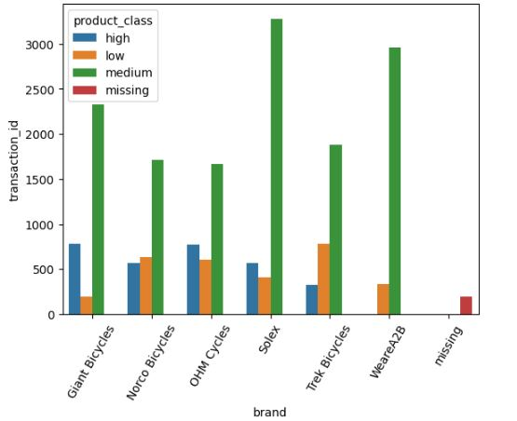
Note: The data and information in this document is reflective of a hypothetical situation and client. This document is to be used for KPMG Virtual Internship purposes only.
Data Exploration
Medium-Class products from [Solex, WeareA2B, Giant bicycles]
Medium class products from [Solex,WeareA2B,Giant bicycles] brand were the most bought by the customers.
Most revenue were from [Giant Bicycles, Solex] sales.
Giant Bicycles & Solex had most sale cancels though had the most sales.
Both owning cars and not owning cars were popular customers
Both gender were popular customers (to be specific females)
Those with deceased indicator “N” were the most popular customers.

Slide 5
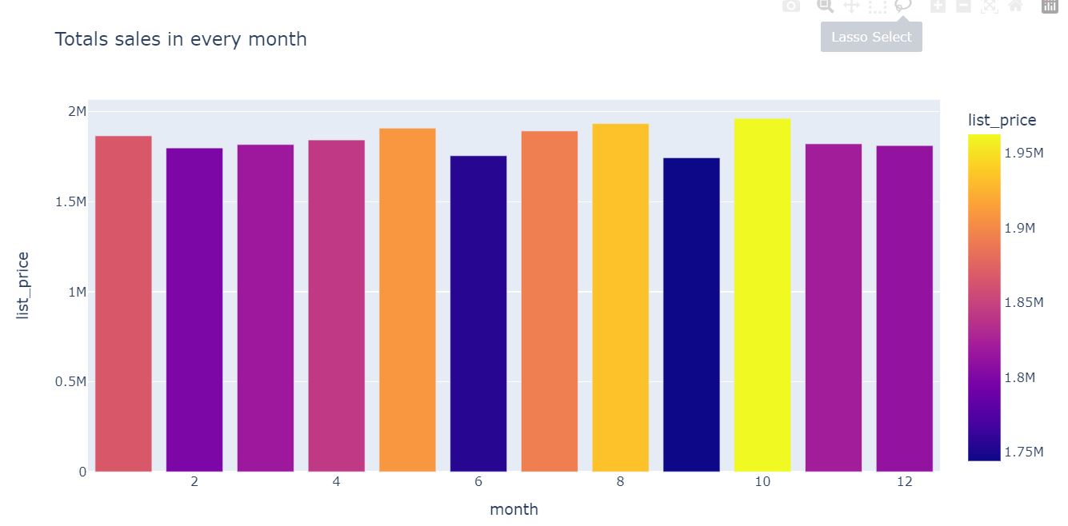
Note: The data and information in this document is reflective of a hypothetical situation and client. This document is to be used for KPMG Virtual Internship purposes only.
Data Exploration
Monthly Sales & Age-groups
Customers who are 50years and above hold 32% of the entire customers.
68% of the customers are considered to be young.
October had the highest sales
September had the lowest sales
There is no much variation in sales between the months

Slide 6
Note: The data and information in this document is reflective of a hypothetical situation and client. This document is to be used for KPMG Virtual Internship purposes only.
Model Development
Place headline insight or information here. This should be the most important point for this slide.
Place any information about this point here.
Place any supporting images, graphs, data or extra text here.

Slide 7
Note: The data and information in this document is reflective of a hypothetical situation and client. This document is to be used for KPMG Virtual Internship purposes only.
Interpretation
Place headline insight or information here. This should be the most important point for this slide.
Place any information about this point here.
Place any supporting images, graphs, data or extra text here.

Slide 8
Note: The data and information in this document is reflective of a hypothetical situation and client. This document is to be used for KPMG Virtual Internship purposes only.
Appendix

Slide 9
Note: The data and information in this document is reflective of a hypothetical situation and client. This document is to be used for KPMG Virtual Internship purposes only.
Appendix
This is an optional slide where you may place any supporting items.

