Slide 1
CSE437 • MACHINE LEARNING PROJECT
Early Prediction of
Player Churn in
Mobile Games
2.19M
gameplay events
converted into early
churn-risk signals
Comparative modeling • Explainable AI • Development holdout
Notes:
Introduce the main question: can early level-attempt behavior identify players who stop returning the following week? The project turns raw event logs into player-level predictors, compares four classifiers, and explains the selected model.
[Sources]
- Project repository and generated results
- Kaggle: Prediction of User Loss in Mobile Games

Slide 2
The dataset is mildly imbalanced — Group 2
8,158
2,658
labeled training players
development players
41
33.5%
engineered predictors
minority churn class
Primary metrics: AUROC • Precision • Recall | Additional: F1 • AUPRC
2
Notes:
Explain why this is Group 2: the minority class is between 5% and 40%. Therefore AUROC, precision, and recall are the required comparison metrics. F1 and AUPRC are included for additional context.
[Sources]
- data/raw/data/train.csv
- reports/split_summary.csv
- Course project metric guidance supplied by instructor

Slide 3
Workflow isolates the holdout from every selection decision
01
02
03
04
05
06
Raw logs
Clean + join
Aggregate
Tune
Select
Evaluate
2.19M
attempts
TSV parsing
metadata join
41 player
features
4 models
5-fold CV
CV AUROC
OOF threshold
Dev holdout
SHAP + errors
Training only
One final evaluation
3
Notes:
Walk left to right. The key methodological choice is the boundary after threshold selection: all feature preparation, tuning, winner selection, and threshold selection occur from training data. The development set is evaluated only once.
[Sources]
- src/build_features.py
- src/train_models.py
- reports/project_summary.md

Slide 4
Forty-one features summarize player behavior
Activity
Progress
Attempts, sessions, active days, observation span
Maximum level, unique levels, recent mean level
Performance
Time + difficulty
Success, failure, retries, help use, remaining steps
Recency, weekend/night share, duration, pass rate
Compared models: Logistic Regression • Random Forest • Histogram Gradient Boosting • XGBoost
4
Notes:
Describe how event rows become one feature vector per player. Emphasize that user_id is excluded and imputation happens inside each CV fold. Four model families range from a linear baseline to tree ensembles.
[Sources]
- src/build_features.py
- models/model_metadata.json

Slide 5
Random Forest wins a close four-model comparison
Selection rule
0.8067
Random Forest
5-fold CV AUROC
Why not Logistic Regression?
It had slightly higher dev AUROC, but the holdout cannot be used to change the selected model.
5
Notes:
Compare the three required Group 2 metrics. Random Forest was selected before looking at development metrics because it had the highest mean training CV AUROC. Logistic Regression's slightly higher holdout AUROC is reported, but does not retroactively change the model choice.
[Sources]
- reports/model_selection_summary.csv
- reports/metrics.csv

Slide 6
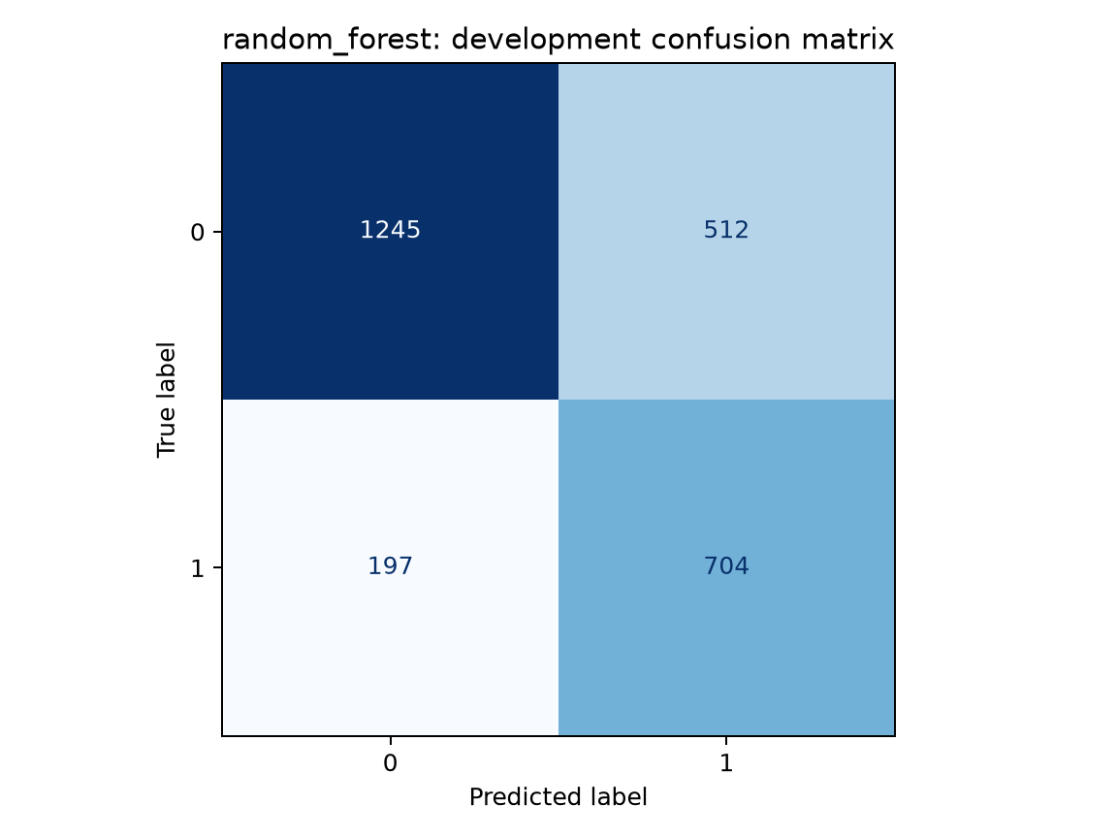
The final model catches 78% of churners
0.802
0.579
0.781
0.665
AUROC
Precision
Recall
F1-score
Threshold 0.320 — chosen from training out-of-fold predictions
704 churners correctly flagged
197 churners missed
512 retained players falsely flagged
6
Notes:
Lead with recall because missing a future churner is the main retention risk. At the training-only threshold, the model catches 704 of 901 churners. Precision is lower because 512 retained players are also flagged, so interventions should be low-cost and reversible.
[Sources]
- reports/metrics.csv
- reports/metric_confidence_intervals.csv
- reports/figures/confusion_matrix.png

Slide 7
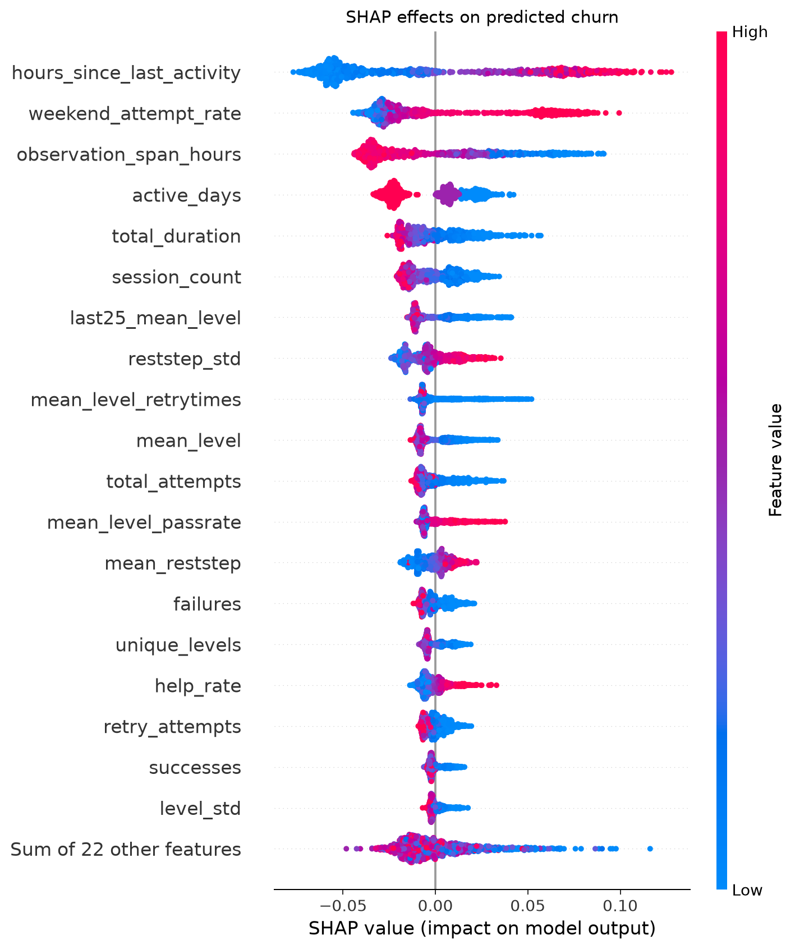
Recency and continuity dominate the risk signal
Model associations
Longer time since last activity raises predicted risk
Short observation spans and fewer active days raise risk
Lower progression and less play time reinforce the signal
Association ≠ causation
7
Notes:
Explain SHAP carefully: points to the right increase model output. Recency is strongest, followed by weekend concentration and observation span. These are predictive associations, not proof that manipulating a feature will retain a player.
[Sources]
- reports/shap_importance.csv
- reports/figures/shap_beeswarm.png
- Lundberg & Lee (2017), A Unified Approach to Interpreting Model Predictions

Slide 8
Useful early warning — not yet deployment proof
What we learned
What comes next
Early gameplay behavior provides a stable AUROC ≈ 0.80
Validate on a later cohort or a different game
Random Forest catches most churners at a training-only threshold
Monitor probability calibration and behavior drift
Recency, continuity, and progression drive predictions
Test low-cost interventions with controlled experiments
Conclusion: the model is ready for further validation and experimentation, not automatic intervention.
8
Notes:
Close with a balanced message. The predictive signal is useful and the evaluation is methodologically sound, but the dataset represents one game and a short window. External and experimental validation are the correct next steps.
[Sources]
- reports/project_summary.md
- reports/error_analysis_summary.csv

