Slide 1

Home Loan Prediction App

Slide 2
Introduction
The main goal of this project was to create a tool that allows users to input various parameters, such as gender, marital status, dependents, educational level, loan amount, etc. and predict whether they will be approved for a home loan.
Project Repository
https://github.com/NysB/Project4
Team
Fedorenko, Olena
Chen, Xing Ying
Saliaj, Evis
Nys, Brecht

Slide 3
Tools and Technology
Backend
Python Pandas
Python Flask
Python numpy
Python pickle
Scikit-learn
Frontend
HTML / CSS
Azure web app

Slide 4
Data Sources
https://www.kaggle.com/datasets/rishikeshkonapure/home-loan-approval?select=loan_sanction_train.csv
Loan_ID | Gender | Married | Dependents | Education | Self_Employed | ApplicantIncome | CoapplicantIncome | LoanAmount | Loan_Amount_Term | Credit_History | Property_Area | Loan_Status
LP001002 | Male | No | 0 | Graduate | No | 116980 | 0.0 | 0 | 360.0 | 1.0 | Urban | Y
LP001003 | Male | Yes | 1 | Graduate | No | 91660 | 30160.0 | 51200 | 360.0 | 1.0 | Rural | N
LP001005 | Male | Yes | 0 | Graduate | Yes | 60000 | 0.0 | 26400 | 360.0 | 1.0 | Urban | Y

Slide 5
Machine Learning Model
Clean Data
Train Model
Outcome

Slide 6
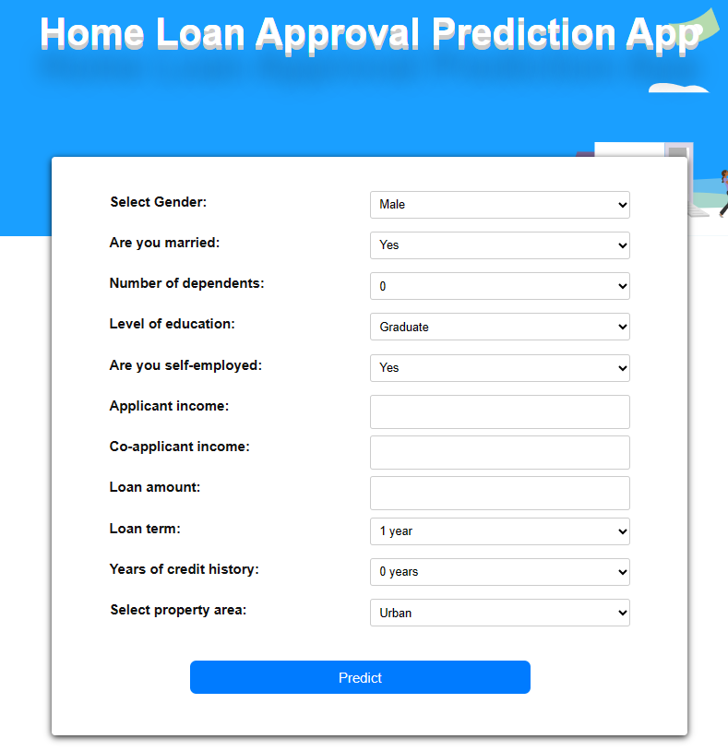

Demo functionality

