Slide 1

NBA Dashboard

Slide 2
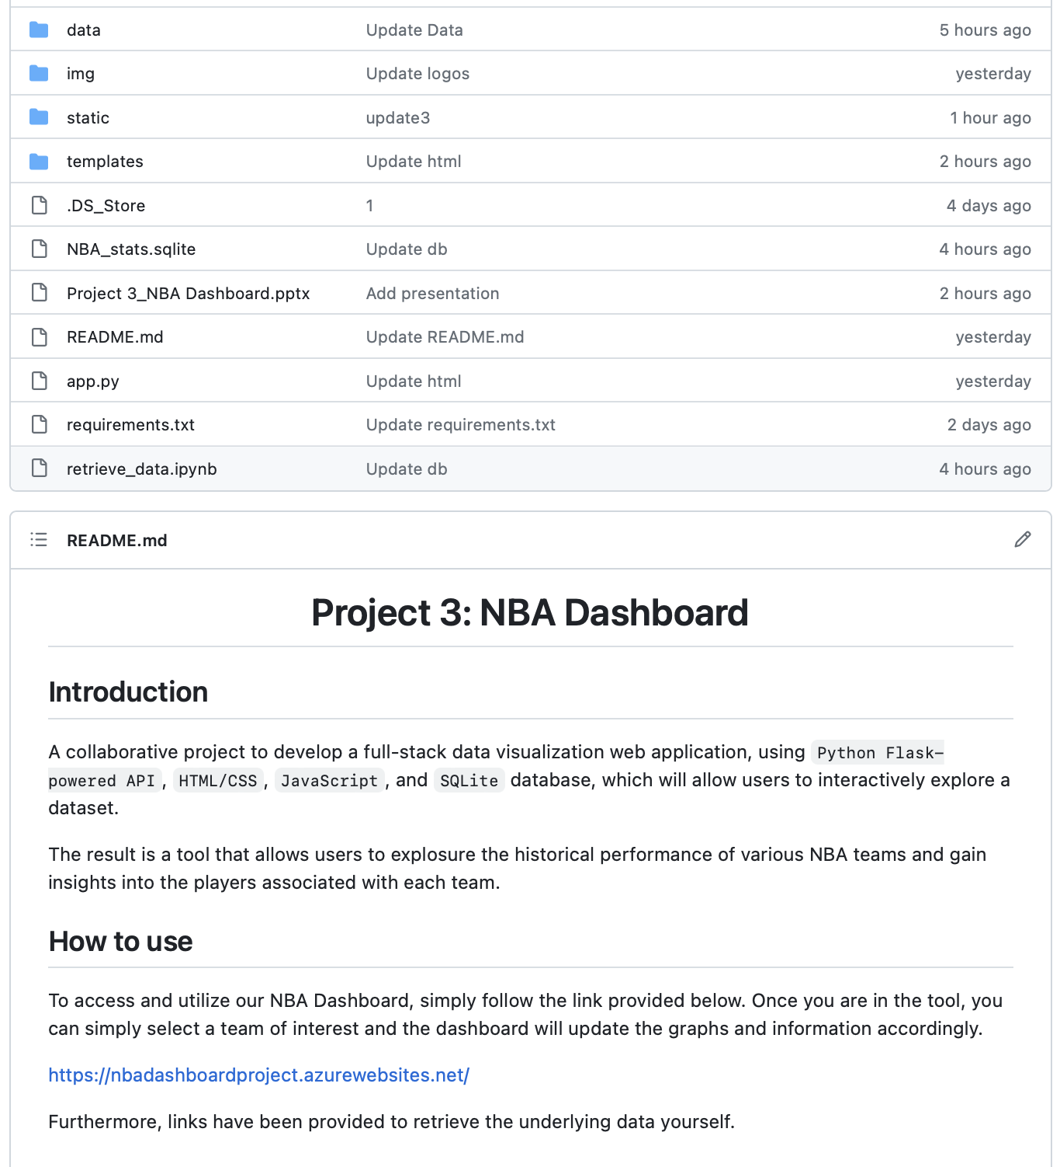
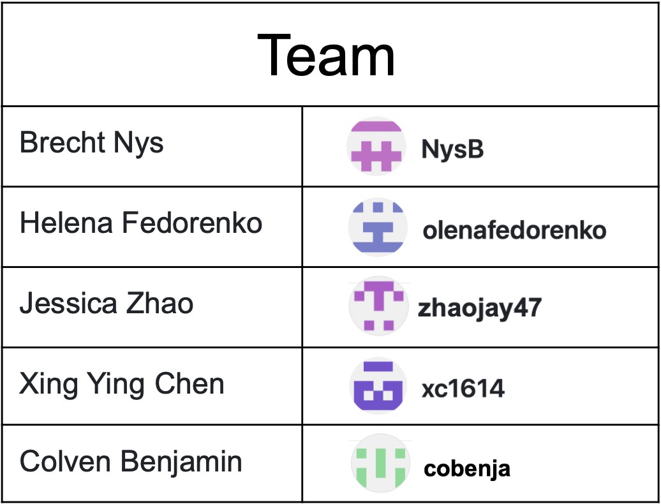
Project Repository
https://github.com/NysB/Project_3
​ ​

Slide 3
Tools and Technology
Backend
Python
Flask
sqlalchemy
sqlite
pandas
numpy
Frontend
JavaScript
d3
Plotly
SimpleCSS
HTML
?

Slide 4
Data Sources
https://basketball.realgm.com/nba/stats
https://basketball.realgm.com/nba/team-stats

Slide 5
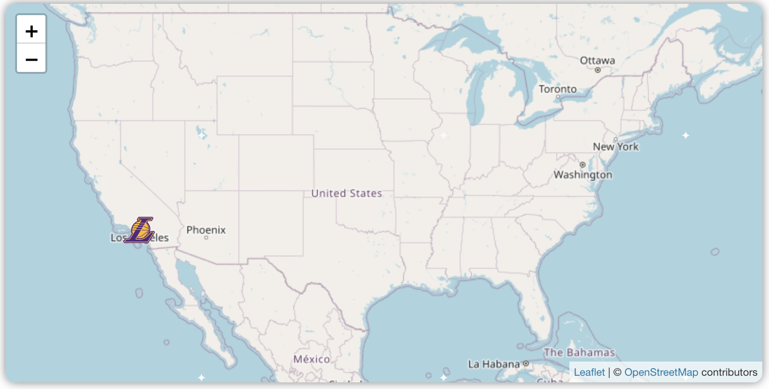
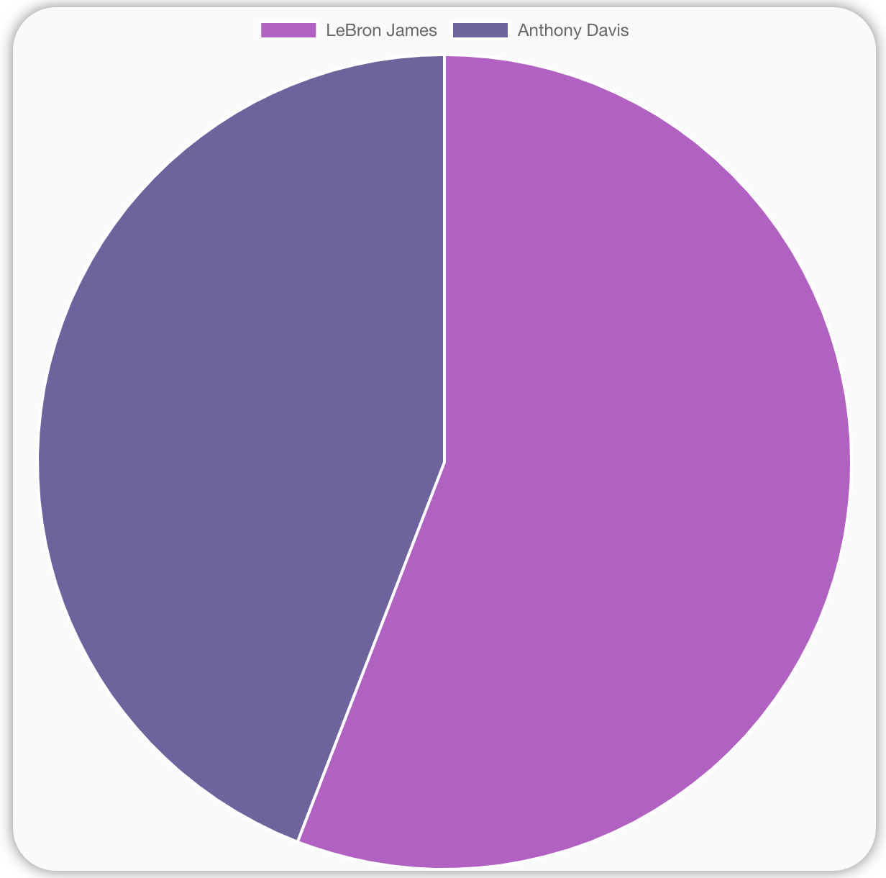
Explain functions of the web/user experience

Slide 6
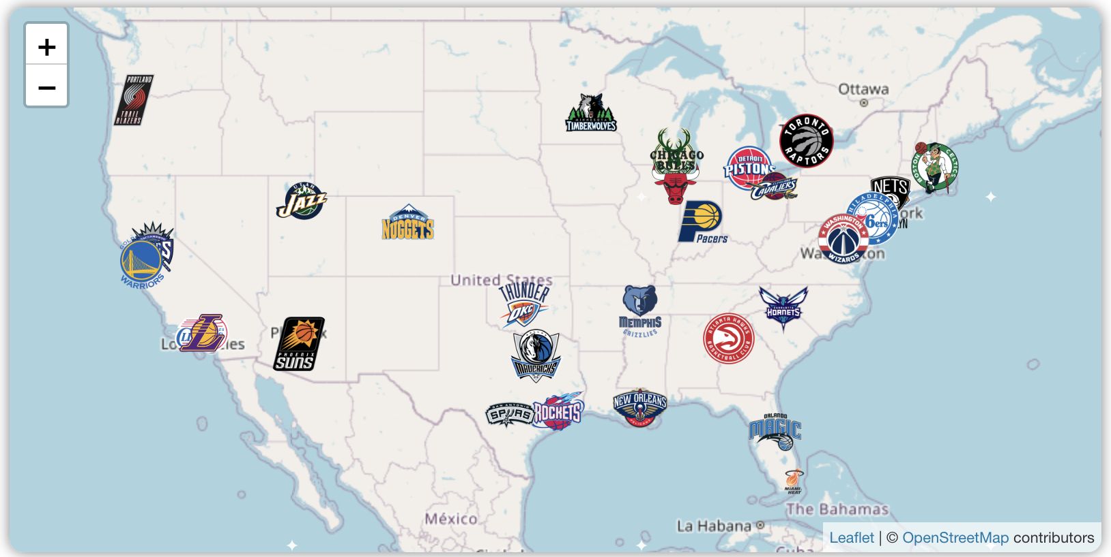
Graphics
Bar chart for team score
Bar chart for player age
Team map for team locations

Slide 7
Team Map

Slide 8
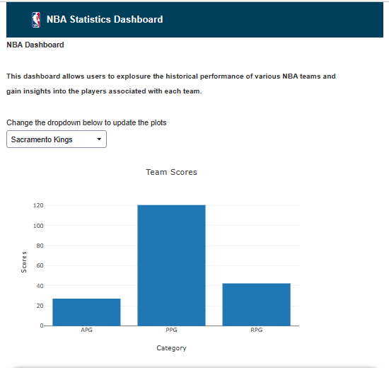

Demo functionality

