Slide 1
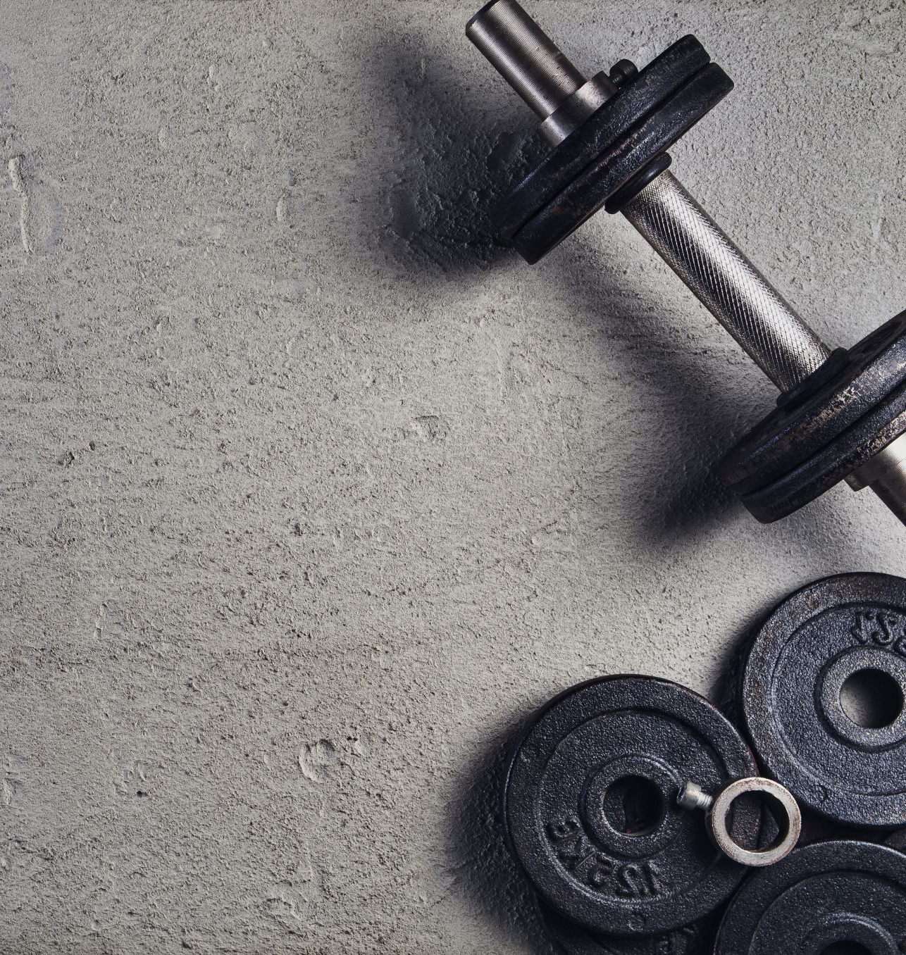
Android Mini Project (MyFit App – A fitness Centric App)
Presented by-
Pratyush Avi A203
Ajay Dabas A209

Slide 2
Scope
The MyFit app has been developed keeping fitness as center foci. It complements a fitness regime to incubate a positive attitude towards exercise and general well-being. The aim of this project is to promote a healthy lifestyle, exercise and generate awareness. To facilitate this, our app provides numerous features. We designed the application to facilitate the users to be able to keep fit/achieve their weight goals using portable devices such as smart phones.

Slide 3
ADVANTAGES
User can register and see the exercises from any part of the world on their smartphone.
It can be used as a guide for training purposes.
Efficient solution to your tracking needs.
User-friendly UI for easy understanding.
Profile created using Firebase Real-Time database, so the availability is high, and the database remains more portable/scalable.

Slide 4
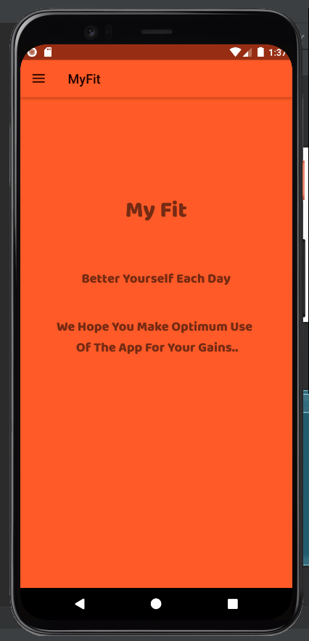
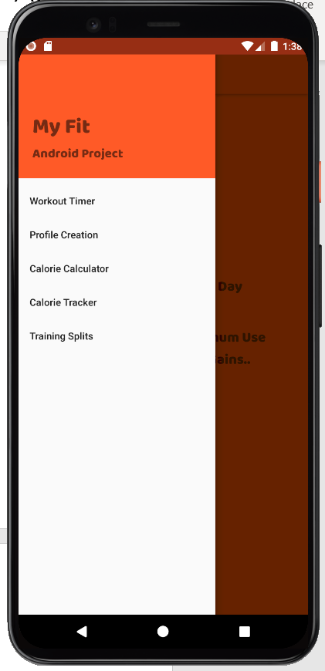
Flow
Register for MYFIT App.
Drawer Layout which implements Navigation View where Menu is displayed.
Menu
Workout timer
User profile (Creation)
Calorie Calculator
Calorie Tracker
Training splits

Slide 5
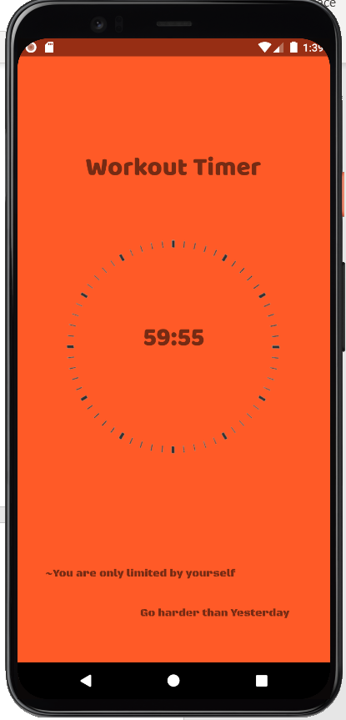
Workout Timer
Timer is based on using a Handler.
It's a little more work than the built-in classes, but we find that it is vastly more efficient, and we have more control over it.
The Handler is a class that will handle code execution over a specific Looper / Thread by default.
Otherwise we can specify where the Handler executes its code by passing in the Looper to the Handler constructor like so:
- new Handler(Looper.getMainLooper());
The reason we would recommend
the looper is because we have a higher
Flexibility of control, as it is a slightly
lower down abstraction over the
TimerTask methods.

Slide 6
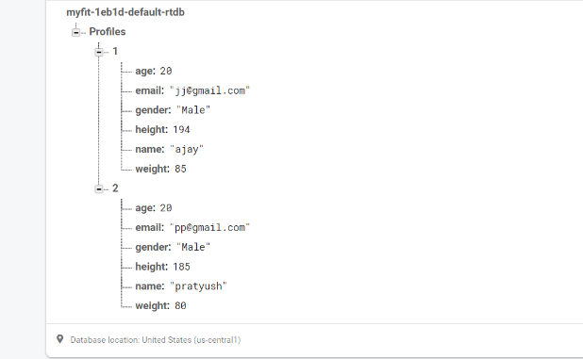
User Registration (Profile Creation)
Use of firebase is been used for Registration.
Firebase provides a full set of authentication options out-of-the-box. Firebase automatically stores your users’ credentials securely and redundantly (with replication and daily off-site backups).
This separates sensitive user credentials from
your application data, and lets you focus on the
user interface and experience for your app.
We create a “Profiles” Database in Firebase to address our database needs.
The database stores credentials such as name, age, height, weight, gender and email.

Slide 7
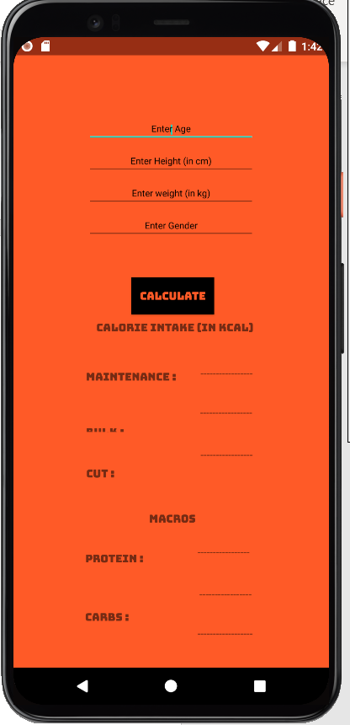
Calorie Calculator
To calculate recommended calorie intake according to the Harris-Benedict formula as well as the macros (protein, carbs and fats) according to the input given
by the user.
Calorie Recommendation and Macros get
calculated on different input and will show
the results for specific input.

Slide 8
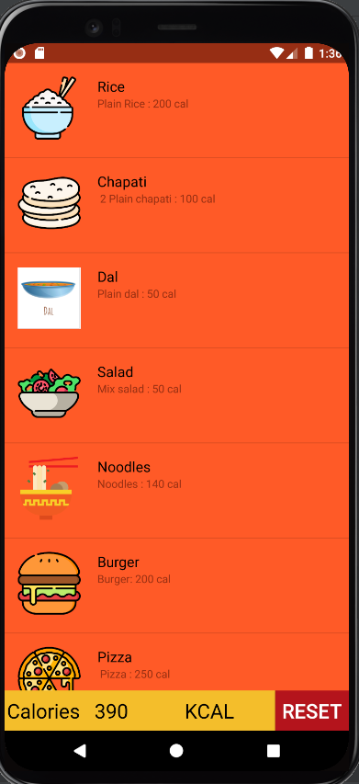
Calorie Tracker
This feature enables the user to track their calorific consumption throughout the day and log the foods that are consumed throughout the day.
Utilization of Listview to display
the food.
Created Model file for adding
varieties of food in showcase.

Slide 9
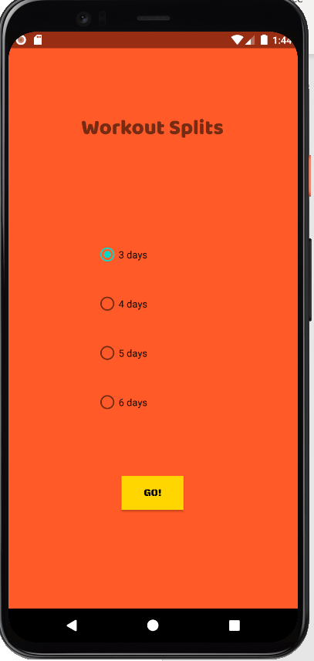
Training Split
Use of radio button for splitting the workout days.
The radio button helps identify the number of days in a week a user desires to workout (3 through 6 days).
The users are given options as to decide the number of days and the training splits for the week are
displayed for unique selections.

Slide 10
Thank You
-BY MYFIT

