Slide 1
Defcamp 0x7DB
- Ionut “Nytro” Popescu
- Formatul Portable Executable
......................................................
http://www.rstcenter.com/forum/

Slide 2
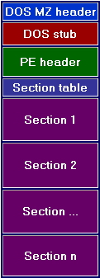
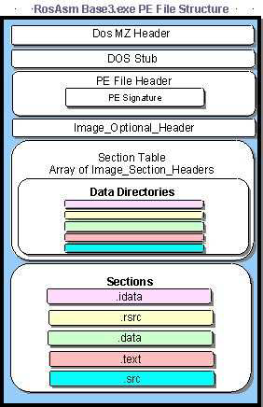
Formatul Portable Executable

Slide 3
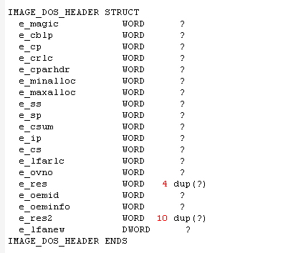

Slide 4
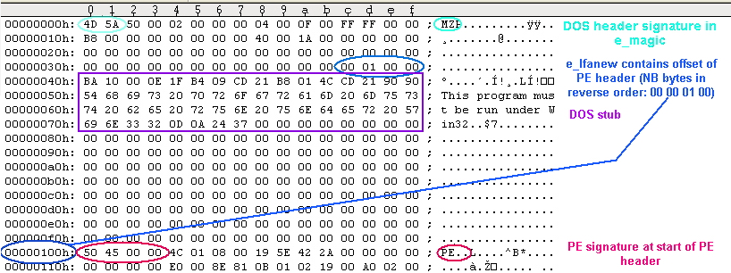

Slide 5
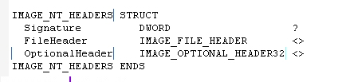
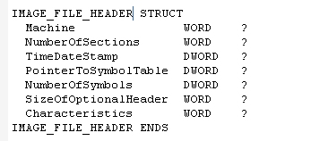

Slide 6
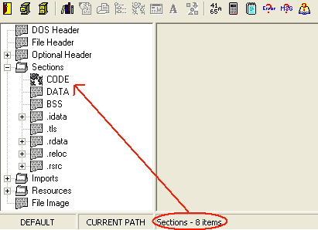

Slide 7
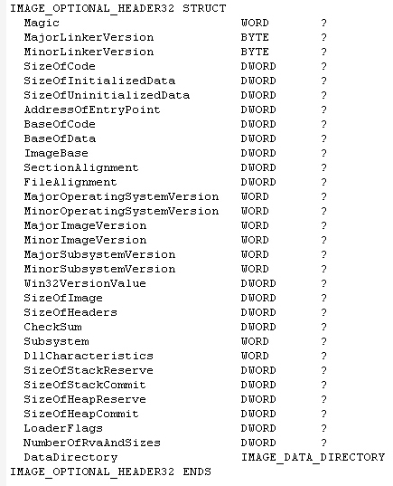

Slide 8
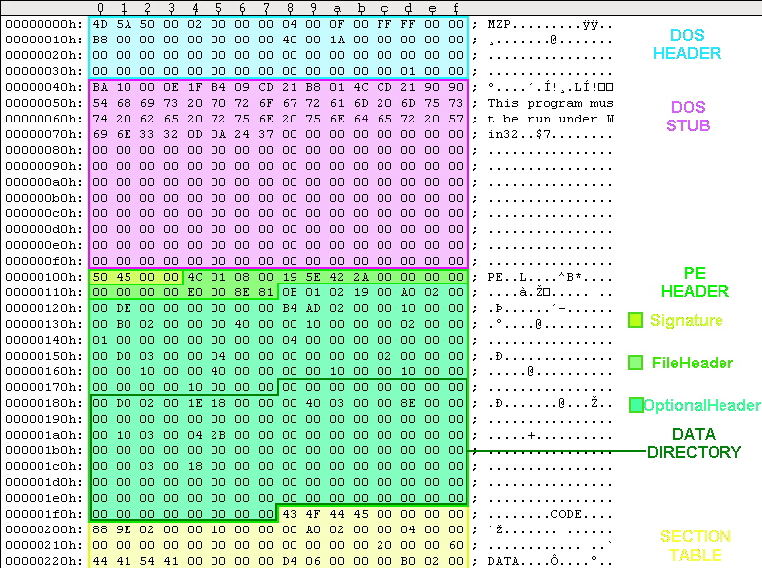

Slide 9

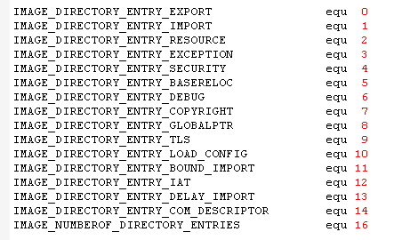

Slide 10
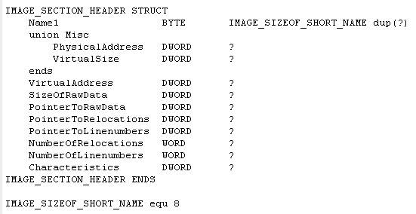

Slide 11
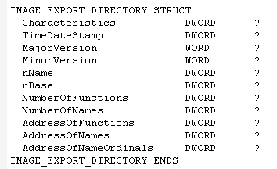

Slide 12
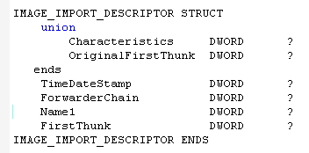
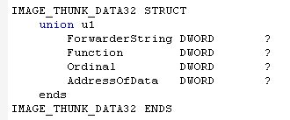


Slide 13
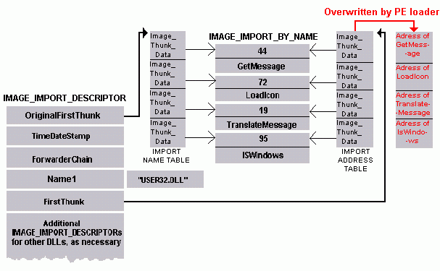

Slide 14
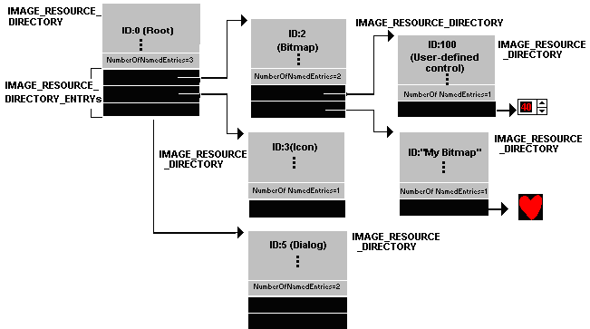

Slide 15
DLL Injection
- Registry
- SetWindowHookEx
- CreateRemoteThread

Slide 16
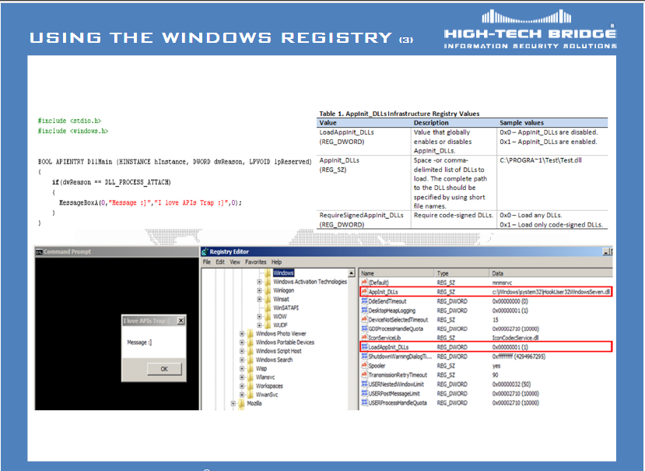
Registry

Slide 17
SetWindowsHookEx
HHOOK SetWindowsHookEx
( int idHook, HOOKPROC lpfn, HINSTANCE hMod, DWORD dwThreadId );
WH_CALLWNDPROC Installs a hook procedure that monitors messages before the system sends them to the destination window procedure. For more information, see the CallWndProc hook procedure.
WH_CBT Installs a hook procedure that receives notifications useful to a computer-based training (CBT) application. For more information, see the CBTProc hook procedure.
WH_KEYBOARD Installs a hook procedure that monitors keystroke messages. For more information, see the KeyboardProc hook procedure.

Slide 18
CreateRemoteThread
HANDLE WINAPI CreateRemoteThread(
__in HANDLE hProcess,
__in LPSECURITY_ATTRIBUTES lpThreadAttributes,
__in SIZE_T dwStackSize,
__in LPTHREAD_START_ROUTINE lpStartAddress,
__in LPVOID lpParameter,
__in DWORD dwCreationFlags,
__out LPDWORD lpThreadId );

Slide 19
API Hooking
- Proxy DLL
- SSDT (Service Symbol Dispatch Table)
- Inline Hooking
- IAT Patching

Slide 20
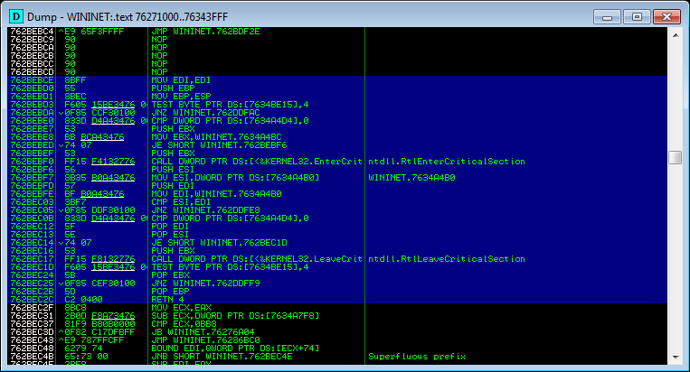
Exemplu API

Slide 21
Load PE File
CopyMemory idh, abExeFile(0), Len(idh)
If idh.e_magic <> IMAGE_DOS_SIGNATURE Then
MsgBox "MZ signature not found!", vbCritical, "File load error"
Exit Sub
End If
CopyMemory inh, abExeFile(idh.e_lfanew), Len(inh)
If inh.Signature <> IMAGE_NT_SIGNATURE Then
MsgBox "PE signature not found!", vbCritical, "File load error"
Exit Sub
End If
si.cb = Len(si)
If CreateProcess(vbNullString, fisier, 0, 0, False, CREATE_SUSPENDED, 0, 0, si, pi) = 0 Then Exit Sub
context.ContextFlags = CONTEXT86_INTEGER
If GetThreadContext(pi.hThread, context) = 0 Then GoTo ClearProcess
Call ReadProcessMemory(pi.hProcess, ByVal context.Ebx + 8, addr, 4, 0)
If addr = 0 Then GoTo ClearProcess
If ZwUnmapViewOfSection(pi.hProcess, addr) Then GoTo ClearProcess
ImageBase = VirtualAllocEx(pi.hProcess, ByVal inh.OptionalHeader.ImageBase, inh.OptionalHeader.SizeOfImage, MEM_RESERVE Or MEM_COMMIT, PAGE_READWRITE)
If ImageBase = 0 Then GoTo ClearProcess
Call WriteProcessMemory(pi.hProcess, ByVal ImageBase, abExeFile(0), inh.OptionalHeader.SizeOfHeaders, ret)
lOffset = idh.e_lfanew + Len(inh)
For i = 0 To inh.FileHeader.NumberOfSections - 1
CopyMemory ish, abExeFile(lOffset + i * Len(ish)), Len(ish)
Call WriteProcessMemory(pi.hProcess, ByVal ImageBase + ish.VirtualAddress, abExeFile(ish.PointerToRawData), ish.SizeOfRawData, ret)
Call VirtualProtectEx(pi.hProcess, ByVal ImageBase + ish.VirtualAddress, ish.VirtualSize, Protect(ish.characteristics), addr)
Next i
Call WriteProcessMemory(pi.hProcess, ByVal context.Ebx + 8, ImageBase, 4, ret)
context.Eax = ImageBase + inh.OptionalHeader.AddressOfEntryPoint
Call SetThreadContext(pi.hThread, context)
Call ResumeThread(pi.hThread)
Exit Sub

