Slide 1
How hackers steal credit cards – Incognito mode
Ionut Popescu
Penetration tester @ KPMG Romania
http://www.kpmg.com/ro/en/pages/default.aspx
Administrator @ Romanian Security Team
https://rstforums.com/forum/

Slide 2
About credit cards
Magnetic stripe
EMV (chip)
NFC
Credit cards
Debit cards
Gift cards
Fleet cards

Slide 3
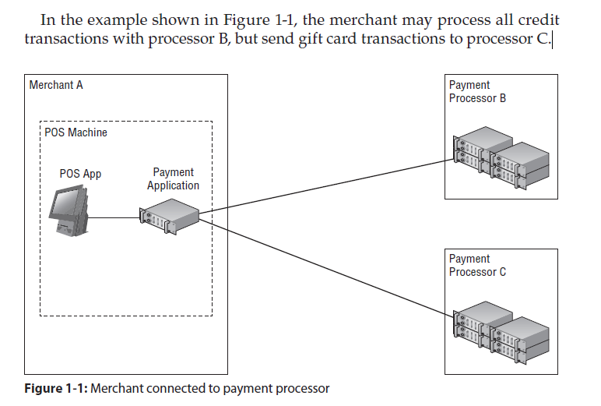
Payment example

Slide 4
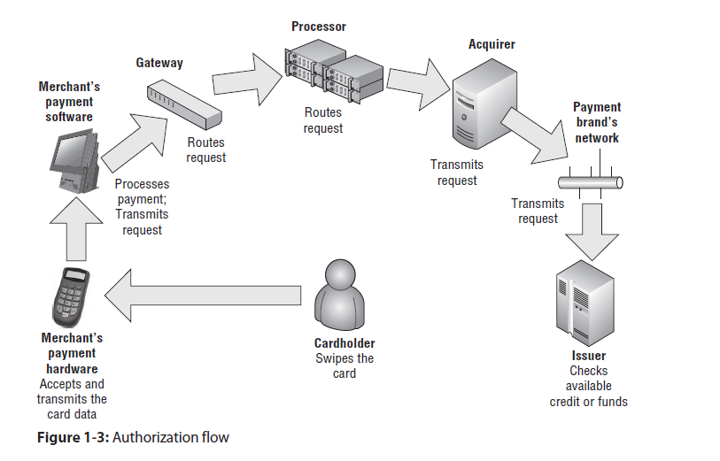
Payment authorization

Slide 5
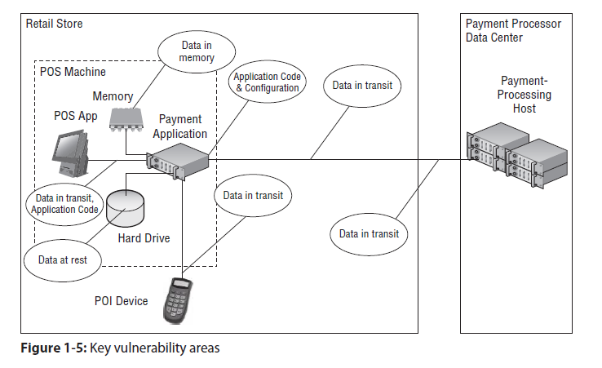
Vulnerability areas

Slide 6
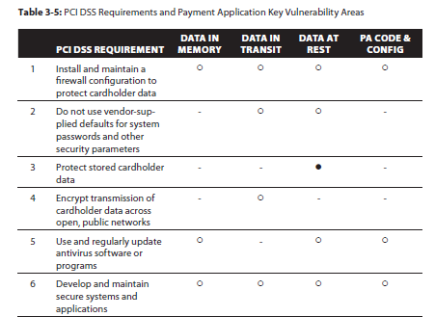
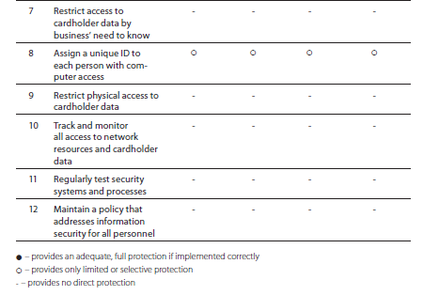
Payment Card Industry Data Security Standard

Slide 7
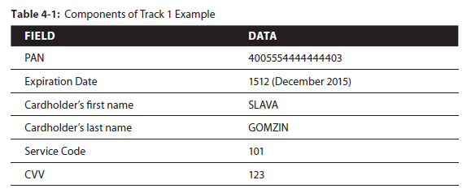
Magnetic stripe credit cards
Track 1 (79 bytes):
%B4005554444444403^GOMZIN/SLAVA^1512101000000012300?

Slide 8
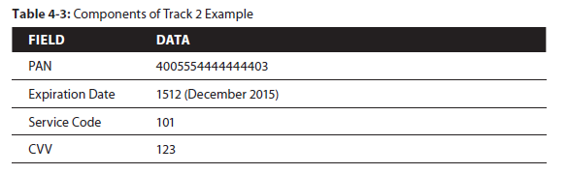
Magnetic stripe credit cards
Track 2 (40 bytes):
;4005554444444403=1512101000000012300?

Slide 9
PAN – Primary account number
Digits | Value
6 | Bank/Issuer Identification Number
9 | Individual Account Identifier
1 | Check digit – Luhn algorithm
Bank | Bank/Issuer Identification Number
American Express | 34, 37
Maestro | 5018,5020…
Mastercard | 51-55
VISA | 4
VISA Electron | 4026, 4405…

Slide 10
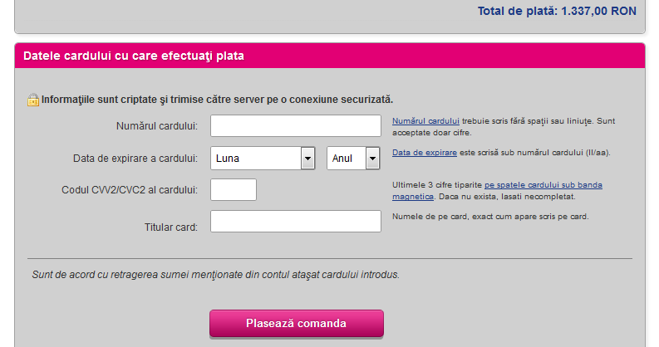
Online payment

Slide 11
EMV Credit cards
Chip and PIN: remote or local check
Secure communication: crypto, certificates
CVV generated automatically (dynamic)
Card holder name is not stored

Slide 12
Is EMV safer than MSR?
Most EMV cards contain a magnetic stripe, for either backwards compatibility in non-EMV environments.

Slide 13
NFC credit cards
Fancy & useless (personal opinion)
Easier to attack (NO CVV and PIN)
Dynamic CVV (single transaction)
“In a demonstration just before her talk, Paget read a card in my wallet through my back pocket without touching me, successfully obtaining the card’s information.”
And now how to solve those problems? Perhaps the simplest solution, Paget advises, is to kill your card’s RFID chip by frying it in the microwave. But that’s a more delicate task than it might seem. “Three seconds in the microwave will kill the chip,” she says. “Five seconds will set it on fire.”

Slide 14
Credit card breach
Access internal network (WiFi, employee…)
POS devices connected to Internet (internal network)
SQL Injection in E-commerce websites
Phishing
Skimming

Slide 15
Credit card breach
Example: The TJX Companies, Inc. (TJX)
Crack wireless WEP password
Steal credit cards from POS/servers
Attacker: Albert Gonzales – 20 years… of jail

Slide 16
RAM Scraping
Read memory (from processes) on POS systems
Find credit card data: PAN, cardholder name, CVV

Slide 17
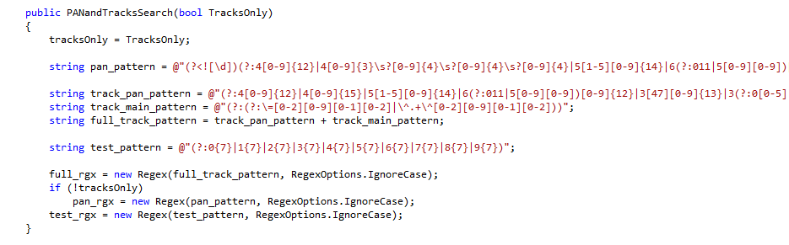
Search PAN

Slide 18
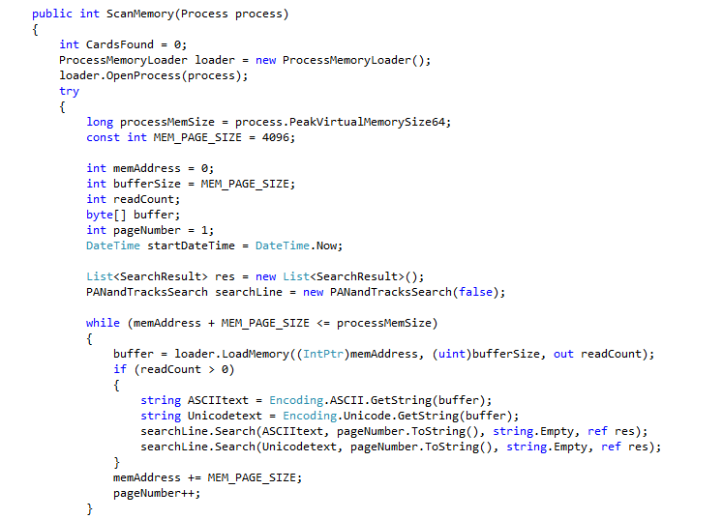
Search in memory

Slide 19
Search in memory
Use functions to access processes memory, read memory and find credit cards.
Windows API functions used:
OpenProcess
ReadProcessMemory
Search credit card
Note: Attackers may not know where to search for, so they search in almost all processes.
What are they doing with credit card data:
Exfiltrate data from internal network
Sell credit card dumps
Buy a Lamborghini

Slide 20
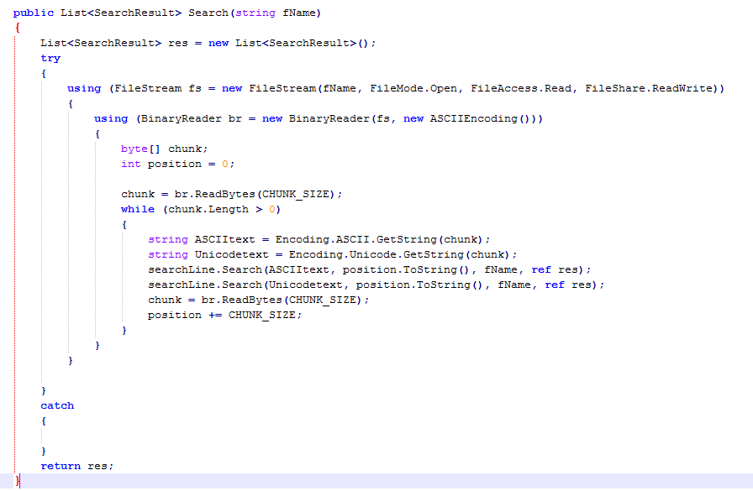
Search on disk

Slide 21
Search on disk
Attack may work for:
POS systems
Backup servers
Database servers
Anything else
Why:
Application logs
Temporary files
Backup files
Database files
Note: An attacker may check POS applications configuration file, it may contain sensitive information like: server, username & password.

Slide 22
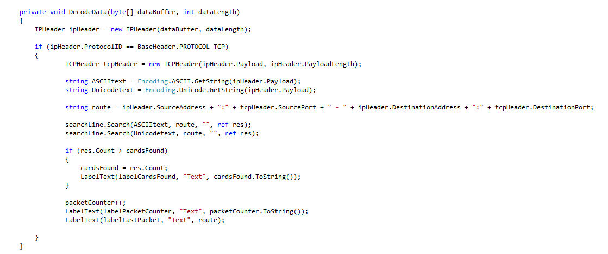
Search on network traffic

Slide 23
Search on network traffic
There are two possibilities:
Intercept local traffic (from local POS system)
Man in the Middle against other POS systems
Steps to intercept local traffic:
Create a raw socket
Set socket option to include headers
IOCTL SIO_RCVALL to get all packets
Inspect network traffic and get credit cards
Steps for Man in the Middle:
ARP spoofing to “proxy” network traffic between POS & server
Hope there are no SSL certificate validations
Make a plain text or SSL server with a self-signed certificate
Inspect network traffic and get credit cards

Slide 24
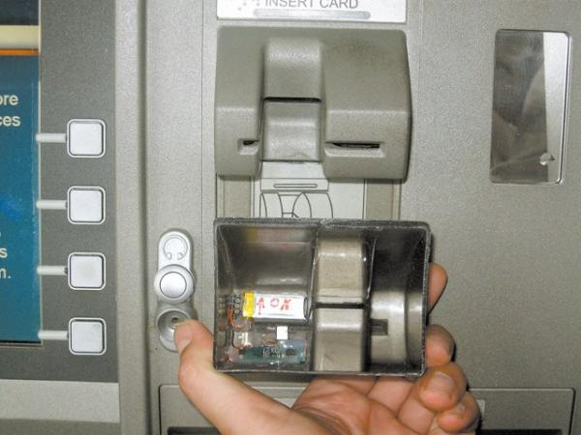
Skimming #1

Slide 25
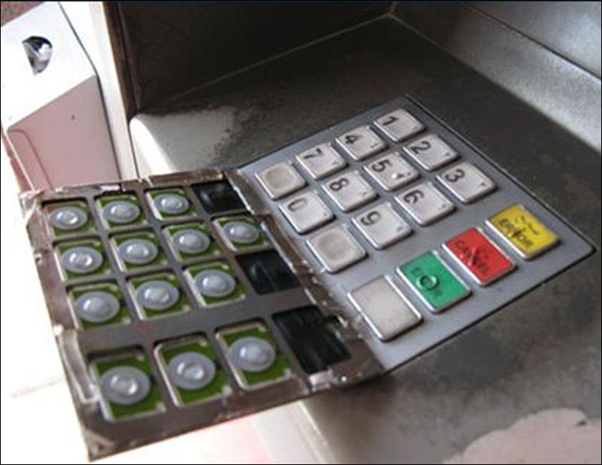
Skimming #2

Slide 26
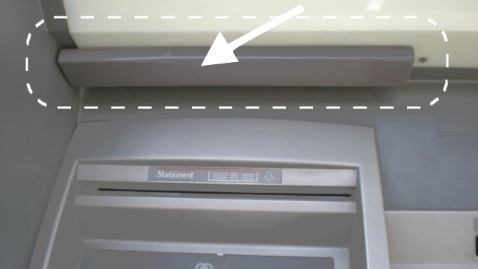
Skimming #3

Slide 27
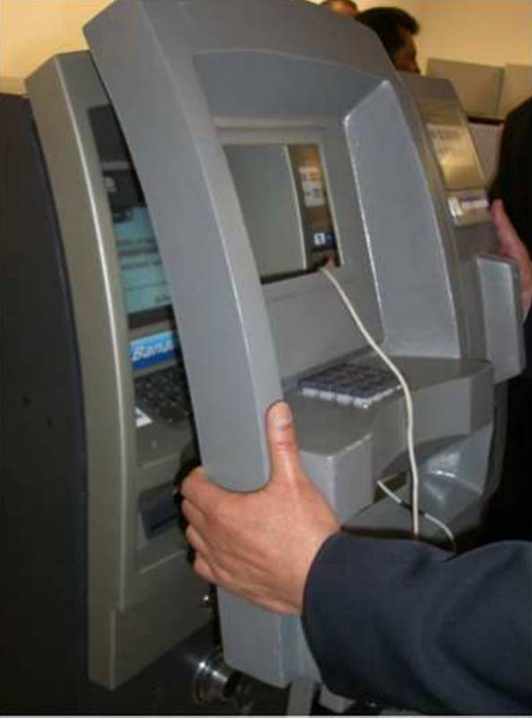
Skimming #4

Slide 28
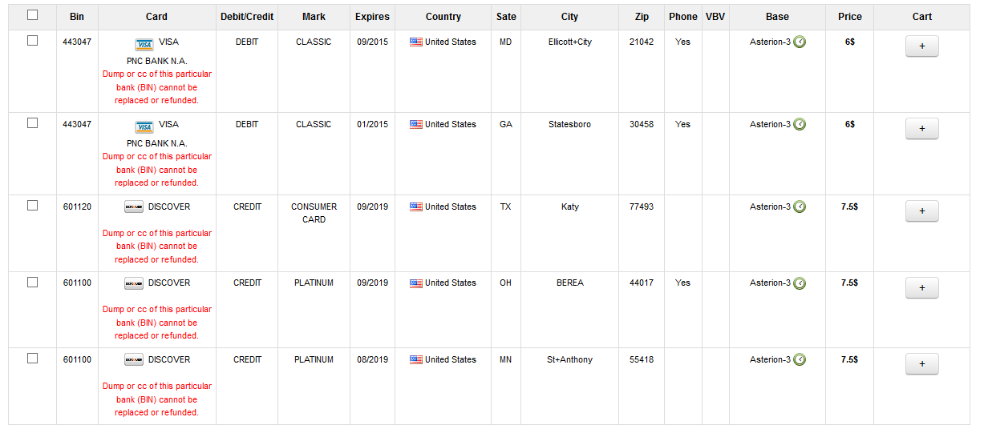
CC (credit card) dumps

Slide 29
Money
Buy “online” things
Sell things for money
Clone credit cards
Buy from shops
Withdraw from ATM

Slide 30
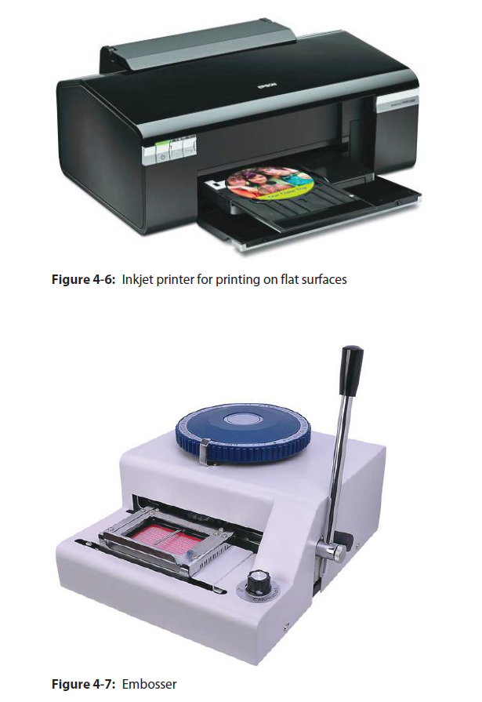
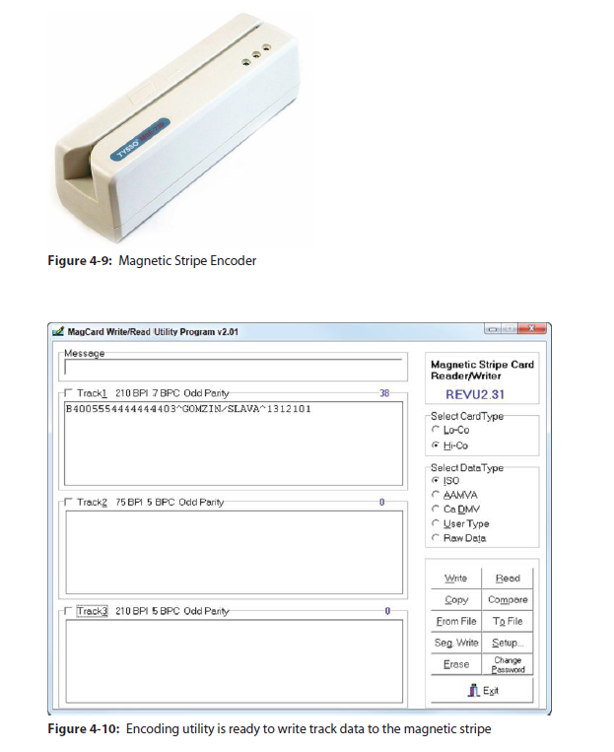
Clone cards

Slide 31
Infecting users with malware
Users access Internet banking
Log in with username & password
Log in with digipass
Use digipass to sign transactions
Attack mobile devices
Attack web browsers

Slide 32
Mozilla Firefox in memory
Component | Memory
Firefox.exe | Mozilla Firefox code
kernel32.dll | Windows component
ntdll.dll | Windows component
nss3.dll | Mozilla Firefox component
mozjs.dll | Mozilla Firefox component
STACK | Temporary data in memory
HEAP | Temporary data in memory

Slide 33
NSS3.dll
Contains code related to “Internet communication”
Export functions:
- PR_Write: Used to send data to a server
- PR_Read: Used to read data from a server
Mozilla Firefox calls this functions to make HTTP & HTTPS requests!
Ex. PR_Write(fd, “POST /login.php?user=nytro&pass=TALKS”, 37);
Banking Trojans intercept this function call and save sensitive information!

Slide 34
Intercepting function calls
Firefox.exe → nss3.dll → PR_Write → https://www.bank.com/
Firefox.exe → nss3.dll → Attacker.DLL:
→ Save “login.php?user=x&pass=y”
→ nss3.dll → PR_Write → https://www.bank.com/
Also known as “Form grabber”

Slide 35
How?
Inject DLL:
OpenProcess (opens firefox.exe process)
Get LoadLibrary address (function used to load a DLL)
WriteProcessMemory (write DLL name in Firefox.exe memory)
CreateRemoteThread (call LoadLibrary with DLL written before)
Monitor API calls:
Get PR_Write address (in the export table – GetProcAddress(“nss3.dll”, “PR_Write”))
Place a jmp/call (ASM instruction to jump to attacker’s code)
Return to original function (call original function)

Slide 36
Google Chrome
Component | Memory
Chrome.exe | Google Chrome code
kernel32.dll | Windows component
ntdll.dll | Windows component
chrome.dll | Mozilla Firefox component
STACK | Temporary data in memory
HEAP | Temporary data in memory
There is NO “nss3.dll” even if Google Chrome uses this library.
The nss3.dll is STATICALLY linked in chrome.dll
It is NOT possible to get function address like in Firefox with GetProcAddress!

Slide 37
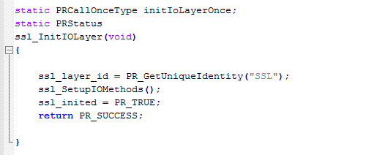
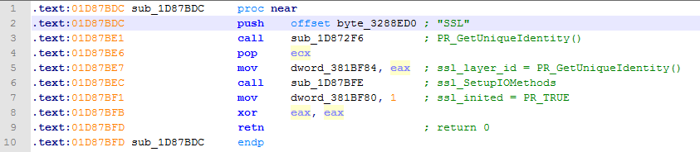
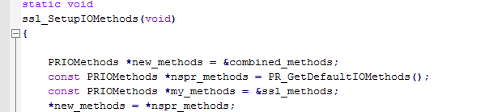
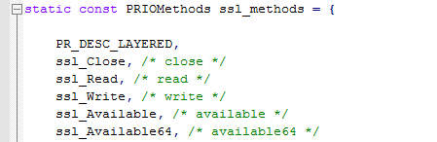
How?
Search in chrome.dll the SSL_Write function address!

Slide 38
How?
Search “SSL” string in Chrome.dll memory
Find “push offset SSL_string” instruction in Chrome.dll memory
Find “call sub_1D87BFE” (ssl_SetupIOMethods) in Chrome.dll memory
ssl_SetupIOMethods function set the “SSL table”
“SSL table” is an array of functions, one of them is “SSL_Write”
Find “mov dword_381BF98, 4” instruction
dword_381BF98 is a pointer to SSL table
Forth element of the array is SSL_Write
Monitor SSL_Write calls

Slide 39
Questions?

Slide 40
Contact
ionut.popescu@outlook.com

