Slide 1


SSL Ripper
All your encrypted traffic belongs to us
Ionut Popescu
Security Consultant @ KPMG Romania
“Nytro”

Slide 2

Why?
- External pentest
- Internal pentest
- Social Engineering

Slide 3

Steps
1. Information gathering
2. Vulnerability assessment
3. Exploitation
4. Post exploitation

Slide 4
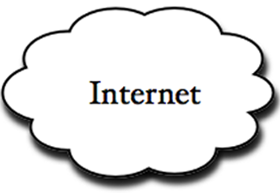
SSL Ripper
- Dumping SSL traffic -
Application
POST /login ...
Host: server
User-Agent: ...
User=admin&
Pass=123456
Ç#ívã¾¬à‹èYã(ðƒ/Ç#ívã¾¬à‹èYã(ðƒ/Ç#ívã¾¬à‹èYã(ðƒ
E
N
C
R
Y
P
T
SSL Ripper

Slide 5
Applicability
- Browsers: Mozilla Firefox, Google Chrome, Internet Explorer
- Email clients: Microsoft Outlook, Mozilla Thunderbird
- Remote connection: Putty, SecureCRT
Generic, any application that makes use of:
OpenSSL
Netscape Security Services
Microsoft CryptoAPI
Other libraries

Slide 6
How does it work?
Short answer: API Hooking
We need to execute code in other process’ space:
Inject a DLL into a remote process (eg. outlook.exe)
- Allocate space for DLL name (VirtualAllocEx)
- Write DLL name (WriteProcessMemory)
- Create a new thread (CreateRemoteThread)
- On new thread call LoadLibrary with specific DLL
2. Hooks specific APIs:
- Find function address (from export table)
- Place a “jmp” on an internal function
- Do things

Slide 7
Classic DLL Injection
Old stuff, good stuff
// Open process
hProcess = OpenProcess(PROCESS_ALL_ACCESS, false, p_dwID);
// Get LoadLibrary address
pvLoadLibrary = (LPVOID)GetProcAddress(GetModuleHandle("kernel32.dll"), "LoadLibraryA");
// Allocate space in remote process for DLL name
pvString = (LPVOID)VirtualAllocEx(hProcess, NULL, p_sDLLName.length(), MEM_RESERVE | MEM_COMMIT, PAGE_READWRITE);
// Write DLL name in allocated space
bResult = WriteProcessMemory(hProcess, (LPVOID)pvString, p_sDLLName.c_str(), p_sDLLName.length(), &written);
// Create Remote thread to call "LoadLibrary(dll)"
hRemoteThread = CreateRemoteThread(hProcess, NULL, 0, (LPTHREAD_START_ROUTINE) pvLoadLibrary, (LPVOID)pvString, 0, NULL);

Slide 8
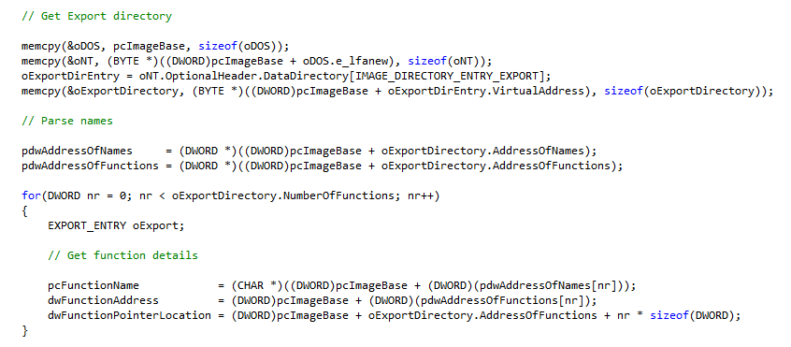
API Hooking #1
1. Parse module (eg. nss3.dll) – Exports table

Slide 9
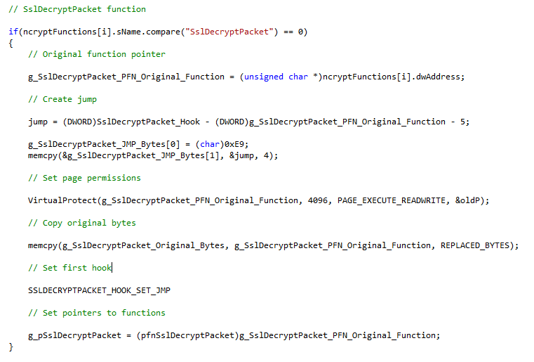
API Hooking #2
2. Set hook: jump to our function

Slide 10
Usual function call
How a usual function call looks like:
kernel32.dll
Firefox.exe ‘s
address space
Firefox.exe
nss3.dll
PR_Read | 0x????a2e0 | Do things
PR_Write | 0x????a2f0 | Do things

Slide 11
Hooked function call
How a hooked function call looks like:
Firefox calls PR_Read/PR_Write (nss3.dll)
It jumps (function code is modified by InjectedDLL) to PR_Read_Hook/PR_Write_Hook functions in InjectedDLL
Functions hooks call original functions and *do things* with data parameters (unencrypted)
Firefox.exe
address space
kernel32.dll
Firefox.exe
InjectedDLL.dll
nss3.dll
PR_Read | 0x????a2e0
PR_Write | 0x????a2f0
Do other things | Jmp PR_Read_Hook
Do other things | Jmp PR_Write_Hook

Slide 12
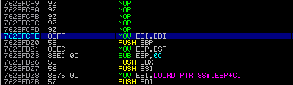
Windows APIs
MOV EDI, EDI – Used for hotpatching (thread safe)
PUSH EBP
MOV ESP, EBP – New stackframe
Hot patching:
1. Replace “mov edi, edi” with a short jump “jmp -5”
2. Place a relative/absolute jump

Slide 13
Example #1 – Firefox
PR_Read
Reads bytes from a file or socket.
PRInt32 PR_Read(PRFileDesc *fd, void *buf, PRInt32 amount);
PR_Write
Writes a buffer of data to a file or socket.
PRInt32 PR_Write( PRFileDesc *fd, const void *buf, PRInt32 amount);
Parameters:
fd - A pointer to the PRFileDesc object for a file or socket.
buf - A pointer to the buffer holding the data to be written.
amount - The amount of data, in bytes, to be written from the buffer.

Slide 14


Example #1 – Details
PR_Read source:
PR_IMPLEMENT(PRInt32) PR_Read(PRFileDesc *fd, void *buf, PRInt32 amount)
{
return((fd->methods->read)(fd,buf,amount));
}
Disassembly - Tail call optimization :
Hooked function:

Slide 15
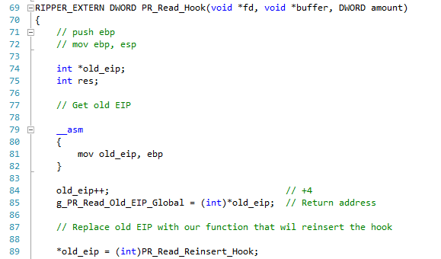
Under the hood
First, we’ll do two important things:
Backup old EIP (to return from normal function call)
Replace old EIP with our “Reinsert_Hook” function

Slide 16
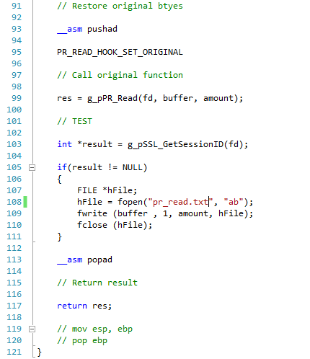
Under the hood
Second, “do things”:
Backup registers
Restore original bytes
Call original function
“Do things”
Restore registers
Return (to reinsert hook)

Slide 17
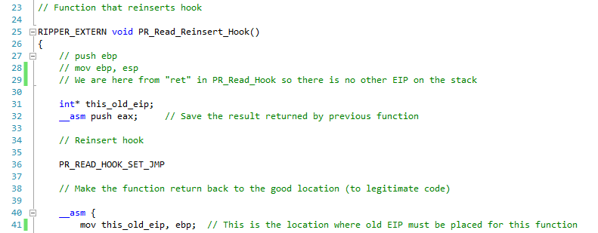
Under the hood
Restore hook on PR_Read:

Slide 18
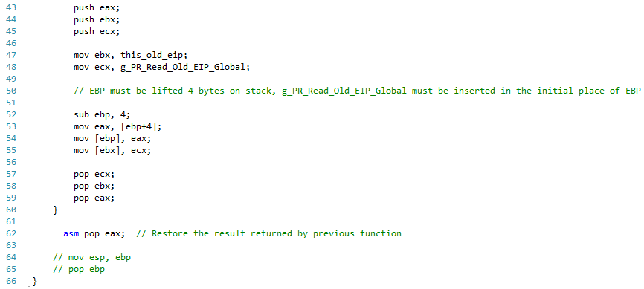
Under the hood
Restore old EIP (before call PR_Read) in the right place:

Slide 19
Example #2 - Outlook
SslEncryptPacket (ncrypt.dll)
SECURITY_STATUS WINAPI SslEncryptPacket (
_In_ NCRYPT_PROV_HANDLE hSslProvider, _Inout_ NCRYPT_KEY_HANDLE hKey,
_In_ PBYTE *pbInput,
_In_ DWORD cbInput,
_Out_ PBYTE pbOutput,
_In_ DWORD cbOutput,
_Out_ DWORD *pcbResult,
_In_ ULONGLONG SequenceNumber,
_In_ DWORD dwContentType,
_In_ DWORD dwFlags
);
pbInput [in] A pointer to the buffer that contains the packet to be encrypted.
cbInput [in] The length, in bytes, of the pbInput buffer.

Slide 20
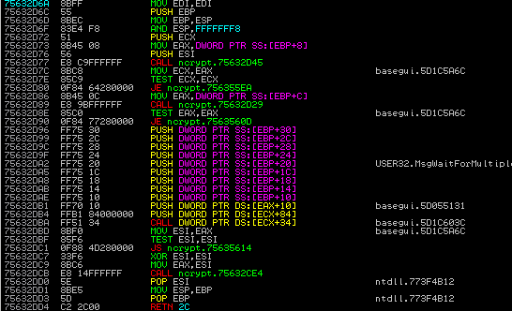
Example #2 - Details
Somethings does not look OK... RETN vs RETN 2C

Slide 21
Calling conventions
__cdecl
__cdecl is the default calling convention for C and C++ programs. Because the stack is cleaned up by the caller, it can do vararg functions. The __cdecl calling convention creates larger executables than __stdcall, because it requires each function call to include stack cleanup code. The following list shows the implementation of this calling convention.
__stdcall
__stdcall calling convention is used to call Win32 API functions. The callee cleans the stack, so the compiler makes vararg functions __cdecl. Functions that use this calling convention require a function prototype.

Slide 22
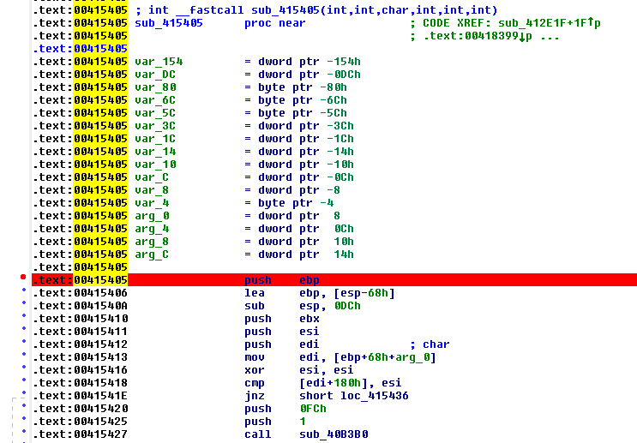
Example #3 - Putty
No exported functions from a DLL – direct code injection

Slide 23
Demo
SSLRipper.exe – DLL Injector
InjectedDLL.dll – DLL that is injected into processes
Attacker
Virtual Machine - Kali
Victim
Host - Windows 8

Slide 24
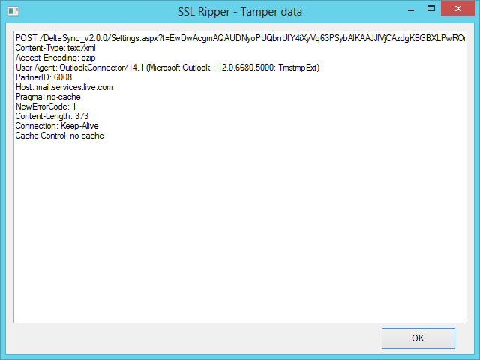
SSL Ripper – Tamper data
Tamper data – Modify packets in realtime

Slide 25
Future work
Support for all SSL software
Support for x64
Thread safe
Bypass EMET
Metasploit post exploitation module
GUI version
Possibility to modify data
* First version will be released when it is stable

Slide 26
Questions?
Contact:
ionut.popescu@outlook.com

