Slide 1
Keyloggers
Johnny Wong & Nehemiah Yu

Slide 2

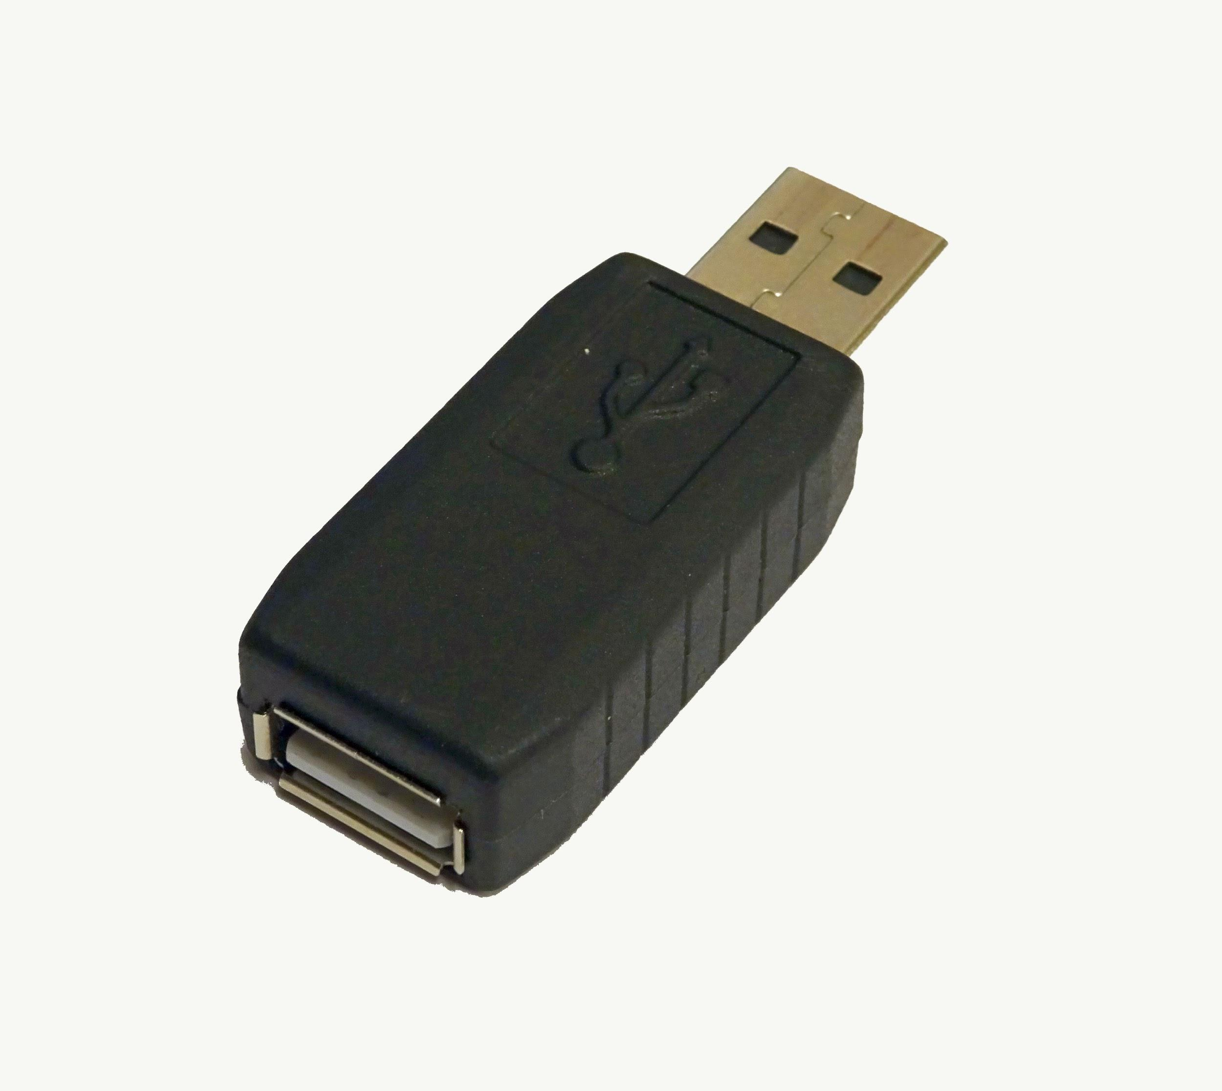
What is a Keylogger
Keystroke logging (keylogging) refers to the action of recording the keys struct on a keyboard typically covertly without the knowledge of the person using the computer.
It doesn’t necessarily have to be a software, it can also be an external device
Legitimate programs may have keylogging functions which can be used to call certain program functions using “hotkeys” or to toggle between keyboard layouts.
Although keyloggers are generally perceived as illegal there are many instances in which it would be legal including: parental control, company security, law enforcement, etc.

Slide 3


Why it matters
Unlike other types of malicious programs, keylogger generally present no threat to the system but rather can pose a threat to the user themselves.
People get a hold PIN codes, passwords, and personal information that can lead to compromised information.
Keyloggers are currently one of the main methods of cyber fraud as they can run undetected and cost the person possibly much of their savings or information.

Slide 4

What we used
Pynput is a python library that allows you to control and monitor input devices including mouse and keyboard
Smtplib is python’s built in library to send basic emails using a Simple Mail Transfer Protocol(SMTP) server
Auto-py-to-exe is a program that compresses python(.py) scripts into an executable (.exe) file.

Slide 5
General Overlook of Files
Git clone https://github.com/Nyu10/KeyLogger-Virus-Working-.git to follow along our demonstration
(Three Versions of Keylogger)
keylogger.py - saves your keyboard log files into a text.txt
keylogger2.py - sends your keyboard log files to my email
Valorant.exe - sends your keyboard log files to my email, but it is an Windows Application Executable disguised as the popular game, VALORANT

Slide 6
How we created our keylogger
Basic Keylogger that Writes to File (keylogger.py writes to text.txt)
Using pynput we had created a python script that logged keyboard strokes and transcribed the key onto a text file
To Start: python keylogger.py
Key Features
Automatic Installation of Pynput v1.6.8
Every 8 words creates a new line in text.txt (this can be easily edited)
Click ESC key to exit program

Slide 7
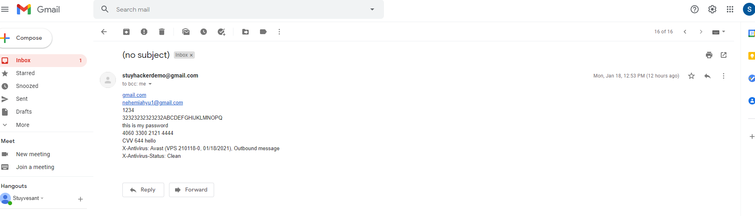
Quick Code Review/Live Demonstration of Keylogger2.py
Summary: Sends your keylog files to my email (email is editable) using Smtplib (simple mail transfer protocol python module)
Sends an email every 10 words

Slide 8
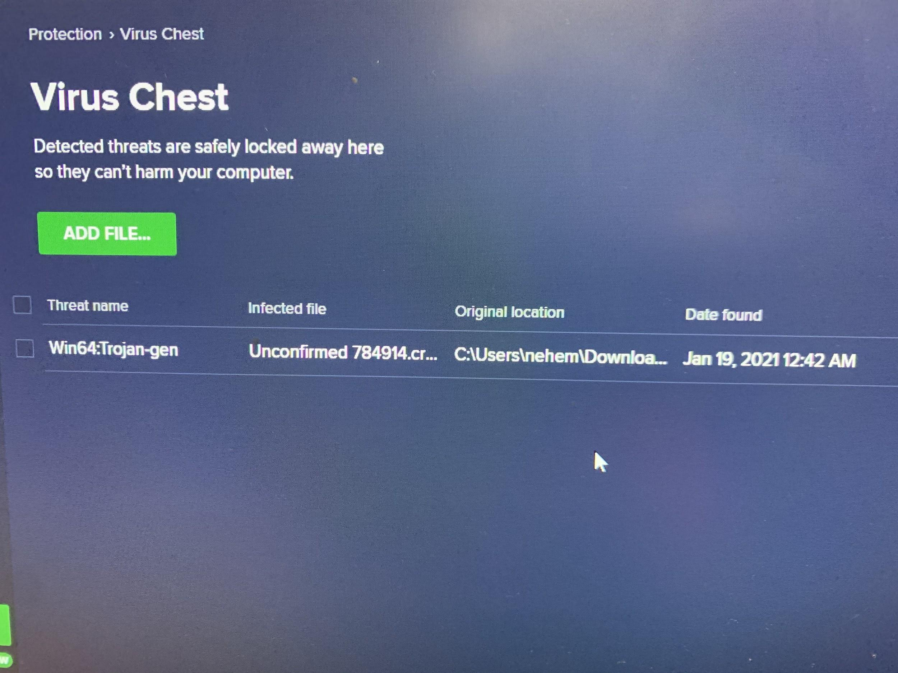
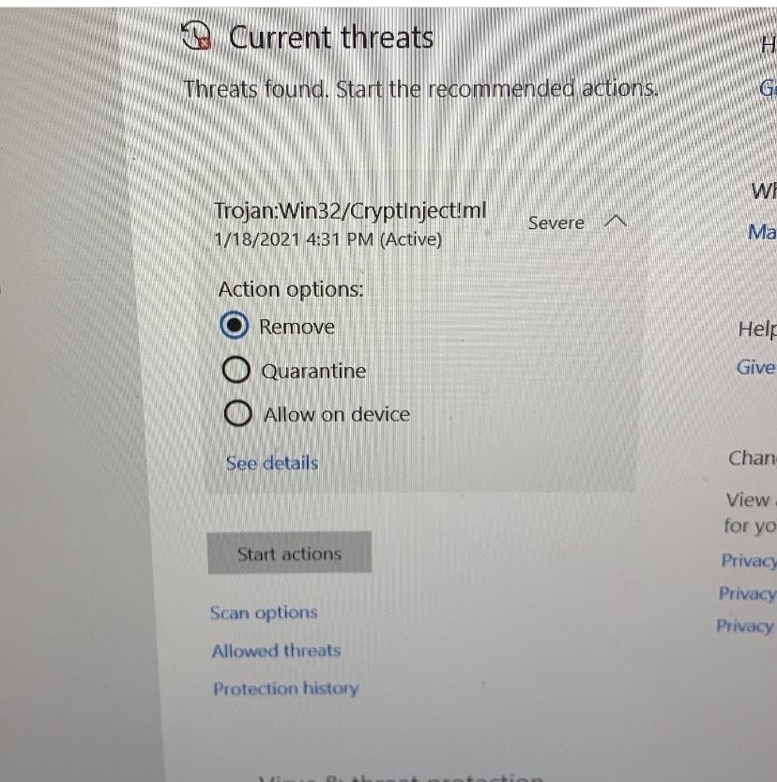
Valorant.exe
Used auto-py-to-exe to convert python file to executable (.exe does not work on Macs)
Added Valorant Icon to .Exe file
Figured out there was an error with the newest version of pynput, had to downgrade it to from version 1.7.2 to version 1.6.8 (We added code to automate pynput install so virus is automated)
Valorant.exe will get flagged as a Virus

Slide 9
Known Issues
Antivirus programs (such as Avast Free Antivirus and Microsoft Defender) will flag Valorant.exe as a virus
Solution: Tell your antivirus application that the files are good, such as "restore" and "retrieve" "not a threat"
The ASCII Art (the "YOU HAVE BEEN HACKED") causes an error on my GitBash, but no error on my VSCODE Git Terminal.
UnicodeEncodeError: 'charmap' codec can't encode characters in position 4-6: character maps to
Solution: simply delete the YOU HAVE BEEN HACKED print statement from the code.

Slide 10
Closing Remarks
Read our README.md (it’s pretty comprehensive)
This project was for Educational purposes.
DO NOT TRY TO USE OUR KEYLOGGER AS A LEGITIMATE VIRUS BECAUSE IT IS A FEDERAL CRIME IN MOST CASES AND FINES, ARRESTS, AND JAIL TIME COULD BE WARRANTED
“Unauthorized access of another person's information on a computer is illegal.”
Hope you guys enjoyed!

