Slide 1

Ethproofs call #9 - Verity Client
Shouki Tsuda / Nyx Foundation
Notes:
Verity: Nyx Foundation's project to build the most secure Lean Consensus client. Key idea: mathematical proof and real code meet in one system.

Slide 2

What is Verity?
A Lean Consensus client
Mathematically align specification and implementation
Its backend runs consensus logic that is formally verified as far as possible
Inspired by Cardano
Notes:
Verity is a Lean Consensus client. Its core design philosophy is to remove the drift between the specification and the implementation. The backend runs consensus logic that is formally verified as far as possible. The approach is inspired by Cardano.

Slide 3


How it works
The runtime
Runs everything with side effects: P2P, RPC, storage, etc.
Memory-safe and concurrent, proven in real clients, and reuses existing code like leanMultisig
The verified consensus logic
Runs as pure functions: validation, STF, fork choice
This core logic can be mathematically proven correct
[ P2P / Sync / RPC / Storage / Metrics ]
Rust
|
v
[ FFI Adapter Layer ]
|
v
[ Validation / STF / Fork Choice ]
Lean
Notes:
Two languages: Lean is the brain (core logic, proven, pure functions); Rust is the body (fast, safe, everything else). The diagram shows Rust on top, Lean at the bottom, joined by a thin FFI adapter - the boundary we design most carefully.

Slide 4
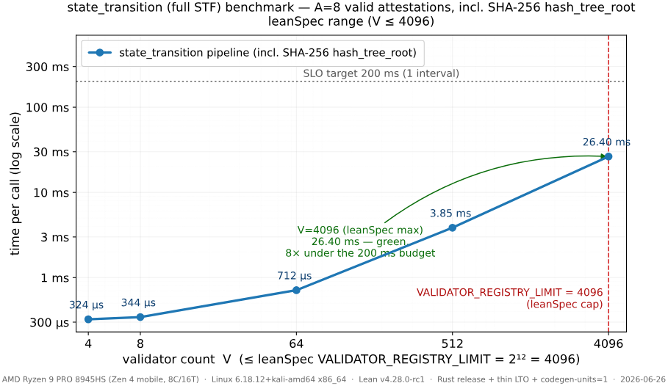
STF FFI benchmark
Notes:
We benchmarked the full state transition over the FFI — with a real SHA-256 hash_tree_root and 8 valid attestations. Up to the leanSpec maximum of 4096 validators it stays well under the 200-millisecond SLO — about 26 milliseconds at the cap, roughly 8 times under budget.

Slide 5
A few concerns about FFI
Connecting Lean and Rust must be both safe and efficient. Three issues:
Performance: Lean's runtime must start up, which adds overhead
Memory safety: Lean uses reference counting - a different model from Rust's
Interfaces: types like String, Array and Nat can't be passed to Rust directly
Design rule: keep calls to a minimum and data formats simple
Notes:
The hardest part is the FFI bridge: it must be safe and efficient. Three issues - performance (runtime startup overhead), memory safety (reference counting vs Rust), interfaces (basic types can't cross directly). Rule: few calls, simple data.

Slide 6
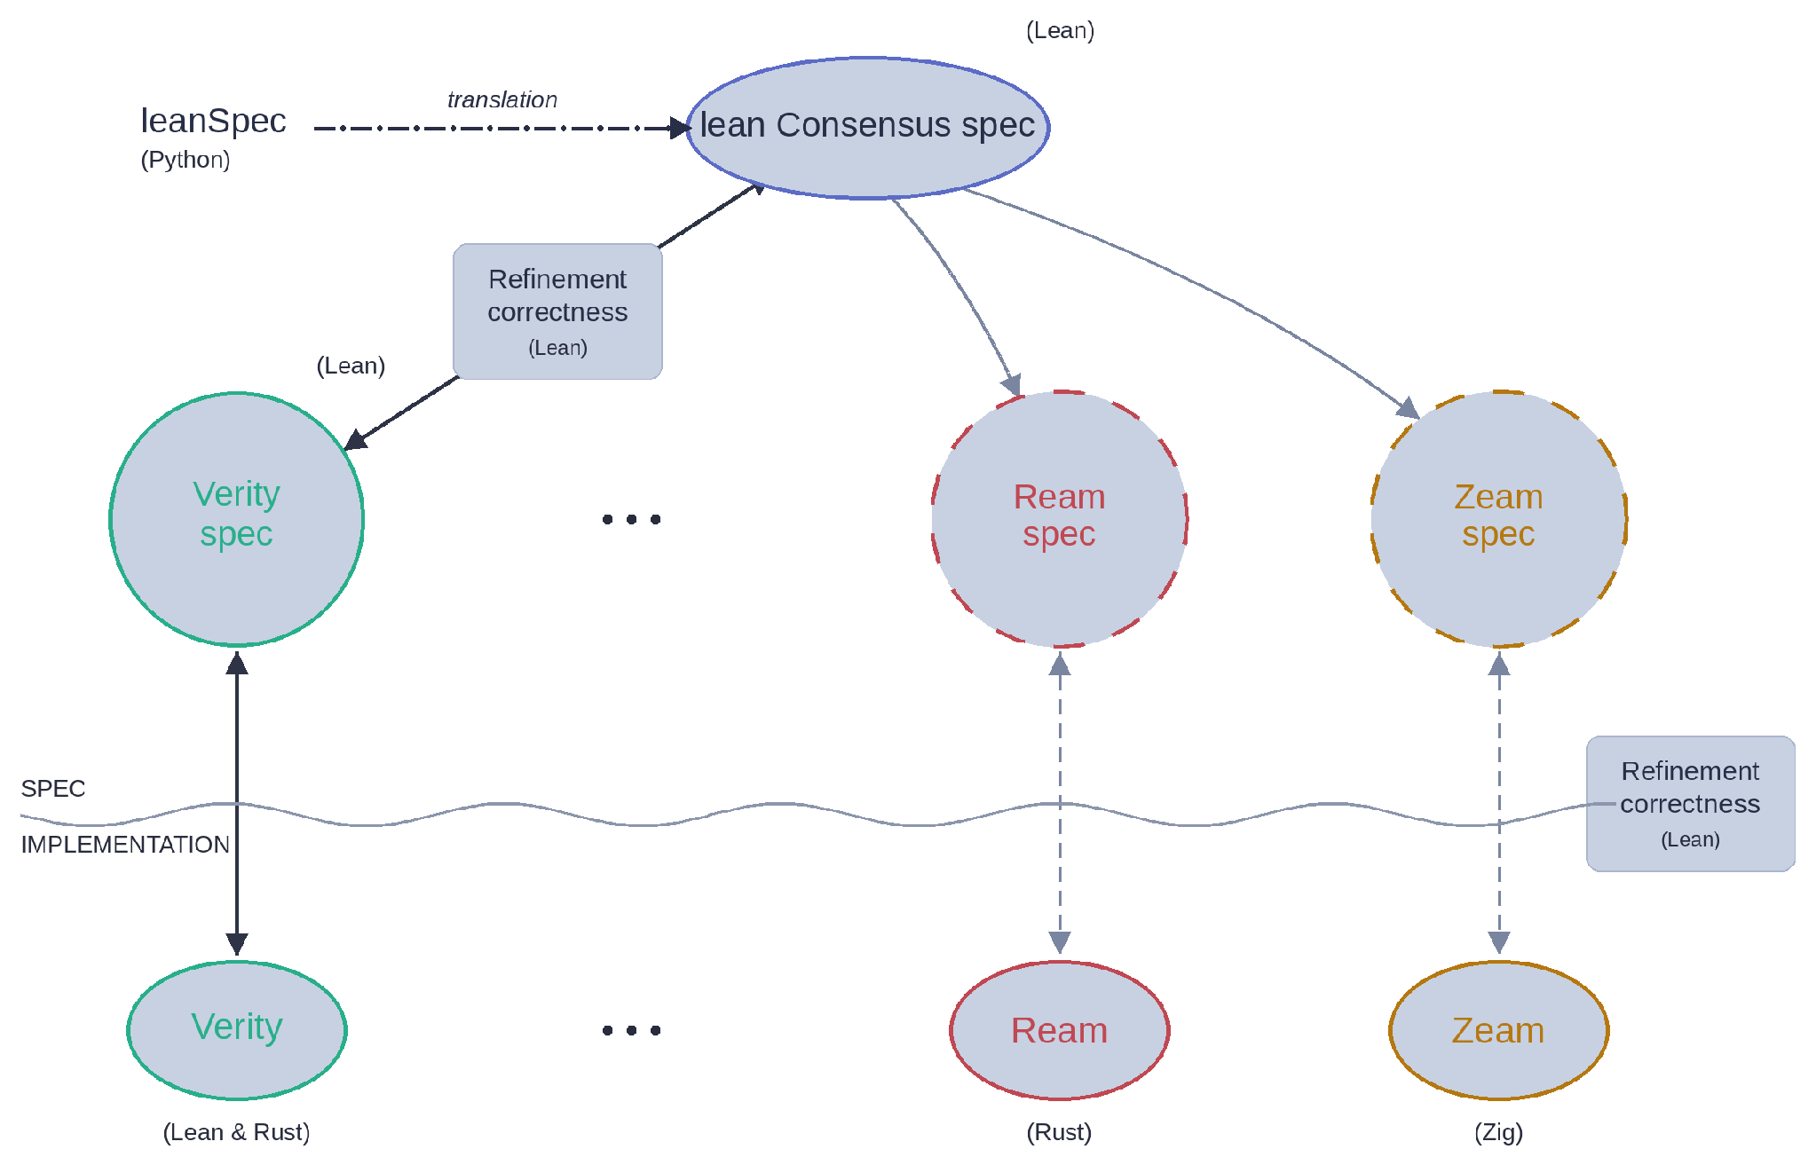
Notes:
Finally, the bigger goal, shown in this diagram. The proofs we write aren't only for Verity - they're meant to be shared across all of Lean Consensus. The shared lean Consensus spec (translated from the Python leanSpec into Lean) sits at the top, and every client - Ream, Zeam, Verity, and others - connects to it. Each client only needs to prove its own functional correctness against that shared spec. So our real aim is stronger security for the whole Ethereum ecosystem, not just one client. This is still conceptual, so please read the full post and share your feedback. Thank you.

Slide 7

Our work
formal-leanSpec
https://github.com/NyxFoundation/formal-leanSpec
Re-defining the Lean Consensus spec in Lean
goldfish-fv
https://github.com/NyxFoundation/goldfish-fv
Guaranteeing the safety of Goldfish
verifiable-stf
https://github.com/NyxFoundation/verifiable-stf
PoC: running a zkVM guest program in Lean
https://verityclient.com/
Notes:
Where we are now - three repositories are already public. formal-leanSpec re-defines the Lean Consensus spec in Lean. goldfish-fv works on guaranteeing the safety of the Goldfish protocol. And verifiable-stf is a proof of concept for running a zkVM guest program in Lean. Thank you.

Slide 8
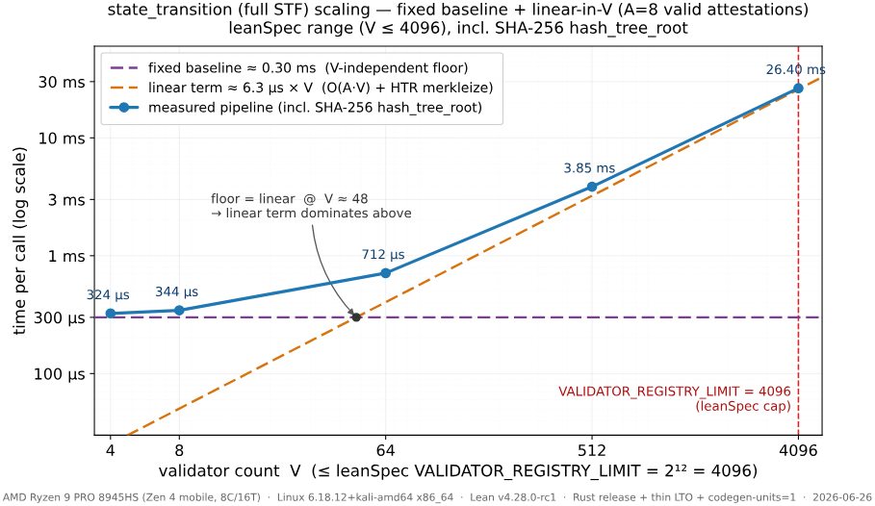
Appendix — STF scaling: baseline + linear
Notes:
Appendix. The state-transition cost splits into a fixed baseline of about 0.30 ms (V-independent floor) plus a linear term of about 6.3 microseconds per validator (O(A*V) work plus hash_tree_root merkleization). The two cross over near V=48; above that, the linear term dominates.

Slide 9
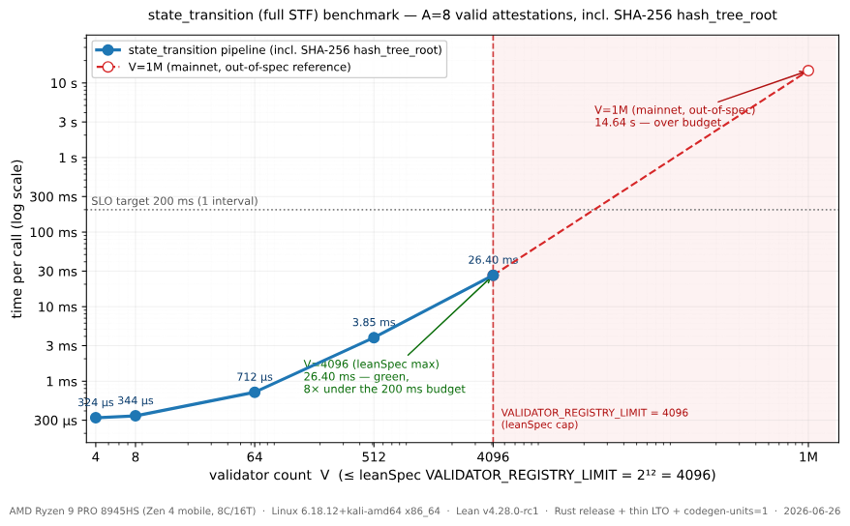
Appendix — STF benchmark (incl. V=1M reference)
Notes:
Appendix. The same benchmark with a mainnet-scale V=1,000,000 reference point added. That point is out of spec for leanSpec (cap 4096) and takes about 14.6 seconds, over the 200 ms budget — shown only for context.

Slide 10
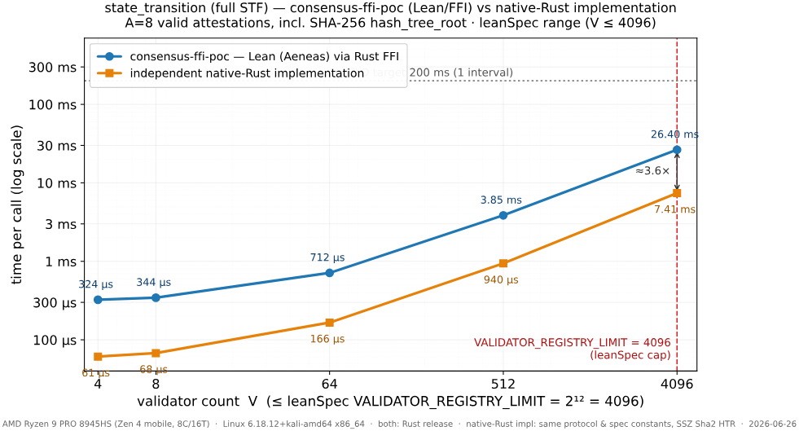
Appendix — STF: FFI (Lean) vs native-Rust

