Slide 1


ENTRY 01
"Orientation: Welcome to the Precinct"
TRAINING VIDEO
DATE OF PRODUCTION: 8/2/20XX
PRECINCT ARCHIVE // RECOVERED MEDIA // CLASSIFICATION: STANDARD

Slide 2

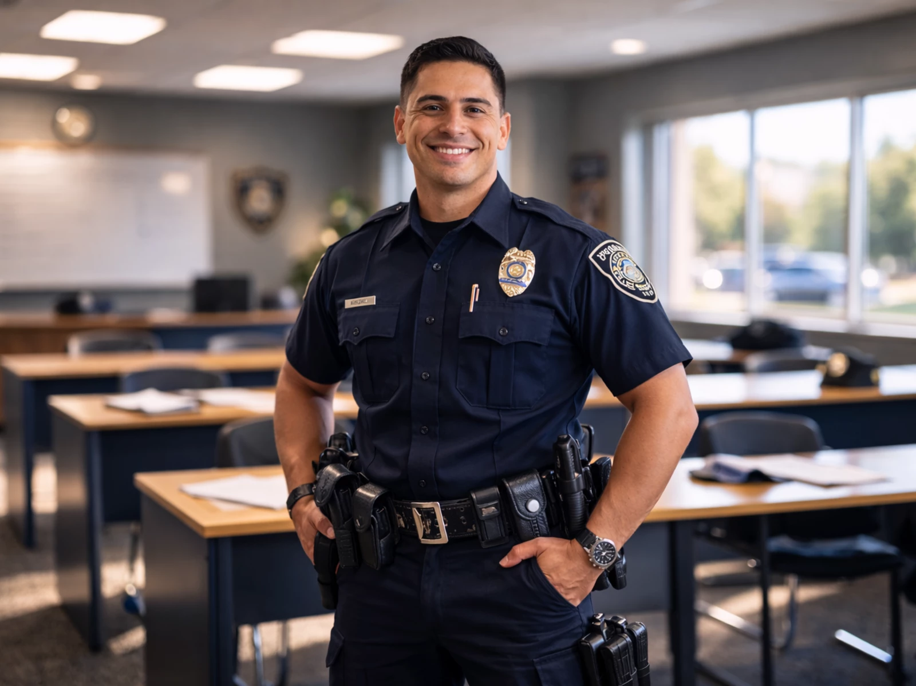
REC
00:00:14
Getting Started
Firstly, welcome to the team we are so happy for you to join us. First things first you should have your ID card and badge ready. Your ID card will let you into all the buildings we have on campus.
PRECINCT ARCHIVE // RECOVERED MEDIA // CLASSIFICATION: STANDARD

Slide 3
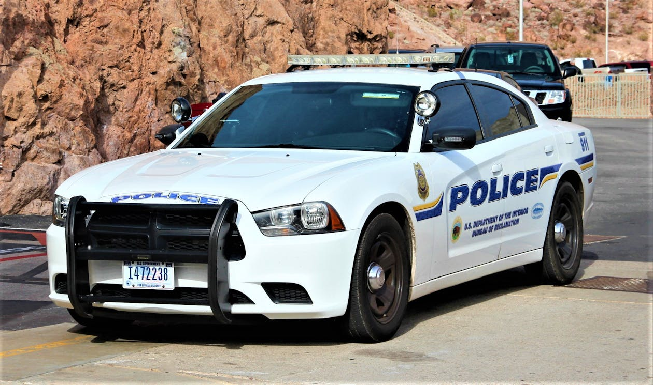
REC
00:01:32
What To Expect
On your first day we will go a bit slower walk you around our campus and visit all the required buildings. Then take a quick drive around the city to take in all you will see.
PRECINCT ARCHIVE // RECOVERED MEDIA // CLASSIFICATION: STANDARD

Slide 4

REC
00:02:18
How We Work Around Here
Your day to day around here won’t be anything shocking just talking to a few citizens here and there . One or two traffic stops, you have nothing to worry about.
PRECINCT ARCHIVE // RECOVERED MEDIA // CLASSIFICATION: STANDARD

Slide 5

REC
00:03:05
What to do if you see an Anomaly
This is a rare occurrence around here but when it does happen, these are the steps
1. see if anybody is around we don’t want any bystanders to get hurt
2.Once all bystanders are out of the zone slowly walk towards the anomaly.
3. Capture the anomaly in the box labeled waste box
PRECINCT ARCHIVE // RECOVERED MEDIA // CLASSIFICATION: STANDARD

Slide 6

REC
00:03:48
How to report anything you find.
To report anything you find go to the database and log the name of the and the code given to you at the start of your day.
PRECINCT ARCHIVE // RECOVERED MEDIA // CLASSIFICATION: STANDARD

Slide 7
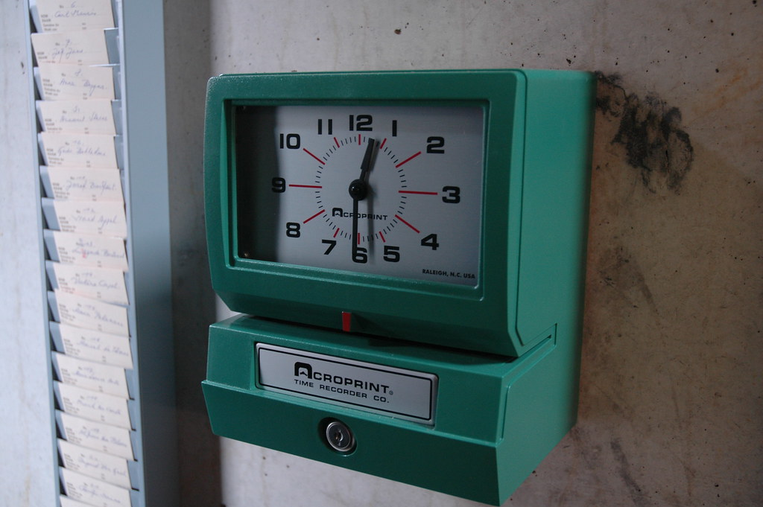
REC
00:04:27
Clocking in and clocking out.
To clock in and out you will use the tablet on wall. You are expected to enter and leave at your said time. Any late or early officers will be reprimanded.
PRECINCT ARCHIVE // RECOVERED MEDIA // CLASSIFICATION: STANDARD

Slide 8

REC
00:05:44
We only except the best.
Only the best is wanted here. If you went the best, then you wouldn’t be here! If you aren't at you best, we will find other ways for you to serve
PRECINCT ARCHIVE // RECOVERED MEDIA // CLASSIFICATION: STANDARD

Slide 9
REC
00:06:12
We hope you are ready to serve this great city. Make some new friends, have a good time. And remember the city of Black Water needs you!
PRECINCT ARCHIVE // RECOVERED MEDIA // CLASSIFICATION: STANDARD

