Slide 1
The Bitcoin OTC Trust Network
Structure and rating patterns
Network Science project | 35,592 ratings | 5,881 users
Team names to be added to the final title page

Slide 2
Research question and data
How are ratings organized, and how did incoming positive ratings become concentrated?
35,592 directed, signed, timestamped ratings
5,881 users • 32,029 positive • 3,563 negative
SNAP Bitcoin OTC, November 2010 to January 2016
Source: SNAP Bitcoin OTC dataset; Kumar et al. (ICDM 2016). Ratings are opinions, not verified trades.
2

Slide 3
Three graph views serve different questions
Full signed, directed graph
Undirected positive projection
Preserves rater → recipient, score, and time. Used for Cytoscape.
18,591 links after reciprocal pairs are collapsed. Used for ER, BA, clustering, paths, and Louvain.
Positive directed graph
In-degree counts favorable ratings received. Used for temporal analysis.
Direction, sign, and rating strength are lost in the projection.
3

Slide 4
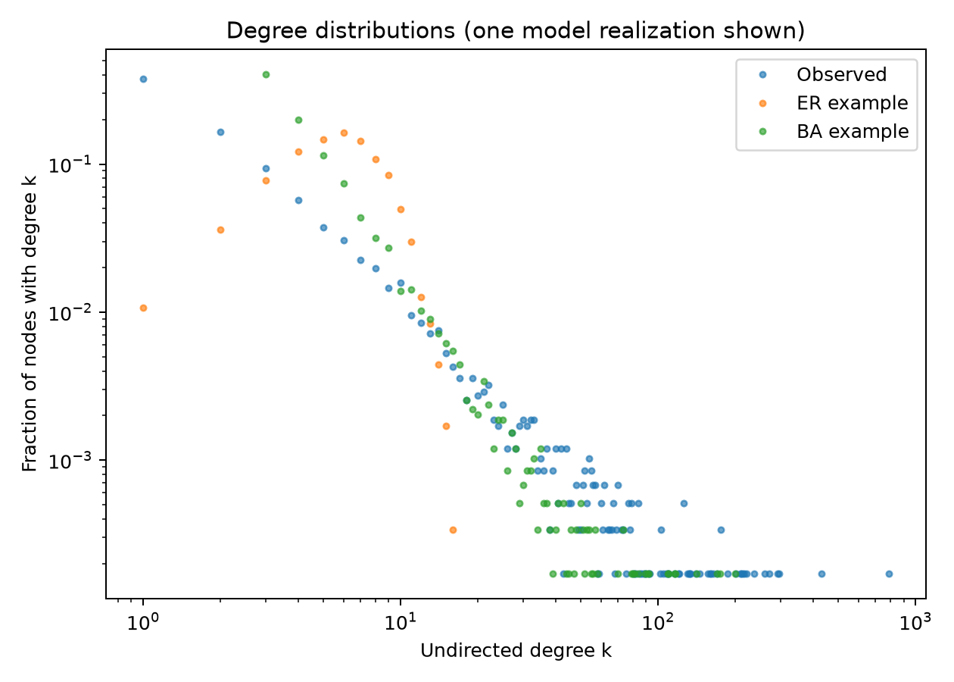
The observed graph exceeds both reference models
Observed
Max degree 788
Transitivity 0.0570
Largest component 94.4%
ER / BA means
Max degree 17 / 231
Transitivity 0.0011 / 0.0042
Ten realizations per model. BA has 5.15% fewer links than the observed projection.
4

Slide 5
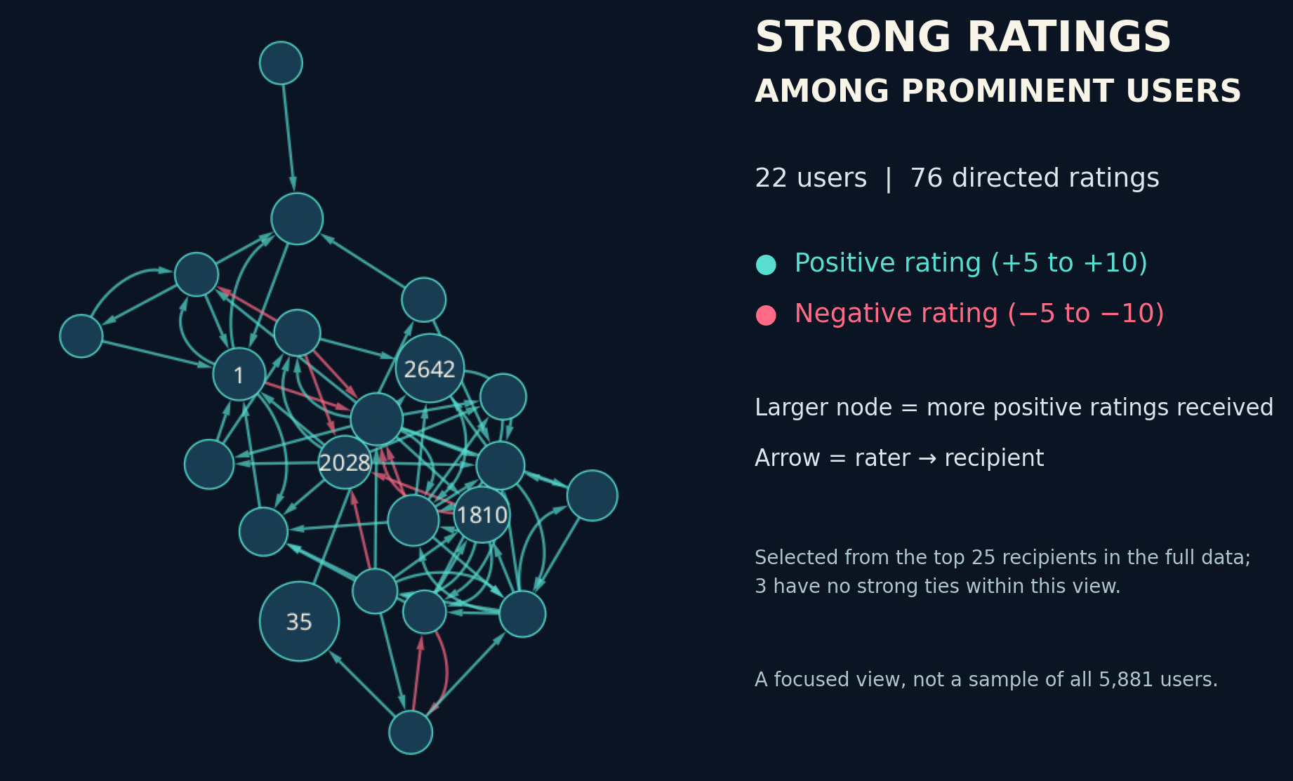
Cytoscape spotlight: strong ratings
Selected using full-data degree; the companion MP4 shows these strong edges appearing by year.
5

Slide 6
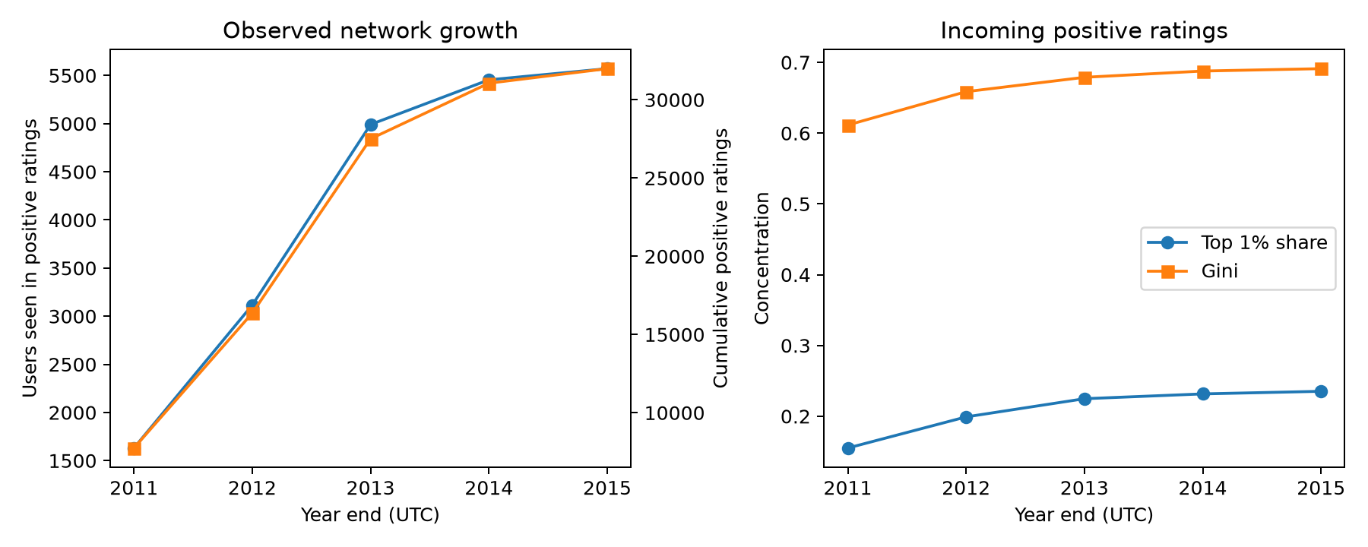
Incoming ratings became more concentrated
Top 1% share: 0.155 → 0.235
Cumulative positive ratings, full years 2011–2015; old ratings are recorded history.
6

Slide 7
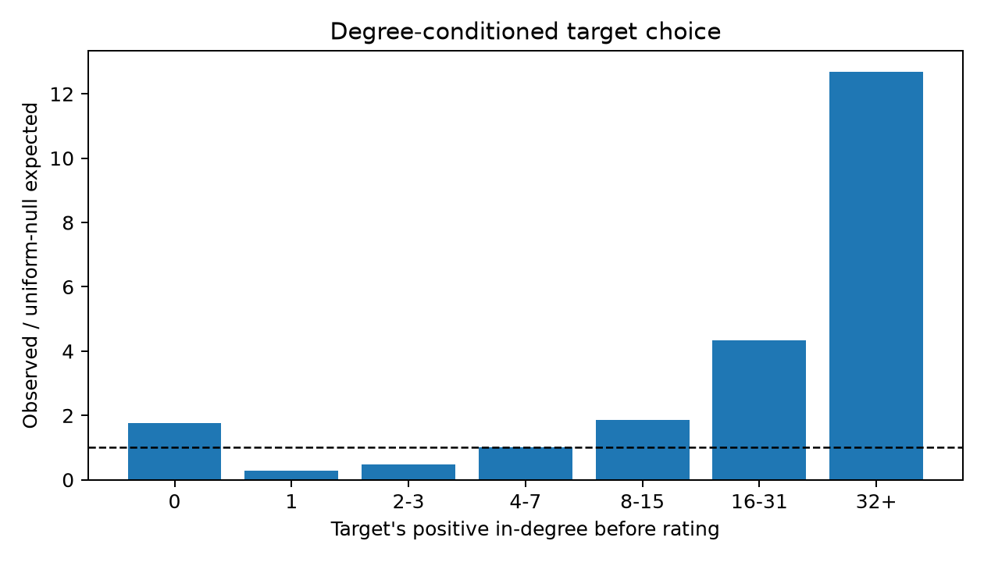
Prior high-degree targets were overrepresented
32+ prior positive ratings
7,356 observed
579 expected
Ratio 12.7
Uniform eligible-target benchmark; association does not establish preferential attachment.
7

Slide 8
What the result means—and what it cannot show
Supported
Limits
The positive network is highly clustered and degree-unequal.
Incoming ratings concentrated over time.
Prominent users received more later ratings than the simple null predicts.
No verified trades or fraud labels.
No rating expiry or full user registry.
Activity, tenure, and visibility may explain target choice.
ER and BA omit signs and direction.
The report includes the +5 rating threshold sensitivity analysis and full methods.
8

Slide 9
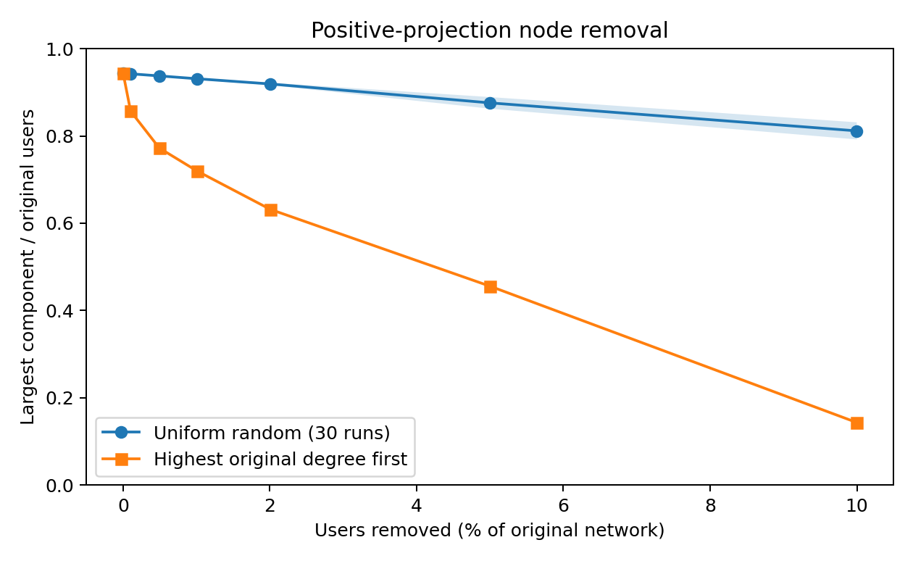
What happens when users are removed?
Remove 5% of users
Random: 87.6% remain connected
Highest degree: 45.6%
Hypothetical node removal on the undirected positive projection; random line averages 30 runs.
9

Slide 10
Code demonstration and conclusion
Live demonstration
Conclusion
1 Open the source-audit notebook
2 Run structural_analysis.py
3 Open the model and temporal notebooks
4 Run node_removal.py and explain the effect
Neither standard model explains the full structure.
Rating concentration increased, but the data do not identify its cause.
Repository: github.com/O-2wice/bitcoin-otc-trust-network-science
10

