Slide 1
CHURNGUARD
Customer Churn Prediction for FreshBasket Retail
Propel Assessment | Data quality • Behavioural signals • Risk scoring • Retention action
Prepared from the committed dataset and reproducible analysis outputs

Slide 2
1. Business problem
• FreshBasket wants to identify loyalty members who may stop purchasing.
• Objective: estimate customer-level churn risk and focus retention outreach where it may be most useful.
• Prediction features must be available before the label window; business action needs a controlled pilot.

Slide 3
2. Target and data
• CHURNED = 1: no purchase transactions in April–June 2024 despite earlier purchase history.
• Eligible modelling population: 2,225 customers; 662 churned (29.8%).
• Predictive activity features end in March 2024; insufficient-history customers are excluded.

Slide 4
3. Data-quality decisions
• Removed exact duplicate rows and investigated repeated customer-months.
• Two conflicting spend pairs were handled by excluding the negative-spend version; this is an inference, not source-owner confirmation.
• 449 customers have all four recent activity features missing; 442 are labelled churned. Missingness may strongly influence the model.

Slide 5
4. Leakage-safe feature groups
• Behaviour: pre-period transactions, spend, basket value, promotions, coupons and active months.
• Engagement/support: app sessions, email opens and support tickets, including January–March recent activity.
• Profile: tenure, age, city, membership tier, marketing opt-in and preferences.

Slide 6
5. Cohort-based validation
Hold out customers from the latest signup-date cohort
Cut-off date: 2023-07-17
Training cohort: 1,780 customers (34.6% churn) | Validation: 445 customers (10.6% churn)
Calibration check: selected-model mean risk 20.2% vs observed validation churn 10.6%.
Caveat: all customers share the same Apr–Jun 2024 label window. Signup-cohort validation is not the same as testing on a later outcome period; the score gap also means absolute probabilities need further calibration.

Slide 7
6. Model comparison
• Best cohort-holdout PR-AUC (average precision): Random Forest (0.699).
• Best cohort-holdout F1: Random Forest (0.583).
• Accuracy alone is insufficient for the 29.75% churn class; precision, recall, F1 and PR-AUC are reported.

Slide 8
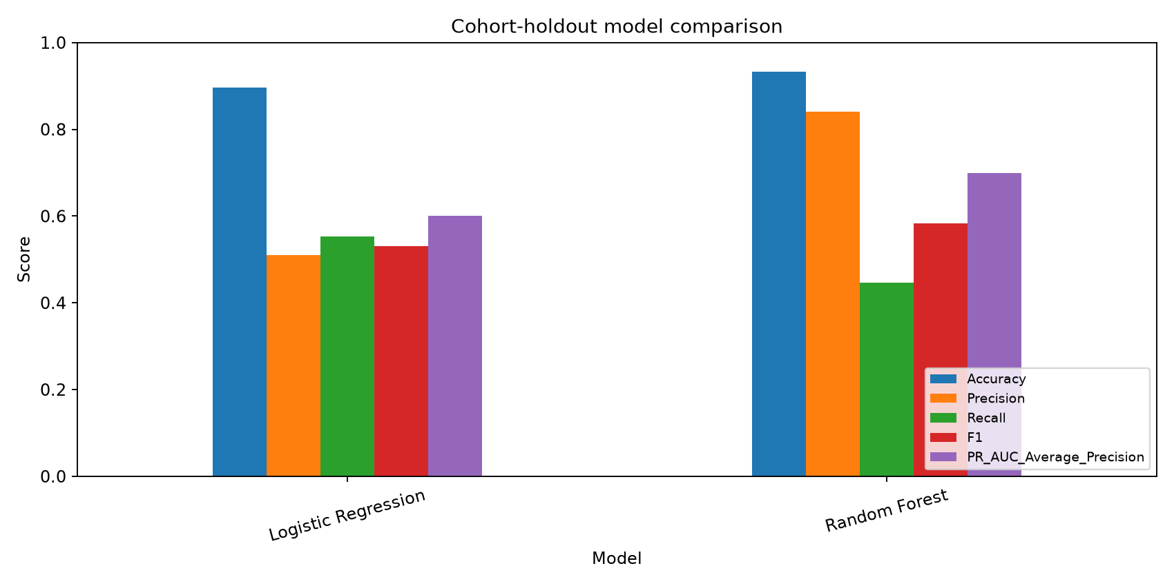
7. Model performance
Cohort-holdout metrics at a fixed 0.50 decision threshold

Slide 9
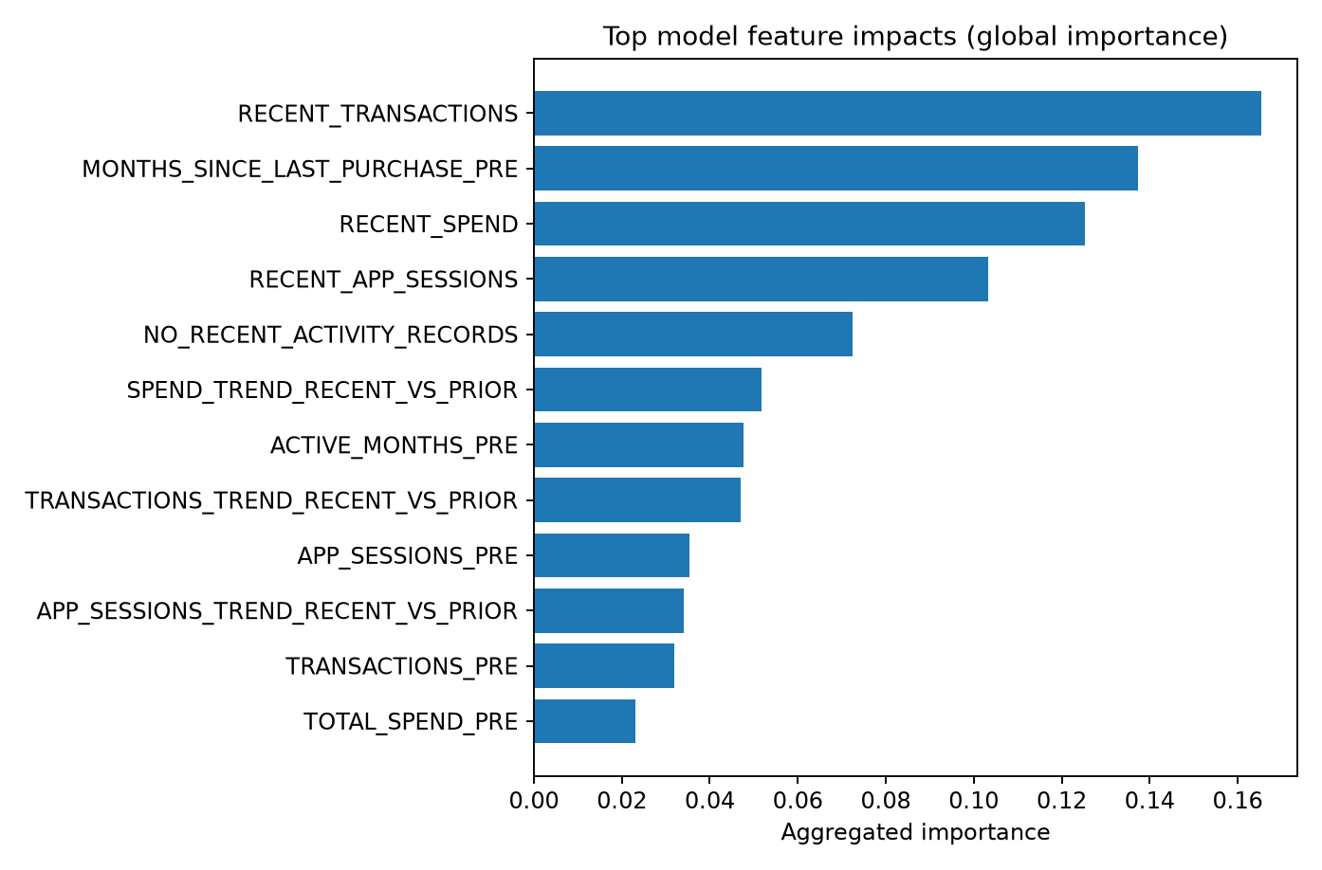
8. Main churn drivers
Global model importance aggregated to original input features; not causal effects

Slide 10
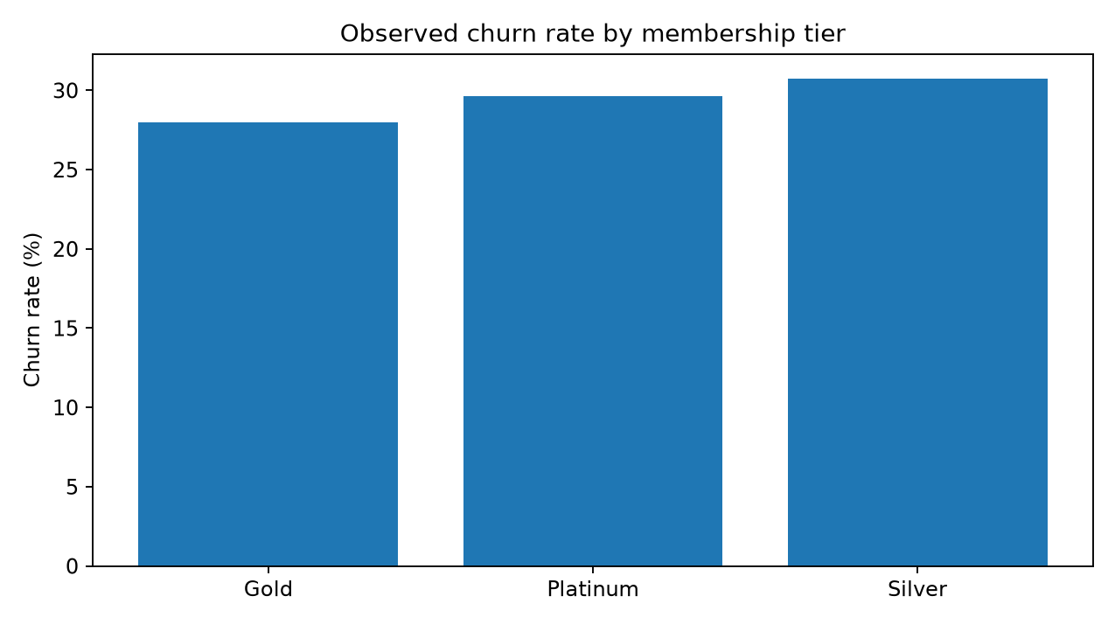
9. Segment risk: membership tier
Observed historical churn rates by membership tier

Slide 11
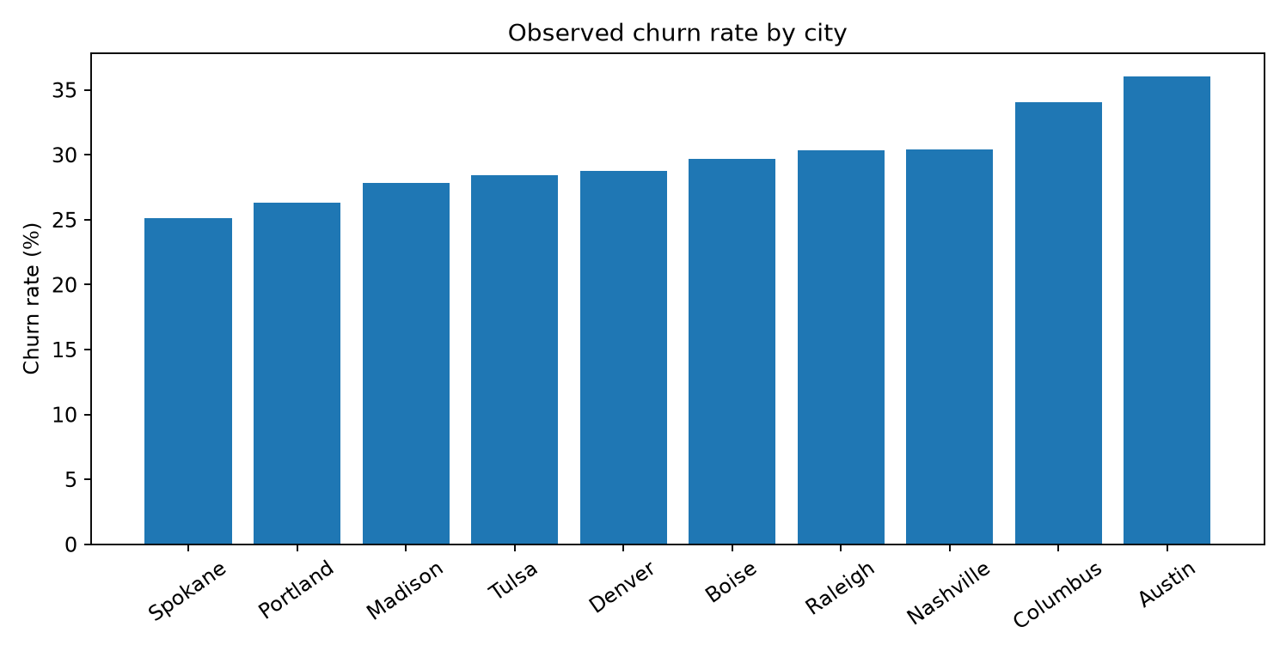
10. Segment risk: city
Observed churn rates across cities; small groups need caution

Slide 12
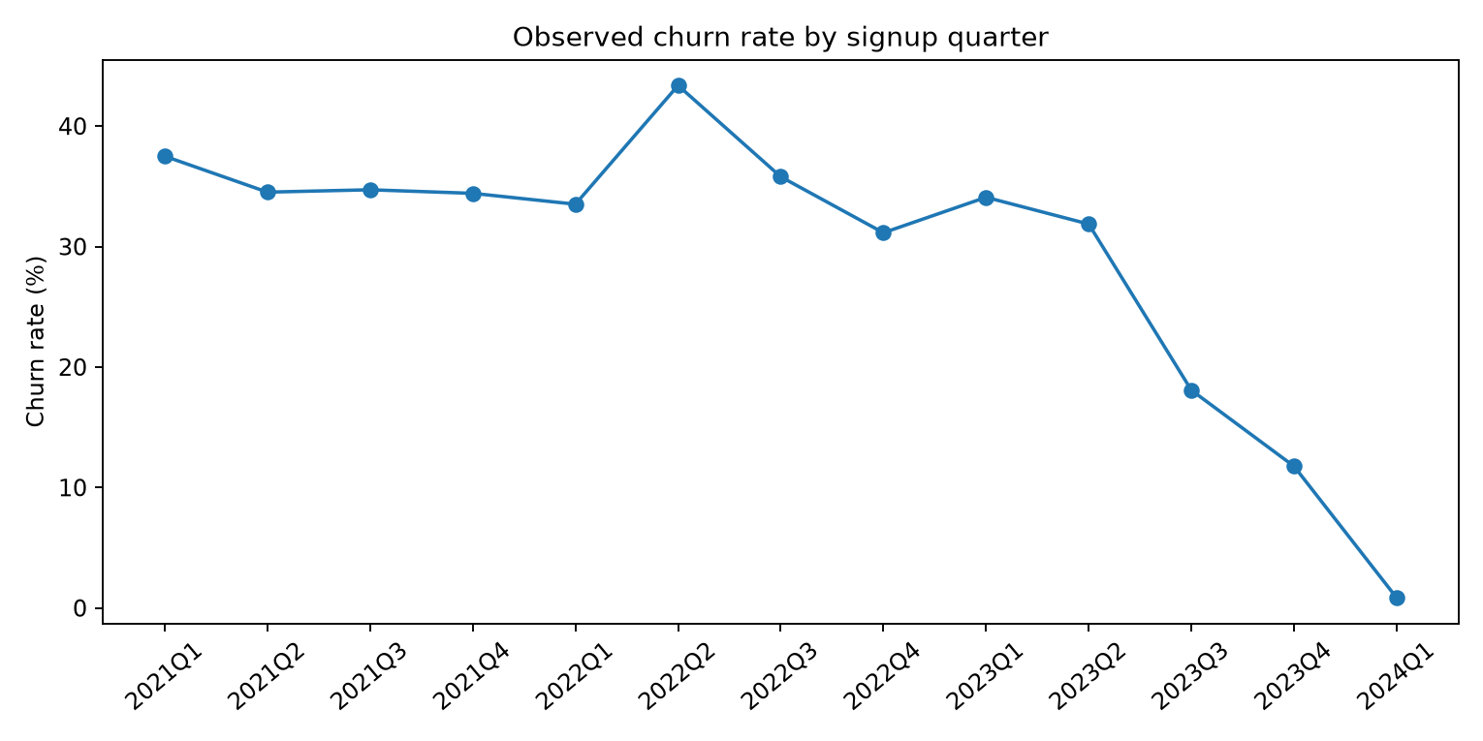
11. Segment risk: signup cohort
Observed churn rates by signup quarter

Slide 13
12. Retention scenario
• Target the top 20% by predicted risk (89 customers).
• Under an assumed 10% relative reduction for contacted customers, modelled expected churn reduction is 4.3 customers.
• This is an illustrative sensitivity scenario, not a causal effect estimate. Coupon cost and treatment effectiveness are not provided.

Slide 14
13. Recommendations and limitations
• Run a controlled retention pilot and compare outcomes against a holdout group before scaling.
• Investigate missing Jan–Mar activity records; confirm whether they mean no shopping or missing telemetry.
• Validation calibration warning: mean selected-model risk 20.2% vs observed churn 10.6%; use scores for ranking only until calibrated.
• One label window limits genuine out-of-time validation; observational patterns do not establish causality.

Slide 15
14. Conclusion and next steps
• Use churn scores to prioritise outreach—not as a final automated decision.
• Monitor recall and precision alongside offer cost and incremental retention.
• Validate on a future outcome window when new labels become available.

