Slide 1

AI NATIVE BY DESIGN
A
CNSBG-Billy Su
AI IN THE BUILD, DETERMINISTIC IN THE RUN
THE FOUR AI NATIVE CONDITIONS
01
AI Did the Reading Work — Once
Condition
Status
AI derived the LDM schema and the design rules from real customer PMD documents. That result is frozen into a fixed engine. The factory runs the engine, not a model.
Machine-readable input — no human reading step
Met
02
Deterministic in Production
Exception boundary — the system never guesses
Met
The same PMD gives the same label file today and six months from now. For MAC and RSN data, an answer that varies is a defect, not a feature.
AI does the work; people approve exceptions
Met
03
Auditable, Not a Black Box
Event-driven trigger — auto-start on new PMD
Every decision maps back to a rule we can show. If a customer challenges a printed label, we can explain exactly why the system produced that value.
Phase 2
04
Offline — No Document Leaves the Site
WHAT THIS IS NOT
Customer documents are never sent outside. No network dependency, no per-use AI cost, no exposure of customer data to any external service.
A coding assistant makes one engineer faster; the workflow is unchanged. Here the workflow changed: a step people used to do is now done by the machine, and people moved to approving exceptions. That is the difference.
2026 Auto Design Label — Internal. All Rights Reserved.
PHASE 1 — IN PROGRESS
1/5
Notes:
FRAMING SLIDE — for reading, not for speaking.
Purpose: answer the two questions a reviewer will ask before looking at any result.
1) Where is the AI? In the build, not in the run. AI derived the LDM schema and the design rules from real customer PMD documents, once. That output is frozen into a fixed engine. Production runs the engine offline.
2) Why is that still AI Native? Engineering 6 asks AI to enter the workflow and become a workforce step, not to sit in the runtime. A step people used to do is now done by the machine; people moved to approving exceptions.
Deliberate design choice, not a shortcut: a production line needs the same answer every time (MAC and RSN cannot vary), needs to be auditable per Engineering 1, and cannot send customer documents outside.
Known gap, stated on purpose: the engine handles document formats already derived. For a new layout, rules are re-derived with AI offline and shipped as an update. Putting a model in the runtime is Phase 2 — the exception boundary already built is what makes that safe to add later.
If asked "is a coding assistant also AI Native?": no. A tool makes one engineer faster and the workflow is unchanged. Here the workflow itself changed.

Slide 2


AUTO DESIGN LABEL
A
CNSBG-Billy Su
BEFORE — People Do the Work
AFTER — AI Works, People Approve
!
Manually reading PMD documents — 30 minutes to 8 hours per model
✓
Document read in 1-5 minutes, not hours — no manual reading
!
Redesigning in Codesoft 6 — requires separate license and training
✓
ZPL generated directly — removes the Codesoft 6 license (Phase 2)
!
MAC/RSN/coordinate entry errors — high defect rate in mass printing
✓
Values taken from the document, never typed — entry errors gone
!
Binary .lab files — no version control, no traceability
✓
Versioned JSON instead of binary — every change is traceable
OPERATING WORKFLOW
1
→
2
→
3
→
4
Read & Interpret Label Document
(AI)
Auto Design
(AI)
Review Results
(Human — exception only)
Export Label File
(AI)
AI NATIVE POSITION:
This is not people using AI. AI is a step inside the workflow — of four steps, AI runs three, and people act only on exceptions. Replicable to any site using PMD + Codesoft 6.
2026 Auto Design Label — Internal. All Rights Reserved.
2/5
Notes:
OPEN — 20s
My last part is an improvement project: Auto Design Label. I want to present it against the F1.0 criteria for AI Native, because I believe this project is a working example of Engineering 6.
PROBLEM — 45s
The problem is in the Label Room. Today, every label is still read and drawn by hand. To make one label, our staff must read the customer PMD document by hand. This takes 30 minutes to 8 hours for one model. Then they draw the label again in Codesoft 6, which needs a separate license and training. All MAC, RSN and position values are typed by hand. This is our main source of errors. The .lab file is binary, so we have no version control and no traceability.
THE SHIFT — 45s
Now look at the new process. Four steps: read, design, review, export. AI does three of them. People do one. And that one step is not data entry. It is approval of exceptions.
This is the point. This project is not people using AI. Nobody opens a tool and asks a question. AI is a step inside the workflow, with its own input, its own output, and its own responsibility. That is the difference between a tool and a workforce.

Slide 3
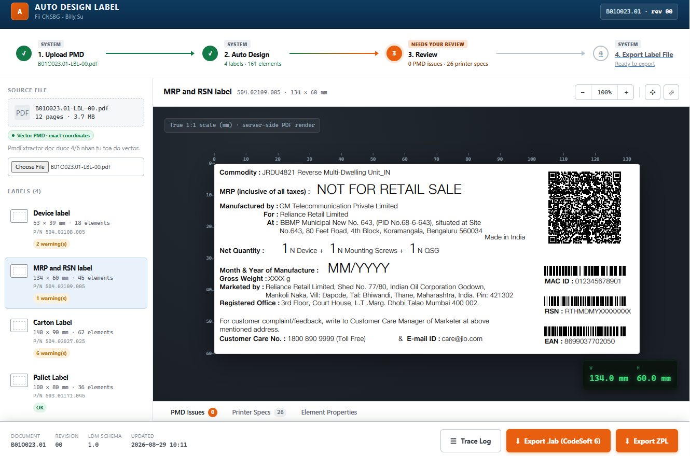
AUTO DESIGN LABEL
A
CNSBG-Billy Su
AI NATIVE — WHAT IS DELIVERED
LIVE INTERFACE — DEMO IN PROGRESS
01
Machine-Readable Input, Not Human Reading
Extracts all PMD content (dimensions, fonts, barcodes, QR codes, positions) into LDM (standardized JSON). No person reads the document.
02
Clear Exception Boundary — AI Never Guesses
On masked values, unclear definitions or conflicts between sections, the system stops and reports. It never infers a “correct” value on its own.
03
AI Designs, Human Approves Exceptions
Generates label designs at true 1:1 scale (mm) for preview and review before and after export. Operators confirm only what was flagged.
04
Traceable by Design — LDM Is Auditable
Every label is versioned JSON (LDM), not a binary .lab file — readable, comparable, auditable. ZPL is generated from the same LDM (Phase 2 license cost-down).
THE AI NATIVE TEST
READ – ANALYSIS – DESIGN – HUMAN REVIEW – EXPORT FILE
TESTING
Switch it off for one week and Label Room goes back to reading PMDs by hand — [X] engineer-hours per week. The work does not slow down; it stops.
2026 Auto Design Label — Internal. All Rights Reserved.
3/5
Notes:
FOUR CONDITIONS — 70s
First, the input is machine-readable, not human-read. The system takes all PMD content into one standard format, LDM. No person reads the document.
Second, there is a clear exception boundary. If a value is hidden, if a definition is not clear, or if two parts of the document do not match, the system stops and reports. It never guesses. I want to say this clearly to QA: the machine does not decide for people. This is not a limitation. It is the condition that allows AI to stand inside a production workflow at all.
Third, AI designs and people approve. True 1:1 scale in millimetres, reviewed before and after export. Operators confirm only what was flagged.
Fourth, everything is traceable. Every label is versioned JSON, not a binary file. ZPL comes from the same LDM, which is the base for Phase 2 license cost-down.
DEMO — 30s
On the right is the real screen, running now. Four labels from one pilot document. Status is On progress: reading and design finished, now at review. I keep the real status on the slide, not a picture made to look nice.
THE TEST — 25s
Switch this system off for one week. Label Room goes back to reading PMDs by hand — [X] engineer-hours per week. The work does not slow down. It stops. That is why I call this a workforce step, not a tool.
>>> FILL IN [X] BEFORE THE MEETING.

Slide 4
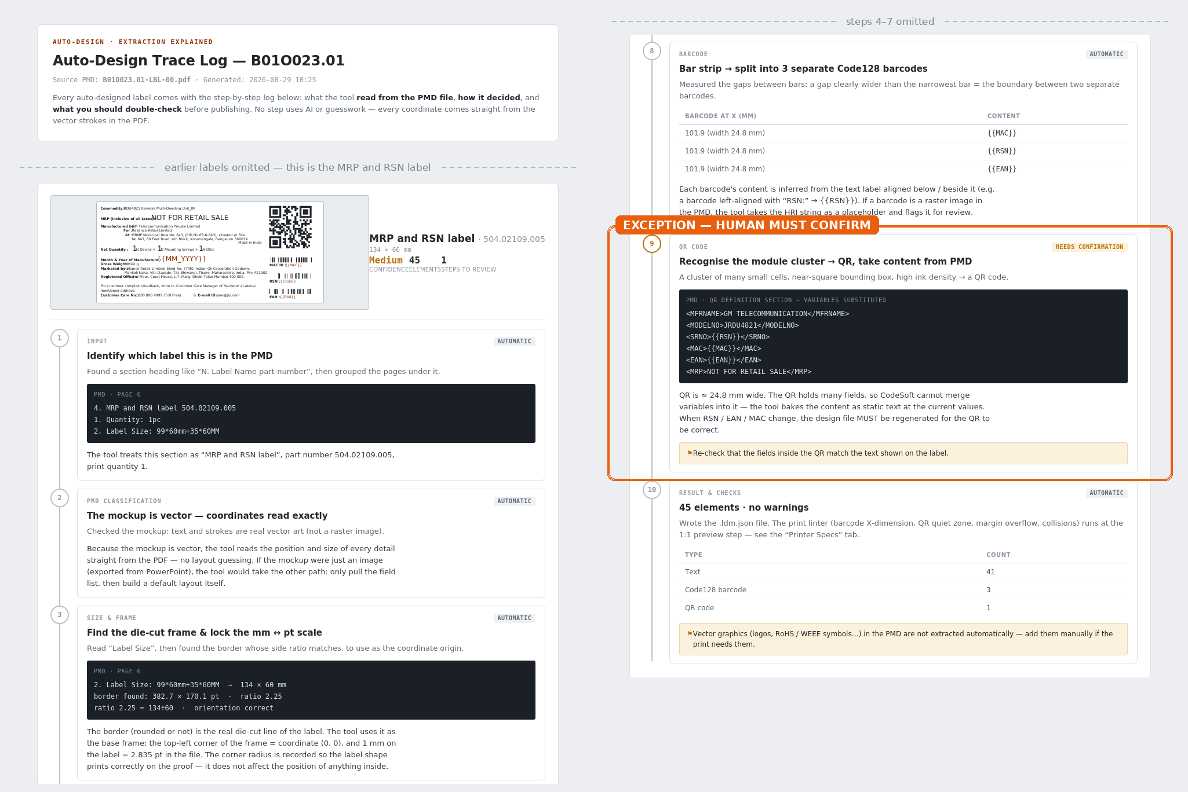
TRACE LOG — AUDIT BY DESIGN
A
CNSBG-Billy Su
WHAT THE LOG RECORDS
TRACE LOG — B01O023.01 (EXCERPT)
01
Ten Steps for Every Label
From identifying the label section in the PMD to the final element count: frame and scale, scope, fonts, text, variables, barcodes, QR.
02
Every Value Cites Its Source
Each step quotes the PMD page and line it read, plus the rule applied — e.g. page 2, Label Size 53×39 mm, confirmed by a border ratio of 1.36.
03
No Guesswork in the Chain
Coordinates come from the vector strokes in the PDF, not from estimation. Bold or light comes from the embedded font name of each glyph.
04
Exceptions Are Marked, Not Hidden
Steps are stamped Automatic, Needs confirmation or Warning. Here the QR step was flagged; two other labels in the document were refused as out of scope.
AUDIT IN PRACTICE
MRP and RSN label — 1 of 10 steps flagged for confirmation
AUDITABLE
If a customer challenges a printed label, we open the log for that run and show the PMD page, the rule, and the value produced.
2026 Auto Design Label — Internal. All Rights Reserved.
4/5
Notes:
TRACE LOG — the evidence behind "Traceable by Design" on the previous slide.
The panel is the real log for the same label shown on the previous slide: MRP and RSN label, 504.02109.005, 134 x 60 mm, 45 elements. Same document, same label, so the reader can follow one object across both slides.
What one log contains, per label: ten steps from input to result. For each step, what was read with the PMD page and line quoted, which rule was applied, and what a person should double-check. Each step is stamped Automatic, Needs confirmation, or Warning.
The highlighted step is the point to make: step 9, the QR code. CodeSoft cannot merge variables into a QR, so the content is baked at the current values and the design must be regenerated when RSN, EAN or MAC change. The tool does not resolve this by itself. It marks the step, states the reason, and hands it to a person. That is the exception boundary, visible in the record.
Two more labels in this document (Screw VOID and Safety seal) were refused entirely: no font table in the PMD means a pre-printed decal, so the tool built no design rather than inventing one.
The practical value: if a customer challenges a printed label, we do not argue from memory. We open the log for that run and show the PMD page, the rule, and the value produced. This is what Engineering 1 means by auditable.
The panel is marked as an excerpt: the file header is kept for context, and the omitted sections are marked on the image itself.

Slide 5
SCALE TO ALL SITES
A
CNSBG-Billy Su
WHY IT SCALES ACROSS SITES
REQUIREMENTS FOR SITE ADOPTION
01
Replicable by Design, Not Site-Specific
Requirement
Priority
LDM is a generic JSON schema — any site using the same PMD format and Codesoft 6 can load it directly, with no need to build a separate engine.
Label documents in PMD (PDF) format
Required
02
Shared Linter for All Standards
Currently using Codesoft 6 + Zebra printers
Required
Printability rules (X-dimension, QR density, boundary overflow) apply to every label type and every site — only the input data differs.
A representative document sample for initial LDM validation
Required
03
Hardware-Independent by Site
Site-specific font files (if different from JioType)
ZplEmitter and PrinterClient communicate over standard ZPL via port 9100 — compatible with any Zebra printer, not locked to any site-specific model.
Optional — Phase 2
Event-driven trigger — auto-start on new PMD release
Phase 2
04
Incremental Rollout, Zero Disruption
Each site converts independently at its own pace — Label Room continues running CS6 in parallel until stability is confirmed.
REQUEST
Approve Phase 2 — event-driven trigger, run-level audit log, and Codesoft 6 license cost-down. And each related site to send one sample PMD this week.
2026 Auto Design Label — Internal. All Rights Reserved.
PHASE 1 — IN PROGRESS
5/5
Notes:
WHY IT SCALES — 40s
Can other sites use this, or only here? LDM is a common format. Nothing is fixed to one site. The print check rules — X-dimension, QR density, boundary overflow — work for every label type and every site. Only the input data differs. The system talks to printers with standard ZPL over port 9100, so any Zebra printer works. This is replicable by design, which is what Engineering 4 asks for.
LOW RISK — 20s
Rollout does not stop production. Each site moves at its own speed. Label Room keeps running Codesoft 6 in parallel until the new system is stable.
WHAT IS NOT DONE — 20s
I also want to be clear about what is not finished. Today the process still starts when a person uploads the document. A fully AI Native workflow should start by itself when a new PMD is released. That trigger is Phase 2, and I put it in the requirement table so it is visible.
REQUEST — 25s
Please approve Phase 2: event-driven trigger, run-level audit log, and removal of Codesoft 6 license cost. And please ask the related sites to send me one sample PMD document this week.
That is the end of my part. I am happy to take questions.
LIKELY QUESTIONS
- Is this really AI or just rule-based? Extraction uses a model; printability checks are deterministic rules. Engineering 6 is about AI standing inside the workflow, not about model size.
- Who runs it after handover? Label Room runs it, IT supports. No extra headcount.
- What will Label Room staff do? Review exceptions and handle ambiguous customer documents — the part the machine deliberately refuses to decide.

