Slide 1
自动打印Label效益評估 by process
 | Before |  |  |  |  | After
Station | STD(sec) | 設備需求 (套) | 單班人力 需求(個) | 平均產能 |  | STD(sec) | 設備需求 (套) | 單班人力 需求(個) | 平均產能 | Remark
ME Edit Label PDF | Old model: Need 3 hour New model: Need 8 hour | Currently used PDF edit/PDF exchange software | 3 man
Label Room Design Label as ME Label PDF | 30 min-1 hour | CodeSoft6 | 1
Use SFC to connect to Zebra printers and print label | 5min | NA
Check the Printed label with designed label
Connect to SFC to upload file to the Label Tracking System | 3min | NA
 |  | Total |  |  |  |  | Total

Slide 2

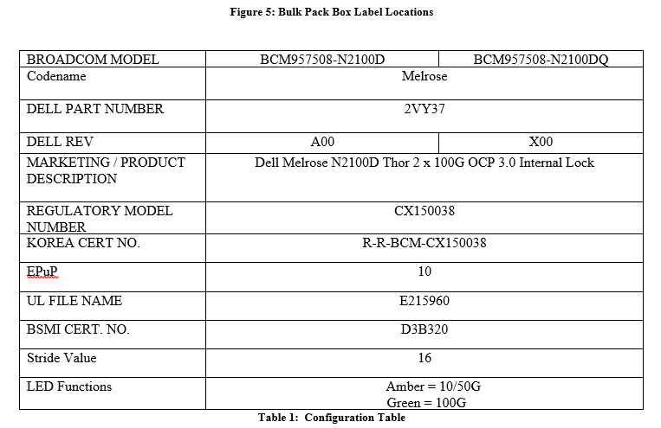
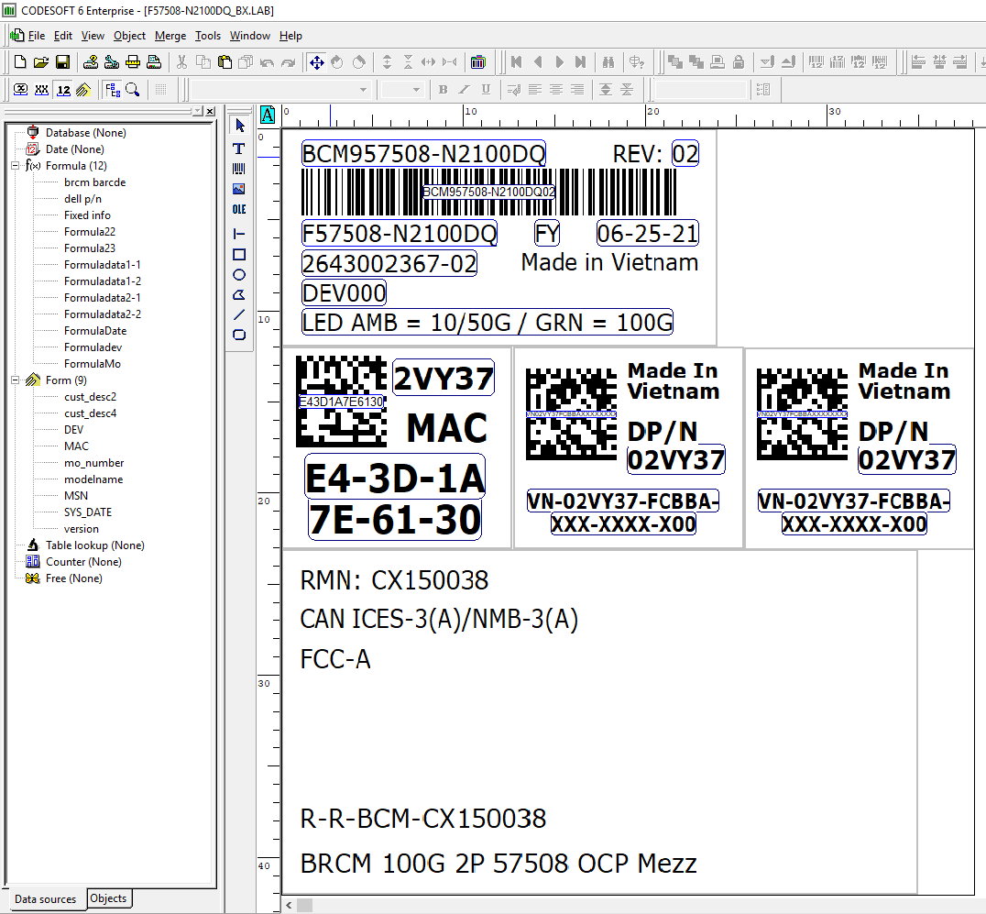
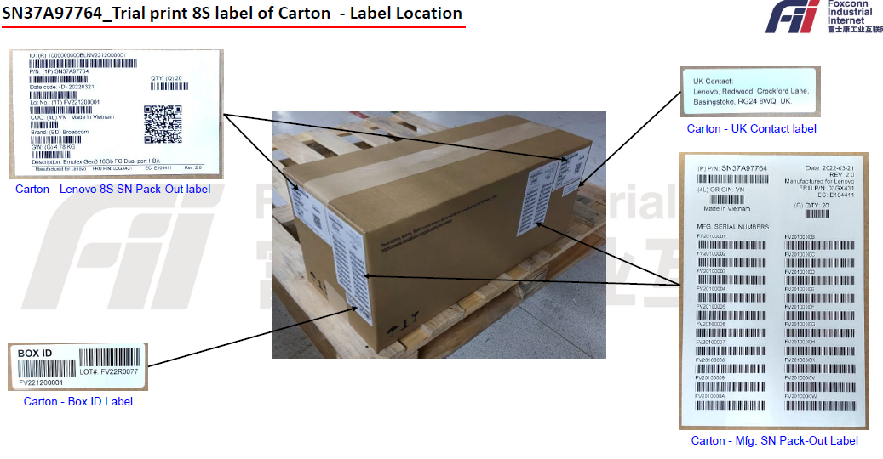
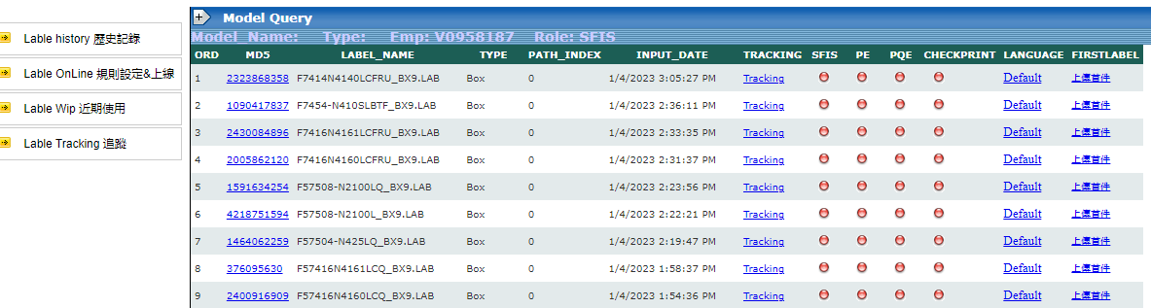
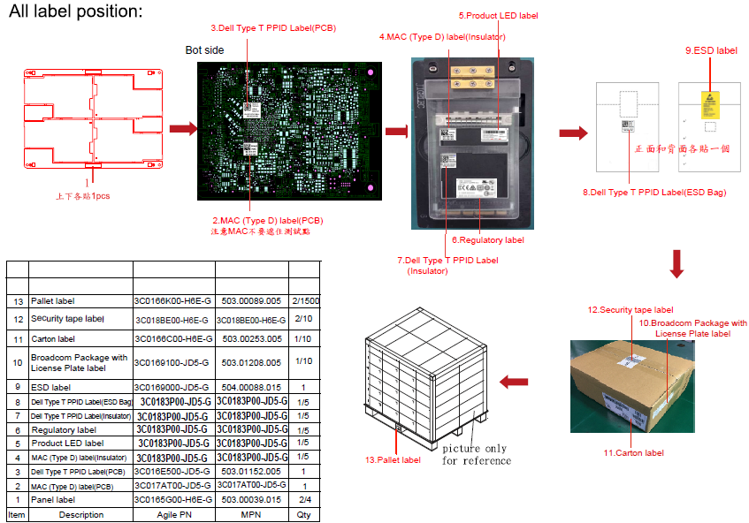
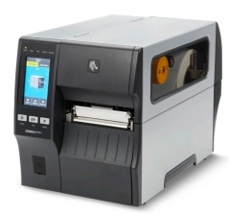
Label Automatic Making (LAM) System Analysis
Owner
ME
Label Room
Label Room
Label Room
Improve
Step 1: ME Edit Customer Word to Label PDF
Step 3: Check the Printed file with designed file
Step 4: Connect to SFC to upload file to the Label Tracking System
Step 2: Design Label as ME Label PDF
Connect to Zebra printers and print
1. ME Read Word
2. ME edit to PDF Label
3. ME send to PDF to Label Room
1. Label Room Read PDF Label
2. Label Room use Codesoft 6 to design Label
3. Label Room send .lab file to printers to print
1. Label Room Check the printed file (font, size, clearance, barcode accuracy…)
1. Label Room sign in SFC to upload label to LTS
Before
Not to implement
1. ME Upload
2. Sys Analysis
3. ME cfm
4. Upload DB
1. Sys Auto Design Label
2. Label Room cfm
3. Print Label
After
1. Sys Link with SFC
2. Upload Label to LTS
Auto CCD Checking: Compare printed label and designed label
Reason not to implement: Auto design so won’t have the errors between printed one and designed one. Label room has already have barcode verifier
Item
Status
Auto read Word file and collect label info)
On progress
Level of difficulty: High
Auto Design Label and send to printers
Evaluating
Level of difficulty: High
Auto connect SFC and check signing status
Evaluating
Level of difficulty: Low

Slide 3
Label Automatic Making (LAM) System Analysis
Old Workflow
Step 1:
ME Read Word and Edit Label Information to PDF file
Step 3:
Label Room Check the Printed file with designed file
Step 4:
Connect to SFC to upload file to the Label Tracking System
Step 2:
Label Room Design Label as ME Label PDF
Connect to Zebra printers and print
Input: Word file
Output: PDF file
Disadvantage: Manual Work
Input: PDF File
Output: Codesoft .lab file
Disadvantage: Manual Work, have to train the software for newbie
Input: .lab file & printed label
Output: OK Label
Disadvantage: Manual Work， Mistake happens with high rate
New Workflow
Step 1:
ME Upload Customer’s Word file
System gets the necessary information and exports Excel file
Step 2:
ME Check the Excel and Word Information
Step 3:
After ME’s Checking, system automatically exports Label image
Step 4:
Label Room check the design with Barcode Verifier
Step 5:
Connect to SFC to upload file to the Label Tracking System
Input: Word file
Output: Excel file, Data on server-> DB
Advantage: No need of people reading and convert infor into pdf
Input: Word from customer and Excel from system. Engineer checking
-> On trial stage need this to preserve the accuracy of the system.
Input: Information on DB
Output: Image
Advantage: No need of people design

Slide 4
Label Automatic Making (LAM) System Analysis
Select Label Template
System Functions
System Operation
Input Word File
APP/ System Convert
Excel File
Auto Design
Output Label
Print
Barcode Verify & Send to SFIS
Check Point
Check Point
Check Point
LAM System Overall Operation Workflow
Project Schedule
01/11
02/15
04/20
04/25
05/04
05/15
05/29
06/15
需求評估
開始開發
完成開發
AI 完成內部測試
用戶試用
Debug
驗收
導入使用

Slide 5
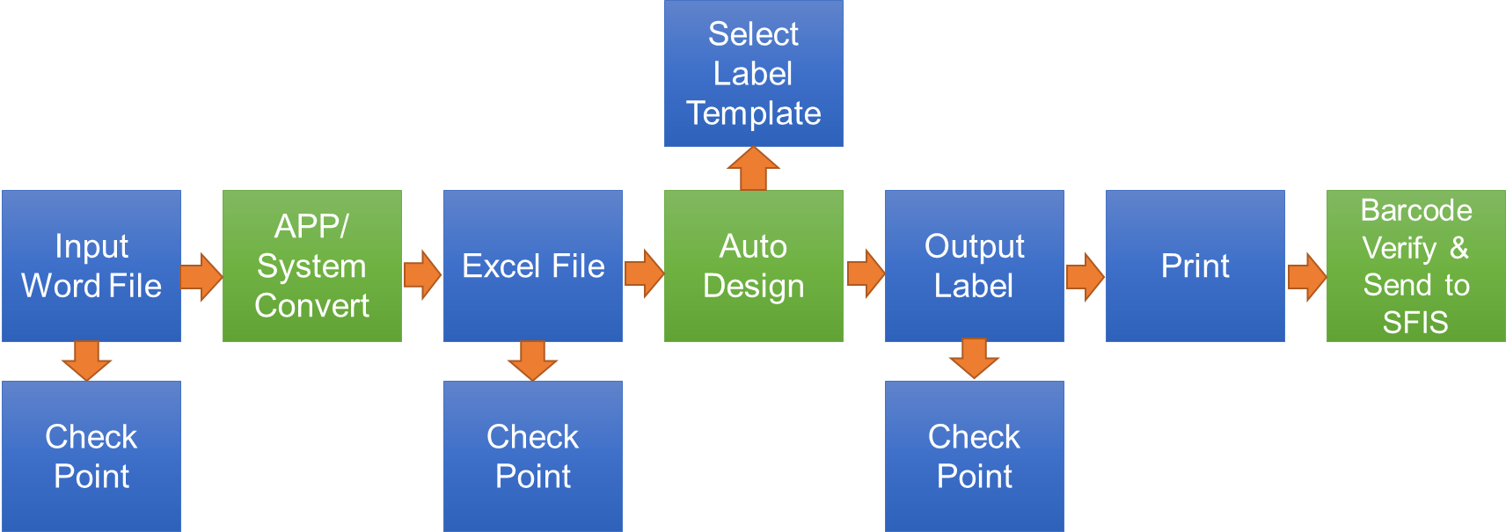
Label Automatic Making (LAM) System Analysis
Workflow
Main Steps to follow
Project + Programming Schedule
01/11
02/15
02/28
03/18
03/25
04/06
04/20
04/25
05/04
05/15
05/29
06/15
需求評估
開始開發
Read Word File & Get info
Auto Template Label
Connect to printers and Print
Auto Design Label
System UI & Functions adjust
AI 完成內部測試
用戶試用
Debug
驗收
導入使用

Slide 6
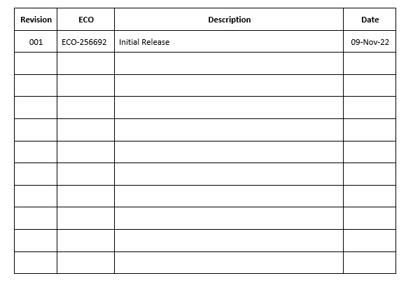
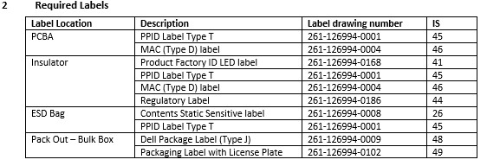
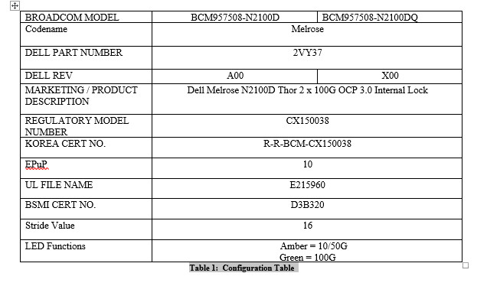
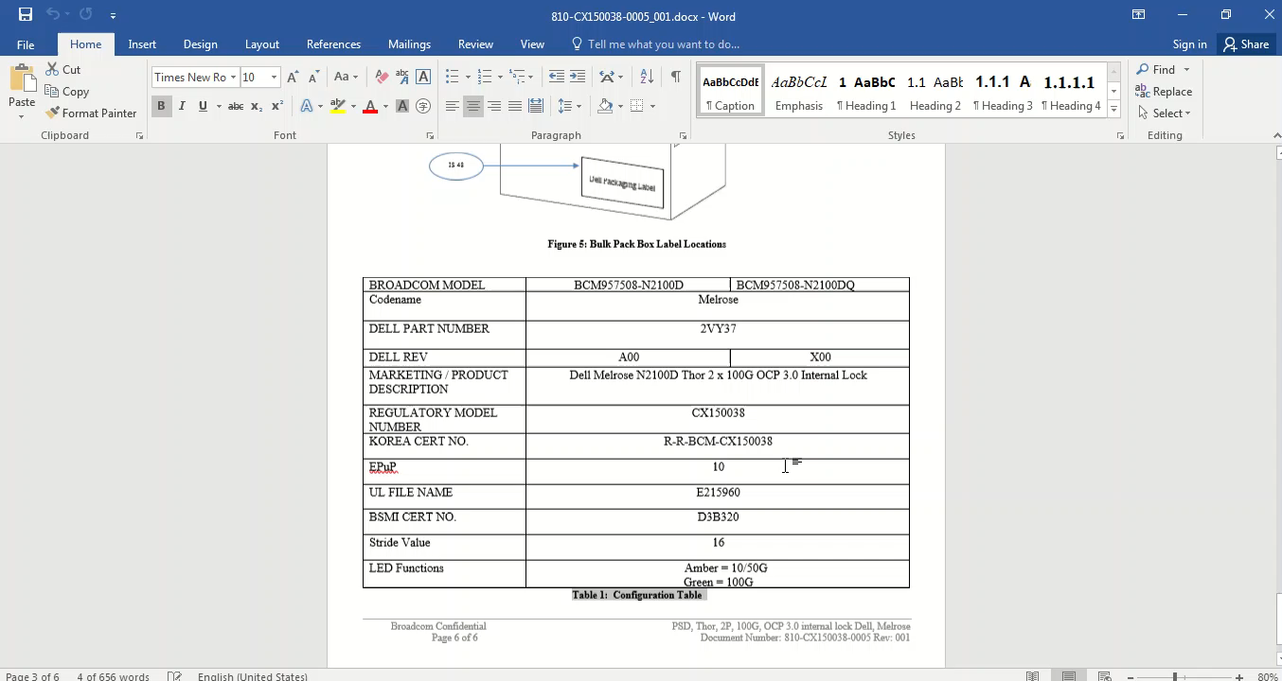
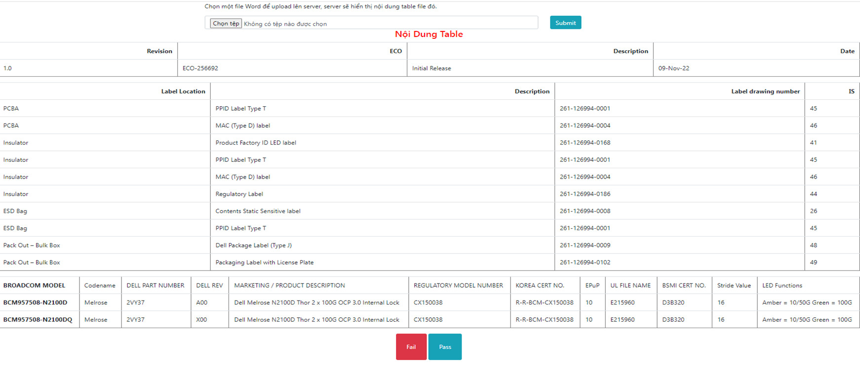
Read Word and Get Information to Excel file
Word里面的Table
完成LAM System 第一Function：成功讀取 Word file裡面的Table，數據拿取準確。
上傳Word file
ME 檢查
Pass or Fail
演示視頻
LAM system 读取出来的信息

