Slide 1
SMART AND SIMPLE USER FRIENDLY MINI EXCEL
Dhanashree Mahajan
Om Tambde
Somnath Shinde

Slide 2
INTRODUCTION
Excel is a spreadsheet software developed by Microsoft it costs Rs. 13,199 there are other alternates but they are not as powerful as Excel
We introduce MiniExcel a web app using React using modern technology for heavy computation which light weight libraries
Additional features that make MiniExcel more user friendly and easy to use
Auto generation of random dataset for testing
Open Source project so free of cost

Slide 3
OUR Features
Excel basic functions (Done)
Graph, holograph, designs (In Progress)
Dataset generation / API fetch (InProgress)
Collaboration mode — two people can edit at the same time (like Google Sheets). (NSY)
Inline data filtering — click a column header to instantly filter/sort. (NSY)
Trend detection → Finds patterns over time or across categories. (NSY)
Notes:
NSY – Not Started Yet

Slide 4
technologies used
NodeJS/Express
React + Vite
HTML
CSS
JavaScript
Firebase (Can be changed)

Slide 5
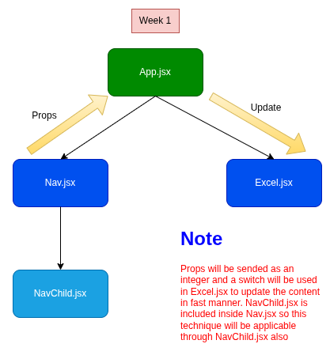
Data FlowChart

Slide 6
LITERATURE SURVEY
S. No | Author / Source | Title / Focus | Key Findings / Contributions | Year / Reference
1 | Microsoft Research | Spreadsheet Technology Overview | Spreadsheets evolved from simple data entry tools to platforms supporting end-user programming; Excel and LibreOffice Calc are widely used. | 2016
2 | Syncfusion | Syncfusion React Spreadsheet | Provides Excel-like features including data binding, editing, formatting, import/export, and supports over 500 Excel functions. | 2023
3 | MESCIUS Developer | MESCIUS React Spreadsheet | Offers a complete React spreadsheet solution with extensive Excel functions for domains like finance, healthcare, and engineering. | 2023
4 | Infragistics | Infragistics React Excel Library | Integrates Excel functionalities into React apps, supporting data manipulation and file handling. | 2023
5 | Microsoft Research | End-User Programming in Spreadsheets | Highlights how non-programmers use spreadsheets for complex calculations, emphasizing the need for intuitive interfaces and error-checking. | 2020
6 | ResearchGate | Spreadsheet Quality Assurance | Reviews common quality issues in spreadsheets and suggests QA techniques like formal verification and testing. | 2023
7 | Microsoft Learn | React & Excel Integration | Explains building Excel task pane add-ins using React and Excel JavaScript API to extend Excel functionality in web apps. | 2023

