Slide 1
CMSC204
Kartchner
V(StateGraph) = {Oregon, Alaska, Texas, Hawaii, Vermont, NewYork, California}
E(StateGraph) = {(Alaska, Oregon), (Hawaii, Alaska), (Hawaii, Texas), (Texas, Hawaii), (Hawaii, California), (Hawaii, New York), (Texas, Vermont), (Vermont, California), (Vermont, Alaska)}
1. Draw the StateGraph
Hawaii
Alaska
Texas
California
New York
Oregon
Vermont

Slide 2
a. Show the adjacency matrix that would describe the edges in the graph. Store the vertices in alphabetical order
States
1. Oregon
2. Alaska
3. Texas
4. Hawaii
5. Vermont
6. New York
7. California
1 | 2 | 3 | 4 | 5 | 6 | 7
0 | 0 | 0 | 0 | 0 | 0 | 0
1 | 0 | 0 | 0 | 0 | 0 | 0
0 | 0 | 0 | 1 | 1 | 0 | 0
0 | 1 | 1 | 0 | 0 | 1 | 1
0 | 1 | 0 | 0 | 0 | 0 | 1
0 | 0 | 0 | 0 | 0 | 0 | 0
0 | 0 | 0 | 0 | 0 | 0 | 0
3. b. Show the adjacency lists
that would describe the edges in the graph
1. Oregon
2. Alaska
3. Texas
4. Hawaii
5. Vermont
6. New York
7. California
1
4
5
2
3
6
7
2
7

Slide 3
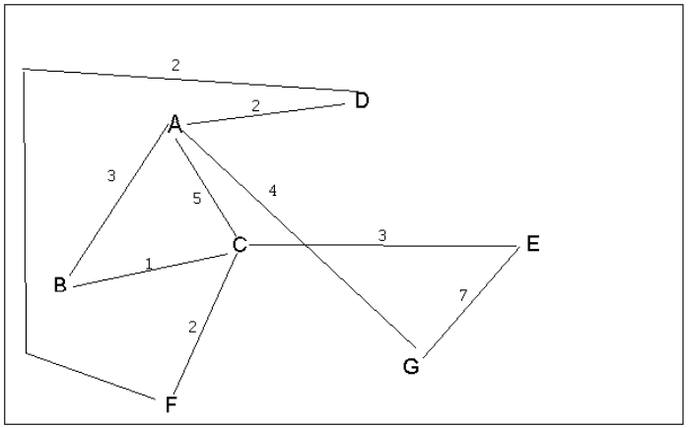
4 a. Which of the following lists the graph nodes in depth first order beginning with E?
A) E, G, F, C, D, B, A
B) G, A, E, C, B, F, D
C) E, G, A, D, F, C, B
D) E, C, F, B, A, D, G
4 b. Which of the following lists the graph nodes in breadth first order beginning at F?
A) F, C, D, A, B, E, G
B) F, D, C, A, B, C, G
C) F, C, D, B, G, A, E
D) a, b, and c are all breadth first traversals

Slide 4
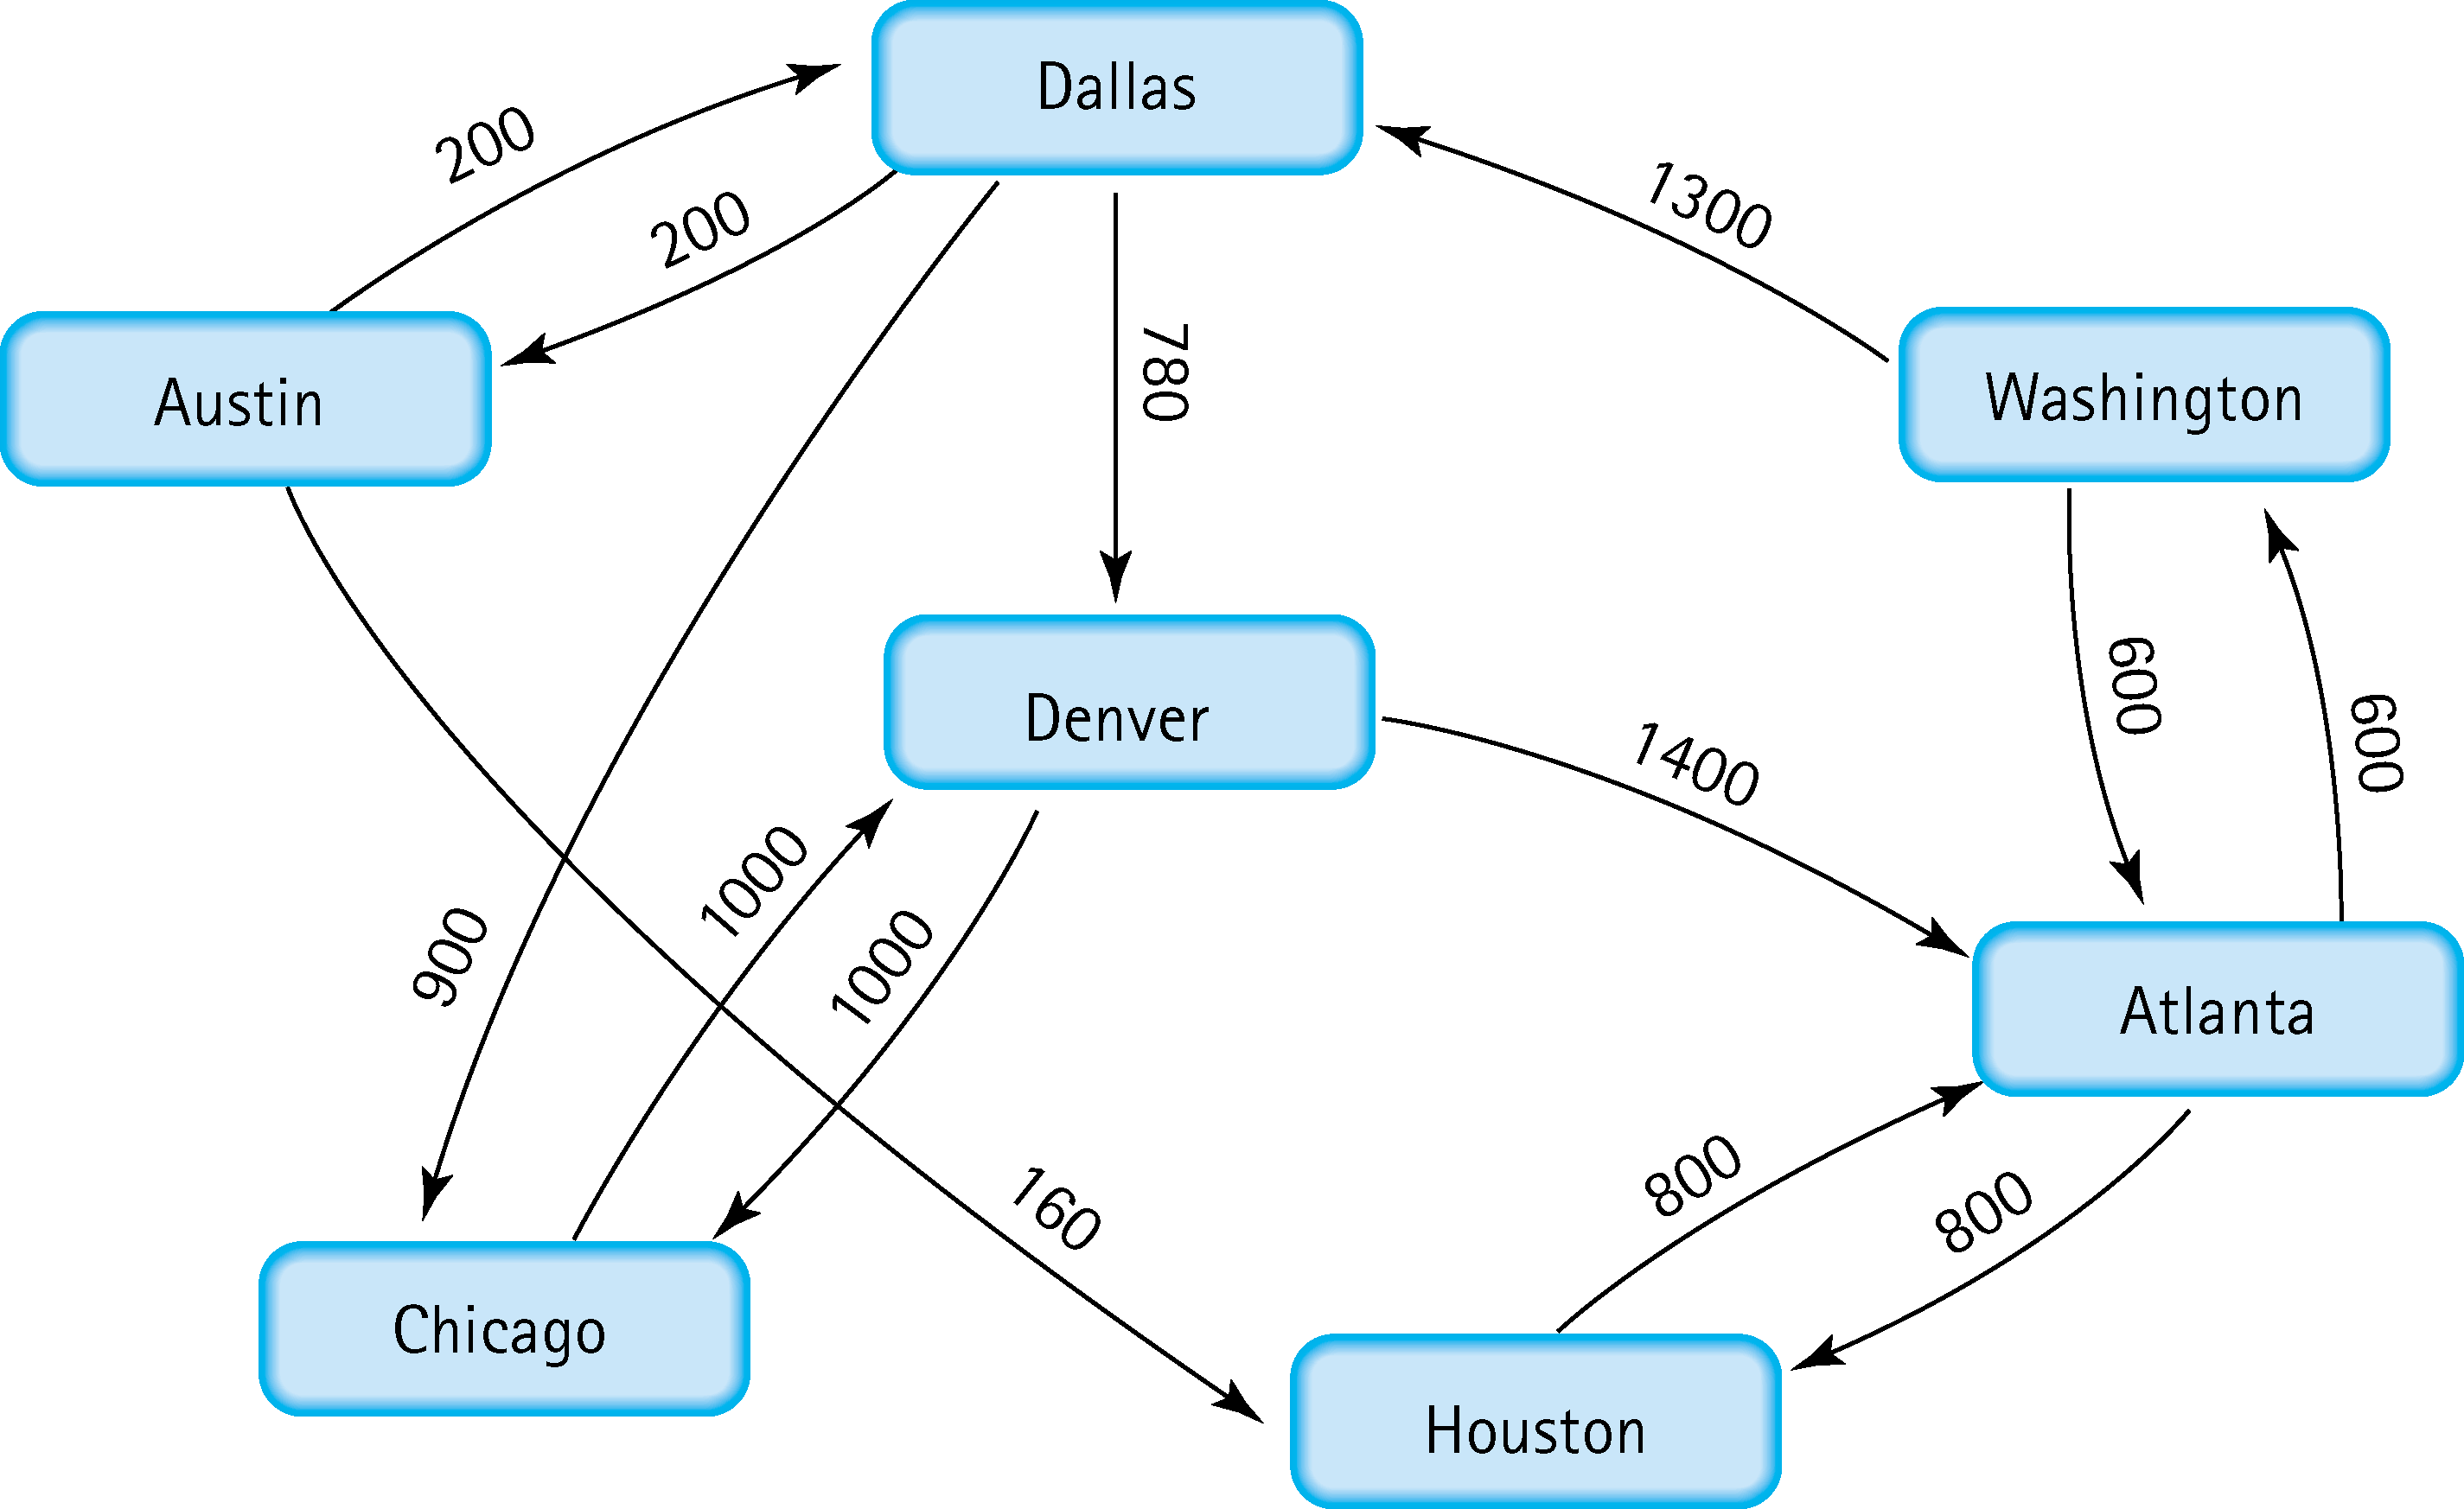
5. Find the shortest distance from Atlanta to every other city
Atlanta – Washington
Atlanta – Houston
Atlanta – Washington – Dallas
Atlanta – Washington – Dallas – Denver
Atlanta – Washington – Dallas – Chicago
Atlanta – Washington – Dallas - Austin

Slide 5
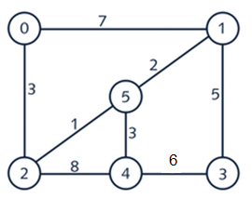


6. Find the minimal spanning tree using Prim’s algorithm. Use
0 as the source vertex . Show the steps.
Minimum spanning tree
0
0 | 2
0 | 2 | 5
0 | 2 | 5 | 1
0 | 2 | 5 | 1 | 4
0 | 2 | 5 | 1 | 4 | 3
3 < 7
1< 7,8
2 < 3,7,8
3 < 5,8
5 < 6

Slide 6


7. Find the minimal spanning tree using Kruskal’s algorithm.
Show the weights in order and the steps.
Edge Added (weight) | All vertices Connected
2-5 (Step: 1) | 2,5
5-1 (Step: 2) | 1,2,5
5-4 (Step: 3) | 1,2,4,5
2-0 (Step: 4) | 0,1,2,4,5
1-3 (Step: 5) | 0,1,2,3,4,5

Slide 7
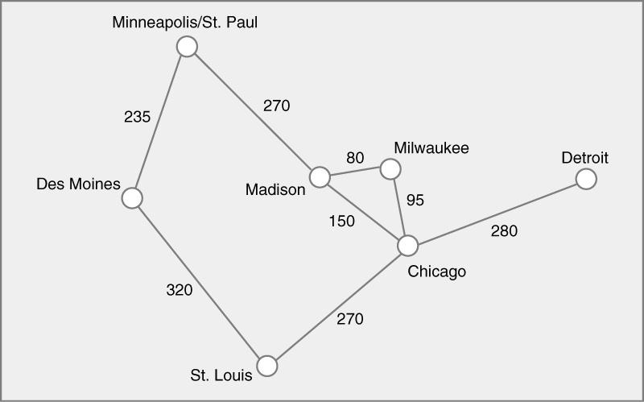




8. Find the minimal spanning tree using the algorithm you prefer. Use
Minneapolis/St. Paul as the source vertex

Slide 8
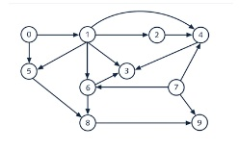
9. List the nodes of the graph in a breadth first topological ordering. Show the
steps using arrays predCount, topologicalOrder and a queue
predCount | toplogicalOrder | Queue
0|1|1|3|3|2|2|0|2|2 |  | 0,7
0|0|1|3|3|1|2|0|2|2 | 0 | 7,1
0|0|1|3|2|1|1|0|2|1 | 0|7 | 1
0|0|0|2|0|0|0|0|2|1 | 0|7|1 | 2,5,6
0|0|0|2|0|0|0|0|2|1 | 0|7|1|2 | 5,6,4
0|0|0|2|0|0|0|0|1|1 | 0|7|1|2|5 | 6,4
0|0|0|1|0|0|0|0|0|1 | 0|7|1|2|5|6 | 4,8
0|0|0|0|0|0|0|0|0|1 | 0|7|1|2|5|6|4 | 8,3
0|0|0|0|0|0|0|0|0|0 | 0|7|1|2|5|6|4|8 | 3,9
0|0|0|0|0|0|0|0|0|0 | 0|7|1|2|5|6|4|8|3 | 9
0|0|0|0|0|0|0|0|0|0 | 0|7|1|2|5|6|4|8|3|9

Slide 9
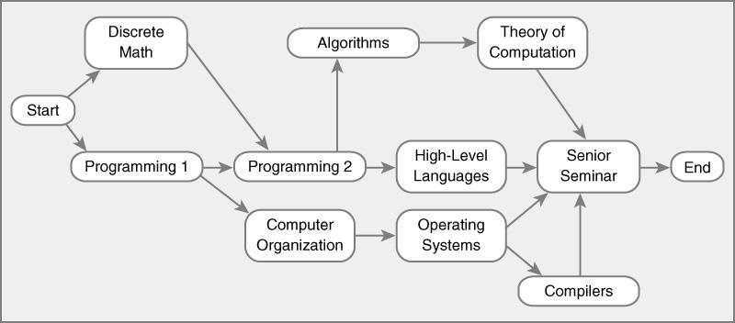
10. List the nodes of the graph in a breadth first topological ordering.
Start
Discrete Math
Programming 1
Programming 2
Computer Organization
Algorithms
High-level Languages
Operating Systems
Theory of Computation
Compiler
Senior Seminars
End

