Slide 1
Athlete Monitor-Group 21
Project Presentation
Group Members:
Chengpei Zhang
Donghao Lyu
Guanjie Wang
Ruiyuan Wang
Yutao Xu
Yufan Xu

Slide 2

Overview
Purpose:
Communication (post reply) (US 3, 4, 11)
Friends list (US 17)
Checking train record(US 13, 15)
Image Copyright 2014 DigitalGlobe Inc
Notes:
For our main project， we design three main functions in monitor althlete. First one is communications
Yutao will introduce the main function of use story 11 and 3

Slide 3
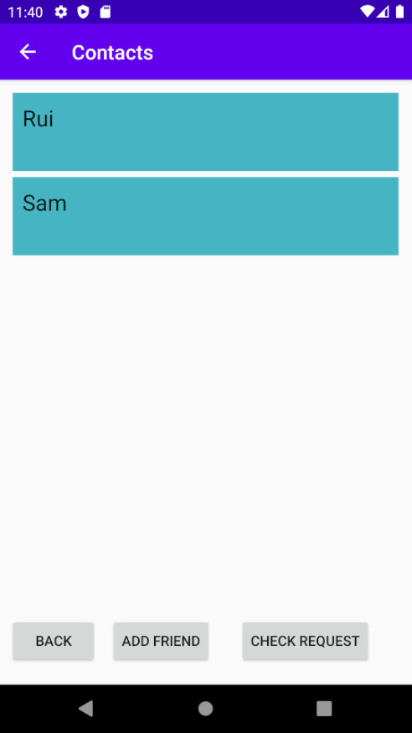
User Story 11
As a coach, I Want to pair multiple athletes So That I can assign different tasks to different athletes.
Notes:
I will introduce two main functions in this project, one is friend list, the other is post and review function. The project aims to connect coach and athlete by matching different types of users. Meanwhile, Coach can post task and athlete can view task posted from coach. For user story 11, a user can check if there is a friend request that submit by other users, and become friend for each other.

Slide 4
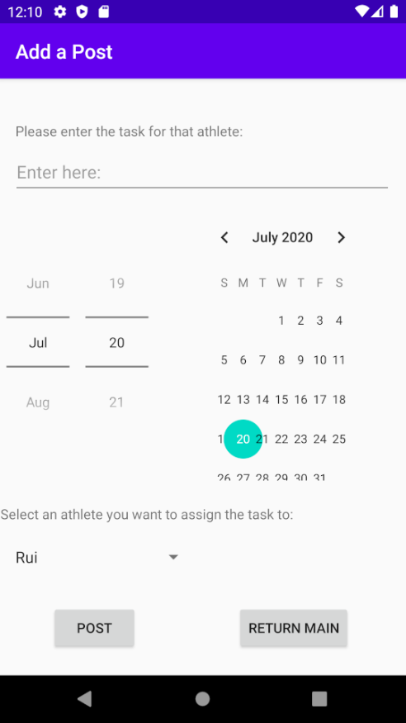
User Story 3
As a coach, I Want to post and assign a task to athlete So That they can know their training schedule.
Notes:
For user story 3, a coach can post a task to athlete. By adding date, content and the athlete who want assigned to.
Next part, we will introduce implmentaion challenge and successs

Slide 5
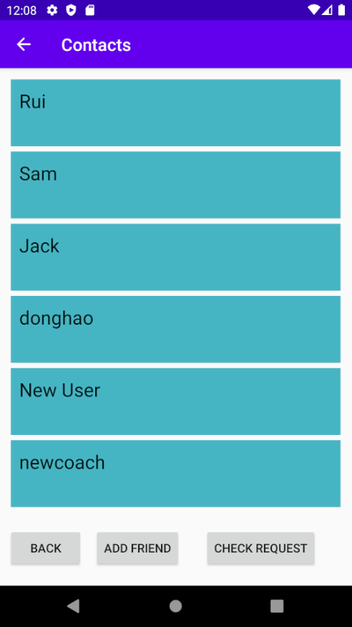
Implementation Success:
Friend List RecyclerView
Nicely showing the friend data from Firestore.

Slide 6
Implementation Challenge:
Firestore database
Login issue while testing

Slide 7
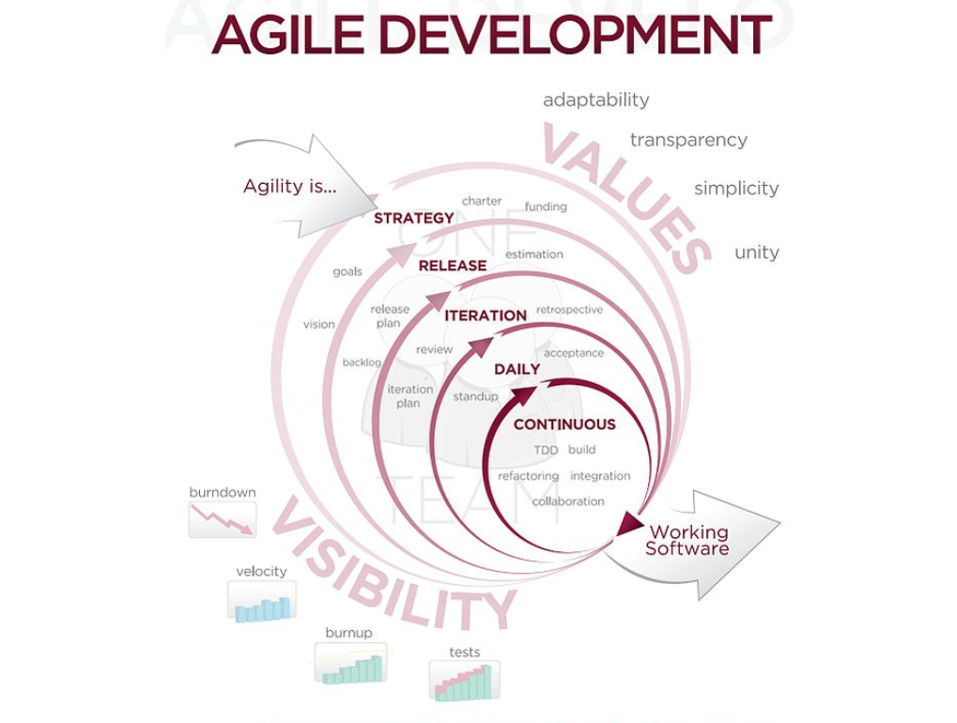
Success in software process:
Testing codes oftenly
(lecture 2 p.16)

Slide 8

Challenges in software process:
Unfamiliar cooperation tools (Git)

Slide 9
Demo Time!

