Slide 1
Introduction to R and RStudio Session 4: Intro to ggplot2

Slide 2
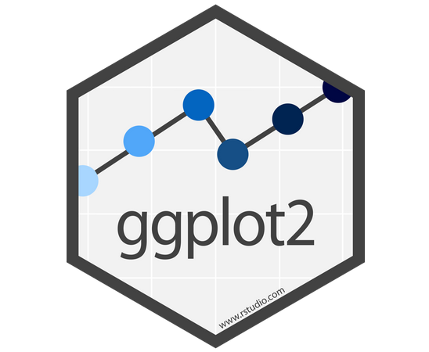
A grammar of graphics

Slide 3
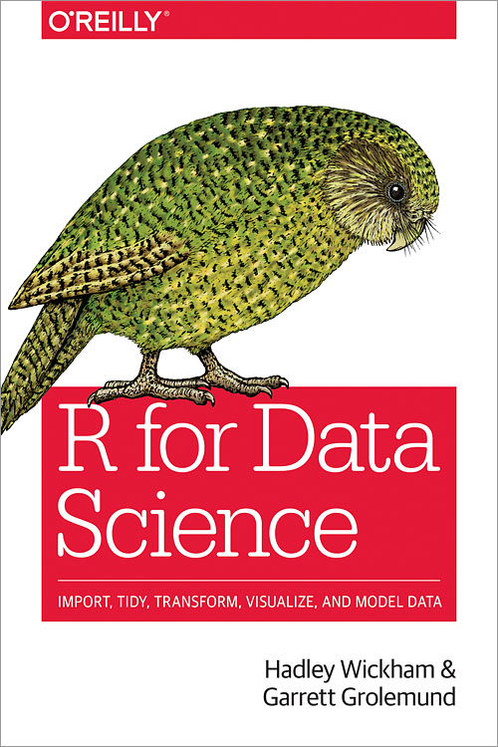
Acknowledgement
This session shadows Chapter 3 of the excellent:

Slide 4
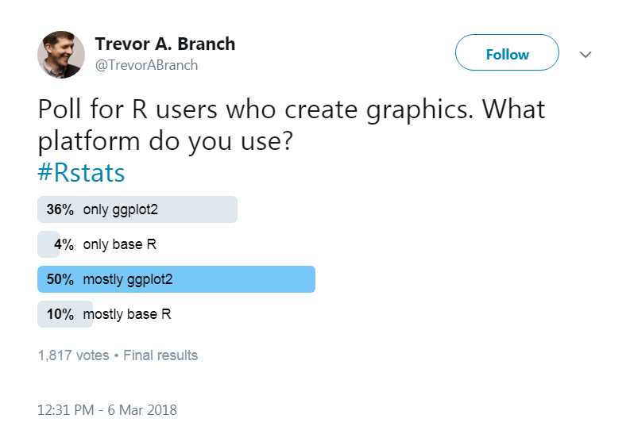
ggplot2
Is one of several plotting systems in R

Slide 5
Why is ggplot popular?
Well designed and supported
Highly versatile
Attractive graphics (with a little work)
1. Why start with ggplot: http://varianceexplained.org/r/teach_ggplot2_to_beginners/
2. Argument against: https://simplystatistics.org/2016/02/11/why-i-dont-use-ggplot2/

Slide 6
ggplot2
ggplot2 is part of the tidyverse.
So, at the top of your script type:
library(tidyverse)

Slide 7
Project 1: Let’s explore a perennial challenge for the NHS:

Slide 8



Pressures in A&E
Demand
Capacity
A&E
1.
2.
This Photo by Unknown Author is licensed under CC BY-SA-NC
1.
This Photo by Unknown Author is licensed under CC BY-SA-NC
2.
Notes:
A&E pressures are often linked to increases in demand, while role of capacity (having the resources to do the required work), and its interaction with demand, is usually ignored. Picture diagram
Capacity could be defined as “possessing the resources to do the required work”.
Capacity factors in an urgent care setting include the number of cubicles and rooms, the number of ambulance bays, staffing levels and key diagnostics by modality. These factors summarise the ability of the service to treat patients in a safe and timely manner. The focus of this analysis will be on staffing levels and infrastructure available at A&E and whether it has an effect on average length of attendance.

Slide 9
Data: Capacity in A&E
The dataset we loaded earlier, capacity_ae¹, shows changes in the capacity of A&E departments from 2017 to 2018.
1. Closely based on datasets collected by the NHS Benchmarking Network

Slide 10
Data: Capacity in A&E
The object named capacity_ae is a
data frame.

Slide 11
What is a data frame?
A data frame stores tabular data:
Variables
id
sex
6
score
1
6
F
10.24
Observations
7
2
6
8
6
F
9
5.98
3
6
M
7.62

Slide 12
tibble = data frame
In the tidyverse you may see the term “tibble”.
We’ll take “tibble” to be synonymous with “data frame”
id
sex
6
score
1
6
F
10.24
7
2
6
8
6
F
9
5.98
3
6
M
7.62

Slide 13
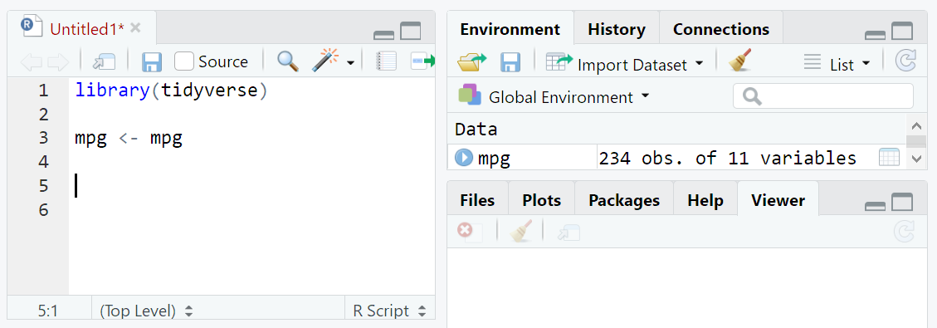
Viewing the data frame
Option 1:
Click on the text in the “Environment” pane

Slide 14
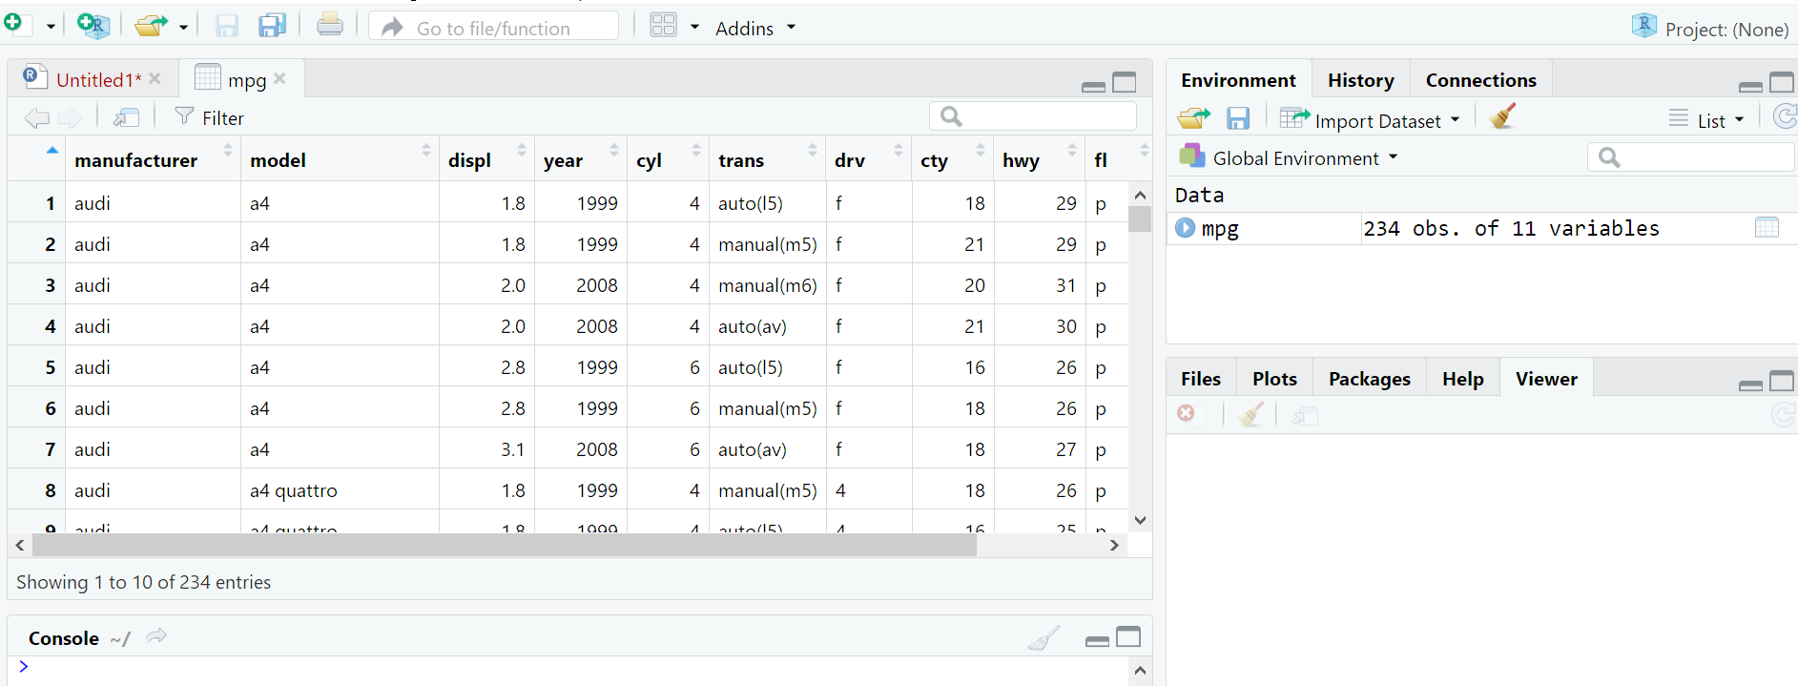
Viewing the data frame
This brings up a view of the data in a new tab:

Slide 15
Viewing the data frame
Click here to show the data frame in a new window*
*Useful when using with multiple monitors

Slide 16
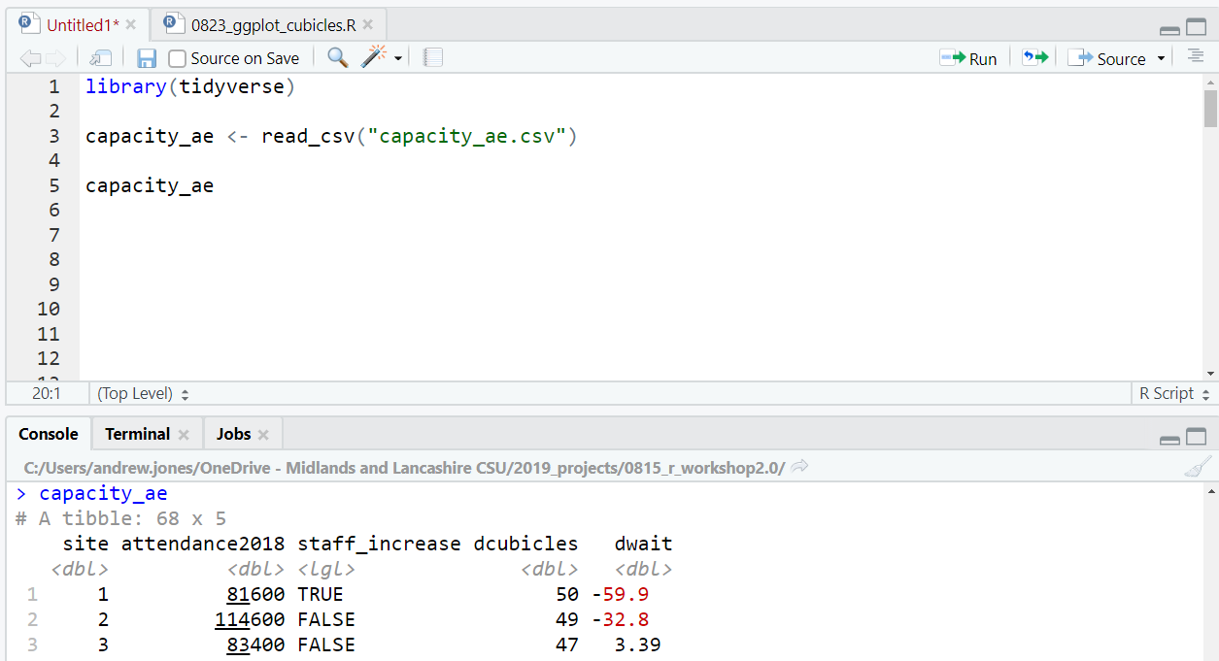
Viewing data: Option 2
Type the name of the dataset in editor/console, and run the line (Ctrl + Enter).
Run
Prints
data frame to console

Slide 17
Q1. How many sites? Q2. Do we understand the variable names?
(and what they mean)

Slide 18
Q1. How many sites? Q2. Do we understand the variable names?
difference in average ____ from 2017 to 2018
id
site | attendance2018 | staff_increase | dcubicles | dwait
Did # staff increase between 2017 and 2018

Slide 19
“The simple graph has bought more information to the data analyst’s mind than any other device” John Tukey

Slide 20
Graphics with ggplot2

Slide 21
Q. Is a change in the number of cubicles available in A&E associated with a change in length of attendance ?

Slide 22
Q. Is a change in the number of cubicles available in A&E associated with a change in length of attendance ?
change in length of attendance
change in # cubicles

Slide 23
Q. Is a change in the number of cubicles available in A&E associated with a change in length of attendance ?
ggplot(data = capacity_ae) + geom_point(aes(x = dcubicles, y = dwait))
Note that
R is case sensitive

Slide 24
Breakdown
ggplot(data = capacity_ae) +
geom_point(aes(x = dcubicles, y = dwait))
1. We begin our plot with ggplot()
2. Inside ggplot()
we can specify
our dataset
3. Next, we add layer(s) with +

Slide 25
How do we move from data to graphic?

Slide 26
Choices
1. What shape will represent the data?

Slide 27
Choices
1. What shape will represent the data?
geometric
object

Slide 28
Choices
1. What shape will represent the data? (geom)
2. What visual (aesthetic) attributes do we give to the geom?

Slide 29
Choices
1. What shape will represent the data? (geom)
2. What visual (aesthetic) attributes do we give to the geom?
size

Slide 30
Choices
1. What shape will represent the data? (geom)
2. What visual (aesthetic) attributes do we give to the geom?
position (x)

Slide 31
Choices
1. What shape will represent the data? (geom)
2. What visual (aesthetic) attributes do we give to the geom?
position (y)

Slide 32
Choices
1. What shape will represent the data? (geom)
2. What visual (aesthetic) attributes do we give to the geom?
colour

Slide 33
A statistical graphic
Data variables → geometric objects.
(aesthetic
attributes of)

Slide 34
A statistical graphic
Data variables → geometric objects.
ggplot(data = capacity_ae) +
geom_point(aes(x = dcubicles, y = dwait))
(aesthetic
attributes of)
Here, other aesthetic properties (size, colour, etc.) are set by default

Slide 35
Functions ( )
ggplot(), geom_point(), and aes() are functions.
Running a function does something
Functions are given zero or more inputs (arguments)
Arguments of a function are separated by commas

Slide 36
Functions ( )
You can explicitly name arguments;
ggplot(data = capacity_ae) + ...
Or not:
ggplot(capacity_ae) + ...
(provided you have the arguments in the correct order!)

Slide 37
Functions ( )
ggplot(data = capacity_ae) + geom_point(aes(x = dcubicles, y = dwait))
Here, we have provided ggplot() with one named argument
And given aes() two named arguments
Unspecified (yet required) arguments will often revert to default values

Slide 38
Shorthand
Since ggplot2 knows the order of essential arguments, I will tend not to name arguments from now on. So:
ggplot(capacity_ae) +
geom_point(aes(dcubicles, dwait))
no need for “data =“
x goes first
y goes second

Slide 39
geoms
We tend to describe plots in terms of the geom used:
geom_bar()
geom_line()
geom_boxplot()
geom_histogram()

Slide 40
Layering geoms
We can display more than one geom in a plot:
ggplot(capacity_ae) + geom_point(aes(dcubicles, dwait)) + geom_...(aes(dcubicles, dwait))
to add a layer
then specify another geom

Slide 41
Your turn
This is our current plot:
ggplot(data = capacity_ae) + geom_point(aes(x = dcubicles, y = dwait))+
... ... ...(...(... ... ))
Add a geom_smooth layer (to help identify patterns)
Hint: Don’t forget the aes() values in the new layer
Extension: If you prefer, re-write in shorthand

Slide 42
Your turn
A geom_smooth layer can help us identify patterns. Add geom_smooth() to our current plot:
ggplot(data = capacity_ae) +
geom_point(aes(x = dcubicles, y = dwait)) +
geom_smooth(aes(x = dcubicles, y = dwait))

Slide 43
One more thing
We’d probably prefer a linear fit
rather than a non-linear fit: ___________________________________________________
ggplot(capacity_ae)+
geom_point(aes(dcubicles, dwait)) +
geom_smooth(aes(dcubicles, dwait),
method = “lm”)
Fit a linear model

Slide 44
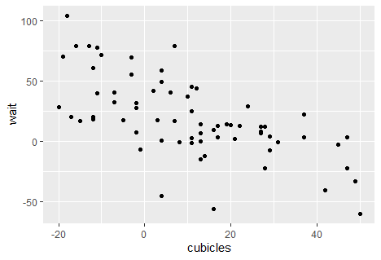

Slide 45
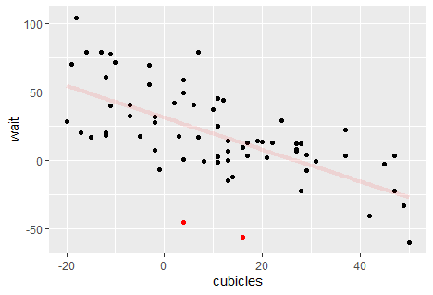

Slide 46
What is happening here?

Slide 47
Hypothesis
The two sites have seen staffing increases
We can map point colour to the staff_increase variable to find out.
So each point is given a colour which will depend on the value of staff_increase.
aesthetic attribute

Slide 48
Adding another dimension
Put an argument inside aes() if you want a visual attribute to change with different values of a variable.
ggplot(capacity_ae) +
geom_point(
aes(dcubicles, dwait, colour = staff_increase))
We could have equally have chosen size or shape - but these make graphic less clear

Slide 49
Outcome
The two sites in question have indeed seen an increase in staff levels.

Slide 50
Important distinction
If you want a visual attribute to be applied across the whole plot, the argument goes outside aes()
ggplot(capacity_ae) +
geom_point(
aes(dcubicles, dwait),
colour = “red”
)

Slide 51
Important distinction
If you want a visual attribute to be applied across the whole plot, the argument goes outside aes()
ggplot(capacity_ae) +
geom_point(
aes(dcubicles, dwait),
size = 4
)

Slide 52
Small multiples
Another way to visualise the relationship between multiple variables is with a facet_wrap() layer:
ggplot(capacity_ae) +
geom_point(aes(dcubicles, dwait)) +
facet_wrap(vars(staff_increase))
1. Set up our basic 2-D graphic
2. Then, tell facet_wrap you want a panel for each category of “staff increase”

Slide 53
Small multiples
Another way to visualise multiple variables simultaneously is with a facet_wrap() layer:
ggplot(capacity_ae) +
geom_point(aes(dcubicles, dwait)) +
facet_wrap(vars(staff_increase), ncol = 1)
facet_wrap is used with categorical variables

Slide 54
Demonstrating geoms: (note: these are simple, unpolished graphics)

Slide 55
Q. How are “wait” values distributed? Histogram
ggplot(capacity_ae) +
geom_histogram(aes(dwait))

Slide 56
Q. How are “wait” values distributed? Histogram
ggplot(capacity_ae) +
geom_histogram(aes(dwait), binwidth = 10)

Slide 57
Q. Number of attendances by site? Bar plot
ggplot(capacity_ae) +
geom_col(aes(x = site,
y = attendance2018))

Slide 58
Q. Number of attendances by site? Bar plot
ggplot(capacity_ae)+
geom_col(
aes(x = reorder(site, attendance2018), y = attendance2018))
Reorder site by attendances

Slide 59
Q. Distribution of “wait” for each value of staff level? Box plot
ggplot(capacity_ae) +
geom_boxplot(
aes(staff_increase, dwait))

Slide 60
Plot labels
ggplot(capacity_ae) +
geom_boxplot(aes(staff_increase, dwait))+
labs(
title = “Do changes in staffing …”,
y = “Waiting time”
)

Slide 61
... + ggsave(“plot_name.png”)
Add layer to your ggplot
or: pdf, jpg as you wish
By default: saves a plot in the same dimensions as plot window.
In future, you’ll wish to add height, width and “units” arguments to specify plot dimensions:
ggsave(plot_name.png, units = “cm”,
height = 10, width = 8)

Slide 62
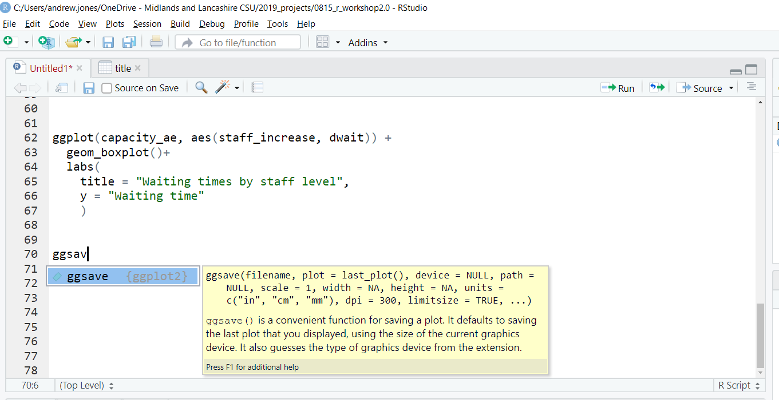
What does this function do?
If you want a visual attribute to be applied across the whole plot, the argument goes outside aes()
ggplot(capacity_ae) +
geom_point(
aes(cubicles, wait),
colour = “red”
)

Slide 63
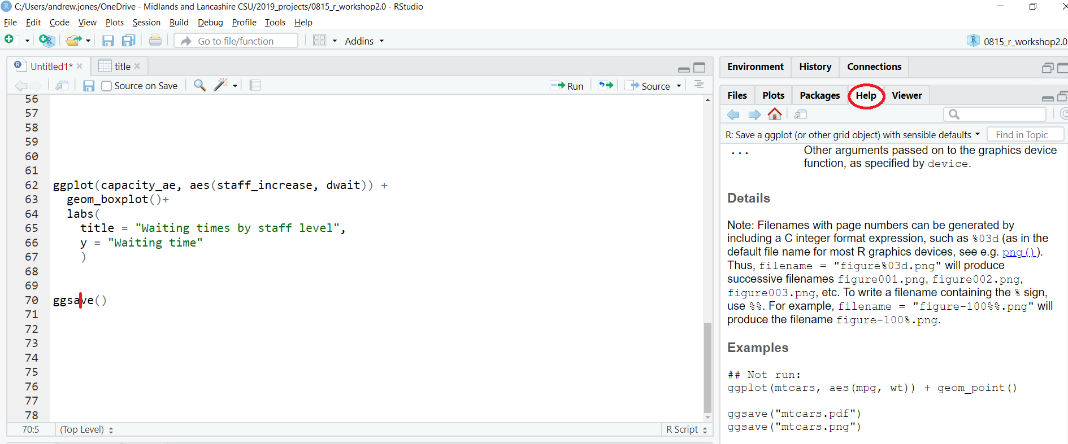
What does this function do?
Have your cursor in the function name and press F1

Slide 64
What does this function do?
Have your cursor in the function name and press F1
Note: typing ? before the function and executing will do the same

Slide 65
Save your script!
Think of your script¹ as the “real” part of your analysis.
File → Save As… → ggplot_intro.R
Or, shortcut:
Ctrl + s
1. Rather than the objects you create

Slide 66
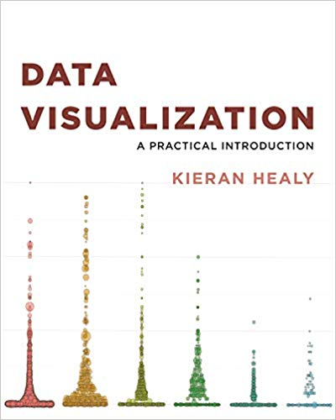
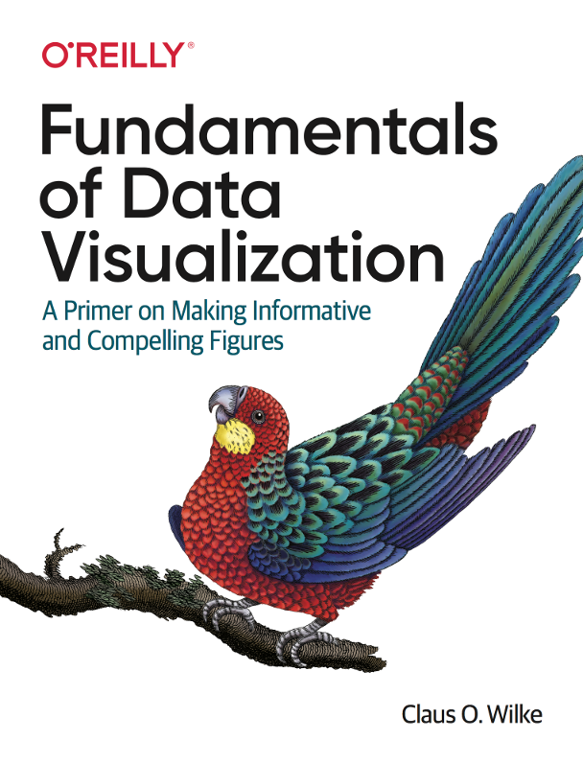
Recommended Reading
All freely available online (hardcopies also recommended)
http://socviz.co/
https://r4ds.had.co.nz/
https://serialmentor.com/dataviz/

Slide 67
accidental aRt
https://twitter.com/accidental__aRt

Slide 68

This material was created for the NHS-R community by:
Andrew Jones @The Strategy Unit
The work is licenced under:
Creative Commons
Attribution-ShareAlike 4.0
International
To view a copy of this license, visit
https://creativecommons.org/licenses/by-sa/4.0/

Slide 69
End

Slide 70
Your turn
A geom_smooth layer can help us identify patterns. Add geom_smooth() to our current plot:
ggplot(capacity_ae) +
geom_point(aes(dcubicles, dwait)) +
geom_smooth(aes(dcubicles, dwait))
More succinct but…

Slide 71
Layering geoms
A geom_smooth layer can help us identify patterns. Add geom_smooth() to our current plot:
ggplot(capacity_ae) +
geom_point(aes(dcubicles, dwait)) +
geom_smooth(aes(dcubicles, dwait))
duplication!

Slide 72
Layering geoms
To avoid duplication, we can pass the common local aes() arguments to ggplot() to make them global
ggplot(capacity_ae, aes(dcubicles, dwait))+
geom_point() +
geom_smooth()
In the ggplot() function, aes()
is the standard 2nd argument

Slide 73
Chapter number

Slide 74
Contact us

