Slide 1
Introduction to R and RStudio Session 5: Data wrangling with dplyr

Slide 2
Wrangling
Reshaping or transforming data into a format which is easier to work with
(…for later visualisation, modelling, or computing of statistics…)

Slide 3
A note on “tidy” data
Tidyverse functions work best with tidy data:
Each variable forms a column.
Each observation forms a row.
(Broadly, this means long rather than wide tables)

Slide 4
The tool: dplyr package
(dee-ply-r)
dplyr is a language for data manipulation
Most wrangling puzzles can be solved with knowledge of just 5 dplyr verbs (5 functions).
These verbs will be the subject of this session.

Slide 5
Project 2:

Slide 6
Project 2: Exploring Mental Health (MH) Inpatient Capacity

Slide 7
Project 2:
We have been asked to conduct an analysis of Mental Health inpatient capacity in England.
As part of this, we will be looking at the changes in the number (and occupancy) of MH beds available in recent years.

Slide 8
Background
Maintaining clinical effectiveness and safety when a ward is fully occupied is a serious challenge for staff.
Inappropriate out of area placements mean individuals are separated from their social networks for the duration of their inpatient care.

Slide 9
The Data:
KH03 returns (bed numbers and occupancy) by organisation, published by NHS England.
Scraped from the NHSE statistics website*:
https://www.england.nhs.uk/statistics/statistical-work-areas/bed-availability-and-occupancy/bed-data-overnight/
* and partially cleaned

Slide 10

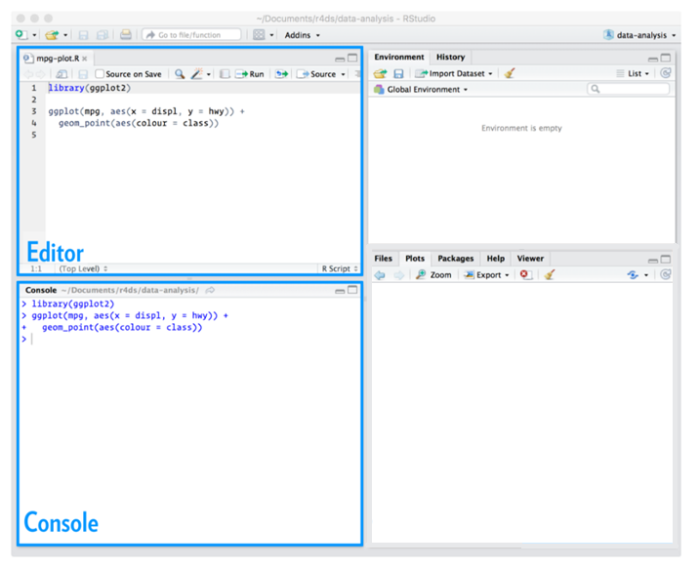
Start a new script

Slide 11
Load the data:
beds_data.csv

Slide 12
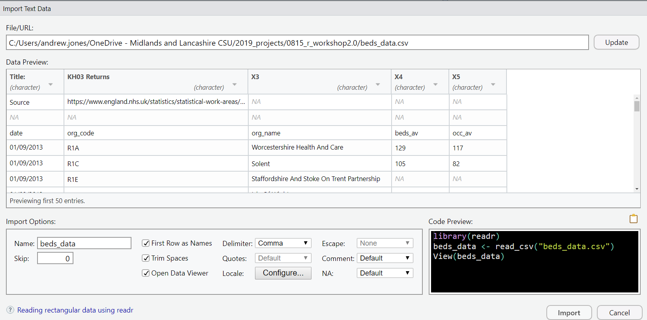
Less friendly csvs
Load beds_data.csv
Notice that something isn’t quite right here

Slide 13
Less friendly csvs
Load beds_data.csv
Metadata present above the
data we’d like

Slide 14
Less friendly csvs
Load beds_data.csv
In this case, “Skip” 3 rows so the column headers appear at the top of the preview…

Slide 15
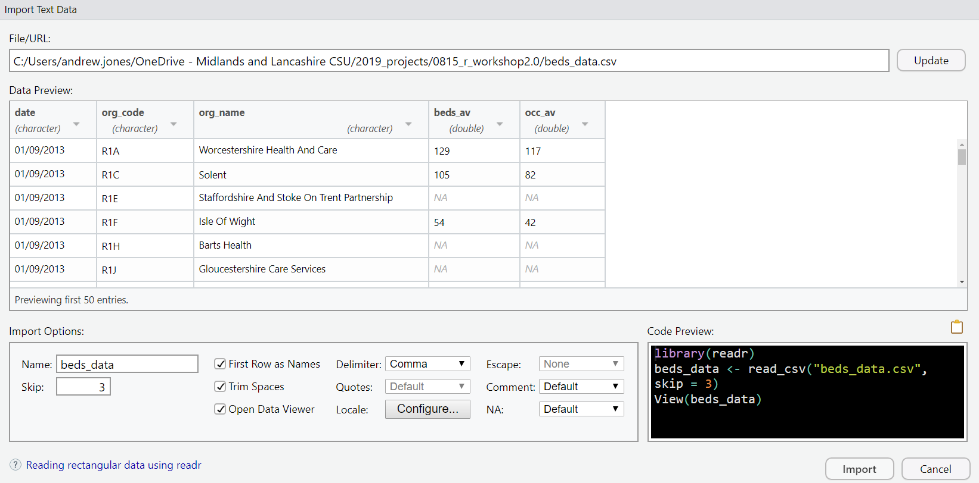
Less friendly csvs

Slide 16
Less friendly csvs
One more thing to fix:
Click on the drop down menu by the column “date”

Slide 17
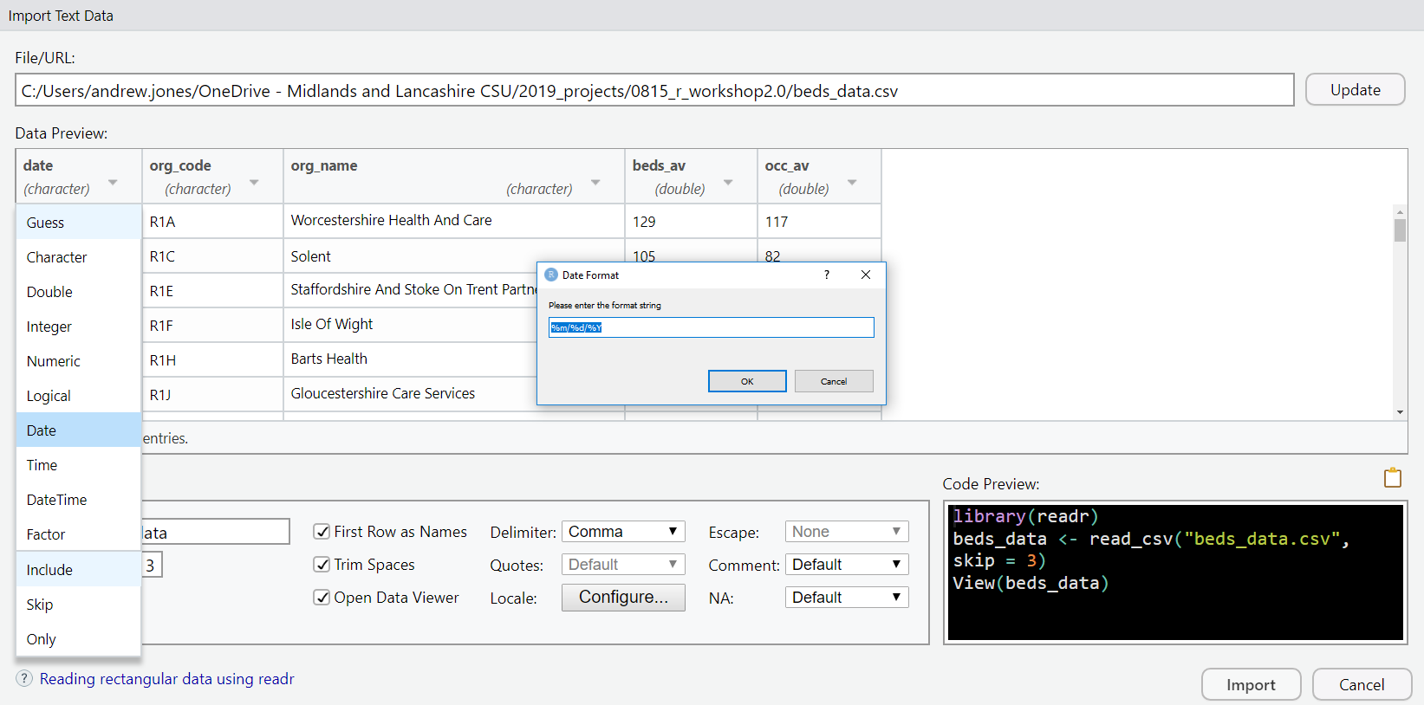
Less friendly csvs
Read in the “date” column as a Date!
%d/%m/%Y
Then repeat steps 2-6 as before

Slide 18
Preview the data

Slide 19
The data:
Average number of beds available / occupied at midnight over the 3-month period.
Observations quarterly
date
org_code
org_name
beds_av
occ_av
-
-
-
NA
NA
-
-
-
48
33
This is real data –
so there are real issues
(which we’ll work with)

Slide 20
The tool: dplyr
5
will help us gain a deeper understanding of our
data sets.
arrange
filter
key verbs:
mutate
group_by
summarise

Slide 21
An aside:
Very soon we will want to use a series of these dplyr commands...

Slide 22
Series of commands = Recipe
Imagine a recipe for mashed potato:
Start with a...
potato then
peel then
slice into medium sized pieces then
boil for 25 minutes then
mash

Slide 23
An aside:
Imagine a recipe for mashed potato:
Start with an R object
potato then
peel then
slice into medium sized pieces then
boil for 25 minutes then
mash

Slide 24
An aside:
Imagine a recipe for mashed potato:
Start with an R object
potato then
peel() then
slice into medium sized pieces then
boil for 25 minutes then
mash

Slide 25
An aside:
Imagine a recipe for mashed potato:
potato then
peel() then
slice(size = “medium”) then
boil for 25 minutes then
mash

Slide 26
An aside:
Imagine a recipe for mashed potato:
potato then
peel() then
slice(size = “medium”) then
boil(t = 25) then
mash

Slide 27
An aside:
potato %>%
peel() %>%
slice(size = “medium”) %>%
boil(t = 25)

Slide 28
An aside:
Imagine a recipe for mashed potato:
Input object
potato %>%
peel() %>%
slice(size = “medium”) %>%
boil(t = 25)
Output = hot chopped potato

Slide 29
An aside:
Imagine a recipe for mashed potato:
potato %>%
peel() %>%
slice(size = “medium”) %>%
boil(t = 25)
What is the output after this step?
Each step builds on the previous one

Slide 30
Tidyverse syntax
data_frame then
do_this(rules) then
do_this(rules)
Input
dplyr verb
Output
(new data frame)

Slide 31
Tidyverse syntax
data_frame %>%
do_this(rules) %>%
do_this(rules)

Slide 32
The tidyverse
Combine simple pieces to solve complex puzzles
data_frame %>%
do_this(rules) %>%
do_this(rules)

Slide 33
Using dplyr

Slide 34
Q1. Which organisation provided the highest number of Mental Health (MH) beds?

Slide 35
1. arrange
Reorder rows based on selected variable
beds_data %>%
arrange(beds_av)
Input data frame
“then”
dplyr verb
variable to arrange by

Slide 36
1. arrange
Reorder rows based on selected variable
beds_data %>%
arrange(beds_av)
Input data frame
“then” = Ctrl + Shift + m
dplyr verb
variable to arrange by

Slide 37
1. arrange
Reorder rows based on selected variable
beds_data %>%
arrange(beds_av)
defaults to ascending order

Slide 38
1. arrange
As we’d like descending order:
beds_data %>%
arrange(desc(beds_av))
for text and numeric
variables

Slide 39
Q2. Which 2 organisations provided the highest number of MH beds in Sept. 2018?

Slide 40
Q2. Which 2 organisations provided the highest number of MH beds in Sept. 2018?
We’ll use
arrange()
as before

Slide 41
Q2. Which 2 organisations provided the highest number of MH beds in Sept. 2018?
We’ll use
arrange()
as before
But we require only observations with this date

Slide 42
2. filter
pick observations by their value
beds_data %>%
filter( )
Input data frame
“then”
dplyr verb

Slide 43
2. filter
pick observations by their value
... %>%
filter(date == “2018-09-01”)
The expression inside brackets should return
TRUE or FALSE
We are testing equality so ==
we are choosing rows where this expression is TRUE

Slide 44
2. filter
pick observations by their value
beds_data %>%
arrange(desc(beds_av)) %>%
filter(date == “2018-09-01”)

Slide 45
Q3. Which 5 organisations had the highest percentage bed occupancy in Sept. 2018?

Slide 46
Q3. Which 5 organisations had the highest percentage bed occupancy in Sept. 2018?
We’ll use
arrange()
as before

Slide 47
Q3. Which 5 organisations had the highest percentage bed occupancy in Sept. 2018?
We’ll use
arrange()
as before
filter()
as before

Slide 48
Q3. Which 5 organisations had the highest percentage bed occupancy in Sept. 2018?
We’ll use
arrange()
as before
We don’t have this variable…
filter()
as before

Slide 49
Q3. Which 5 organisations had the highest percentage bed occupancy in Sept. 2018?
We’ll use
arrange()
as before
We don’t have this variable…
filter()
as before
but we can create it:

Slide 50
3. mutate
create new variables from existing ones
beds_data %>%
mutate(perc_occ = occ_av / beds_av)

Slide 51
3. mutate
beds_data %>%
mutate(perc_occ = occ_av / beds_av)
RHS usually a function of existing variable(s)
new column will be named
NOT a test of equality, so =

Slide 52
3. mutate
beds_data %>%
mutate(perc_occ = occ_av / beds_av) %>%
filter(date == “2018-09-01”) %>%
arrange(desc(perc_occ))
We can refer to variables we’ve just created above

Slide 53
Q4. What was the mean number of beds, (across all trusts) for each value of date?

Slide 54
Q4. What was the mean number of beds (across all trusts) for each value of date?
Let’s first look at how we’d produce summary stats like a mean…

Slide 55
4. summarise
collapse many values into a single summary value
beds_data %>%
summarise(mean_beds = mean(beds_av))
Similar syntax to mutate:
new column name
(summary)
function using existing columns

Slide 56
4. summarise
collapse many values into a single summary value
beds_data %>%
summarise(mean_beds = mean(beds_av))
but in this case our code returns NA
Similar syntax to mutate:
new column name
(summary)
function using existing columns

Slide 57
4. summarise
collapse many values into a single summary value
beds_data %>%
summarise(mean_beds =
mean(beds_av, na.rm = T))
We’ll need to remove NA values to get a suitable mean
T is short for TRUE

Slide 58
4. summarise
collapse many values into a single summary value
beds_data %>%
summarise(mean_beds =
mean(beds_av, na.rm = T))
This code produces a single summary value for the whole dataset

Slide 59
Q4. What was the mean number of beds, (across all trusts) for each value of date?

Slide 60
Q4. What was the mean number of beds, (across all trusts) for each value of date?
Now we know how to use summarise…

Slide 61
Q4. What was the mean number of beds, (across all trusts) for each value of date?
Now we know how to use summarise…
We’ll produce a summary value for each value of date

Slide 62
5. group_by
For each group…
beds_data %>%
group_by(date) %>% ...
For each value of date…
(do something):
group_by does nothing to the change the data frame...
But it does change a setting behind the scenes

Slide 63
5. group_by
For each group… summarise (produce single summary value)
beds_data %>%
group_by(date) %>%
summarise(
mean_beds = mean(beds_av, na.rm =T)
)

Slide 64
group_by and summarise
a very common pattern:
A column for the summary
A column is created for each grouping variable
beds_data %>%
group_by(date) %>%
summarise(
mean_beds = mean(beds_av, na.rm = T)
)
date
mean_beds

Slide 65
a very common pattern:
group_by and summarise
beds_data %>%
group_by(date) %>%
summarise(
mean_beds = mean(beds_av, na.rm = T)
)
A row for each unique value of date
date | mean_beds
“2010-06-01”
“2010-09-01”

Slide 66
5a. ungroup
Often it’s safest to remove the grouping after you’ve performed the required operation
a
beds_data %>%
group_by(date) %>%
summarise(
mean_beds = mean(beds_av, na.rm =T)) %>%
ungroup()

Slide 67
Which 5 organisations have the highest mean % bed occupancy? (over the 8 year period)

Slide 68
Which 5 organisations have the highest mean % bed occupancy? (over the 5 year period)

Slide 69
Which 5 organisations have the highest mean % bed occupancy?
1. Create a new variable
mutate()

Slide 70
Which 5 organisations have the highest mean % bed occupancy?
2. Then, for each of the…
group_by()
1. Create a new variable
mutate()

Slide 71
Which 5 organisations have the highest mean % bed occupancy?
2. Then, for each of the…
3. Summary stat using summarise
group_by()
1. Create a new variable
mutate()

Slide 72
Which 5 organisations have the highest mean % bed occupancy?
2. Then, for each of the…
3. Summary stat using summarise
group_by()
1. Create a new variable
mutate()
4. As before,
we’ll use
arrange

Slide 73
Which 5 organisations have the highest mean % bed occupancy?
2. Then, for each of the…
3. Summary stat using summarise
group_by()
1. Create a new variable
mutate()
4. As before,
we’ll use
arrange
Tip: Run the code after each new line to check it returns the output you’d expect.

Slide 74
Over to you…

Slide 75
Which 5 organisations have the highest mean % bed occupancy?
2. Then, for each of the…
3. Summary stat using summarise
group_by()
1. Create a new variable
mutate()
beds_data %>%
mutate(_ = _)%>%
group_by() %>%
summarise(_ = _ ) %>%
arrange()
4. As before,
we’ll use
arrange
Tip: Run the code after each new line to check it returns the output you’d expect.

Slide 76
Solution
beds_data %>%
mutate(perc_occ = occ_av / beds_av) %>%
group_by(org_name) %>%
summarise(mean_pocc =
mean(perc_occ, na.rm = T)) %>%
arrange(desc(mean_pocc))

Slide 77
How many columns associated with each observation?
Extension:
summarise(number = n())
This is a common pattern – it will count the number of rows associated with each group

Slide 78
Solution
beds_data %>%
mutate(perc_occ = occ_av / beds_av) %>%
group_by(org_name) %>%
summarise(mean_pocc= mean(perc_occ),
number = n())%>%
arrange(desc(mean_pocc))
Adding another
summary column

Slide 79
6. select
select a subset of variables from existing data set
beds_data %>%
select(org_code, org_name)

Slide 80
6. select
select a subset of variables from existing data set
beds_data %>%
select(-org_code)
To remove a column

Slide 81
6. select
select a subset of variables from existing data set
beds_data %>%
select(1:3)
You can also refer to columns by number. Here 1:5 saves having to type: 1,2,3,4,5

Slide 82
6. select
select a subset of variables from existing data set
beds_data %>%
select(org_name, everything())
If you want this column at the start of your data frame

Slide 83
Recommended Style
https://style.tidyverse.org/

Slide 84

here

Slide 85

This material was created for the NHS-R community by:
Andrew Jones @The Strategy Unit
The work is licenced under:
Creative Commons
Attribution-ShareAlike 4.0
International
To view a copy of this license, visit
https://creativecommons.org/licenses/by-sa/4.0/

Slide 86
End

Slide 87
Addendum

Slide 88
An aside: Data frames part II
With ggplot and dplyr we have been working with data frames.
Variables in columns
date
org
beds_av
“2010-03-01”
“5AA”
100
“2010-03-01”
“5BB”
80
“2010-03-01”
“5CC”
200

Slide 89
An aside: Data frames part II
We can think of a data frame as a series of columns, bound together by an invisible “data frame” structure.
date
org
beds_av
“2010-03-01”
“5AA”
100
“2010-03-01”
“5BB”
80
“2010-03-01”
“5CC”
200

Slide 90
An aside: Data frames part II
If we remove the structure we can examine a column in isolation.
Data frame structure removed
beds_av
100
80
200

Slide 91
An aside: Data frames part II
These simple columns may be called vectors.
beds_av
100
80
200

Slide 92
An aside: Data frames part II
Vector types include integer and character
beds_av
100
80
200

Slide 93
An aside: Data frames part II
You can create a vector with c()
c(100, 80, 200)
c stands
for “combine”
beds_av
100
80
200

Slide 94
An aside: Data frames part II
You can add the data-frame structure to the vector with tibble()
tibble(beds_av = c(100, 80, 200))
Name your column
c stands
for “combine”

