Slide 1
Efficient Asymmetric Cryptography for RFID Access Control
Ben O’Neill
Emmanuel College

Slide 2

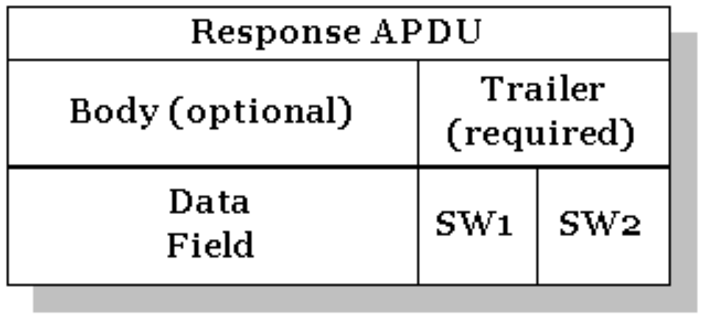

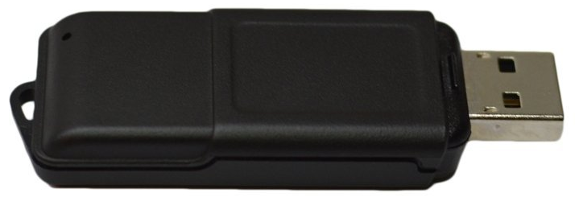
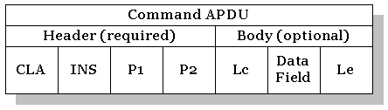
Background - Smartcards
Command-response APDUs, client-server model.
Java Card: implementation of ISO7816.
Reprogrammable using a subset of Java.
Existing university smartcard system (MIFARE classic) is inadequate.
Relied on obfuscation of implementation details.
Limited on-card memory for keys, forces reuse of same key for multiple terminals.
(other weaknesses…)

Slide 3
Project goals
Access control system based on asymmetric cryptography
Support card revocation.
Robust against compromised keys.
Resolve problems with current university smartcard system.
Achieve reasonable authentication time.
Mitigate cost of introduction, ensure system is secure.

Slide 4
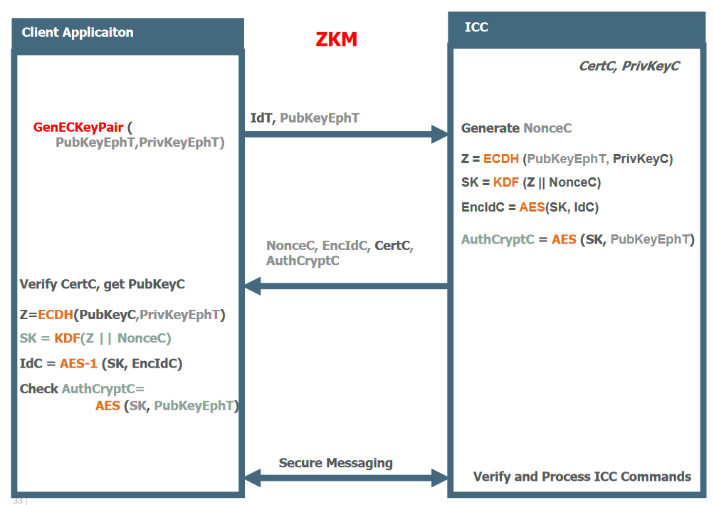
Implementation
Protocol: OPACITY ZKM
Zero Key Management - terminal doesn’t store secrets.
Elliptic Curve Diffie-Hellman key agreement.
Persistent binding – optimisation. Generate secret for next encounter.
Java Card 3.0.4 smartcards.
2.2.2 has library deficiencies

Slide 5
Work completed
Core of project implemented – working prototype.
Mostly implemented optimised protocol involving Persistent Binding.
Scripts manage issuing and authentication of cards.
Still to be done
More user-friendly card issuing interface.
Finalize Persistent Binding implementation.

