Slide 1

Case Study : Cyclistic

Slide 2
introduction
Cyclistic is a bike-share company launched in 2016, The initial marketing strategy of the company focused on flexible pricing plans for single-ride passes, full-day passes, and annual memberships. Annual members are identified as more profitable than casual riders, prompting a strategic shift to convert existing casual riders into members.

Slide 3
target
The goal to be achieved is how to transfer
casuals
into
members
the

Slide 4
casuals
members
customer that does not have a subscription institution
customer that does have a subscription institution

Slide 5
We will divide this topic into four basic categories:
Data Manipulation
Visualization
Conclusions
Suggestions

Slide 6
Data Manipulation
From the start_at column, we extract the hour, day of the week, and month columns and The difference in time is in minutes through subtraction that started_at and ended_at

Slide 7
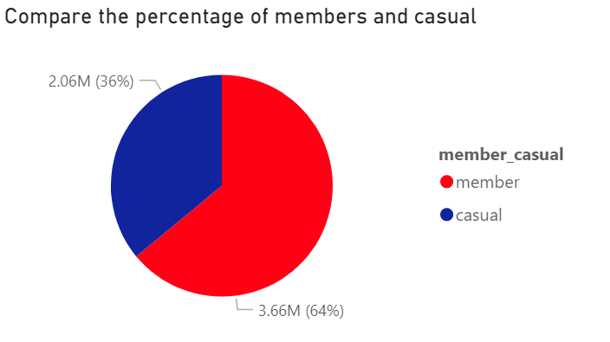
Visualization
We note that the percentage of members is more than one percentage
conclusions
suggestions

Slide 8
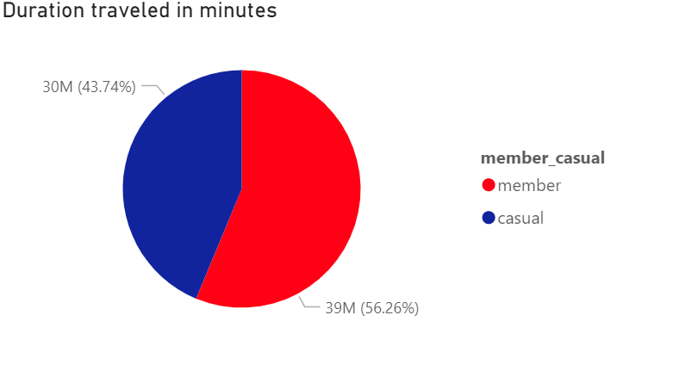
Visualization
But we note at the same time that the length of time spent by the casuals and members is close compared to the percentage of members and casuals

Slide 9
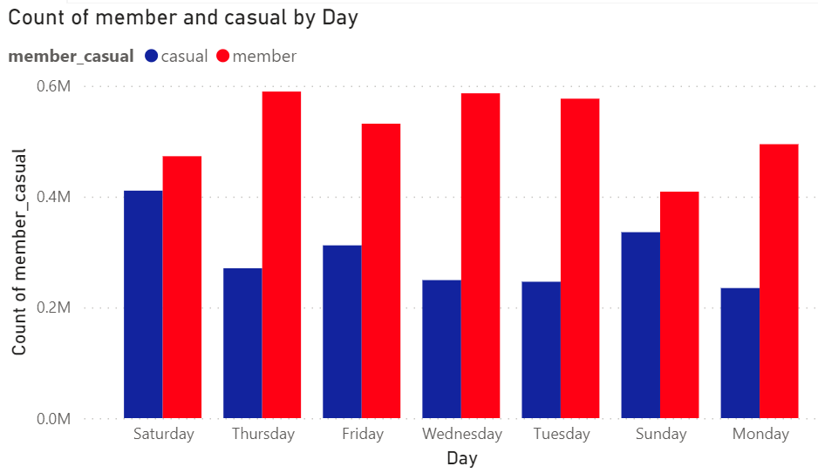
Visualization
We notice that casual prefer to use our services on weekends

Slide 10
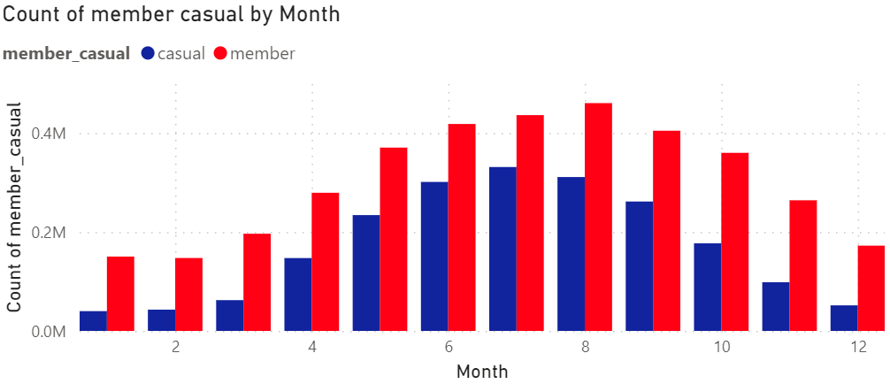
Visualization
We notice that the demand for our services increases from the fifth month to the tenth month This may be due to people preferring to use bicycles in warmer climates and other means of transportation in colder climates.

Slide 11
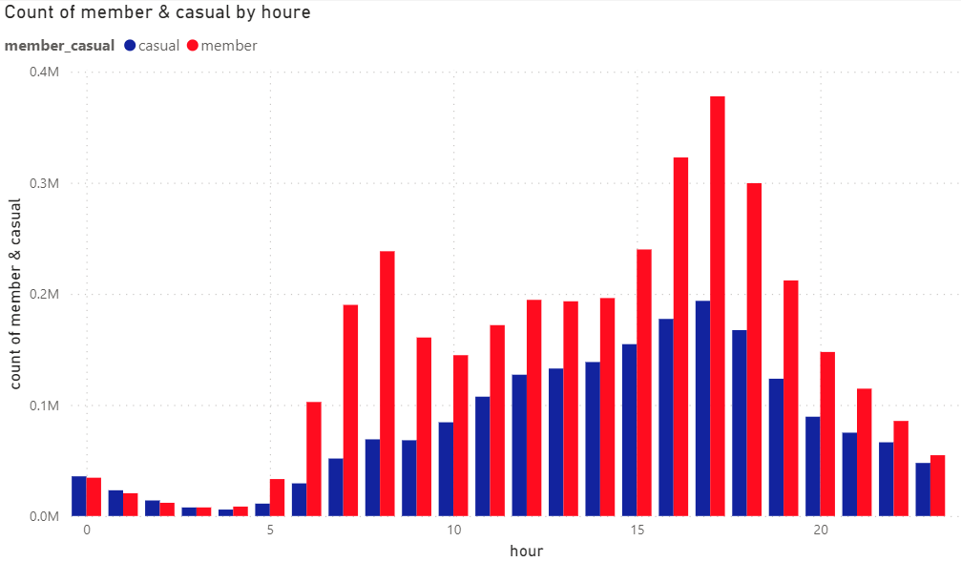
Visualization
We notice an increase in demand between four and six in the evening, which corresponds to the end of working hours, but we also notice that they do not use it in the same proportion when going to work, which means that customers often and not only use our services to go to and from work. They may even prefer to use it for other things after leaving work, such as sports

Slide 12
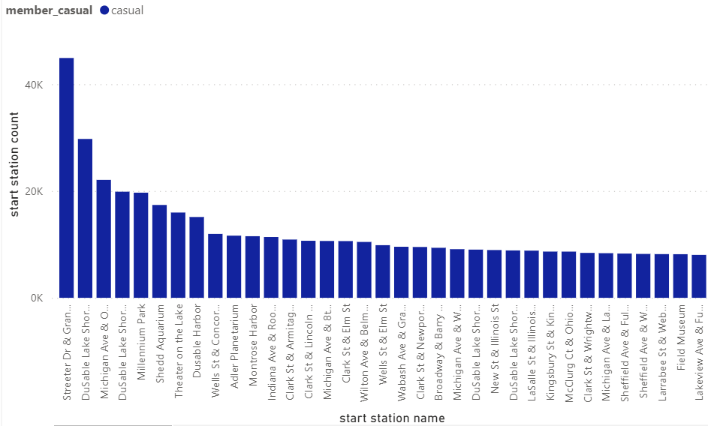
Visualization
We note that the most used started stations by casuals are Streeter DR & Grand Ave , DuSable Lake Shore Dr & Monroe St, Michigan Ave & Oak St, DuSable Lake Shore Dr & North Blvd, Milennium Park, Shedd Aquarium, Theater on the lake, Dusable Harbor
Visualization

Slide 13
Conclusions
What we can conclude from the data available to us is that the best time to target casualties is during the summer and spring heat, on weekends, and also between 4 and 6 o’clock, in addition to that they often request our services for going out and exercising. Special offers in the summer and spring season, It is better to focus on these stations Streeter DR & Grand Ave , DuSable Lake Shore Dr & Monroe St, Michigan Ave & Oak St, DuSable Lake Shore Dr & North Blvd, Milennium Park, Shedd Aquarium, Theater on the lake, Dusable Harbor

Slide 14
Suggestions
for better results I suggest that we start collecting data on the ages of users because this will help us target them with ads. In addition, if they are young, they may not have enough money to engage and frequently use our services, so we will offer them special offers.

