Slide 1

Department of Computer Science and Engineering
Project Report on
A LIGHTWEIGHT MACHINE LEARNING APPROACH ON INDIA’S CROP YIELD PREDICTION USING HISTOGRAM BASED GRADIENT BOOSTING REGRESSOR(HGBR)
Under the Supervision of
Mrs. D. Srilatha Reddy
Assistant Professor, Department of CSE
Presented By:
Student Name (23N85A0501)
Student Name (22N81A0525)

Slide 2
ABSTRACT
This project focuses on implementing the Histogram-Based Gradient Boosting Regressor (HGBR) for efficient and accurate predictive modeling. The model leverages histogram-based binning to reduce computational complexity and improve training speed compared to traditional gradient boosting methods.
The objective of this project is to analyze and predict target values by training the HGBR model on a structured dataset, optimizing performance through hyperparameter tuning and feature selection. The model’s effectiveness is evaluated using standard regression metrics such as Mean Squared Error (MSE) and R² score.
Results demonstrate that HGBR provides high accuracy with faster training time, making it suitable for large-scale datasets and real-world machine learning applications.

Slide 3
Introduction
Agriculture has been the backbone of India’s economy for centuries, supporting a large portion of the population and contributing significantly to GDP.
Traditional farming practices in India have relied heavily on experience, seasonal patterns, and manual observation for decision-making.
However, these conventional methods often fail to accurately predict crop yield due to unpredictable factors like climate change, soil variability, and rainfall fluctuations.

Slide 4
Introduction(Contd).
With the advancement of Machine Learning, data-driven approaches can be used to improve prediction accuracy and assist farmers in making informed decisions.
Among various techniques, Histogram-Based Gradient Boosting Regressor (HGBR) offers an efficient and scalable solution for handling large agricultural datasets.
This project focuses on applying HGBR to predict crop yield more accurately, helping to overcome the limitations of traditional prediction methods.

Slide 5
Problem Definition
Traditional crop yield prediction methods in India rely on farmer experience, historical patterns, and manual estimation, which are often inaccurate and inconsistent. These age-old approaches fail to account for complex factors such as changing climate conditions, soil diversity, and unpredictable rainfall.
Modern Machine Learning models improve prediction accuracy but often require high computational power, large memory, and longer training time. This makes many advanced models impractical for real-world agricultural use, especially in resource-constrained environments.
There is a need for a solution that balances accuracy and efficiency in crop yield prediction. This project addresses the problem by using Histogram-Based Gradient Boosting Regressor (HGBR) to provide faster and reliable predictions with reduced computational cost.

Slide 6
Literature Survey
Several studies have applied Machine Learning techniques such as Linear Regression, Decision Trees, and Random Forest for crop yield prediction.
Traditional models like Linear Regression are simple but often fail to capture complex non-linear relationships in agricultural data.
Advanced ensemble methods like Random Forest and Gradient Boosting provide better accuracy but can be computationally expensive.

Slide 7
Literature Survey(Contd).
Recent research highlights the effectiveness of Gradient Boosting techniques in handling large and complex datasets with improved prediction performance.
However, many existing approaches do not focus on optimizing both training speed and resource efficiency.
This project explores Histogram-Based Gradient Boosting Regressor (HGBR) as a solution that balances accuracy, speed, and scalability in crop yield prediction.

Slide 8
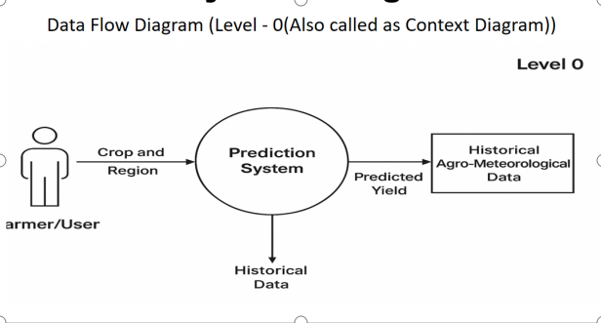
System Design

Slide 9
System Design(Contd).
The system begins with the user (farmer) providing input such as crop type and region. The Prediction System acts as the central component that processes all inputs and data.
The system also takes historical agro-meteorological data (rainfall, temperature, etc.) as input for better prediction. In Level 1, the data is sent to the model training module, where the machine learning model (HGBR) learns patterns.
After processing, the system generates the predicted crop yield based on input and historical data. Finally, the result is shown in the result display module, making it easy for users to understand the output.

Slide 10
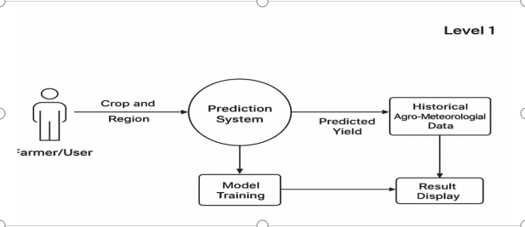
System Design(Contd).

Slide 11
Methodology
The project follows a systematic approach involving data collection, preprocessing, and model implementation.
Dataset Source: Collected from Kaggle with historical crop yield data
Key Features Used: Meteorological Data: Rainfall, temperature, humidity. Soil Parameters: Soil type, Nitrogen (N), Phosphorous (P), Potassium (K). Crop Information: Crop type and season. Target Variable: Crop yield (tonnes per hectare)
Data Preprocessing Steps: Handling Missing Values using mean imputation, Encoding Categorical Data (crop type, region) into numerical form, Data Normalization to ensure balanced feature contribution.

Slide 12
Methodology(Contd).
Proposed Model: Histogram-Based Gradient Boosting Regressor (HGBR)
Working Principle: Uses Gradient Boosting (sequential learning from errors), Applies Histogram Binning to improve efficiency.
Advantages of HGBR: Faster training with reduced computational complexity, Efficient for large agricultural datasets, Handles nonlinear relationships effectively.
Tools & Technologies: Python (core language), Scikit-learn (HGBR model), Matplotlib (visualization).
Hyperparameters Tuned: Learning Rate, Max Depth,Number of Iterations.
Evaluation Metrics: R² Score, Mean Squared Error (MSE), Mean Absolute Error (MAE), Mean Squared Log Error (MSLE).

Slide 13
Requirement Specifications
System Requirements
The system is a machine learning-based crop yield prediction application.
Requires structured agricultural data such as: Rainfall, Temperature, Soil type, Crop details.
Main processing stages include: Data Input, Data Preprocessing, Model Training, Prediction Generation.
Designed to be scalable and efficient for handling multi-feature datasets.

Slide 14
Requirement Specifications(Contd).
User Requirements
The system is designed for: Farmers, Agricultural researchers, Government agencies.
Users should be able to: Input agricultural parameters (crop, region, weather data), Receive predicted crop yield.
Output should be: Simple and easy to understand, Visually interpretable (graphs/charts).
System should require minimal technical knowledge.

Slide 15
Requirement Specifications(Contd).
Functional Requirements: Accept input data (rainfall, temperature, crop type, etc.), Perform preprocessing (cleaning, encoding, scaling), Train machine learning model (HGBR), Predict crop yield, Display results to the user.
Performance Requirements: Provide accurate predictions, Ensure low computation time, Handle large datasets efficiently.
Evaluation Metrics Used: Mean Absolute Error (MAE), Root Mean Squared Error (RMSE), R² Score.

Slide 16
Implementation
System Overview
The system is implemented as a machine learning-based pipeline designed specifically for accurate crop yield prediction using agricultural data.
It follows a structured workflow consisting of: Data Collection from reliable sources, data preprocessing to clean and prepare the dataset, model training using advanced ML algorithms, prediction generation based on input parameters.
The entire system is designed using a modular approach, where each component handles a specific task efficiently.
This modular design improves scalability, maintainability, and clarity, making the system easier to extend and upgrade.

Slide 17
Implementation(Contd).
Tools and Technologies Used
Programming Language: Python, chosen for its simplicity, flexibility, and strong support for data science applications
Libraries Used: Pandas – for efficient data handling, cleaning, and preprocessing operations, NumPy – for performing fast numerical computations and array manipulations, Scikit-learn – for implementing machine learning models, especially HGBR, Matplotlib / Seaborn – for creating graphs and visualizing data trends and results.
These tools collectively enable efficient data processing, model building, and result visualization in the system.

Slide 18
Implementation(Contd).
Data Processing and Model Development
The dataset is initially loaded into the system and analyzed to understand its structure, features, and data distribution.
Data Preprocessing Steps: Handling missing values using appropriate techniques like mean imputation. Removing duplicate and inconsistent records to improve data quality, encoding categorical variables such as crop type and region into numerical form, scaling numerical features like rainfall and temperature for better model performance.
Model Development: Histogram Gradient Boosting Regressor (HGBR) is initialized as the main model, the model is trained using the processed dataset to learn patterns, it captures complex relationships between environmental factors and crop yield.

Slide 19
Implementation(Contd).
Prediction and Evaluation
Prediction Process: User inputs such as crop type, region, and environmental conditions are provided to the trained model, The model processes these inputs and generates predicted crop yield values.
Model Evaluation: The predicted values are compared with actual values from the test dataset to measure performance.
Evaluation Metrics Used: Mean Absolute Error (MAE) to measure average prediction error, Root Mean Squared Error (RMSE) to penalize larger errors, R² Score to evaluate how well the model explains the data.
These evaluation techniques ensure that the model is accurate, reliable, and capable of handling real-world agricultural data.

Slide 20
Testing
Model Evaluation
Evaluated using standard regression metrics on test data
R² Score: 0.719 → Model explains ~72% variance in yield
Adjusted R²: 0.712 → Consistent performance after feature penalty
RMSE: 858.78 → Moderate prediction error magnitude
MAE: 81.75 → Low average absolute deviation
RMSLE: 0.166 → Good performance on log-transformed targets
SMAPE: 15.50% → Acceptable percentage error across regions
Log-target transformation improved stability and reduced skew impact

Slide 21
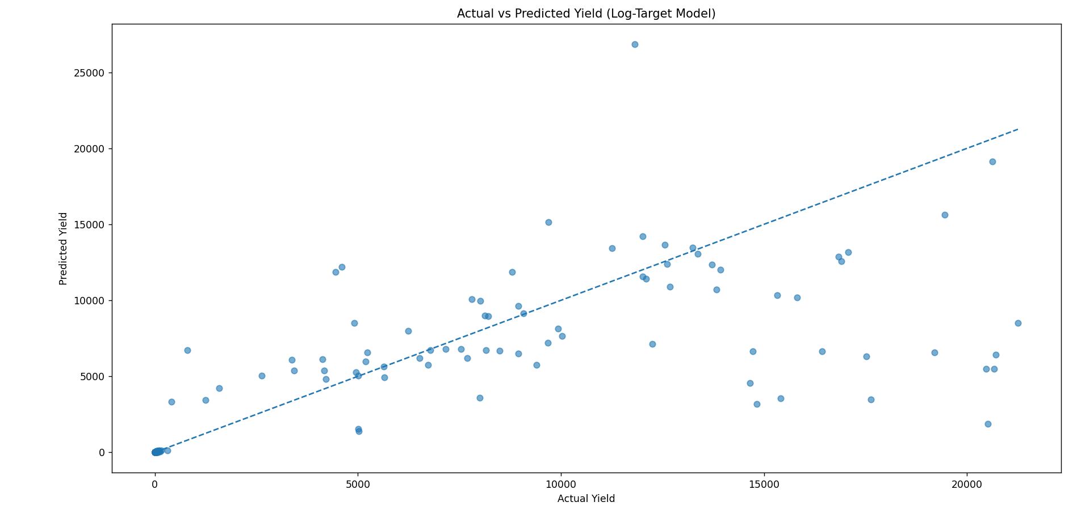
Testing(Contd).
Actual vs Predicted Plot:
Predictions follow general trend (positive correlation)
Some dispersion at higher yield values → slight underfitting in extremes

Slide 22
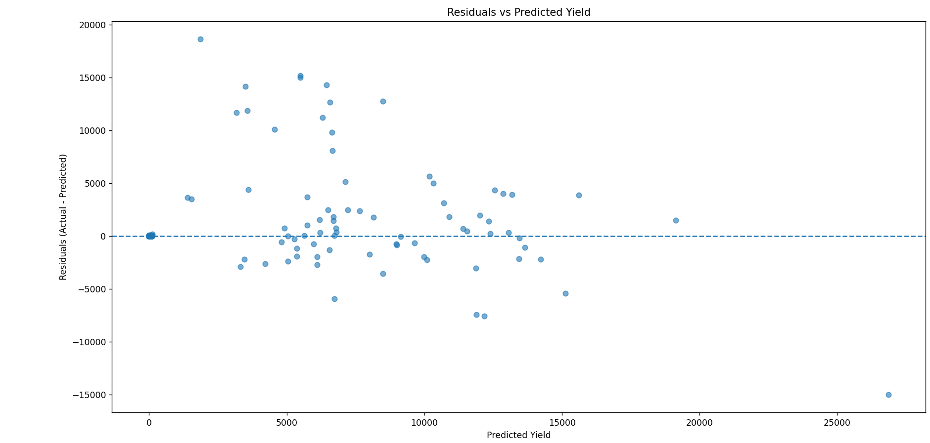
Testing(Contd).
Residual Analysis:
Residuals centered around zero → no strong bias.
Spread increases with higher predictions → heteroscedasticity observed.
Few outliers with large errors (high-yield regions).
Model captures overall pattern but struggles with extreme yield values.

Slide 23
Testing(Contd).
Spatial Testing:
Interactive Folium map used for geographic validation
Displays predicted crop yields across Indian states
Helps identify regional prediction variations
Example insight: Northeastern states (e.g., Arunachal Pradesh) show moderate predictions
Visual tool aids in: Detecting spatial inconsistencies, Understanding regional agricultural patterns.
Confirms model generalization across diverse climatic zones in India

Slide 24
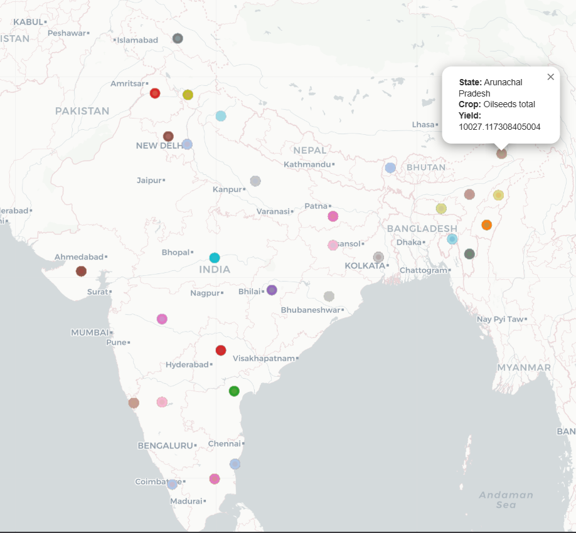
Testing(Contd).

Slide 25
Conclusion and Future Enhancements
Conclusion
Developed a lightweight crop yield prediction model using Histogram Gradient Boosting Regressor (HGBR)
Achieved strong predictive performance (R² ≈ 0.72) with low error metrics
Log transformation improved handling of skewed agricultural data
Model successfully captures overall yield trends across Indian states
Residual analysis shows minimal bias, though extreme values remain challenging
Folium-based visualization confirms good spatial generalization
Suitable for resource-constrained environments due to efficiency and scalability

Slide 26
Conclusion and Future Enhancements(Contd).
Future Enhancements
Incorporate real-time weather and satellite data for dynamic predictions
Use deep learning models (e.g., LSTM, CNN) for temporal and spatial patterns
Improve handling of outliers and high-yield variance regions
Integrate soil health, irrigation, and fertilizer usage data
Perform hyperparameter optimization & ensemble techniques for higher accuracy
Develop a web/mobile-based decision support system for farmers
Extend model to crop-specific and district-level predictions for finer granularity

Slide 27
Thank you …
Any Questions?

