Slide 1
Library Management System
Database Design and Implementation
2024/12/25

Slide 2


Project Background and Goals
Project Background:
With the increasing demands of library management, traditional manual systems are no longer sufficient for modern management needs.
Developing an intelligent library management system can significantly improve the management efficiency and user experience in libraries.
Project Goals:
Manage Book Information: Implement functions for adding, deleting, editing, and querying books.
User Management: Implement role management for readers, librarians, and administrators.
Borrowing and Returning: Track book borrowing, returning, and renewal statuses.
Reservations and Reviews: Allow users to reserve books and leave reviews and ratings.

Slide 3
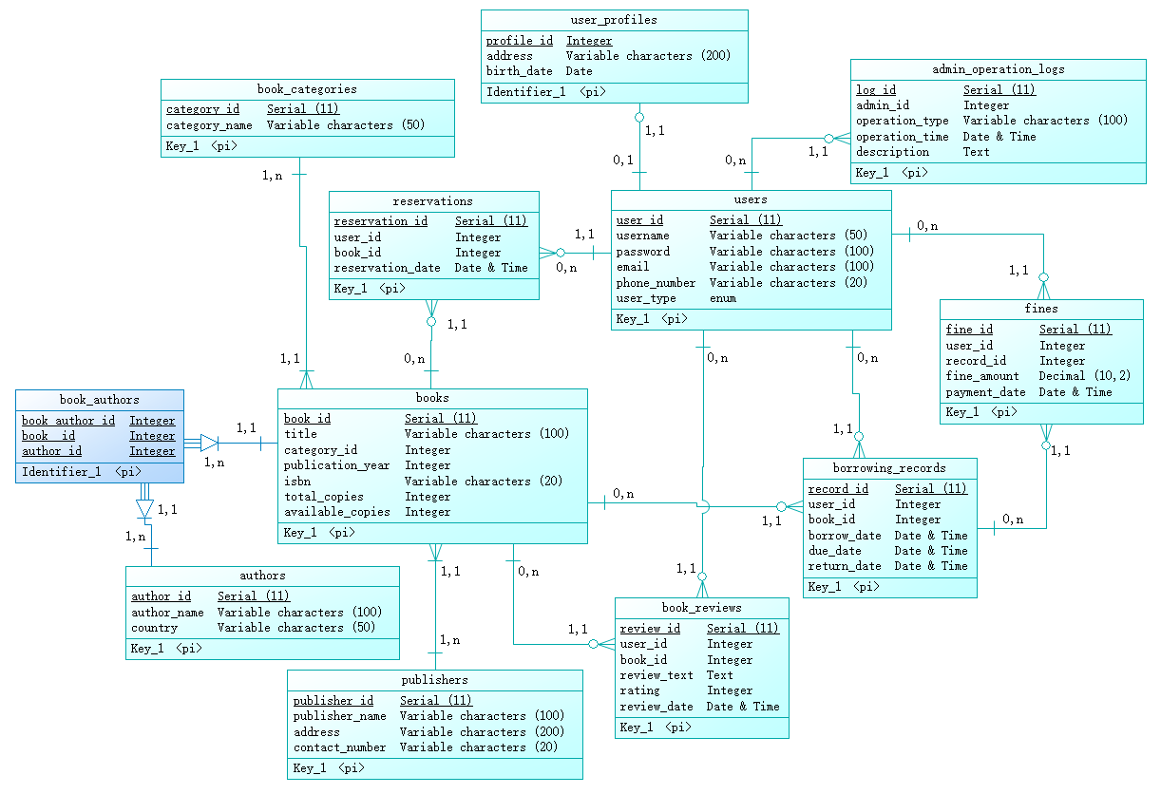
Database Design Overview
Overview of Database Structure:
Main Entities: Users, Books, Borrowing Records, Book Categories, Publishers, Authors, etc.
Relationships: Foreign key relationships between entities (e.g., Users and Borrowing Records, Books and Authors/Publishers).
ER Diagram (Entity Relationship Diagram):

Slide 4
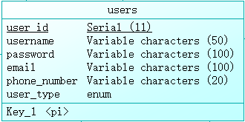
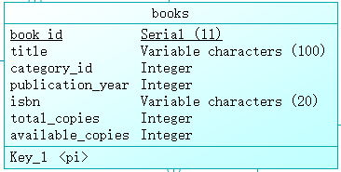
Database Table Design
1. Users Table (users):
Columns: user_id, username, password, email, phone_number, user_type
2. Books Table (books):
Columns: book_id, title, author, publisher, publication_year, isbn, category, total_copies, available_copies
3. Borrowing Records Table (borrowing_records):
Columns: record_id, user_id, book_id, borrow_date, due_date, return_date
4. Book Categories Table (book_categories):
Columns: category_id, category_name
5. Fines Table (fines):
Columns: fine_id, user_id, record_id, fine_amount, payment_date
6. Reservations Table (reservations):
Columns: reservation_id, user_id, book_id, reservation_date

Slide 5
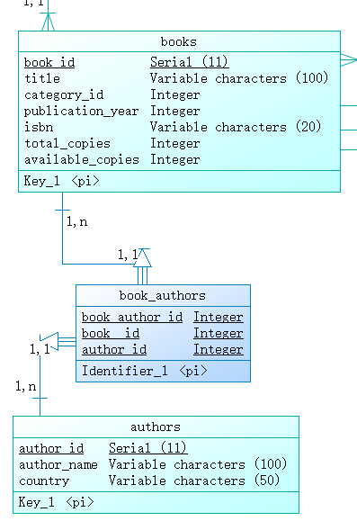
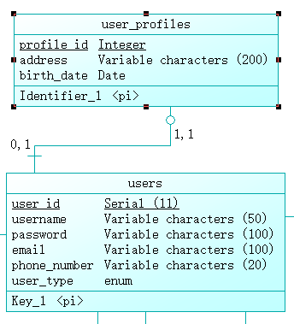
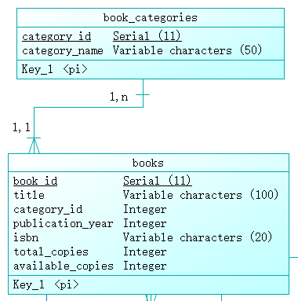
Database Table Design
one to one
one to many
many to many

Slide 6
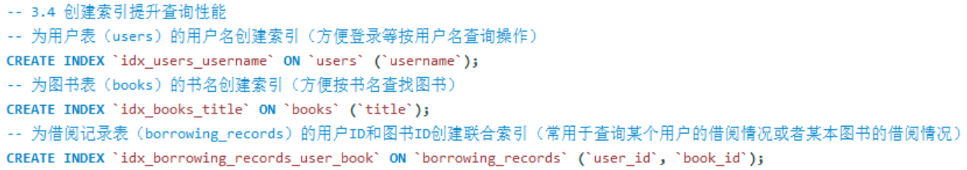
Database Optimization and Index Design
Index Optimization:
Indexes on frequently queried fields (e.g., username in users, title in books)
significantly improve query performance.
Foreign Key Constraints:
Foreign key constraints ensure data consistency and integrity, for example,
deleting users or books automatically updates or deletes related borrowing records and reviews.
Query Optimization:
Used composite indexes and optimized queries to reduce database response time
and ensure efficient system performance.

Slide 7
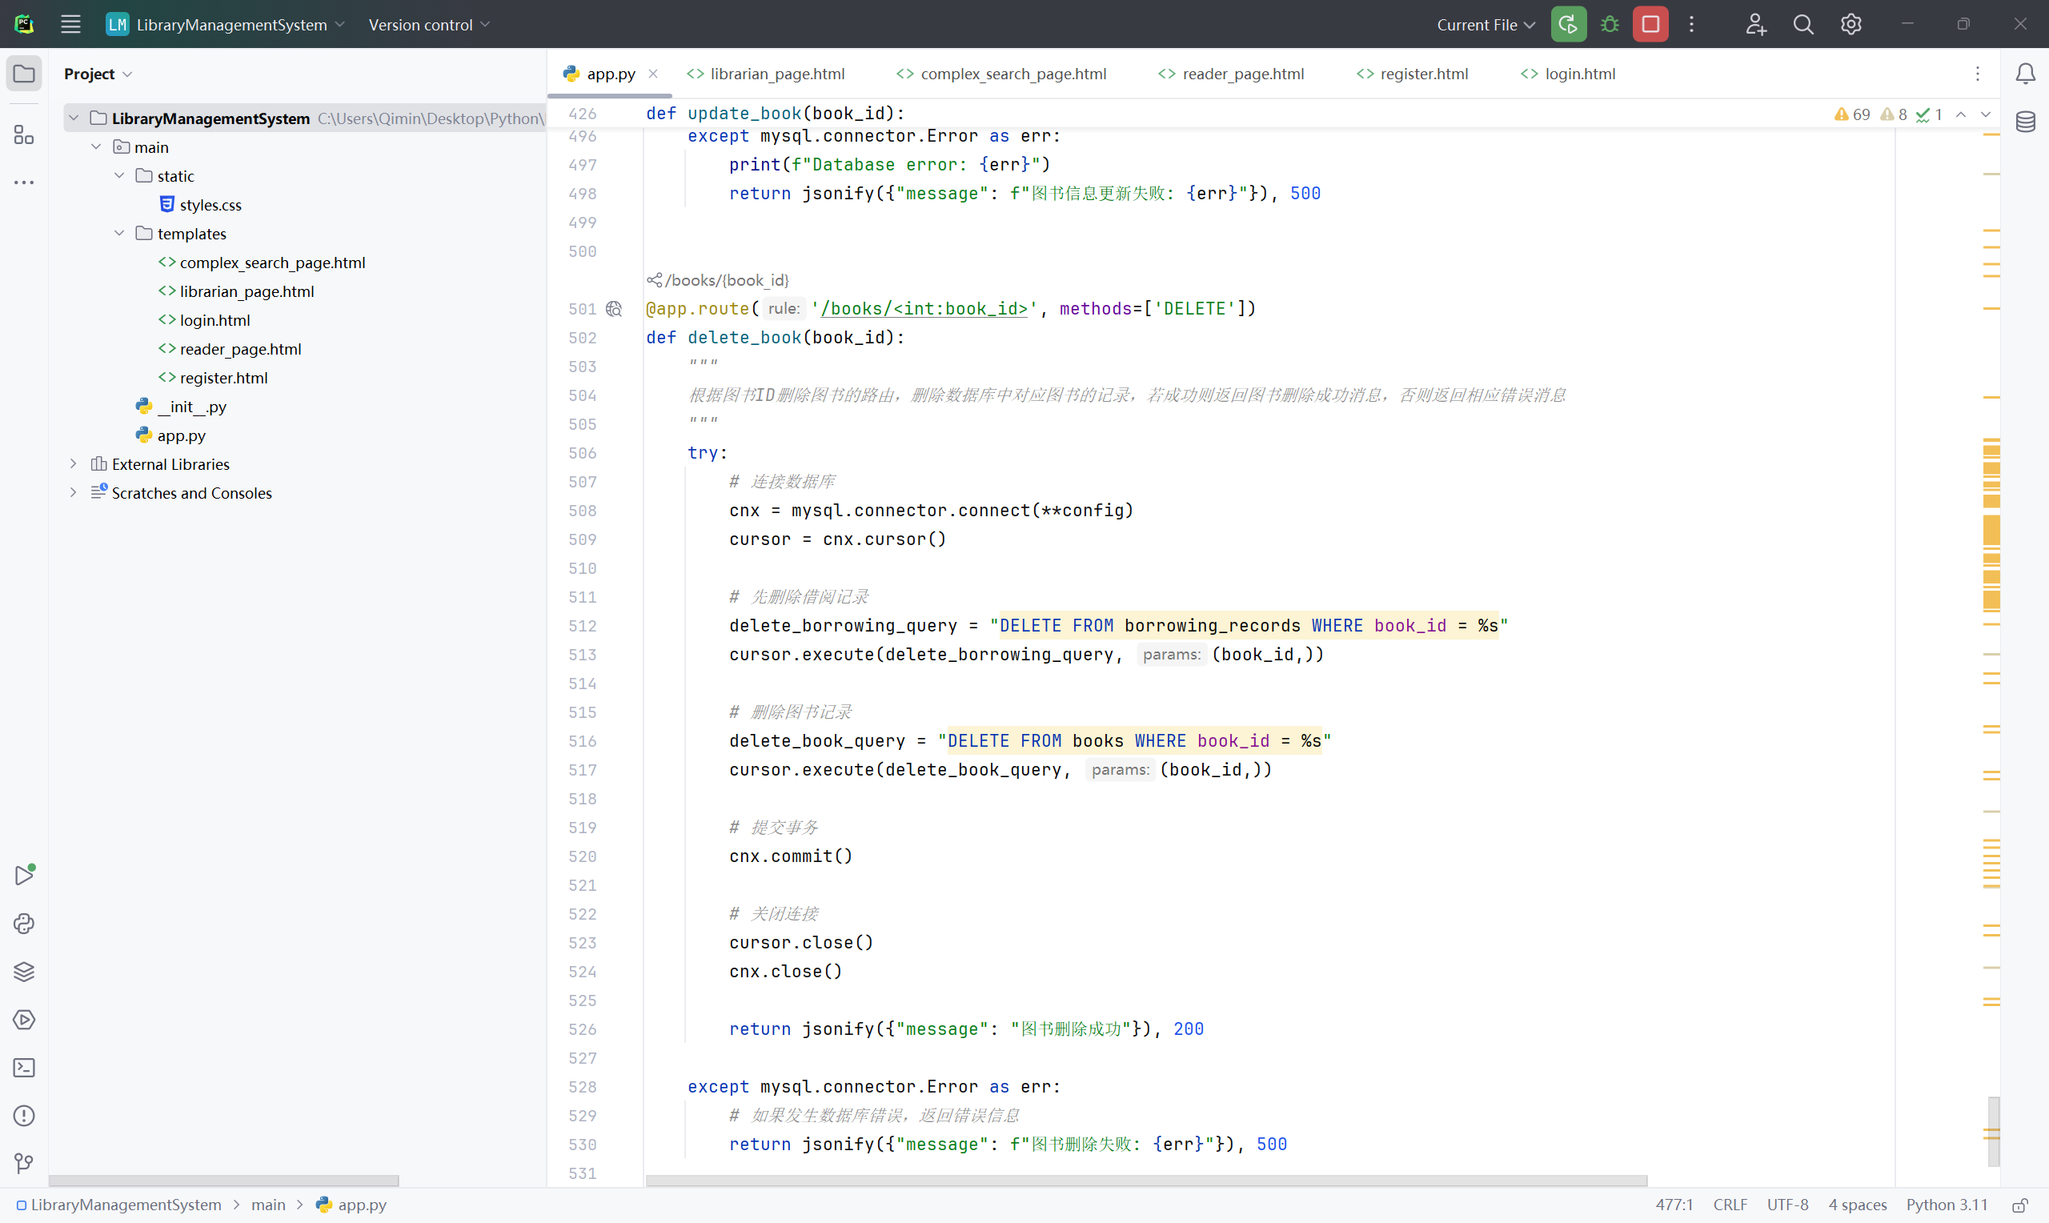
Project Implementation Process
Technology Stack:
Frontend: HTML
Backend: Python
Database: MySQL
Development Process:
Requirements Analysis: Defined system functionalities and database design.
Database Design: Created the ER diagram and database tables.
Development Stage: Frontend and backend development, implementing database operations and system functionalities.
Testing Stage: Functional testing, performance testing, and adjustments based on user feedback.

Slide 8
Challenges Faced
Database Design:
Initially struggled with designing relationships between books, authors, publishers, and borrowing records.
Solution: Used foreign keys to maintain data integrity and implemented
many-to-many relationships where needed.
Query Optimization:
Writing complex SQL queries to join multiple tables and perform aggregations was challenging.
Solution: Optimized queries by using indexes on commonly queried columns,
and broke down complex subqueries into smaller parts.
User Interface:
Designing an intuitive UI for librarians and users that makes complex features easy to use.
Solution: Focused on simplicity and user feedback during development.

Slide 9
Key Features
User Authentication:
1. Secure login and registration.
2. Role-based system for different user types (e.g., readers and librarians).
Book Management:
1.CRUD operations for books (Add, Edit, Delete, Search).
2. Multiple filters for searching by title, author, publisher, etc.
Complex Search:
1. Multi-criteria search with complex queries like joins, aggregations, and subqueries.
2. Provides insights into book availability, borrow statistics, and more.

Slide 10
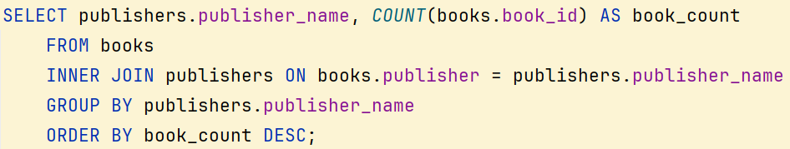
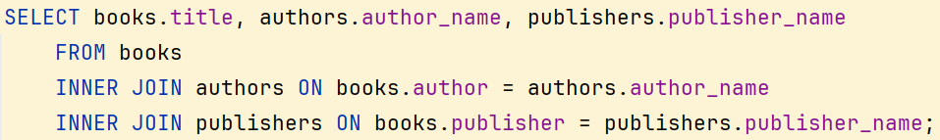
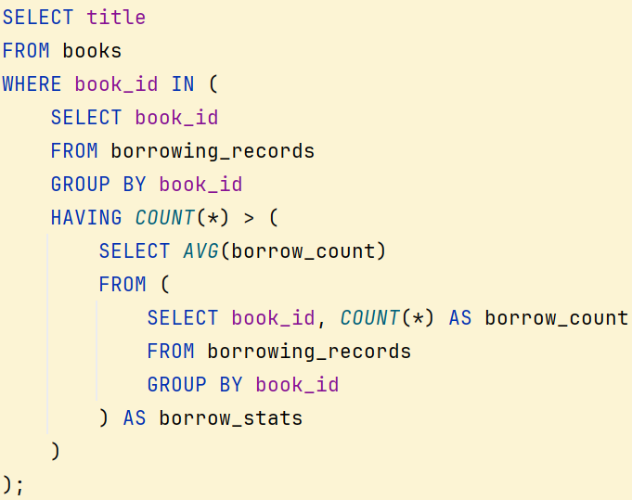

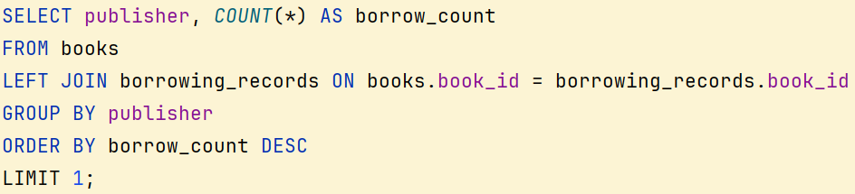

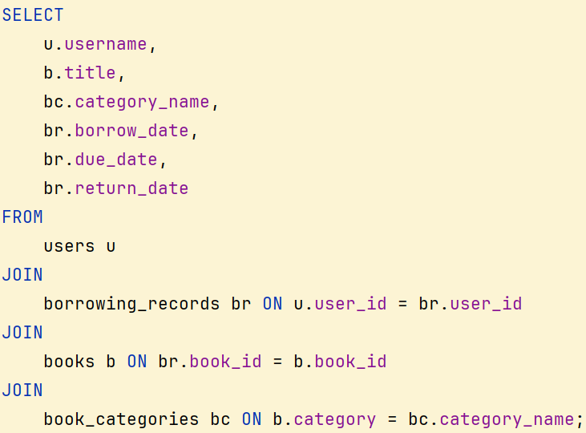
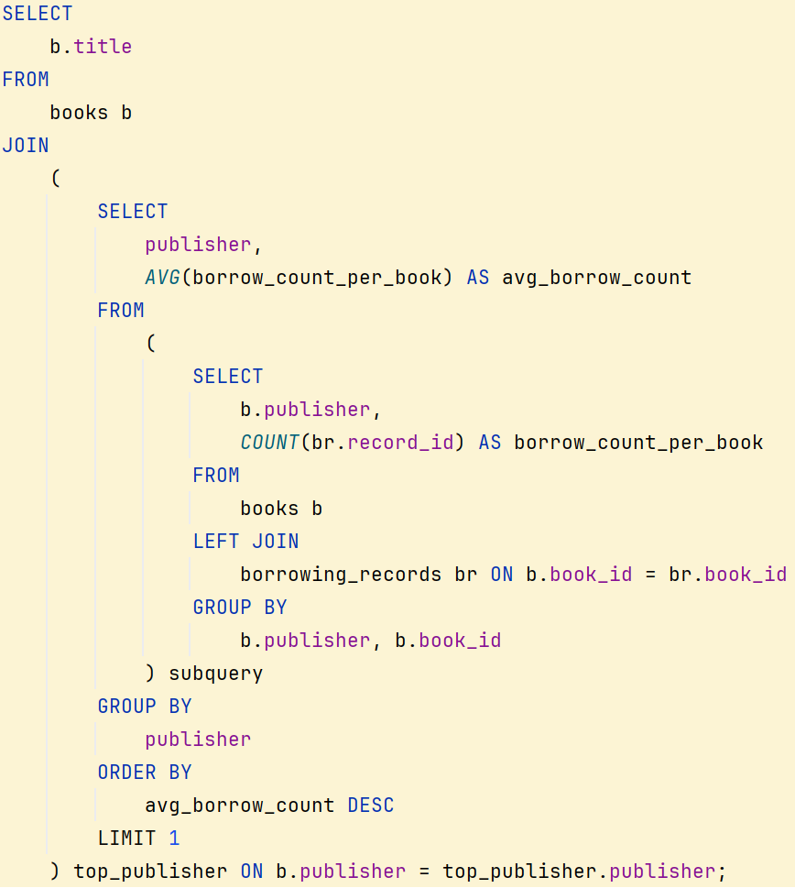
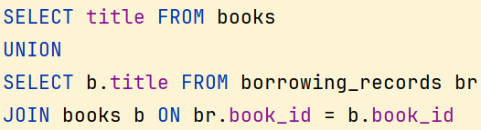
Key Features
Aggregate functions with GROUP BY and ORDER BY clauses
Complex Search:
Join queries (inner, outer, self)
Single-table queries
Subqueries
Correlated subqueries
Date and time functions
Set operations (UNION, INTERSECT, EXCEPT)
Multi-table join queries
Division queries

Slide 11
Summary
Core Features:
Security:
Scalable:
User management, book CRUD operations, complex search.
Login, session management, and secure querying practices ensure a safe user experience.
The system is built to scale with additional features like book borrowing
and overdue notifications.

Slide 12
Project Achievements
Successfully built a fully functional web-based library management system.
Demonstrated proficiency in SQL by incorporating complex search
queries such as joins, subqueries, and aggregation.
Provided a user-friendly interface for both librarians and users.
Delivered a robust and scalable solution,
ensuring smooth database operations.

Slide 13
Future Improvements
Mobile Compatibility:
Ensure the web application is responsive and works well on mobile devices.
Advanced Features:
Implement features like overdue book alerts, user ratings for books,
and recommendations based on borrowing history.
Data Analytics:
Add data visualization for borrowing trends, book popularity, etc.,
to help librarians make informed decisions.

