Slide 1
CBI NI Digital Forum 14th December 2018
Dr Owen Sims
Senior Policy Advisor, CBI

Slide 2
Agenda
Time | Agenda Item
08:00 – 08:10 | Welcome and introductions Angela McGowan, Director, CBI NI
08:10 – 08:30 | NI Digital Economy: Taking Stock, Looking Ahead Owen Sims, Senior Policy Advisor, CBI NI
08:30 – 09:00 | Foreign Direct Investment Strategy Alan Wilson, Head of International Investment, Invest NI
09:00 – 09.20 | Discussion on key digital issues and opportunities facing NI firms
09.20 – 09.25 | Any other business Further actions
09:25 – 09.30 | Wrap-up and close

Slide 3
Attendees
Name | Title | Company
Tom Gray | Chief Technology Officer | Kainos
Susan McKane | Head of Catalyst Belfast FinTech Hub | Danske Bank
Catherine Harrison | Vice-President HR | First Derivatives
Seamus Cushley | Director, Blockchain, FinTech & Innovation | PwC
George Maybury | NI Central Government Sector Manager | BT
Tara Simpson | Managing Director | Instil Software
Damian McAreavey | Project Manager | Etain Ltd
William Hamilton | Managing Director | Liberty IT
John Healy | Vice President & Managing Director | Allstate
Michael McEnery | Education Manager | CCEA
Alan Wilson | Head of International Investment | Invest NI
Paul Moore | Core Development Manager | Civica
Angela McGowan | Director, Northern Ireland | CBI NI
Owen Sims | Senior Policy Advisor | CBI NI

Slide 4
Background: The CBI NI Digital Forum
The CBI NI Digital Forum has been established to:
Develop policy for Northern Ireland’s Digital Economy;
Inform organizations of developments within the economic environment for digital skills & investment; and
Convening companies with policy-makers and government officials.
Output will take the form of policy recommendations to help construct a Digital Strategy, but will be mainly shaped by members. Intends to meet quarterly.
Meetings are an opportunity to:
Discuss the digital economic environment within the Northern Irish economy.
Discuss your Digital ‘State of Trade’ (e.g. projects, adoption challenges).
Engage with senior members of Invest NI on international investment and skills strategy.

Slide 5
NI Digital Economy: Taking Stock, Looking Ahead

Slide 6
Overarching Claim
“The digital economy has been successful in Northern Ireland, but a number of barriers are hindering growth.”
£3.2bn
generated through direct, indirect and induced (spillovers) in GVA. It now generates over 8% of NI total GVA.

Slide 7
Jobs generated by Digital economy
45,541
workers currently employed in the knowledge economy. `
79,000
direct, indirect and induced jobs in 2017, accounting for 8.5% of total NI employment.
~1.73
One of the largest multipliers in the Northern Irish economy.

Slide 8
Success of the digital economy
NI has been the second fastest growing region in terms of Knowledge Economy activity, second only to Scotland.
However:
It is starting from a relatively low base.
There are a number of indicators that show the environment is unstable.

Slide 9
SKILLS: Rising wage costs
Overall, average wage in private sector in Northern Ireland: £22,717.
Is 25% lower than in Public sector.
On average, wages in the knowledge economy have increased by 22.8%, now average over £30,000.
“Average”: The digital economy is comprised of SIC codes, as opposed to SOC. Requires parsing out of specific roles.
19.1%
25.3%
7.3%
17.9%
22.8%

Slide 10
Skills: The pace of wage inflation

Slide 11
Skills: Demand already outstripping supply
Rank | Subject area | UK vacancies | Skills barometer
1 | Computer science | 2895 | Under-supplied
2 | Engineering | 1589 | Under-supplied
3 | Mathematics | 1301 | Under-supplied
4 | Computer software engineering | 640 | Under-supplied
5 | Business administration | 545 | Over-supplied
6 | Electrical engineering | 504 | Under-supplied
7 | Statistics | 484 | Broadly in balance
8 | Physics | 430 | Under-supplied
9 | Computer engineering | 234 | Under-supplied
10 | Economics | 154 | Over-supplied
Top 10 disciplines sought by technology / AI employers.
Many are under-supplied.
Supporting apprenticeships could be mechanism to resolve this issue, but Apprenticeship Levy?

Slide 12
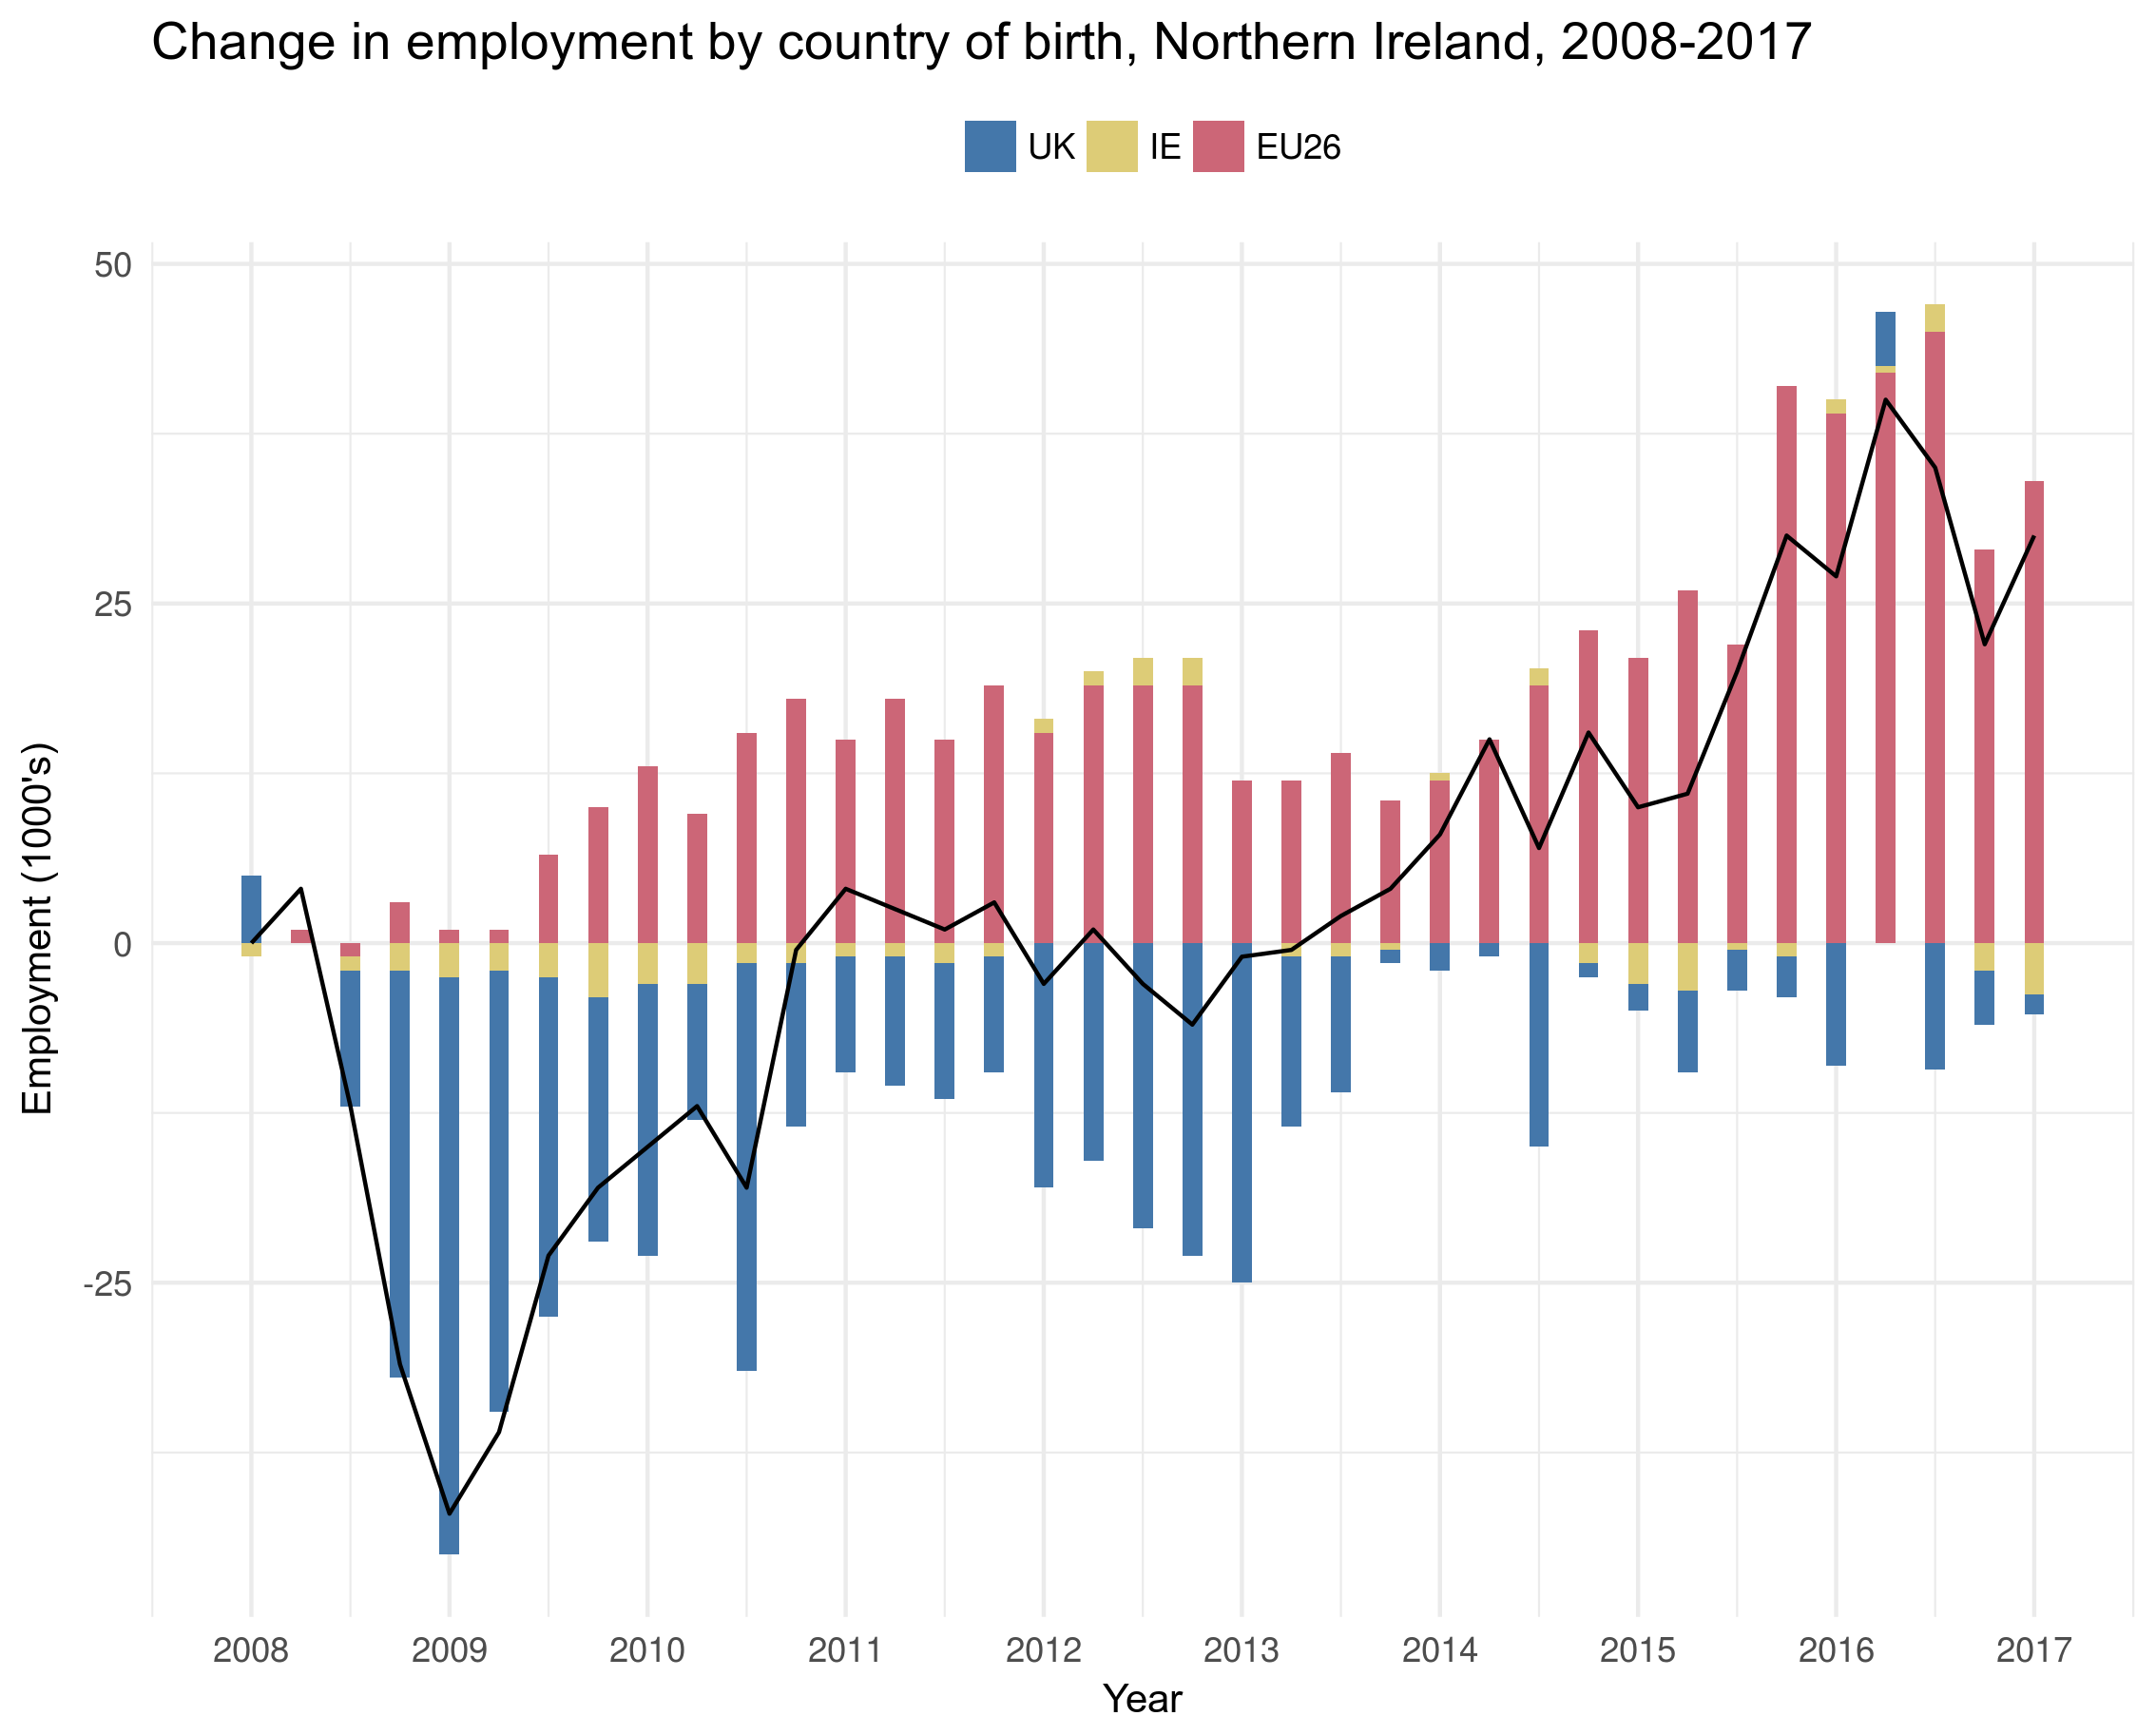
Skills: Migration
Northern Ireland is increasingly dependent on supply of migrant labour
Fills skills gaps at all levels of operational complexity
Technology sector in NI is exposed to the proposed threshold of £30,000.

Slide 13
Fiscal: start-up blockers
NI has nearly doubled the number of digital start-ups since 2010.
Still remains a low % relative the rest of the UK.
Technology firms have noted:
Lack of finance
Access to markets
Business rates
as the main barriers to growth.

Slide 14
Fiscal: Private Equity & Venture capital
The number of private equity and venture capital investments to firms in NI has continued to increase over the last decade.
However, the value of each investment has diluted.
In terms of the number of enterprises, NI has the highest number of investments but the lowest value.

Slide 15
Infrastructure: Digital & Physical
City Deal
£350 million available for development of the Belfast City Region
Looking for £500+ million of private funding
Momentum to engage with tech firms
Employing a Digital Officer
Stratum
Only 88% of premises in NI have access to at least superfast services
Falls short of the 95% target set by UK Government
Up to £200m of funding could be made available
Belfast/Ireland
Translink have proposed better connecting Dublin & Belfast Enterprise
Reduces time & increases frequency
Makes journey ‘commutable’
Could provide access to workforce.

Slide 16
FDI: Complemented with economy
FDI increases employment
Employees hired by foreign companies tend to have a higher GVA, but the calculation is skewed.
Smaller economies are more exposed and prone to capital flight.
Investment must be made in the wider digital economy alongside FDI
Develop a virtuous cycle

Slide 17
Other concerns
Opportunities
Lack of Executive
Impact of Brexit on:
Future labour supply
Cross-border cooperation
Capital flows
Free flow of data
Digital Single Market
The Future of Work
Review of the 14 – 19 curriculum
Permanent Secretaries given more decision-making power
City Deals
Corporation Tax
Success in Ireland
Focus FDI on specific target areas for growth (e.g. AI clusters)
Facilitate knowledge spill-over

Slide 18
Questions for forum
What other areas of concern are firms currently facing? Future concerns?
When do you expect your business to feel its most acute digital skills needs?
What should the CBI prioritise with respect to influencing policy?
How do you want the digital economy to be represented?

Slide 19
Priorities for 2019
Tech Group plays the leading role in setting the digital and technology policy agenda for the CBI
This meeting is an opportunity for technology leaders to shape and identify the major digital priorities for this year
Are we focusing on the right issues? What are the critical priorities in the coming months?
Securing the free flow of data
Engaging in international digital iniatives
Highlighting the importance of data flows to the whole economy and achieving a data deal with the EU
Shaping a competitive UK data protection regime
Influencing major proposals on issues from digital tax to the Digital Single Market
Shaping the flagship Digital Charter
Embracing digital across all sectors & examining trust in technology
Identifying where industry and government can collaborate, technological solutions and regulatory red lines
Maintaining a focus on ensuring the UK is the best place to grow a digital business
Help firms understand, adopt and prepare for digitisation
Examine data and privacy landscape to explore how government and business can improve trust in tech
Delivering world leading digital infrastructure & improving cyber security
Access to global talent
Making the evidence based case for skilled migration which is crucial to firms across the economy
Influence Government rollout of quality business-dedicated connectivity

