Slide 1
CBI NI Digital Skills Initiative
Invest Northern Ireland
25th March 2019

Slide 2

Opportunity at hand
There exists general concern that there is an lack of stability in the current labour market for digital skills.
Requires alignment between industry, educational institutions and Government.
CBI to provide analysis and potential actions that can be taken by Government.
Initial review of the sentiment of industry.

Slide 3
Industry sentiment
To understand the overall concerns of business.

Slide 4
The NI economy is coming to a tipping point on digital skills
76%
Businesses currently have digital skills shortages
95%
Businesses expect their need for digital skills to grow
60%
Businesses expect to feel their most acute digital skills needs over next 1-2 years
72%
Businesses expect to feel their most acute digital skills needs over next 3-5 years

Slide 5
Digital skills gaps are already present in software engineering and data analytics
Skill | % businesses struggling to hire for these skills
Software engineering | 43%
Data analytics | 37%
IT support and system maintenance | 3%
Digital marketing and sales | 19%
Cyber and IT security | 24%
Computer literacy | 0.4%
Understanding of how digital technologies work | 19%
Soft skills (problem-solving etc) | 9%

Slide 6
There are a wide range of actors that have an important role
61%
Businesses strongly agree that it is important for government to take action to address UK digital skills gaps
35%
Businesses strongly agree that collaboration with partners, supply chains, charities, is important to address UK digital skills gaps
41%
Businesses strongly agree that the role of business is greater than the role of government in addressing UK digital skills gaps

Slide 7
Confidence over future ni lABOUR supply
How confident are you that there will be sufficient people available in the future to meet your organisation’s skills needs?

Slide 8
UK-wide Confidence

Slide 9
Skills provision
To review the demand, enhance the overall supply and quality of digital skills, and address known skills gaps in Northern Ireland.

Slide 10
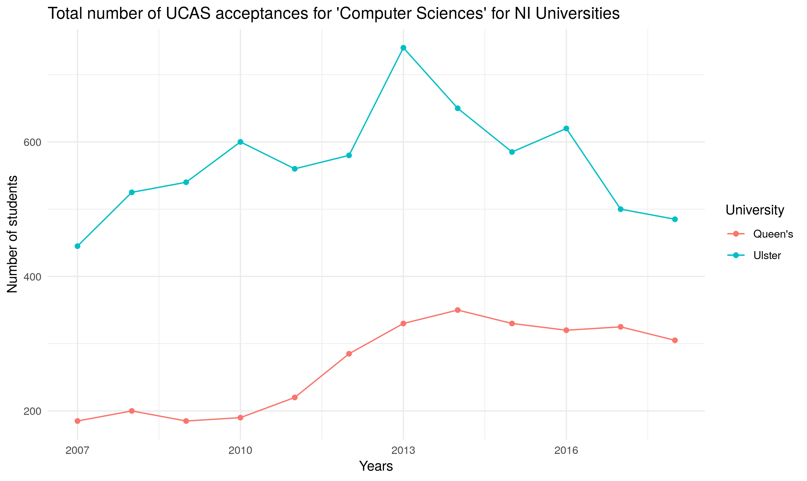
Supply: UNIVERSITY STUDENTS (1)
Overall number of students enrolling in ‘Computer Sciences’ (broad category as defined by UCAS) in NI universities has fallen.
Majority of this fall seems to have come from UU.
Given dropouts, overall approximately 500 University graduates per year.
25% -- 30% female participation rate.
Source: UCAS

Slide 11
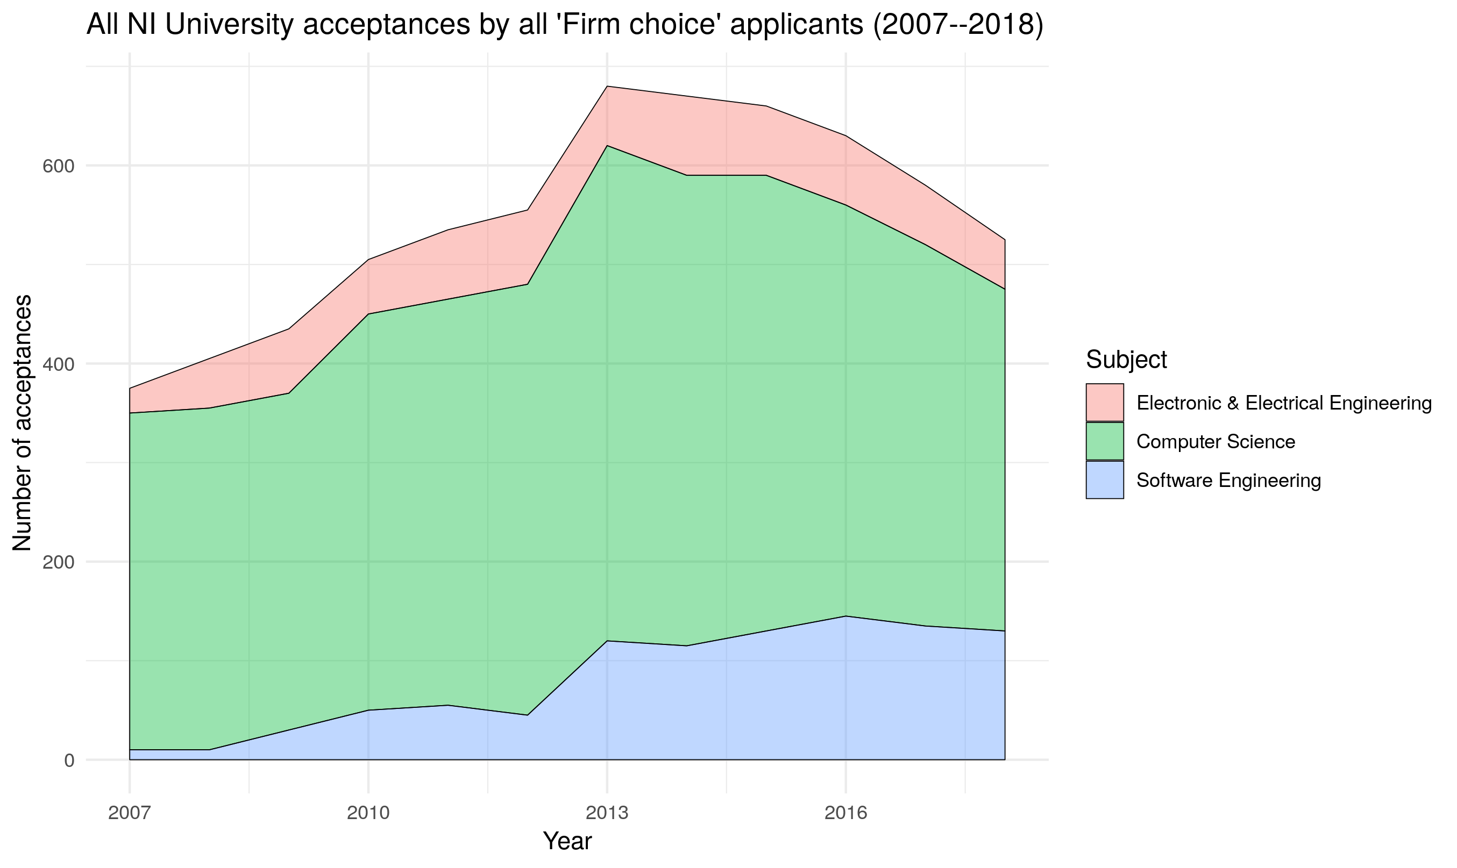
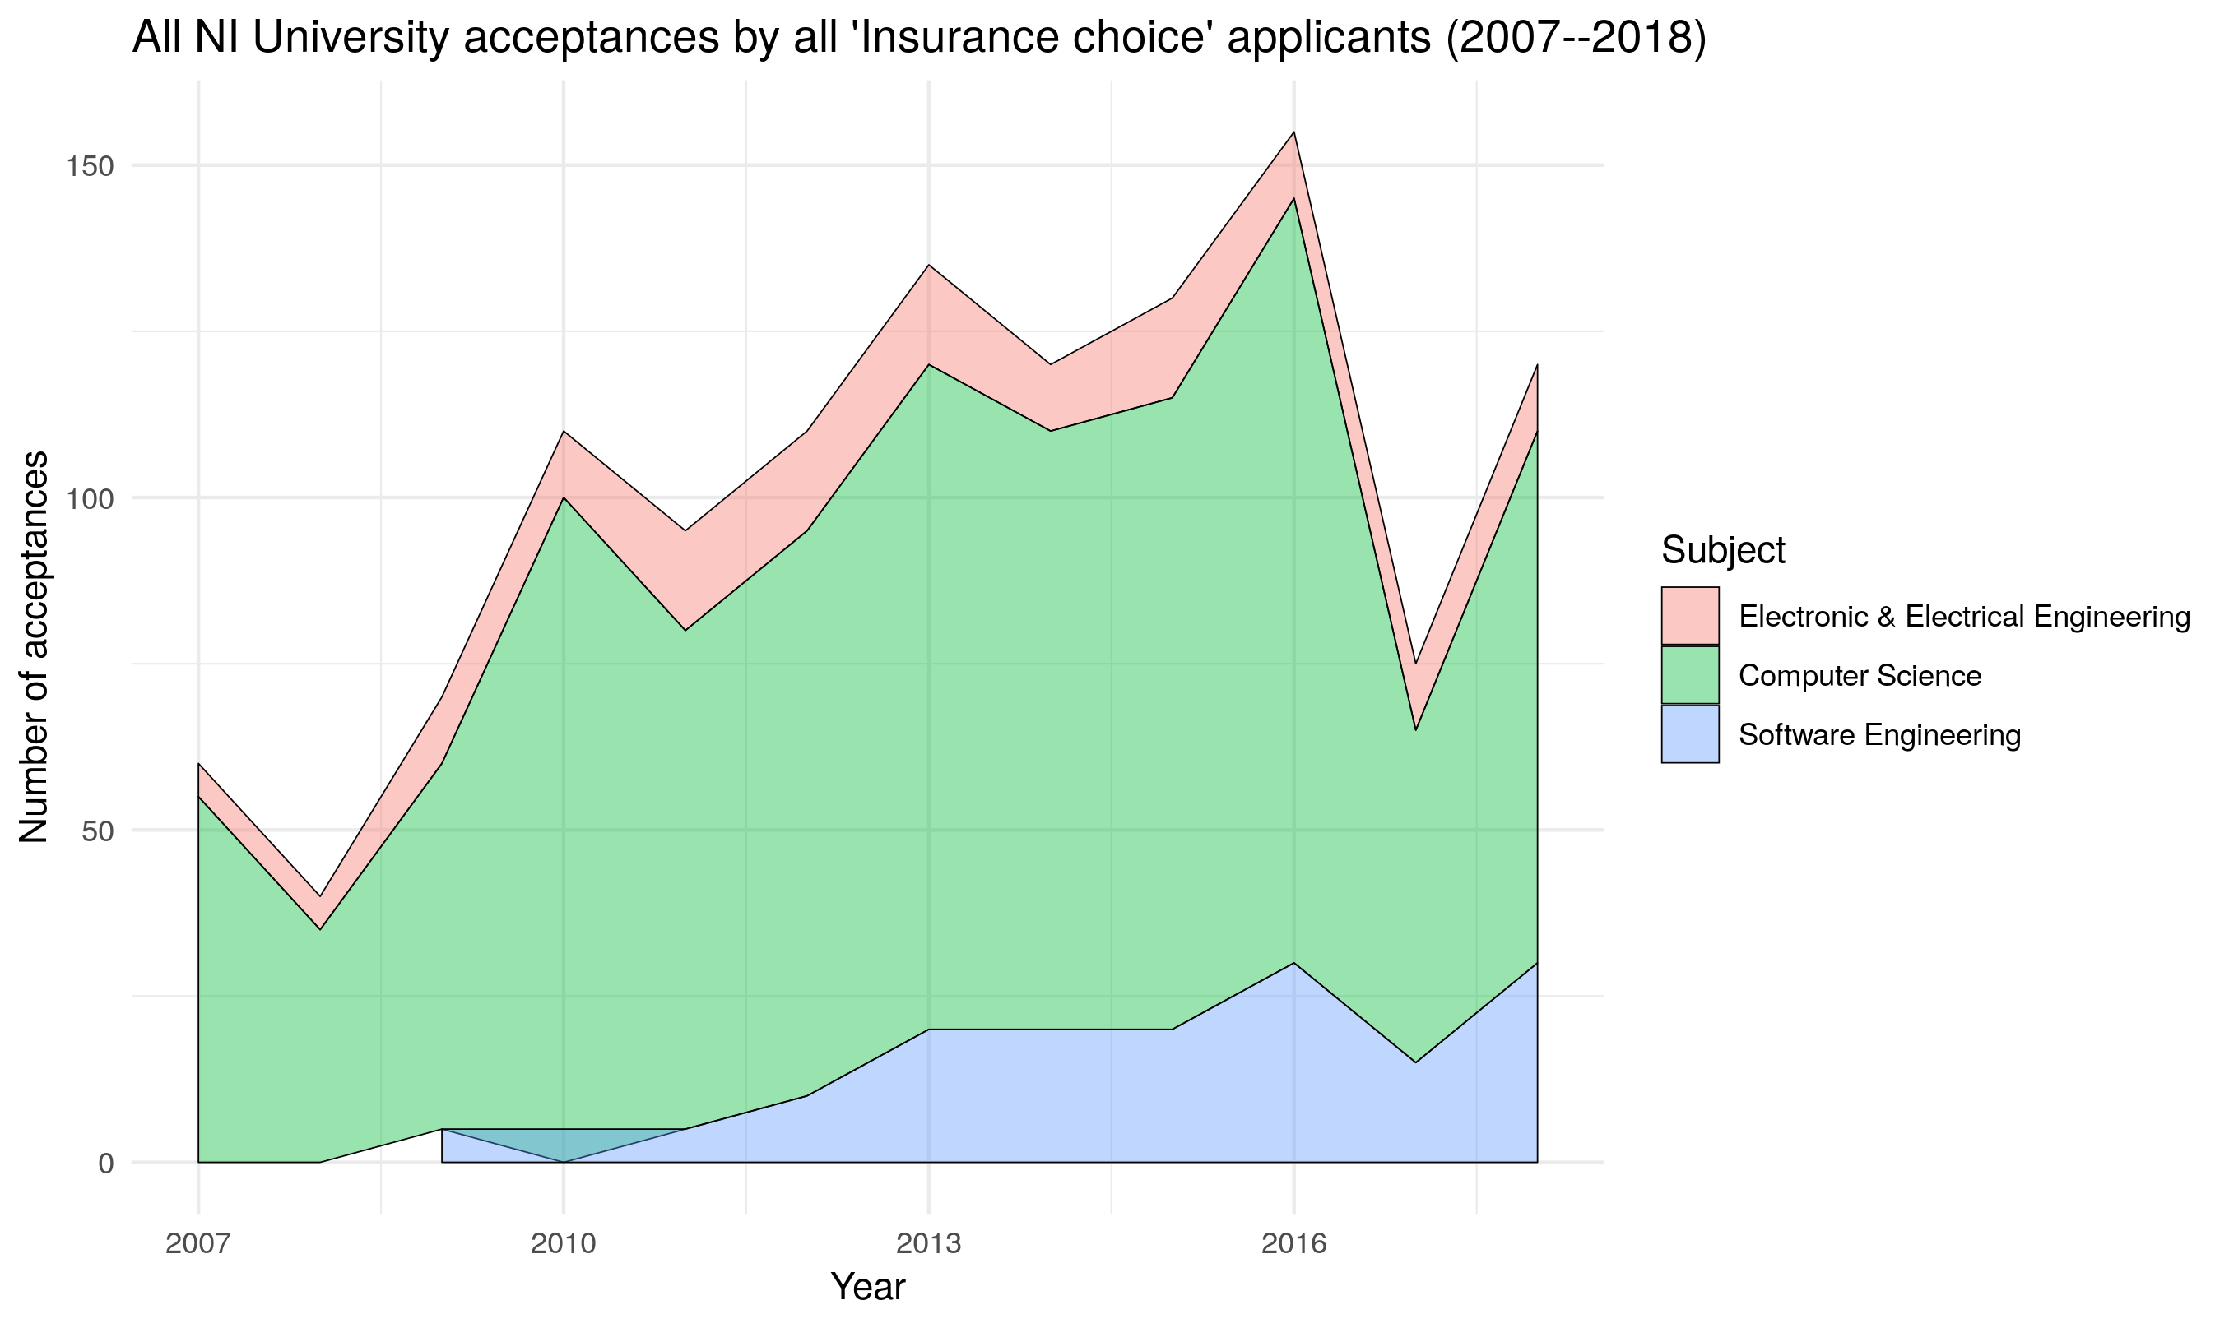
Supply: UNIVERSITY STUDENTS (2)
NI students are increasingly choosing GB universities. Therefore, NI universities rely on students that are selecting local Universities as their ‘Insurance Choice’.
Source: UCAS
Number of NI Universities selecting students in EEE/CS as their ‘Firm Choice’ has fallen over the past 5 years.

Slide 12
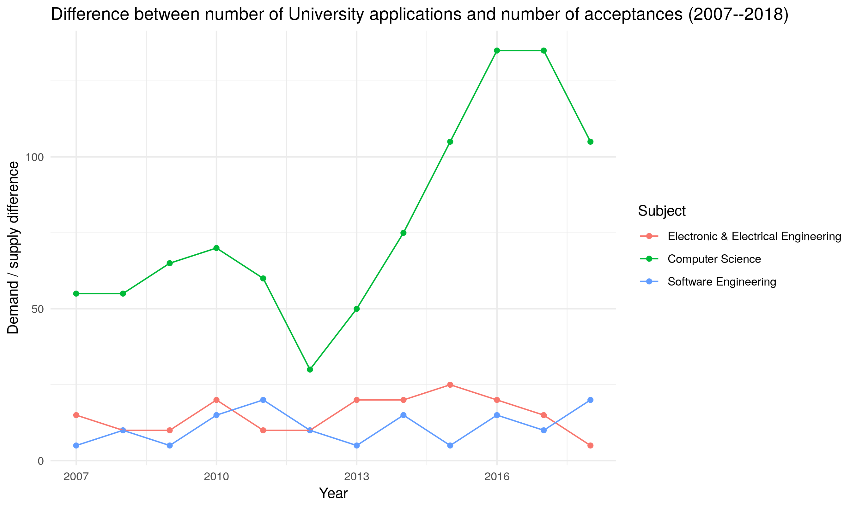
Supply: UNIVERSITY STUDENTS (3)
Although Software Engineering has become more popular, the demand has largely been met by NI Universities.
The surplus of demand has dramatically increased for CS, specifically over the last 5 years.
Student to staff ratios in NI Universities are poor: 20.9 (QUB) and 24.1 (UU).
Concern that the pipeline of PhDs and lecturers to teach CS and ICT-related fields at postgraduate & undergraduate levels in QUB and UU are falling.
Doctorial training: 4000 places awarded in UK – only 25 awarded in Northern Ireland.
Other issues

Slide 13
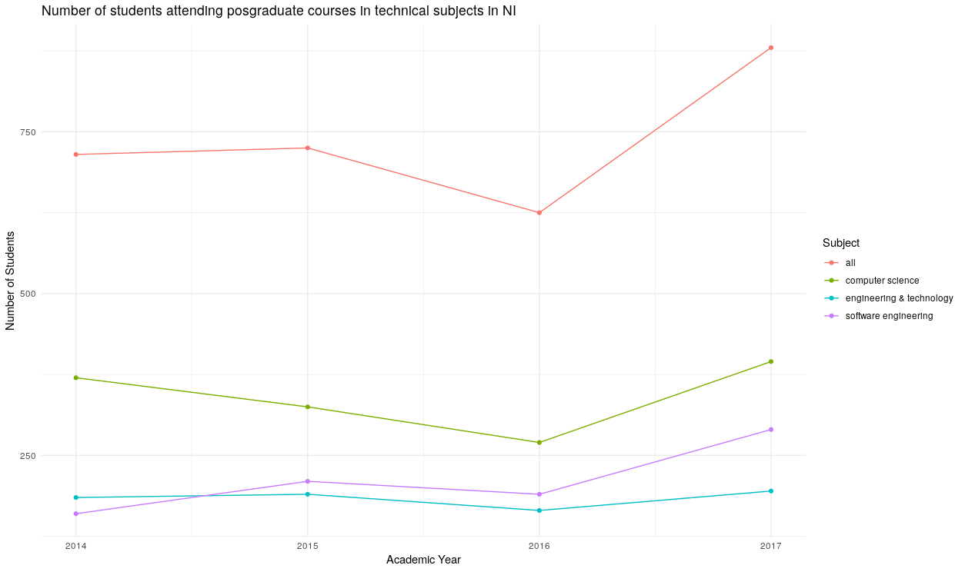
Supply: Postgraduate students
Postgraduate education in technical subjects in Northern Ireland has grown in the last year.
The biggest growth in % terms overall has been in software engineering, however growth in CS over the past year has been significant.

Slide 14
Supply: UNIVERSITY Courses
QUB
UU
Artificial Intelligence (Stage 3, Optional)
Intelligent Information System (Stage 3, Optional)
Information System Security (Stage 3, Optional)
Advanced Intelligent Information Systems (Stage 4, Optional)
Systems Security (Stage 2, Compulsory)
Big Data and Distributed Computing (Stage 4, Optional)
Artificial Intelligence (Stage 4, Optional)
Data Analytics (Stage 4, Optional)
One of the highest drop-out rates. Why?
No alternative routes when students drop out.
Requires discussion between Universities, schools and industry.

Slide 15
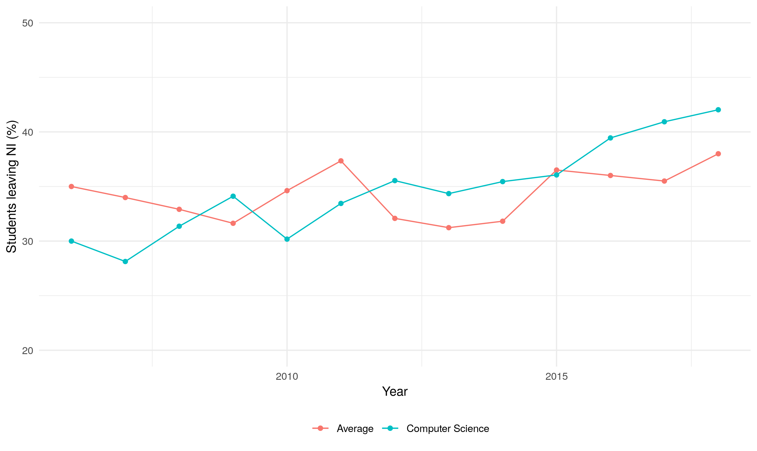
Supply: Students leaving for University
NI students who apply for a course in Computer Science are above average more likely to leave to attend a University in GB or Rest of World.
Overall this is equal to just over 250 EEECS students per year leave NI to study elsewhere.
Approx. two-thirds of the 250 do not come back.
No known initiatives are in place to attract back students that leave NI to study and work (perhaps too late!)

Slide 16
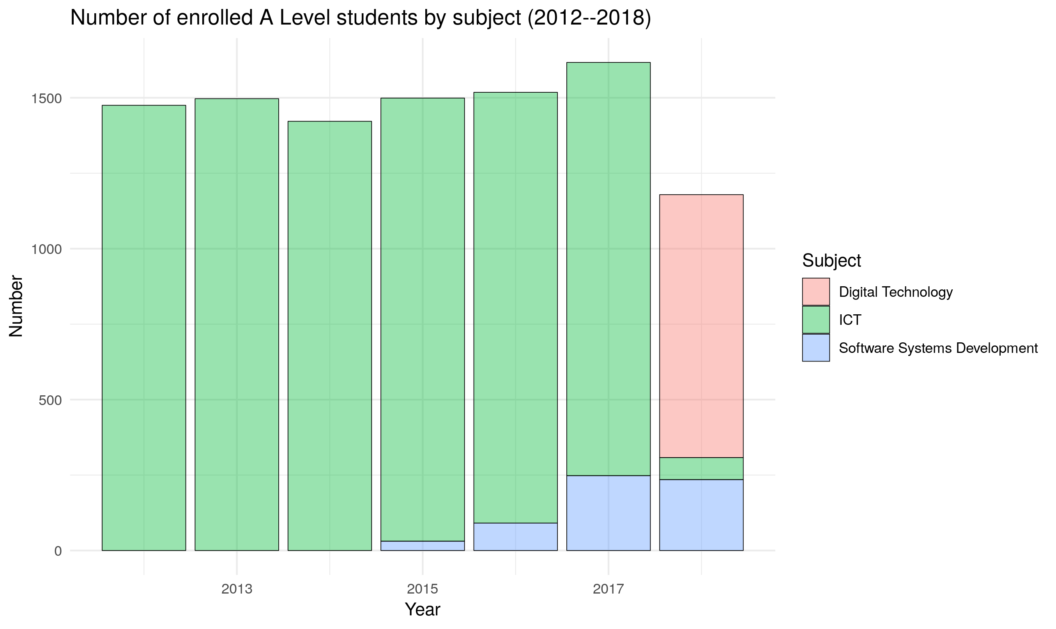
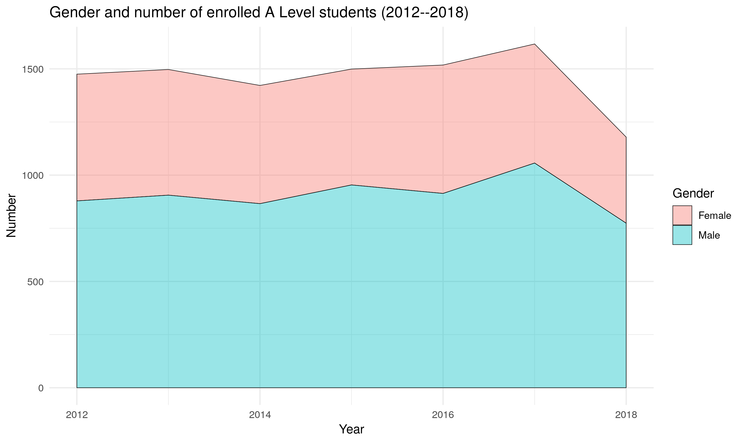
Supply: A Level Students
Introduction of Software Systems Development A-level seems to have more split the pool of willing students as opposed to increasing it.
Approx. 34% female to 66% male at this level.
Females generally perform better than males.

Slide 17
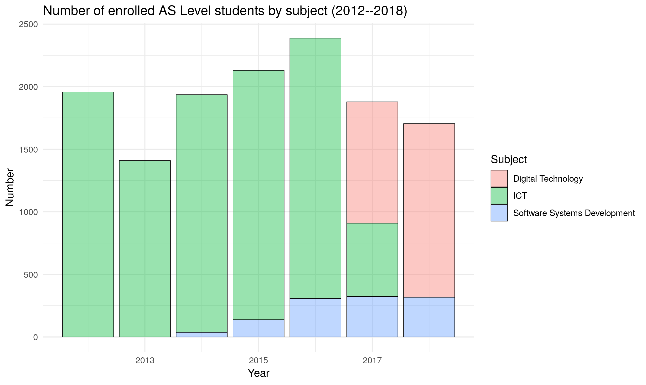
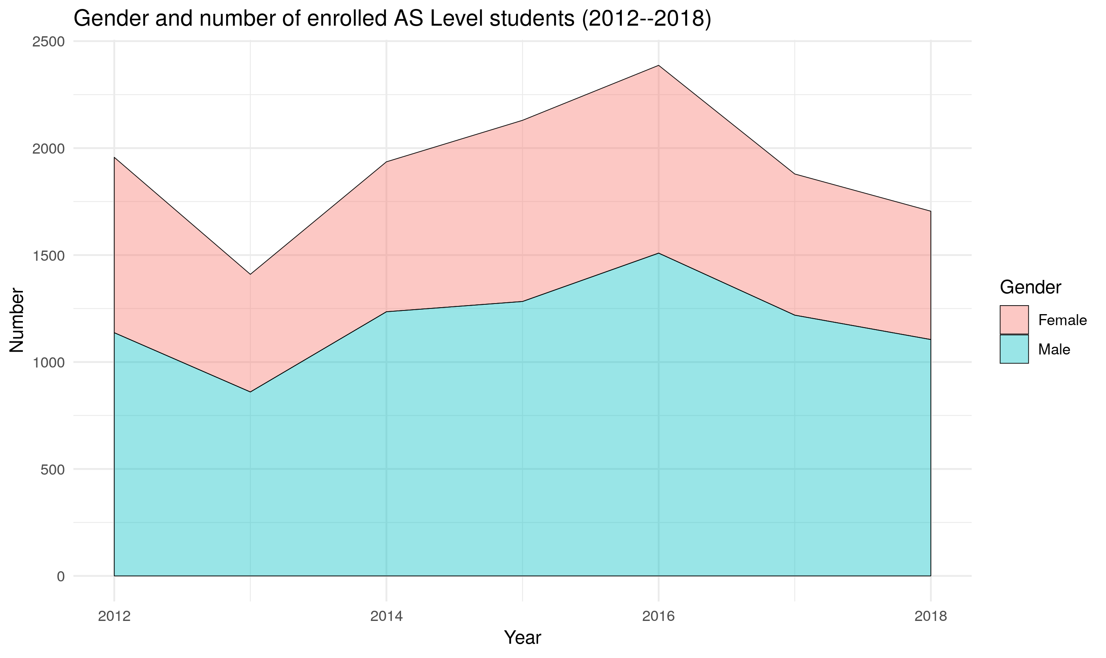
Supply: AS Level Students
20% -- 25% are lost from AS Level.
Looks like there is a continued downward trend.
Again, generally, females perform better.

Slide 18
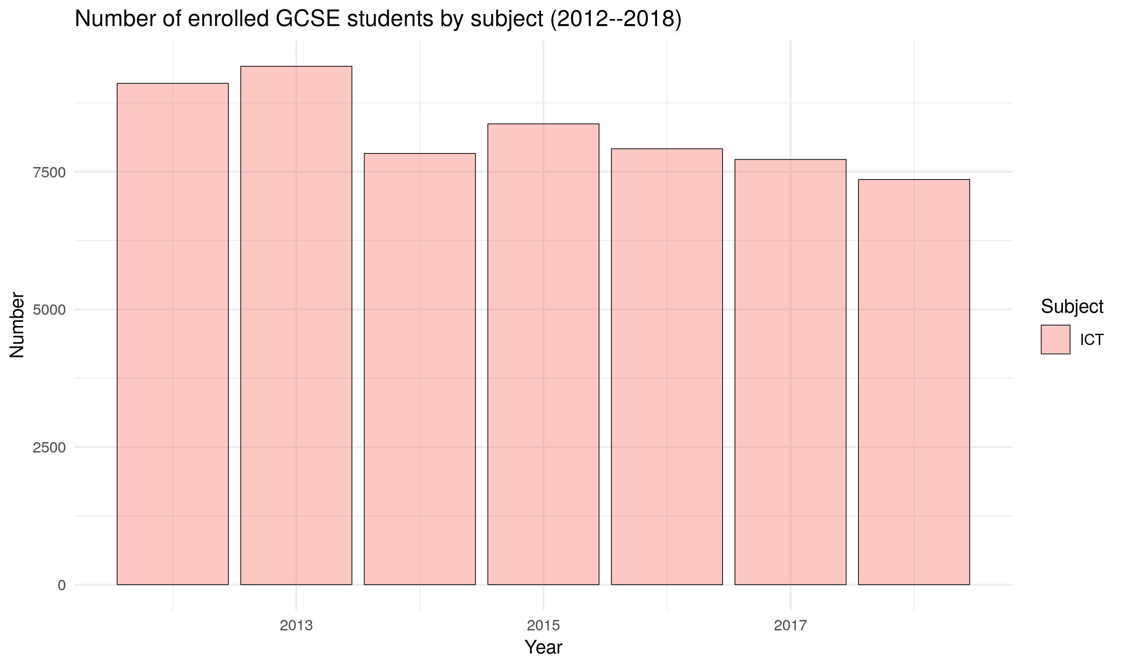
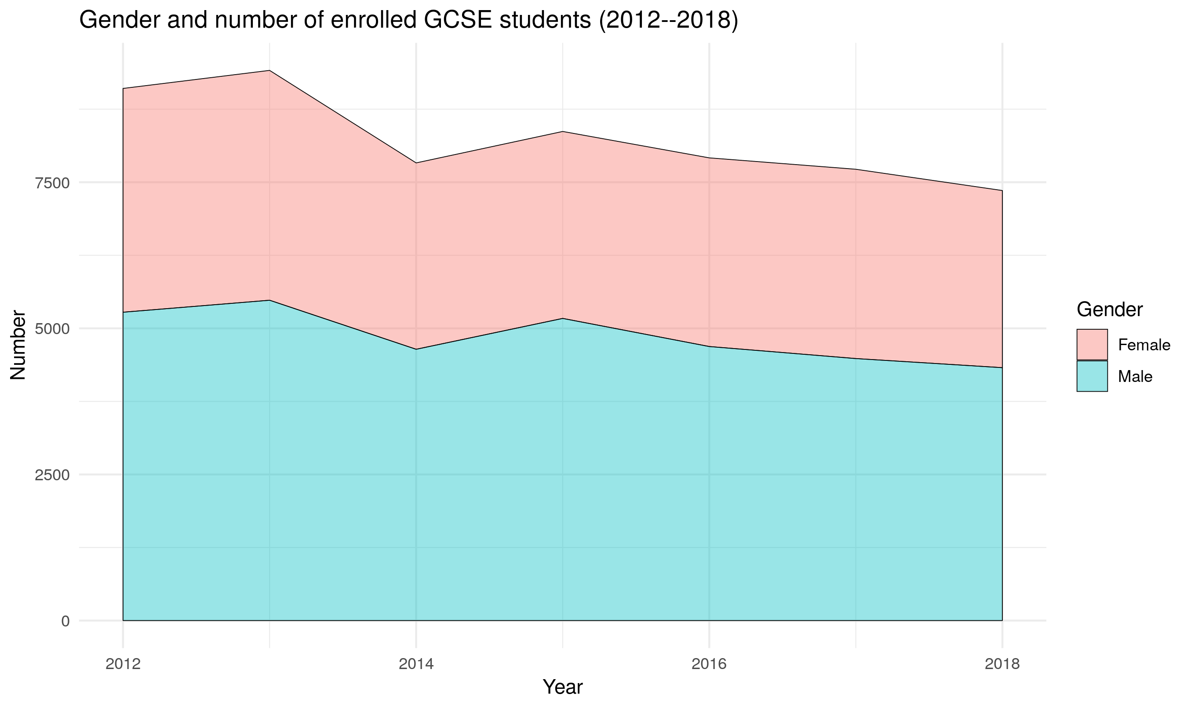
Supply: GCSE Students
82% leave from GCSE to AS level.
Again, the overall supply seems to be diminishing at this level.
43% female to 57% male at this level.
Yes… females continue to perform better!

Slide 19
Supply: Assured skills Academies
315
people trained
276
Number
found employment
2,293
applications
Serves 13.7% of people interested in developing specific skills.
Provides a short-term solution, but the marginal cost to train more people is minimal.

Slide 20






Supply: Recognition of Alternative routes
Incredible number of online resources (Udemy, YouTube, CodeTree, etc.).
Individual skills developed can be used across a large number of other disciplines.
Remote teamwork can be developed through the use of Git code repositories.
Local teamwork can be developed through tech meet-ups.
Employers look at portfolios and heatmaps and provide challenges that are posted on repos, Uni’s should too!
Gaining real-world experience is accessible at all ages.
Teachers and parents need support for meetups and hackathons (more than 40 in Greater Belfast alone!).

Slide 21
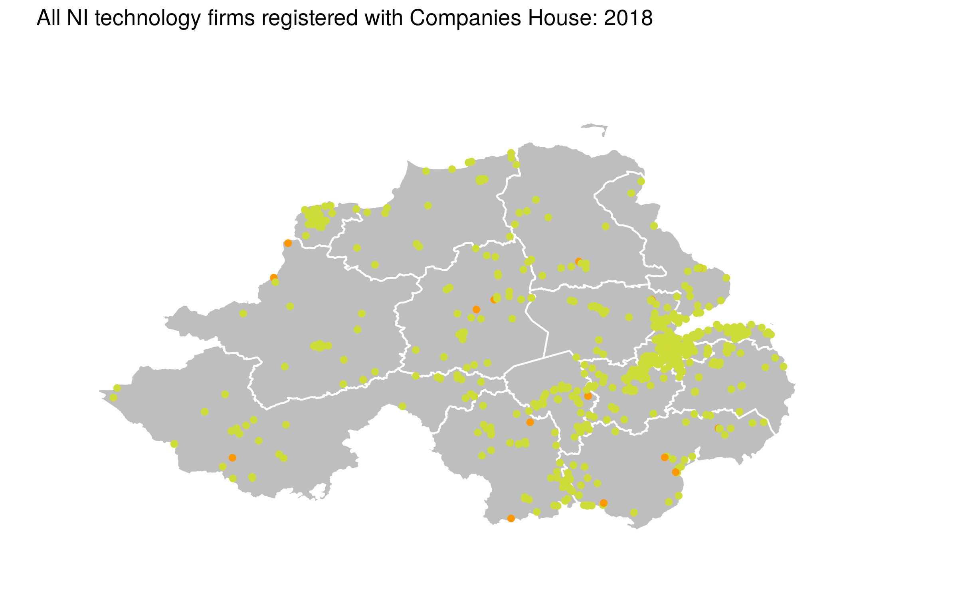
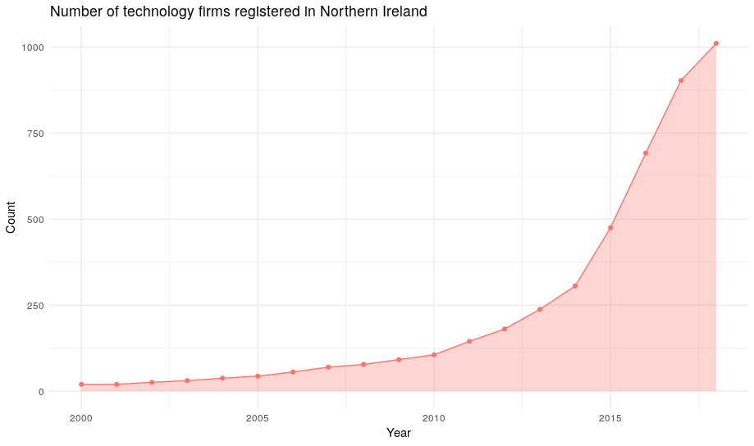
Demand: Information & communication companies
The number of technology firms registered in Northern Ireland (Companies House data) has grown exponentially over the last two decades.
This is in light of the declining supply of labour in ICT.

Slide 22
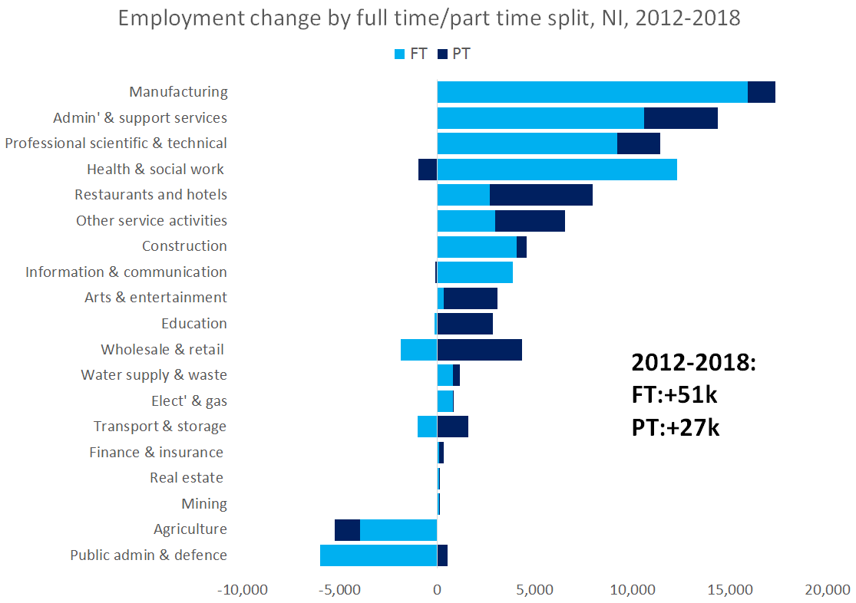
Demand: Information & communication companies
Approx. 4,800 jobs in the information & communication sector and the 12,000 in professional scientific sector.
Lower-skilled labour typically involved in the sectors with high employment growth, such as manufacturing, admin, restaurants & hotels.

Slide 23
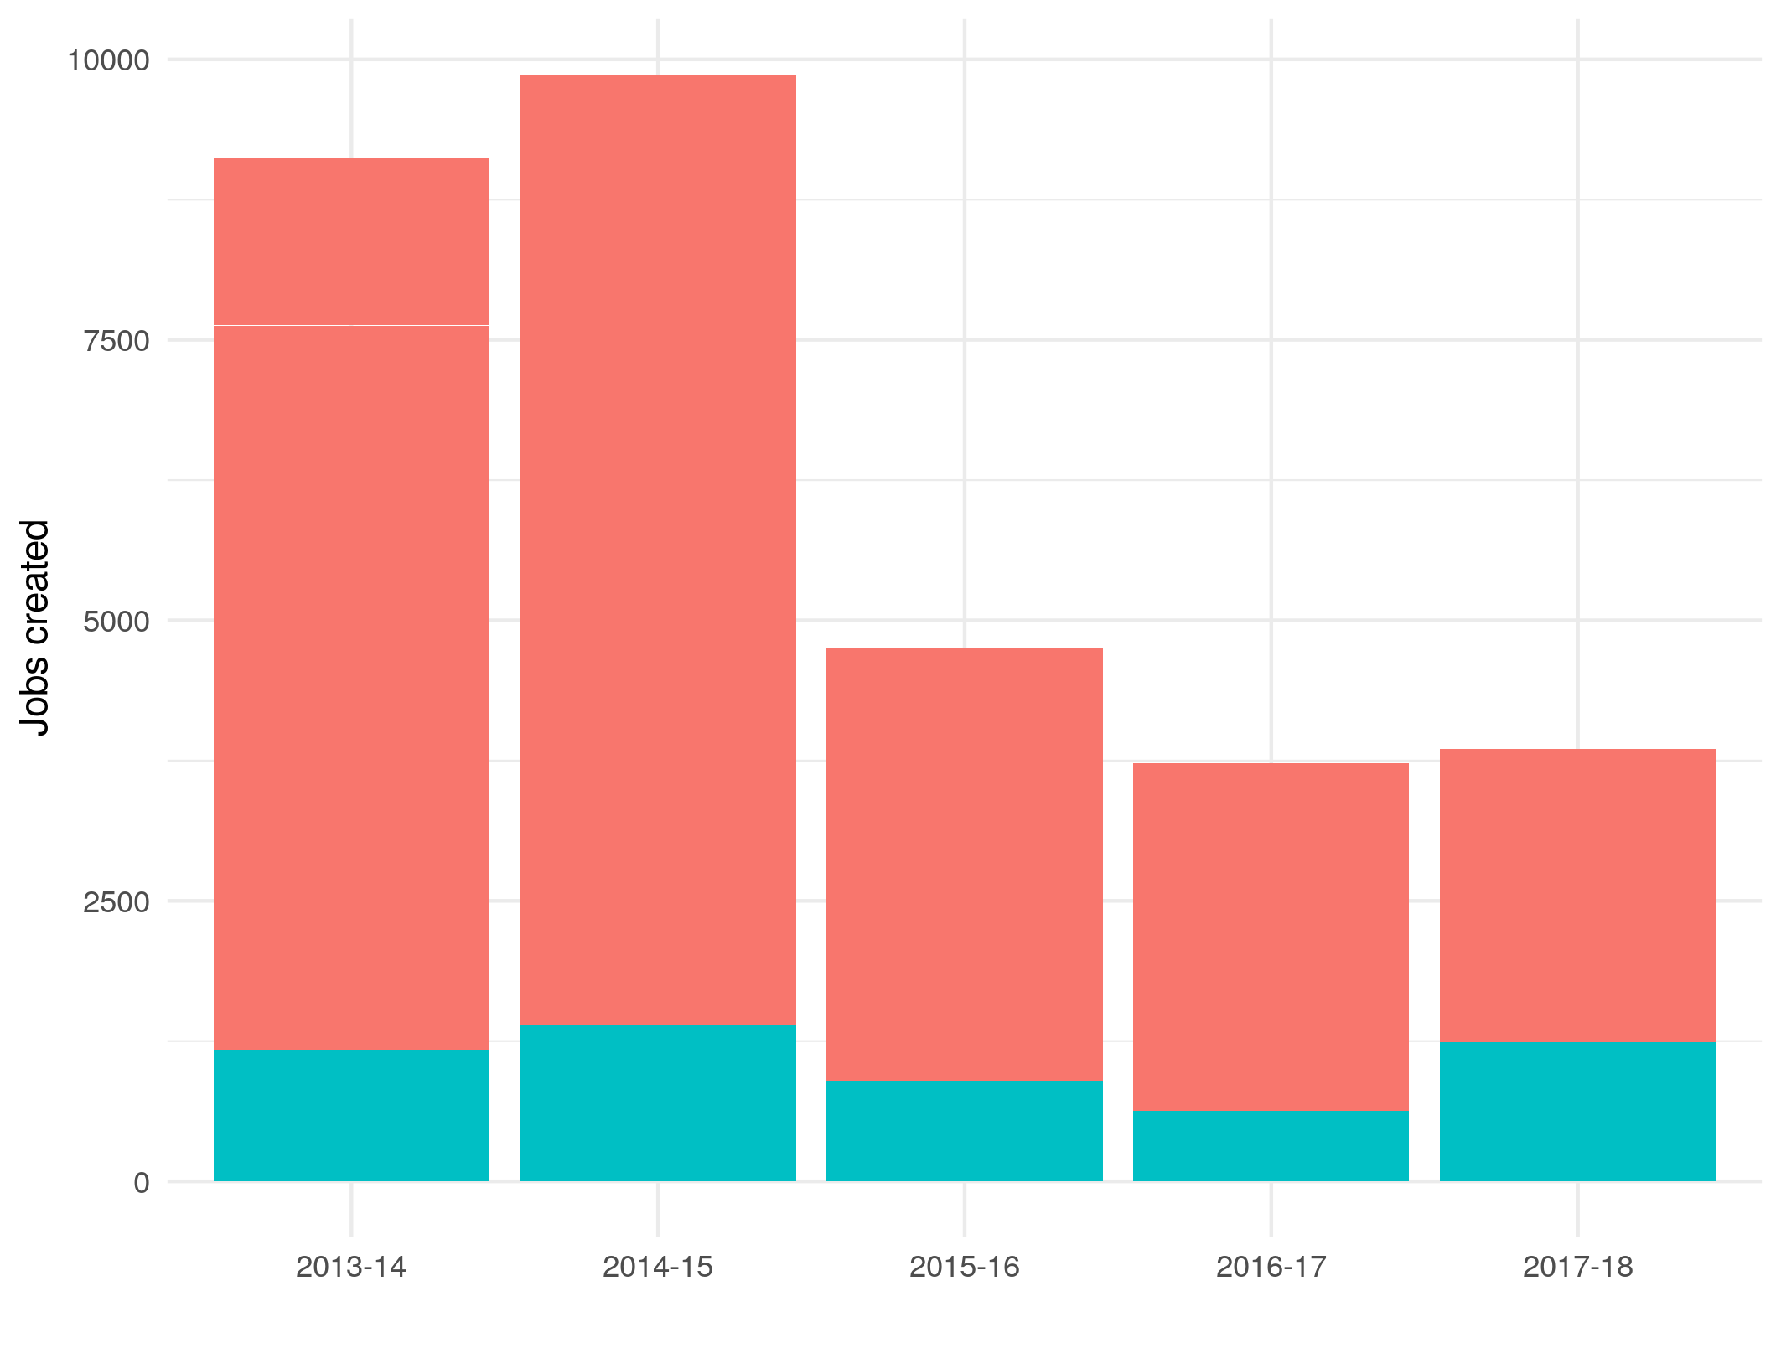
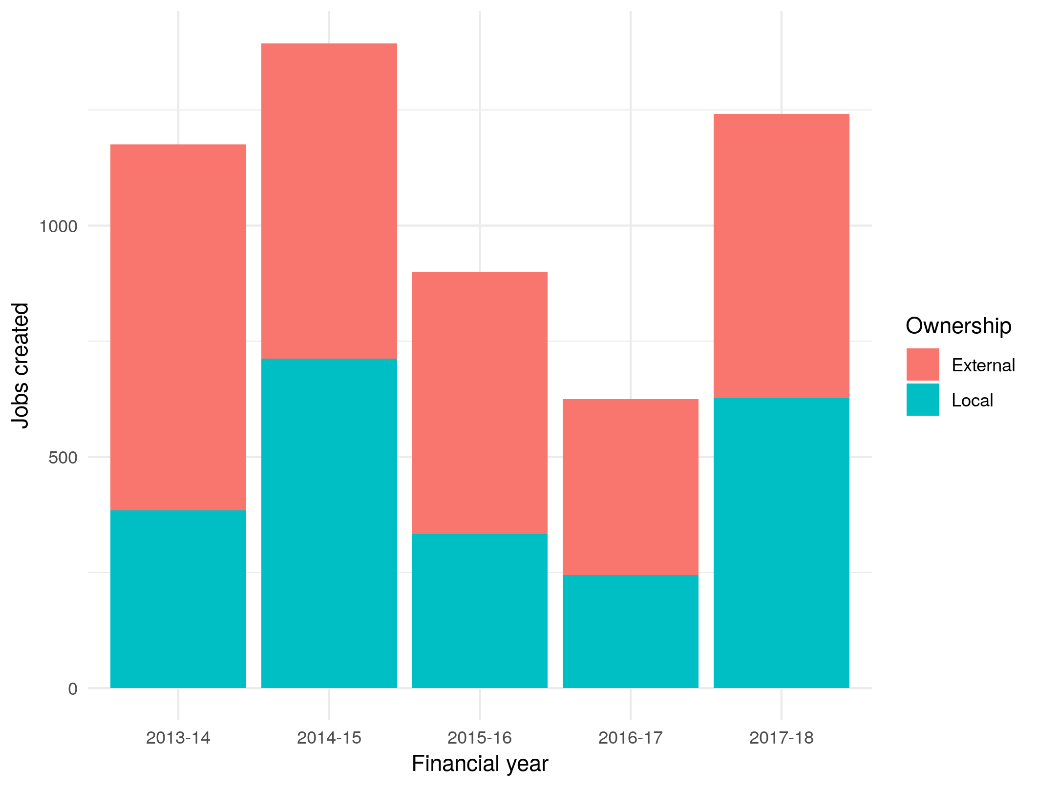
Demand: FDI projects
Over 5 years, Invest NI supported 11,265 projects, assisting the generation of 31,317 jobs, with 5,335 in Information & Communication.
Jobs created across all investment projects
Jobs created across ICT investment projects

Slide 24
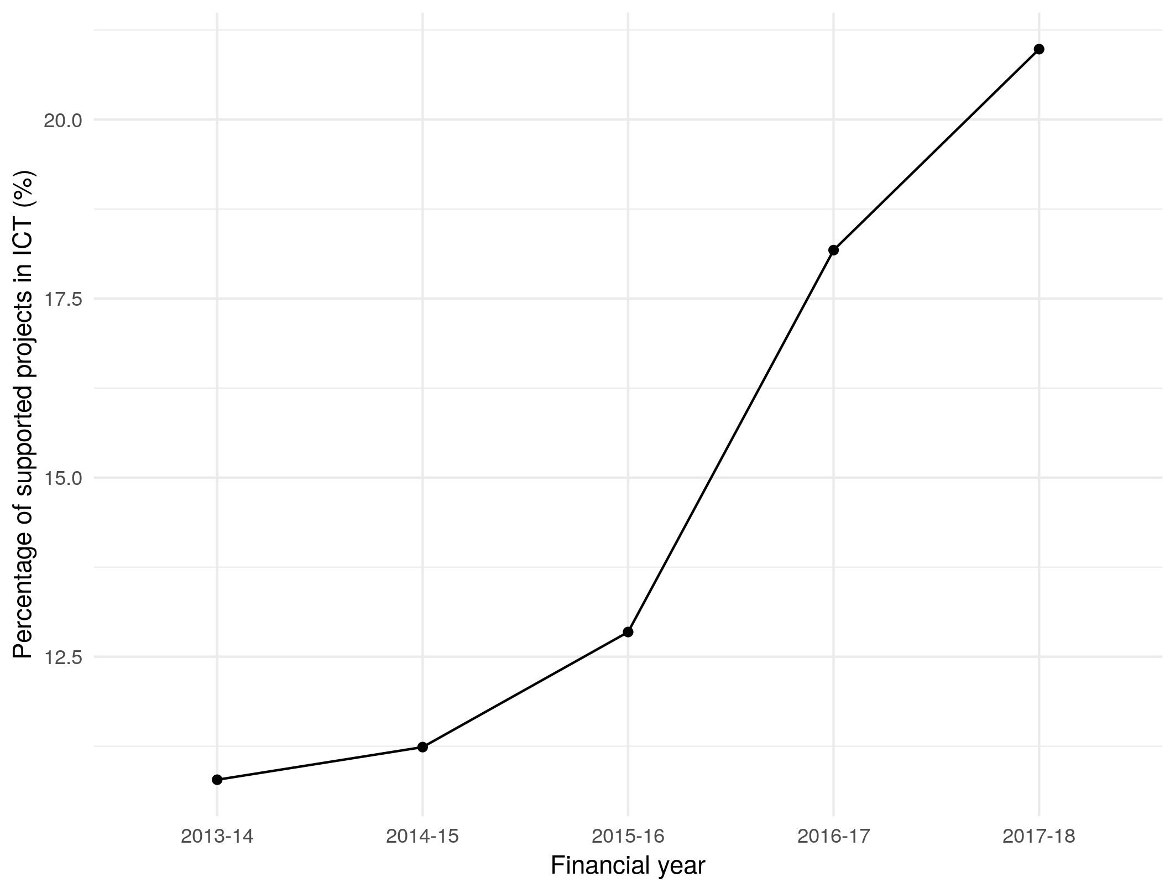
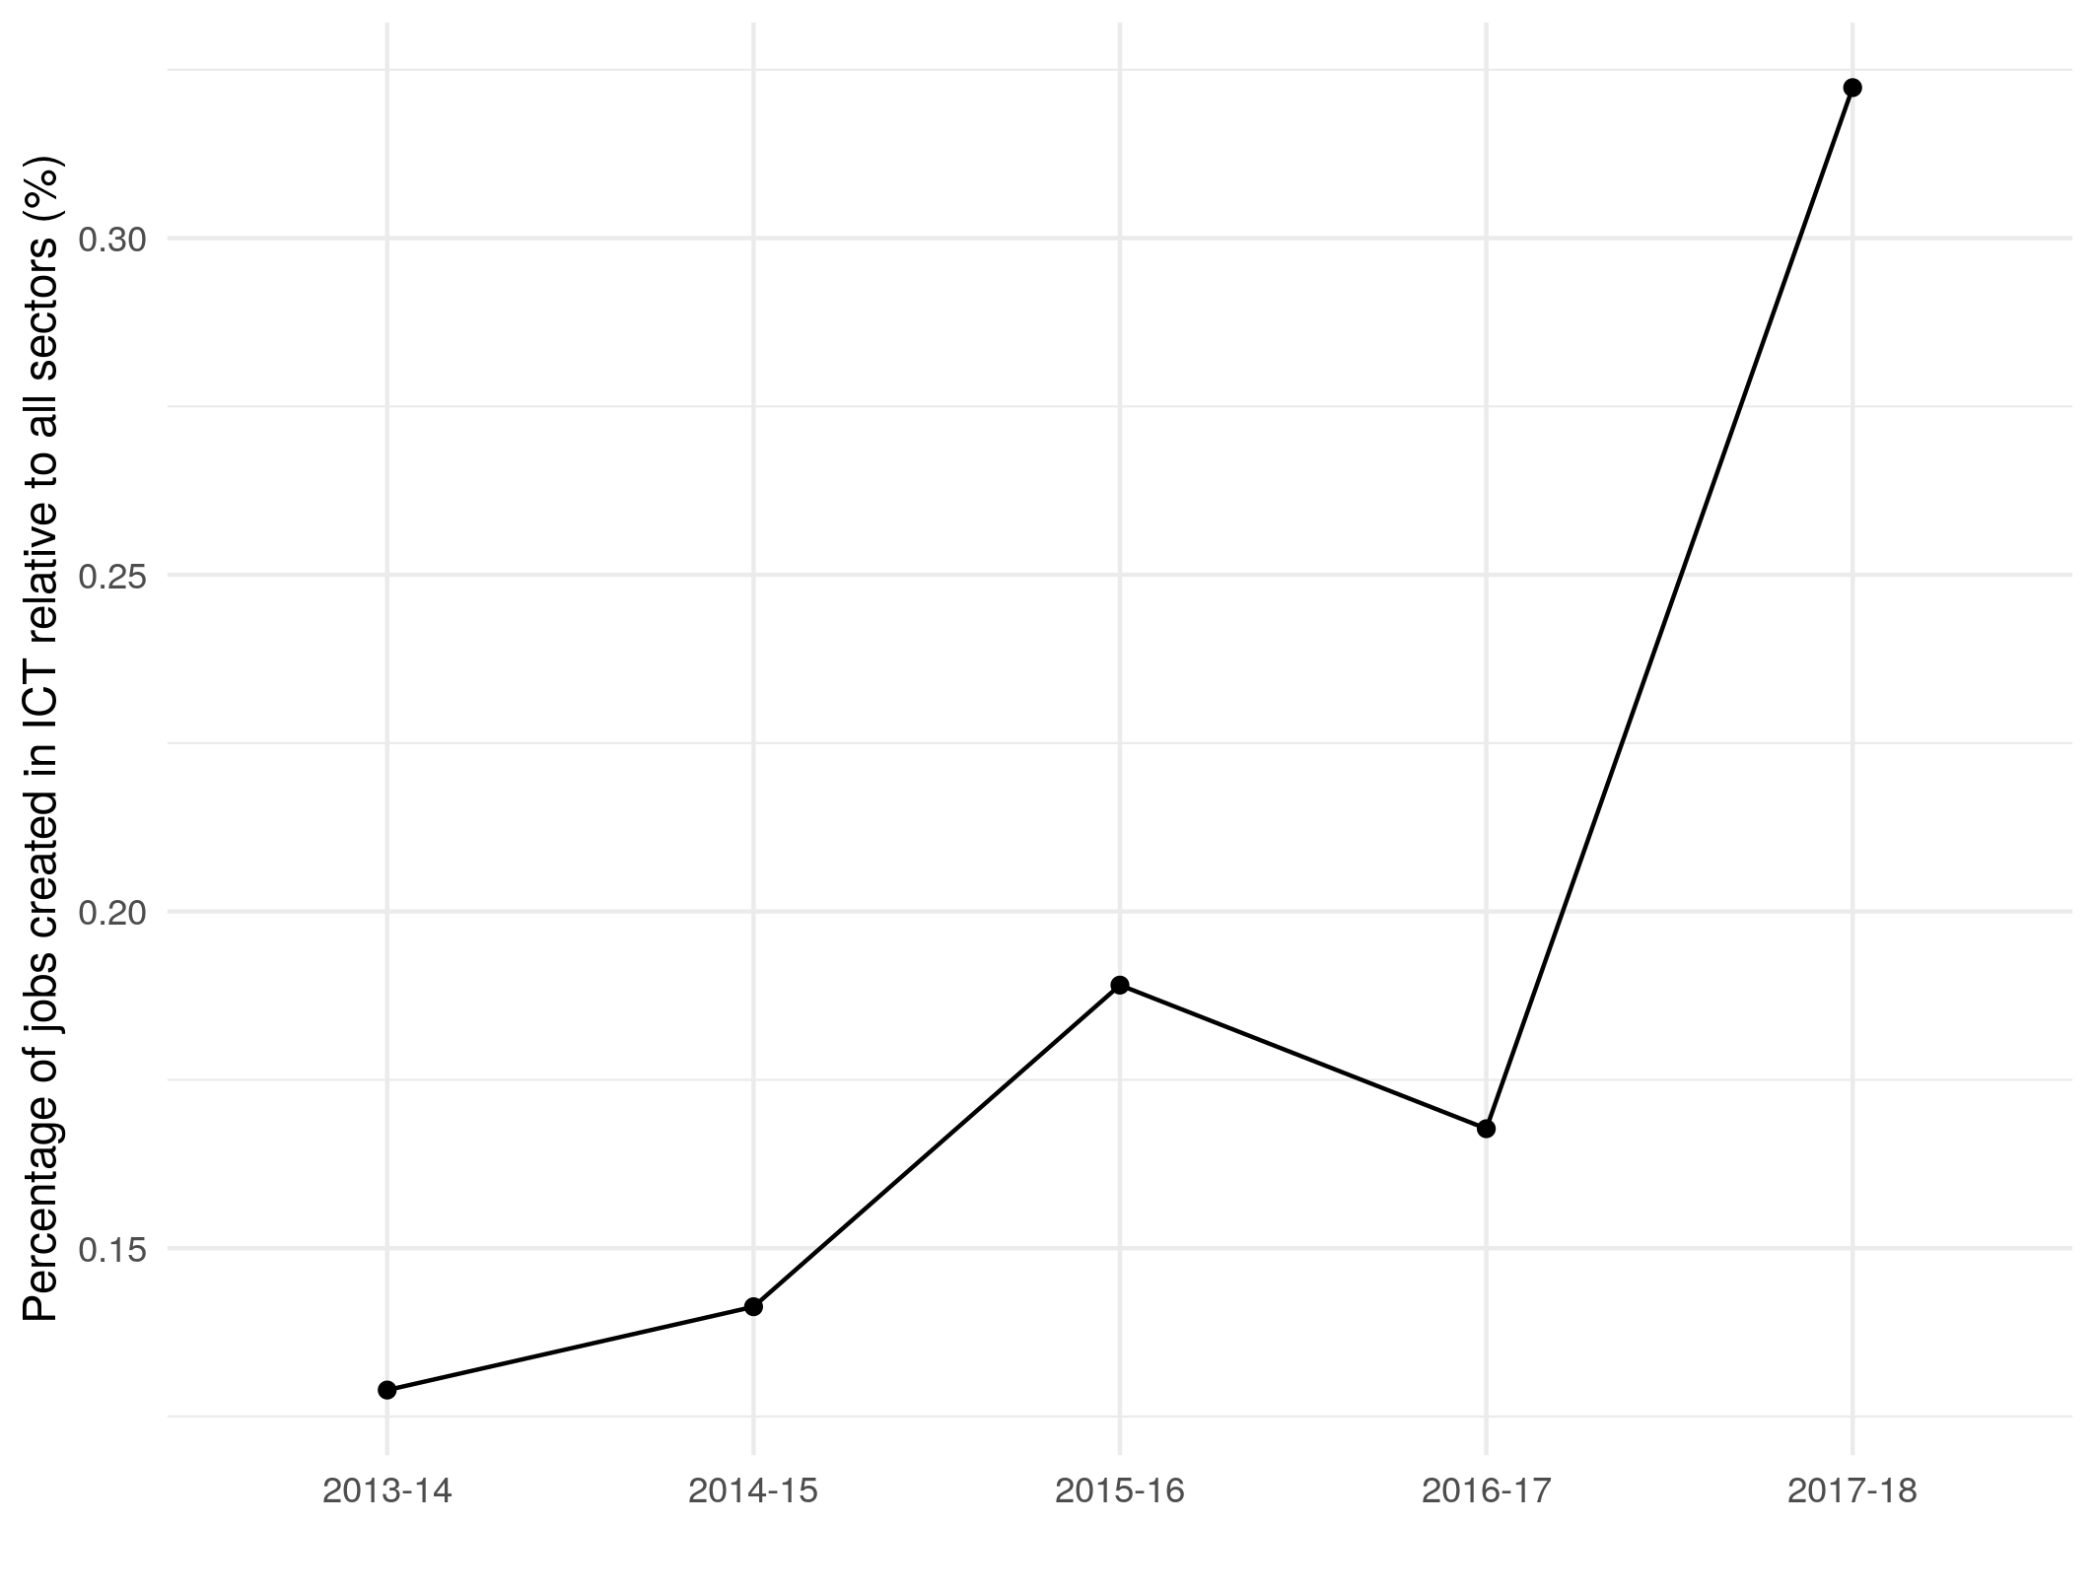
Demand: Proportion of jobs and investment
Proportion of projects invested in ICT
Proportion of jobs created in ICT
Increased proportion of projects supported by Invest NI in the Information and Communication sector – along with it an increase in the proportion of jobs supported.

Slide 25
Skills: Overall Demand and supply
At max. 600
Individuals supplied to the labour market every year (may be even less given leakage)
~1,000
Jobs being generated per year (may be even more given the drive of private sector)

Slide 26
Skills: Demand already outstripping supply
Rank | Subject area | Vacancies | Skills barometer
1 | Computer science | 2895 | Under-supplied
2 | Engineering | 1589 | Under-supplied
3 | Mathematics | 1301 | Under-supplied
4 | Computer software engineering | 640 | Under-supplied
5 | Business administration | 545 | Over-supplied
6 | Electrical engineering | 504 | Under-supplied
7 | Statistics | 484 | Broadly in balance
8 | Physics | 430 | Under-supplied
9 | Computer engineering | 234 | Under-supplied
10 | Economics | 154 | Over-supplied
Top 10 disciplines sought by technology / AI employers.
Many are under-supplied.
Supporting apprenticeships could be mechanism to resolve this issue, but Apprenticeship Levy in NI causes a problem.

Slide 27
Skills Provision: Actions
Short-term
Review current and projected demand and supply for ICT professionals.
Review and address known critical skills shortages for ICT professionals.
Form agreement on sub-sectors and areas for growth and the supply of skills and FDI into those areas.
Accommodate for more spaces in Academies that tend to be over-subscribed.
Agreement within Industry for HLA’s.
Medium-term
Help primary and secondary teachers to equip themselves to teach digital wraparound skills.
Include ICT in Continuous Professional Development for teachers.
Better business representation in primary and secondary education.
Encourage the up-take of ICT-related studies at A-level.
Encourage the take-up of ICT-related studies at college and university.
University syllabus to better reflect industry needs and policy / growth areas and clusters.
Ringfence PhD funding for ICT and software engineering-related disciplines in universities… More teaching fellows?

Slide 28
Sector Attractiveness
To increase student and graduate interest in working in the ICT sector in Northern Ireland.

Slide 29
Attractiveness: UNIVERSITY STUDENTs
52% of NI computer science and software engineering graduates pursue a career in the ICT industry.
8% are ICT consultants
32% are web (application) developers
7% are data scientists / analysts
10% are network / system designers and engineers
43% are software designers and engineers
28%

Slide 30
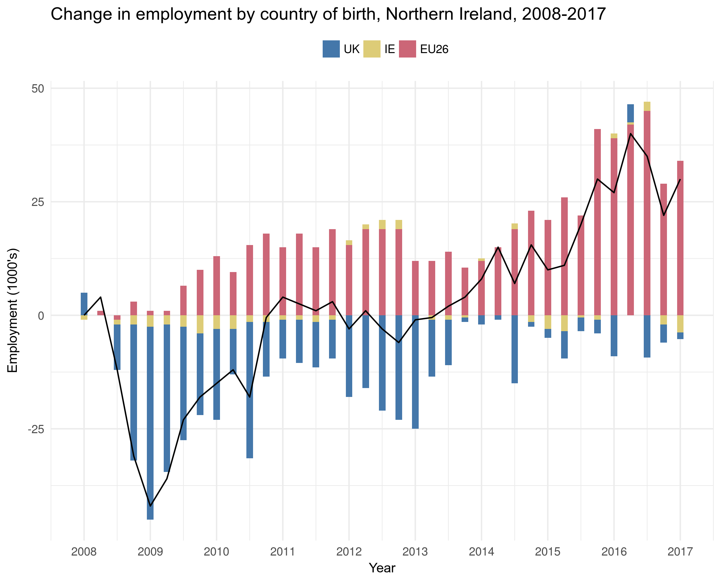
Global skills: Migration
We need more people!
According to UUEPC, average salary of Knowledge Economy: £28,000.
Below proposed salary threshold.
Netherlands and Danish Government support and host business to provide ambassador programmes to attract global talent.
42% of Ireland’s tech workforce are from foreign nations.
Less than 10% for Northern Ireland.

Slide 31

Skills, awareness & Initiatives
Over 43 STEM / STEAM skills and awareness initiatives across the public and private sectors.
Diluted activity with the Bring I.T. On programme: not as many ambassadors.
Bring I.T. On seemed to work, but…
Is Belfast Met the right home for the programme?
Should industry and Government focus on a broader programme, such as “I.T’s Your Choice”?

Slide 32
Sector Attractiveness: Actions
Short-term
Understand why people with relevant skills choose not to work in Northern Ireland.
Promote career opportunities to primary and second level students.
I teachers and
Support initiatives that address the gender imbalance, particularly from A-levels.
Review and encourage more engagement with the ‘Bring IT On’ programme.
Agreement on global ambassador programmes to other nations.
Medium-term
Establish initiative to help teachers in training (at, say, University Colleges) to better understand the career opportunities for students.
Government to develop programmes to attract back NI students that leave for University education.
Government to assist in the development of global ambassador programmes.

Slide 33
Coordination & communication
To reduce duplication of effort and remove silos by increasing coordination, communication and agreement between industry, Government and educational stakeholders.

Slide 34
Skills Provision: Actions
Continual
Consult industry regarding FDI strategy for ICT sector.
Universities and colleges to work with industry when updating syllabus.
Support and improve coordination of skills initiatives.

