Slide 1
NI Digital Economy: taking stock, looking ahead 17th January 2019
Dr Owen Sims
Senior Policy Advisor, CBI

Slide 2
Overarching Claim
“The digital economy has been successful in Northern Ireland, but a number of barriers are hindering growth.”
£3.2bn
generated through direct, indirect and induced (spillovers) in GVA. It now generates over 8% of NI total GVA.

Slide 3
Jobs generated by Digital economy
45,541
workers currently employed in the digtial economy. `
79,000
direct, indirect and induced jobs in 2017, accounting for 8.5% of total NI employment.
~1.73
One of the largest multipliers in the Northern Irish economy.

Slide 4
Success of the digital economy
NI has been the second fastest growing region in terms of Knowledge Economy activity, second only to Scotland.
However:
It is starting from a relatively low base.
There are a number of indicators that show the environment is unstable.

Slide 5
SKILLS: Rising wage costs
Overall, average wage in private sector in Northern Ireland: £22,717.
Is 25% lower than in Public sector.
On average, wages in the knowledge economy have increased by 22.8%, now average over £30,000.
“Average”: The digital economy is comprised of SIC codes, as opposed to SOC. Requires parsing out of specific roles.
19.1%
25.3%
7.3%
17.9%
22.8%

Slide 6
Skills: The pace of wage inflation

Slide 7
Skills: Demand already outstripping supply
Rank | Subject area | Vacancies | Skills barometer
1 | Computer science | 2895 | Under-supplied
2 | Engineering | 1589 | Under-supplied
3 | Mathematics | 1301 | Under-supplied
4 | Computer software engineering | 640 | Under-supplied
5 | Business administration | 545 | Over-supplied
6 | Electrical engineering | 504 | Under-supplied
7 | Statistics | 484 | Broadly in balance
8 | Physics | 430 | Under-supplied
9 | Computer engineering | 234 | Under-supplied
10 | Economics | 154 | Over-supplied
Top 10 disciplines sought by technology / AI employers.
Many are under-supplied.
Supporting apprenticeships could be mechanism to resolve this issue, but Apprenticeship Levy in NI causes a problem.

Slide 8
Skills: The need for skills is increasing

Slide 9
Skills: Confidence over the future supply
How confident are you that there will be sufficient people available in the future to meet your organisation’s skills needs?

Slide 10
Skills: UK-wide Confidence

Slide 11
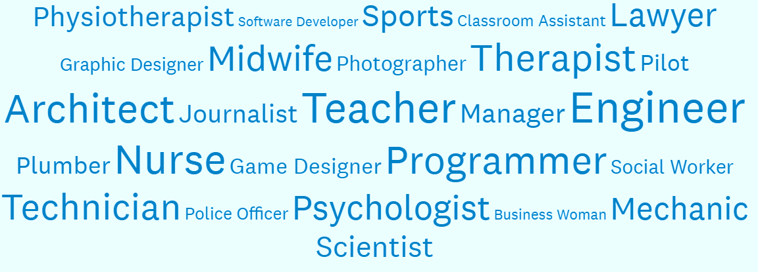
Skills: What young people want to be…
51/49
51% of young people know what career they want
49% are undecided
Top 10 careers
Engineer
Teacher
Nurse
Architect
Programmer
Technician
Midwife
Psychologist
Lawyer
Therapist

Slide 12
Skills: What firms are looking for…
Importance
Importance

Slide 13
Skills: Firms are clear about School priorities
Which of the following should be the priority area for action in schools?
Primary Schools
1. Promoting STEM Subjects
2. Broader Skills (listening, creativity, teamwork)
3. Awareness of career options
4. Foreign language learning
5. Promoting humanities subjects
Secondary Schools
1. Promoting STEM Subjects
2. Awareness of career options
3. Broader Skills (listening, creativity, teamwork)
4. Foreign language learning
5. Promoting humanities subjects

Slide 14
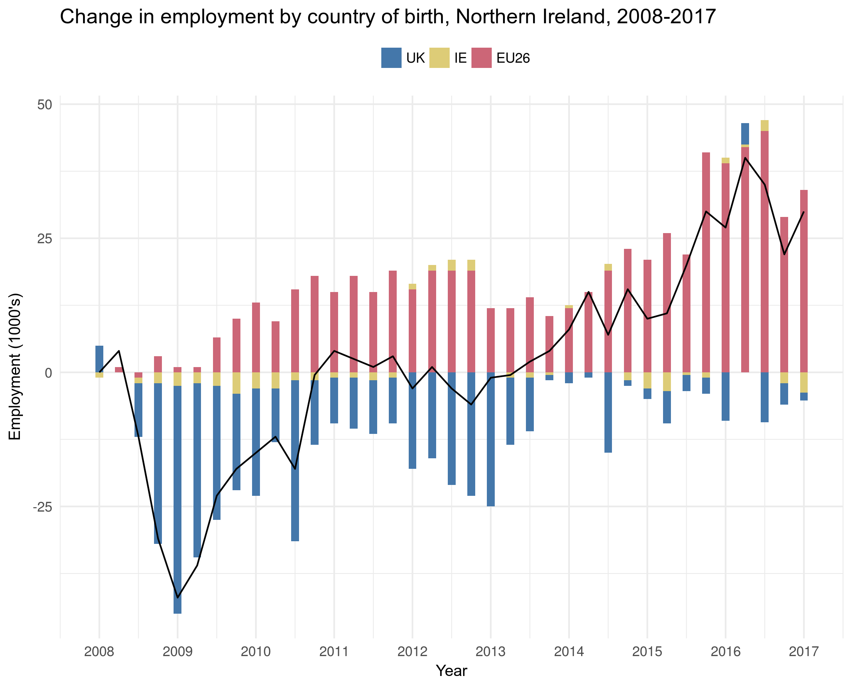
Skills: Migration
Northern Ireland is increasingly dependent on supply of migrant labour
Fills skills gaps at all levels of operational complexity
Technology sector in NI is exposed to the proposed threshold of £30,000.

Slide 15
Fiscal: start-up blockers
NI has nearly doubled the number of digital start-ups since 2010.
Still remains a low % relative the rest of the UK.
Start-ups have noted:
Lack of finance
Access to markets
Business rates
as the main barriers to growth.

Slide 16
Fiscal: Private Equity & Venture capital
The number of private equity and venture capital investments to firms in NI has continued to increase over the last decade.
However, the value of each investment has diluted.
In terms of the number of enterprises, NI has the highest number of investments but the lowest value.

Slide 17
Infrastructure: Digital & Physical
City Deal
£350 million available for development of the Belfast City Region
Looking for £500+ million of private funding
Momentum to engage with tech firms
Employing a Digital Officer
Stratum
Only 88% of premises in NI have access to at least superfast services
Falls short of the 95% target set by UK Government
Up to £200m of funding could be made available
Belfast/Ireland
Translink have proposed better connecting Dublin & Belfast Enterprise
Reduces time & increases frequency
Makes journey ‘commutable’
Could provide access to workforce.

Slide 18
FDI: Complemented with economy
FDI increases employment
Employees hired by foreign companies tend to have a higher GVA, but the calculation is skewed.
Smaller economies are more exposed and prone to capital flight.
Investment must be made in the wider digital economy alongside FDI
Develop a virtuous cycle

Slide 19
Other concerns
Opportunities
Lack of Executive
Impact of Brexit on:
Future labour supply
Cross-border cooperation
Capital flows
Free flow of data
Digital Single Market
The Future of Work
Review of the 14 – 19 curriculum
Permanent Secretaries given more decision-making power
Region City Deals
Success of Ireland
Focus FDI on specific target areas for growth (e.g. AI clusters)
Facilitate knowledge spill-over

Slide 20
The CBI NI Digital Forum
The CBI NI Digital Forum has been established to:
Develop policy for Northern Ireland’s Digital Economy;
Inform organizations of developments within the economic environment for digital skills & investment; and
Convening companies and educational organisations with policy-makers and government officials.
Builds on recommendations and work conducted by MATRIX NI.
Output will take the form of policy recommendations to help construct a Digital Strategy.

Slide 21
Any questions?

