Slide 1
CBI NI Q2 Regional Council
15 MAY 2018
Barclays Eagle Labs

Slide 2
Welcome from Barclays

Slide 3
Scottish Government Migration Presentation

Slide 4

Scotland’s Population Needs and Migration Policy Discussion paper on evidence, policy and powers for the Scottish Parliament
CBI Northern Ireland
Council Meeting
Craig Thomson
15 May 2018

Slide 5
Overview
Why the Scottish Government wants to pursue a distinct approach to migration
What that means for both EU/EEA migration and for international migration
What next?

Slide 6
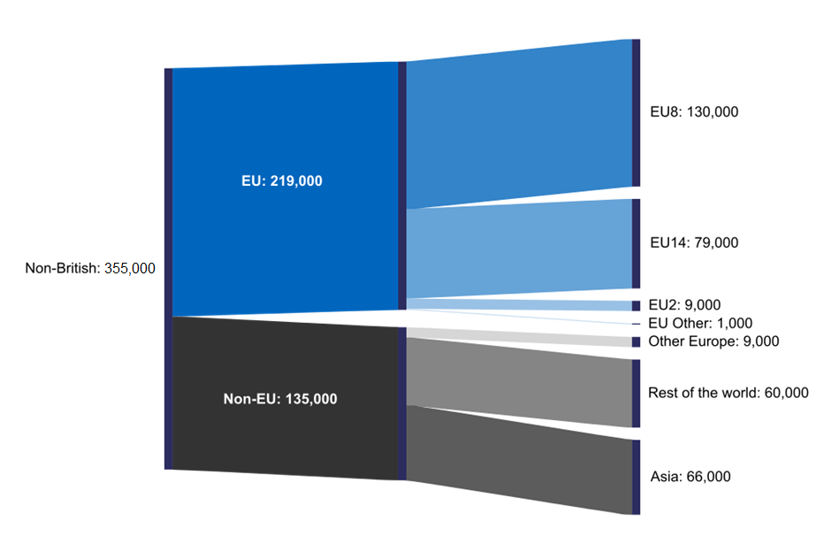
Situation
Population by non-UK nationality, Scotland, year ending June 2017

Slide 7
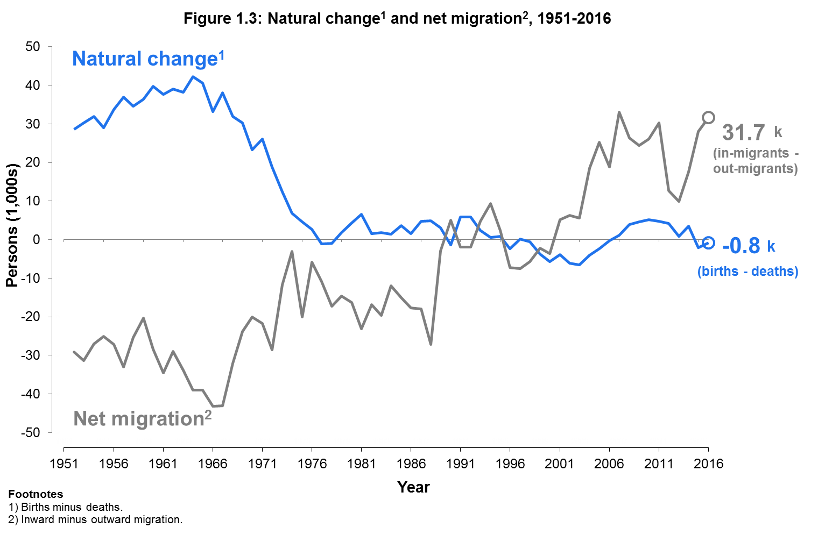
History
Natural change and net migration, Scotland, 1951-2016

Slide 8
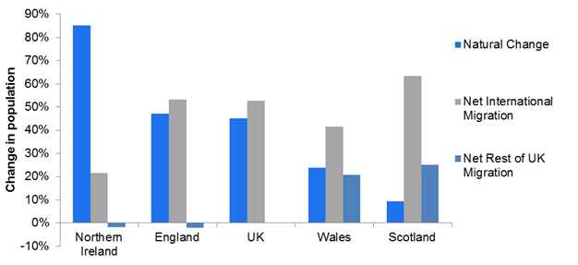
Turnaround
Natural change and net migration as proportion of change in population
between mid-2006 and mid-2016

Slide 9
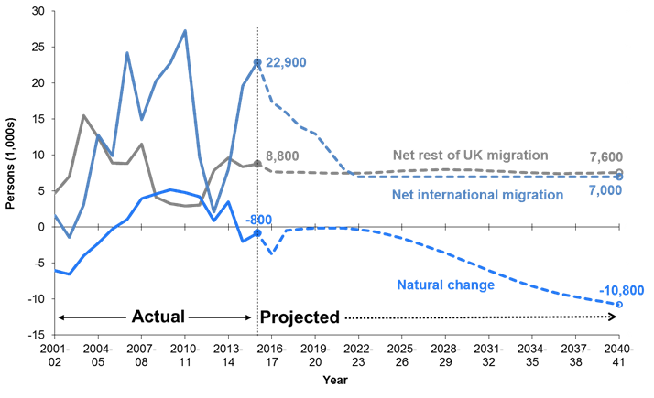
Projections
Actual and projected natural change and net international
and rest of UK migration in Scotland

Slide 10
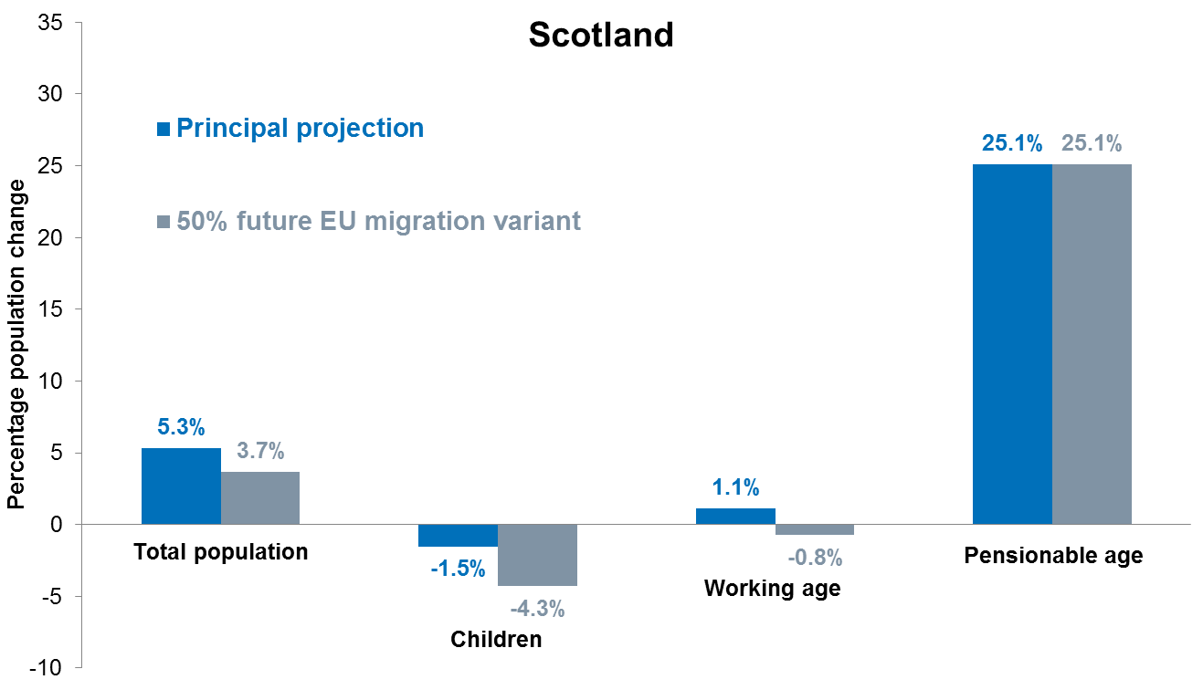

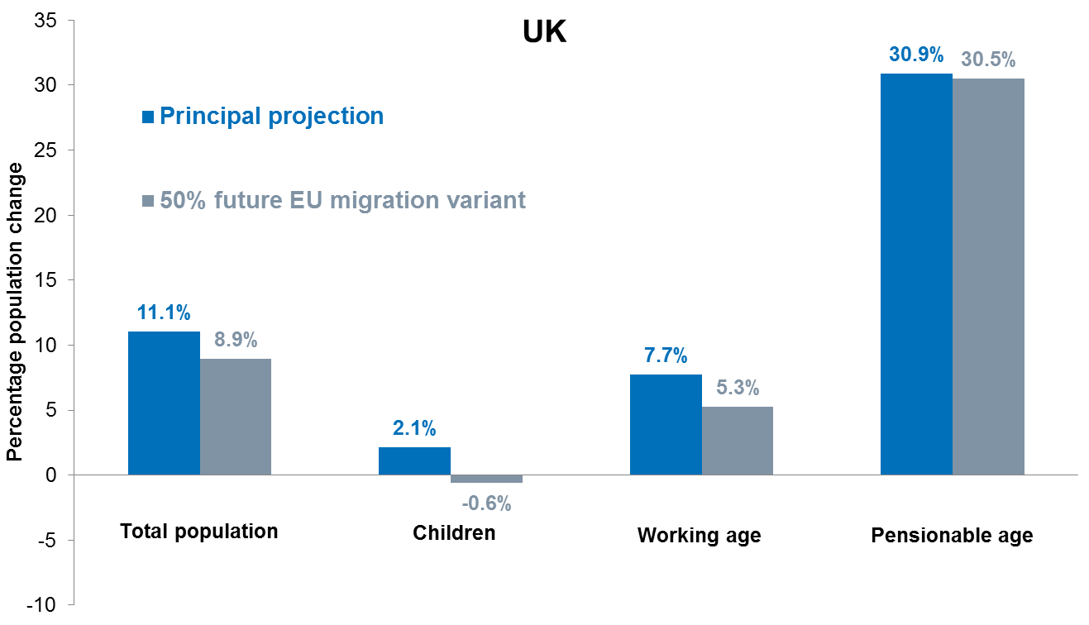
Age Structure
"The size of the population aged 16 to 64, which makes up most of the working age population, is very important for the economy and public finances. These individuals are more likely to be working and will be generating the highest tax receipts, for example, in income tax."

Slide 11
Reduced Growth
Change in real GDP, Scotland and rest of the UK from lower working age population

Slide 12
Different Scenarios
 | 2020 |  | 2030 |  | 2040
 | Scotland | rUK | Scotland | rUK | Scotland | rUK
Base case ‘Principal projection’ | -0.4% | -0.4% | -2.3% | -2.0% | -4.5% | -3.7%
‘50% reduction EU migration’ projection | -0.6% | -0.5% | -3.1% | -3.0% | -6.2% | -5.9%
‘Low migration projection’ | -0.9% | -0.8% | -4.7% | -4.0% | -9.3% | -7.6%
On average each additional EU citizen working in Scotland contributes a further £34,400 in GDP.
The total contribution by EU citizens working in Scotland is approximately £4.42 billion per year.
The fiscal contribution made by EU migrants is estimated on average to be £10,400 in Government Revenue for each additional EU citizen working in Scotland.

Slide 13
Different Approaches
Scottish Government | UK Government
Maintain and increase migration to help permanently grow population | Reduce net migration to the UK to the tens of thousands
Access skills needed across all sectors of the economy | System focused on highly-skilled (graduate level and above)
Attract migrants with the intention to live permanently in Scotland | Main route linked to specific job – no long-term certainty
Recognise importance of family life, allow close non-UK family to join legal residents | High salary requirements and complex system for family migration
Allow students at Scottish universities to live and work here after graduating | Post-study work route in immigration system ended

Slide 14
Free Movement
Retain benefits of Free Movement of People by UK remaining in European Single Market and Customs Union on leaving the EU.
If not in Single Market, immigration system for EEA nationals that maintains as many of the benefits of free movement as possible.
Depends on nature of agreement between UK and EU.

Slide 15
New Route
Initial proposal:
Single category of visa issued by Scottish Ministers within UK system.
Points-based general migration route, criteria decided by Scottish Ministers but may include e.g. age, education, income, previous experience in Scotland/UK.
Residence in Scotland as a visa condition.
No cap or quota driven by UK net migration target.

Slide 16

Longer Term
Redesign immigration system to build in regional approaches from outset?
“A regional scheme would almost certainly be preferable for Wales to a national scheme with a sector-based approach. In particular, assuming the Welsh government had a significant input into both any overall cap or quota, and the targeting and administration of a regional scheme,
it would be possible to tailor any such scheme more closely to Wales’ economic, labour market and demographic needs; it would also make it easier to ‘market’ Wales to new migrants. By contrast, a national scheme based wholly or largely on a sector-based approach would not necessarily target all the sectors of concern to Wales; and would not necessarily result in migrants in those sectors coming to Wales.”

Slide 17



International Examples
Canada
Provinces and Territories have bilateral agreements with federal government on migration through Provincial Nominee Programmes.
Focus on dispersing economic migrants beyond typical settlement patterns around Toronto, Quebec, Vancouver.
Australia
Regional flexibilities within points-based system to grow population in rural and remote areas.
Switzerland
Cantons have control over immigration and citizenship.
Residence permits are issued by Cantonal Migration Offices with quotas determined by the Swiss government.

Slide 18
New Powers
Options:
Primary Legislation
Bill at Westminster
scheduled Immigration Bill?
future Scotland Bill?
Secondary Legislation
Section 30 Order under Scotland Act 1998

Slide 19
What Next?
Ongoing engagement
Discussion to influence public attitudes
Discussion with policy and political interests
Continuing policy development
Build on and flesh out initial proposals
Respond to concerns and opportunities identified in discussions
Series of New Powers discussion papers
Trade, Employment, Social Security & Employability to follow

Slide 20

Craig Thomson
craig.thomson@gov.scot
@craigthomson745

Slide 21
Any other Business

