Slide 1
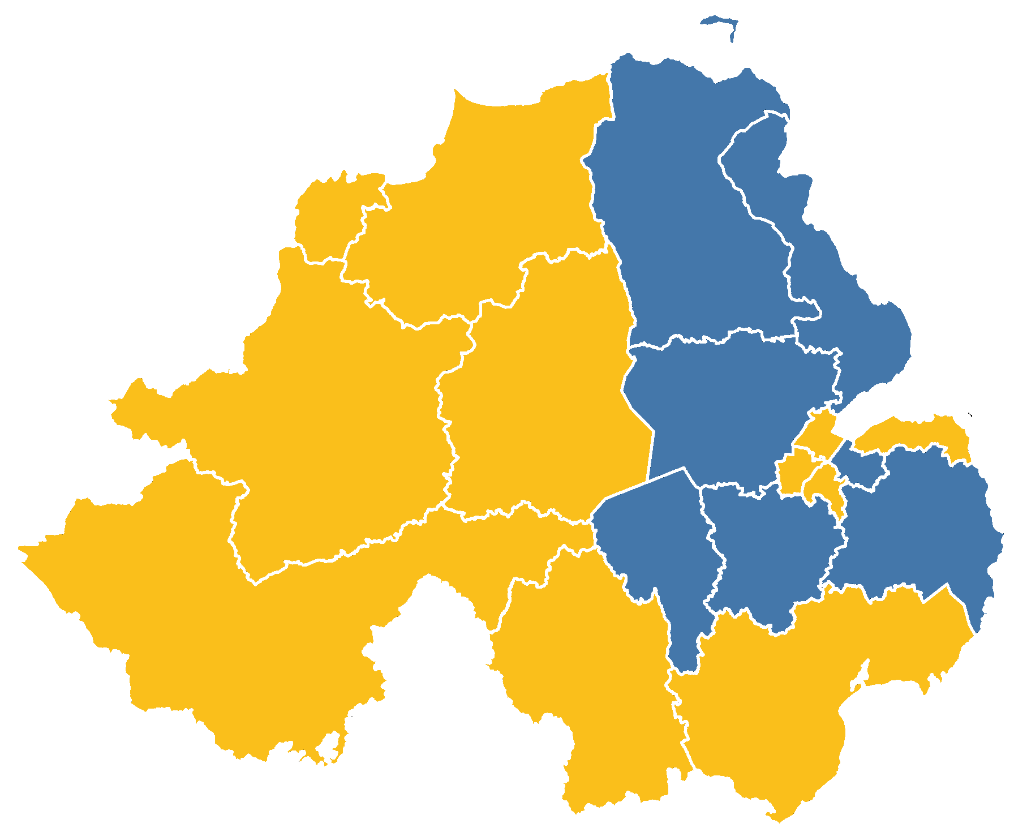

The impact of Brexit on the Northern Irish economy
Dr. Owen Sims
6th July 2018
bit.ly/CBI-NI-Owen

Slide 2
Presentation outline
Investigate the impact of Brexit on three areas of the Northern Irish economy:
  Trade. Imports & exports;
  Labour. Migration & the labour market; and
  Investment. FDI & entrepreneurship.
Aim to provide some insight on the predicted consequence of Brexit to these areas using CGE and DSGE models.
Initial results highlight:
  Added frictions for international trade, structural change in labour market, and uncertain environment for investment.
  A significant long-term negative impact to real GDP and Government revenue reducing their fiscal abilities.

Slide 3
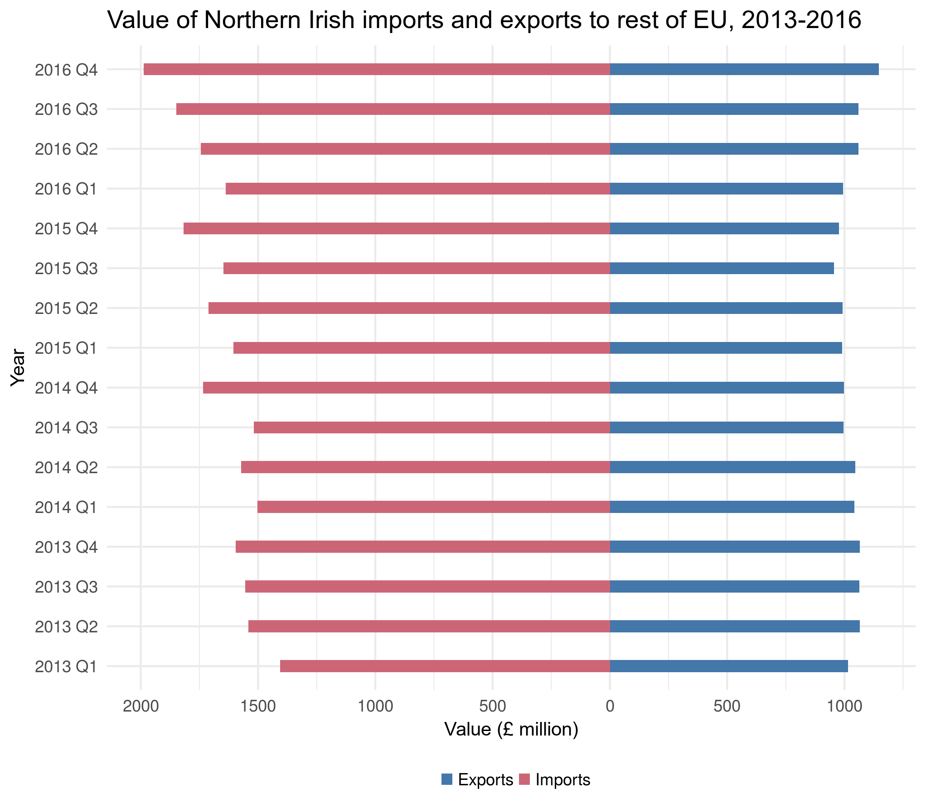
Trade: Imports & exports
In 2016, NI exports to non-UK EU economies was valued at £11.4bn.
Over time there has been a steady increase of Northern Ireland’s dependence on other EU markets.
Particularly with respect to the demand for imports; even with a weakening currency.

Slide 4
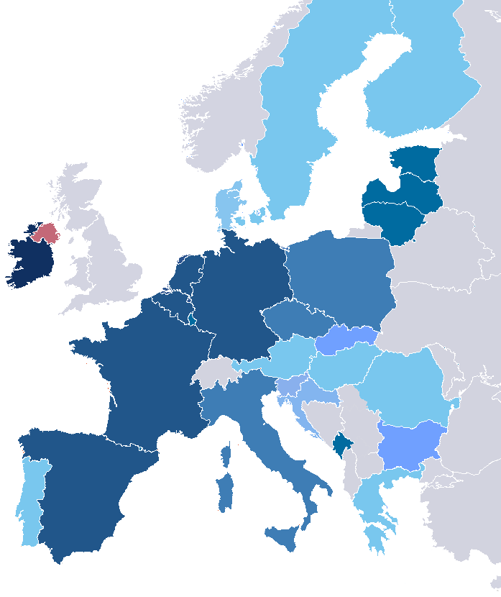
Trade: Other EU countries
Ireland is NI’s largest export market.
Exports to Ireland valued at £4.0bn, rest of EU valued at £2.6bn, and the rest of the world valued at £4.8bn.
However, NI exports to GB in 2016 accounted for 59% of all external sales, compared to only 12% of exports to Ireland.

Slide 5
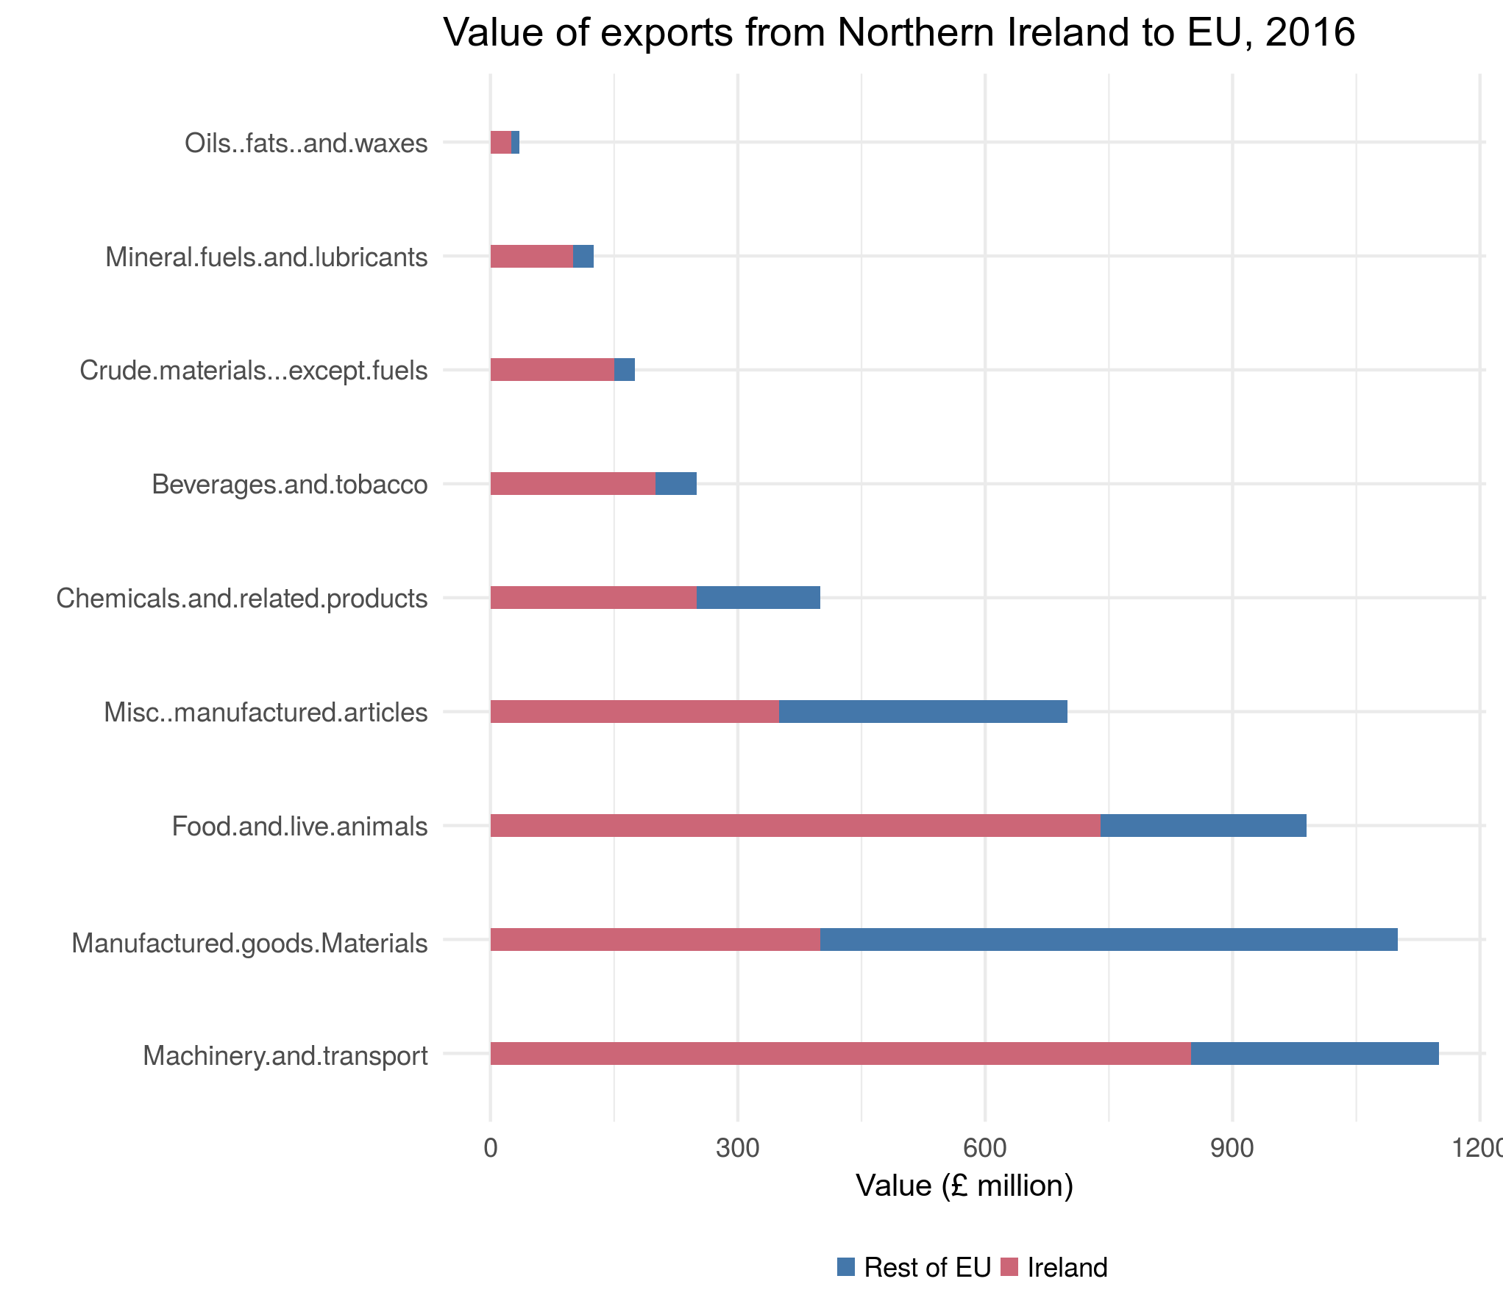
Trade: Top exporting sectors
‘Machinery and Transport Equipment’ is NI’s largest export sector, comprising ~38% of total exports to the EU.
Combined, the top three sectors make up 70% of all exports from NI to the EU.
These industries are most prone to border and currency issues.

Slide 6
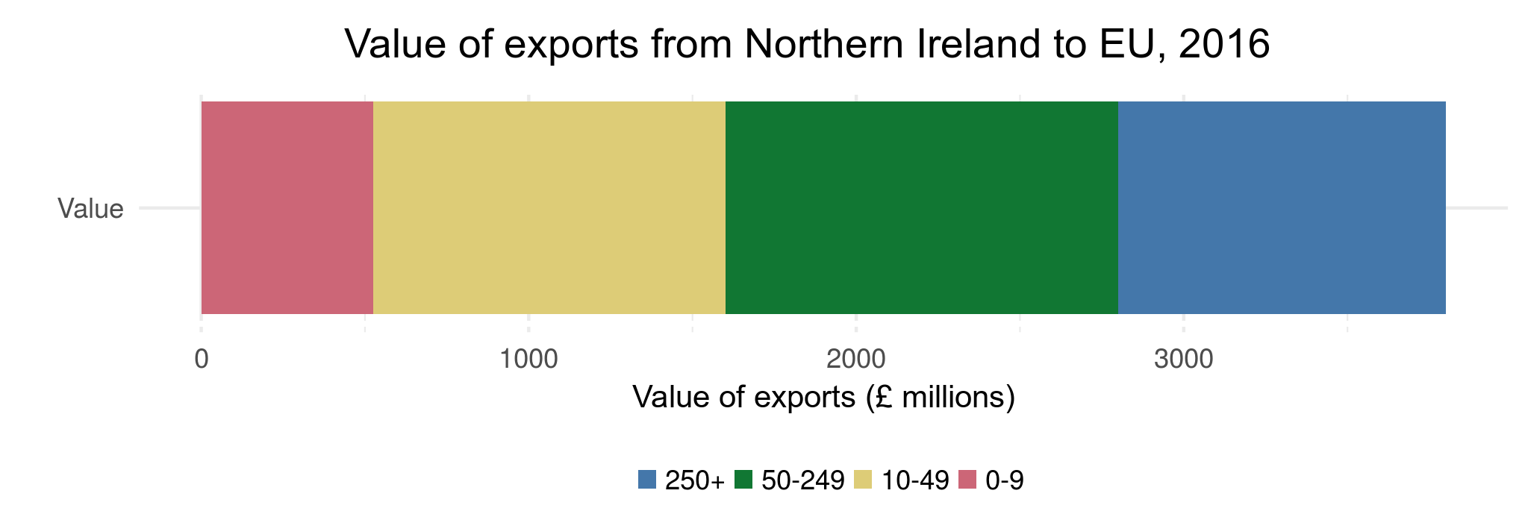
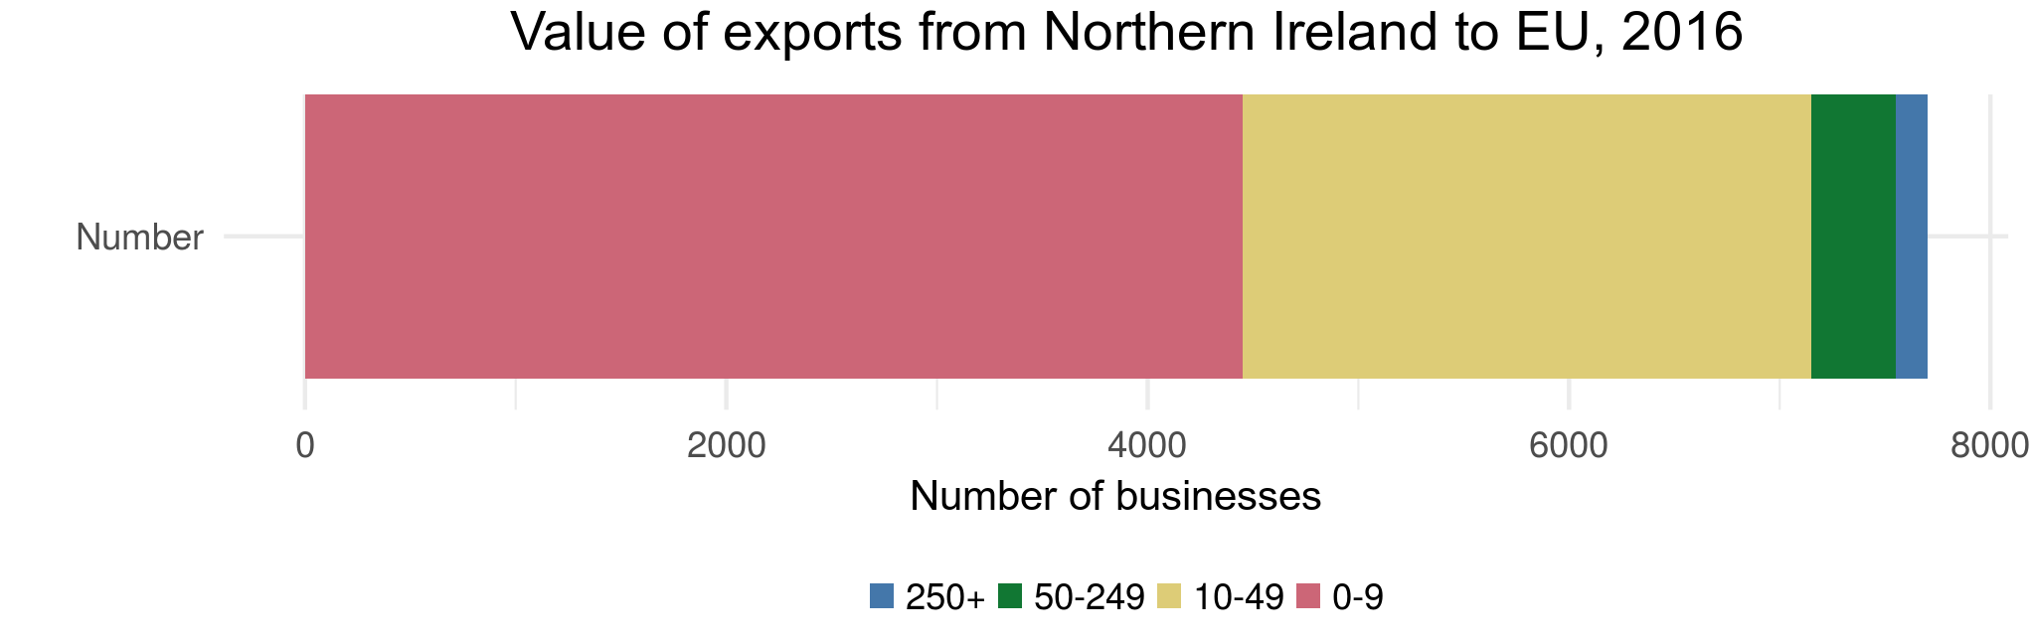
Trade: Big and small business
Small businesses are most at risk to demand and supply-side shocks.
SME’s account for ~92.9% of all businesses that export to EU countries and ~42.1% of the total value of exports.

Slide 7
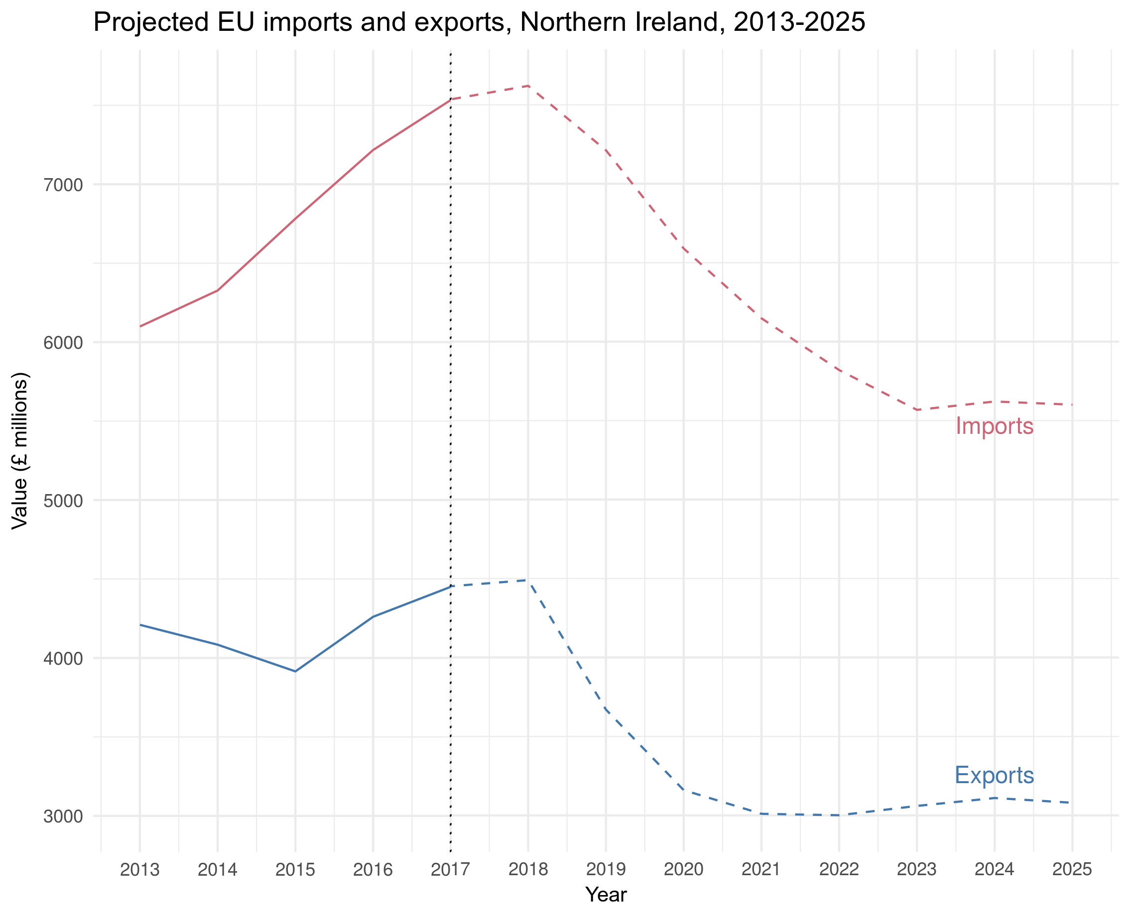
Trade: Predictions
Assuming away rigidities (e.g. contracts and sticky prices) we project a significant drop in both imports and exports.
This is particularly heightened when increased frictions are added for cross-boarder trade with Ireland.
Alongside reduced consumption and low internal demand, this is reflected in a fall in real GDP.

Slide 8
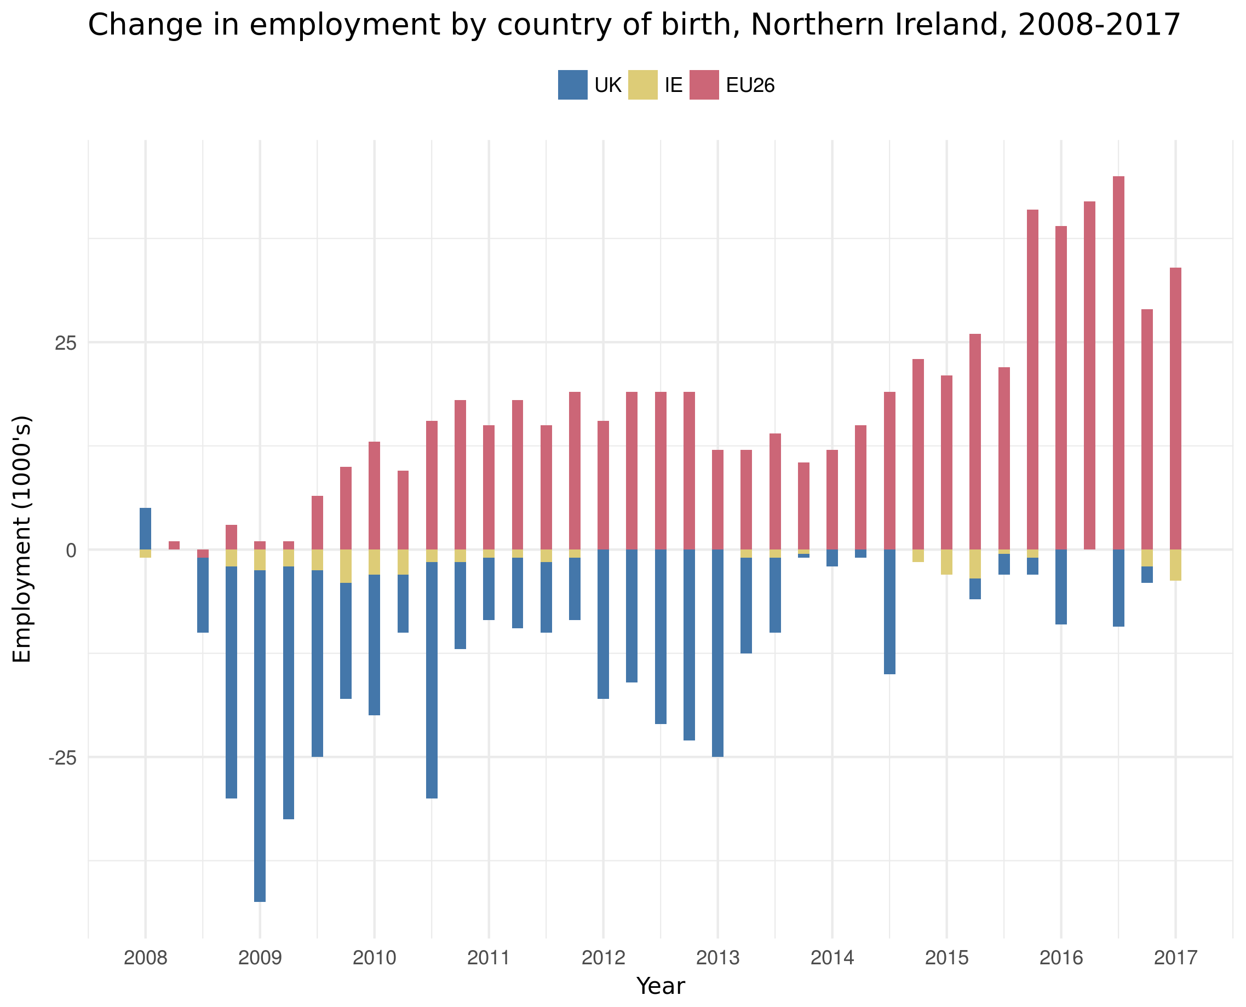
Labour: Contribution to employment
Employment fell by 40,000 between 2008 Q1 and 2009 Q2 due to financial crisis.
Over the past decade migrants from EU26 economies driven employment in NI beyond the pre-crisis levels.
Since 2014 employment has risen by more than 40,000 due to migration.

Slide 9
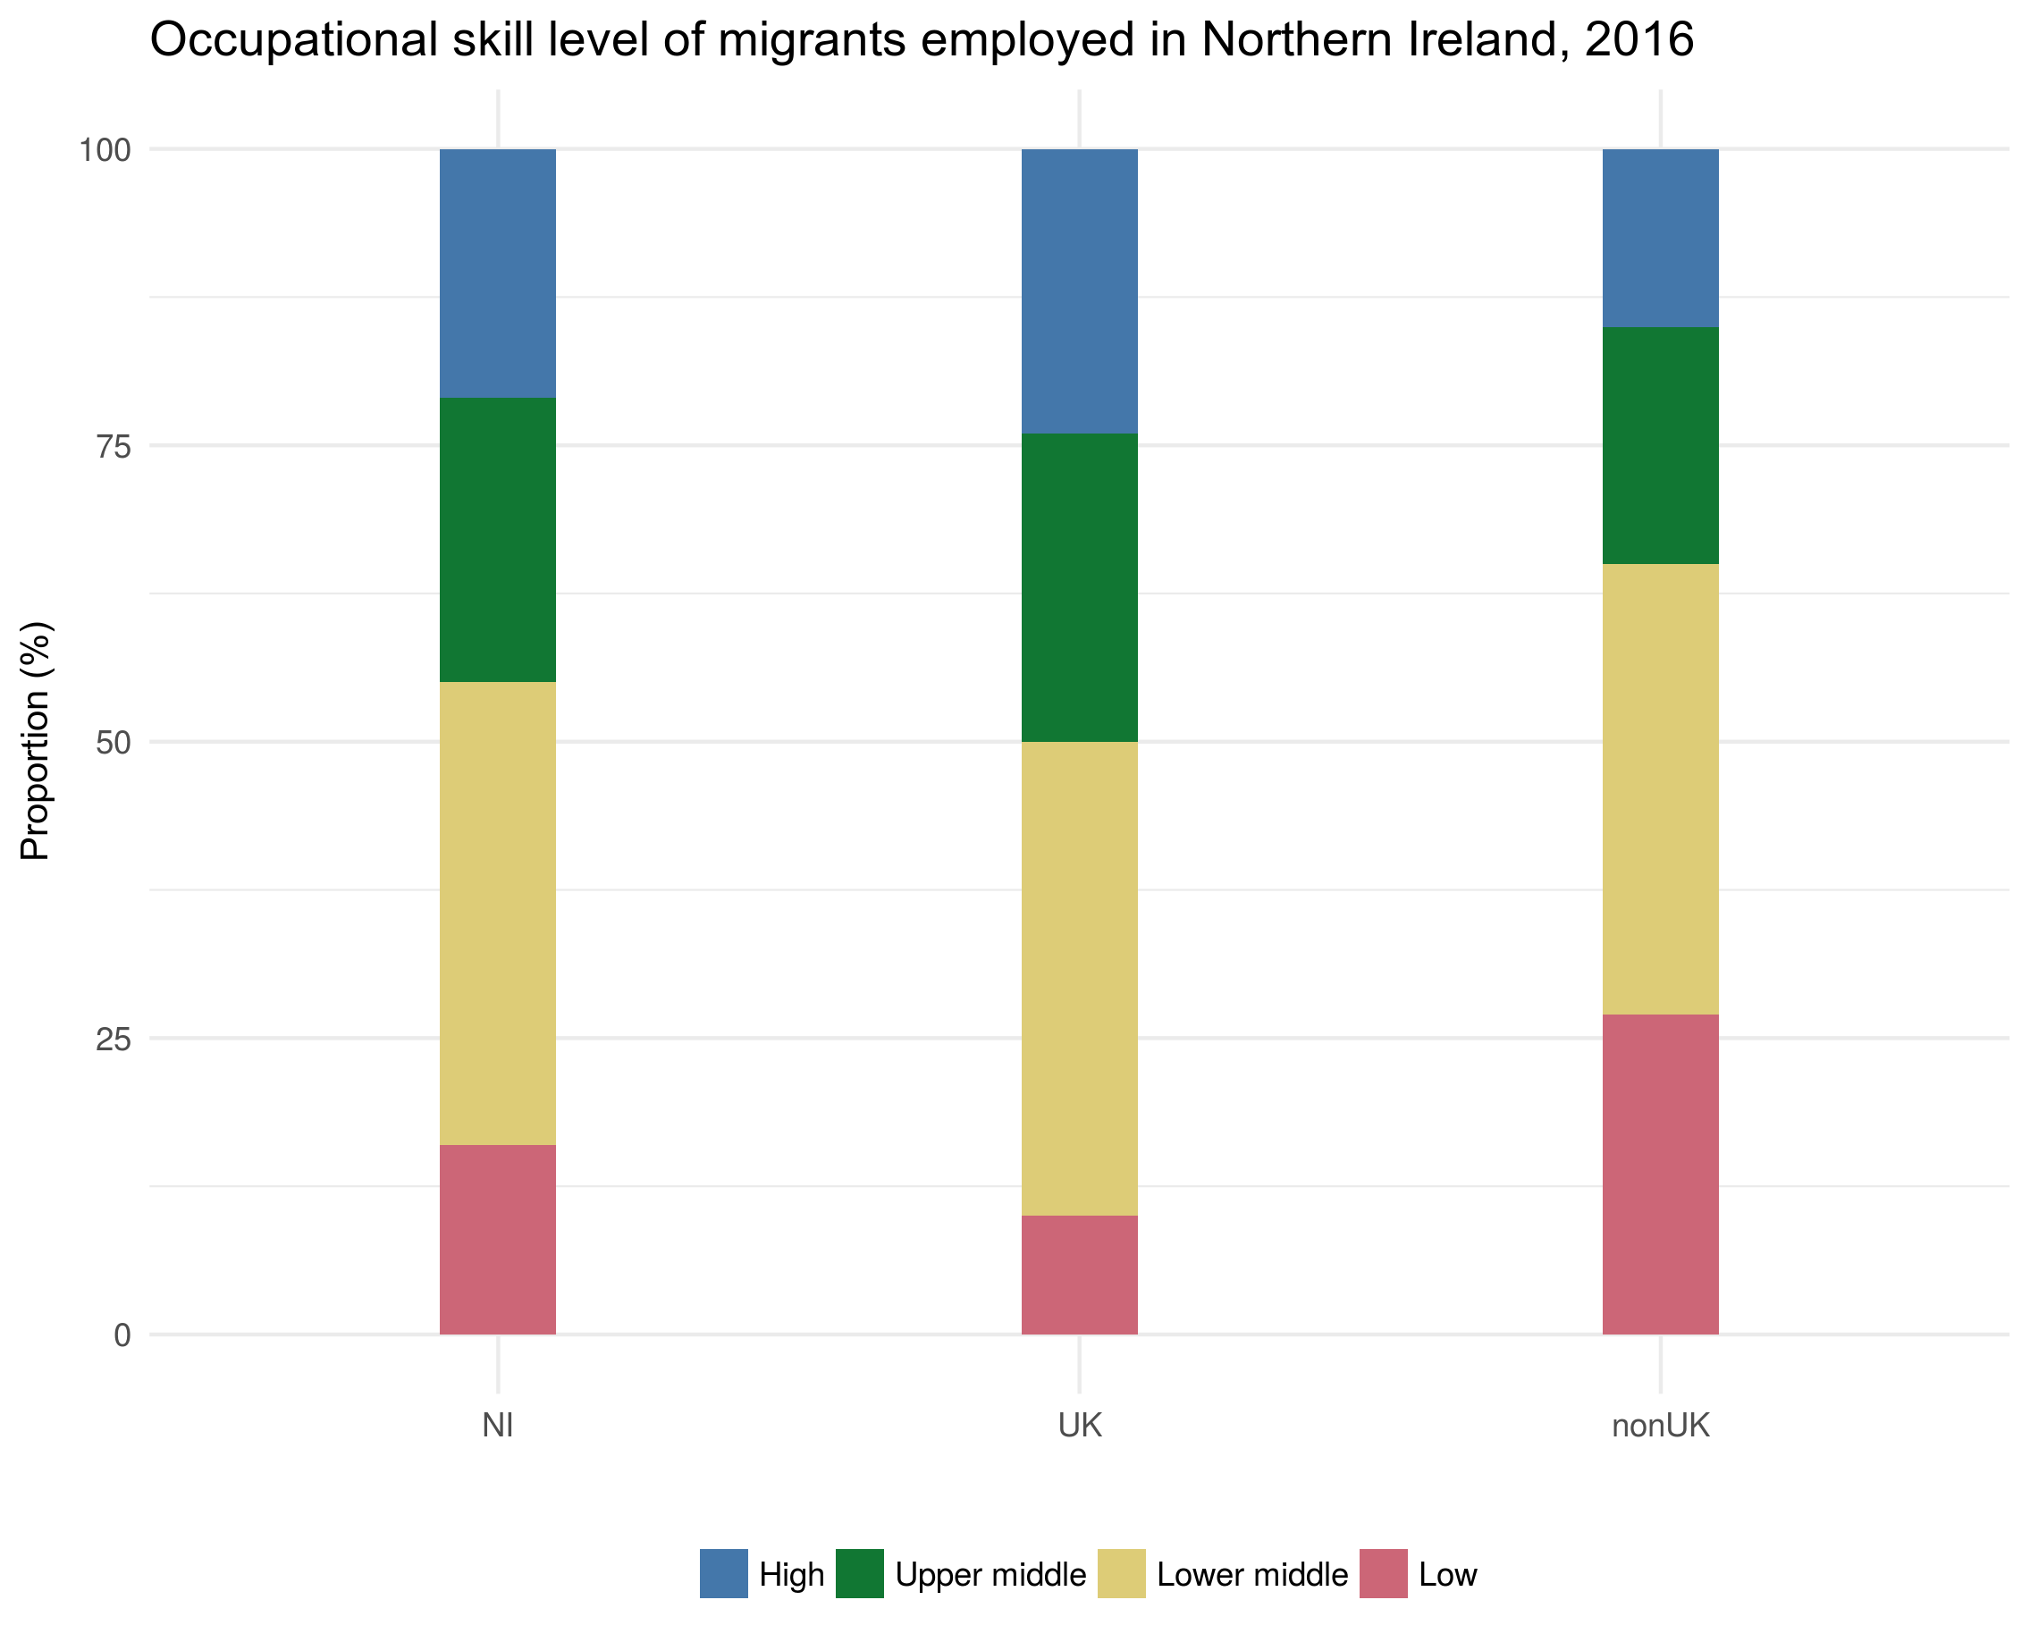
Labour: Skills gap
Foreign and domestic companies already concerned of NI skills gap.
Non-UK migration fills skills gaps in both lower and upper levels of employment.
Not strong evidence to suggest that migrants from non-UK compete for the same jobs as economically active members of GB.

Slide 10
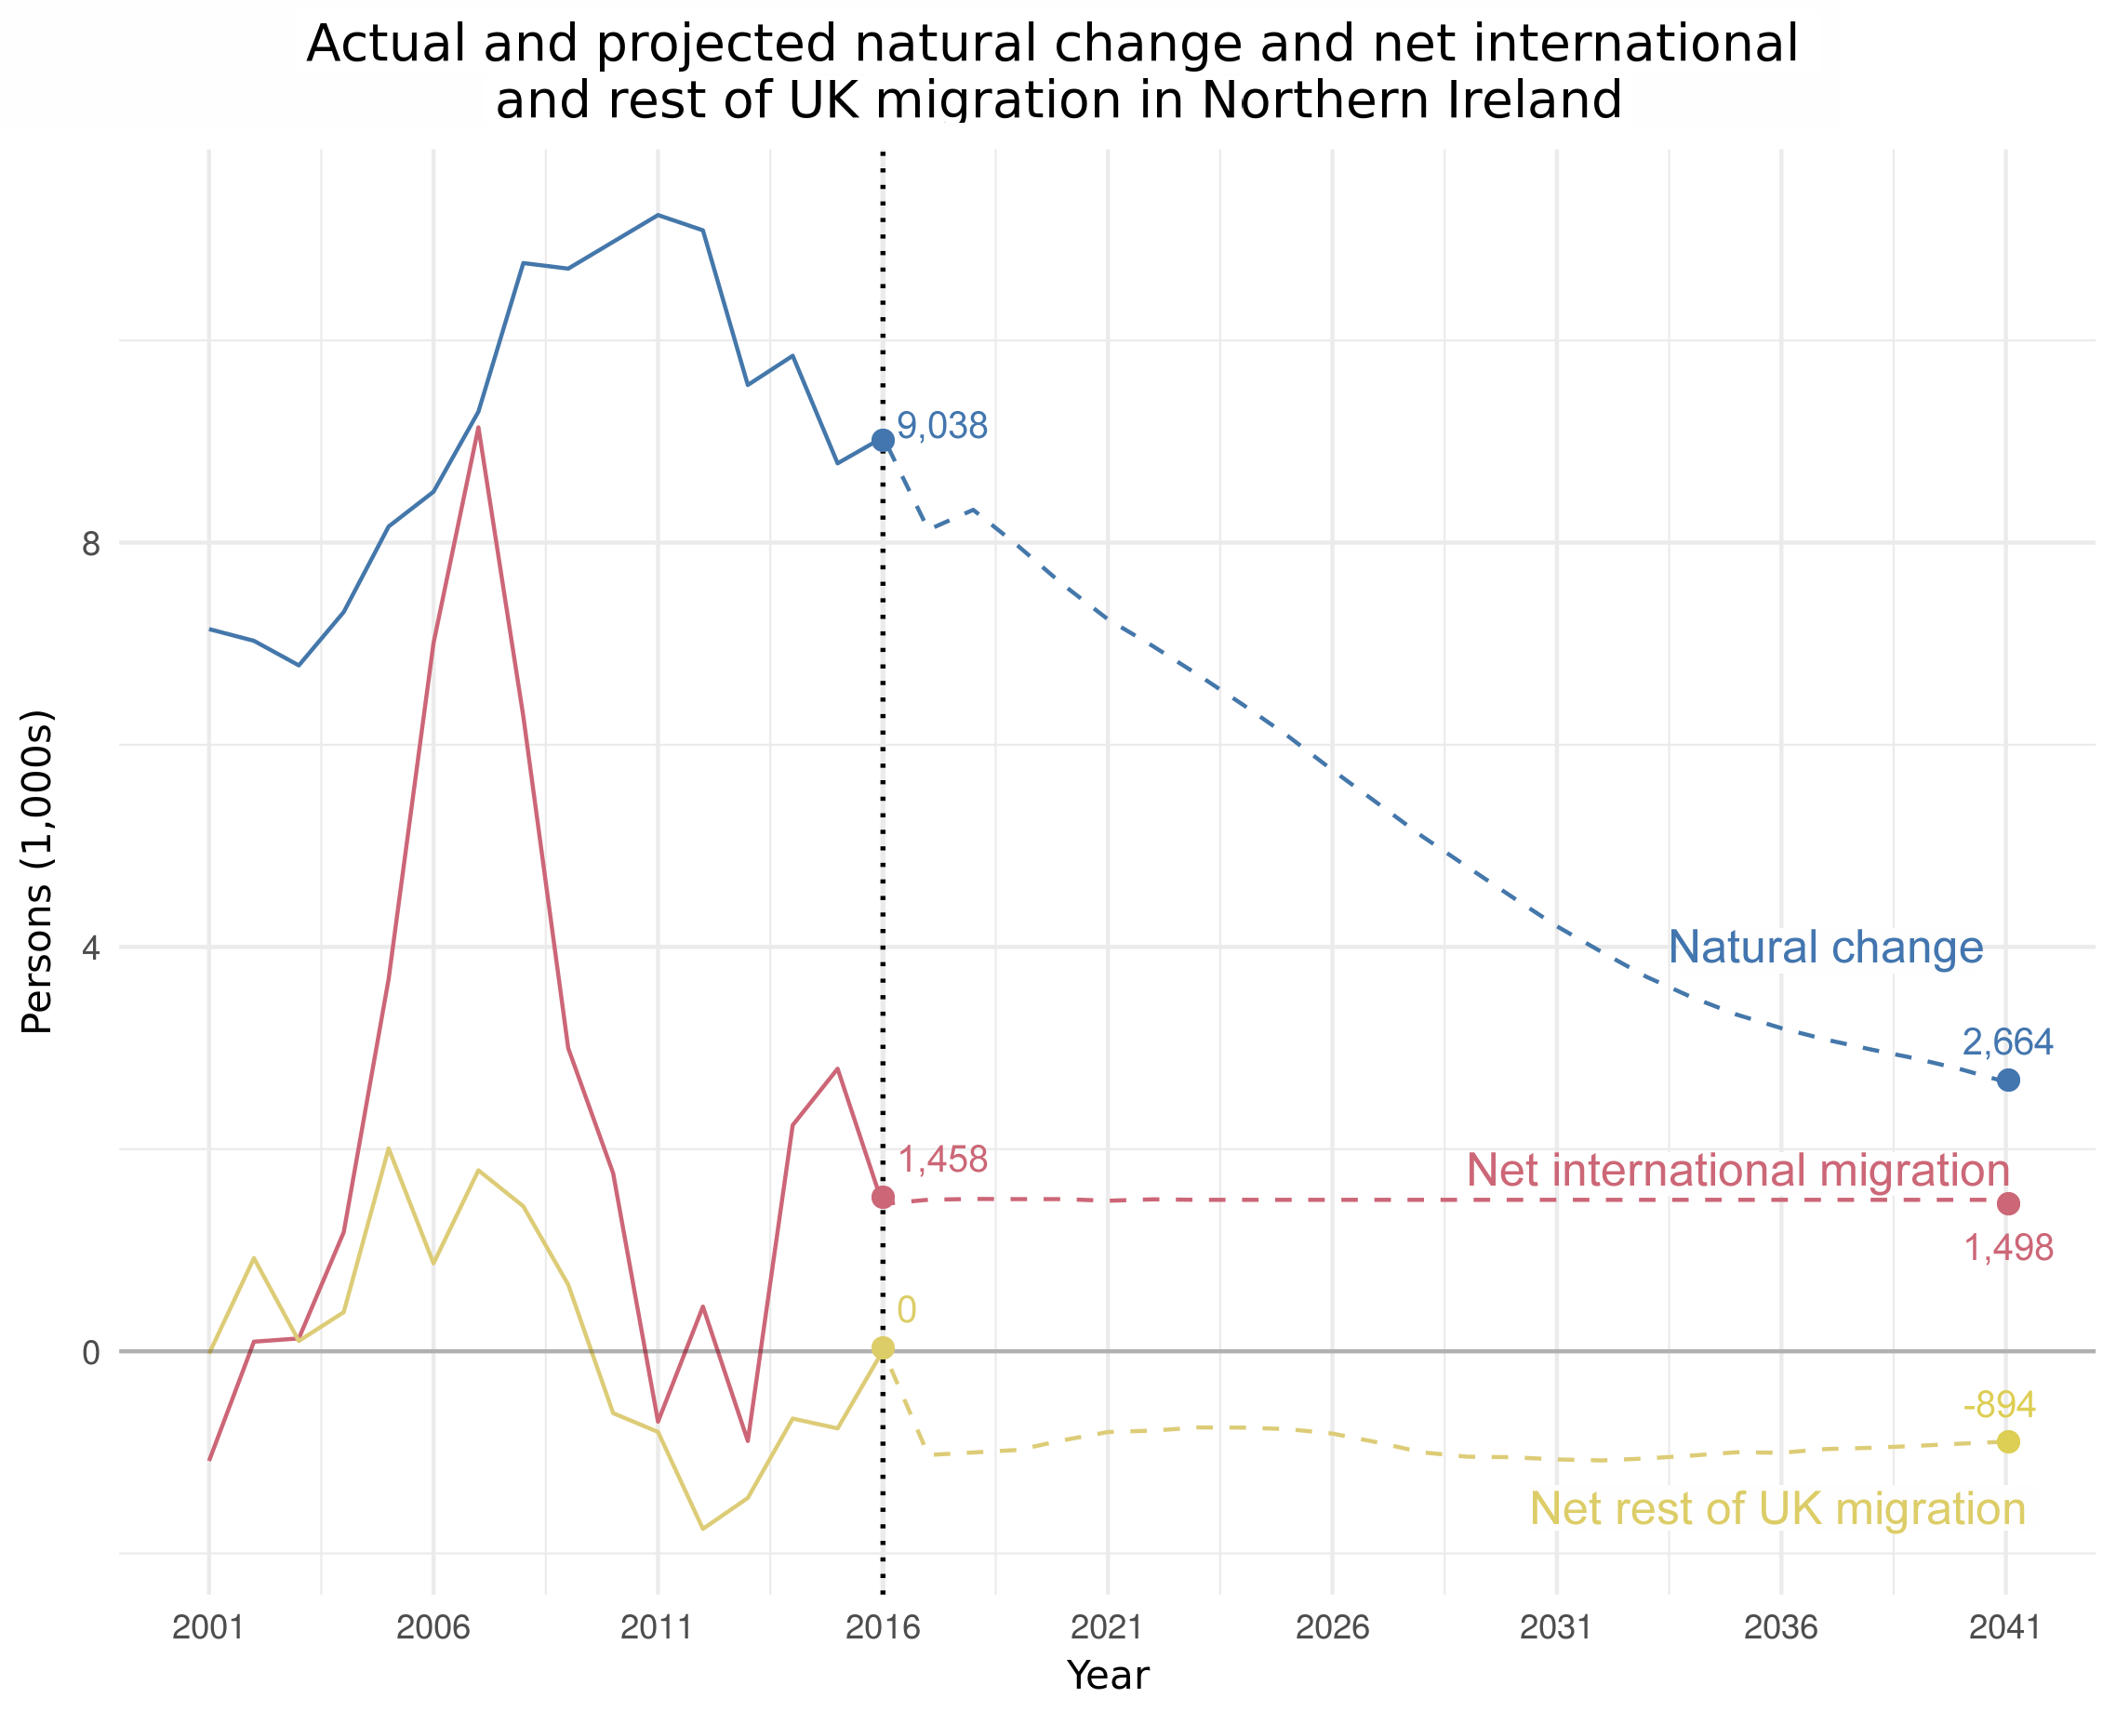
Labour: Principal projections
Principal research from the ONS predicts declining natural change (births-deaths) to NI population.
The Figure suggests a sustained ‘brain drain’ of the NI population to the rest of the UK.
However, positive international inflows, particularly from the EU26, boosts NI population.

Slide 11
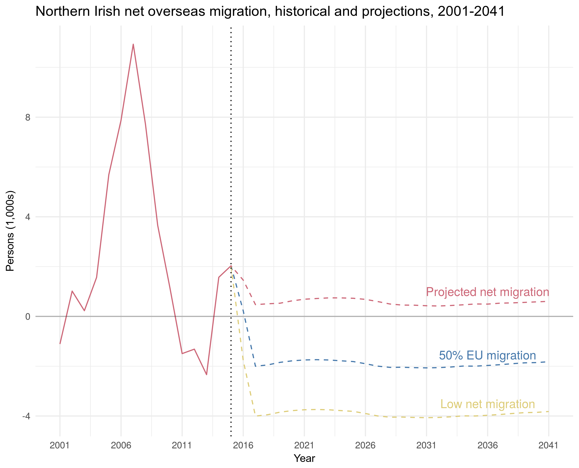
Labour: Projection variants
Further research from the ONS provides variant migration projections for NI.
Particularly, the consequence of Brexit leads to a significant ‘low net migration’ variant.
Suggests a future in which outflows from current migrants and the brain drain dramatically lower the NI population.

Slide 12
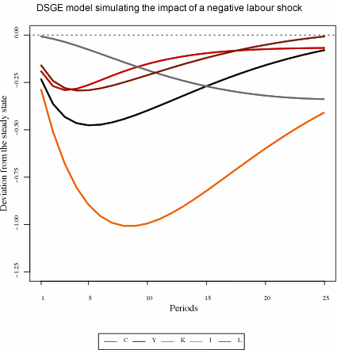
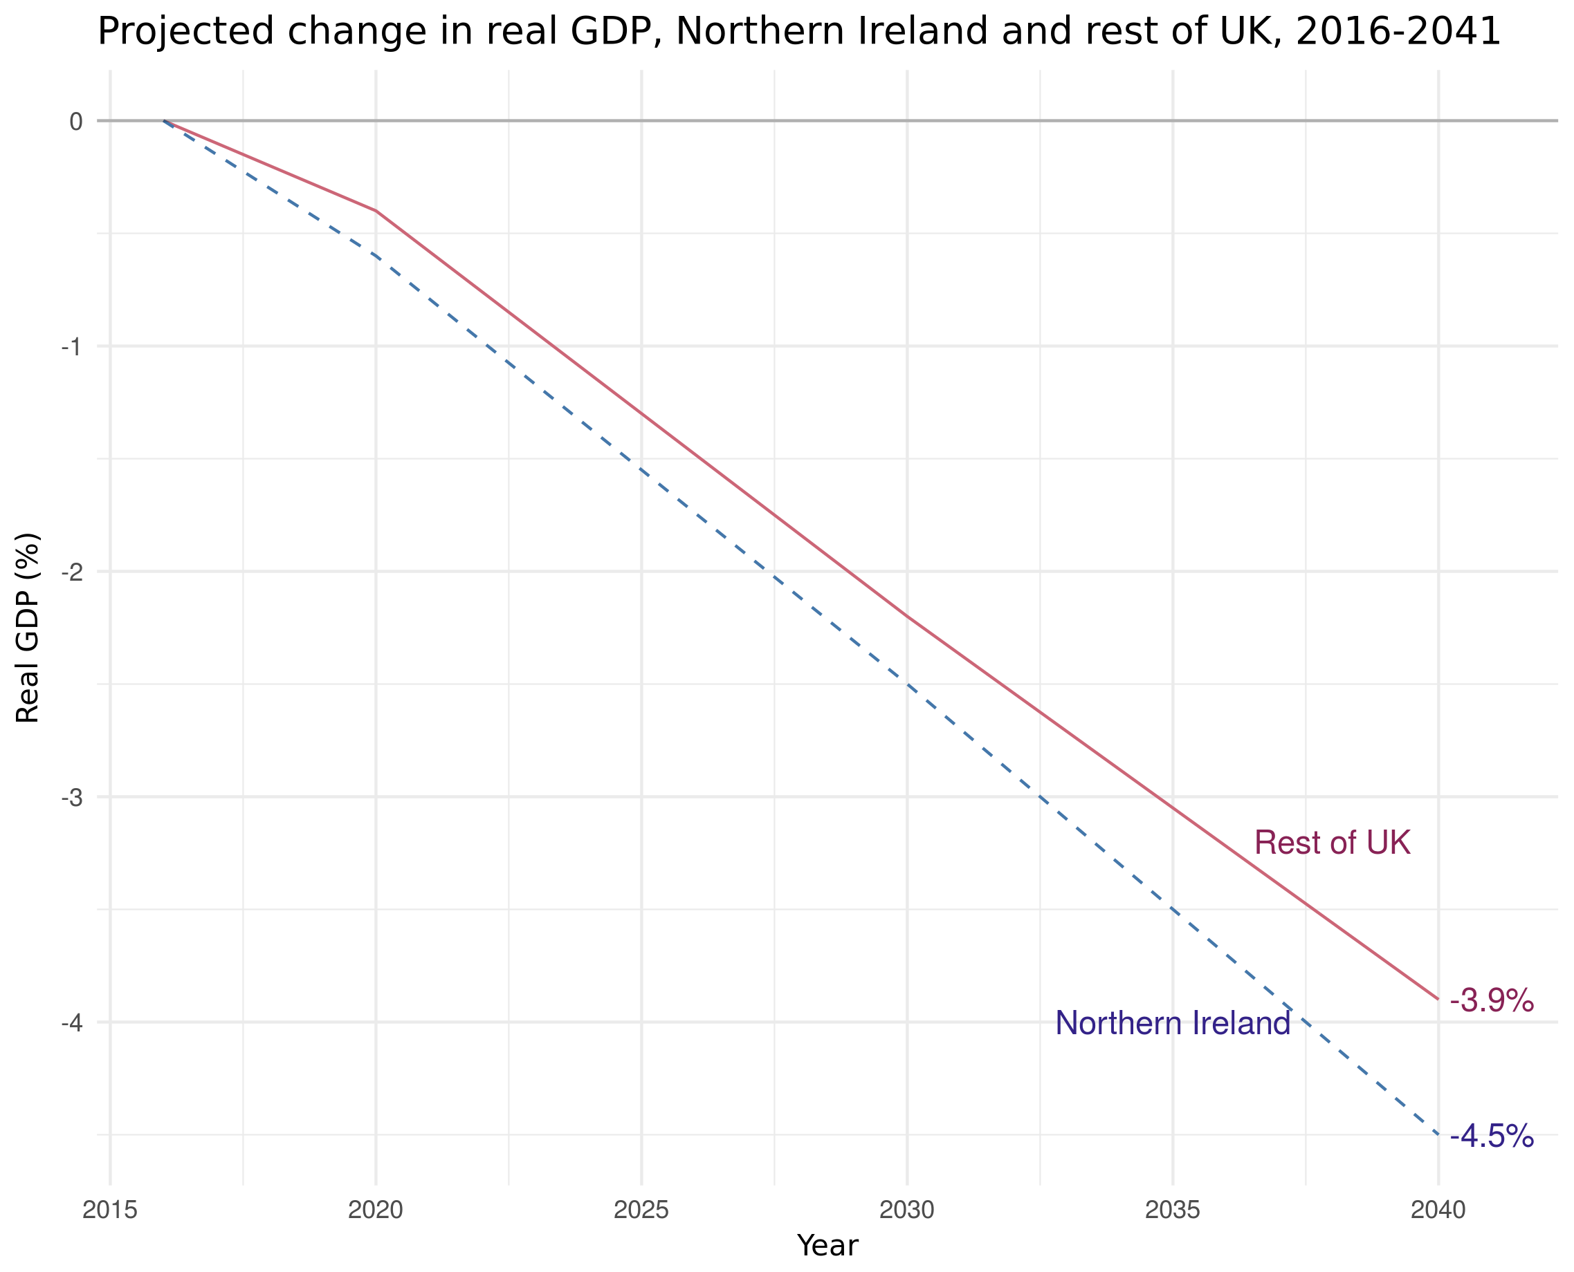
Labour: Impact on real GDP
Structural change to the Northern Irish labour market generates a new long-run steady state with a lower real GDP.
Leads to: (1) Fall in taxation and Government revenue; (2) Reduction in derived domestic demand; and (3) Further reduction in internal investment and FDI.

Slide 13
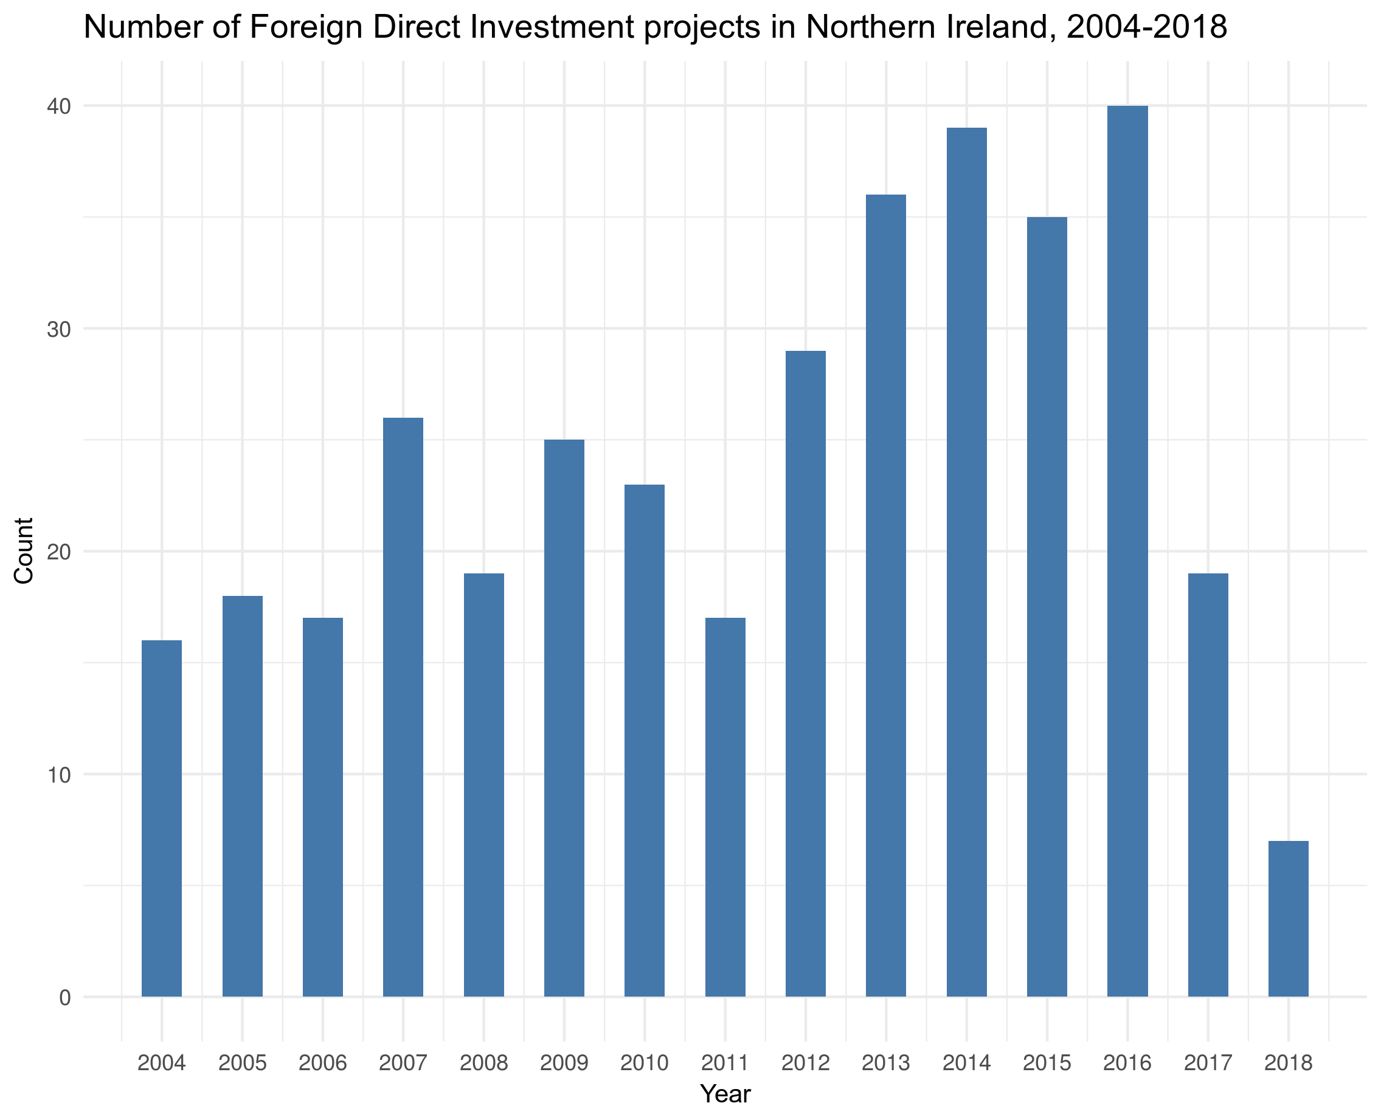
Investment: Fall in FDI projects
According to INI, Belfast remains a top destination for FinTech, cyber security R&D and general software projects.
However, EY’s Attractiveness Survey showed that FDI projects fell by ~54% in 2017.
Political instability and uncertainty of Brexit have diminished performance.

Slide 14
Concluding points
Key points we know:
  Trade. Apart from internal trade with the rest of the UK, Ireland remains NI’s biggest export market: valued at £4.0bn. The impact of a ‘hard’ border will add significant frictions to this market, reducing both imports and exports.
  Migration. NI employment has become increasingly reliant on labour from EU26 and less on labour from the rest of the UK.
  Investment. FDI projects have already fallen in anticipation of Brexit; this mindset could lead to a self-fulfilling prophecy.
The predicted outcome of Brexit:
  It’s difficult to know the exact impact that Brexit will have on the Northern Irish economy. Particularly since the terms of severance are still undecided.
  However, further stigmatising ourselves from the global economic network can only lead to negative impacts.

Slide 15
Any questions?

