Slide 1
<O2A>
Team Members:
Tirta Aji
Farid Al Ayubi
Jason Frederick K
Daffa F.
Contact email: tirtaajin33@gmail.com

Slide 2
Project information
Goal
This project aims to design, verify, and tape out a fully open-source, parameterized serial communication IP block — integrating UART, I2C, and SPI controllers — targeting the GlobalFoundries GF180MCUD process node using the IIC-OSIC-TOOLS and OpenLane2 digital design flow.By exposing a rich set of compile-time Verilog parameters (such as protocol enable flags, FIFO depth, data-path width, and addressing mode) alongside a runtime-configurable APB-Lite register interface, the IP is designed to serve as a reusable, community-grade building block that any open-source SoC integrator can instantiate and customize without modification to the core RTL.

Slide 3
Project Overview
Design – High Level Proposal
The IP is structured into four independent Verilog modules: a UART block (8N1/8N2, programmable baud divider, parameterized TX/RX FIFO depth, optional RTS/CTS flow control), an I2C block (7-/10-bit addressing, 100 kHz / 400 kHz / 1 MHz SCL, optional slave mode and multi-master arbitration), an SPI block (full-duplex, modes 0–3, configurable word width up to 32 bits, up to four chip-select lines), and a top-level Wrapper & Parameterized block that instantiates all three through Verilog generate constructs, exposes a single APB-Lite slave port to the host processor, arbitrates interrupts, and provides per-protocol clock gating.Compile-time parameters govern structural decisions that become permanent at tapeout, while runtime parameters such as baud-rate divisor, SPI clock polarity/phase, I2C SCL divider, and interrupt watermarks are stored in a memory-mapped register file and can be written by firmware at any time after power-on.

Slide 4
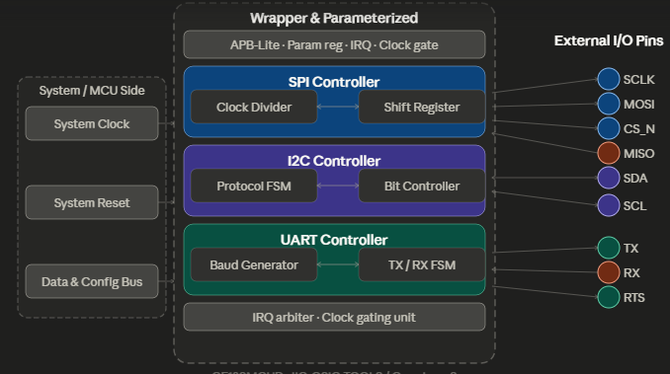
Project Information

Slide 5
Project Information
Application
This controller acts as a reliable digital bridge for embedded systems, enabling seamless data acquisition from various external peripheral modules such as industrial field sensors and debugging terminals.

Slide 6
Team background
Our team is composed of three third year and one second year undergraduate Electrical Engineering Students from Diponegoro University, Indonesia. We have no prior IC design Experience.

Slide 7
Questions, Suggestions, Doubts?

